Slide 1
Building the Iowa
Environmental Mesonet
Daryl Herzmann
Iowa State University
Department of Agronomy

Slide 2
Presentation Outline
Motivations for a Mesonet
  Details on the Iowa Environmental Mesonet
Motivations for data sharing
Motivations for application development
IEM Network Example: KCCI SchoolNet8
Wake everybody up from the nap

Slide 3
What is an Environmental Mesonet?
Environmental
  We did not want to just focus on weather. We are interested in all sorts of environmental data.
Meso – Net
  'Meso' refers to a spatial scale between the large scale synoptic systems and the microscale. Basically from the size of individual clouds to the synoptic weather disturbance.
  'Net' refers to a network.

Slide 4
Motivations for our Mesonet
The baseline FAA/NWS ASOS network is not adequate spatially or temporally to resolve many mesoscale phenomena.
A cost effective and high density network can be built using pre-existing resources.
Data needs to be collected and housed in a central location to promote research and education.

Slide 5
We aren't just focused on Iowa!
Process NWS/FAA data from surrounding states including Kansas, Missouri, and Nebraska
Started a similar mesonet project in South Dakota
Communication with Missouri about their meso-networks
Work with the High Plains Climate Center
Will soon be processing data from Texas, Oklahoma, and Utah

Slide 6
Combining diverse datasets
We gather, combine, compare and disseminate data from at least 9 observing networks.
Each network has a different data format and internet transfer mechanism!
These networks include....

Slide 7
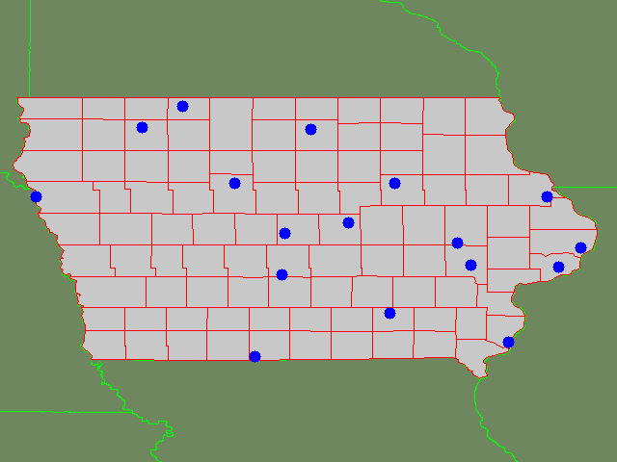
Automated Surface Observing
System (ASOS) Network
FAA/NWS flagship observational network.
15 sites located at the major airports.
Hourly METAR reports and sub-hourly special bulletins when conditions warrant.

Slide 8
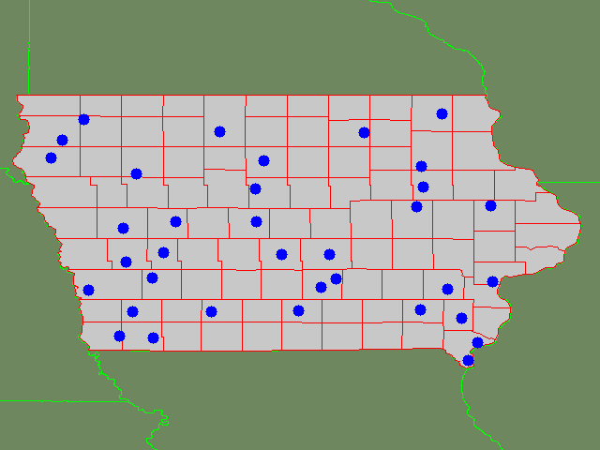
Automated Weather Observing
System (AWOS) Network
Owned/Operated by the state.
Three METAR observations per hour and no special bulletins.
Similar instrumentation as the ASOS network.
Not all stations have rainfall tipping buckets.

Slide 9
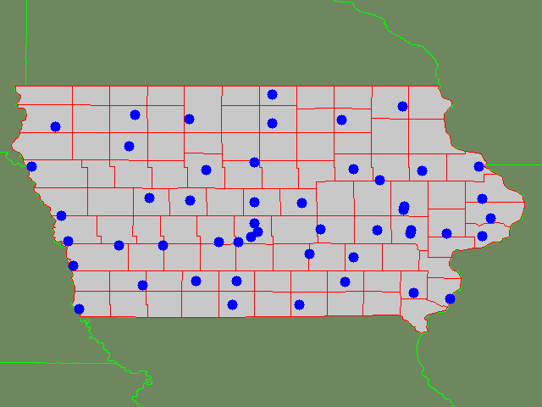
Roadway Weather Information Systems (RWIS) Network
Owned/Operated by the Department of Transportation.
Produces an observation every 10 minutes.
Includes pavement temps and characteristics
Some stations record precipitation.

Slide 10
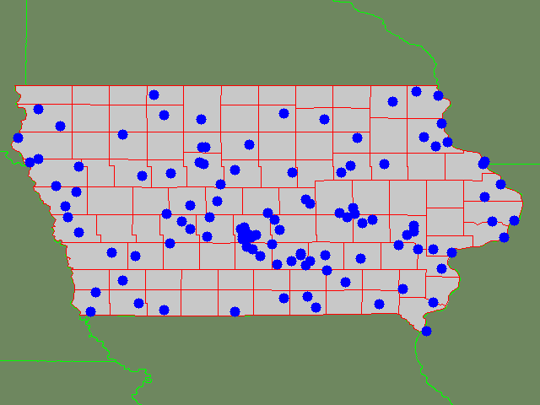
USGS River Gauging /
Data Collection Platform Network
Hydrological data sent to us by the National Weather Service.
Mostly USGS sites.
Monitor stream flow and rainfall.
Obviously, primarily located along water bodies!

Slide 11
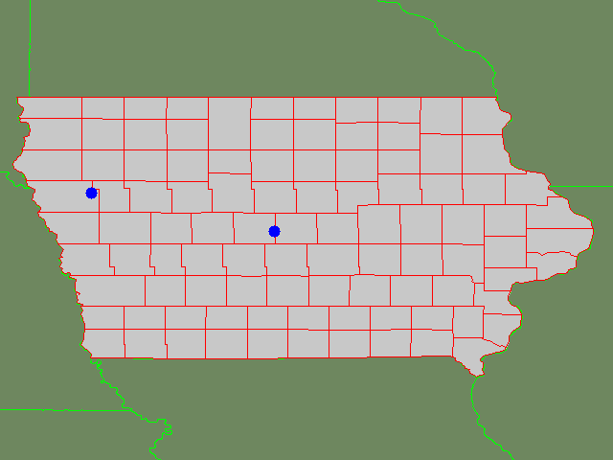
Soil Climate
Analysis Network (SCAN)
Operated by the Natural Resources Conservation Service (NRCS) of the USDA.
5 soil levels providing temps and moisture.
We also process stations from Nebraska and Missouri.

Slide 12
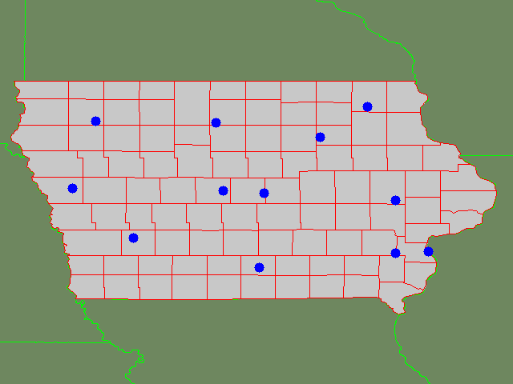
Iowa State Ag Climate Network
Located on Iowa State Research Farms.
Hourly values of radiation, soil temps, and atmospherics.
Data is QC'd by High Plains Climate Center.
Currently being outfitted with 5 soil levels sensors.

Slide 13
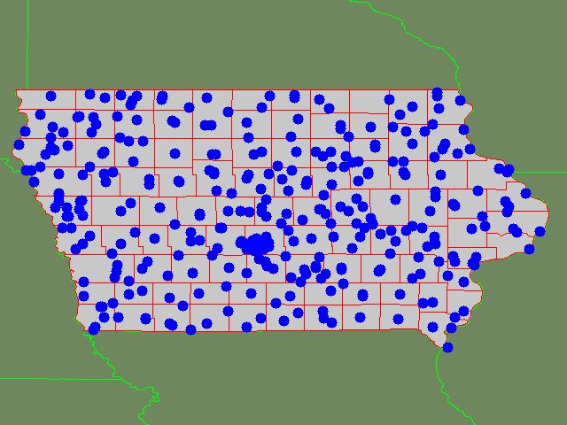
NWS Cooperative Observer
Network
Climate observing network with data dating back before 1900.
Most sites report once per day with climatic information.
Data can be delayed from some sites which do not report in real-time.

Slide 14
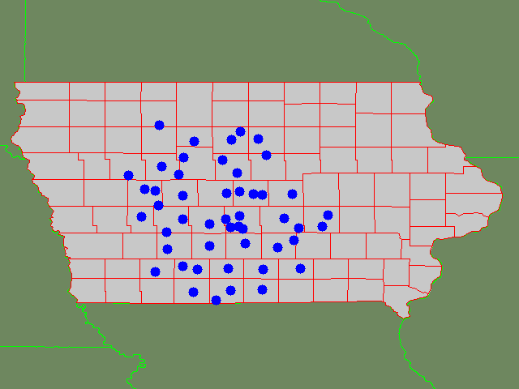
KCCI-TV SchoolNet8 Network
Located on the roofs of schools.
Some sites have siting issues, many don't.
Produce invaluable data in data sparse regions.
Report information in real-time with a new ob every ~ 10 seconds.

Slide 15
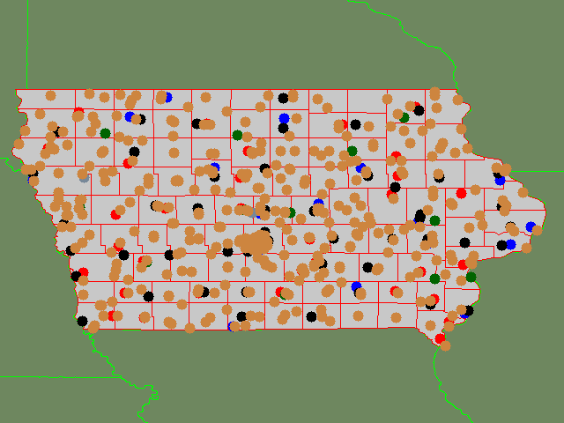
We put them all together...
A single archive of all networks in one location.
Station metadata record for each network.
Dramatically improved spatial and temporal coverage

Slide 16
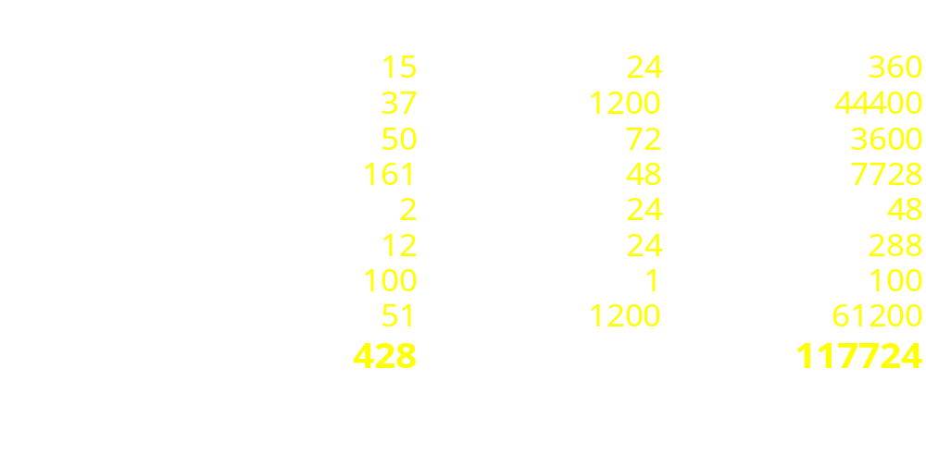
Daily Iowa Mesonet Totals
This does not include remotely sensed data like
profilers, NEXRADs, RAOBs, and satellites.

Slide 17
Motivations for Data Sharing
Save money
Save time
Increase the value of the network
Build goodwill between entities with similar operational tasks.
Cross discipline approach to collaboration.

Slide 18
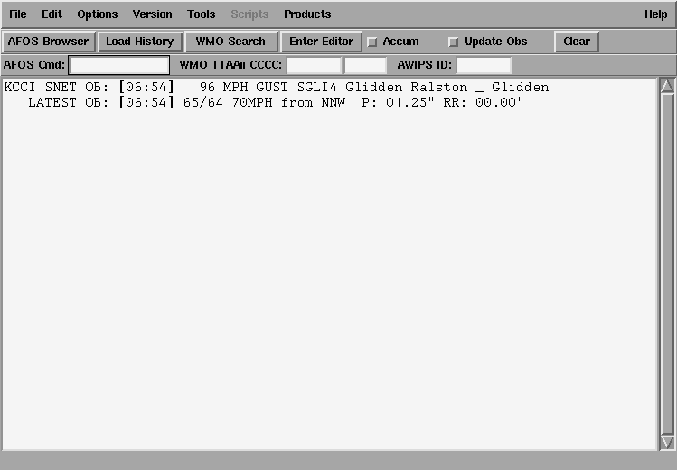
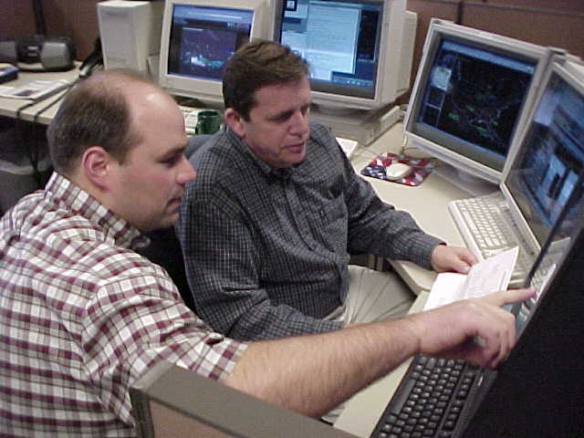
Government Agency / Private Sector
Des Moines NWS Forecasters using an automated wind alert from the SchoolNet.

Slide 19
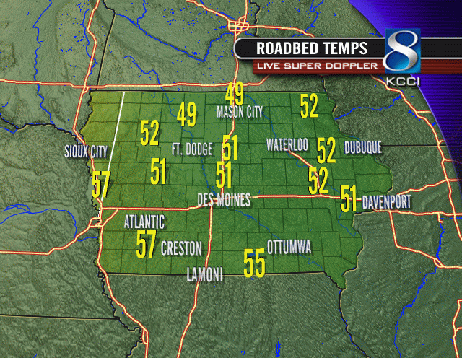
Private Sector / State Agency
On-Air Image generated by KCCI-TV showing DOT owned Roadway Weather Sensor (RWIS) information.

Slide 20
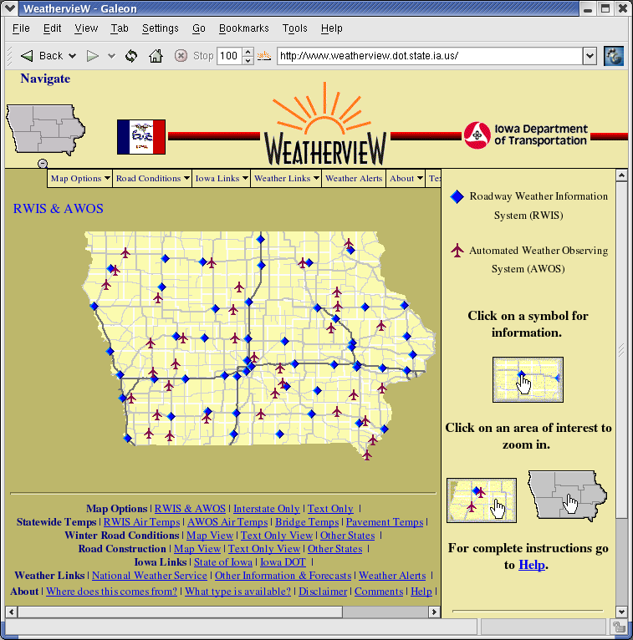
Academia / State Agency
The popular DOT WeatherView site displaying information from the RWIS/AWOS network.

Slide 21
Motivations for
Application Development
We build applications for what endusers need, but make things extensible for other purposes.
GIS plays an important role in providing cross platform applications and data solutions. GIS provides a mechanism to quickly combine diverse information together.
The IEM will only provide Open Source / Cross Platform solutions to meet the data needs.

Slide 22
Open Source? & Cross Platform?
The wheel must not be continually reinvented.
Applications should speak to each other in community accepted standards.
  Open GIS Consortium
  XML-RPC / SOAP
Data must be generated in standard formats. Simple ASCII data files are evil!
  NetCDF, HDF, XML, sensorML

Slide 23
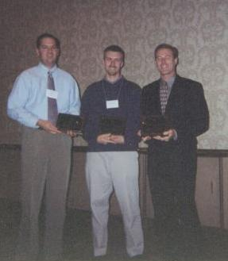
IEM Example: KCCI SchoolNet8
An example of the partnerships the Iowa Mesonet is built on.
Sharing data and resources to meet the challenges of managing an observing network.

Slide 24
Before the IEM got involved.
Data collected and sent to website, on-air display.
Data was not archived.
Data was not quality controlled.
Data requests from the public, National Weather Service were impossible to fill with non-existant IT support.
The network had a single purpose and meet that lone purpose well.

Slide 25
The need for the IEM
As the network kept expanding, the management resources required also expanded.
The amount of data flowing was overwhelming to keep track of.
The public and schools were demanding more usability with the data and educational opportunities.

Slide 26
What the IEM did.
We processed their data without any changes on their end.
Built needed web applications and data manipulation programs.
Processed the data through Forecast System Lab's (FSL) MADIS project for QC and to widely distribute the data.

Slide 27
What KCCI did.
Convince management that sharing data was a good idea.
Provide responsive and timely information to data quality concerns.
Provide valuable feedback to the IEM for application development.
Promote the IEM with the focus on data sharing.

Slide 28
Before After
On-Air Display
Website with currents
Local display at schools.
Full-featured website with many unique applications.
Local School engagement with the network. Energy...
Widely used and accepted data network.
Publicity galore!

Slide 29
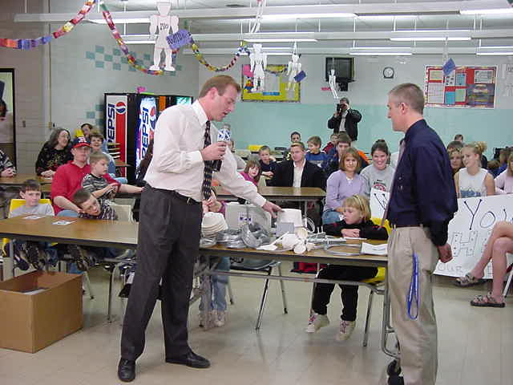
Data Users
National Weather Service
Storm Prediction Center
River Forecast Center
APRS FireNet
Research Community
Weather enthusists
Other TV stations!

Slide 30
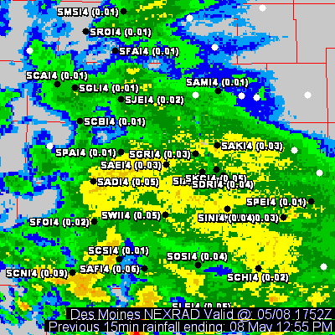
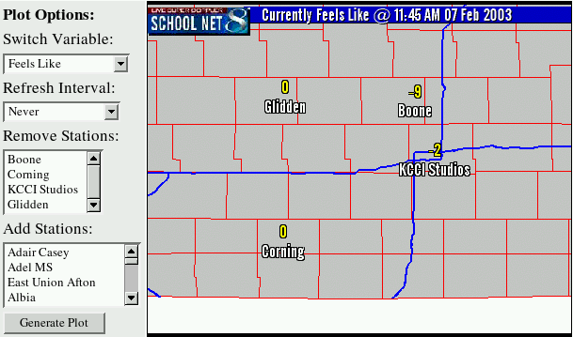
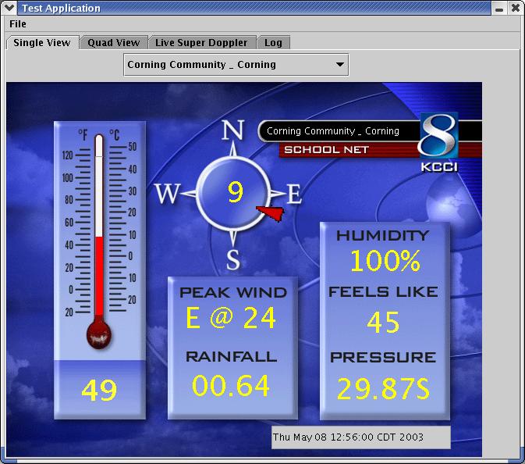
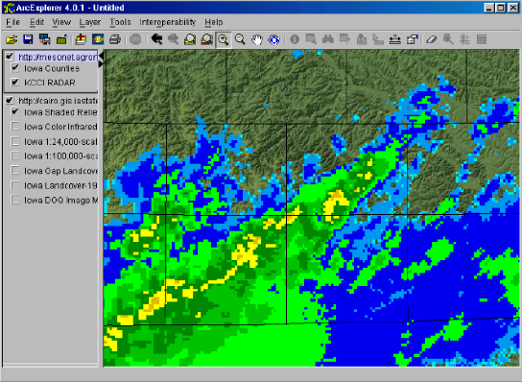
Data Applications

Slide 31
Example Conclusion
The first step was sharing the data and then the entire world of possibilities opened up.
The partnership has been beneficial to both sides, with the general public ultimately benefiting.
The partnership has allowed the network to continue expansion to 50 stations and growing.
The users are energized and the schools are excitied to be apart of this data sharing effort.

Slide 32
What can the IEM do for the EPA?
We can proctor the QC of your meteorological data.
We can quickly compare your data and produce reports in many formats.
We can increase your data userbase and promote your network through media partnerships.
Provide data in LITTLE_R / RAWINS format!
Script for the AIRS database

Slide 33
Conclusions
Sharing data is the key to maintain any observational network. Single purpose networks will ultimately meet their demise because of small userbases and small funding pools to draw from.
The Iowa Environmental Mesonet is willing to help in any way possible.
Thanks! Daryl Herzmann <akrherz@iastate.edu>

