Slide 1
Serving NEXRAD imagery with Open-Source GIS
Daryl Herzmann
Dr Raymond Arritt
Iowa Environmental Mesonet
Department of Agronomy
Iowa State University

Slide 2
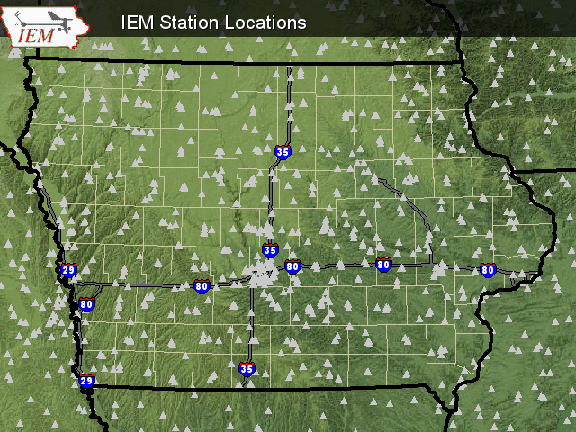
Iowa Environmental Mesonet
We collect, analyze, display, disseminate, and archive environmental data.
Archive holds over 350 million obs.
Each day we process ~200,000 obs.
Build partnerships between private, public, and academic sectors.

Slide 3

Open Source / Open GIS
Inter-operable
Non-proprietary
Cross-platform
Community Energy
Global collaboration
http://www.opengis.org
http://www.freegis.org
Penny Marshall discussing e-business
strategy with Linux.
“It is all about timing, kid”
(IBM Commercial)

Slide 4

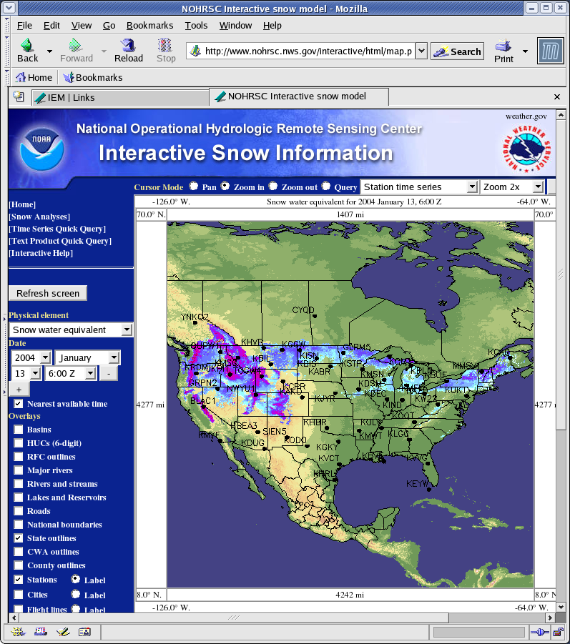
Mapserver http://mapserver.gis.umn.edu
Open Source
GIS Web Mapping
Supports WMS/WFS OGC standards
Supports a vast number of GIS data sources
Actively developed by a world-wide community

Slide 5
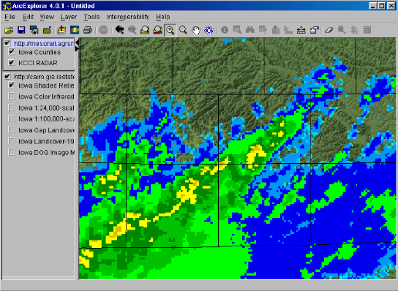
WMS: Web Map Service
Server listens for HTTP GET or POST (xml encoded) requests
Server responds with an image, an exception, or XML encoded capabilities
Issues of transparency, time, and meta-data
ESRI ArcExplorer combining WMS layers from IEM Mapserver and Iowa State GIS Lab OrthoServer.

Slide 6
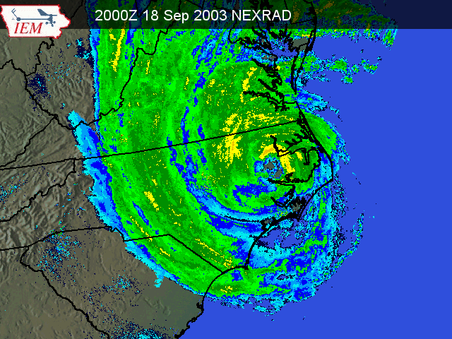
Available GIS Datasets
Publicly accessible Spatial Database of observations
National 2km & Midwest 1km base reflectivity rasters generated and archived every 5 minutes
Numerous download pages of historical data in a GIS Ready format.
High res floater done for Hurricane Isabel. Archive is available for
download.

Slide 7
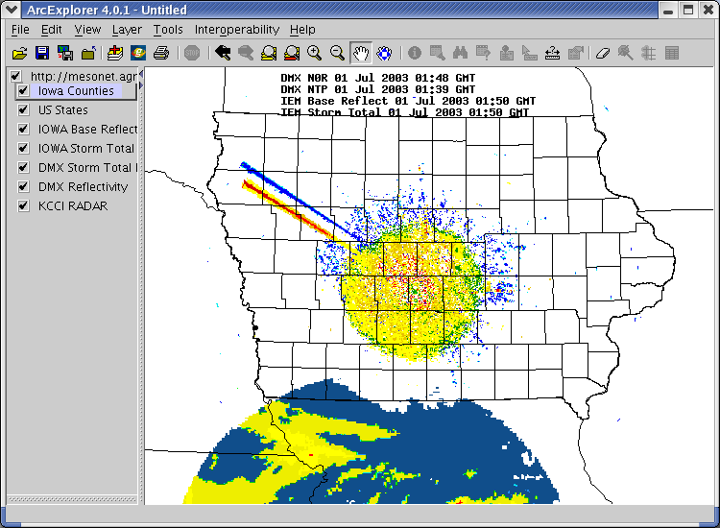
NEXRAD Web Map Service http://mesonet.agron.iastate.edu/wms/comprad.php?
Publicly Accessible WMS with composite base reflectivity
Raw layers are available for HTTP download
Will remain public until I get slashdotted
NEXRAD and TV radar both showing 'solar spikes' at sunset.

Slide 8
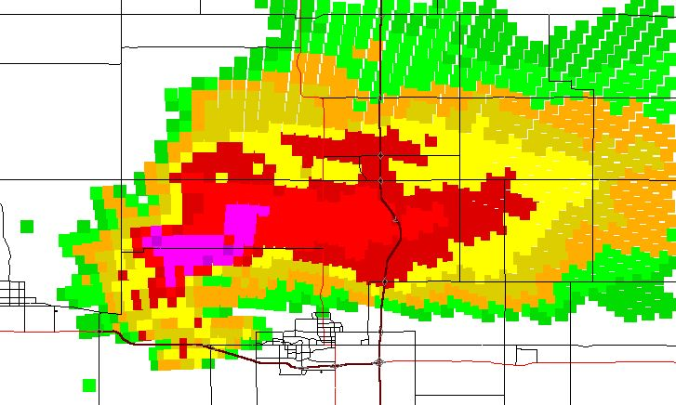
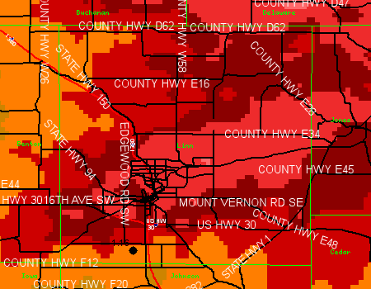
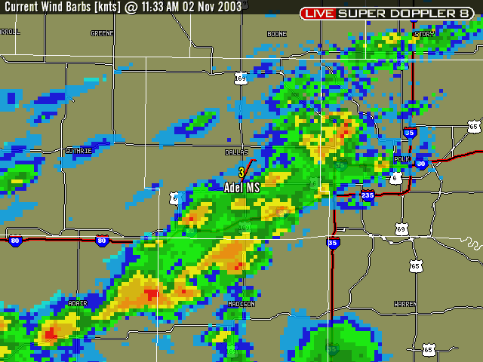
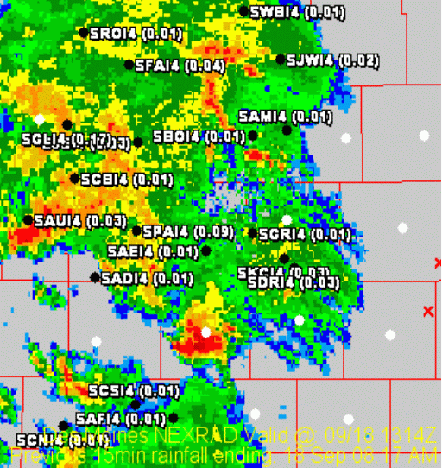
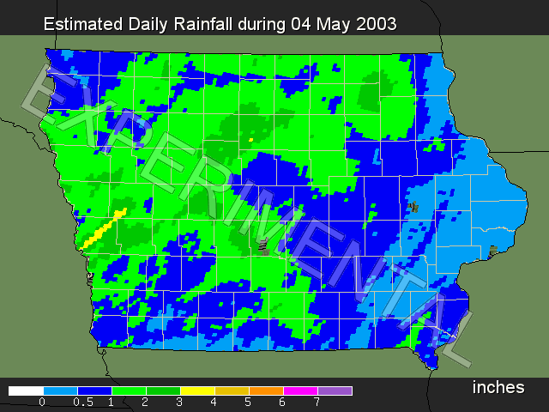
Mapping Applications

Slide 9
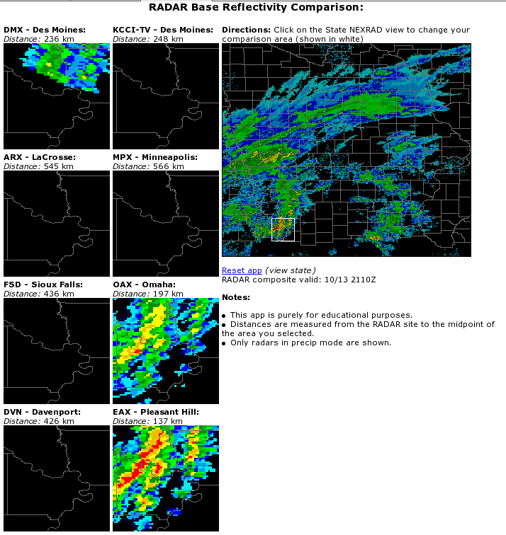
RADAR Comparisons
Dynamically compare 7 NEXRADs, 1 TV C-band RADAR, and a composite
Powered by PHP MapScript with ~50 lines of code
Click on the composite to compare the 8 RADARs

Slide 10
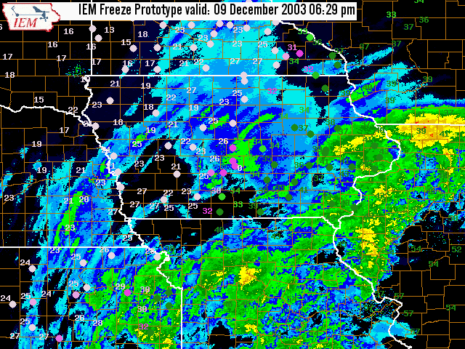
IEM Freeze
GIS Layers
NEXRAD
Road Temps
Air Temps
State Borders
County Borders
Label
Logo!

Slide 11
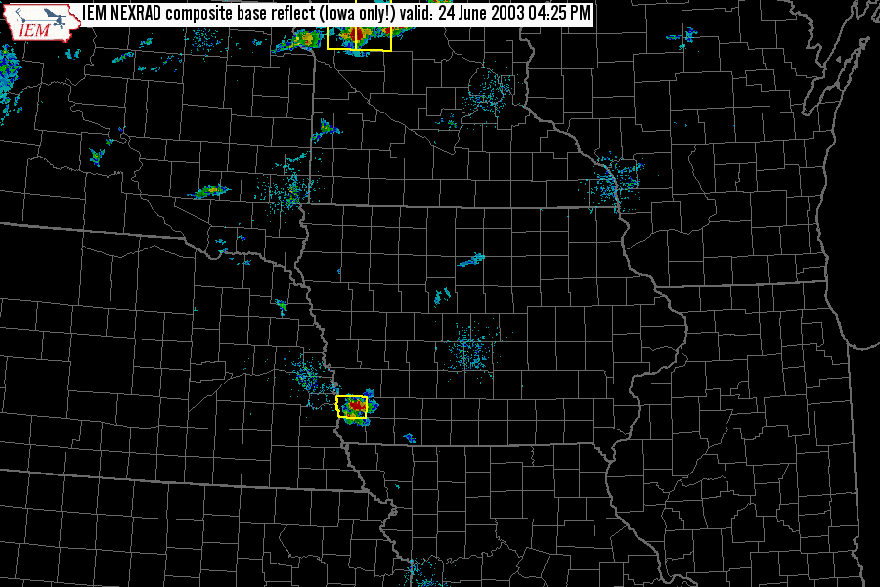
NEXRAD with warnings

Slide 12
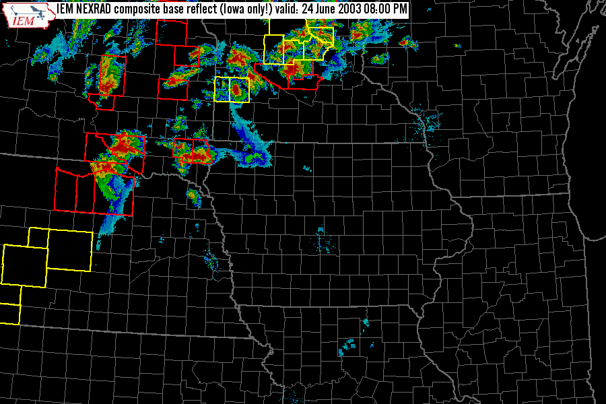
Terrible Tuesday

Slide 13
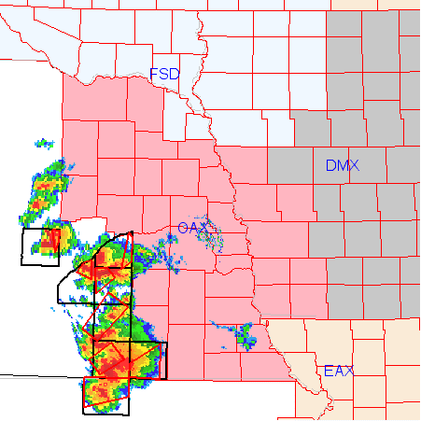
Using NWS Warning Polygons
Warnings are mined into a spatial database in real time
Mapserver can use this as a data layer
Warnings are synced with the NEXRAD layer for display
Provides valuable insight for the specific areas and tracks the forecasters are concentrating on
Great data-source for verification studies

Slide 14

Summary
Where is the IEM going with GIS?
  I don't know.
What will I show next year at AMS/IIPS/GIS?
  Perhaps I won't be invited!
Who can use our software and data?
  Anybody who likes Open-Source and isn't afraid to have some fun in the process!
Will OSS/Mapserver/Linux rule the world?
  YES! WHA-HA-HA!!!

Slide 15

I'm done, questions?
Daryl Herzmann
3010 Agronomy
515-294-5978
akrherz@iastate.edu

