Slide 1
KCCI SchoolNet8
Website Guide
Daryl Herzmann
Iowa Environmental Mesonet
Iowa State University

Slide 2
Motivation
Show what is available on the website
Provide details on Science Discovery for the resources
Explain example plots and charts

Slide 3
Topics
Comparing Observations
Solar Radiation
Sortable Current Conditions
One Minute Data Traces
Web Cameras

Slide 4
Topics
Live Super Doppler8 App
Using RADAR with Obs and Warnings
Orthophotography
Wind Barbs
Navigating SchoolNet8.com

Slide 5
2. Solar Radiation

Slide 6
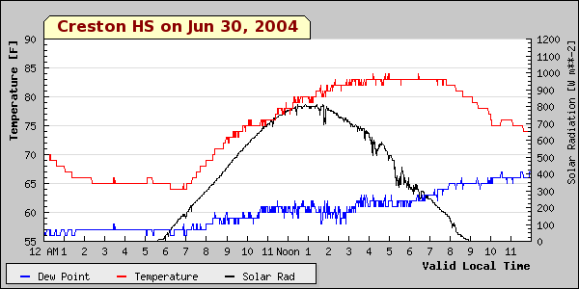
A Sunny Day

Slide 7
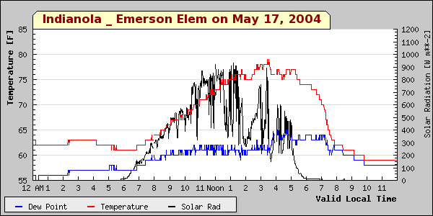
Sun, clouds, sun, clouds

Slide 8
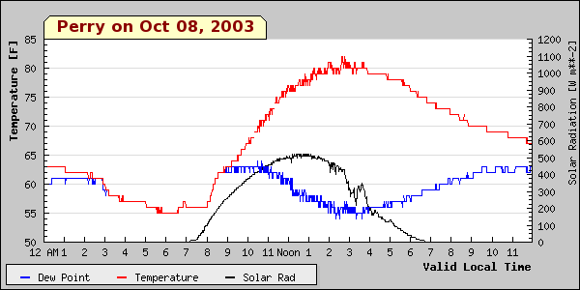
A sunny fall day

Slide 9
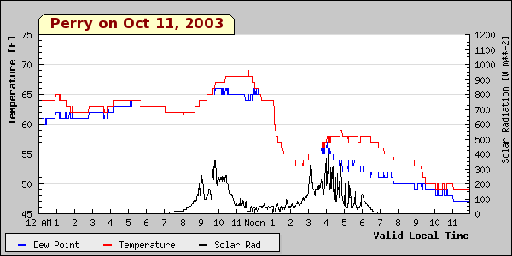
A cloudy fall day

Slide 10
Website Activity:
Make a plot of high temps

Slide 11
Website Activity:
Getting comfortable with the Live Super Doppler8 App

