Slide 1
GIS + IEM + Other Acronyms
Daryl Herzmann
Department of Agronomy
Iowa State University
@akrherz

Slide 2
Caveats Galore
My degree is in Meteorology (2001)
If you believe Meteorologists, it is your own fault
I rarely use “traditional” GIS software stacks
I don’t use GIS Desktop Apps
There are often “better” data alternatives than me now-a-days, maybe

Slide 3

So then, who am I and why am I here?
The year was 2002 and Open-GIS looked cool!
Early adapter of PostGIS (GIS extension for PostgreSQL)
Used U of Minnesota Mapserver
Started to implement a bunch of OGC Services
Super-Nerds like Patrick Brown and Howard Butler helped me along

Slide 4









IEM: Iowa Environmental Mesonet What is this ‘Mesonet’ you speak of?
“Meso” (mesoscale ~10s km) “Net” (network)
Environmental Data Warehousing Project
Iowa State operates one of the networks combined within the IEM Project
We partner with lots of folks

Slide 5
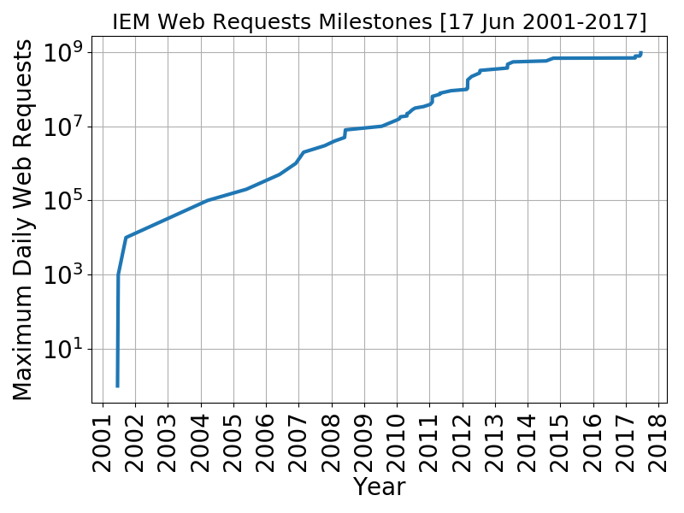
IEM Website Traffic
Webfarm of ten nodes and two LBs
Backend caching and service nodes
Almost all of this traffic is servicing… GIS Requests!
Almost all of this traffic is from un-knowing users!
Whew!
Uh oh

Slide 6
Types of GIS Requests Serviced
WMTS (Web Map Tile Service) /c/tile.py/1.0.0/ridge::USCOMP-N0R-201710091305/5/6/12.png
OGC WFS (Web Feature Service) OGC WMS (Web Map Service) /cgi-bin/wms/nexrad/n0r.cgi?SERVICE=WMS&REQUEST=GetMap&VERSION=1.1.1
Geo-JSON(P) vector data via crude APIs
User manual downloads of shapefiles, rasters, text files with lat/lon, etc

Slide 7
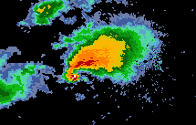
How I abuse the PNG format.
Having PNG files associated with geo-referenced world files is not that fancy
I use the color index level to discretize a physical quantity
(255 levels)
index=0 black/offsite/missing
Causes some grief as most systems want to convert a RGB triple to a quantity

Slide 8
Would you please get to detailing the data you have and how I can get my greedy hands on it?

Slide 9
The beloved wall of text
NEXRAD RADAR
1995- Composites
2005 – Storm Attribute Table
2010 – Single Site RADAR
2017 – HRRR Forecasted Ref
NWS Alerts
2005- Watch/Warning/Adv
1997 – SPC Watches
2002 – Convective Outlooks
2008 – Mesoscale Discussions
2015 – Pilot Reports (PIREP)
NWS Forecast Model
1997- Assorted Grib Archives
2000- Model Output Stats
2002 – Convective Outlooks
2008 – Mesoscale Discussions
Point Observations
1950- Station Data
1893- COOP/Climate Data
2001- Derived Products
1940 – RAOB Soundings
2003 – Local Storm Reports
Satellite
2005- GOES East/West
2012- SMOS (Soil Moisture)
AWIPS Projection + EPSG:4326 services
Precipitation
1981- Oregon State PRISM
2013 – NOAA MRMS
1951 – IEM Reanalysis
Iowa Road Winter Wx
2006 – State Patrol/DOT Reports
1995 – RWIS Observations

Slide 10
But where do I find any of this on your train wreck of a website?
Google is your friend
Main sections “GIS”, “GIS OGC Web Services”, and “Current JSON Web Services”
https://mesonet.agron.iastate.edu/GIS/
https://mesonet.agron.iastate.edu/ogc/
https://mesonet.agron.iastate.edu/json/
Call me, text me, tweet me, email me, whatever, I respond!

Slide 11
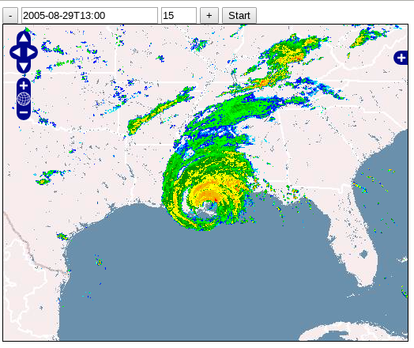
#1 Most Popular: RADAR Map Services
“IEM” -> “GIS” -> “OGC Services”
WMS-T (time aware)
WTMS (time is hacked into service name)
Every 5 minutes, back to 1995 CONUS

Slide 12
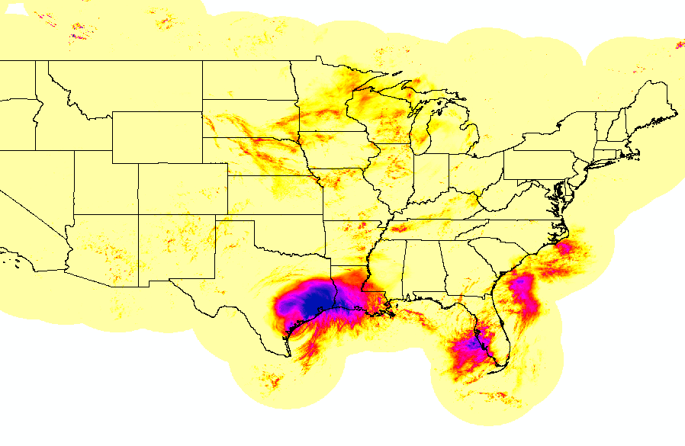
#2 Most Popular: IEM GIS Rainfall Products
“IEM” -> “Most Popular” -> “IEM GIS Rainfall”
ERDAS IMG current/past MRMS estimates
Manual point extractions
NCEP Stage IV daily point/polygon shapefiles

Slide 13
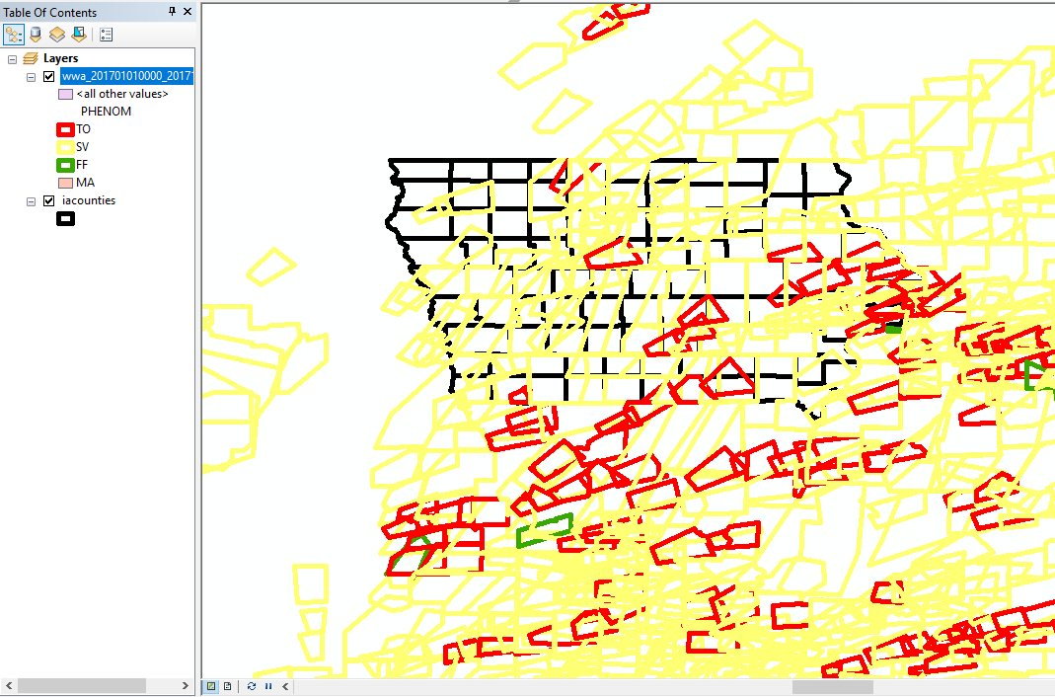
#3 Most Popular: NWS Watch/Warnings/Advisories
“IEM” -> “GIS” -> “Archived NWS Warnings”
Most complete known archive on the internets!
Custom Shapefile/KML downloads
“real-time” feeds as well

Slide 14
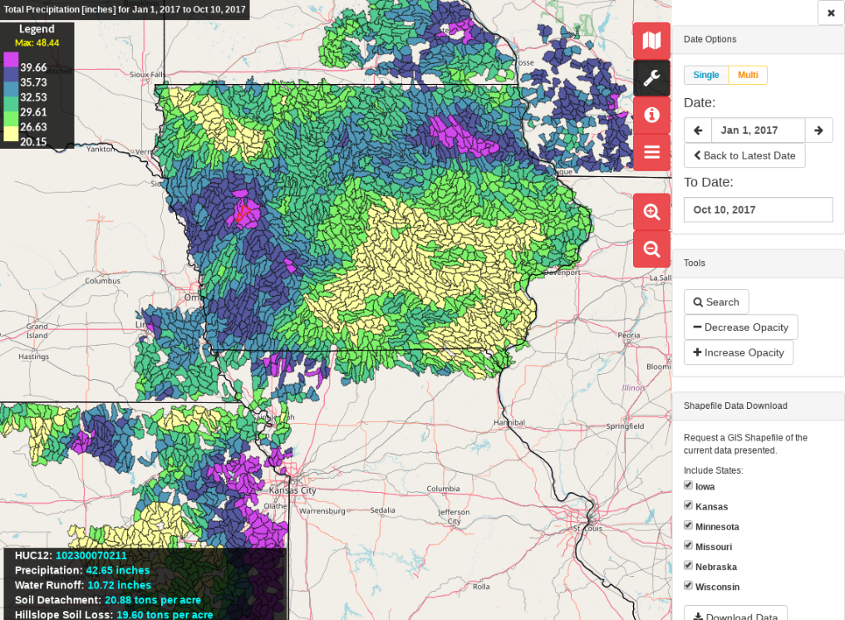
Since I have the floor: The Daily Erosion Project (DEP)
https://dailyerosion.org/
http://northcentralwater.org/acpf/
GIS exports of daily erosion model, precip by HUC12
Brian Gelder, David James, Rick Cruse et al
Expansion work continues

Slide 15

But daryl, why haven’t you implemented X software or Y service?
Answer: Likely because nobody has ever asked me!

Slide 16
Are there “better” GIS alternatives to the IEM these days?
https://nowcoast.noaa.gov/
https://idpgis.ncep.noaa.gov/
https://realearth.ssec.wisc.edu/doc/dataaccess.php
Insert Rumsfeld’s known-unknowns here

Slide 17
So in closing…
I have lots of data
You have way more GIS knowledge than me
Let us work together to automate the flow of data into your GIS!
If I don’t hear from you, I assume all my services are working great and I’ll implemented more kludgy services to talk about for my next GIS talk!

Slide 18

I'm done, questions?
Daryl Herzmann
3015 Agronomy
294-5978
akrherz@iastate.edu
@akrherz

