Slide 1

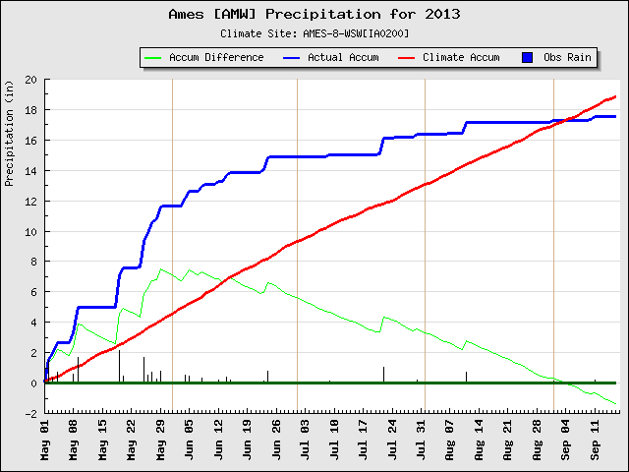
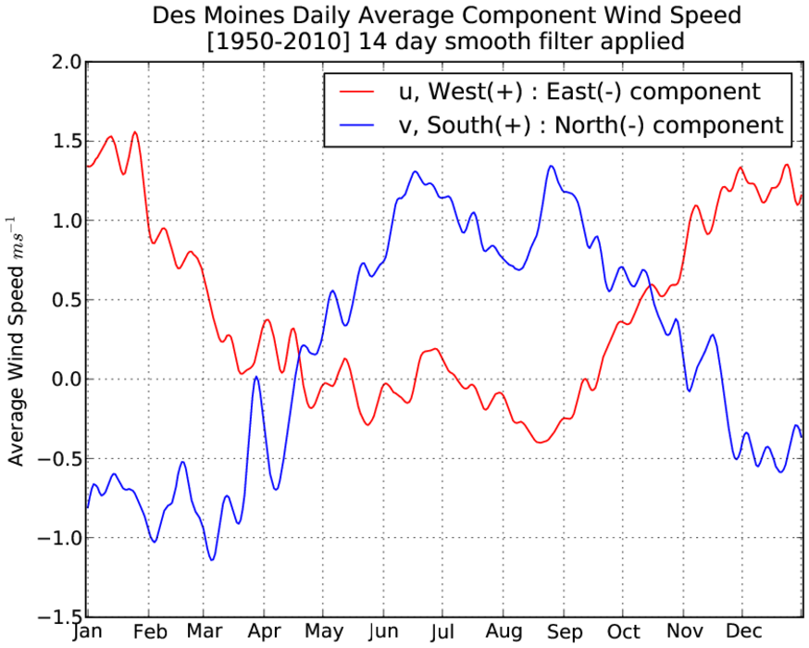
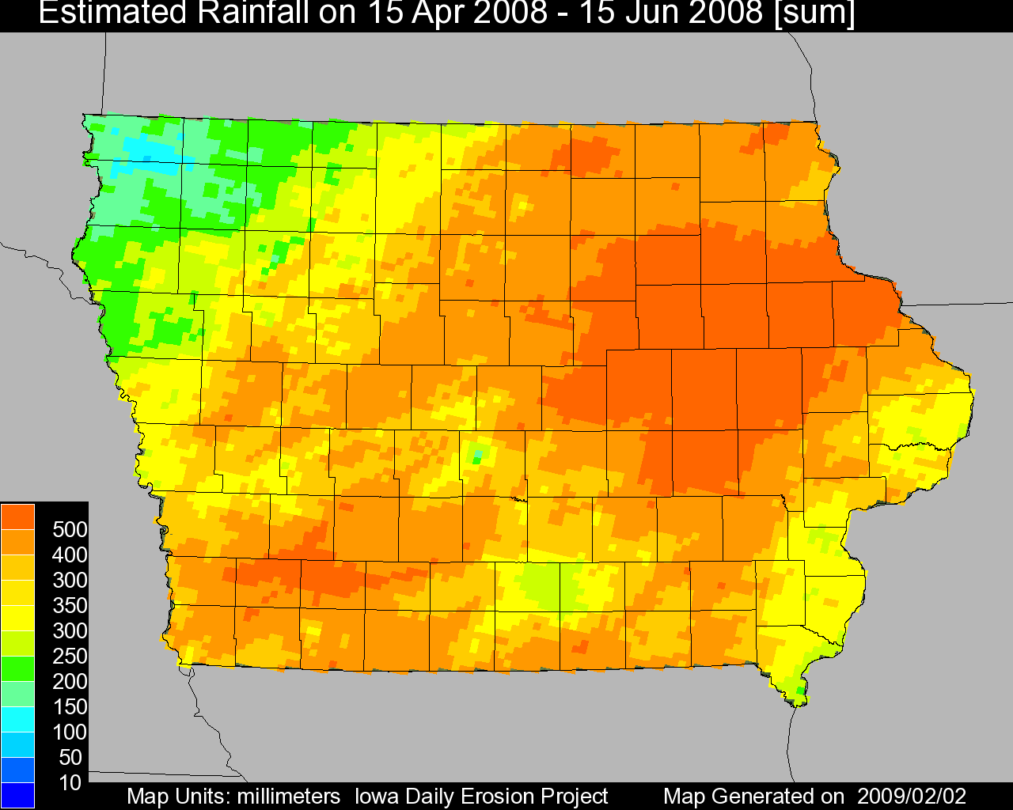
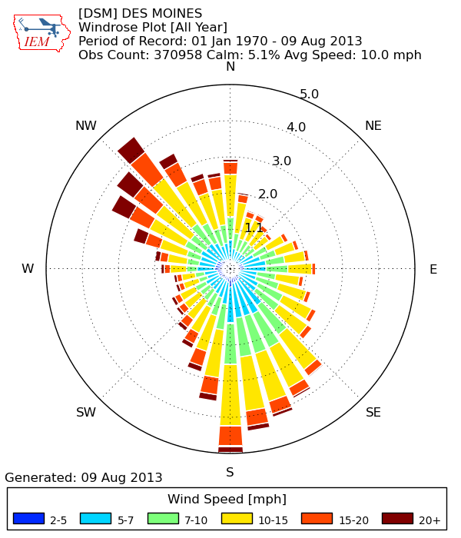
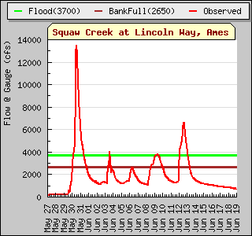
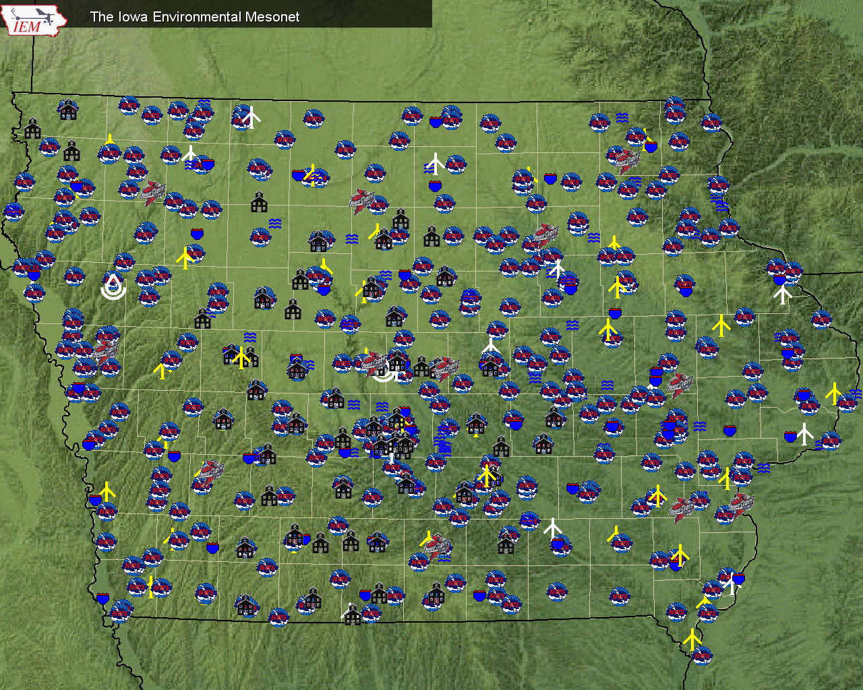









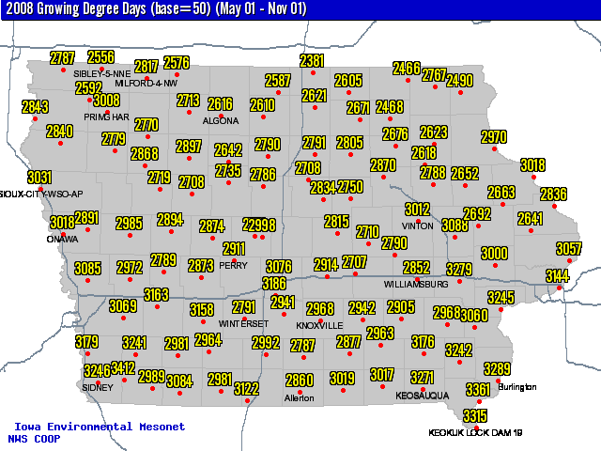
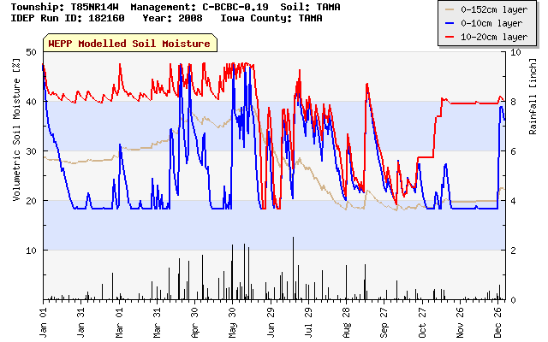
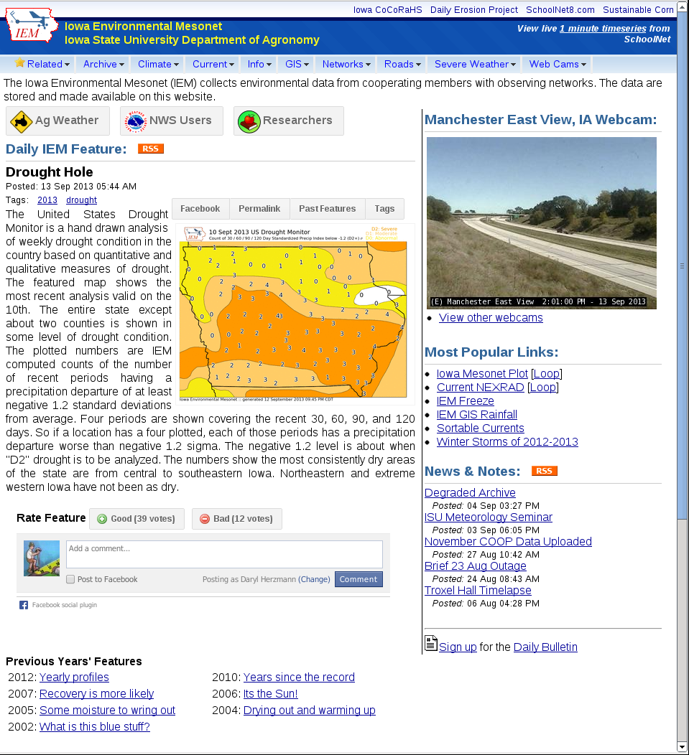
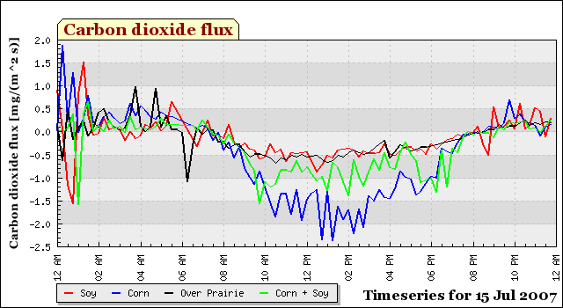
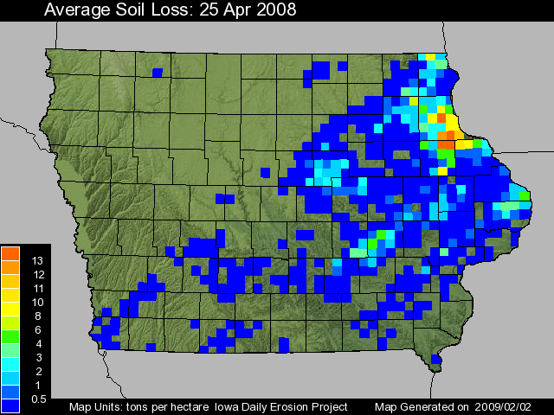
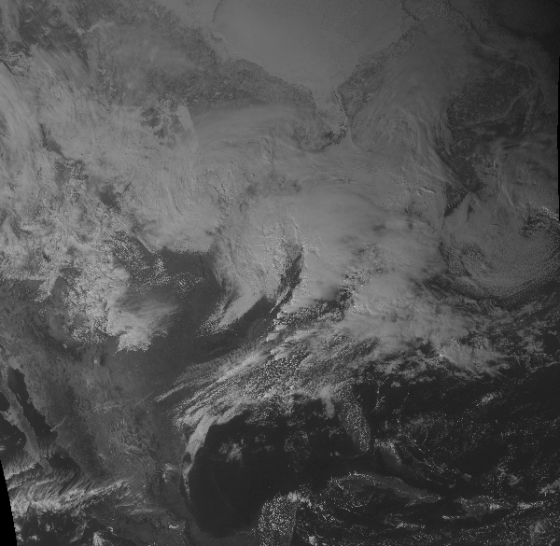
Iowa Environmental Mesonet (IEM): Capturing Iowa’s Weather and Climate Variability
Daryl Herzmann and Raymond Arritt, Department of Agronomy
Wind
Water
The IEM is an environmental data warehousing project seeking to capture weather and climate datasets to support multi-disciplinary research at ISU and beyond. The IEM builds these datasets through partnerships with data providers generating well over 300,000 observations per day from hundreds of platforms spread throughout the state.
The term “mesonet” refers to a NETwork of observational sensors observing phenomena on the MESOscale. The mesoscale is spatial scale on the order of size of clouds to an individual storm system.
The IEM gathers and archives observations of wind from automated platforms reporting as temporally fine as every 6 seconds. This archive can be used to provide assessments of Iowa’s wind climatology.
The IEM maintains a long term archive of daily rainfall observations dating back to 1893. These numbers provide the climatology that years like this year can be compared to.
Background
Figure to the left shows Iowa’s strong annual signal for u and v wind components. The blue line shows the dominate northerlies (negative v) in the winter time and southerlies (positive v) in the summer time.
The IEM provides a real time high resolution gridded analysis of rainfall available in GIS formats. This image shows the tremendous total amount of rainfall during a portion of the Floods of 2008 in Eastern Iowa.
Wind roses are commonly used to quickly show preferred wind speeds and direction. Plots like this one can be generated on the website for over 100 locations in Iowa and thousands more around the globe!
The IEM also collects stream flow information providing an online downloadable archive. This hydrograph shows the Ames Squaw Creek flood events in 2008.
The Meso-Network
Soil
Air
The symbols represents the diversity of stations providing near real time data.
The Iowa Daily Erosion Project (IDEP) is a near real-time modeling effort to analyze soil erosion potential based on high resolution inputs of rainfall, soils, and management practices.
The website allows customized generation of maps based on daily high and low temperature observations. In this map, a common agricultural unit of Growing Degree Days is presented.
A model run is made for each point of a representative sample of Iowa soils, hill slopes, and management on a township level. Each run generates a time and depth profile of soil moisture.
IEM server stats:
~300,000 website users per day
~50 billion point observations
15 terabytes of data available on demand
50 gigabytes archived per day
IEM Daily Feature:
Once per day blog of current weather and climate info in Iowa
The IEM collects soil and atmospheric flux information provided by advanced observation equipment operated by the National Laboratory for Agriculture and the Environment.
Website
A statewide raster analysis of soil displacement is shown here for an intense rainfall event in April 2008.
Version 2 of this project is underway and include:
Explicit slopes and soils
1km/5min Precipitation
Satellite Derived Cropping
The IEM provides a near-realtime and archive of GIS ready satellite images. The image to the left is from GOES East on 2 March 2012.
http://mesonet.agron.iastate.edu

