Slide 1

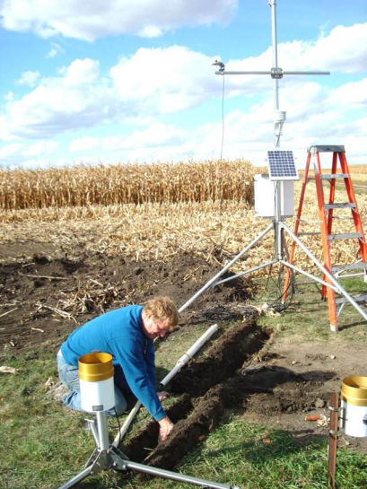
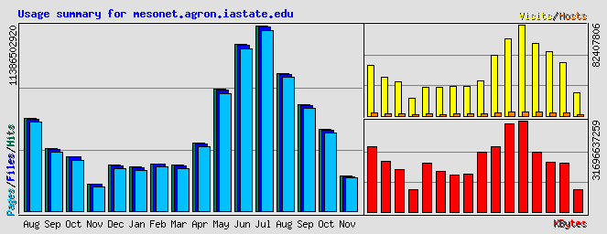
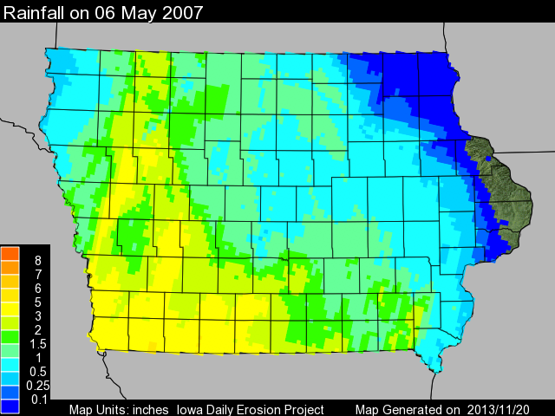
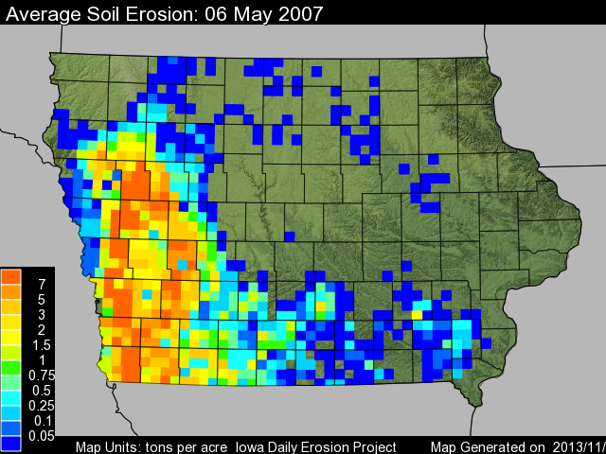
Iowa Environmental Mesonet
Capturing weather and climate variability to support Ag research.
Daryl Herzmann and Prof Ray Arritt, Department of Agronomy
Iowa Soil Moisture Network
Past Year’s Website Usage
Prof Elywnn Taylor
Replaces ISUAG network, circa 1986
Soil: 4,12,24, 50”
Solar, Wind, T, RH, P
Goal: 1 per county
20/99 deployed
82 billion web requests
~5 million unique IPs
300 TB data xfer
Peak 12k req/sec
Stewardship of Unique Datasets
Iowa Daily Erosion Project
Δ5min NEXRAD composites since 1995
QC’d NWS COOP data since 1893 to today
Ingest/Archive of SHEF hydrological data
Accessible archives of METAR + RAOB
Severe Weather Products 1986-today
NWS Text Product Archives
Large weather webcam imagery archive
IEM Archives driving soil erosion modelling.

Slide 2

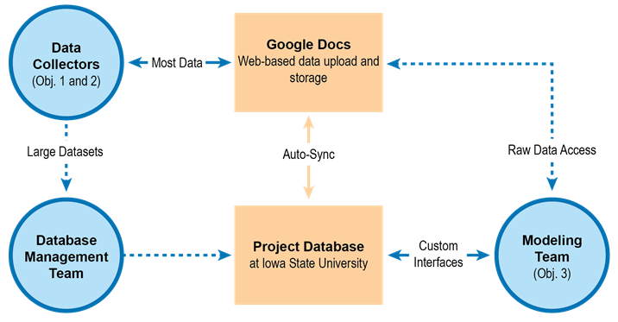
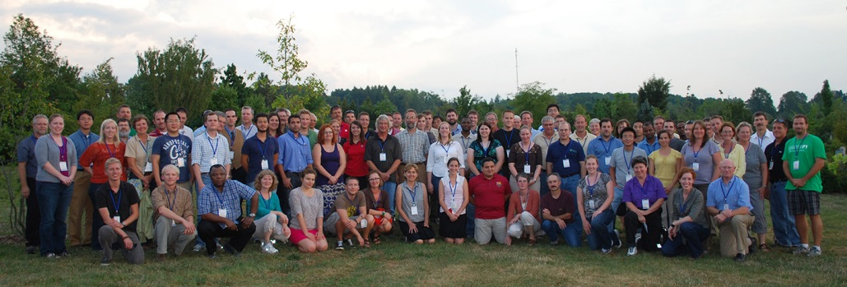
Corn Systems Climate CAP (USDA: $20 mil / 5yr)
Sustainable corn-based systems in a changing climate.
Prof Lois Wright-Morton et al, Prof Ray Arritt and Daryl Herzmann included
Building Central Database
Our Team
170 Collaborators
11 Institutions
37 research sites
9 states
Our project mission:
Objective 3 Systems Analysis + Predictive Modeling
We're scientists working together to create a suite of practices for corn-based systems that:
are resilient in times of drought
reduce soil and nutrient losses under saturated soil conditions
reduce farm field nitrogen losses
retain carbon in the soil
ensure crop and soil productivity
Running a suite of models
LCA, SWAT, SALUS
Providing downscaled CMIP3 + CMIP5 data
BCCA (has precip problems)
BCSD (monthly, not daily)
Dr Katherine Hayhoe daily regression

