Slide 1

Mesonet Refresher
Daryl Herzmann
@akrherz
2 April 2019

Slide 2
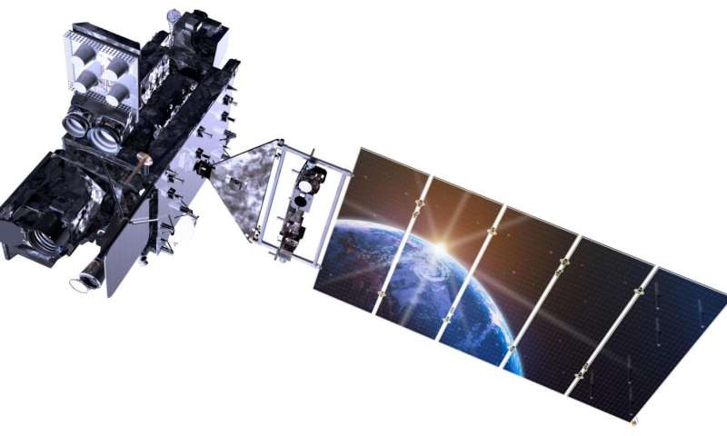
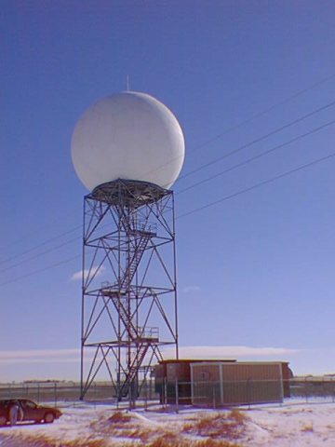
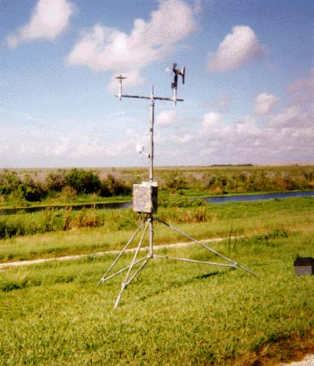
Why do weather stations exist?
?????
Planetary Boundary Layer
PS. the Earth is not Flat.
Images: weather.gov

Slide 3
OK daryl, no more attempts at confusing drawings

Slide 4
If Weather Stations are so important, why doesn’t the government place them like weeds over Iowa?
Money does not grow on trees
Maintaining weather stations is more expensive than installing them
Impractical to measure the variability that exists
Caution: If variability scares you, avert your eyes for the next few slides

Slide 5
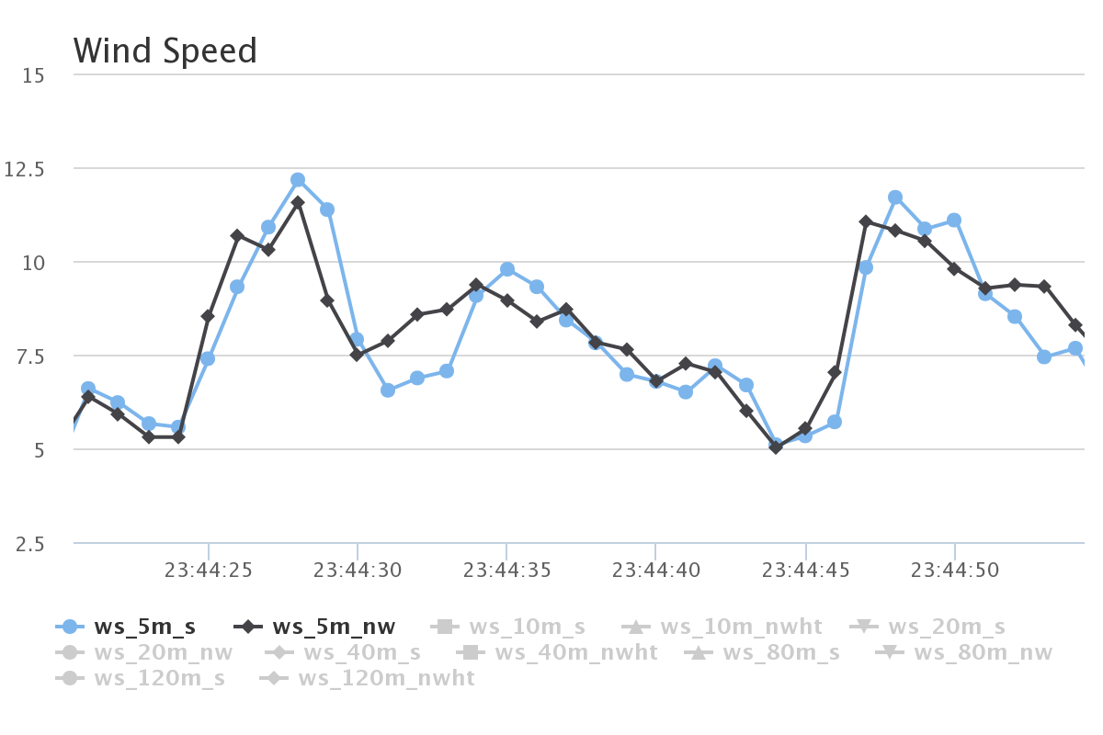
ISU “Tall Towers” 1 second interval Wind Speed [mps]
This entire plot is just 1 minute of data!
Two sensors at same height, mounted at different directions on the tower. We also have 20 Hz data ☺

Slide 6
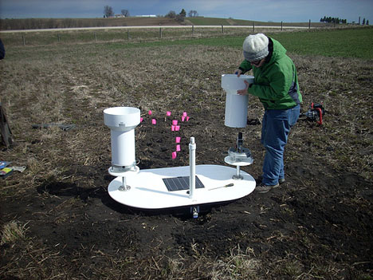
Precipitation Variability
Iowa Flood Center experiment with tipping buckets 3 feet apart
Found some cases of noticeable differences between these two gauges
In general case, which gauge is right? ☺
http://iowafloodcenter.org/notes-from-the-field-rain-gauges/

Slide 7
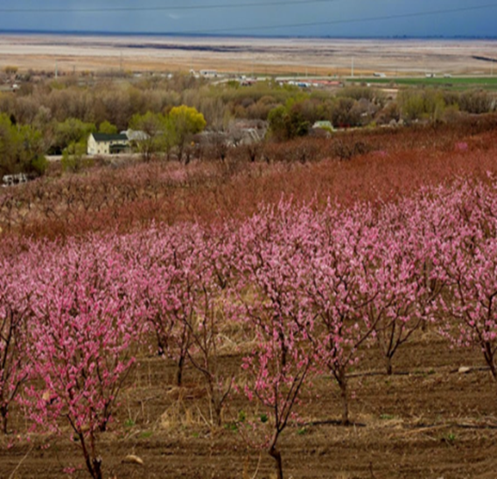
Temperature Variability
Subtle topography / elevation changes make a difference!
Similar to wind, one second plots sometimes show rapid temperature fluctuations
Urban Heat Islands impact temperature representativity
Photo: Dr Elywnn Taylor

Slide 8
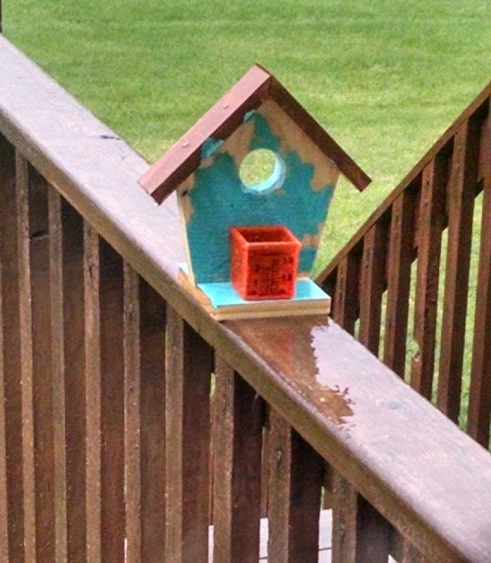
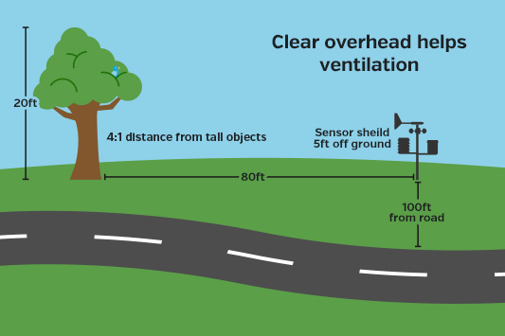
Bah, My weather station at my house is highly accurate!
https://www.wunderground.com/weatherstation/installationguide.asp

Slide 9
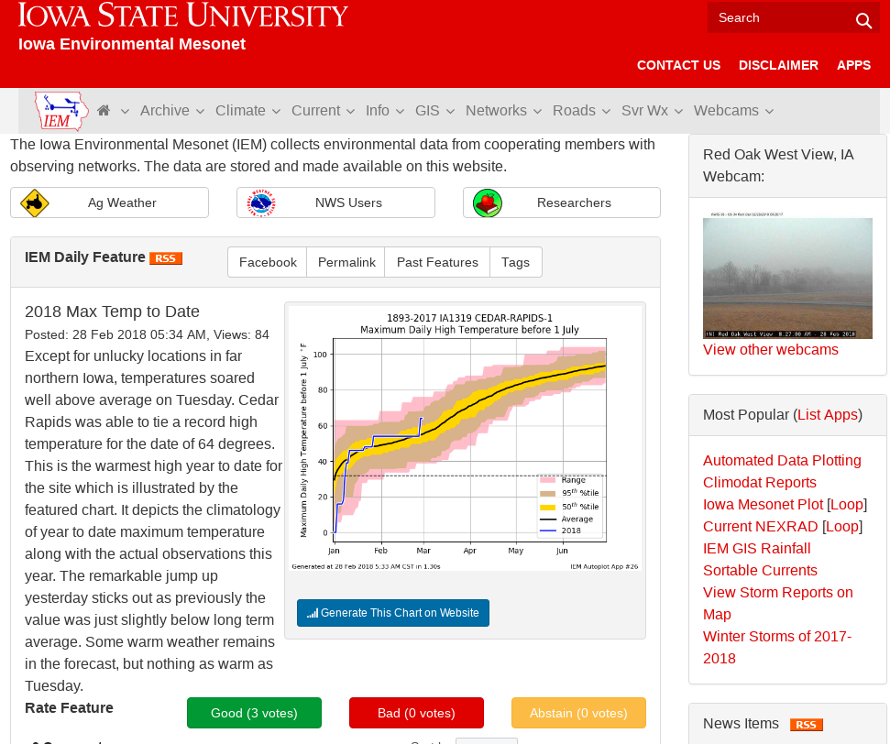
Having said all that, let us collect all the weather station data we can find!
Iowa Environmental Mesonet
“Meso” is a fancy weather term for a spatial scale (10s of miles)
Aggregate data from many different observation networks
Rest of my talk shamelessly promotes my website!

Slide 10
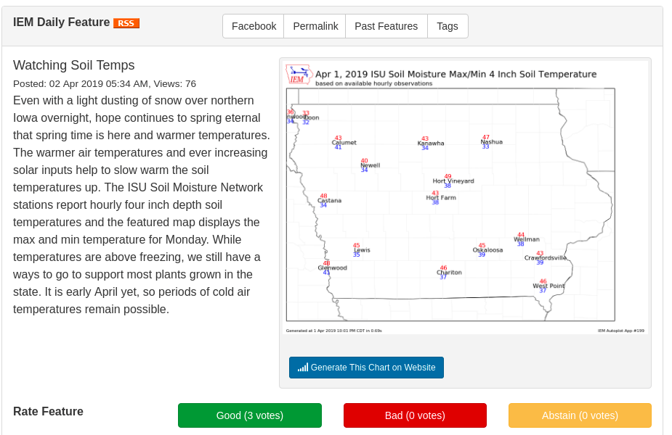
Plugging my IEM Daily Feature
Highlights something hopefully relevant each day
RSS Feed if you don’t want to check website daily, also view past features
Often links to IEM app that generated the plot, so you can tweak, download raw data

Slide 11
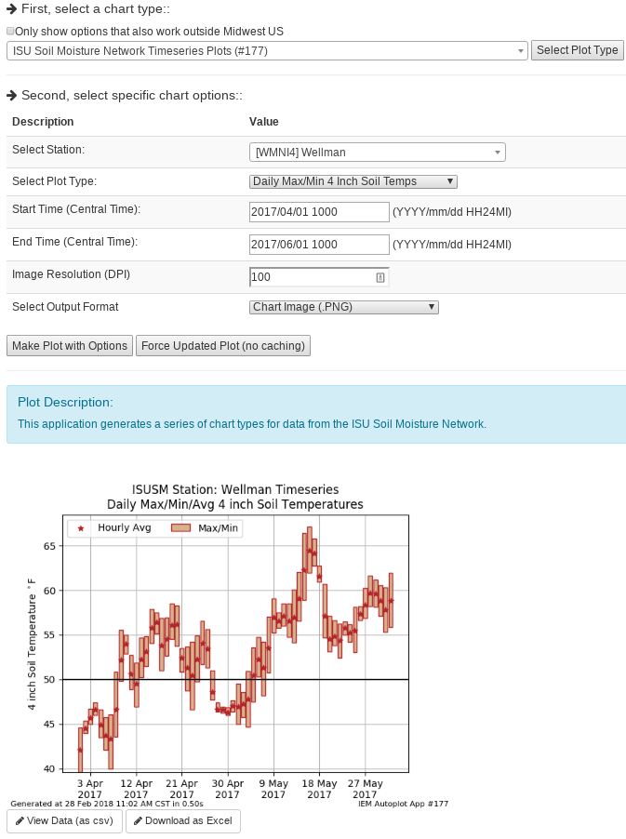
IEM Auto Plotting
Select Plot Type
Select Plot Options
Description
Custom Generated Plot
Download Raw Data (Excel)

Slide 12
Which network should I use?
Data Need | Recommendation
“Daily” High/Low Temps + Precipitation | NWS COOP IEM “Long Term Climate” / “Climodat”
Wind | ISU Soil Moisture ASOS / AWOS (Airport weather stations)
Solar Radiation | ISU Soil Moisture
Hourly Rainfall, not snow | ISU Soil Moisture / ASOS / AWOS
River Stage | DCP (USGS gauges)
Soil Temperature/Moisture | ISU Soil Moisture / SCAN
Humidity | ISU Soil Moisture / ASOS / AWOS
Pavement Temperatures | RWIS
Unicorns | Sorry, we don’t have that, yet.

Slide 13
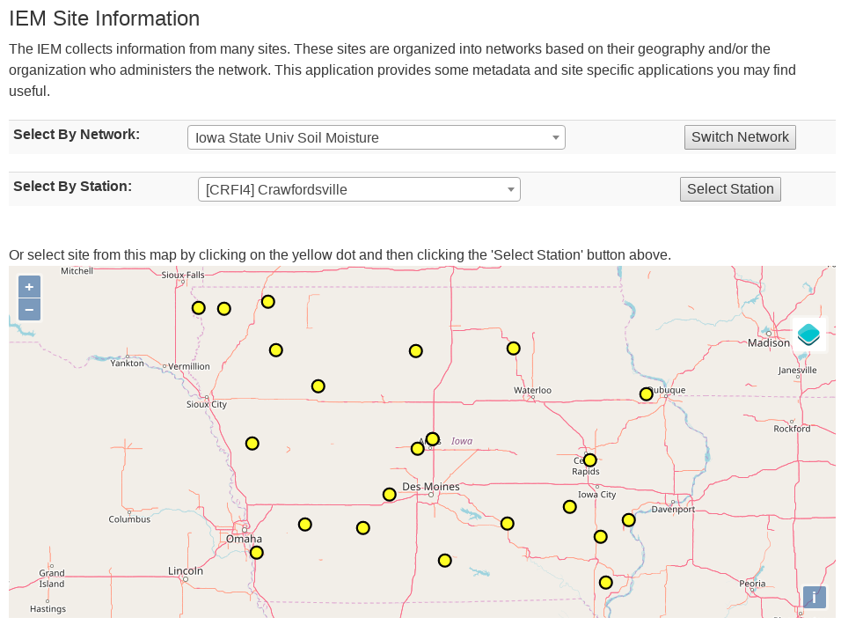
How do I find my closest station within a given IEM network?
IEM -> Info Tab -> Station Data + Metadata

Slide 14
Some Weather Variables to Monitor
Growing Degree Days
Temperatures
Soil Moisture/Temperature
Precipitation
Wind

Slide 15
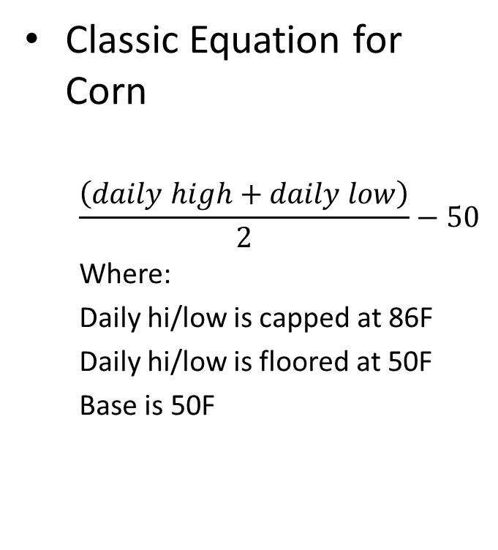
What are Growing Degree Days (GDD)?
Classic Equation for Corn
$$\frac{\left(daily high+daily low\right)}{2}−50$$
Where:
Daily hi/low is capped at 86F
Daily hi/low is floored at 50F
Base is 50F
Example 1
High 90
Low 48
GDD: (90 86 + 48 50)/2 – 50 = 18
Example 2
High 40
Low 32
GDD: (40 50 + 32 50)/2 – 50 = 0

Slide 16
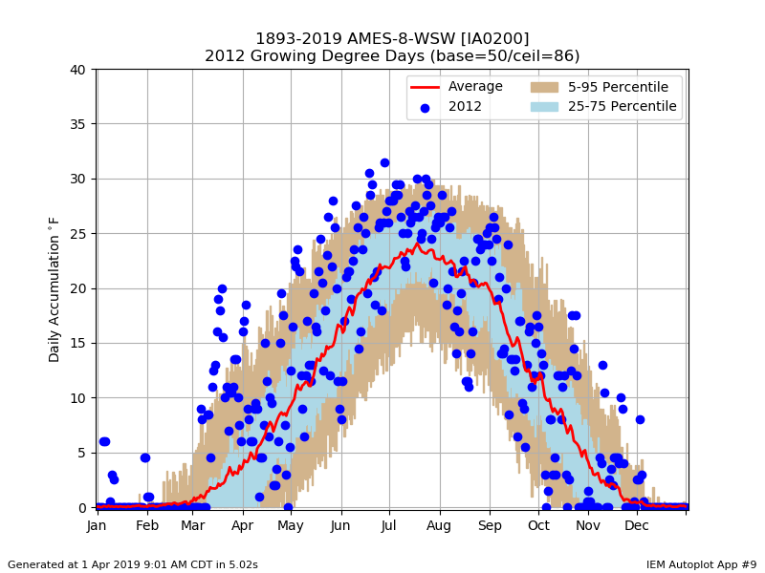
Web Link

Slide 17
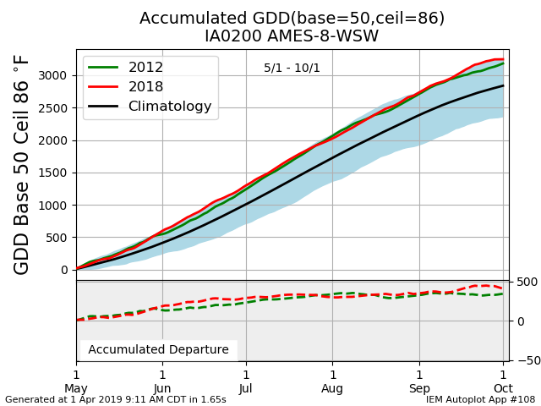
Web Link

Slide 18
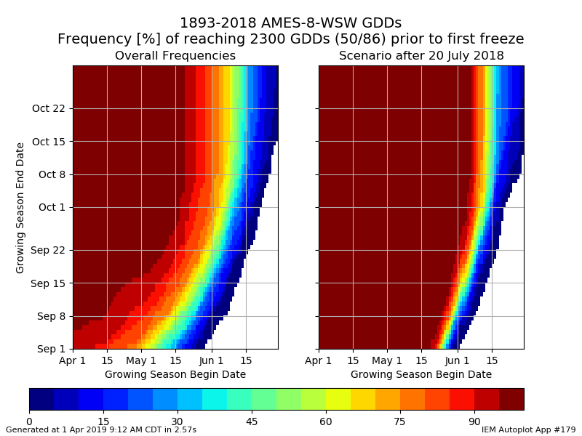
Web Link

Slide 19
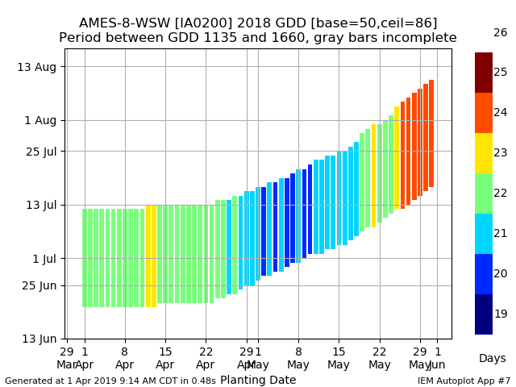
Web Link

Slide 20
Some Weather Variables to Monitor
Growing Degree Days
Temperatures
Soil Moisture/Temperature
Precipitation
Wind

Slide 21
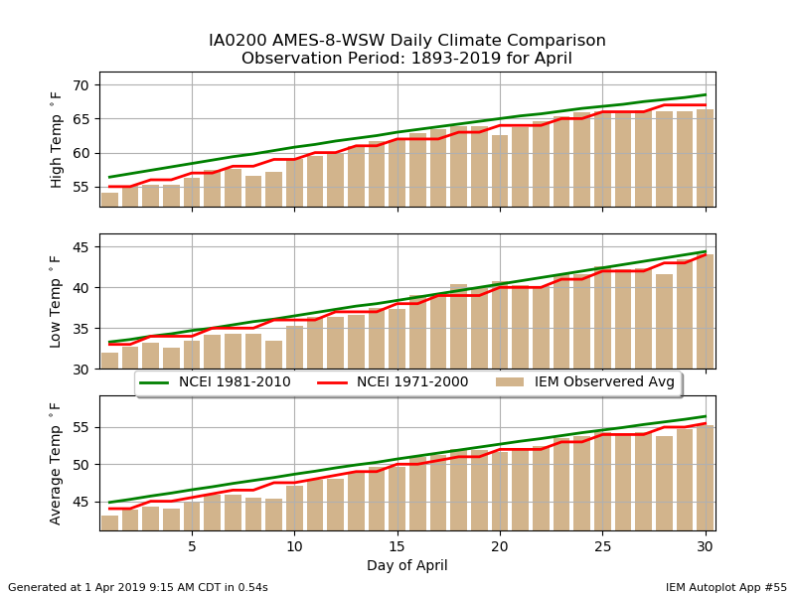
Web Link

Slide 22
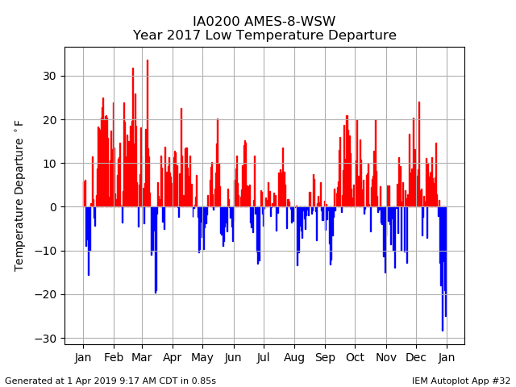
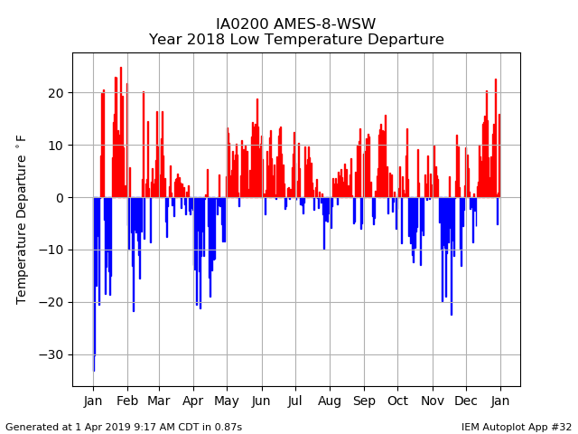
2017 Daily Low Temp Departure
2018 Daily Low Temp Departure
Web Link (Autoplot #32)

Slide 23
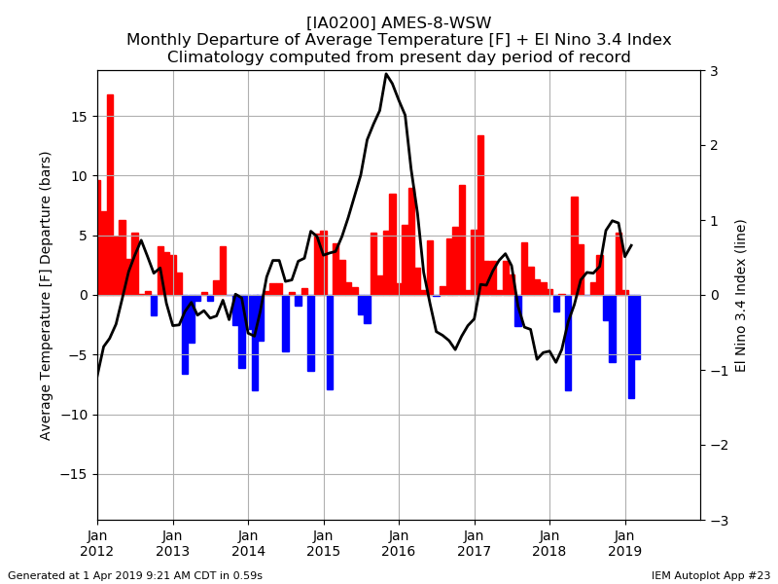
Web Link

Slide 24
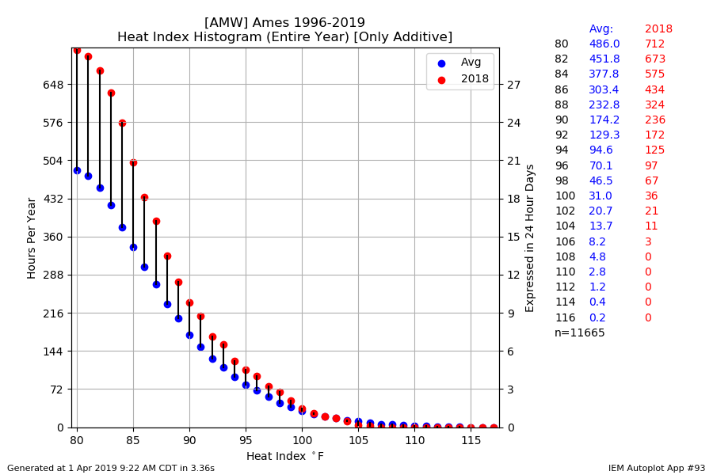
Web Link

Slide 25
Some Weather Variables to Monitor
Growing Degree Days
Temperatures
Soil Moisture/Temperature
Precipitation
Wind

Slide 26
ISU Soil Moisture Caveats Galore
Only 12, 24, and 50 inch depth readings for moisture
4 inch soil temperature is not in the crop field
Sensors don’t work properly when soil is frozen
We’ve had issues with lightning knocking out sensors
Newly installed sensors need time to find equilibrium

Slide 27
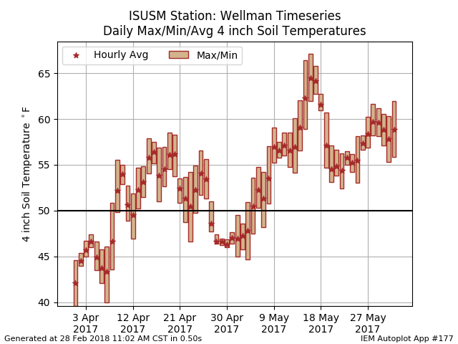
Web Link

Slide 28
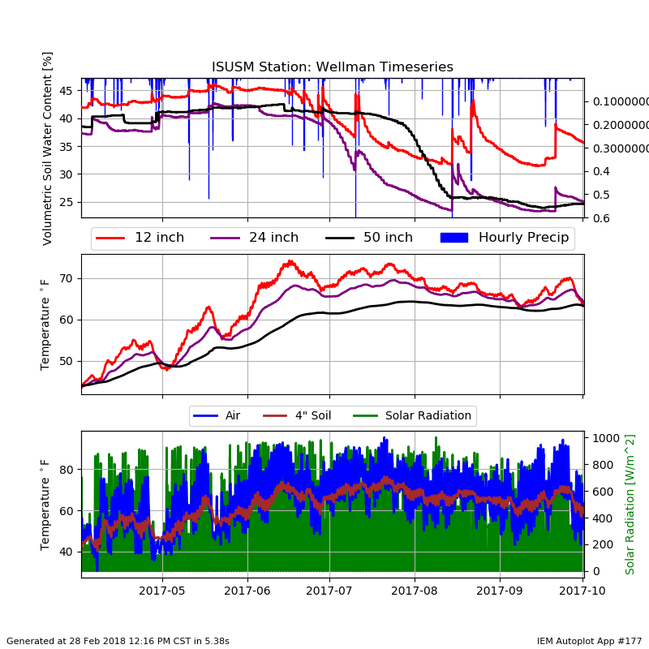
Web Link (Autoplot #177)

Slide 29
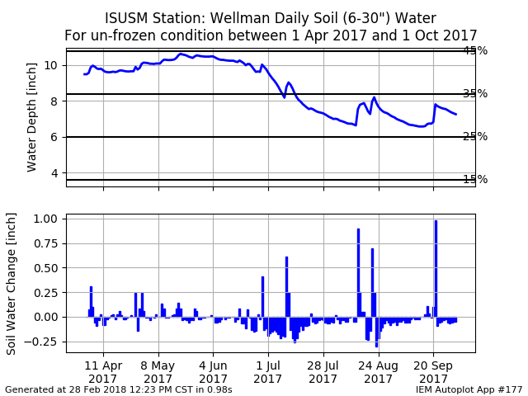
Web Link

Slide 30
Some Weather Variables to Monitor
Growing Degree Days
Temperatures
Soil Moisture/Temperature
Precipitation
Wind

Slide 31
What is an Arridity Index?
Normalize a departure by its Standard Deviation (units of sigma)
Standard Deviation is a measure of the amount of spread/variability in the data
For example, a 1 inch departure during the winter is different than summer
Allows combination of temperature and precipitation with a common unit (sigma)
Equation (Std High Temperature) – (Std Precipitation)
Temperature | Precipitation | Arridity
Very Hot (2.5) | Wet (1) | 2.5 – 1 = 1.5
Warm (1) | Very Dry (-2.5) | 1 - -2.5 = 3.5
Cold (-1) | Wet (1) | -1 – 1 = -2
Very Cold (-2.5) | Very Dry (-2.5) | -2.5 - -2.5 = 0

Slide 32
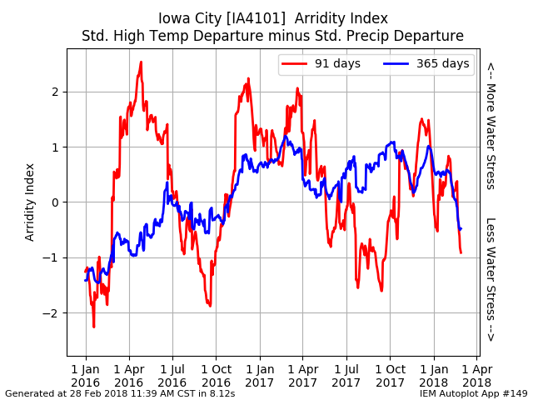
Web Link

Slide 33
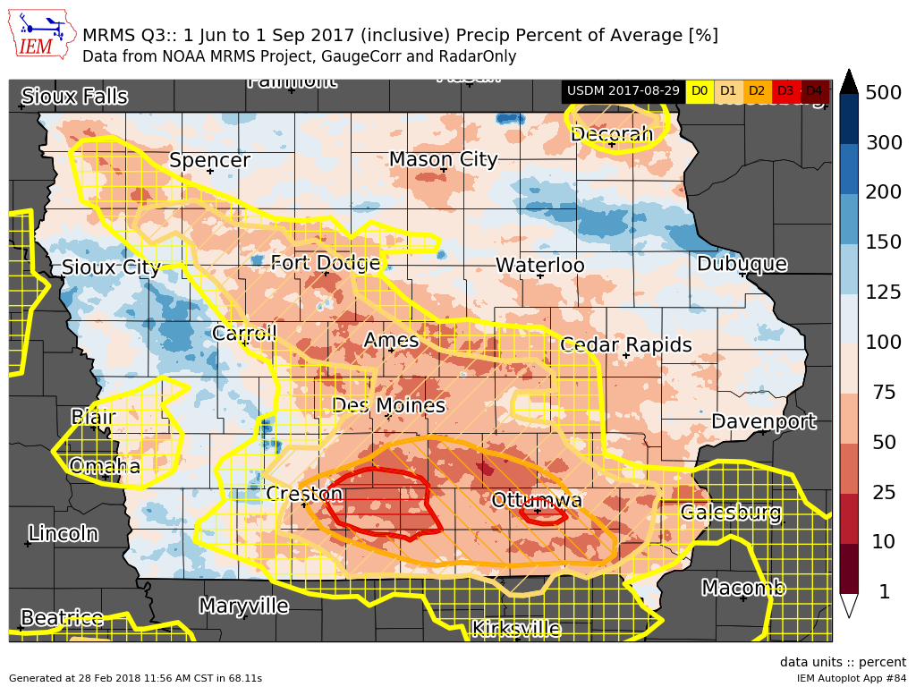
Web Link

Slide 34
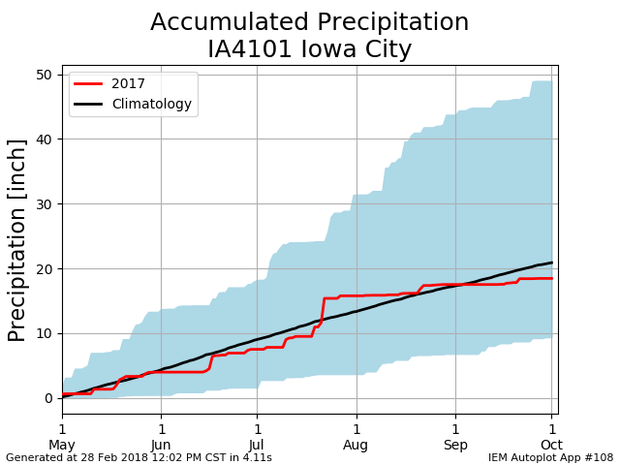
Web Link

Slide 35
Some Weather Variables to Monitor
Growing Degree Days
Temperatures
Soil Moisture/Temperature
Precipitation
Wind

Slide 36
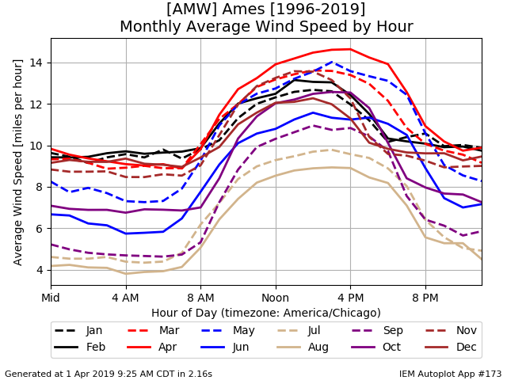
Web Link

Slide 37
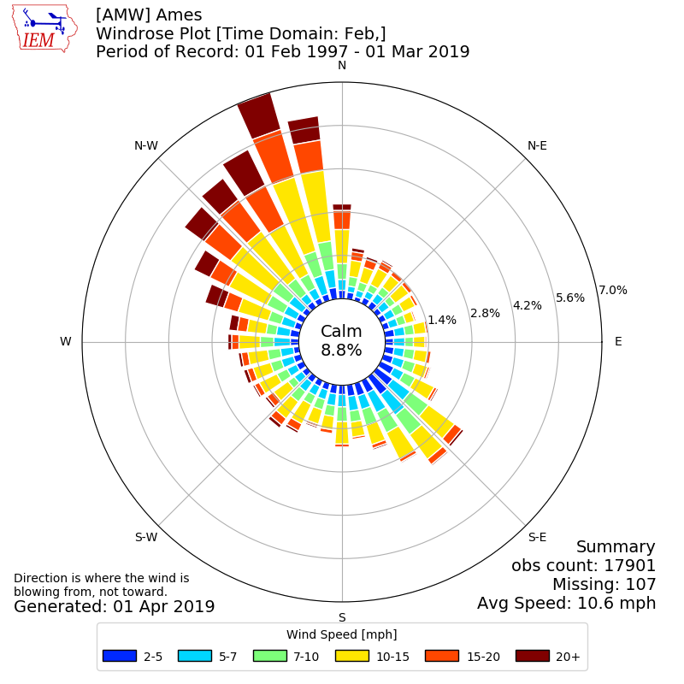
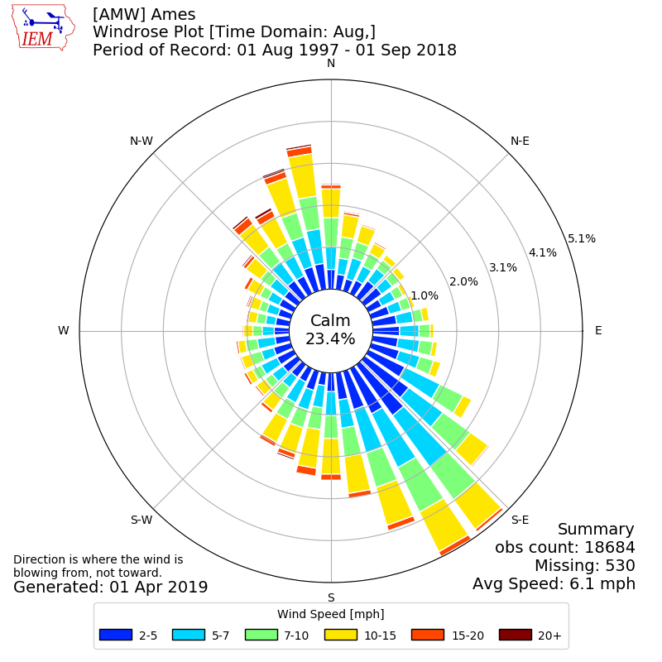
February vs August Wind Rose
Web Link

Slide 38

OK, enough of my rambling…. Questions? https://mesonet.agron.iastate.edu “Info” Tab -> Presentations
Twitter: @akrherz
akrherz@iastate.edu
515-451-9249

