Slide 1
104. Exploiting the Iowa Environmental Mesonet website for fun and profit
Daryl Herzmann
akrherz@iastate.edu

Slide 2
Partitioning the next hour of your life
IEM Project Introduction (5 min)
IEM Website Organization/Navigation (5 min)
Profit by Eight Common Task Demos (40 min)
Fun Things to do (hope for time)

Slide 3

Who am I and Why am I here?
Hi, I’m daryl! I’m staff in Agronomy with a BS in Meteorology (2001).
I’m the proprietor of the IEM website.
Help folks in the Ag sector use my website!

Slide 4

What is going on here? https://mesonet.agron.iastate.edu
For past 21 years, I’ve implemented about 95% of the requests made of me for weather / climate products + data.
Unmitigated website feature sprawl with ~150 apps, ~30 download portals, and ~230 automated plotting apps.
To atone for these sins, I promptly answer all the emails I get. (GOTO step 1)

Slide 5
30,000 foot view of the IEM
Other states have a University/State “Mesonet” with staff (gasp), deployed equipment, and research programs.
ISU has a “Soil Moisture Network”, which is a quasi mesonet, some call it the mesonet, but it is not what the IEM is!
Data from the Soil Moisture Network is found on the IEM website, along with everything else under the sun! To make things fun and confusing.

Slide 6
Let’s Tool Around on the IEM Website

Slide 7
Task 1: Using IEM Explorer
For your location
Find nearest long term climate site
Find nearest airport weather station
Play around with various popular content links

Slide 8
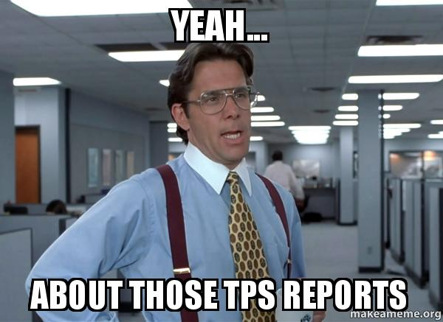
Task 2: TPS Reports
Temperature
Precipitation
Snow
Determine the June 2021 precipitation total and departure from average

Slide 9
Task 3: Growing Season Totals
Generate a map of 22 April to 22 September total precipitation for 2012 and 2022
Show the magic that is copy-from webpage, paste into notepad, copy from notepad, paste into Excel

Slide 10
Task 4: Soil Temperatures
Find a map of Iowa soil temperatures on 1 May 2022
Download the raw observations from the ISU Soil Moisture Network

Slide 11
Task 5: Solar Radiation
Download daily solar radiation estimates from NWS COOP sites for 2022 into Excel
Generate chart of daily observations from ISU Soil Moisture Network

Slide 12
Task 6: IEM Autoplot Chart
Find a chart of Nino 3.4 index and Iowa precipitation departures
Download the raw data from the chart into Excel for further analysis.

Slide 13
Task 7: NWS Warning Information
My mom’s farm took damage on 28 June 2017.
Go find NWS Warning information and storm reports for the event
Step through RADAR maps to see the timing of the storm

Slide 14
Task 8: Wind Roses
Generate a wind rose for the day of 14 June 2022
Check out the pre-generated monthly/annual climatology plots

Slide 15
Fun Task 1: Webcam Archive
How did things look during the blizzard of 4 February 2021 around noon?
Check out akrherz’s YouTube Channel for fancy loops.

Slide 16
Fun Task 2: High Res Precipitation Maps
Create a fine scale map of precipitation estimates for 27 August 2022 for Winneshiek County
For the same area, generate a map of departures between 1 July and 31 August 2022

Slide 17

And we are done!
EMAILS PLEASE, I LOVE EMAIL
akrherz@iastate.edu
I’m on the twitters
@akrherz

