Slide 1
Correlations Between Observed Snowfall and NAM Forecast Parameters : Part 2 – Thermodynamic Considerations
Michael L. Jurewicz, Sr.
NOAA/NWS Binghamton, NY
November 1, 2006
NROW 8
Albany, NY

Slide 2
Outline
Snowfall Microphysics
  Review of Conceptual Models / Recent Research
  Results from our study
    Correlations
    Scatter-plot diagrams
Stability Trends
Case Study Examples
Conclusions

Slide 3
Omega in the Dendrite Zone…Very Well Correlated to Event Total Snowfall
This parameter provided one of the better correlations (nearly 0.75)
Dendrite Zone is defined as follows:
  The portion of the column where temperatures ranged from -12C to -18C; and the relative humidity was greater than 80%
Notes:
The magnitude of omega in the dendrite zone, directly over the snow band, showed a fairly strong correlation to heavy snowfall.

Slide 4
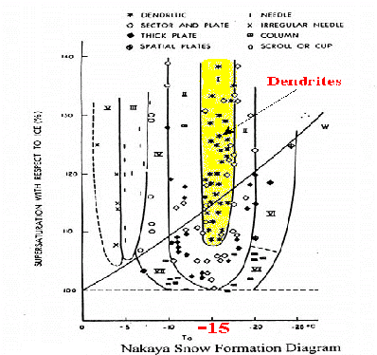
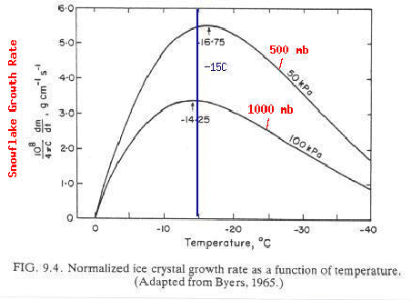
Snow Growth Rates
Maximize around -15ºC with dendrites the preferred crystal type
Dendrites are “effective” snow accumulators because of the extra “space” within each crystal
Notes:
Summary slide on some of the previous work on snowfall microphysics.

Slide 5
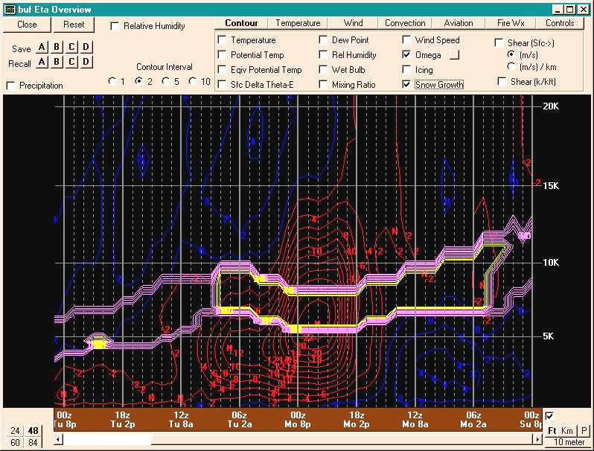
“Cross-Hairs” Signature
3”- 4”/hr
Lift Maximizes right in the Dendrite Zone
Notes:
A graphic illustrating an example of the “Cross-Hairs” technique, developed by Waldstreicher, et al. This particular data was from an intense lake-effect snow event in the Buffalo, NY area. The red contours represent omega, while the purple and yellow contours show isotherms specifically in the dendrite zone (between -12C and -18C).

Slide 6
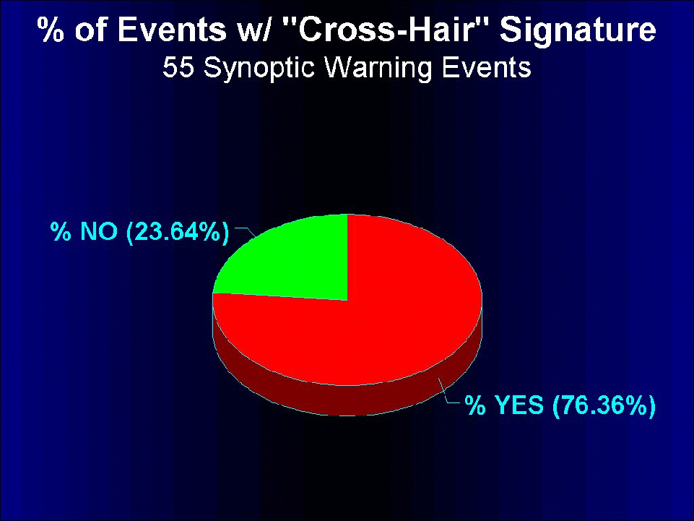
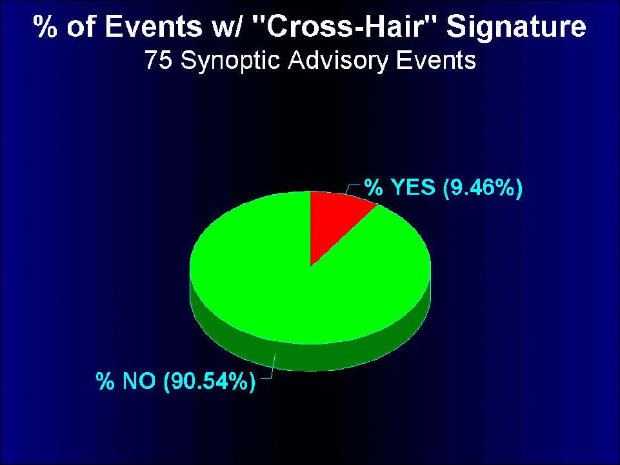
Waldstreicher Study
1998-2001
Northeast US
20 km eta
Notes:
Results of a large-scale study done by Waldstreicher, et al. on the aforementioned “Cross-Hairs” technique.

Slide 7
Omega Comparisons
For the “Weak to Moderate” snowfall events (mostly between 3 and 7 inch totals), Maximum Dendrite Zone Lift was a good discriminator
  If one were to simply look at Maximum Omega, without regard for crystal growth mechanisms, there would be an inherent risk of “over-forecasting” snowfall in these type of events
    Higher False Alarm Ratios (FAR’s)
Notes:
A quick summary of early findings for dendrite zone omega, directly associated with snow bands, specifically for the lighter snow cases.

Slide 8
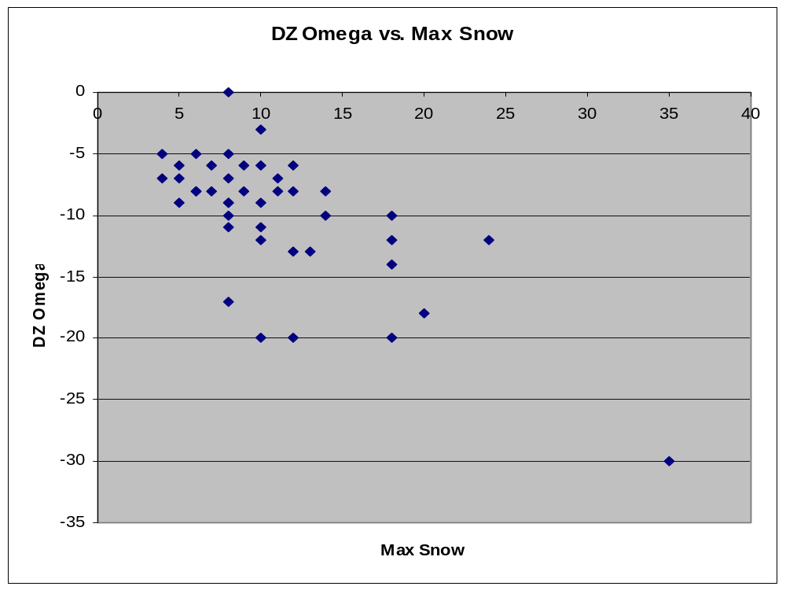
Most Lighter snow cases had much weaker DZ lift
The majority of heavier snow cases (at least 10”) had significant DZ lift (at least 10 microbars per second)
Notes:
Scatter-plot of dendrite zone omega (y-axis) versus event-total snowfall (x-axis).

Slide 9
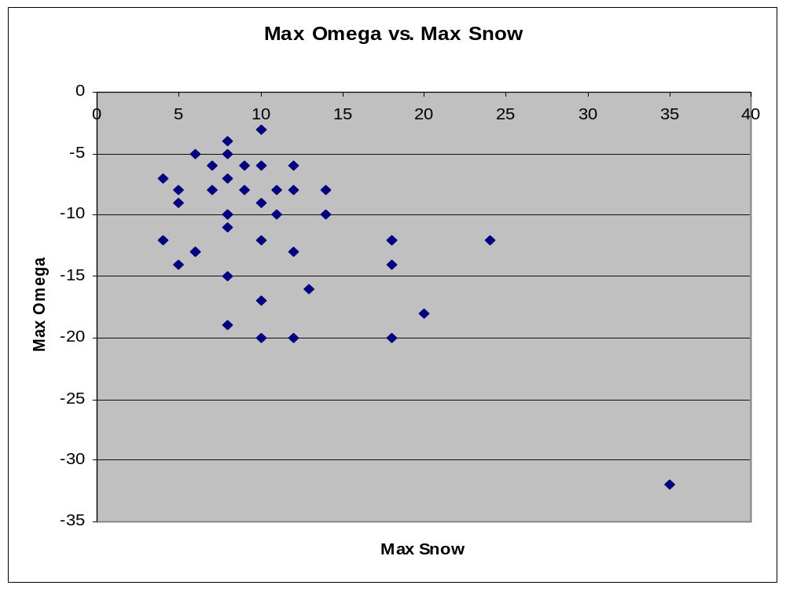
However…the lighter snow cases showed more variability
The majority of heavier snow cases (at least 10”) still had significant lift (at least 10 microbars per second)
Notes:
Scatter-plot of maximum omega (in the column over the snow band, y-axis) versus event-total snowfall (x-axis).

Slide 10
Dendrite Zone (DZ) Depth
Interestingly, this parameter exhibited very weak correlations to snowfall (less than 0.1)
The implication here is that the magnitude of the omega in the DZ is much more important than the actual size of the DZ
  How quickly dendrite production occurs is more critical than the depths to which it occurs
Notes:
How well the vertical depth of the dendrite zone (a saturated column with temperatures between -12C and -18C) correlated to event-total snowfall, for our study.

Slide 11
Trends in Stability (Geostrophic EPV) vs. Event Magnitude
There appeared to be a strong tendency for EPV to decrease sharply 3 to 6 hours prior (T-6 to T-3) to maximum snow band intensity in the “Bigger Storms”
  Thereafter, EPV either levels off or increases as heavier snow starts to fall (between T-3 and T0)
Conversely, for the “Smaller Events”, EPV tends to either remain steady or decrease slightly between T-6 and T0
Findings match those found in several documented Central U.S. cases
  St. Louis Univ. / Univ. of Missouri studies

Slide 12
More on EPV Trends
Correlations to event total snowfall:
  Change in Minimum EPV over the snow band between T-6 and T-3 (-0.89)
    Marked destabilization for the greater snowfalls
  Change in Minimum EPV over the snow band between T-3 and T0 (0.66)
    Noticeable stabilizing trend for the greater snowfalls

Slide 13
What Does This Mean?
These findings suggest the following possibilities:
  First, that more pronounced banding/vigorous frontal circulations are able to “use up” available instability
    By contrast, weaker bands cannot tap into such instability
  Second, that 40-km grid scale models can simulate/attempt to resolve these processes

Slide 14
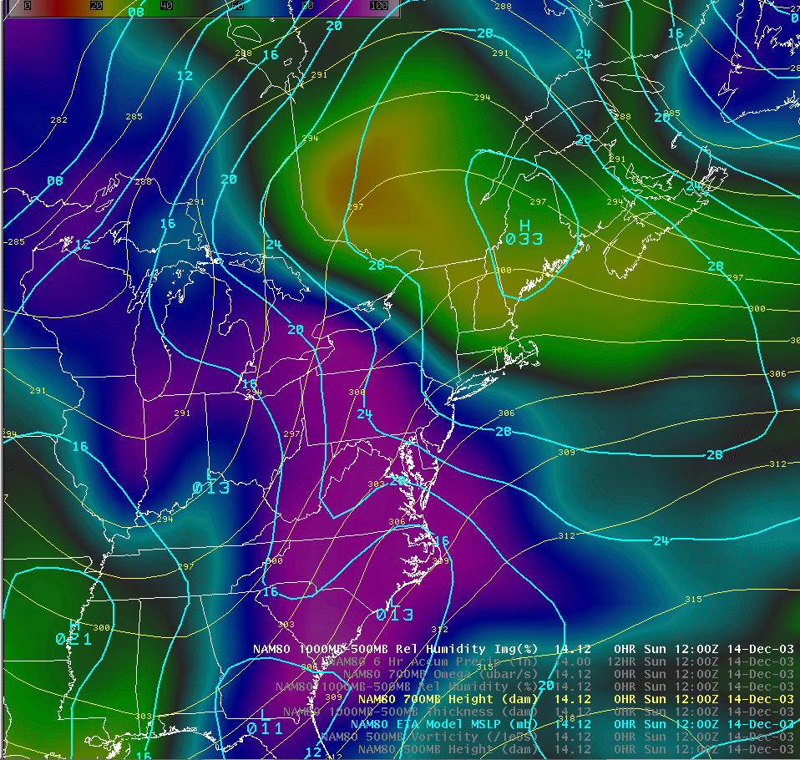
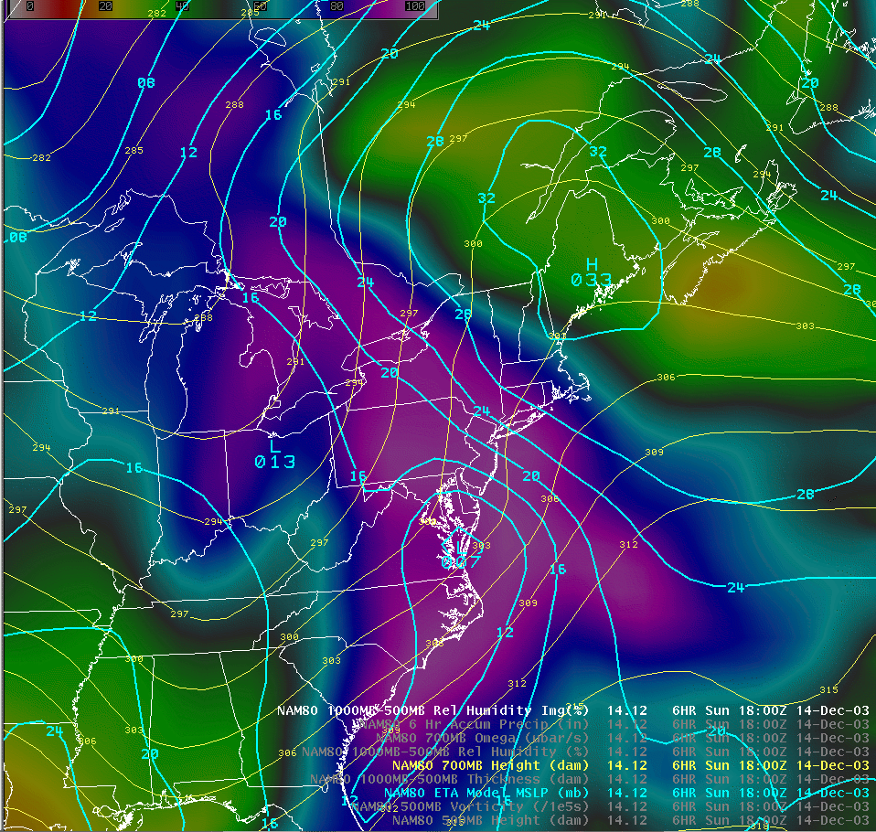
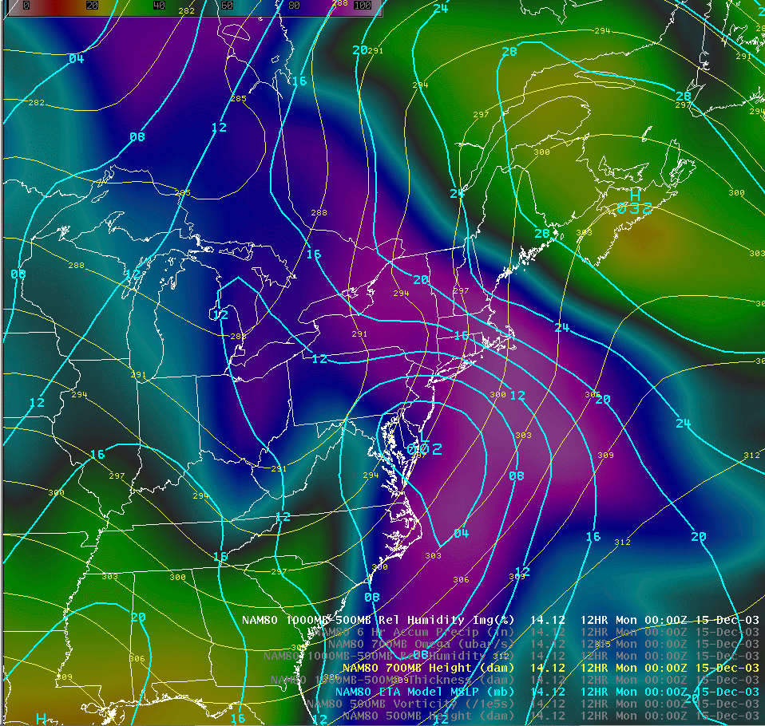
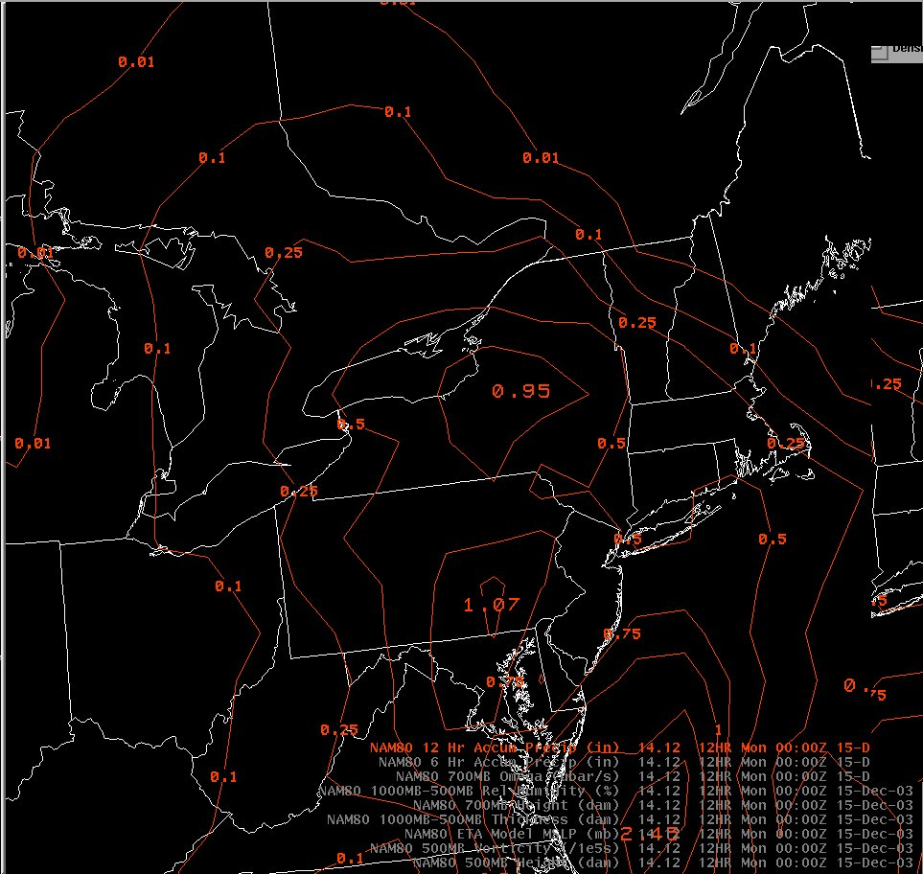
Example – December 14, 2003

Slide 15
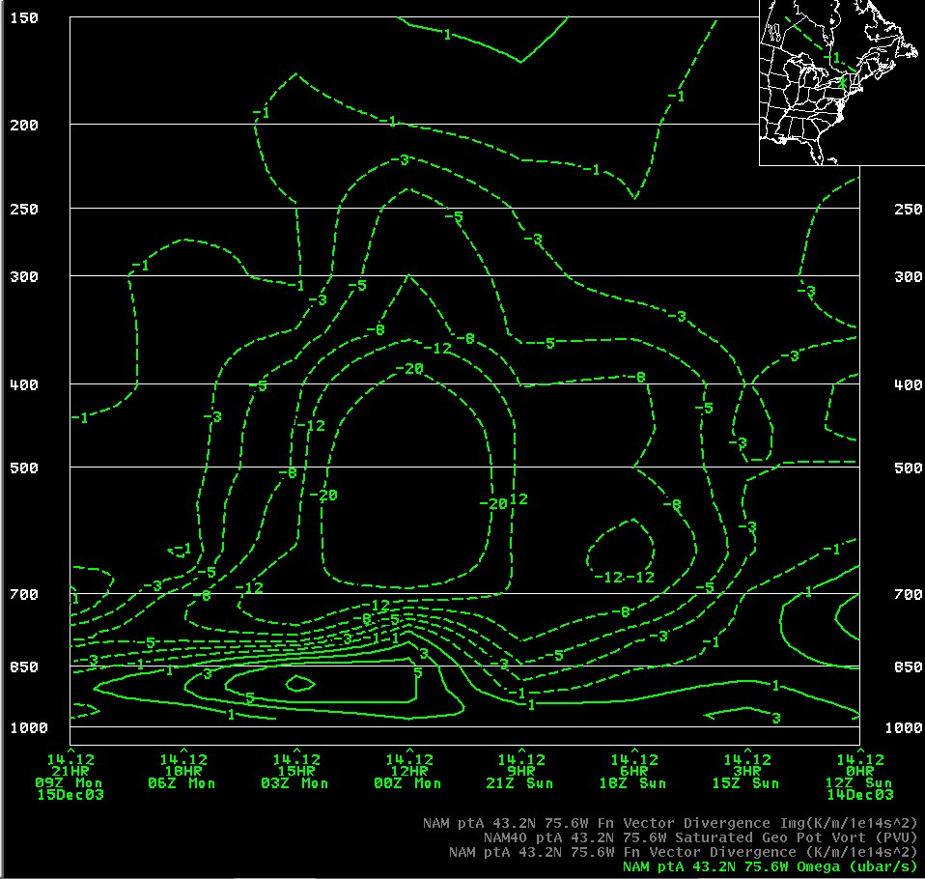
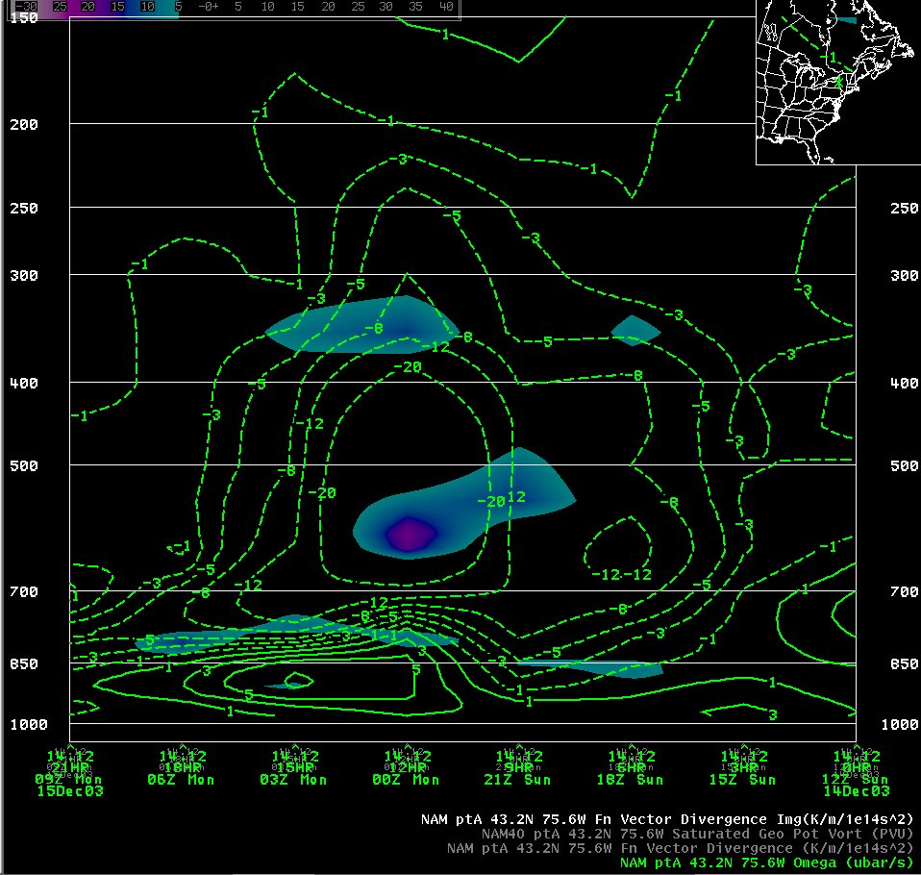
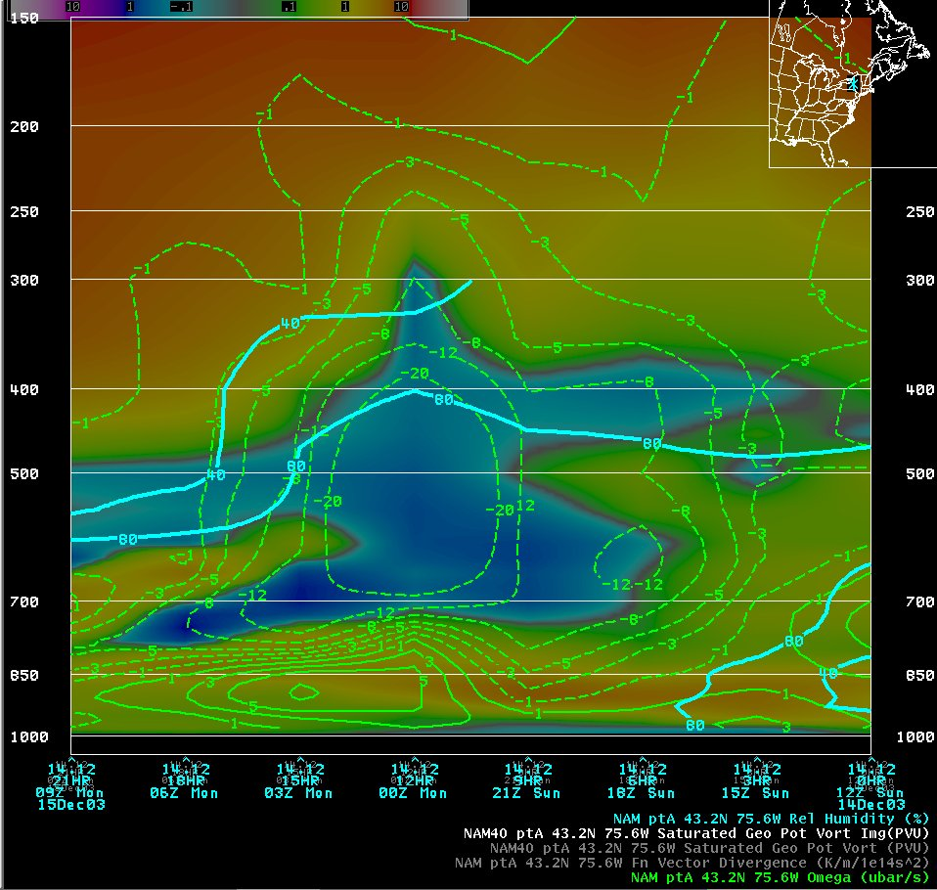
Example – December 14, 2003

Slide 16
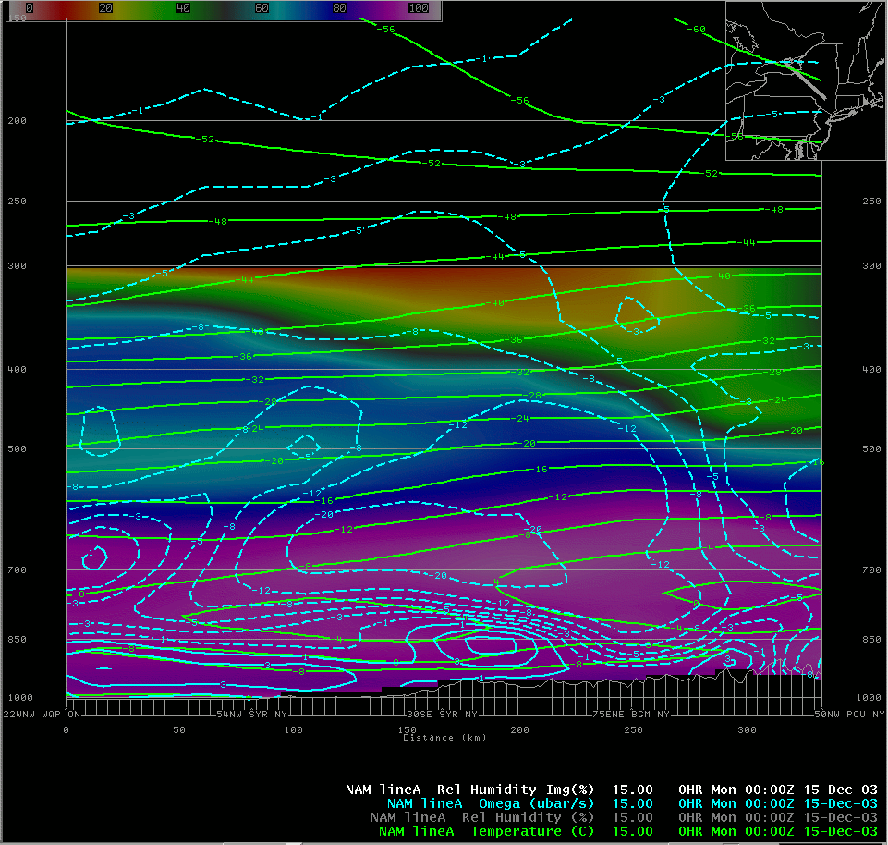
Heavy Snow & Favorable DZ / Lift Configuration, at 0000 UTC, December 15, 2003
Good collocation of Strong Omega and a Favorable Crystal Growth Region
Snow Band

Slide 17
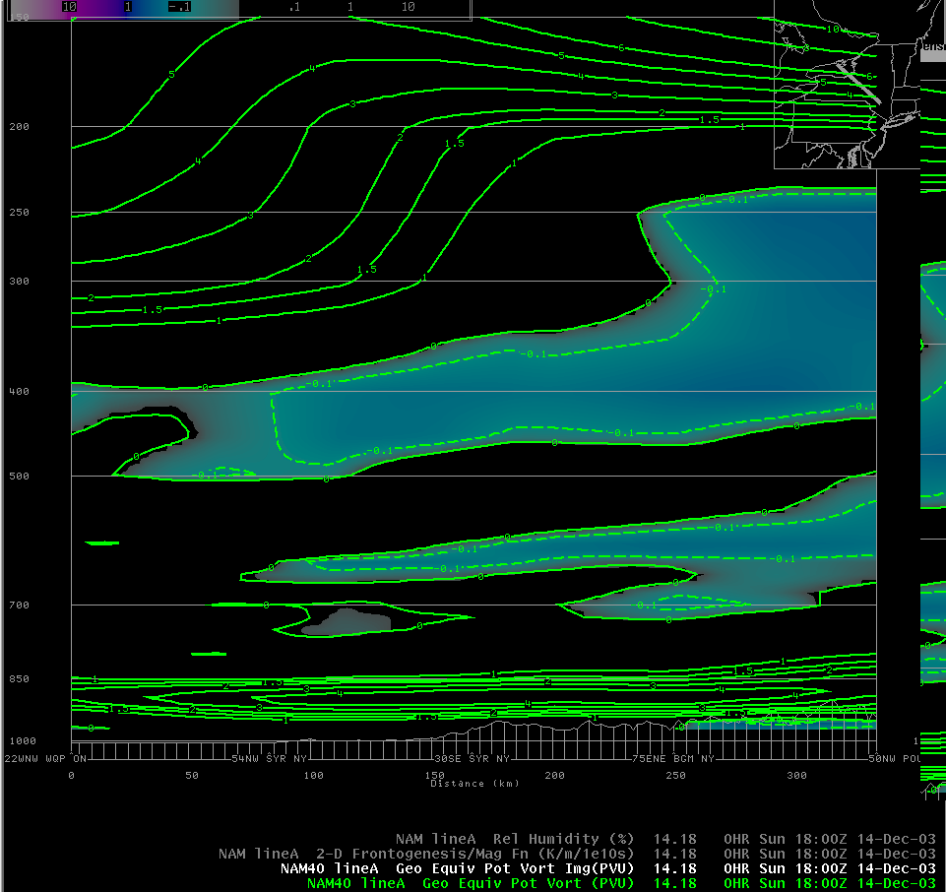
Negative EPV (shaded) for T-6, 1800 UTC, December 14, 2003
Snow Band

Slide 18
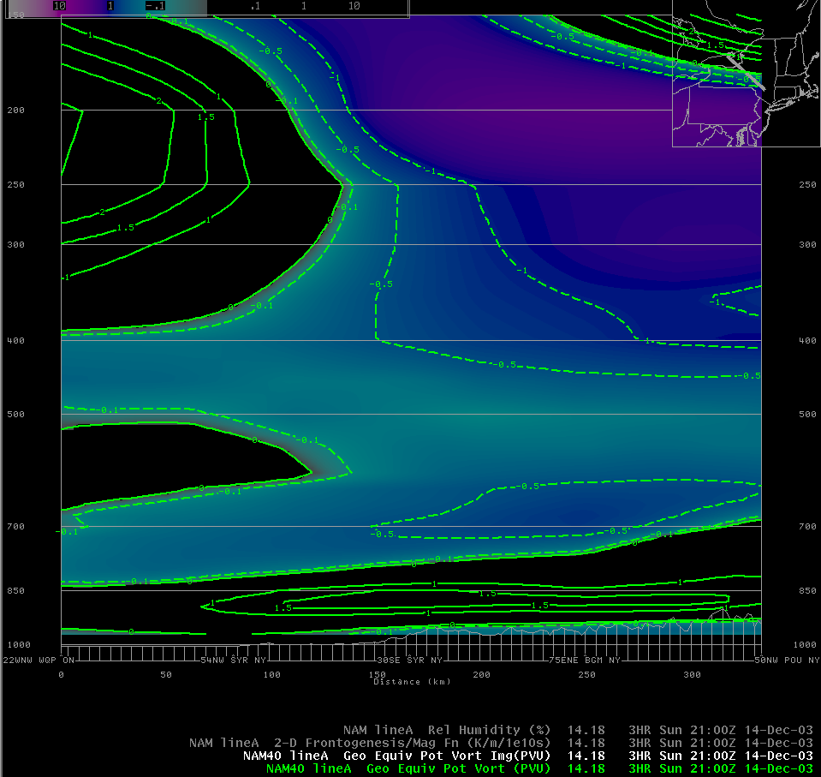
Negative EPV (shaded) for T-3, 2100 UTC, December 14, 2003
Snow Band

Slide 19
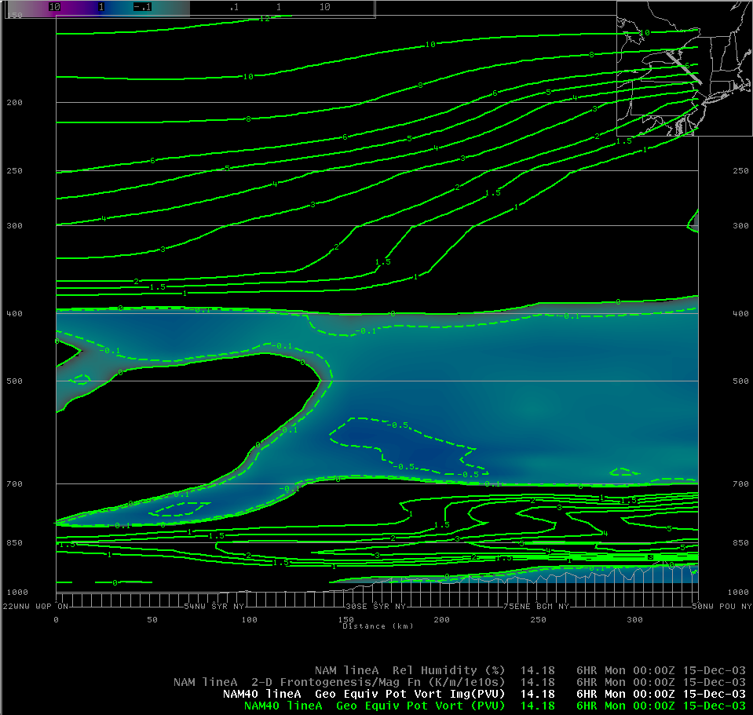
Negative EPV (shaded) for T0, 0000 UTC, December 15, 2003
Snow Band

Slide 20
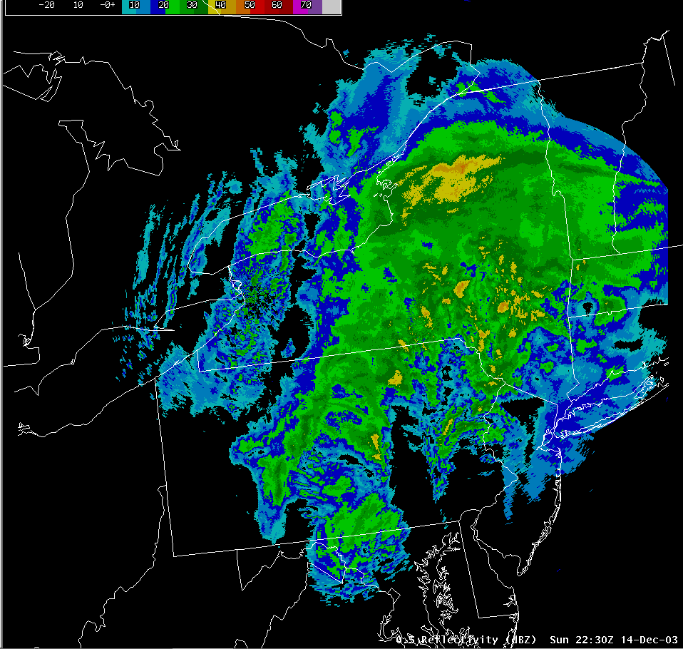
December 14, 2003 - Radar Loop

Slide 21
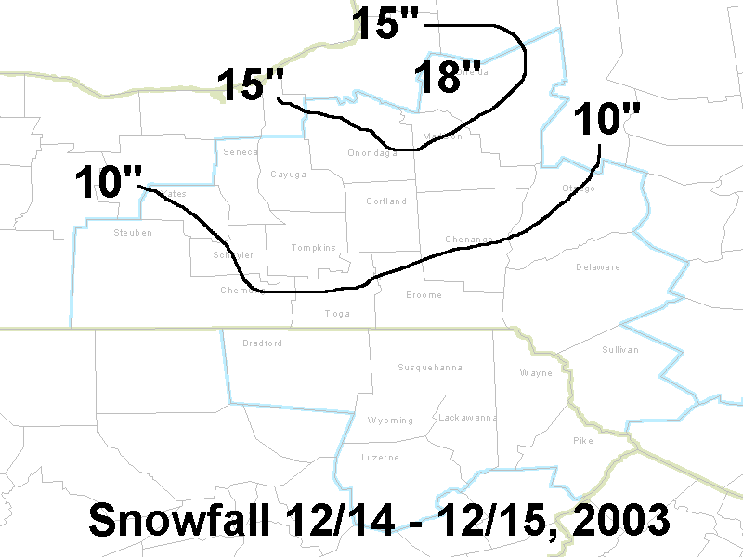
Storm Total Snowfall

Slide 22
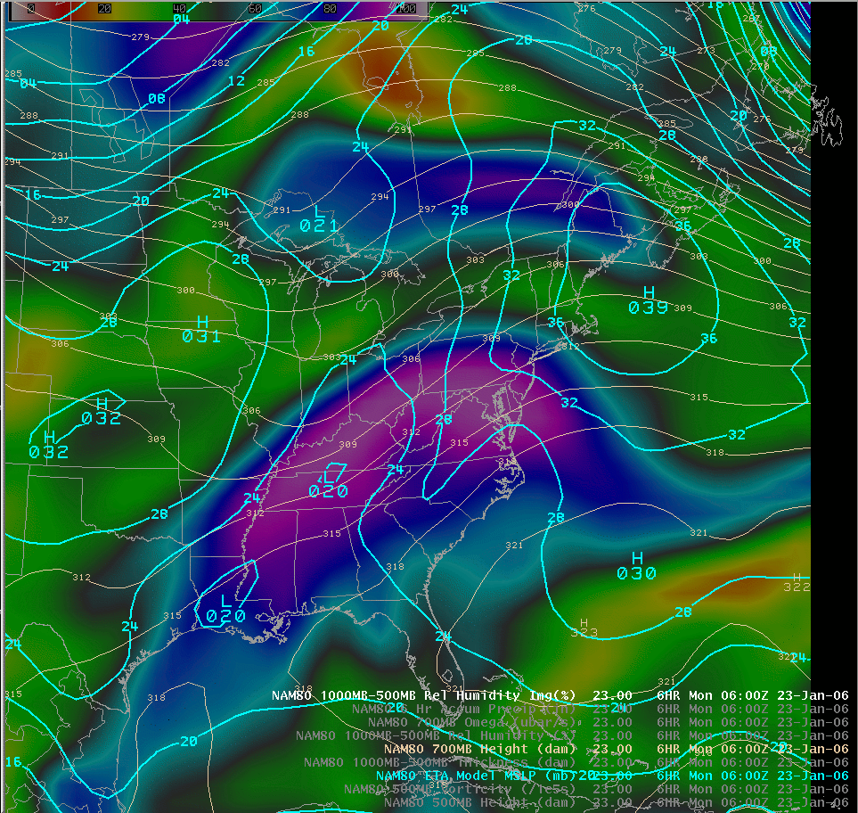
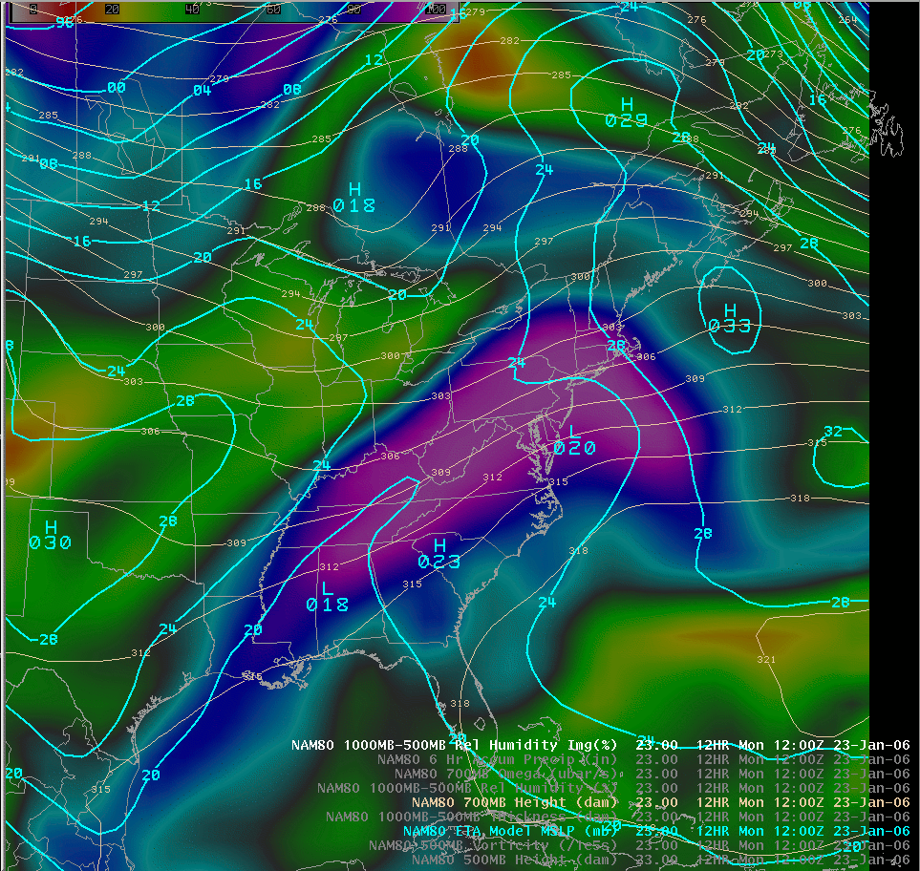
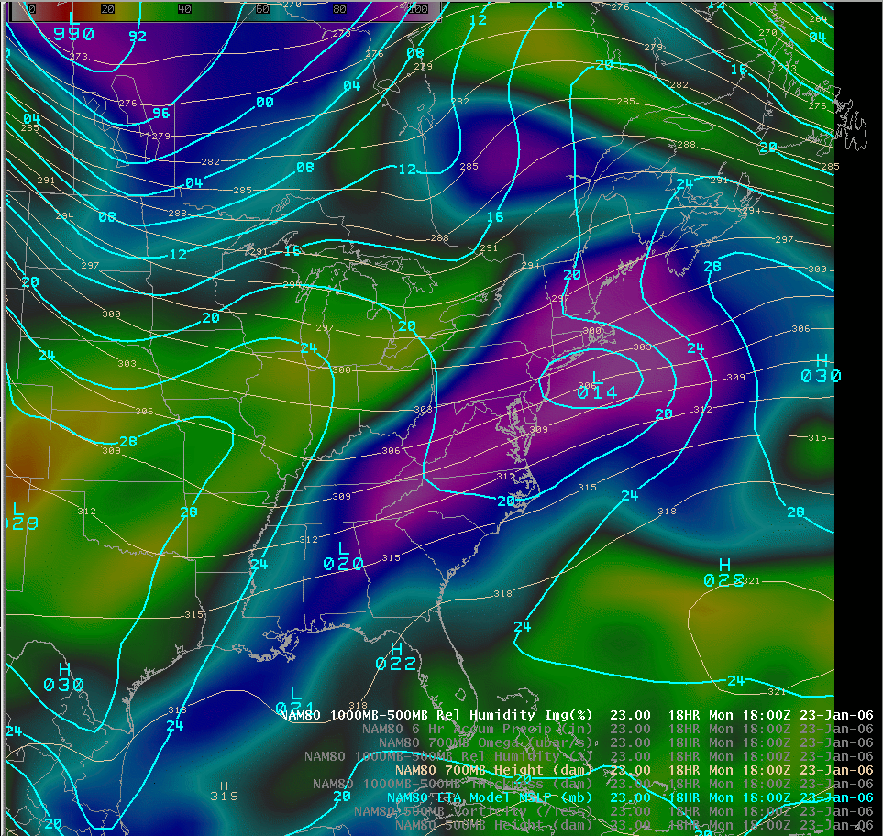
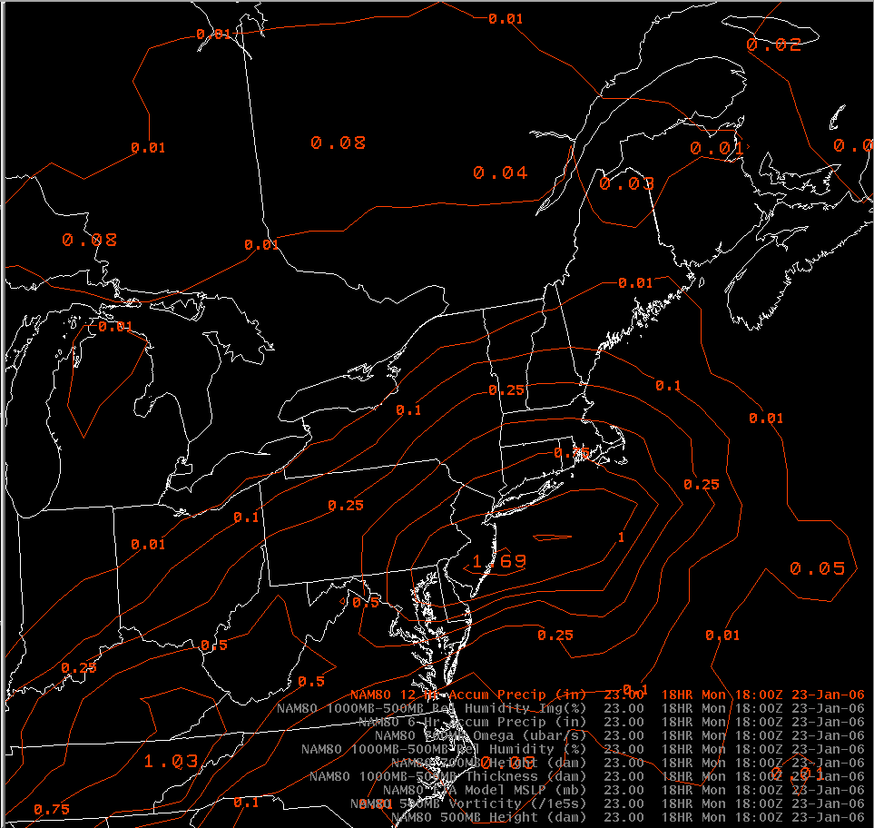
Example – January 23, 2006

Slide 23
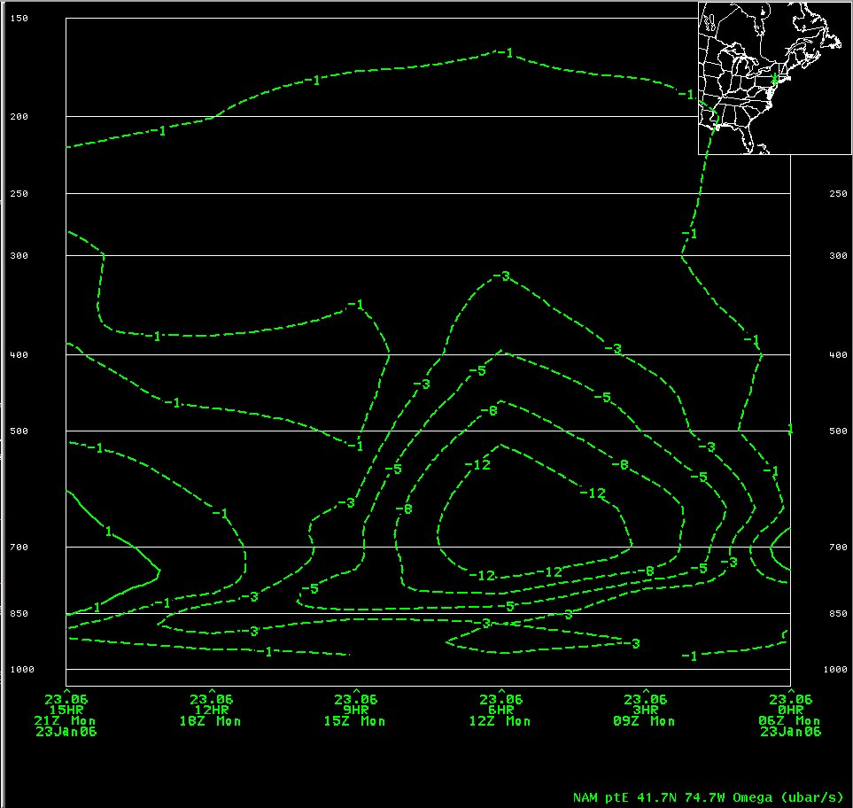
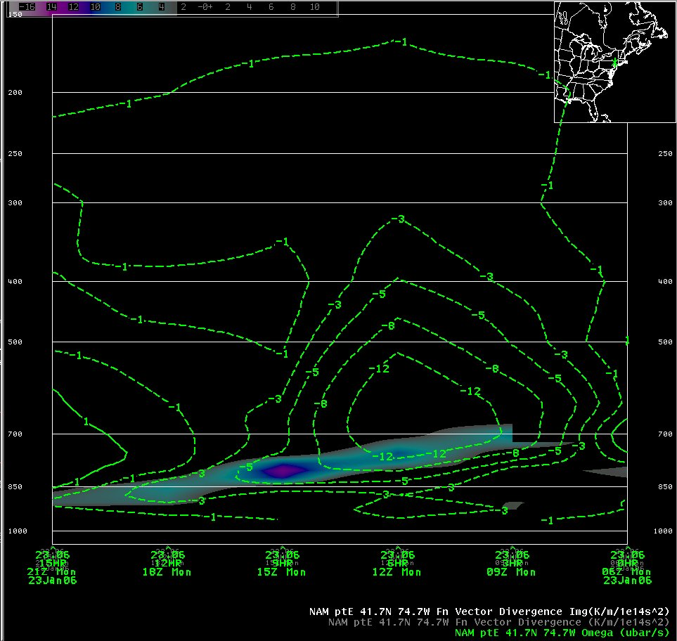
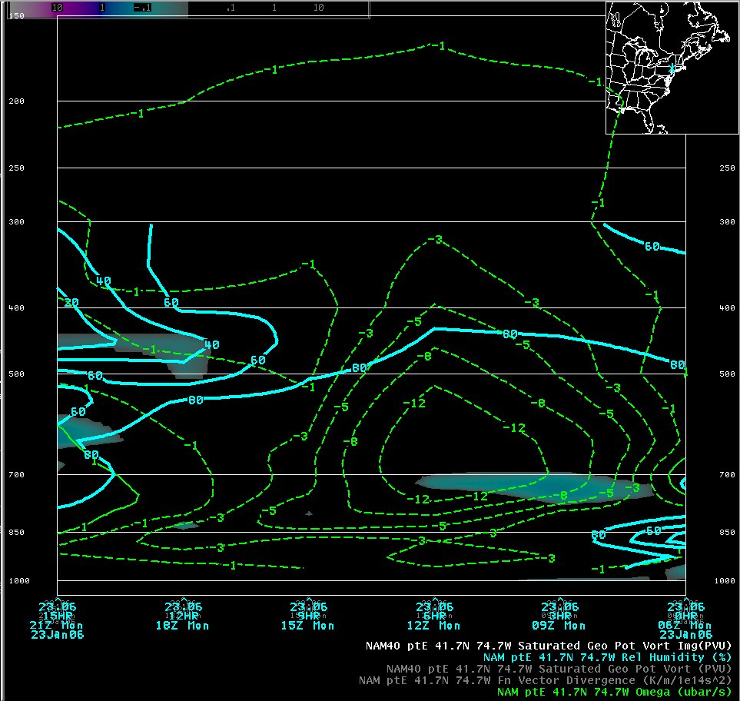
Example – January 23, 2006

Slide 24
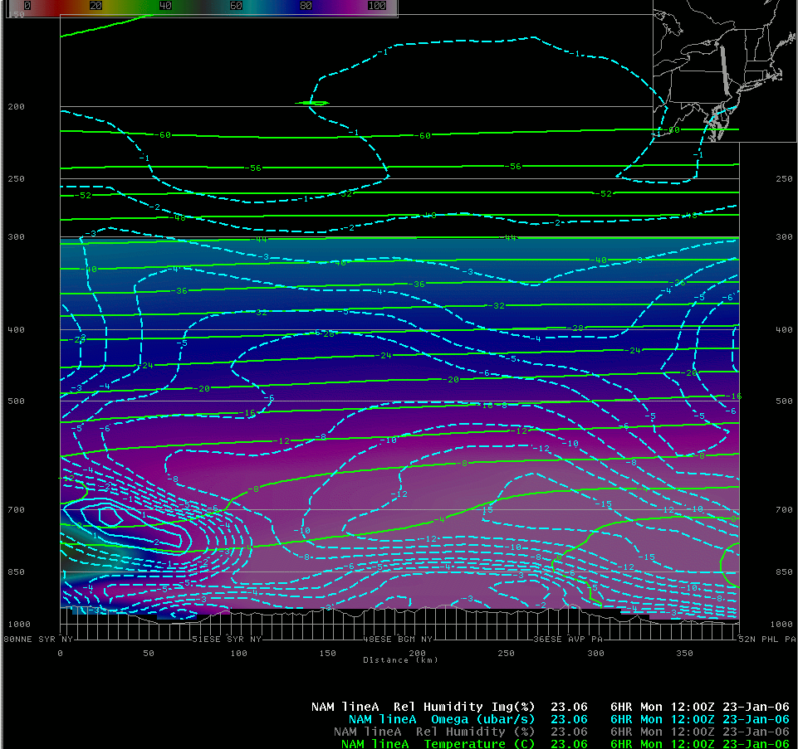
Lighter Snow & Unfavorable DZ / Lift Configuration, at 1200 UTC, January 23, 2006
Best Lift and the Dendrite Zone well removed from one another
Snow Band

Slide 25
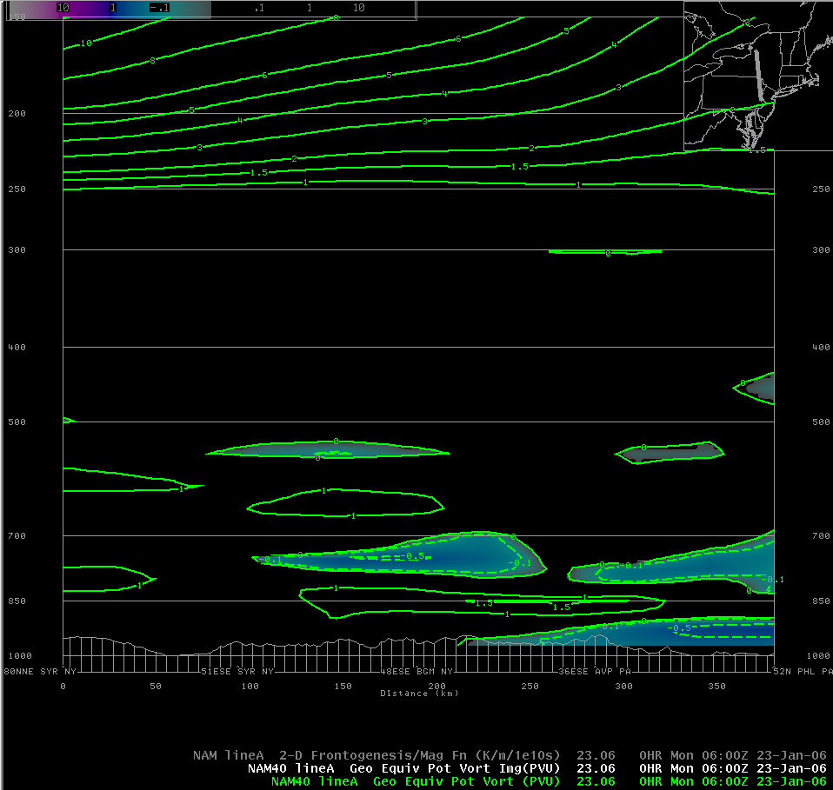
Negative EPV (shaded) for T-6, 0600 UTC, January 23, 2006
Snow Band

Slide 26
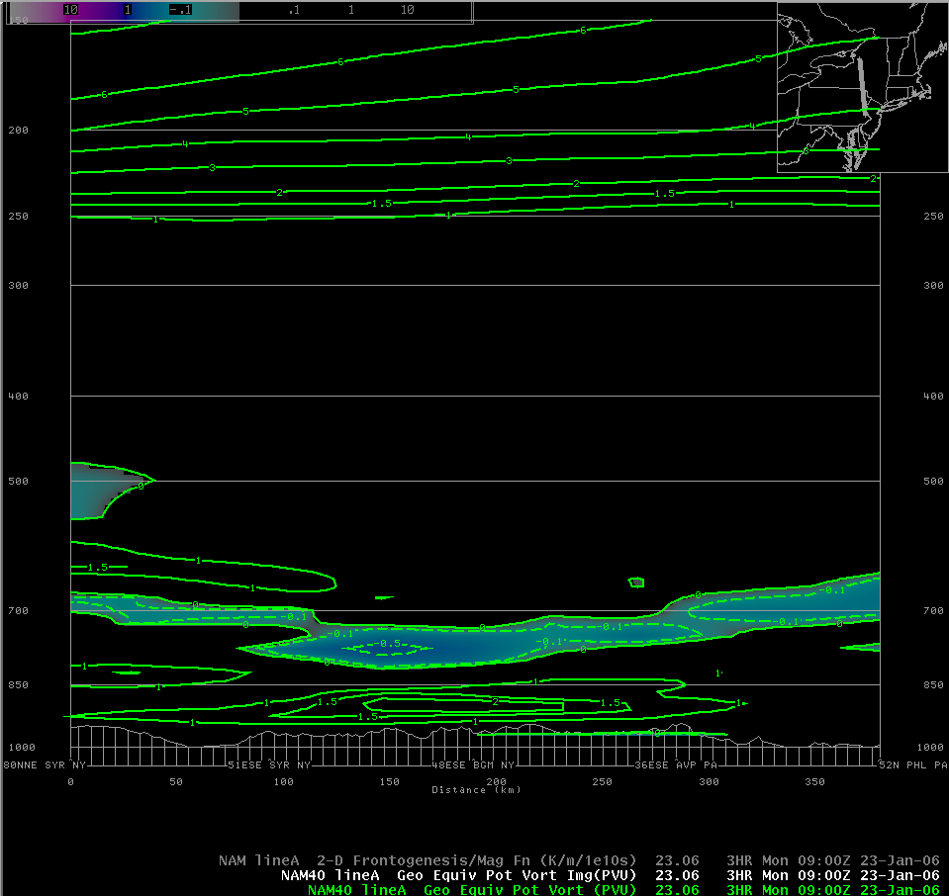
Negative EPV (shaded) for T-3, 0900 UTC, January 23, 2006
Snow Band

Slide 27
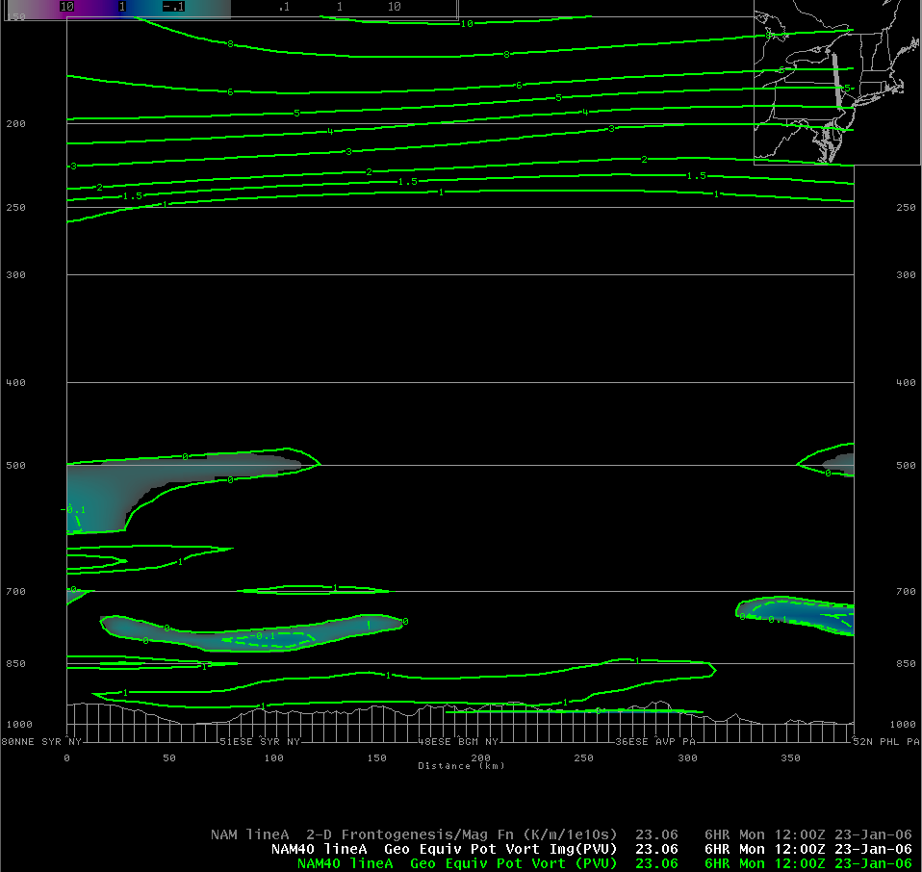
Negative EPV (shaded) for T0, 1200 UTC, January 23, 2006
Snow Band

Slide 28
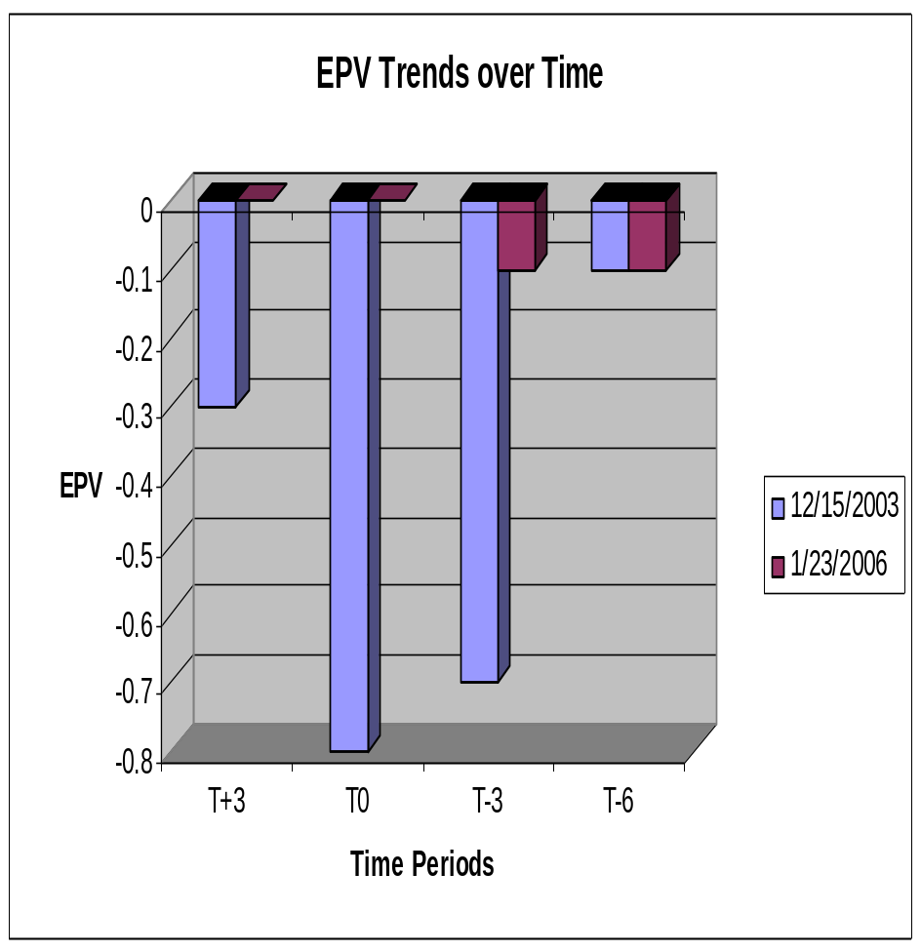
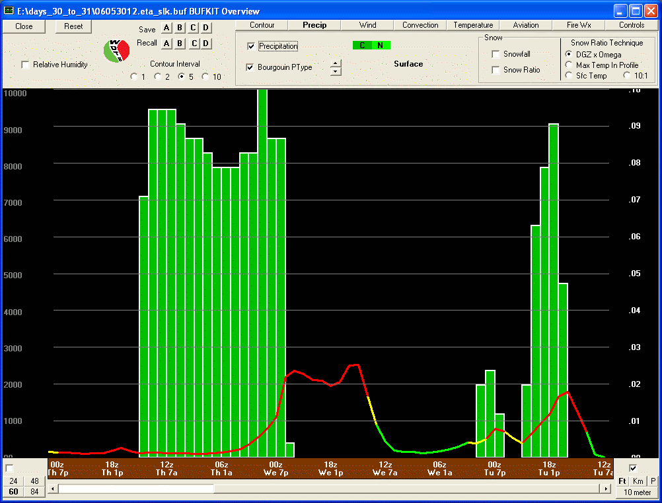
EPV Behavior for 12/15/03 and 01/23/06; also a Comparison to Warm Season Stability Trends
Usual period of +SN

Slide 29
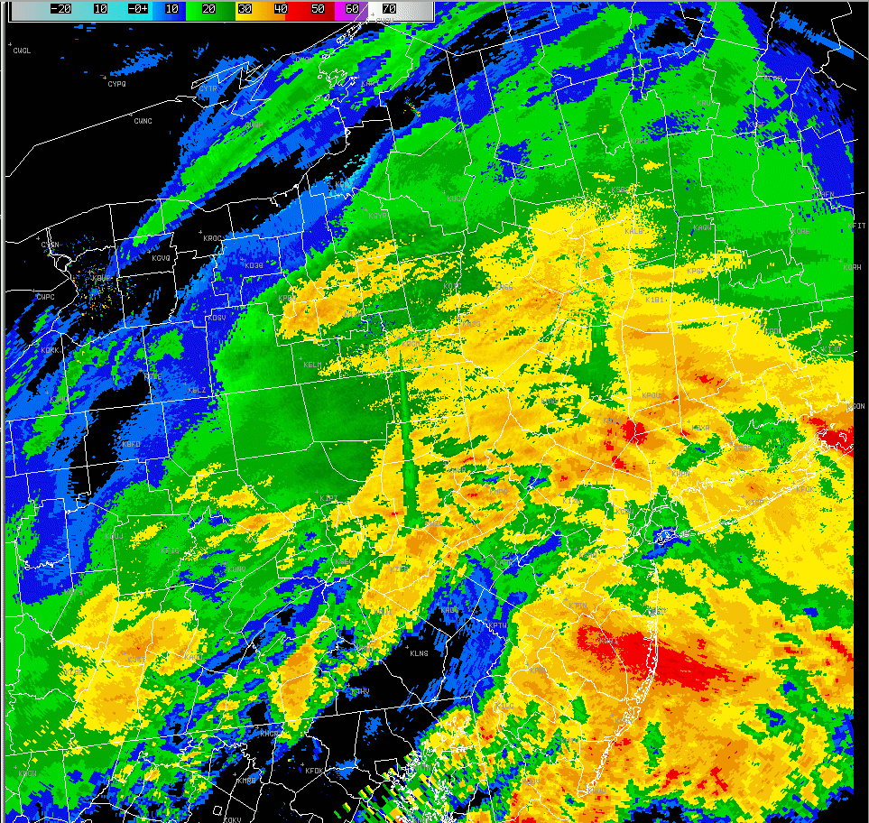
January 23, 2006 –
Radar Loop

Slide 30
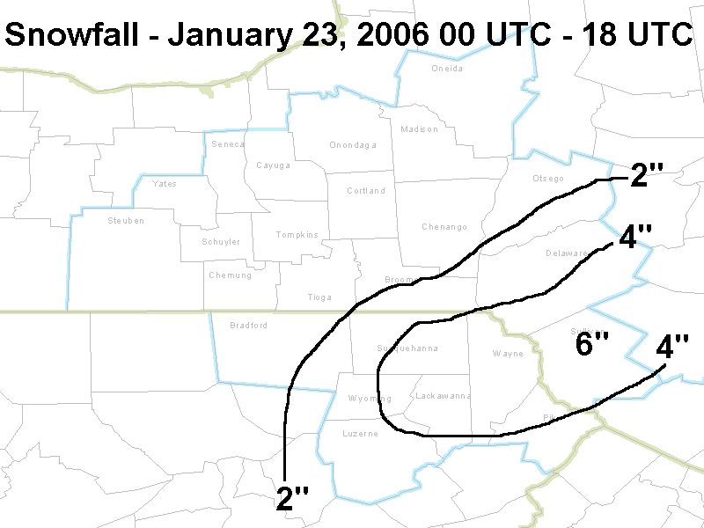
Observed Snowfall

Slide 31
Summary
Maximum Omega in the DZ correlated very well to event total snowfall
  Main value appears to be in separating out the lesser snowfalls (poor accumulation efficiency)
  Strength of DZ Omega is more important than DZ Depth
EPV trends also correlated quite well
  For “Bigger Storms”:
    Pronounced reduction in EPV prior to maximum snow band development (T-6 to T-3)
    Nearly steady or increasing EPV as heavier snow develops (T-3 to T0)
  Same trends not typically seen in the “Weaker Events”
    EPV changes little most of the time

Slide 32
Some Final Thoughts
When banded snowfall is anticipated:
  Looking at data from a time-height perspective provides information on depth and persistence of key features
  Using conventional cross-sections gives you the opportunity to view structural characteristics
    Can be valuable to have a 3-D perspective
    However, you can miss certain aspects in time
The best approach is to use both techniques
Notes:
Some parting wisdom (I think).

Slide 33
Acknowledgements
Keith Wagner, SUNY Albany
Lance Bosart, SUNY Albany
Dan Keyser, SUNY Albany
David Novak, NWS ER, Scientific Services
Jeff Waldstreicher, NWS ER, Scientific Services

Slide 34
Thank You !!
Questions ??

