Slide 1
Using Bufkit to Visualize
Precipitation Amount and Type
WDTB Winter Weather Workshop
July 23, 2003
Ed Mahoney, WDTB
Jeff Waldstreicher, ER/SSD
Tom Niziol, WSFO BUF

Slide 2
New Functionality
BUFKIT - BUFR File Visualization Toolkit
  Release 48 in January 03
Runs On Linux Workstations
Supports Workstation Eta Profiles
  Unlimited Number of Forecast Profiles
Elevated Precipitation Type
Modified Bourgouin Precipitation Type

Slide 3
Visualizations
Snow Amounts
  Application of Cloud Microphysics
Precipitation Type
  Variation of
    Top-Down Approach
    Bourgouin Energy Calculation Technique

Slide 4
Snowfall Amounts
NWP models do a better job at indicating the temporal and spatial distribution of forcing for precipitation, than they do forecasting the actual QPF
  During big snowfalls, much of the snow falls within a small time window
From an impact standpoint, forecasting these brief periods of intense snowfall are as important (and maybe more important) than forecasting the total amounts

Slide 5
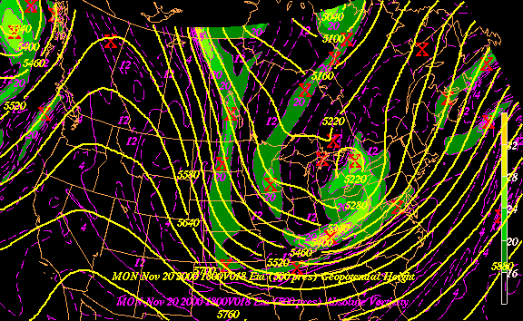
Eta 500mb Height/Vorticity Init. 11/20/00z

Slide 6
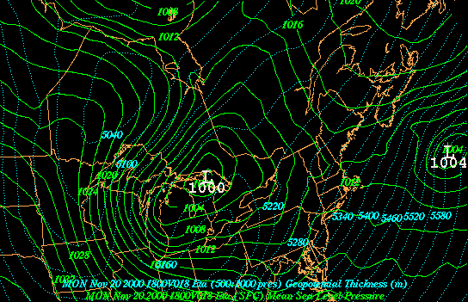
Eta Sfc MSL Pressure Init. 11/20/00z

Slide 7
Snowfall Efficiency
The character of snowfall is related to variations in the
  intensity of lift
  Moisture
  vertical thermal profile (e.g., Snow Microphysics)

Slide 8
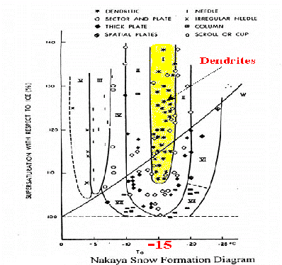
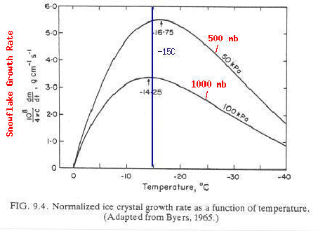
Snow Growth Rates
Maximizes around -15ºC with dendrites the preferred crystal type
Dendrites are “effective” snow accumulators because of the extra “space” within each crystal

Slide 9
Using the Technique With NWP
Can NWP be utilized to forecast periods of efficient (e.g., rapid) snowfall accumulations?
  Ice crystals will maximize near the greatest rising motion (assuming saturation)
  Therefore, dendrites will be favored where omega maximum intersect dendrite-favored temperatures
Model soundings (e.g., BUFKIT) can be used to examine the supersition of omega and the vertical thermal structure

Slide 10
Looking At The Model Solution
Actual Snowfall 24.5 in.
Eta 22km
WSEta 15km
MM5 20km
10 in.
12 in.
5 in.
What About The Models’ Signals?

Slide 11
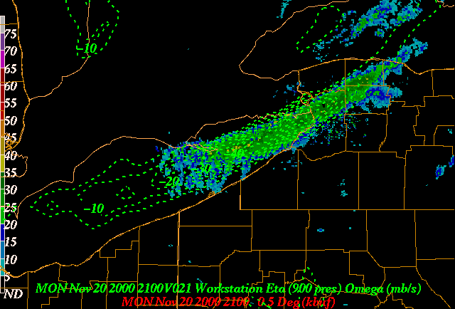
WSEta 1-hr 900mb Omega / 0.5 Reflectivity

Slide 12
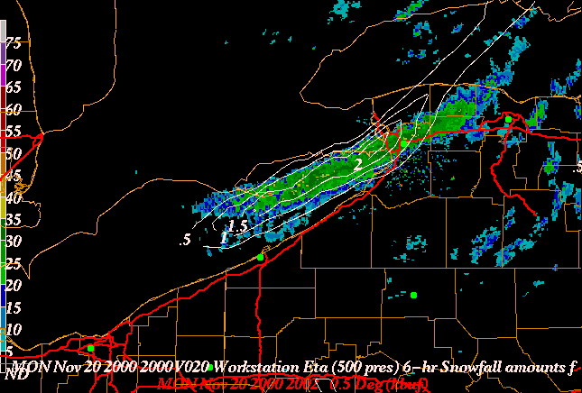
WSEta 1-hr Snowfall (15:1) / 0.5 Reflectivity

Slide 13
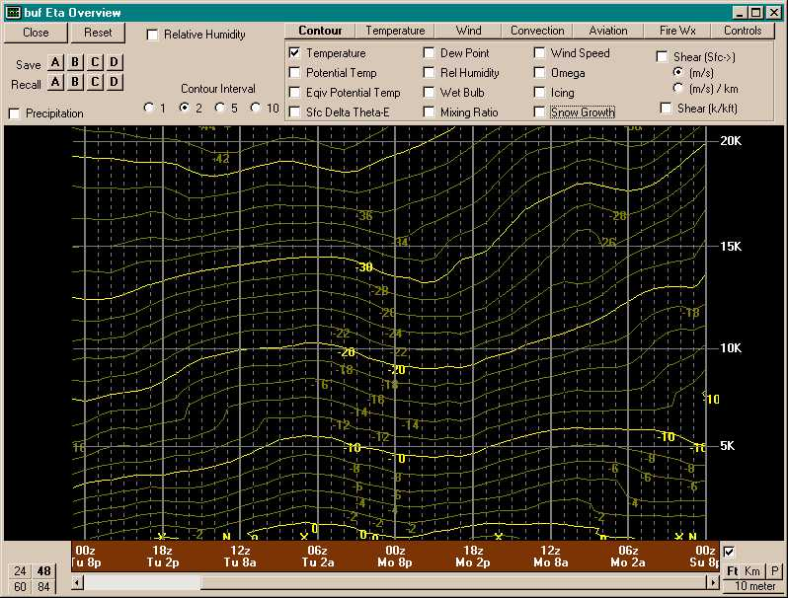
Temperature Time-Height

Slide 14
Dendritic Growth Temperature
12ºC
18ºC

Slide 15
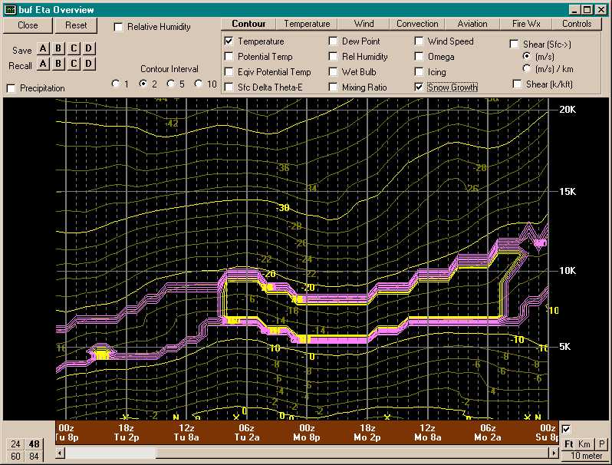
Identify Dendritic Growth Zone

Slide 16
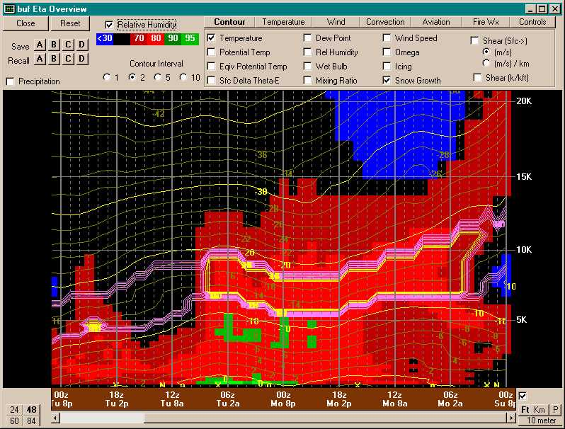
Scan Zone for Moisture

Slide 17
Dendritic Growth
Moisture

Slide 18
Identify Favored Growth Zone

Slide 19
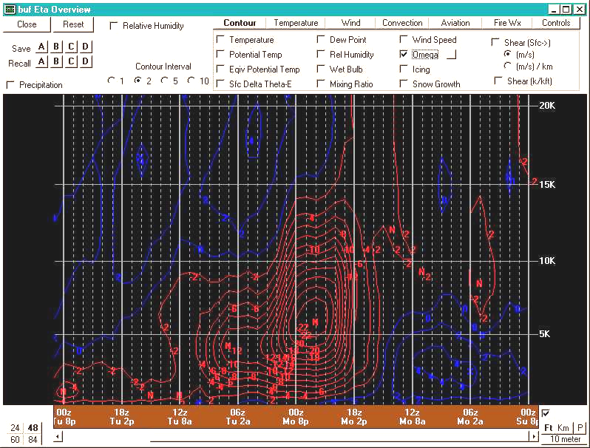
Display Model Omega

Slide 20
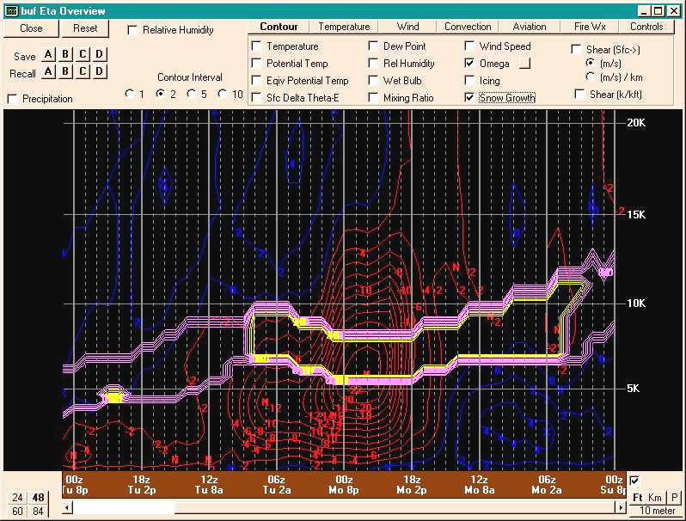
Overlay All Variables
3”- 4”/hr

Slide 21
The Need For Moderate Lift
“Moderate Lift” defined as function of the Model Resolution
  20 km eta stronger than -10 ub s⁻¹
  12 km eta stronger than -15 ub s⁻¹
Configuration should be present in 2 of 3 successive model runs (Run to Run consistency)

Slide 22
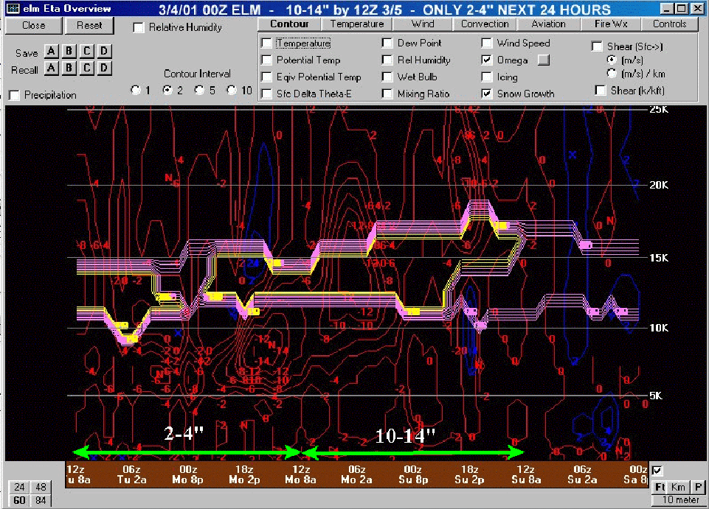
Moderate Lift May Fall Outside Dendritic Growth Zone
-14ub⁻¹

Slide 23
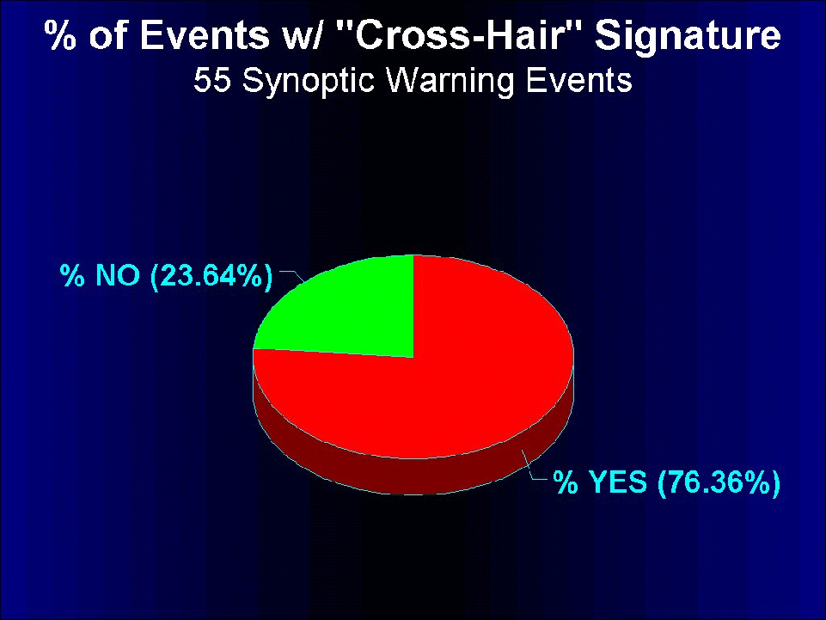
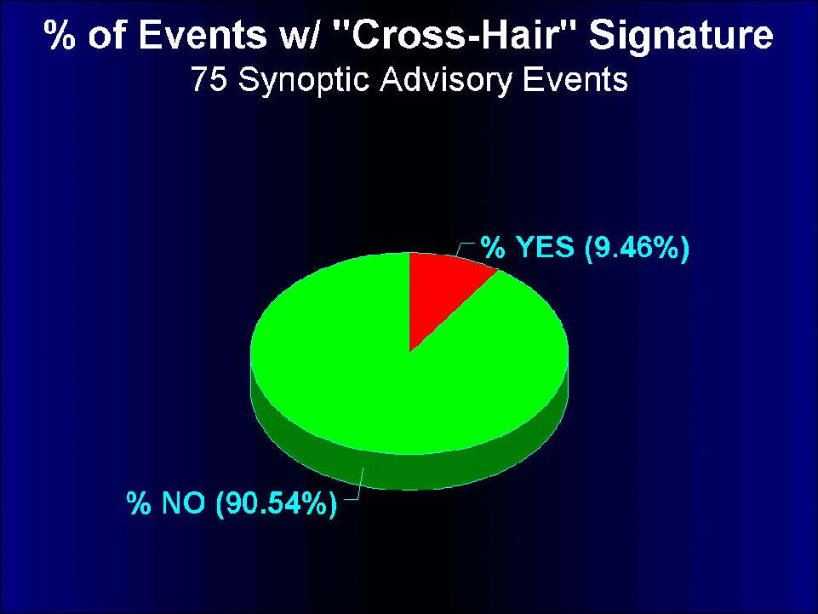
Waldstreicher Study
1998-2001
Northeast US
20 km eta

Slide 24
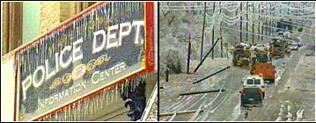
Assessing Elevated Precipitation Type
Based Upon the Bourgouin Energy Area Technique (2000)

Slide 25
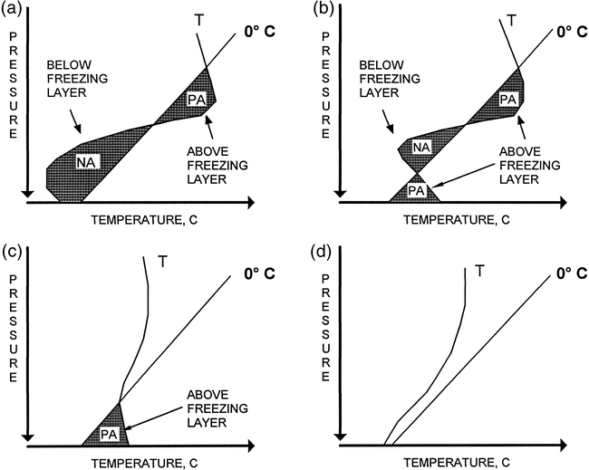
Bourgouin Technique Review
Divide the Temperature Profile into 1 to 4 layers
Compute the + and - energy (J/kg) in each layer

Slide 26
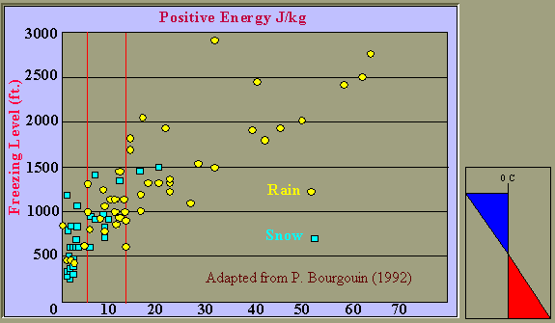
Two-layer – Rain vs Snow

Slide 27
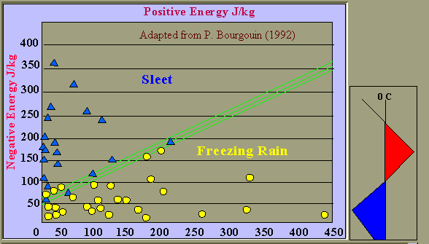
Three Layer – ZR vs IP

Slide 28
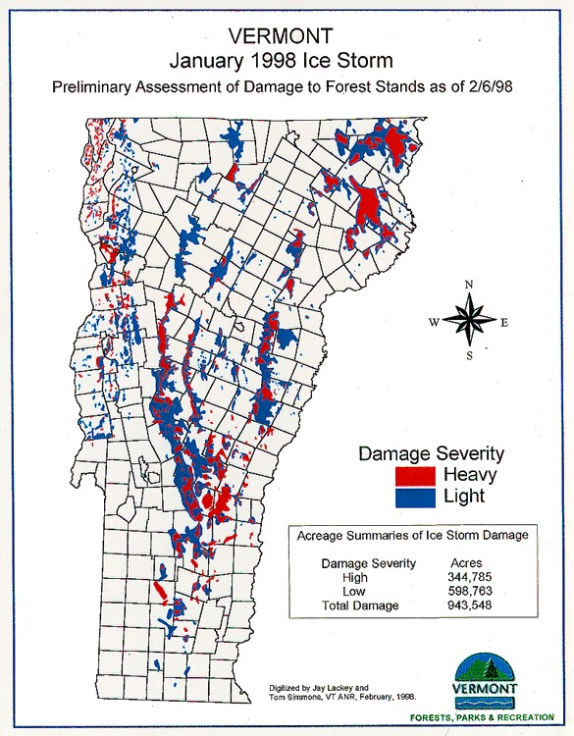
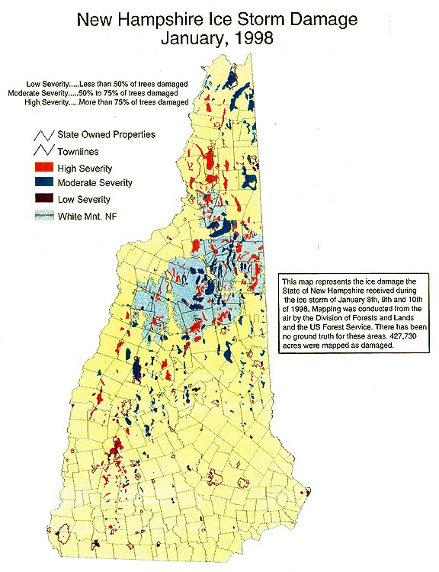
Damage Influenced by Elevation

Slide 29
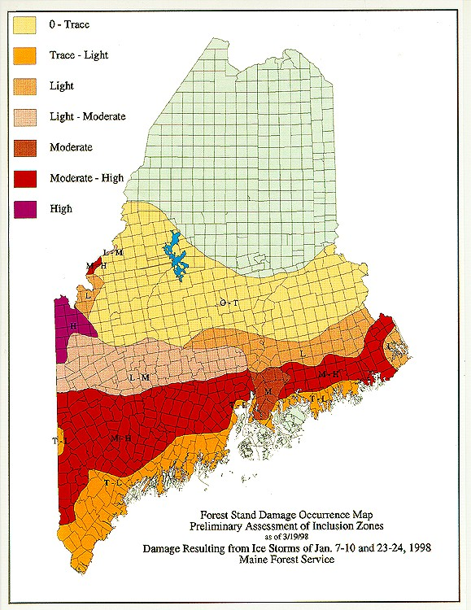
January 1998 Ice Storms

Slide 30
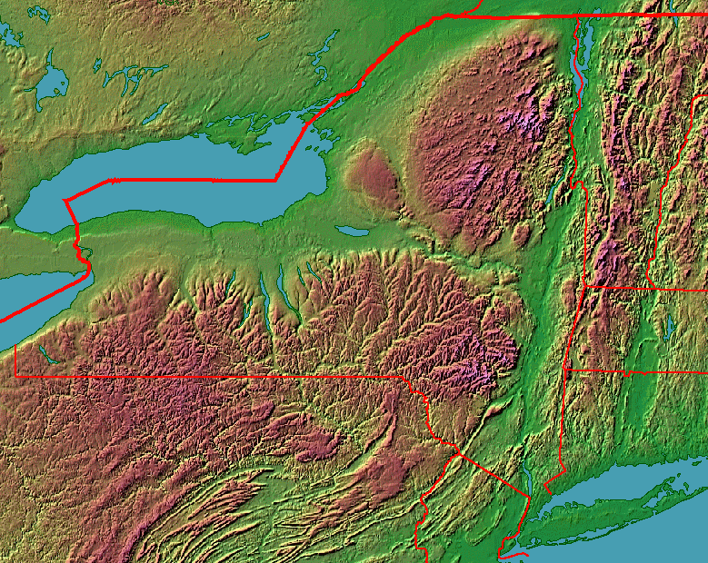
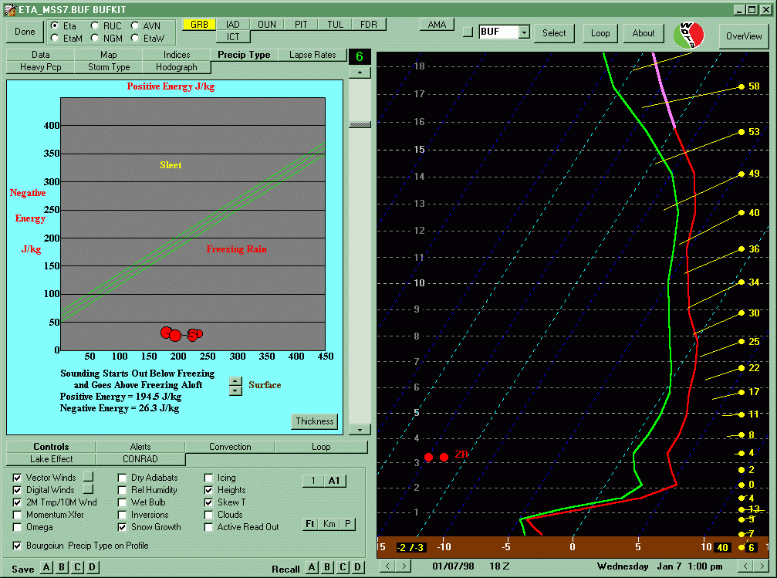

The Freezing Rain Profile

Slide 31
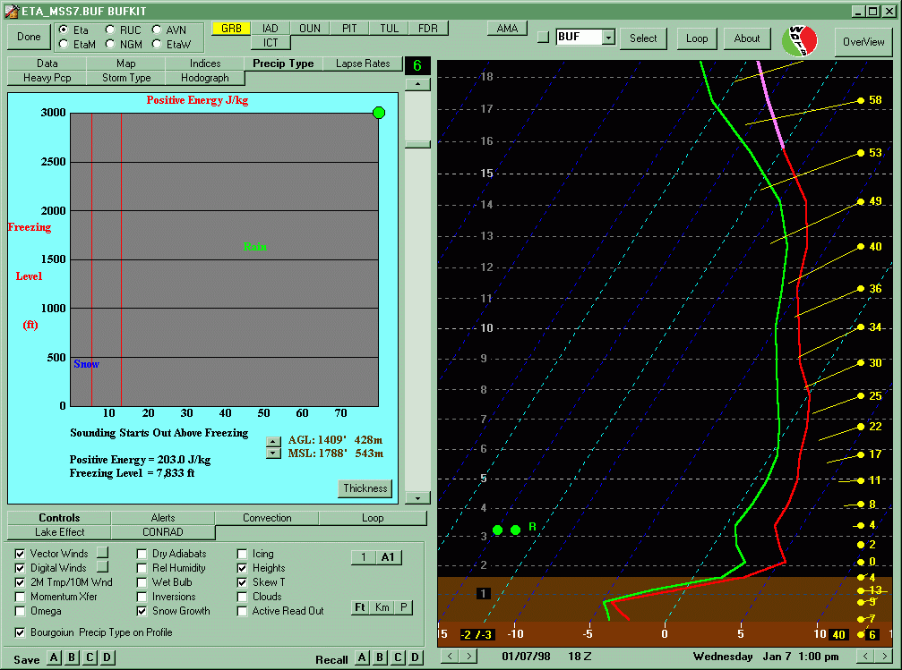
Snow vs Rain Profile

Slide 32
Bourgouin’s Limiation
For Snow Events, Bourgouin Always Assumes Ice Crystals are Present
Top Down Approach
(Microphysics) NOT
Addresses

Slide 33
A Mini Lab
January 1998
  New England and Canada
  Tug Hill, New York
January 2002
  Southeast US
  NE Alabama

Slide 34
Summary
Consider Implementing…
Snow-Microphysics into Your Winter Weather Warning Decision Making Process
  Waldstreicher Study Showed Potential in Differentiating Warning vs Advisory Criteria
Explore the Elevated P-Type Technique for Your CWA this Winter
  Avoid the “Black-Box” Syndrome

