Slide 1
Using BUFKIT to Display and Analyze Meteorological Data
Prepared by:
Sean Nolan¹ and Scott Jackson²
¹Pennsylvania Department of Environmental Protection
²U.S. Environmental Protection Agency
The 2005 National Air Quality Conference
Forecasting Short Course
San Francisco, CA
February 13, 2005

Slide 2
Outline of Presentation
History/background of BUFKIT
How to install and run
  Installation process
  Importing/viewing data
Features of BUFKIT
  Profile screen
  Overview screen

Slide 3
History of BUFKIT
In 1995, the NWS Buffalo office developed BUFKIT to assist forecasters with lake-effect snow events.
By 1997, BUFKIT was expanded to include convective parameters to assist forecasters with non-winter convection.
Today, it is used by various government offices and universities to assist in air quality forecasting.

Slide 4
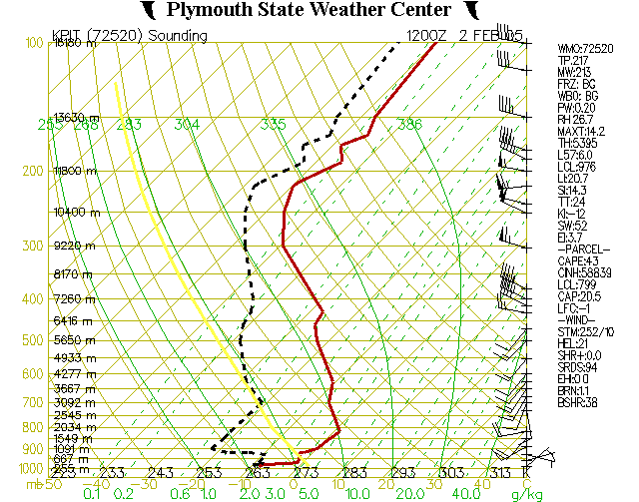
Conventional Websites
Static – not real interactive
Have to access four or five different web sites to get different data, such as soundings, cross sections, hodographs, etc.
Example - Plymouth State University Website (static image)

Slide 5
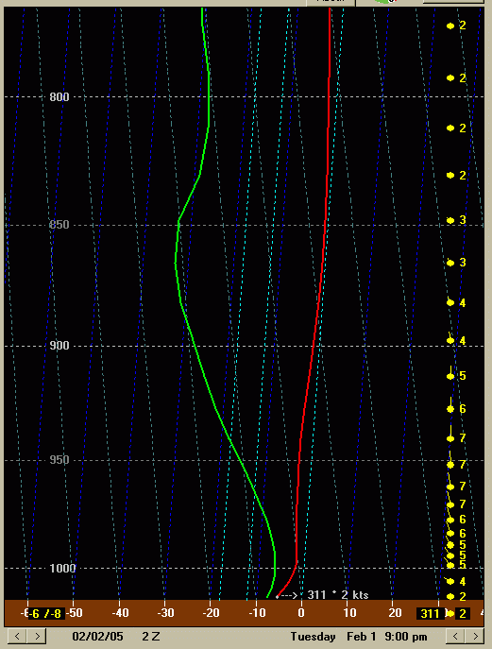
BUFKIT
Interactive – can change options on the fly
A lot of the data is centrally located within one program (can view sounding, cross-sections, convective parameters, etc. at the click of a mouse)
Example – Bufkit (can zoom on a certain section of sounding at the click of a button)
Zoom in on the boundary layer to view better temperature vs. height features

Slide 6
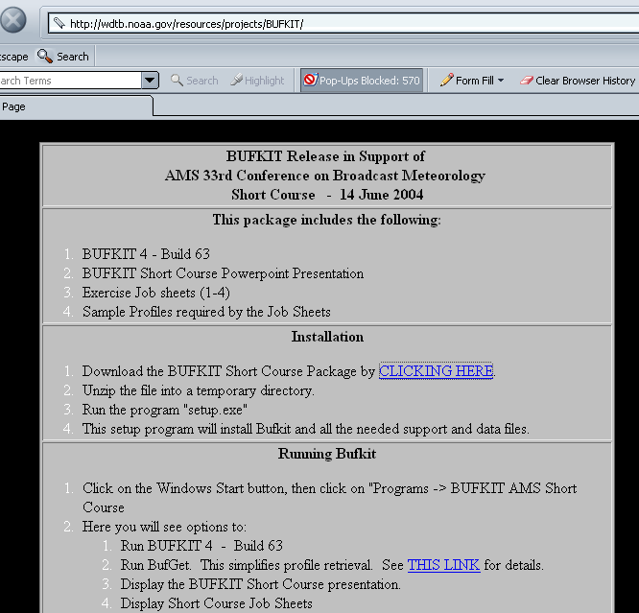
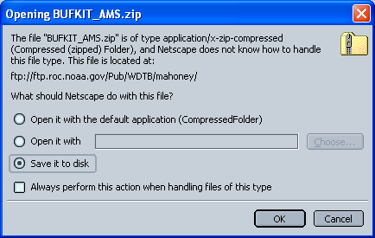
Installation (1 of 2)
Downloading the executable file
Go to www.erh.noaa.gov/buf/bufkit/bufkit.html

Slide 7
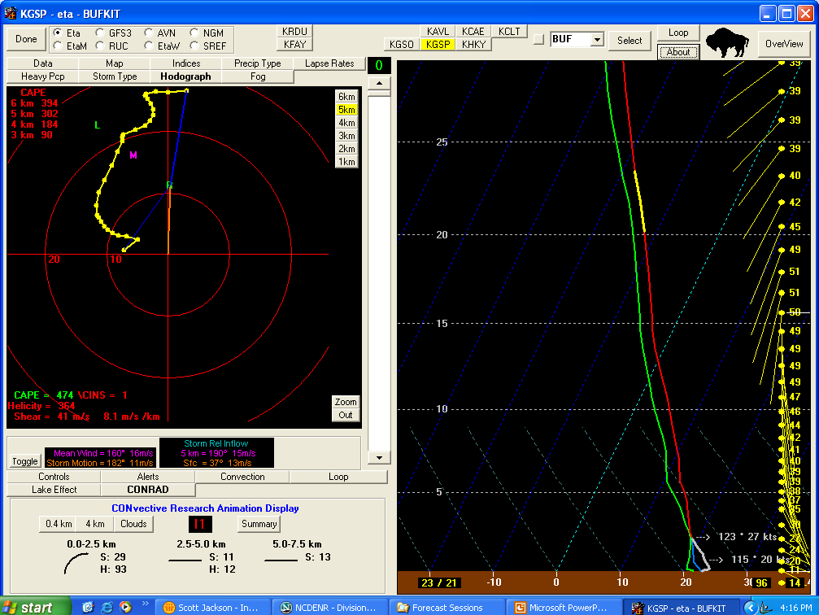
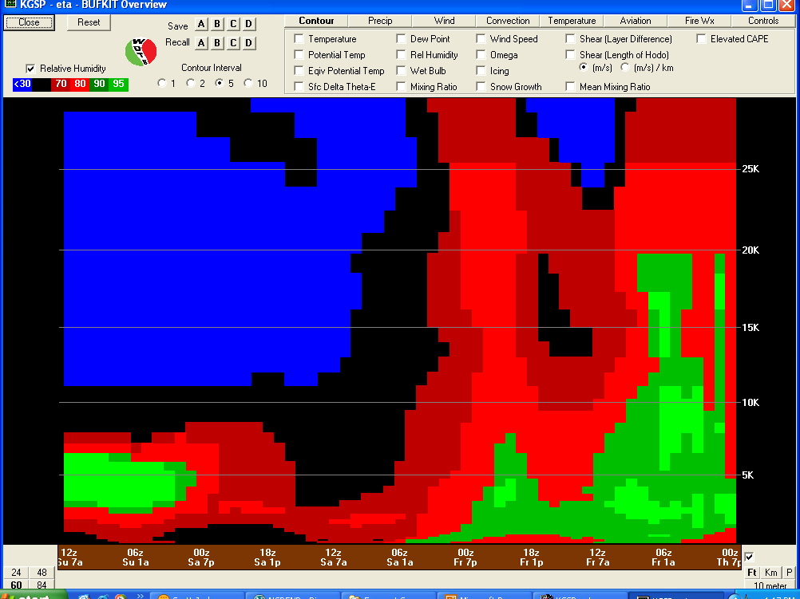
Installation (2 of 2)
BUFKIT is installed . . . Now what?

Slide 8
Setting up BUFKIT
Edits to BUFKIT’s configuration file “bufkit.cfg” are required to make it work in your forecast area(s).
Steps for configuration
  Go to the folder where BUFKIT is installed:
  e.g., C:\Program Files\BUFKIT.
  Open “bufkit.cfg” with a text editor.
  Specify your location and favorite profile sites.

Slide 9
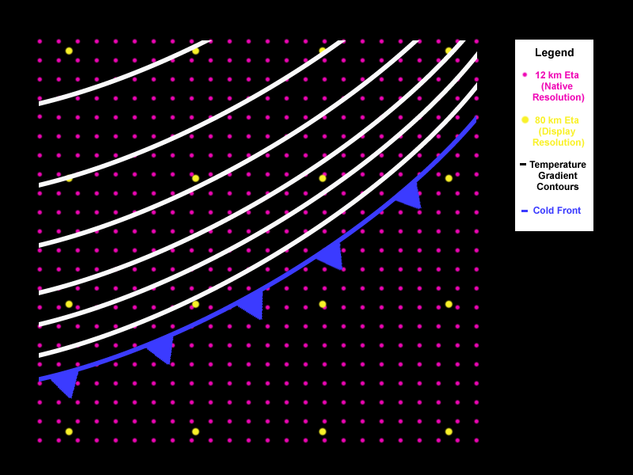
BUFKIT Data (1 of 3)
BUFKIT uses forecast model output from particular gridpoints, typically near the airport in a selected city.
Data from all model layers are available.
Data are hourly from ETA, MM5, and RUC models, every 3 hours from GFS.
Image courtesy of AMS Short Course at 33rd Broadcast Conference

Slide 10
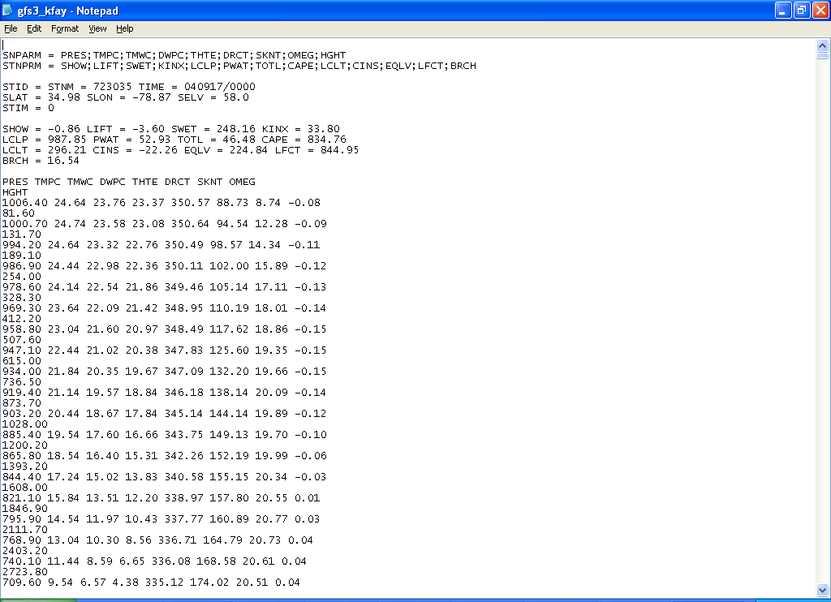
BUFKIT Data (2 of 3)
Raw data are packaged in a text file.

Slide 11
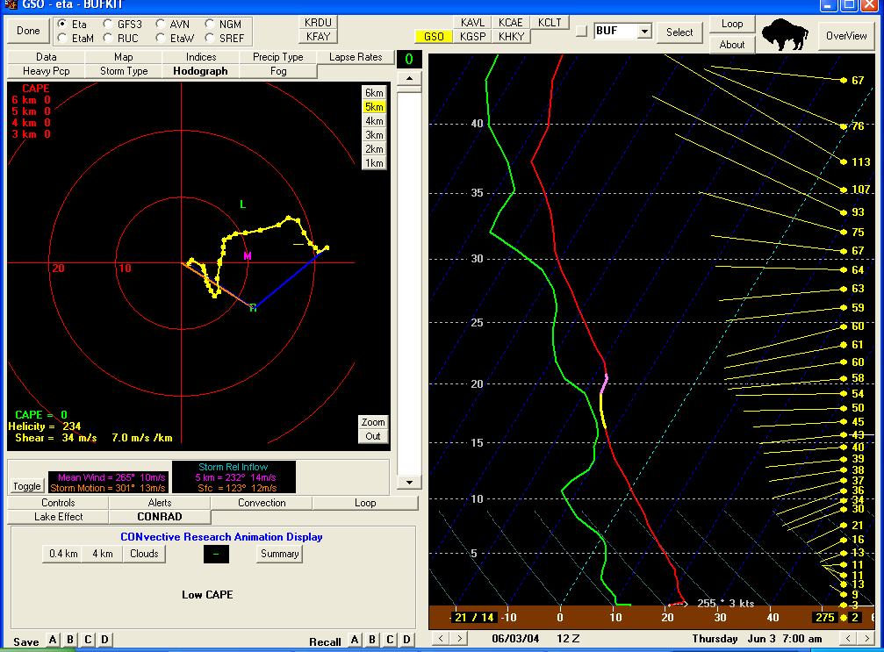
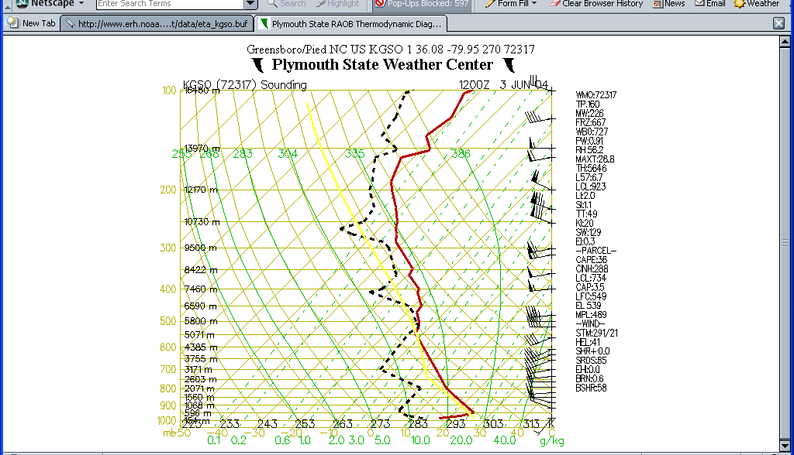
BUFKIT Data (3 of 3)
Data displayed as an upper air “profile”, similar to data collected from a radiosonde

Slide 12
Retrieving BUFKIT Data with BUFGET (1 of 2)
BUFGET is written in a language called TCL/TK; TCL/TK must already be installed on your computer. TCL/TK is available at no cost.
Download and install the TCL/TK package.
Suggestion: Search the Internet with Google for the phrase "active tcl download" and select the first returned site: http://www.activestate.com/Products/Download/Download.plex?id=ActiveTcl
Once TCL/TK is installed, the BUFGET program will work properly.

Slide 13
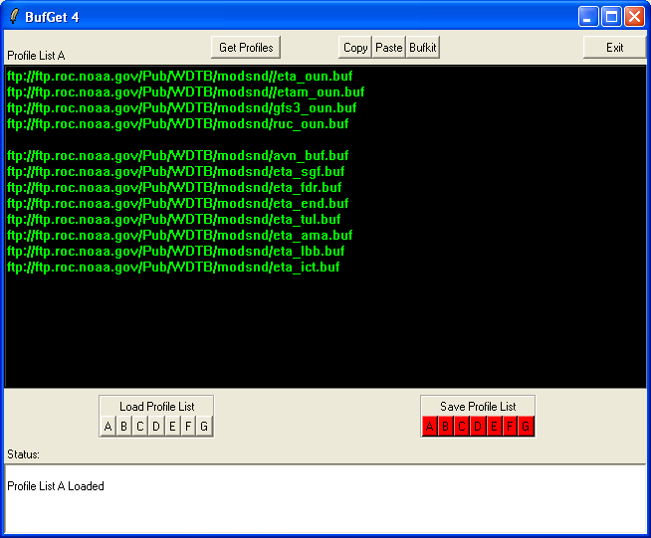
Retrieving BUFKIT Data with BUFGET (2 of 2)
BUFGET is included in the main BUFKIT installation.
It is located in C:Program Files\
BUFKIT\Bufget4.tcl
BUFGET is a utility used for retrieving BUFKIT profile files.

Slide 14
Using Archived Data in BUFKIT
BUFKIT is driven by data in the directory, C:\Program Files\BUFKIT\Data
Copy archived data profile files into this “Data” folder to use old data

Slide 15
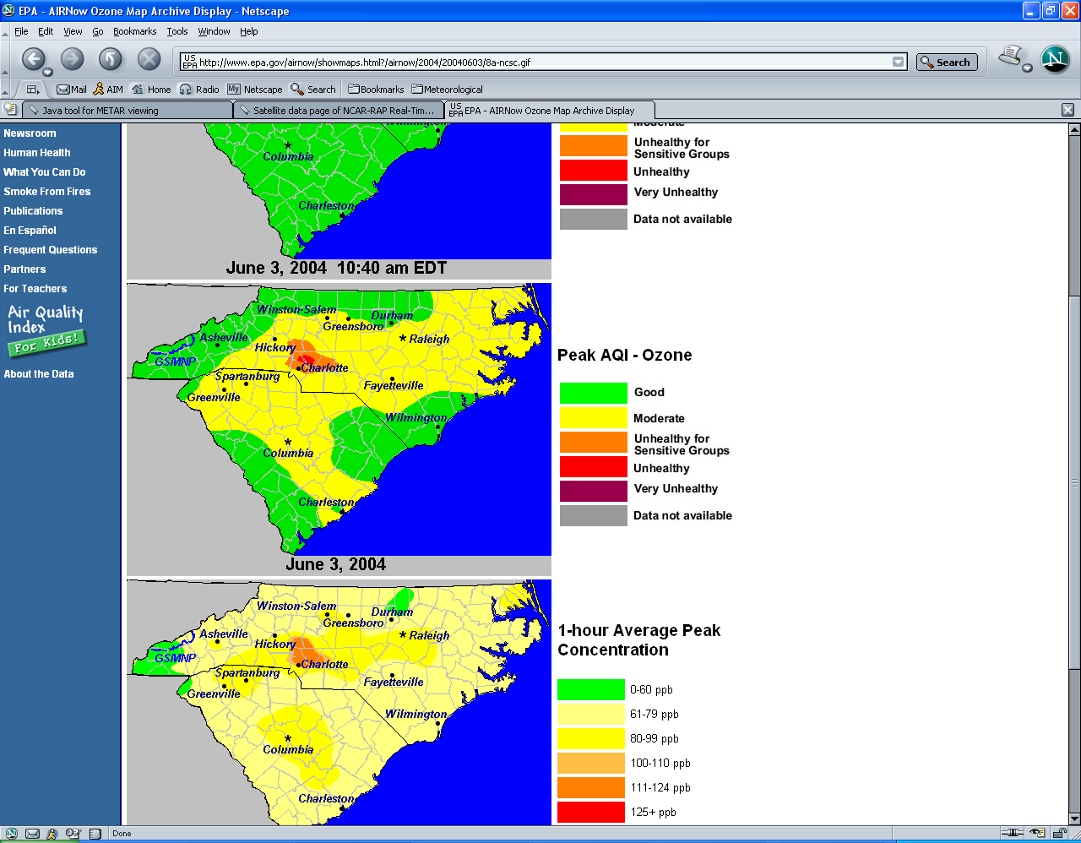
Example of Using Archived Data
Re-analysis of ozone event: June 3, 2004
If the profile files from this day are saved, they can be re-imported into BUFKIT.
Copy archived files into C:\ProgramFiles\
BUFKIT\Data.
Run BUFKIT as normal.

Slide 16
Features of BUFKIT
Displays hourly modeled sounding (on Profile screen)
Calculates convective parameters, including CAPE, CIN, TT, LI, K Index, etc.
Calculates stability parameters, including lapse rates between height levels
Shows a time-height cross-section of the model data (on Overview screen)

Slide 17
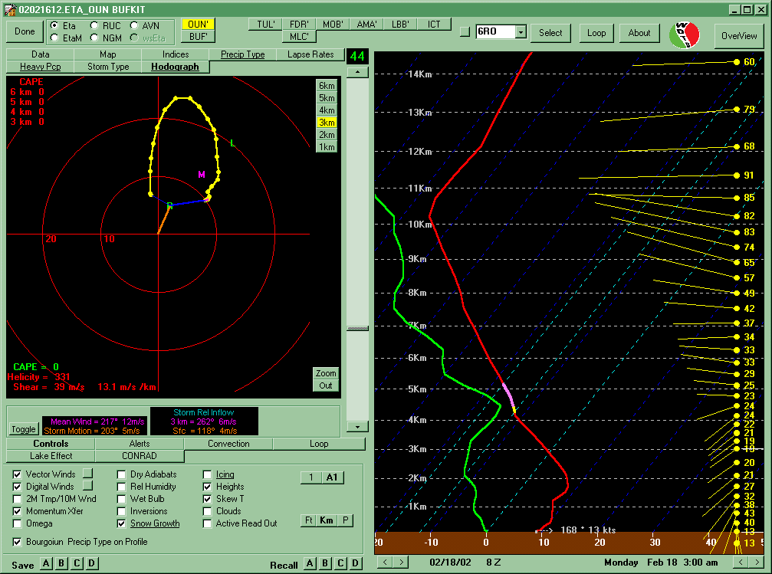
BUFKIT Profile Screen
Profile Panel
Data Panel
Control Panel

Slide 18
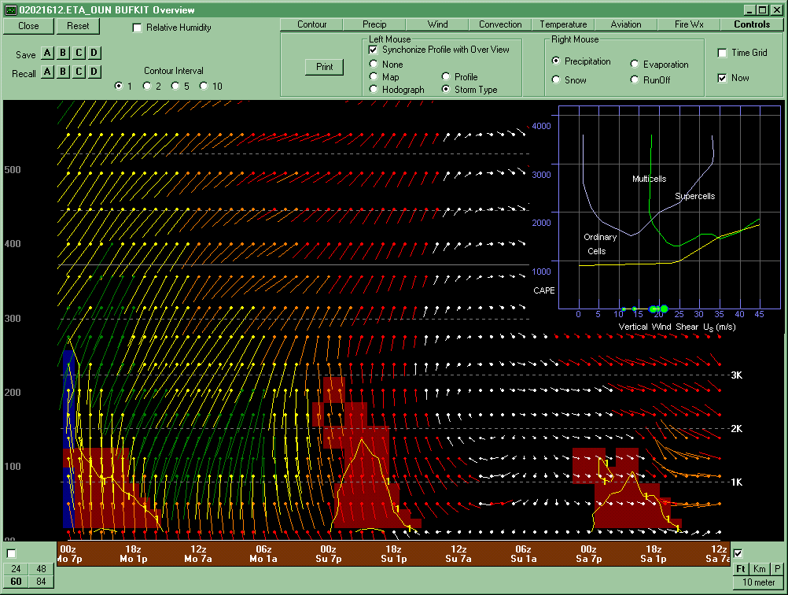
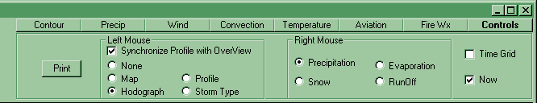
BUFKIT Overview Screen
Profile - A Single Hour
Overview – Time/Height

Slide 19
Features of BUFKIT
Let’s look at a high PM_{2.5} day in Pittsburgh and use BUFKIT features.
Focus on features in the Profile and Overview screens.
Look at sounding data and certain parameters (such as lapse rates, actual modeled data for significant levels, etc.).

Slide 20
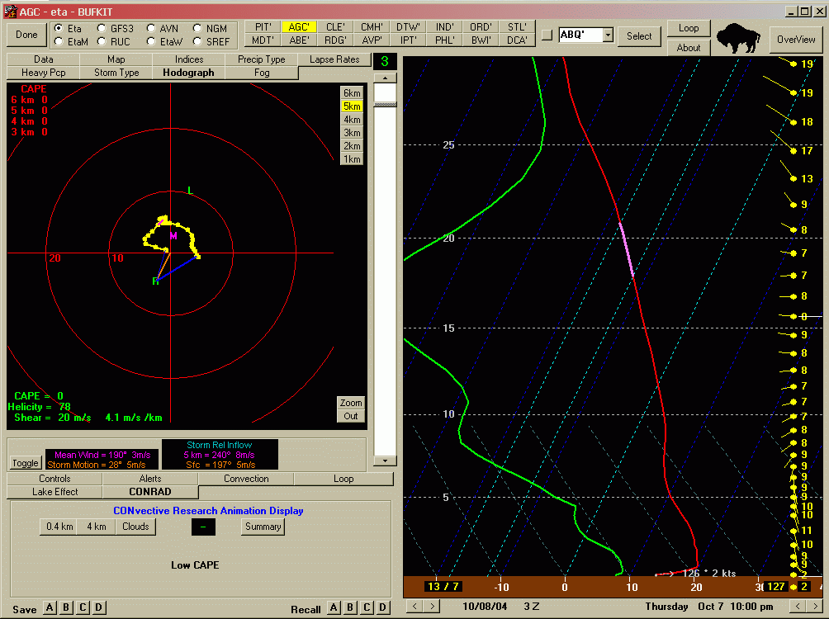
Profile Screen (1 of 4)
Look at October 8 when PM_{2.5} levels reached 73.7 µg/m³
Initial thoughts – Look at the inversion at the surface and the hodograph option

Slide 21
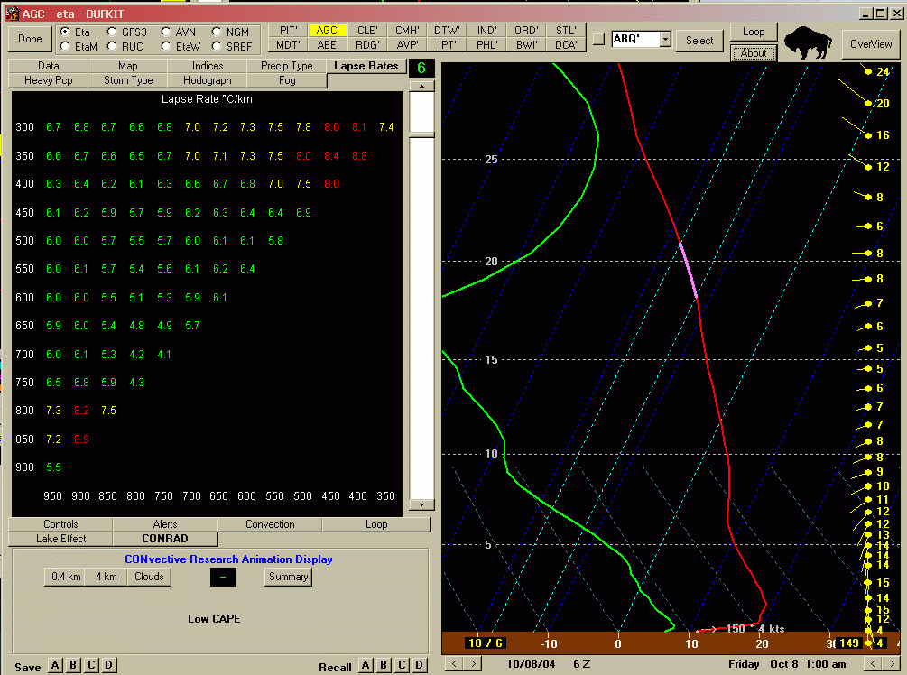
Profile Screen (2 of 4)
Notice the strong surface inversion with southerly winds in boundary layer
Lapse rates also indicate stability near the surface

Slide 22
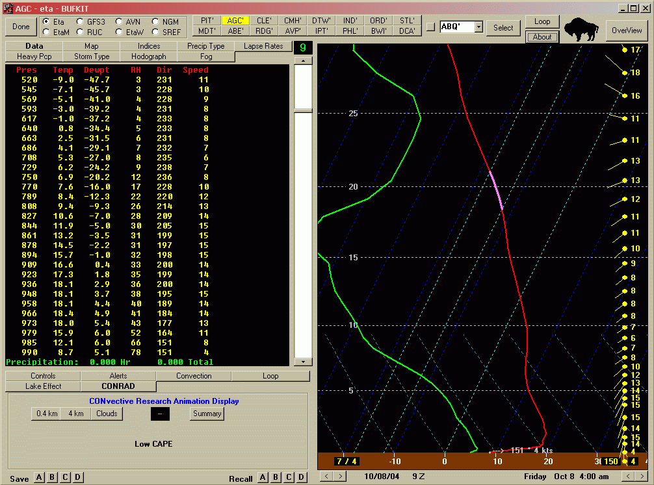
Profile Screen (3 of 4)
Surface inversion prevails through the night – low wind speed under inversion with low-level jet above it
A look at the model data indicates temperatures at
990 mb are lower than 985 mb

Slide 23
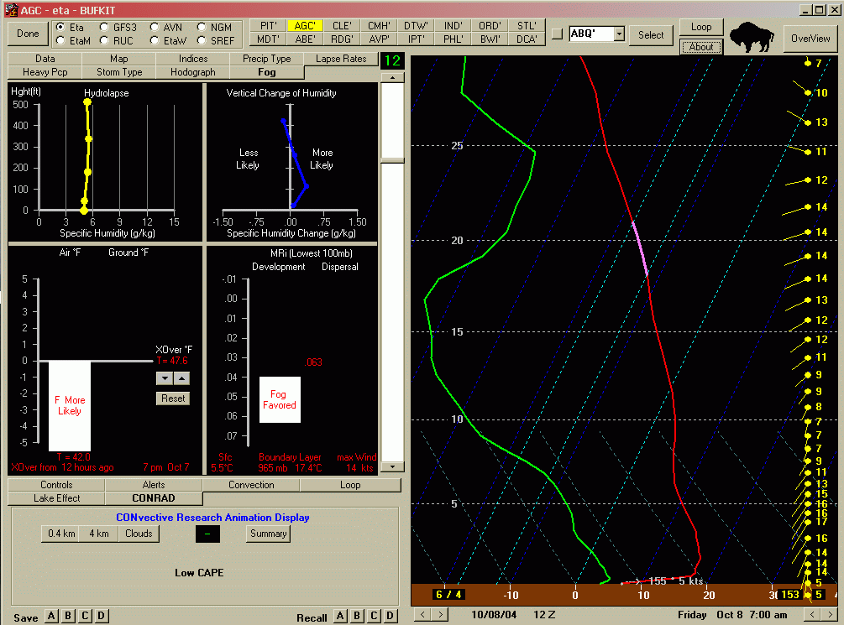
Profile Screen (4 of 4)
Still strong inversion near surface – for over nine hours
A look at the NEW fog parameter shows that fog was likely near dawn – could contribute to higher PM_{2.5} levels

Slide 24
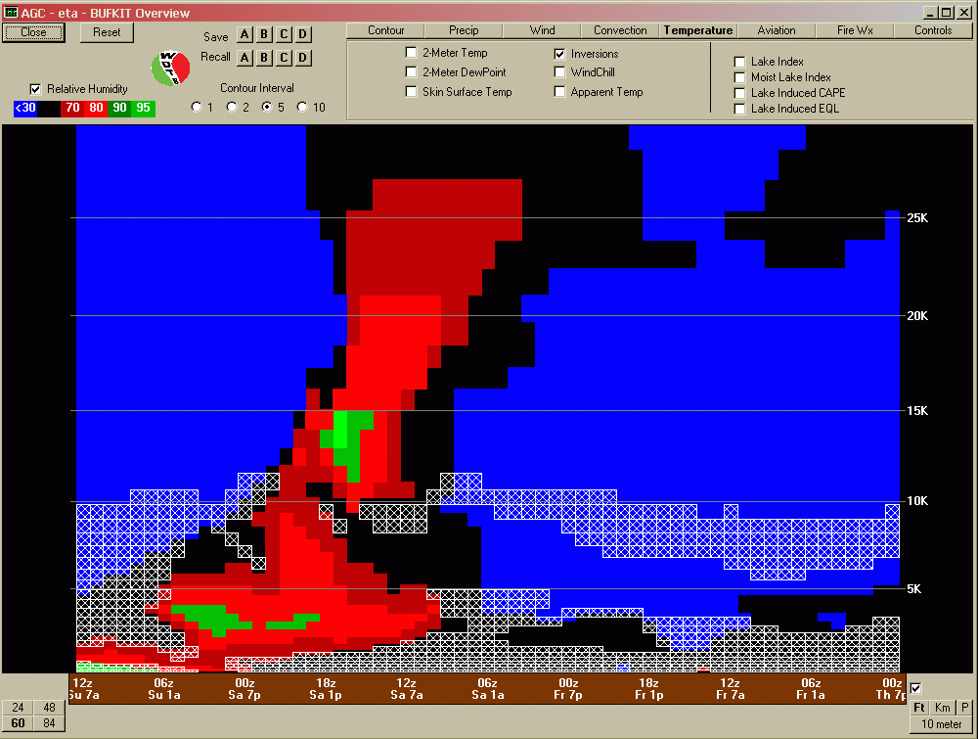
Overview Screen (1 of 3)
Plot shows cross-section of time vs. height of RH and inversion locations

Slide 25
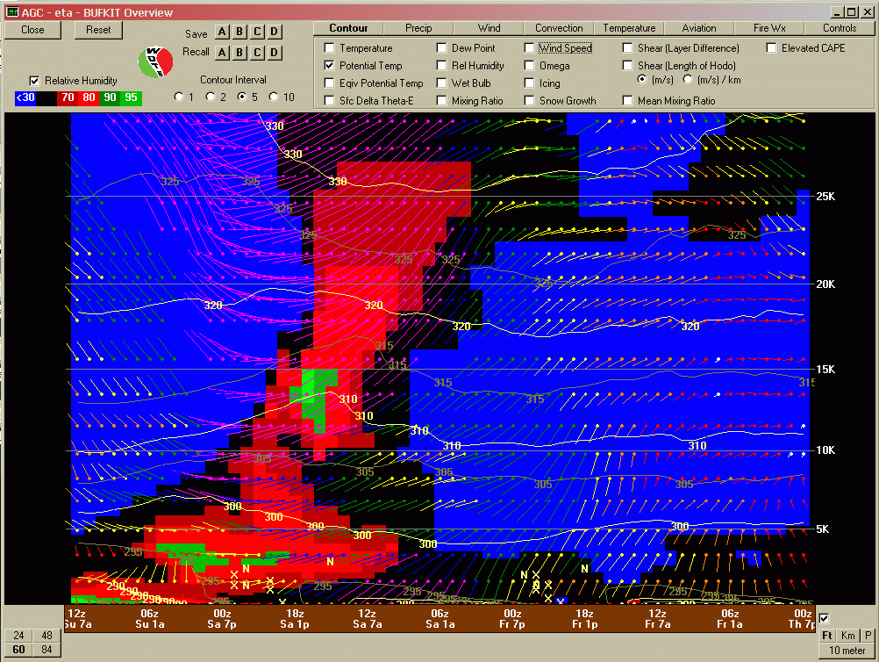
Overview Screen (2 of 3)
Plot shows RH plotted with wind speed and potential temperature
Note that from 00Z on Th 7p through 12Z on Fr 7a that the potential temperature also shows a cooling at the surface (i.e., shallow surface inversion)

Slide 26
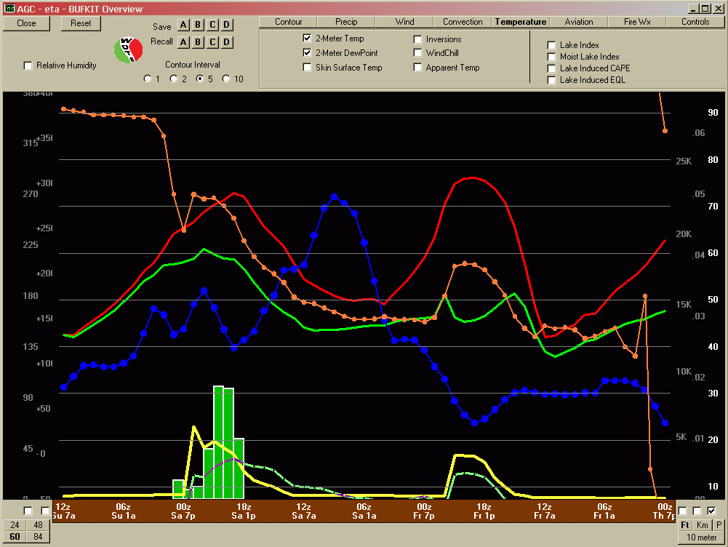
Overview Screen (3 of 3)
BUFKIT can also plot variables at certain levels on one graph.
Examples
  Red line: 2-m T
  Green line (solid): 2-m Td
  Orange line: Wdir
  Blue line: helicity
  Green line (dashed): Wspd
  Green bars: precipitation type and amounts
  Yellow line: mixing heights

Slide 27
Summary
BUFKIT is a very useful tool that utilizes modeled BUFR data and displays it in a manner that is easy to understand
Data can be viewed in sounding mode on the Profile screen
Data can be viewed in time-height cross-section displays on the Overview screen.

Slide 28
Contact Information
Sean Nolan
Pennsylvania Dept of Environmental Protection
senolan@state.pa.us
717-787-1454
Scott Jackson
US EPA, Office of Air Quality Planning and Standards
Jackson.scott@epa.gov
919-541-5647

