Slide 1
GEOSCIENCES COMMUNITY
RESOURCE DISCOVERY SYSTEM
Ben Domenico (ben@unidata.ucar.edu)
PAGE Program for the Advancement of Geoscience Education
UCAR University Corporation for Atmospheric Research

Slide 2
GOALS
Community-wide search engine
incorporation of COMET multimedia images and animations
Metadata and related conventions

Slide 4
Geosciences “Portal” Site
Functions like Yahoo for Geosciences
Multiple tables of contents
  by site
  by instructional topic
  by scientific concept
  by phenomenon, hazard,
Search/Index for geosciences sites

Slide 5
Table of Contents by Site
The easy way to get started
Many already exist
Examples
  Unidata Community Web Sites
  Pointers to K-12 Outreach Activities
  Beverly Lynds list of URLs

Slide 7
Contents by Instructional Topic
General circulation
Coriolis effect
Radiation
Winds
Cloud/precipitation formation
Jet stream formation and jet streaks
Potential Vorticity
Frontogenesis
...

Slide 9
Samples of “Coriolis” URLs
Texas A&M "Winds and Pressure”
Illinois Coriolis Force an artifact of the earth's rotation
COVIS Coriolis Force Illustrations
Lecture 23 from Atmos 100 at Illinois
Millersville: Coriolis effect in a hurricane by Matt Hough

Slide 10
Potential Vorticity Samples
Potential vorticity distribution over the continental United States on April 19, 1991
Potential vorticity over North America - corresponding displays
Potential vorticity surface 3-D graphic depiction

Slide 11
Hydrological Cycle URLs
The Hydrologic Cycle online meteorology guide
WetNet Data
Basic Hydrology for Headwater Forecasting

Slide 12
Cross-disciplinary Concepts
      Radiative transfer
      Convection
      Turbulence
      Biogeochemical cycles
      Hydrologic cycles
      Radiative transfer
      General circulation
      Lithosphere dynamics
      Global climate (modern and paleo)

Slide 14
Hazards, Events, Phenomena
Hurricanes
Volcanos
El Nino
Floods
Tsunamies
Pollution

Slide 15
Search/Index System
Robots currently index 23 servers at a dozen institutions
Full text indexing of >120,000 URLs
2-4K URLs at average server
Robot run takes about 8 hours
Currently awaiting another disk drive

Slide 16
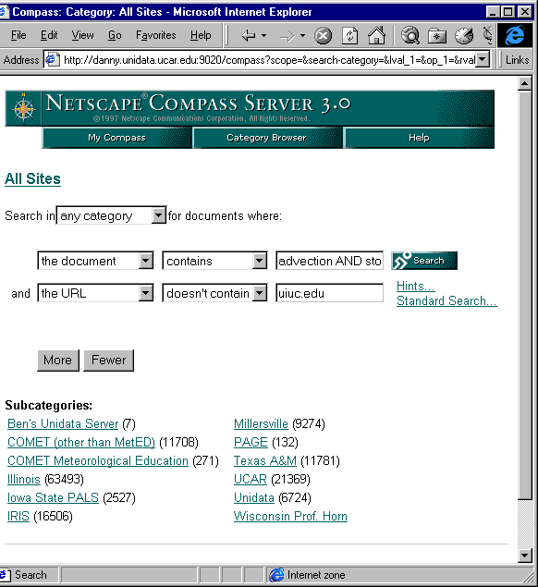
Search/Index System Screen

Slide 17
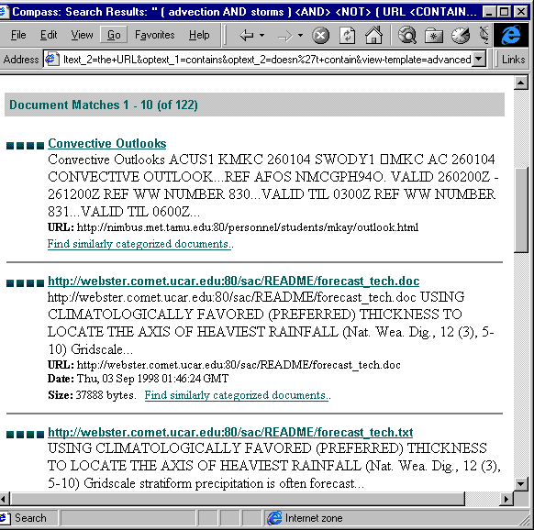
Search Results

