Slide 1
Book1
File created on: 4/21/2023 2:53:33 PM

Slide 2


Slide 3


Slide 4
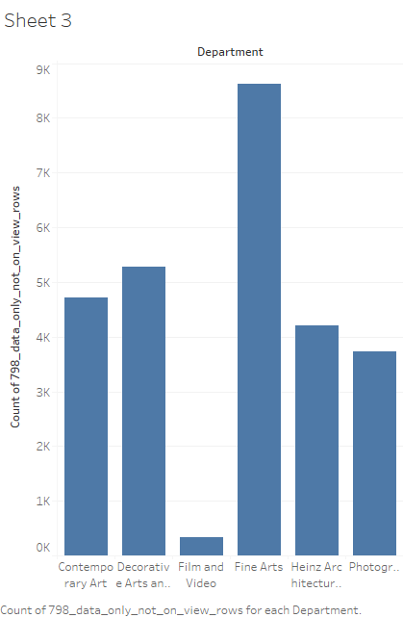

Slide 5
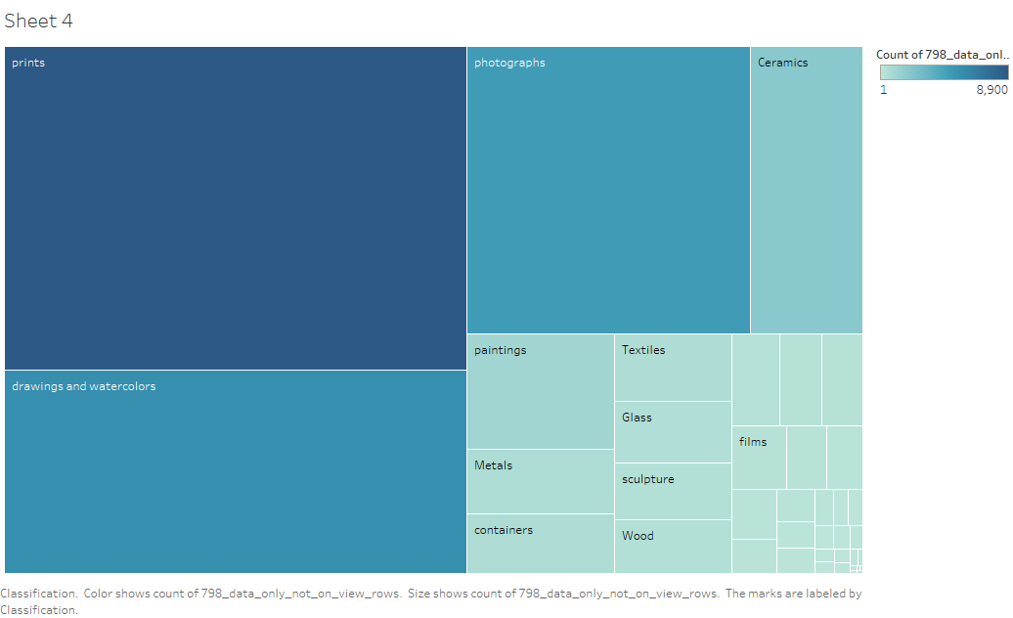

Slide 6
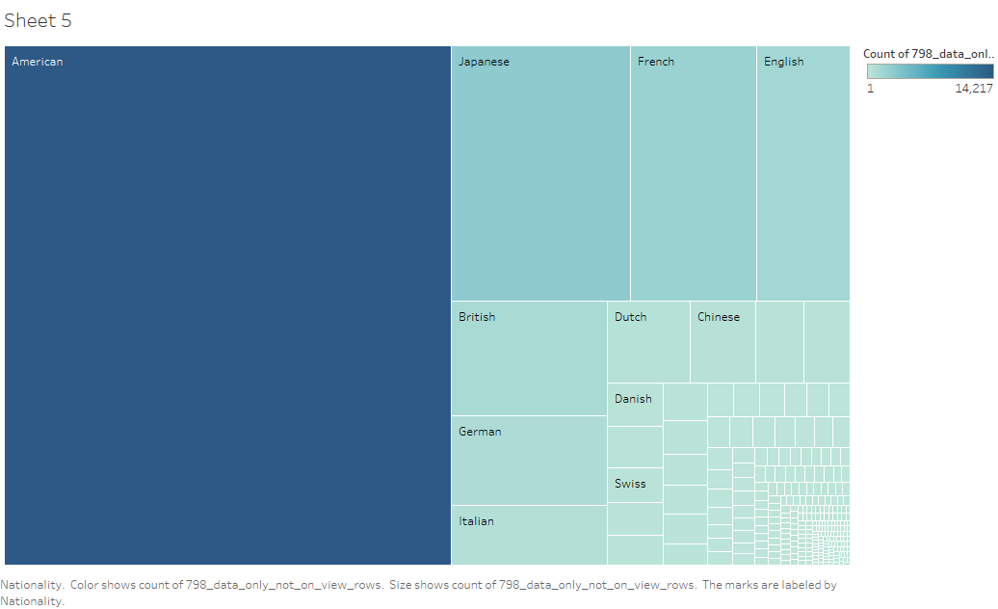

Slide 7
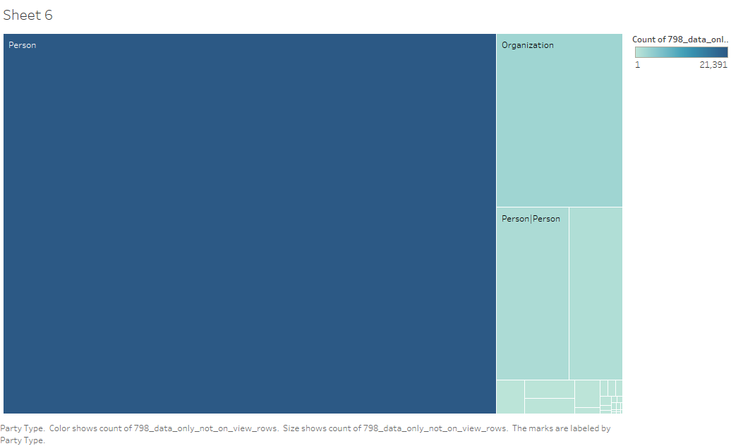

Slide 8
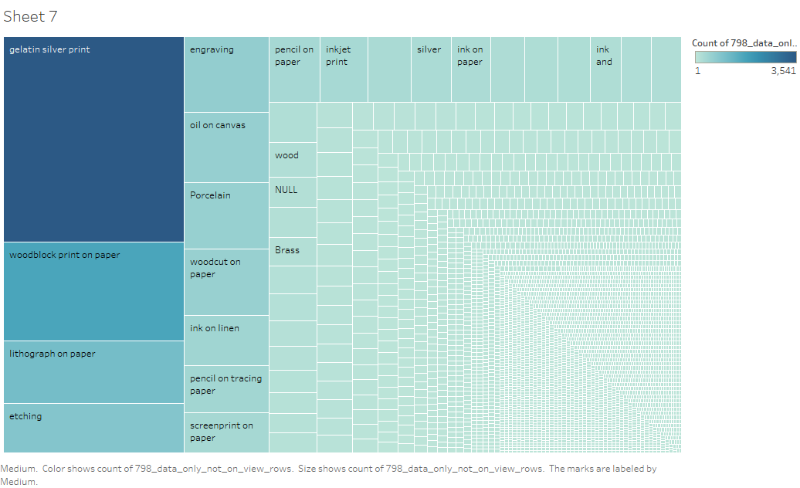

Slide 9
