Slide 1
ExoLexis – AI-Powered Scientific Publication Explorer
Transforming raw research into actionable insights

Slide 2
Challenge
• Scientific publications are vast and complex. • Manually extracting insights is time-consuming. • Space biology and mission-related research often remain fragmented.

Slide 3
Our Solution
ExoLexis automatically fetches and categorizes scientific publications. • Uses AI to extract abstracts, classify topics, and suggest tags. • Allows fast search and filtering by keywords, category, and tags.

Slide 4
How ExoLexis Works
1. Scrape publications from public repositories. 2. Extract abstracts and detect corrections. 3. Use LLaMA AI to categorize and tag research. 4. Store results in MongoDB for fast querying. 5. Display in an interactive frontend with search & filter.

Slide 5
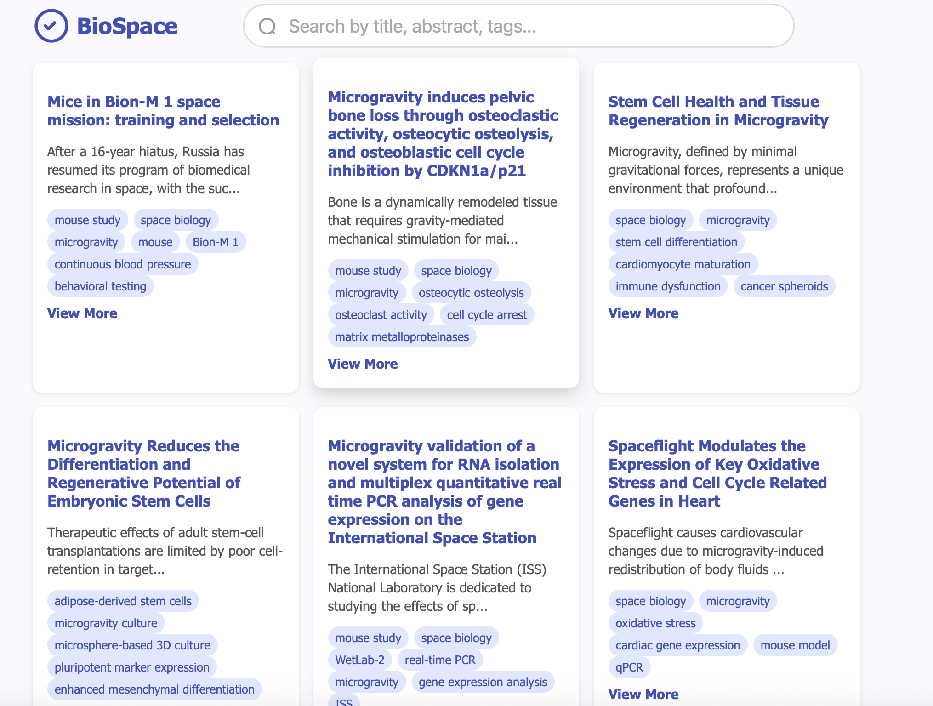
Key Features
• Abstract extraction & correction handling. • Multi-category AI classification. • Tagging for mouse studies, space biology, corrections, etc. • Interactive search and filter in the frontend. • Upsert to prevent duplicate entries in database.

Slide 6
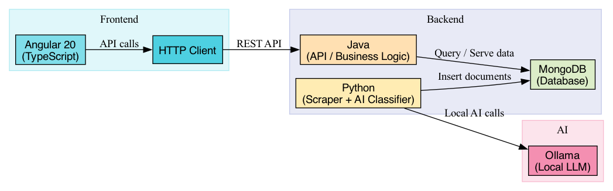
Technology Stack
• Backend: Python (scraper & AI classification), Java, MongoDB • AI: Ollama local model • Frontend: Angular 20, TypeScript, HTTP client

Slide 7
Impact & Future Work
• Enables faster research insights for scientists and mission planners. • Reduces manual work in space biology and mission research. • Future: integration with more repositories, improved AI classification, collaborative annotation.

