Slide 1
how to website
html + css + js

Slide 2
word of warning
html + css kinda suck

Slide 3
an email I recently received*
subject: making website pls halp
i am #1 CS rap fan but i cannot website.
pls make 4 me.
- k. west
p.s. is it too late to comp
*this totally happened i swear

Slide 4
how does website happen?
browser understands 3 languages:
html: general structure
css: modify appearance
javascript: add functionality

Slide 5
overview of html
hierarchical structure
lots of tags, have semantic meanings
have attributes
should make sense independent of appearance

Slide 6
overview of css
structure: <css-selector> {property: value; ...}
select with tag name, id, and/or class
does everything appearance-related

Slide 7
overview of javascript
actual programming language
you can do whatever the fuck you want with it
use sparingly

Slide 8
lets help mr. west!

Slide 9
writing good html
use semantically correct tags
should make hierarchical sense
don't hack for appearance
avoid tags like <br>, <b>, <font>, etc.

Slide 10
<html> <!-- html (put things here pls) -->
</html> <!-- hello, closing tag! you're my best friend :) -->

Slide 11
<html>
<head> <!-- metadata here -->
</head>
<body> <!-- actual stuff to display -->
</body>
</html> <!-- such a nice hug, html tag :) -->

Slide 12
<html>
<head> <!-- adding some metadata -->
<title>My Nerdcore Rap Site</title>
<link rel="stylesheet" href="css/styles.css">
<script type="text/javascript" src="js/script.js"></script>
</head>
<body>
</body>
</html>

Slide 13
<html>
<head>
<title>My Nerdcore Rap Site</title>
<link rel="stylesheet" href="css/styles.css">
<script type="text/javascript" src="js/script.js"></script>
</head>
<body>
<div class="container">
</div>
</body>
</html>

Slide 14
<html>
<head>
<title>My Nerdcore Rap Site</title>
<link rel="stylesheet" href="css/styles.css">
<script type="text/javascript" src="js/script.js"></script>
</head>
<body>
<div class="container">
<h1>Nerdcore rap 8-)</h1> <!-- header 1: big text -->
</div>
</body>
</html>

Slide 15
<html>
<head>
<title>My Nerdcore Rap Site</title>
<link rel="stylesheet" href="css/styles.css">
<script type="text/javascript" src="js/script.js"></script>
</head>
<body>
<div class="container">
<h1>Nerdcore rap 8-)</h1>
<ul class="songs"> <!-- unordered (bulleted) list -->
</ul>
</div>
</body>
</html>

Slide 16
<html>
<head>
<title>My Nerdcore Rap Site</title>
<link rel="stylesheet" href="css/styles.css">
<script type="text/javascript" src="js/script.js"></script>
</head>
<body>
<div class="container">
<h1>Nerdcore rap 8-)</h1>
<ul class="songs">
<li> <!-- list items -->
</li>
<li>
</li>
</ul>
</div>
</body>
</html>

Slide 17
<html>
<head>
<title>My Nerdcore Rap Site</title>
<link rel="stylesheet" href="css/styles.css">
<script type="text/javascript" src="js/script.js"></script>
</head>
<body>
<div class="container">
<h1>Nerdcore rap 8-)</h1>
<ul class="songs">
<li> <!-- a = anchor -> link -->
<a href="/songs/bitcoin/">Bitcoin Baron</a>
</li>
<li>
<a href="/songs/pimping/">The Pimping Lemma</a>
</li>
</ul>
</div>
</body>
</html>

Slide 18
css!
select with #id, .class, or tag_name
combine them (e.g. ul.songs)
get descendents (e.g. #container ul)
pseudoselectors (e.g. #btn:hover)

Slide 19
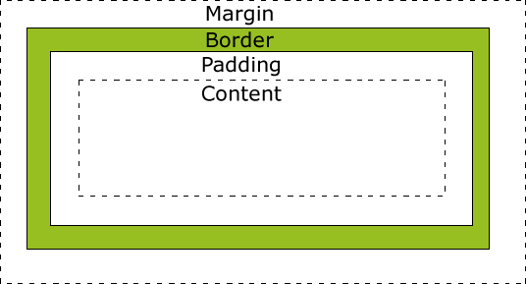
css box model!
content
border
padding (between content + border)
margin (outside border)

Slide 20
css properties!
so many :o
some useful ones:
color (font color)
background-image
background-color
margin, border, padding, width, etc.

Slide 21
position
common values:
static (default)
relative (position statically w/ adjustments)
absolute (position wrt to closest relative parent)

Slide 22
floating elements
want things next to each other? No problem.
float: horizontally (left/right, not up/down)
float: left
stuff after float – flows around it
before the float – not affected

Slide 23
float away from me!
Tired of annoying elements floating all up in your space? No problem!
property: clear
specifies which sides of an element floating elements are NOT allowed.
.text_line{
clear: both
}

Slide 24
javascript
dynamic content responding to user actions
insert using <script></script> tags, or best, keep it in separate file and link it in the <head>:
<script src="js/all.min.js"></script>
grab elements like this:
document.getElementById("demo").innerHTML = "Hello World!";

Slide 25
real talk
could use DOM, but lesbihonest:
jQuery – select using css selectors
$(".content#interstitial").show()
this is the shit

Slide 26
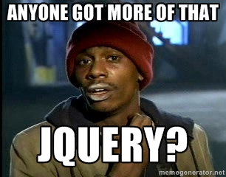

Slide 27
jQuery
Setting text:
$("button.surprise").text("SURPRISE!")
hiding/showing elements:
var $hiddenBox = $( "#message" ); $("#button-container button").on( "click", function( event ) { $hiddenBox.show(); });

