Slide 1
Deepfake Detection: Examining Algorithmic Synergies for Image Similarity
International Conference on Emerging Frontiers in Nonlinear Complex Systems, Computational Intelligence and their Applications (ICNCS-2024)
Akriti Rani, Student
Isha Singh Chauhan, Student
Dr. N. Nathiya, Assistant Professor Senior,
School of Advanced Sciences (SAS), VIT Chennai

Slide 2
Overview
INTRODUCTION
LITERATURE REVIEW
AIM AND OBJECTIVES
DATASET DESCRIPTION
DATA PRE-PROCESSING
FEATURE SELECTION & IMPORTANCE
WORKING OF METRICS AND ALGORITHMS
RESULT & MODEL EVALUATION
CONCLUSION
FUTURE WORK

Slide 3
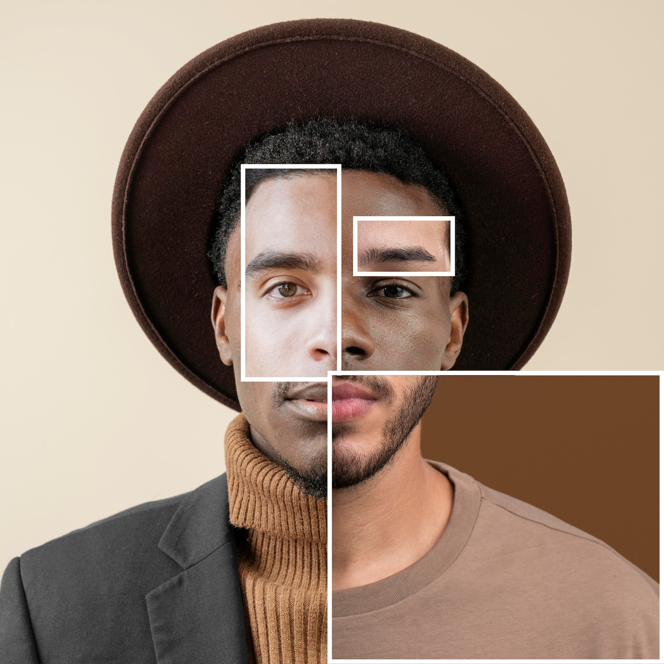
Introduction
Deepfakes refer to media that has been manipulated digitally to show a person saying or doing something that they did not actually do or say. These altered videos and images are often created with malicious intent and can spread false information.
The goal of this project is to create a predictive model which can help in detection of the person whose picture has been manipulated by these deepfake technology considering the original image is absent in dataset directory.
With the image dataset of 23+ celebrities, we extract the feature vectors by different methods of image processing and then analyze these values to train our model.

Slide 4
Literature Review
S. no | Title, Year | Observations | Reference
1. | A survey of machine learning techniques in adversarial image forensics , 2021 | Most (fake) images shared on social media platforms such as Facebook, Twitter, and YouTube undergoes several aggressive transformations like compression, resizing, and re-sampling, making it challenging to detect the original face or video. Images edited using Photoshop or any other editing tool can show different results under shallow and deep methods of detection. | Nowroozi, E., Dehghantanha, A., Parizi, R. M., & Choo, K. K. R. (2021). A survey of machine learning techniques in adversarial image forensics. Computers & Security, 100, 102092.
2. | Understanding ssim, 2020 | The study by Nilsson et al. advocates for a re-evaluation of the broadened application of SSIM beyond its original scope, revealing its limitations in capturing human visual perception. | Nilsson, J., & Akenine-Möller, T. (2020). Understanding ssim. arXiv preprint arXiv:2006.13846.

Slide 5
S. no | Title, Year | Observations | Reference
2. |  | While SSIM proves valuable in some cases, it often produces counterintuitive results, particularly in low-luminance (low-lightning) situations and when pixel value distributions are similar. The paper suggests the need for alternative, more human-centric assessment methods instead of relying on SSIM as an all-encompassing image quality metric. | Nilsson, J., & Akenine-Möller, T. (2020). Understanding ssim. arXiv preprint arXiv:2006.13846.
3. | Image quality assessment through FSIM, SSIM, MSE and PSNR—a comparative study, 2019 | Sara et al. compared various image quality metrics by experimenting on benchmark images subjected to denoising under varying noise levels. | Sara, U., Akter, M., & Uddin, M. S. (2019). Image quality assessment through FSIM, SSIM, MSE and PSNR—a comparative study. Journal of Computer and Communications, 7(3), 8-18.

Slide 6
S. no | Title, Year | Observations | Reference
 |  | The study found that SSIM and FSIM are better than MSE and PSNR as they provide normalized and interpretable perspective, and incorporate perception and saliency-based errors. As noise levels increase, SSIM and FSIM are superior to MSE and PSNR from a human visual perception standpoint. | Sara, U., Akter, M., & Uddin, M. S. (2019). Image quality assessment through FSIM, SSIM, MSE and PSNR—a comparative study. Journal of Computer and Communications, 7(3), 8-18.
4. | Analyzing the role of visual structure in the recognition of natural image content with multi-scale SSIM, 2008 | Rouse et al. aimed to objectively evaluate visual information by predicting recognition thresholds for different image representations. The modified MS-SSIM* component showed better predictive accuracy, emphasizing its importance. | Rouse, D. M., & Hemami, S. S. (2008, February). Analyzing the role of visual structure in the recognition of natural image content with multi-scale SSIM. In Human Vision and Electronic Imaging XIII (Vol. 6806, pp. 410-423). SPIE.

Slide 7
S. no | Title, Year | Observations | Reference
5. | “The word real is no longer real”: Deepfakes, gender, and the challenges of ai-altered video, 2008 | In this Article, Wagner, hints at the crisis humans can run into soon with the ever-growing technology that has already advanced to the point of real-time media manipulation. He talks about a point in the future where we will not be able to distinguish between what is real and what is fake even with the Information professionals, that challenge the misinformation in this hypermediated age. He deduces that the conversations remain divided on two sides of the field: technology production and user engagement. | Wagner, T. L., & Blewer, A. (2019). “The word real is no longer real”: Deepfakes, gender, and the challenges of ai-altered video. Open Information Science, 3(1), 32-46.
6. | Feature extraction and image recognition with convolutional neural networks , 2018 | In this paper Han examines the studies conducted in 2018 on image recognition challenges are explored. The studies utilize a technical solution that leverages Convolutional Neural Network (CNN). | Liu, Y. H. (2018, September). Feature extraction and image recognition with convolutional neural networks. In Journal of Physics: Conference Series (Vol. 1087, p. 062032). IOP Publishing

Slide 8
S. no | Title, Year | Observations | Reference
 |  | This network efficiently extracts object features at a lower computational cost through local connections and weight sharing. Future challenges involve creating a stable computing environment and enhancing speed through hardware and software improvements. | Liu, Y. H. (2018, September). Feature extraction and image recognition with convolutional neural networks. In Journal of Physics: Conference Series (Vol. 1087, p. 062032). IOP Publishing
7. | Mystery behind similarity measures MSE and SSIM, 2014 | G. Palubinskas discusses that SSIM, derived from generalized Dice measures, maintains scale invariance, while MSE relies on absolute standard deviation values. Theoretical findings are substantiated by experiments on both simulated and real data affected by various distortions. | Palubinskas, G. (2014, October). Mystery behind similarity measures MSE and SSIM. In 2014 IEEE International Conference on Image Processing (ICIP) (pp. 575-579). IEEE.

Slide 9
S. no | Title, Year | Observations | Reference
8. | On the Euclidean distance of images, 2005 | In their paper published by Wang et al. introduced a new Euclidean distance metric for images called the IMage Euclidean Distance (IMED). The conventional Euclidean distance is sensitive to deformation and translation because it lacks consideration of pixel spatial relationships. However, IMED partially mitigates this flaw, making it robust to small image perturbations. The authors argue that IMED is the only intuitively reasonable Euclidean distance for images. IMED is then applied to image recognition, and its key advantage is that it can be embedded in most image classification techniques, such as SVM, LDA, and PCA. This embedding is rather efficient and involves a transformation referred to as Standardizing Transform. | Wang, L., Zhang, Y., & Feng, J. (2005). On the Euclidean distance of images. IEEE transactions on pattern analysis and machine intelligence, 27(8), 1334-1339.

Slide 10
Aim and Objective
To create a model which works on the principle of image similarity for deepfake detection.
To develop a machine learning model which will help in identifying the image of the person manipulated by deepfakes.
To use Euclidian distance by simple feature extraction and by CNN feature extraction as two different parameters.

Slide 11
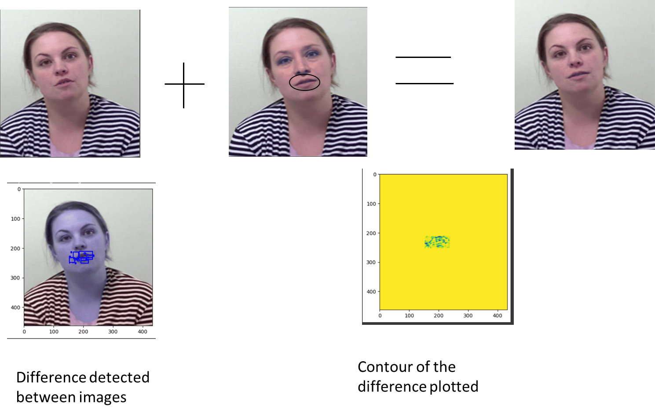
Contour Plotting (Original image)

Slide 12
Dataset Description
The Dataset was gathered from Kaggle dataset repository. https://www.kaggle.com/vishesh1412/celebrity-face-image-dataset and Google
The dataset contains 603 images of 26 people.
The face is extracted from these using MTCNN model and stored for parameter generation.
The deepfake image is generated using ROOP(GitHub) and Face_recognisation package.

Slide 13
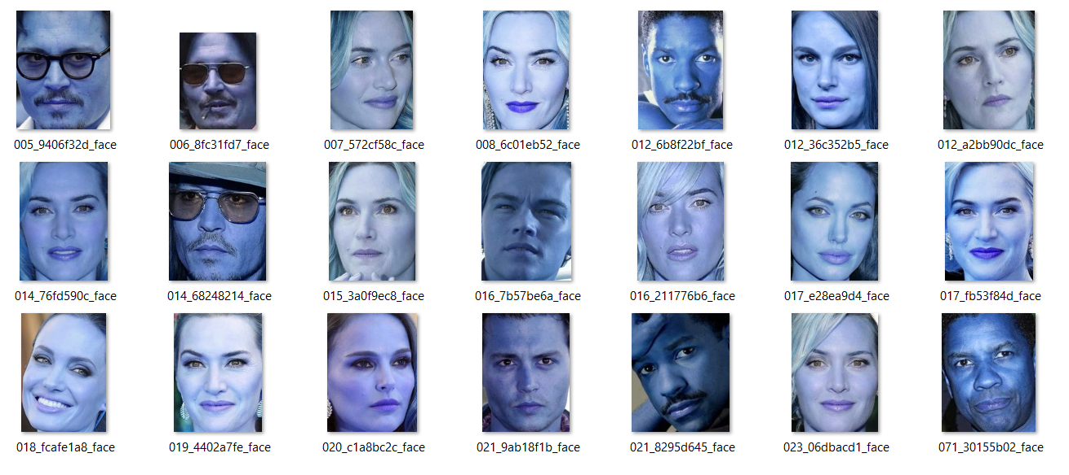
Overview of the Custom Image Dataset:
Sample Images in the directory

Slide 14
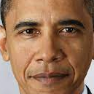
ROOP software
Works on the principle of Generative Adversarial Network (GAN) machine learning model which help in creating high definition videos by extracting the face features from the target image and imposing this on the face feature of the video resulting in creating of a deepfake video by swapping of the faces.

Slide 15
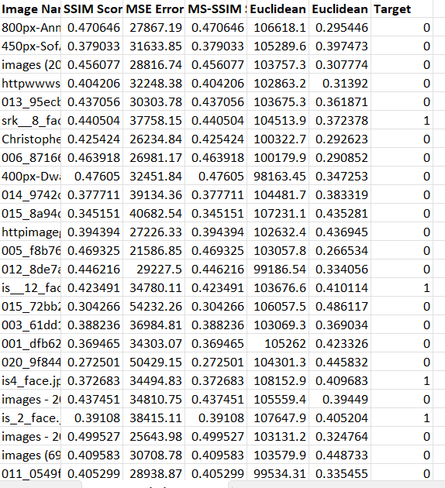
Data Preprocessing
Parameters are generated between the extracted images and the target deepfake image are to be stored in a csv format.
Total 5 parameters- “SSIM”, “MS-SSIM”, “MSE”, “Euclidian Distance(IMED)”, “Euclidian Distance-1” are created.
A binary variable “Target” is created which will assign “Class 1” those whose images have been deepfaked and the rest to ‘Class 0’

Slide 16
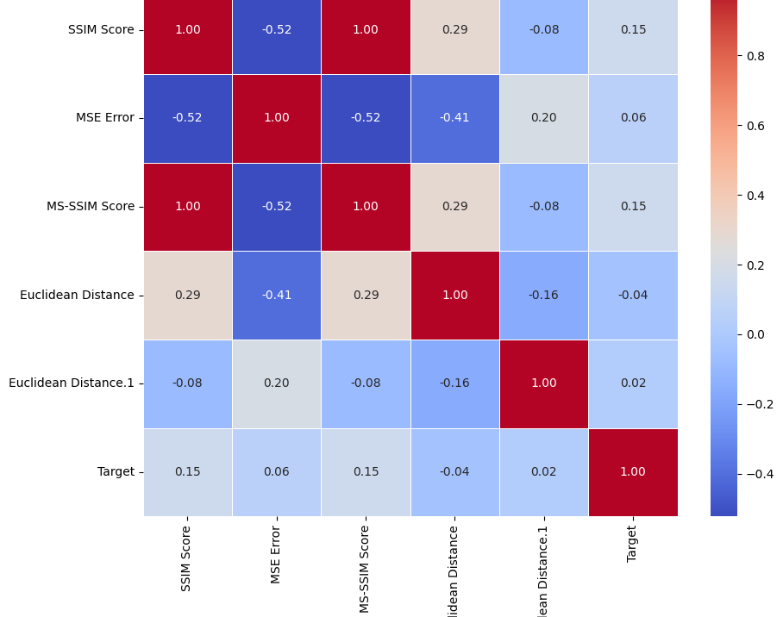
Feature Selection
As we can see form the generated Heatmap of the parameters of our dataset- MS-SSIM and SSIM are highly correlated.
This is because MS-SSIM calculate for overall SSIM .
Hence we can drop either of them for our calculation.
We choose to drop MS-SSIM.

Slide 17
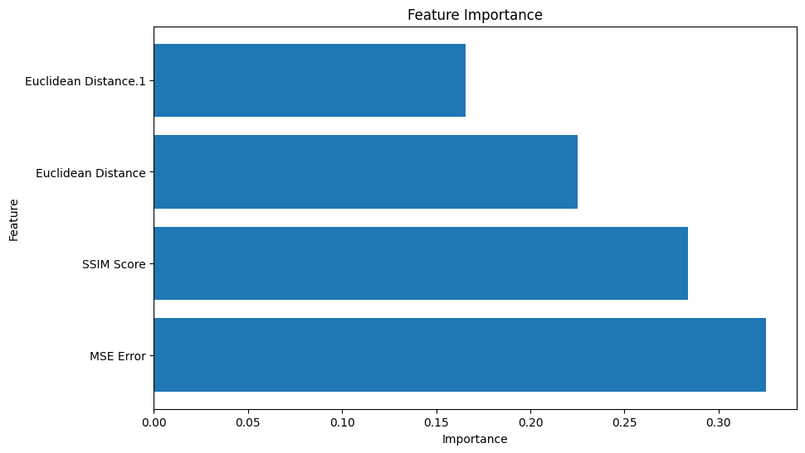
Feature Importance
The following graph shows the importance of each feature present in our dataset.
The MSE and SSIM hold almost the same feature importance.

Slide 18
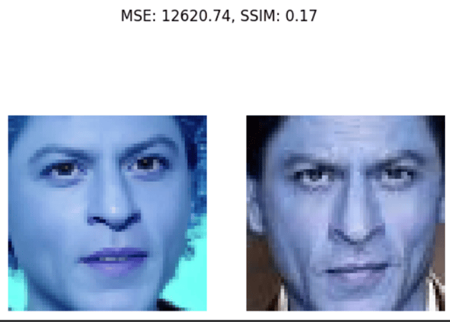
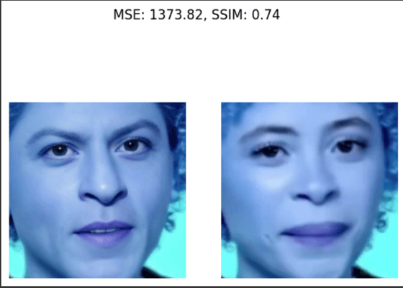
SSIM measure obtained by comparing Original Image

Slide 19
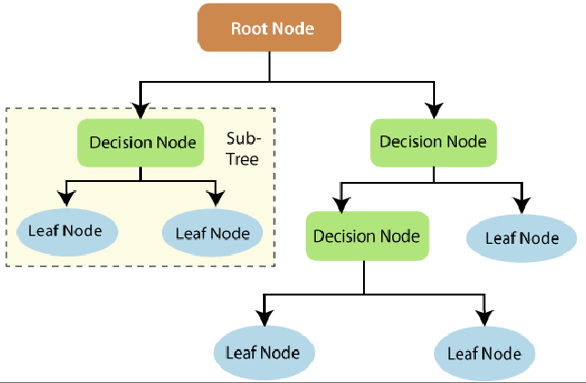
Algorithms Used
Decision Tree:
It is a machine learning technique that makes decisions by recursively partitioning the data based on information gain.
The goal is to split the data at each node based on the feature that provides the most information about the target variable.
The process continues, creating a tree-like structure, with each leaf node represents a decision or outcome.

Slide 20
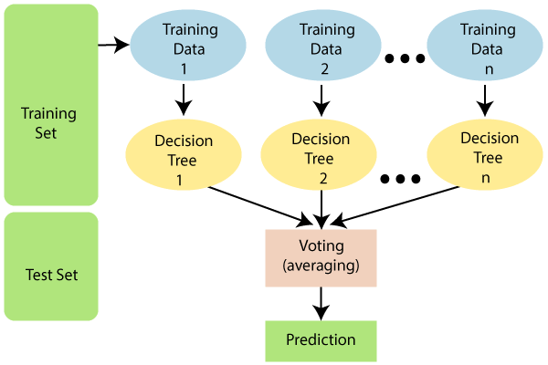
Random Forest :
It is an ensemble algorithm for classification.
It builds multiple decision trees during training and Each tree is trained on a random subset of the data.
The ultimate prediction is obtained by combining individual tree forecasts, which often reduces overfitting and improves generalization across diverse datasets.

Slide 21
Result & Model Evaluation

Slide 22

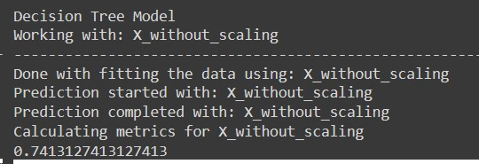
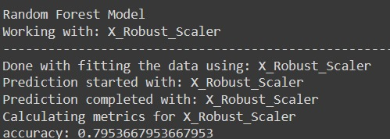
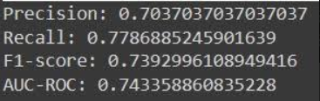

Case 1 - ROOP
Decision Tree Model | Random Forest Model
Observed accuracy - Roc-curve - | Observed accuracy - Roc-curve -

Slide 23
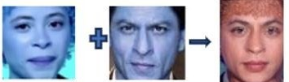
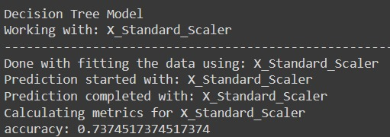
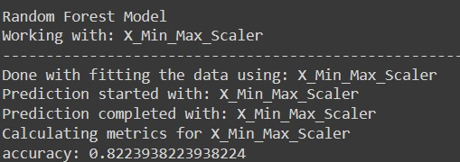
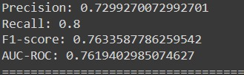

Case 2 - Face_recognisation
Decision Tree Model | Random Forest Model
Observed accuracy - Roc-curve - | Observed accuracy - Roc-curve -

Slide 24
Conclusion
The selected parameters are one of the best for studying the similarity among two images and classifying. Using heatmap gave us an idea about correlation among the parameters.
We observe that in Case where a deepfake software (ROOP) is used the accuracy is comparatively low as compared to the Case with overlapping of images (face_recognisation) has been done. This can be because of various reasons as-
Deepfake software, like ROOP, often utilizes advanced machine learning techniques(GAN etc.) to generate realistic and convincing data. The complexity of the generated data makes it more challenging for a model to correctly distinguish between real and fake instances, resulting in lower accuracy.

Slide 25
Future Work
With the help of improved hardware and cloud storage with good load of GPU, large dataset can be used to train the dataset for improving the accuracy of the model.
The accuracy obtained using is relatively low but can be improved by increasing the size of the training dataset for real images and deepfakes.
Feature extraction methods can be applied to the data frame such as SIFT (Scale-Invariant Feature Transform), SURF (Speeded Up Robust Features) instead of CNN to see the response of the model.
Several other parameters for similarity among images can be deployed for analysis.
Different Models can be used for training such as – Support Vector Machine(SVM) can be used along with kernals method which helps SVM operate in higher-dimensional spaces, capturing non-linear patterns that might exist in the face data since Face recognition tasks often involve non-linear relationships between facial features.

Slide 26
References :
[1] “ Wagner, T. L., & Blewer, A. (2019). “The word real is no longer real”: Deepfakes, gender, and the challenges of AI-Altered video. Open Information Science, 3(1), 32–46
[2] Le, B., Tariq, S., Abuadbba, A., Moore, K., & Woo, S. (2023) . Why Do Facial Deepfake Detectors Fail? In Proceedings of the 2nd Workshop on Security Implications of Deepfakes and Cheapfakes (pp. 24-28).
[3] Akhtar, Z. (2023). Deepfakes Generation and Detection: A Short Survey. Journal of Imaging, 9(1), 18.
[4] Guarnera, L., Giudice, O., & Battiato, S. (2023). Level up the deepfake detection: a method to effectively discriminate images generated by gan architectures and diffusion models. arXiv preprint arXiv:2303.00608.
[5] Sara, U., Akter, M., & Uddin, M. S. (2019). Image quality assessment through FSIM, SSIM, MSE and PSNR—a comparative study. Journal of Computer and Communications, 7(3), 8-18.
[6] Nilsson, J., & Akenine-Möller, T. (2020). Understanding ssim. arXiv preprint arXiv:2006.13846.
[7] Wang, R., Juefei-Xu, F., Ma, L., Xie, X., Huang, Y., Wang, J., & Liu, Y. (2019). Fakespotter: A simple yet robust baseline for spotting ai-synthesized fake faces. arXiv preprint arXiv:1909.06122.

Slide 27
[10] 1909.06122.Channappayya, S. K. M. S. S. Multiscale-SSIM Index Based Stereoscopic Image Quality Assessment.
[11] Palubinskas, G. (2017). Mystery behind similarity measures MSE and SSIM. In 2014 IEEE International Conference on Image Processing (ICIP) (pp. 575-579). IEEE.
[12] Malkauthekar, M. D. (2013). Analysis of Euclidean distance and Manhattan distance measure in Face recognition. In Third International Conference on Computational Intelligence and Information Technology (CIIT 2013) (pp. 503-507). IET.
[13] Pu, Y., Wang, W., & Xu, Q. (2012, June). Image change detection based on the minimum mean square error. In 2012 Fifth International Joint Conference on Computational Sciences and Optimization (pp. 367-371). IEEE.
[14] Khormali, A., & Yuan, J. S. (2021). Add: Attention-based deepfake detection approach. Big Data and Cognitive Computing, 5(4), 49.
[15] s0md3v. (n.d.). ROOP. Retrieved from https://github.com/s0md3v/roop [14-11-2023] ; 14 November, 2023
[16] Neupane parlad, Deep-fake Detection Using OpenCV and MTCNN, retrieved from - https://pub.towardsai.net/deep-fake- detection-using-opencv-and-mtcnn-833625abdd03; 11 November,2023.
[17] Sean Benhur,Towards Data Science retrieved from - https://towardsdatascience.com/a-friendly-introduction-to-siamese -n networks-85ab17522942; 14 November, 2023.
[18] Vishesh Yadav, Celebrity face image dataset, Kaggle, retrieved from - https://www.kaggle.com/vishesh1412/celebrity-face- image-dataset

Slide 28
Thank you!

