Slide 1
Is my phone hacked?
How can I make sure it is not?
Akriti Upadhyay (205120007)

Slide 2
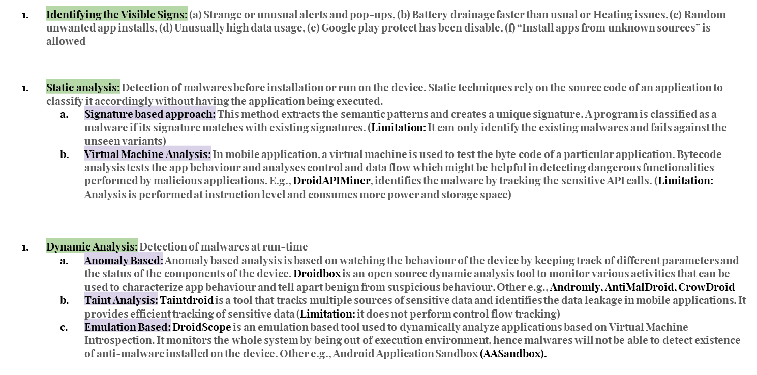

Slide 3
