Slide 1
LULC CHANGE DETECTION OF SATELLITE IMAGES
OF TWO DIFFERENT IMAGES
GRAPHIC ERA DEMMED UNIVERSITY, DEHRADUN
BACHELOR OF TECHNOLOGY
IN
COMPUTER SCIENCE & ENGINEERING
SUBMITTED BY:AKRITI SHARMA
UNIVERSITY ROLL NO.: 2018651
MENTOR NAME:Mr. HEMANT Singh Pokhriya

Slide 2
LULC CHANGE DETTECTION OF SATETILLITE IMAGES OF TWO DIFFERENT DATE
INTRODUCTION:-
The "LULC Change Detection of Different Image Satellites" project is based on deep learning. This project uses deep learning to solve this problem. It provides advantages such as easier operation and greater control of land cover and land use data. Land cover refers to the physical structure of the earth's surface, represented by the distribution of vegetation, water, soil and other physical elements.
We are currently at the edge of having public and continuous access to satellite image data for Earth observation. Governmental programs such as ESA’s Coper-nicus and NASA’s Landsat are taking signiﬁcant efforts to make such data freely available for commercial and non-commercial purpose with the intention to fuel innovation and entrepreneurship.
Land use and land change have become an important part of current strategies for managing natural resources and monitoring environmental change. Observing the Earth from space is now as important as natural resources for understanding human activities over time.
The aim of land use and land cover classiﬁcation is to automatically provide labels describing the represented physical land type or how a land area is used (e.g., residential, industrial)

Slide 3
LULC CHANGE DETECTION OF SATELLITE IMAGES OF TWO DIFFERENT DATES
OBJECTIVE:
Land Use and Land Cover (LULC) change detection using satellite images of two different dates is a common and valuable application in remote sensing and GIS (Geographic Information System). The objective of such a project can be multifaceted, and here are some key goals and components you might consider:
Identify Changes in Land Use and Land Cover: The primary goal is to detect and quantify changes in land use and land cover between the two dates of satellite imagery. This includes changes in urbanization, agricultural land, forests, water bodies, etc.
Temporal Analysis: Analyze the temporal dynamics of land cover changes. Understanding when and how quickly changes occur can provide insights into the rate of urban expansion, deforestation, or other land-use transformations.
Accuracy Assessment: Validate the accuracy of the change detection results. This involves comparing the classified land cover changes with ground truth data or higher-resolution imagery to ensure the reliability of the findings.
Generate Change Maps: Create visual representations of land cover changes, such as change maps, highlighting areas of transformation. These maps can be used for communication and decision-making.
Quantify Change Magnitude: Quantify the extent and magnitude of changes in different land cover classes. This can involve calculating the percentage change in each land cover type or identifying hotspots of significant change.
Impact Assessment: Investigate the potential impacts of land cover changes on the environment, ecosystems, and human activities. Understand the consequences of these changes for biodiversity, water resources, climate, and urban development.

Slide 4
LULC CHANGE DETECTION OF SATELLITE IMAGES OF TWO DIFFERENT DATE
PROBLEM STATEMENT:-
In recent years, the rapid urbanization, climate change, and anthropogenic activities have led to significant alterations in the land use and land cover patterns within [your study area]. Understanding the spatiotemporal dynamics of these changes is critical for sustainable land management, environmental conservation, and informed decision-making by local authorities and policymakers. However, there is a lack of up-to-date and accurate information on the extent, magnitude, and nature of land cover changes in the region.
This project aims to address the following challenges:
Identifying Land Use and Land Cover Changes: Lack of comprehensive information regarding the changes in land use and land cover between [date 1] and [date 2] hinders our ability to understand the evolving landscape.
Quantifying the Impact of Urbanization and Human Activities: The increasing urbanization and human activities are suspected to be major contributors to land cover changes, but the specific impacts and their extent remain unclear.
Environmental Consequences: The consequences of land cover changes on the environment, including effects on biodiversity, water resources, and climate, are not well-studied and understood.
Illegal Activities and Environmental Violations: There is a need to detect and document instances of illegal activities, such as deforestation, unauthorized construction, or land-use changes that may violate environmental regulations.
Data Integration and Holistic Understanding: Limited integration of satellite imagery data with other relevant datasets prevents us from obtaining a holistic understanding of the factors influencing land cover changes and their interconnected impacts.

Slide 5
LULC CHANGE DETECTION OF SATELLITE IMAGES OF TWO DIFFERENT DATES
METHODOLOGY:-
Implementing a deep learning-based methodology for Land Use and Land Cover (LULC) change detection involves several key steps. Here is a generalized outline for such a project:
1. Data Collection and Preprocessing:
a. Satellite Imagery Acquisition:
- Obtain satellite imagery for the two different dates of interest. Ensure compatibility in terms of resolution, spectral bands, and geographic coverage.
b. Data Preprocessing:
- Perform radiometric and atmospheric correction to enhance image quality.
- Georeferenced the images to a common coordinate system.
- Split the images into smaller tiles or patches for efficient processing.
2. Labeling and Ground Truth Generation:
a. Manual Labeling:
- Manually label a subset of the images to create ground truth data for training and validation.
- Label land cover classes such as urban areas, forests, water bodies, etc.

Slide 6
LULC CHANGE DETECTION OF SATELLITE IMAGES OF TWO DIFFERENT DATE
METHODOLOGY:-
b. Data Augmentation:
- Augment the labeled dataset to increase its size and diversity. This helps improve the model's ability to generalize.
3. Deep Learning Model Selection:
a. Architecture Choice:
- Choose a suitable deep learning architecture for image classification. Convolutional Neural Networks (CNNs) are commonly used for this purpose.
b. Transfer Learning:
- Consider using pre-trained models (e.g., ResNet, VGG, or MobileNet) for feature extraction. Fine-tune the model on the labeled dataset for LULC change detection.
4. Dataset Splitting:
-Divide the labeled dataset into training, validation, and testing sets. Ensure a balanced representation of different land cover classes in each set.
5. Model Training:
-Train the deep learning model using the training dataset.

Slide 7
LULC CHANGE DETECTION OF SATELLITE IMAGES OF TWO DIFFERENT DATE
METHODOLOGY:-
6. LULC Change Detection:
a. Image Differencing:
- Apply the trained model to classify land cover in images from the two different dates.
- Perform pixel-wise differencing to identify changes between the classified images.
b. Post-Processing:
- Apply morphological operations to refine the detected changes and eliminate small artifacts.
- Consider temporal filtering to enhance the temporal consistency of the change map.
7. Validation and Accuracy Assessment:
-Compare the predicted changes with ground truth data or higher-resolution imagery to assess the accuracy of the model.
Utilize metrics such as precision, recall, F1 score, and overall accuracy for evaluation.
8. Visualization and Interpretation:
-Visualize the LULC change map and generate summary statistics. Interpret the results in the context of the study area's characteristics and known events.
9. Documentation and Reporting:
-Document the methodology, including parameters, datasets, and results. Prepare a comprehensive report summarizing the LULC change detection findings and their implications.

Slide 8
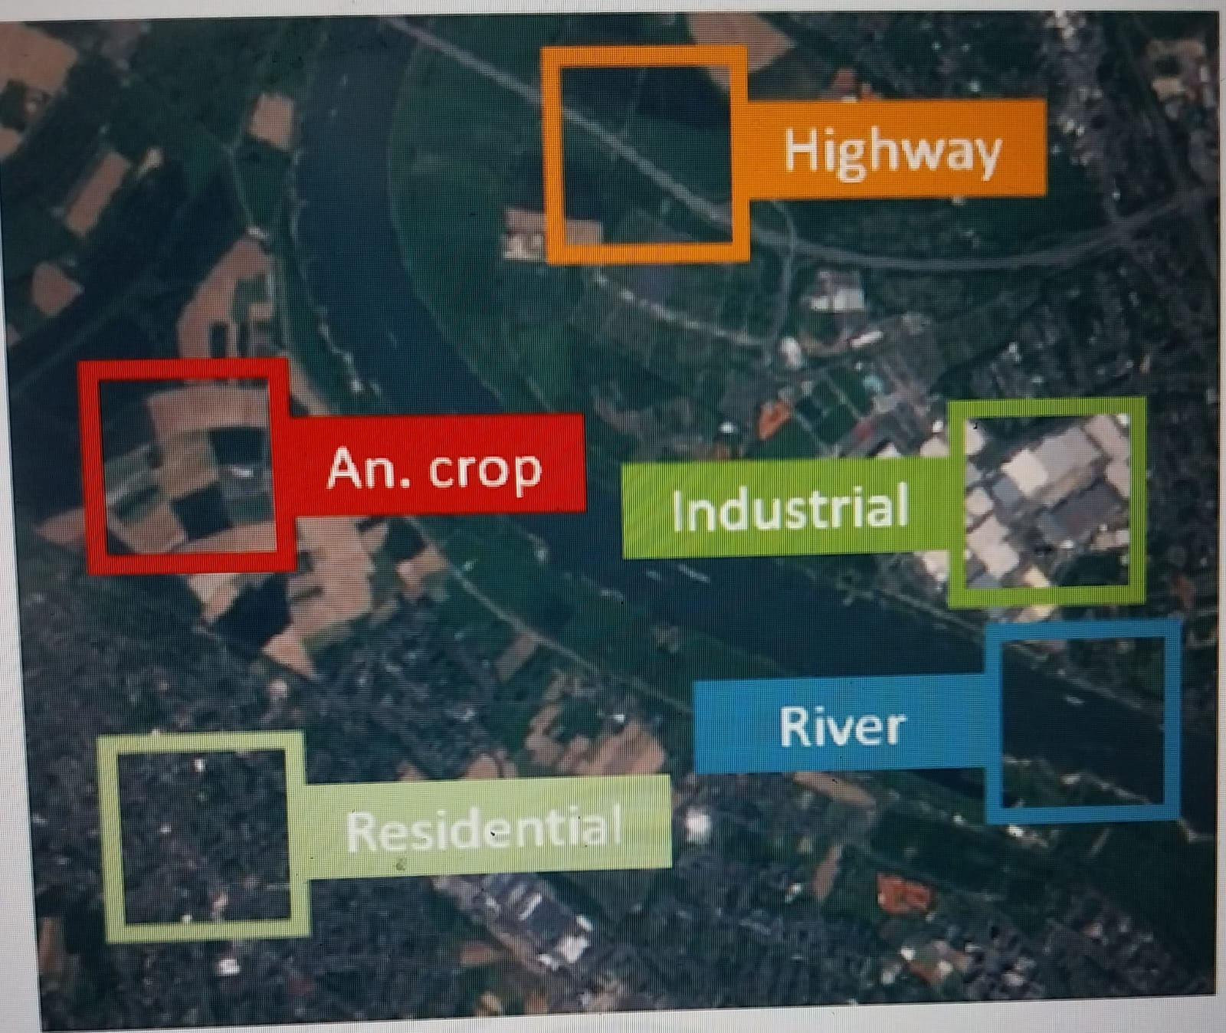
LULC CHANGE DETECTION OF SATELLITE IMAGES OF TWO DIFFERENT DATES
RESULT AND DISCUSSION:-
We believe that combining large amounts of satellite data with powerful machine learning will impact future research. Therefore, one of our main research goals is to use machine learning-based access to big data. To create the image distribution dataset, we performed the following two steps:
1) Acquisition of satellite images: As shown in Figure 5, we collected satellite images of European cities distributed over more than 34 countries.
2) Creating the dataset: Based on the received satellite images, we created a dataset containing 27,000 georeferenced and labeled image blocks. The image block size is 64x64 pixels and is controlled manually.
Fig 1-
Land use and land cover classiﬁcation based onSentinel-2 satellite images.
Patches are extracted with the purpose to identify the shown class.
This visualization highlights the classes annual crop, river, highway,
industrial buildings and residential buildings

Slide 9
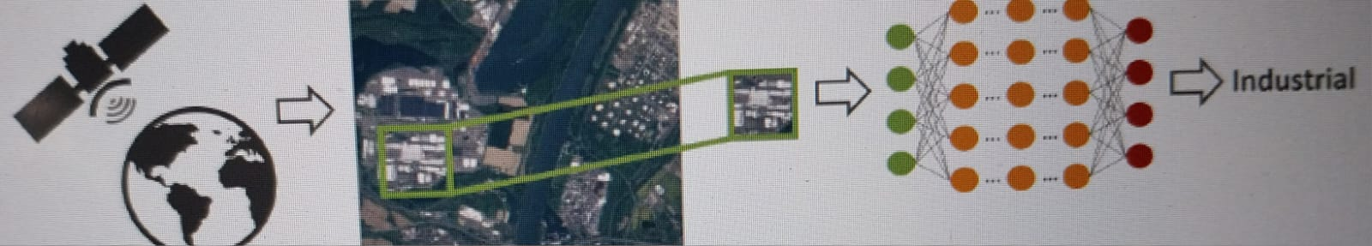
lulc change detection of satellite images of two different dates
RESULT AND DISCUSSION:-
From above diagram we can say that, this illustration shows an overview of the patch-based land use and land cover classiﬁcation process using satelliteimages. A satellite scans the Earth to acquire images of it. Patches extracted out of these images are used for classiﬁcation.The aim is to automatically provide labels describing the represented physical land type or how the land is used. For thispurpose, an image patch is feed into a classiﬁer, in this illustration a neural network, and the classiﬁer outputs the class shownon the image patch.

Slide 10
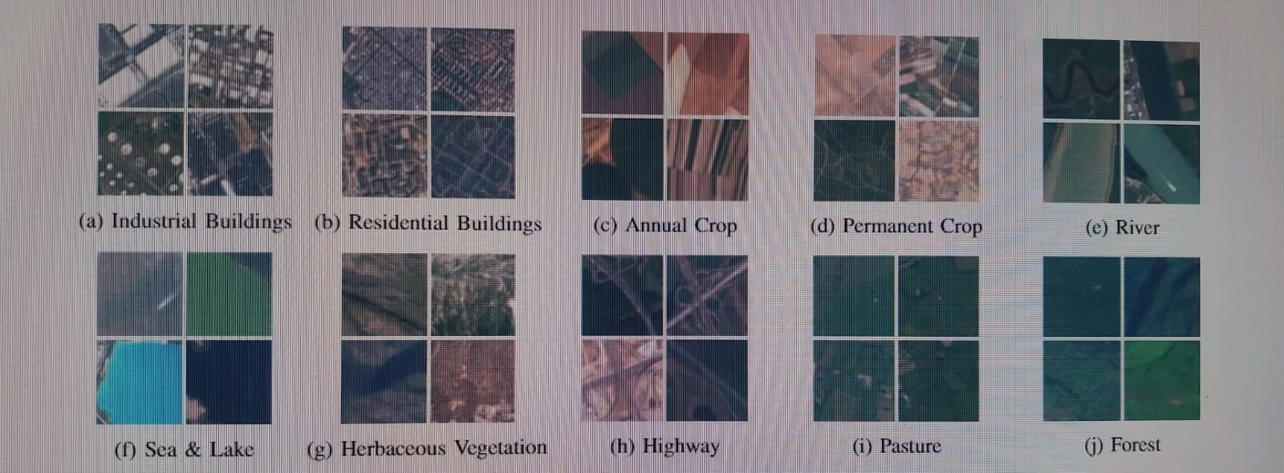
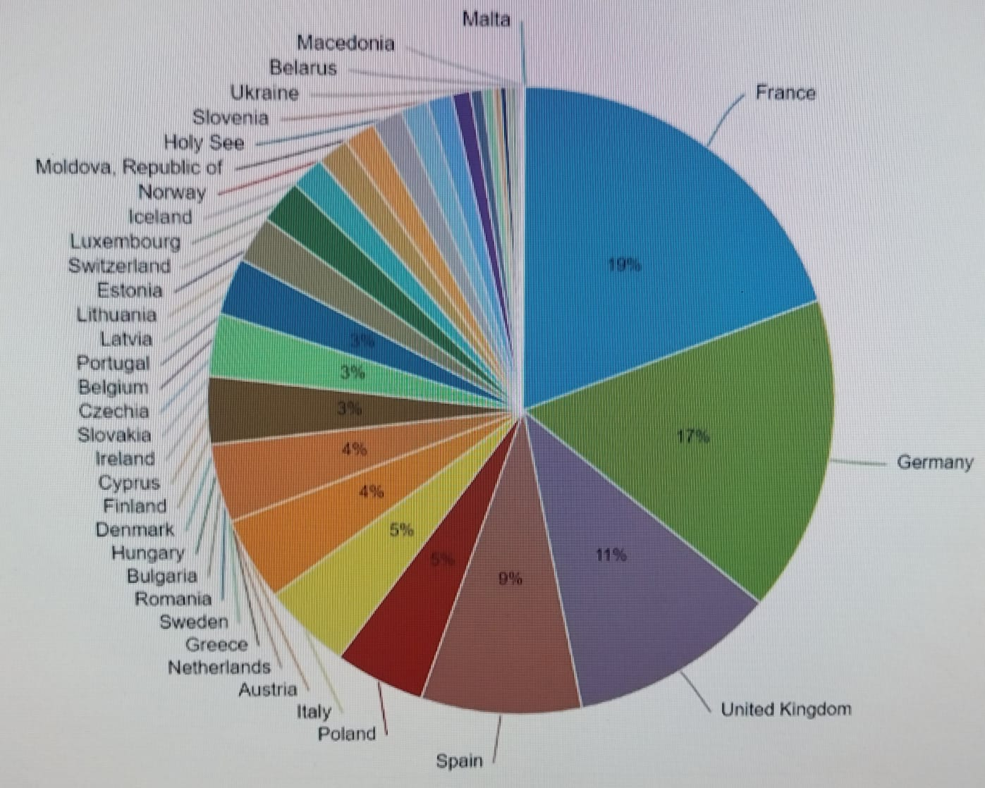
lulc change detection of satellite images of two different date
RESULT AND DISCUSSION:-
From these two figures we can say that, This overview shows sample image patches of
all 10 classes covered in the proposed EuroSAT dataset. The images measure 64x64 pixels.
Each class contains 2,000 to 3,000 image. In total, the dataset has 27,000 geo-referenced
images. EuroSAT dataset distribution. The georeferenced images are distributed all over
Europe. The distribution is inﬂuenced by the number of represented cities per country
in the European Urban Atlas.

Slide 11
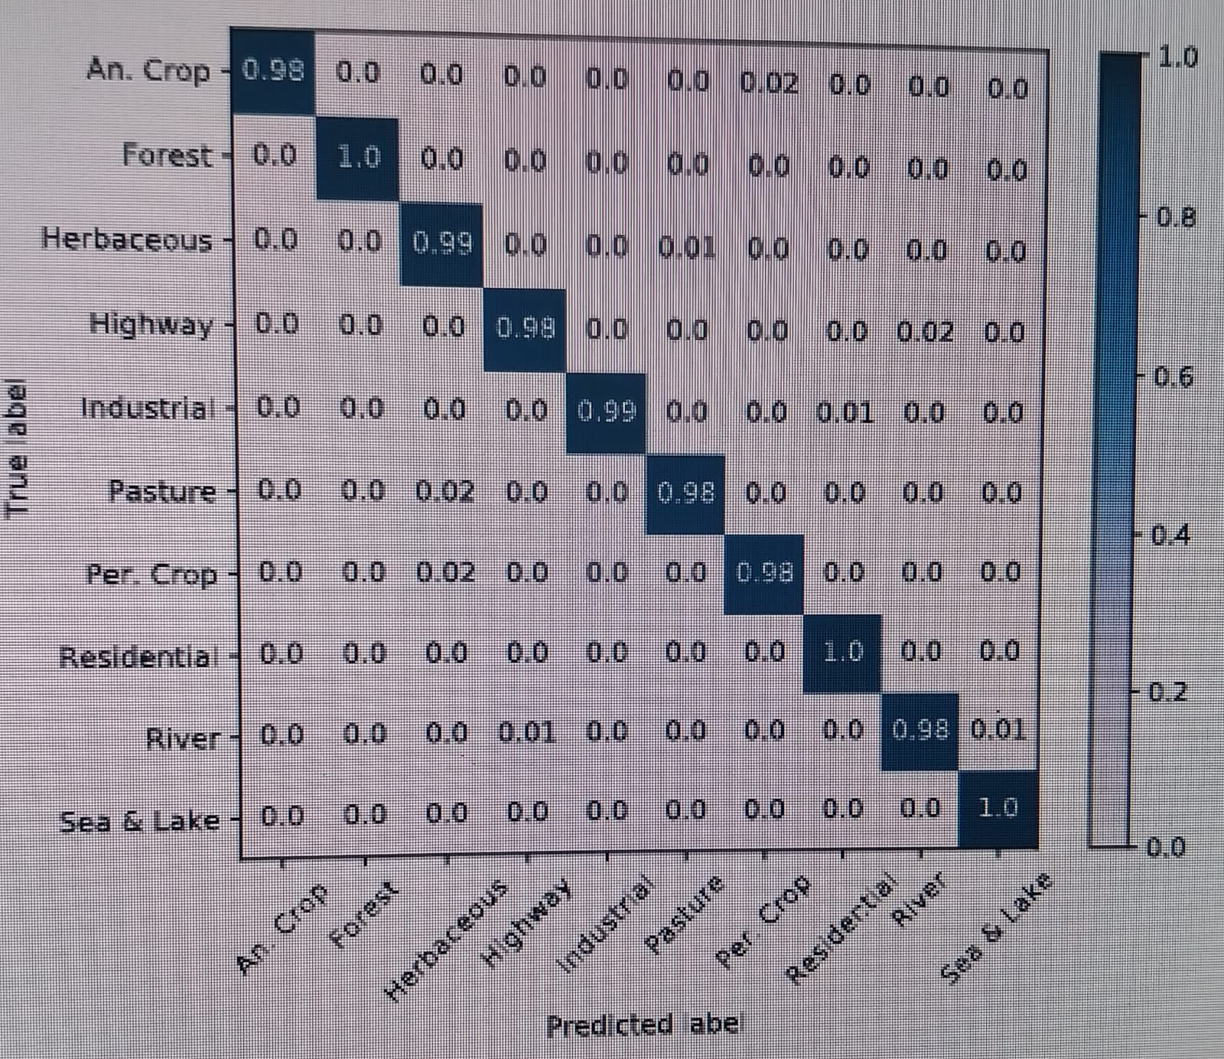
LULC CHANGE DETECTION OF SATELLITE IMAGES OF TWO DIFFERENT DATE
Confusion matrix of ResNet-50 CNN
fine-tuned against Euro SAT data
prepared using satellite images in
RGB color space.
In order to evaluate the performance of
deep CNNs using single-band images as
well shortwave-infrared and color
infrared band combinations, we used
the pertained ResNet-50with a ﬁxed
training-test split to compare the
performance of the different spectral
Bands.

Slide 12
LULC CHANGE DETCTIION OF SATELLITE IMAGES OF TWO DIFFERENT DATES
CONCLUSIN :-
CONCLUSION
In this article we cover the issues of land use and land cover distribution. For this study, we present new information based on remote sensing satellite images. To obtain this information, we used publicly and freely available Sentinel-2 satellite images from the Earth observation program Copernicus.
The prepared data consists of 10 groups containing 13 different spectral bands, a total of 27,000 labels and geographical maps. We provide benchmarks for these data and their spectral bands using state-of-the-art deep convolutional neural networks (CNN). For this new data, we analyzed the performance of 13 different spectral bands.
Test results show that the RGB band combination has an overall classification accuracy of 98.57%, which is better than the shortwave infrared and color infrared band combination, and the classification is better than any single test. Overall, free Sentinel-2 satellite imagery has many uses.
This work is an important first step in using the large amounts of satellite data available for machine learning to monitor Earth's terrain at scale. The information provided can be used in many real-world applications. Potential applications include land use and landscape modification or map enhancement.

Slide 13
LULC CHANGE DETECTION OF SATELLITE IMAGE OF TWO DIFFERENT DATE
THANK YOU

