Slide 1
No-show prediction
Abdulkareem Alanazi
AYAD AL HARBI
Ghassan Alrehaili
Yasser Kaoor

Slide 2
OUTLINE
1. Introduction
2. Workflow
3. Solutions
4. Challenges
5. Tools
6. Conclusion

Slide 3
1.0 INTRODUCTION
About us
Problem statement

Slide 4

2.0 Workflow
EDA
Modeling
Deployment

Slide 5

2.1
EDA
DATASET
CLEANING DATA
ANALYSIS

Slide 6


Kaggle
Dataset
Original Features
New Features
PatientId
AppointmentID
Gender
ScheduledDay
AppointmentDay
Age
appointment_time
This dataset of a hospital in Brazil contains:
110,527 rows , 14 columns.
sameday
Neighbourhood
Scholarship
sameweek
Hipertension
samemonth
Diabetes
age_group
Alcoholism
Handcap
SMS_received
No-show

Slide 7

CLEANING DATA
- Remove negative values.
- Remove wrong entry data.
- Change features to appropriate type .
- Drop features.
- Extracting new features.

Slide 8
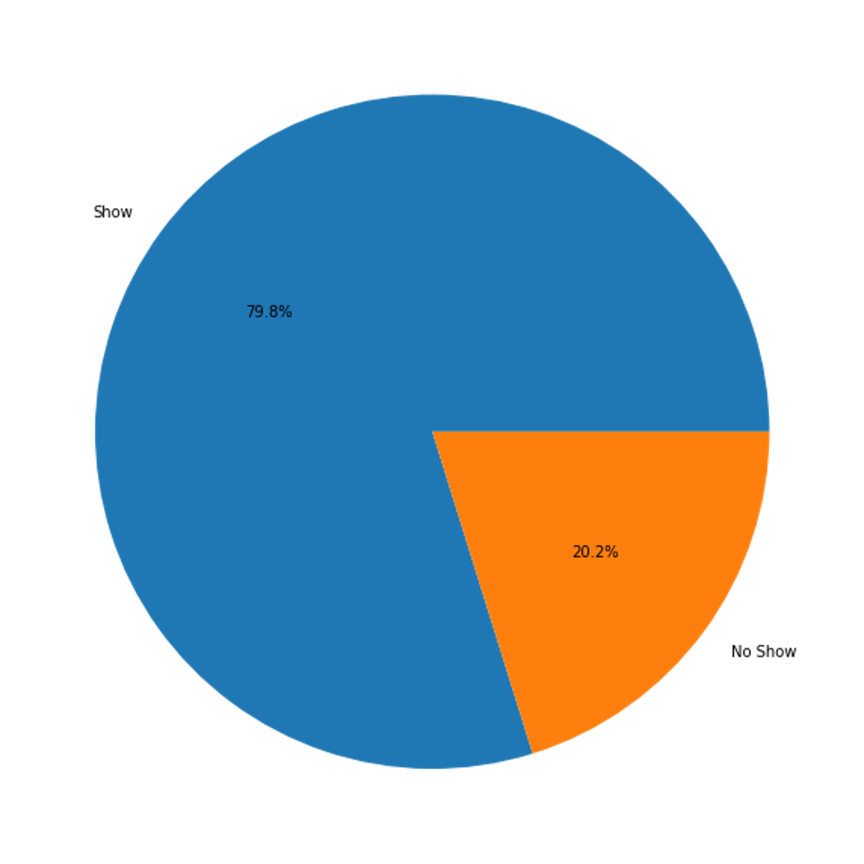
Analysis

Slide 9
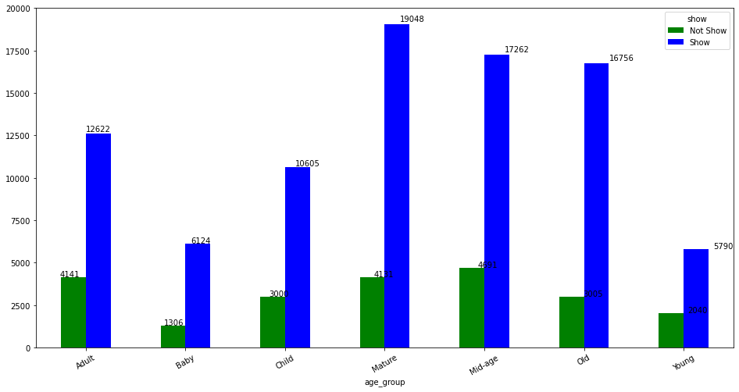
Analysis

Slide 10
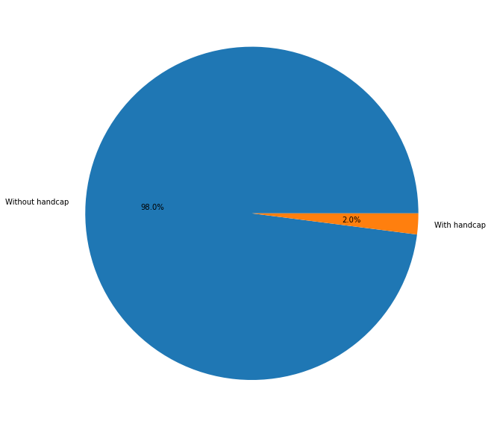
Analysis

Slide 11
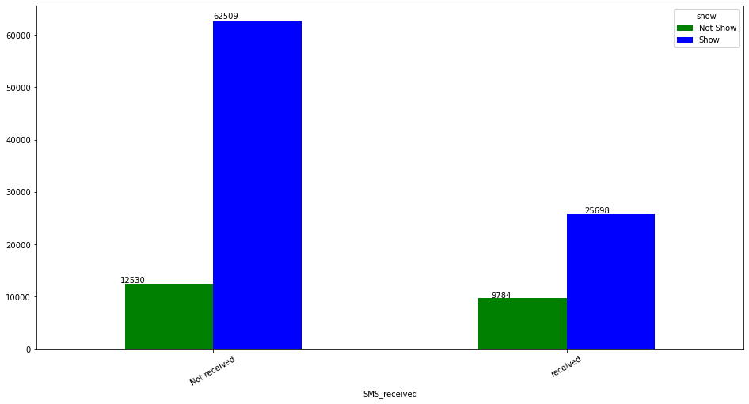
Analysis

Slide 12
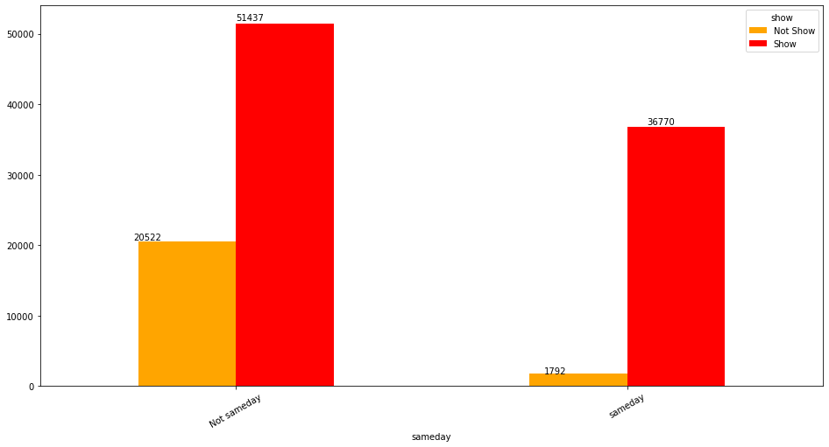
Analysis

Slide 13
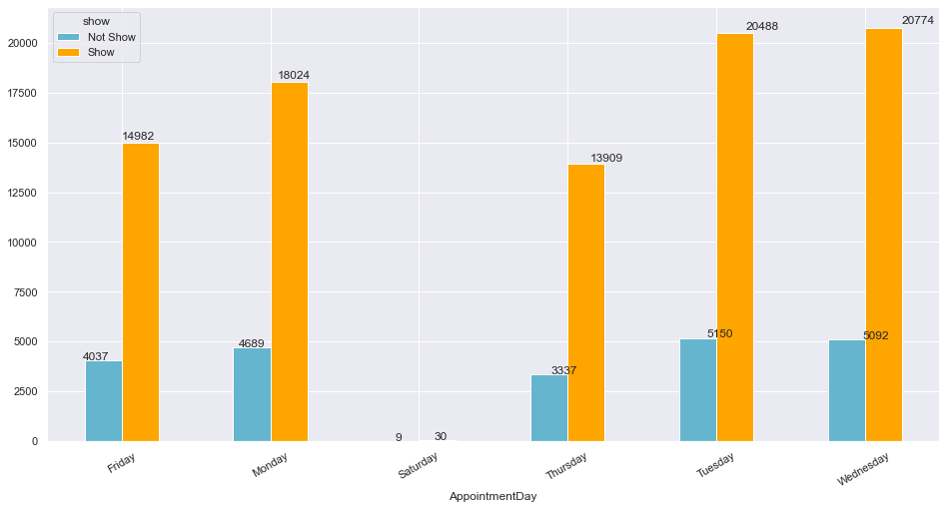
Analysis

Slide 14
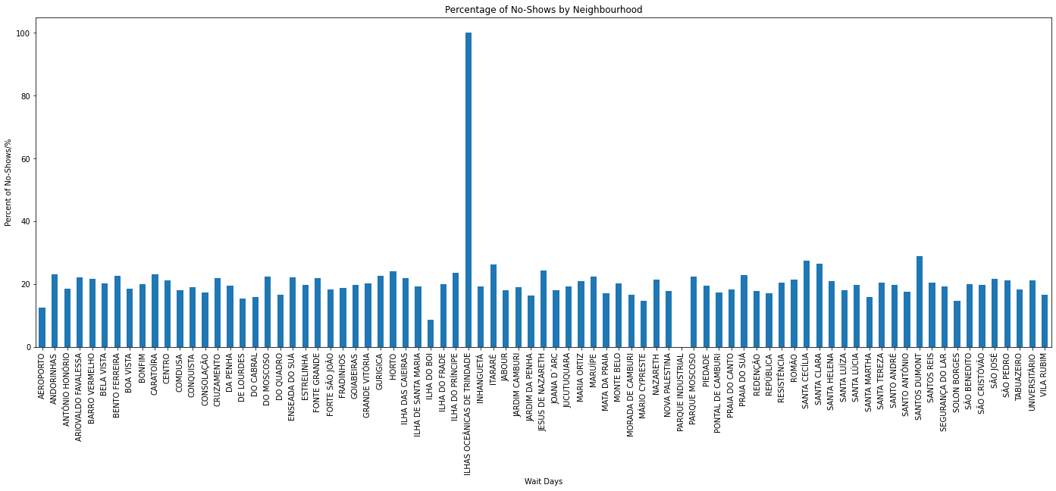
Analysis

Slide 15

2.2
Modeling
FEATURES SELECTION
ALGORITHMS

Slide 16
2.2
Modeling
Age Appointment Time

Slide 17
2.2
Modeling
Algorithms:
KNN
Logistic
Decision Tree
Random Forest
XGBoost
Stacking

Slide 18
2.2
Modeling
Algorithms:
KNN
Logistic
Decision Tree
Random Forest
XGBoost
Stacking
-
3706
TN
771
FP
Actual Show
+
8557
FN
9071
TP
-
+
Predicted Show
Best Model: Random Forest (max depth = 7, number of trees = 20)
Evaluation Metric: Precision
Balancing: Oversampling
Cost Reduction ≈ 82.7%

Slide 19

2.3
Deployment

Slide 20
3.0 Solutions
First
Second
Third
Patients who do not attend, we send the message back to them a day or two before.
The difference between the day of booking and the day of attending the appointment, preferably not more than a week.
Reduce waiting time and make it suitable for no-show prediction.

Slide 21
4.0 Challenges
1- Computational time
2- Deployment
3- Features selection
4- SVM

Slide 22






5.0 Tools
Google colab
Pandas
Visualization
Sklearn
Numpy
Xgboost
Matplotlib ,Seaborn ,Plotly
Classification models

Slide 23

6.0 Conclusion
Take advantage of no-show time.
Solutions for remote neighborhoods(De Trindade neighborhood).
Reducing the number of shift hours on days with low attendance.

Slide 24
THANKS!
Do you have any questions?

