Slide 1


Courses Analysis
EDA Project
By Abdulkareem Alanazi

Slide 2
Outline
Value
About Data
Problem Questions
Problem Solutions
Challenges
Conclusion
Tools

Slide 3

Value
Profit Average 102, 000 SR

Slide 4
About Data
Sample
10,000 Course
Features
16 Feature
Sample Range
2011 - 2020
Source
Kaggle website:
https://www.kaggle.com/jilkothari/udemy-courses-development

Slide 5
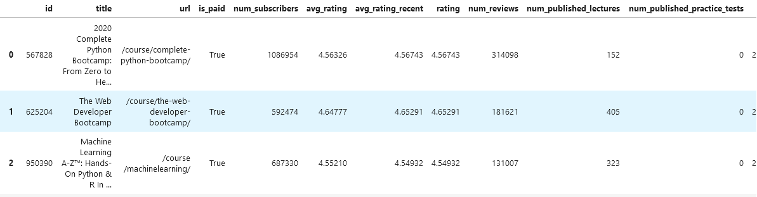
About Data

Slide 6
Problem Questions
Q1
what is the most development topic that the users interested in?
Q2
is the number of lectures make difference?
2
Q3
is the bootcamps courses have more subscribers?
2
3
Q4
Q5
what the popular category over years?
4
Q6
is there relation between price and subscribers?

Slide 7
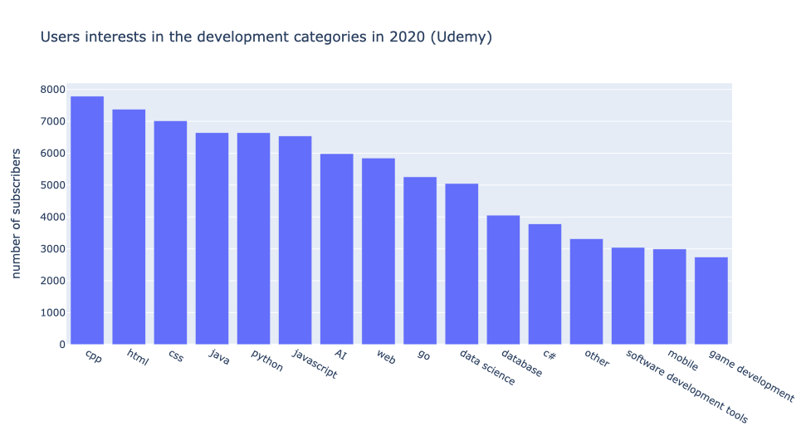
Problem Solutions
Q1: what is the most development topic that the users interested in?

Slide 8
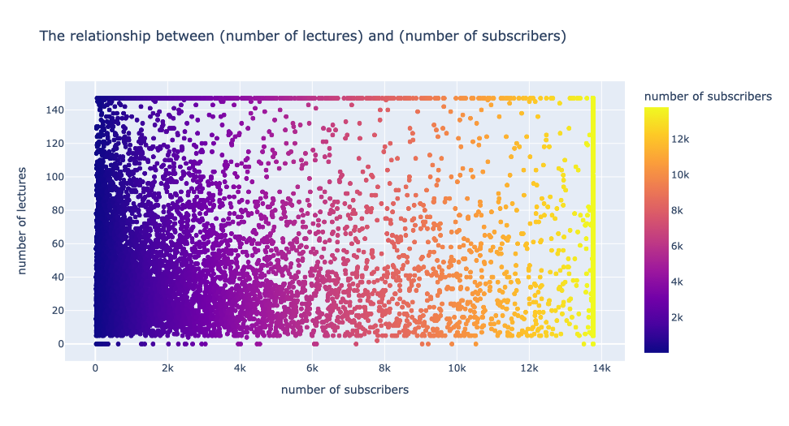
Problem Solutions
Q2: is the number of lectures make difference?

Slide 9
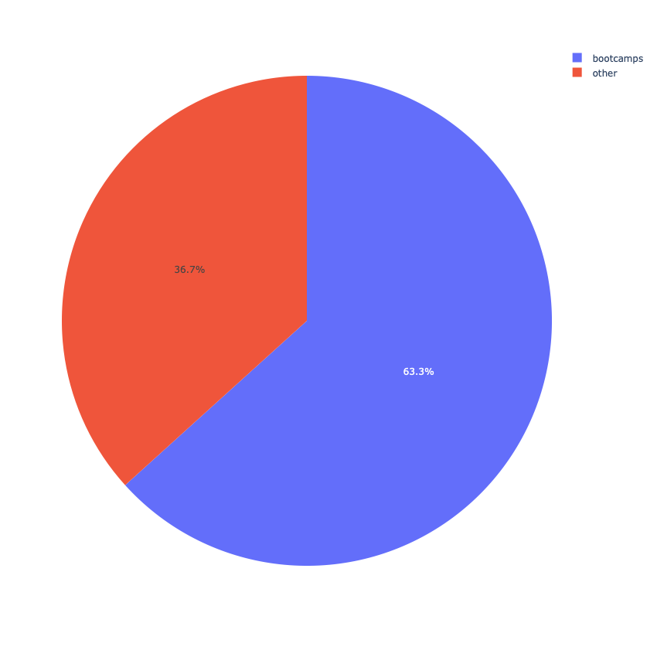
Problem Solutions
Q3: is the bootcamps courses have more subscribers?

Slide 10
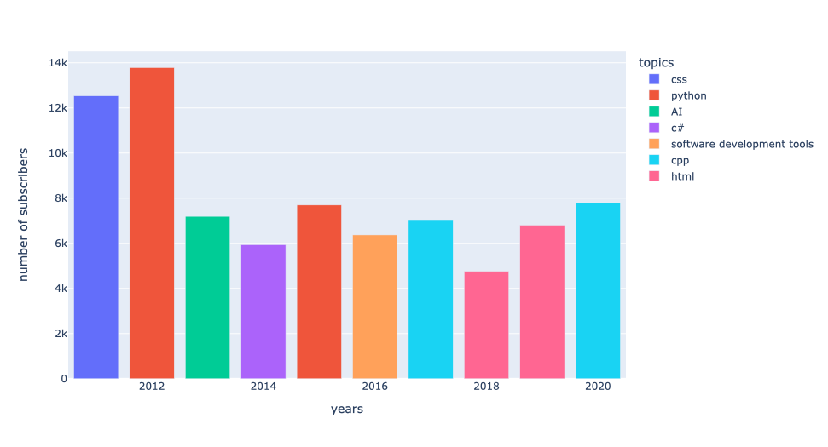
Problem Solutions
Q4: what the popular category over years?

Slide 11
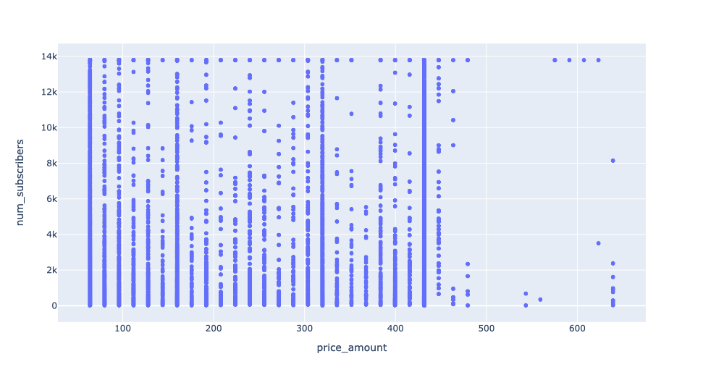
Problem Solutions
Q5: is there relation between price and subscribers?

Slide 12
Challenges
Extract Categories From Course Title
Plotting Graphs
Plotly Library Used
Title
The Web Developer Bootcamp
Title
Categories
The Web Developer Bootcamp
Web

Slide 13
Conclusion
01
Focus on specific trending category
Web applications and its languages javascript, HTML, CSS.
02
Bootcamps
Most of the users focus on bootcamps courses.
03
Number of lectures and prices not matter that much

Slide 14
Tools
Jupyter
Python (Numpy, Pandas, Matplotlib, Seaborn, Plotly)
Power Point

Slide 15
Thank you
For Listening

