Slide 1

U.S. Firefighter Fatalities Analysis, 2000 – 2015
Angela Krontiris

Slide 2
Introduction
What will this project deliver?
Insight into the causes of firefighter fatalities:
What is the leading cause of firefighter fatalities?
Are certain job types or age groups impacted more than others?
If so, then what is the number one type of death related to the leading cause?
Is there anything that can be done to improve the health and safety of firefighters?

Slide 3
Introduction (Cont’d)
How will the analysis be performed?
Analysis performed with Python
Packages used: Pandas, NumPy, Stats Model, Matplotlib, Seaborn
Dataset: Firefighter Fatalities in the U.S. (2000 – 2015) acquired from kaggle.com
Where to access project code?
GitHub: https://github.com/akront1104/Capstone_Project_Firefighter_Fatalities.git

Slide 4
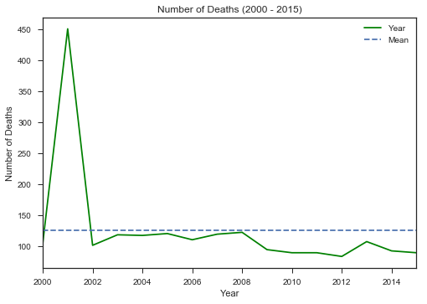
Number of Firefighter Deaths Per Year
In 2001, 343 out of 451 deaths reported were from the September 11 attacks. Average death count for all causes between 2000 – 2015 is 125.

Slide 5
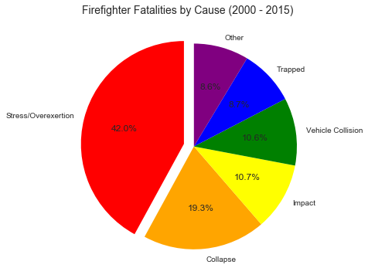
What is the leading cause of firefighter fatalities?
Other includes: Fall, Exposure, Disorientation, Assault, Smoke, Unknown, and Contact
42% of firefighter fatalities are due to overexertion and stress.

Slide 6
Firefighter Fatalities by Job Type
Job Type | Number of Deaths
Career | 953
Volunteer | 880
Wildland Full-Time | 46
Wildland Contract | 40
Wildland Part-Time | 35
Paid-on-Call | 26
Part-Time (Paid) | 16
Industrial | 6
Total | 2002
Highest Rates of Death
Career | 48%
Volunteer | 44%
Notes:
chi-square or anova test to check statistical significance between volunteer and career

Slide 7
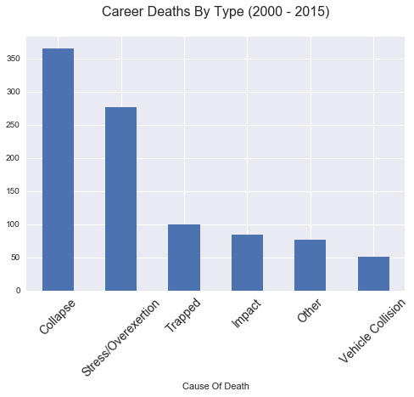
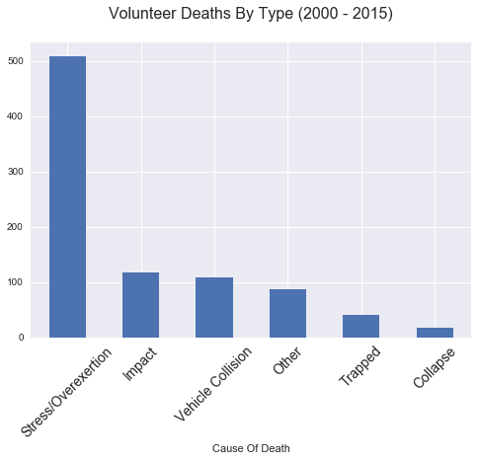
What is the most common cause of death for a Career and Volunteer firefighter?
The most common cause of death for Career and Volunteer firefighters is overexertion and stress. The problem is greater among Volunteer firefighters. This has been a consistent trend each year, except for 2001. In 2001, a major cause of death for Career firefighters was collapse, which is most likely due to the 9-11 attacks.

Slide 8
What is the leading type of death due to Stress and Overexertion?
Career Stress
Volunteer Stress
Nature Of Death | Count
Heart Attack | 241
Stroke | 23
Other | 8
Heat Exhaustion | 3
Unknown | 1
Nature Of Death | Count
Heart Attack | 472
Stroke | 29
Other | 4
Heat Exhaustion | 3
Unknown | 1
Leading Type of Death
Notes:
Background on career and volunteer. For volunteers, how often are they called. They could have other jobs while volunteering

Slide 9
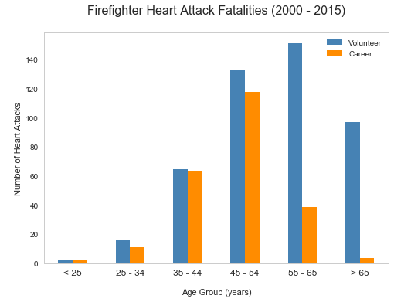
Between what ages is it likely for Career and Volunteer firefighters to have a heart attack?
For both Career and Volunteer firefighters, most heart attack deaths occurred among persons aged 45 – 54 years.

Slide 10
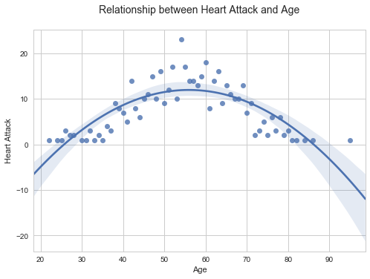
Is there a correlation between heart attack and age?
The maximum number of heart attack fatalities is between 45 – 65 years of age. After 65, the graph begins to decrease. Most Career firefighters retire after 65 years of age, which explains why it decreases after that point. Firefighters under 40 years old are typically in better shape and healthier, which is why the number of heart attack fatalities is lower in the 25 – 40 range.
Notes:
How to quantify polynomial correlation? How strong is the fit between age and heart attack? Shorten text. Bullet points.

Slide 11
Statistical Analysis
Chi-square test to validate the relationship between heart attack and age
Age Group
 | < 25 | 25 – 34 | 35 – 44 | 45 – 54 | 55 – 65 | > 65
# Career Heart Attack | 3 | 11 | 64 | 118 | 39 | 4
# Volunteer Heart Attack | 2 | 16 | 65 | 138 | 151 | 97
P-value (significance level of 0.05) | 0.65 | 0.34 | 0.93 | 0.34 | 4.46e-16 | 2.17e-20
P-value < 0.05
The relationship between the number of Career and Volunteer heart attack fatalities aged 55 and up is statistically significant.

Slide 12
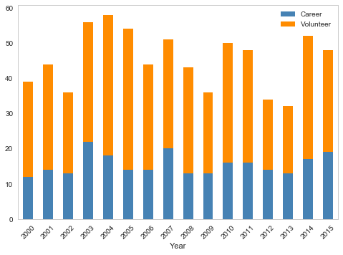
Has the heart attack death rate decreased after the Heart-Healthy Firefighter Program was implemented?
About the Program
In 2003, the National Volunteer Fire Council (NVFC) launched the Heart-Healthy Firefighter Program to reduce the number of firefighter deaths from heart attack. The program provides firefighters with fitness and nutritional education.
7% decrease from 2003 – 2014
Notes:
2003 – 56 heart attacks, 2014 – 52 heart attacks. Compare 10 years later, not much change. There are no consistent changes in heart attack fatalities for both Career and Volunteer firefighters after the Heart-Healthy Firefighter program was implemented in 2003.
Time Series – staistical analysis of all years.

Slide 13
Summary
Each year, an average of 125 firefighters die in the line of duty from a variety of causes including, but not limited to, extreme physical exertion, underlying medical conditions, and structural collapse. Heart attack remains the leading cause of firefighter line-of-duty deaths.
During 2000 – 2015, there was a total of 953 career and 880 volunteer firefighters fatalities. 42% of fatalities were caused by stress and overexertion.
The median age was 55 years (range: 19 – 95 years) for volunteers and 48 years (range: 20 – 74 years) for career firefighters.
For both volunteer and career firefighters, most heart attack deaths occurred among persons aged 45 – 54 years.
The majority of heart attack deaths were attributed to stress and overexertion in both volunteer (93%) and career (87%) firefighters.
While the NYFD have taken steps to improve firefighters health and safety, we still see a high proportion of deaths due to cardiac issues.

Slide 14
What to do Next?
Recommendation:
Implement a behavioral component to the Heart-Healthy Firefighter program. Behavioral intervention can improve the firefighters relative health status or help change their stage of readiness. The program should be mandatory for all firefighters.
Excerpts backing up recommendation:
“Firefighters experience a number of work-related stressors and repeated exposure to traumatic events that can put them at even greater risk of suffering from behavioral health issues, such as anxiety and depression.” Excerpt From: U.S. Fire Administration. “Critical Health and Safety Issues in the Volunteer Fire Service.”
In an article about firefighter heart health, NFFF Executive Director Ronald Siarnicki noted: “If more firefighters are aware of their potential risks for cardiovascular disease and receive guidance on how to manage their lifestyles, the fire service may continue to see fewer incident-related deaths… There will always be incidents that are beyond our control, and there will continue to be line-of-duty deaths, but when there is something like this that can be corrected, it just makes sense to take those preventative steps.”
More information on behavioral interventions and why they are key to any health program: https://www.ncbi.nlm.nih.gov/books/NBK25527/

