Slide 1
QA manual lesson #8
60 min
Created by Nataliia Postyka
Test design.
Bug.
Interview Q&A.

Slide 2
Test design techniques
Equivalence Class Partitioning
Boundary Value Analysis (BVA)
Decision Table based testing.
State Transition
Error Guessing
Equivalence Class Partitioning
Equivalent Class Partitioning allows you to divide set of test condition into a partition which should be considered the same. The concept behind this technique is that test case of a representative value of each class is equal to a test of any other value of the same class. It allows you to Identify valid as well as invalid equivalence classes.
Example: Consider that the input values are valid between -5 to 15 and 55 to 65.
Therefore the test conditions created will have 3 equivalence classes-
— to 4 (invalid)
5 to 15 (valid)
16 to 54 (invalid)
55 to 65 (valid)
66 to — (invalid)
Therefore, you can now select test cases according to one value from each class, i.e., 1, 6, 38, 61 and 90

Slide 3
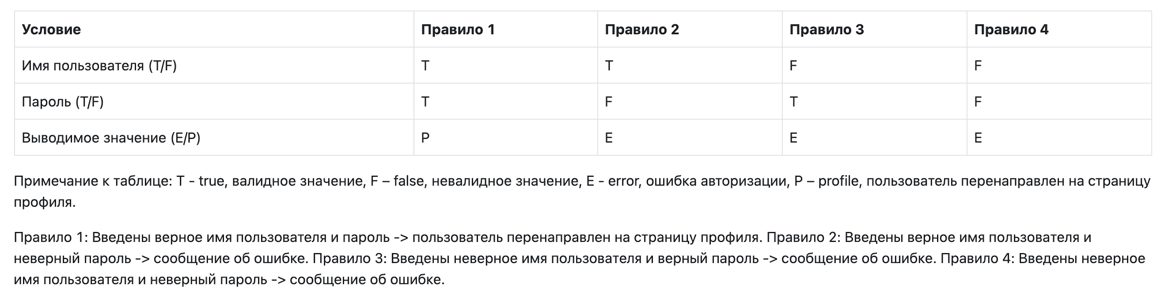
Boundary Value Analysis (BVA)
Boundary value analysis is based on testing at the boundaries between partitions. It includes maximum, minimum, inside or outside boundaries, typical values and error values.(Boundary value is an input or value on the border of an equivalence partition.)
Example: Input condition is valid between 1 to 10 -> Boundary values 0,1,2 and 9,10,11
Decision Table Based Testing.
A decision table is also known as to Cause-Effect table. This software testing technique is used for functions which respond to a combination of inputs or events. For example, a submit button should be enabled if the user has entered all required fields.
The first task is to identify functionalities where the output depends on a combination of inputs. If there are large input set of combinations, then divide it into smaller subsets which are helpful for managing a decision table.
For every function, you need to create a table and list down all types of combinations of inputs and its respective outputs. This helps to identify a condition that is overlooked by the tester.

Slide 4
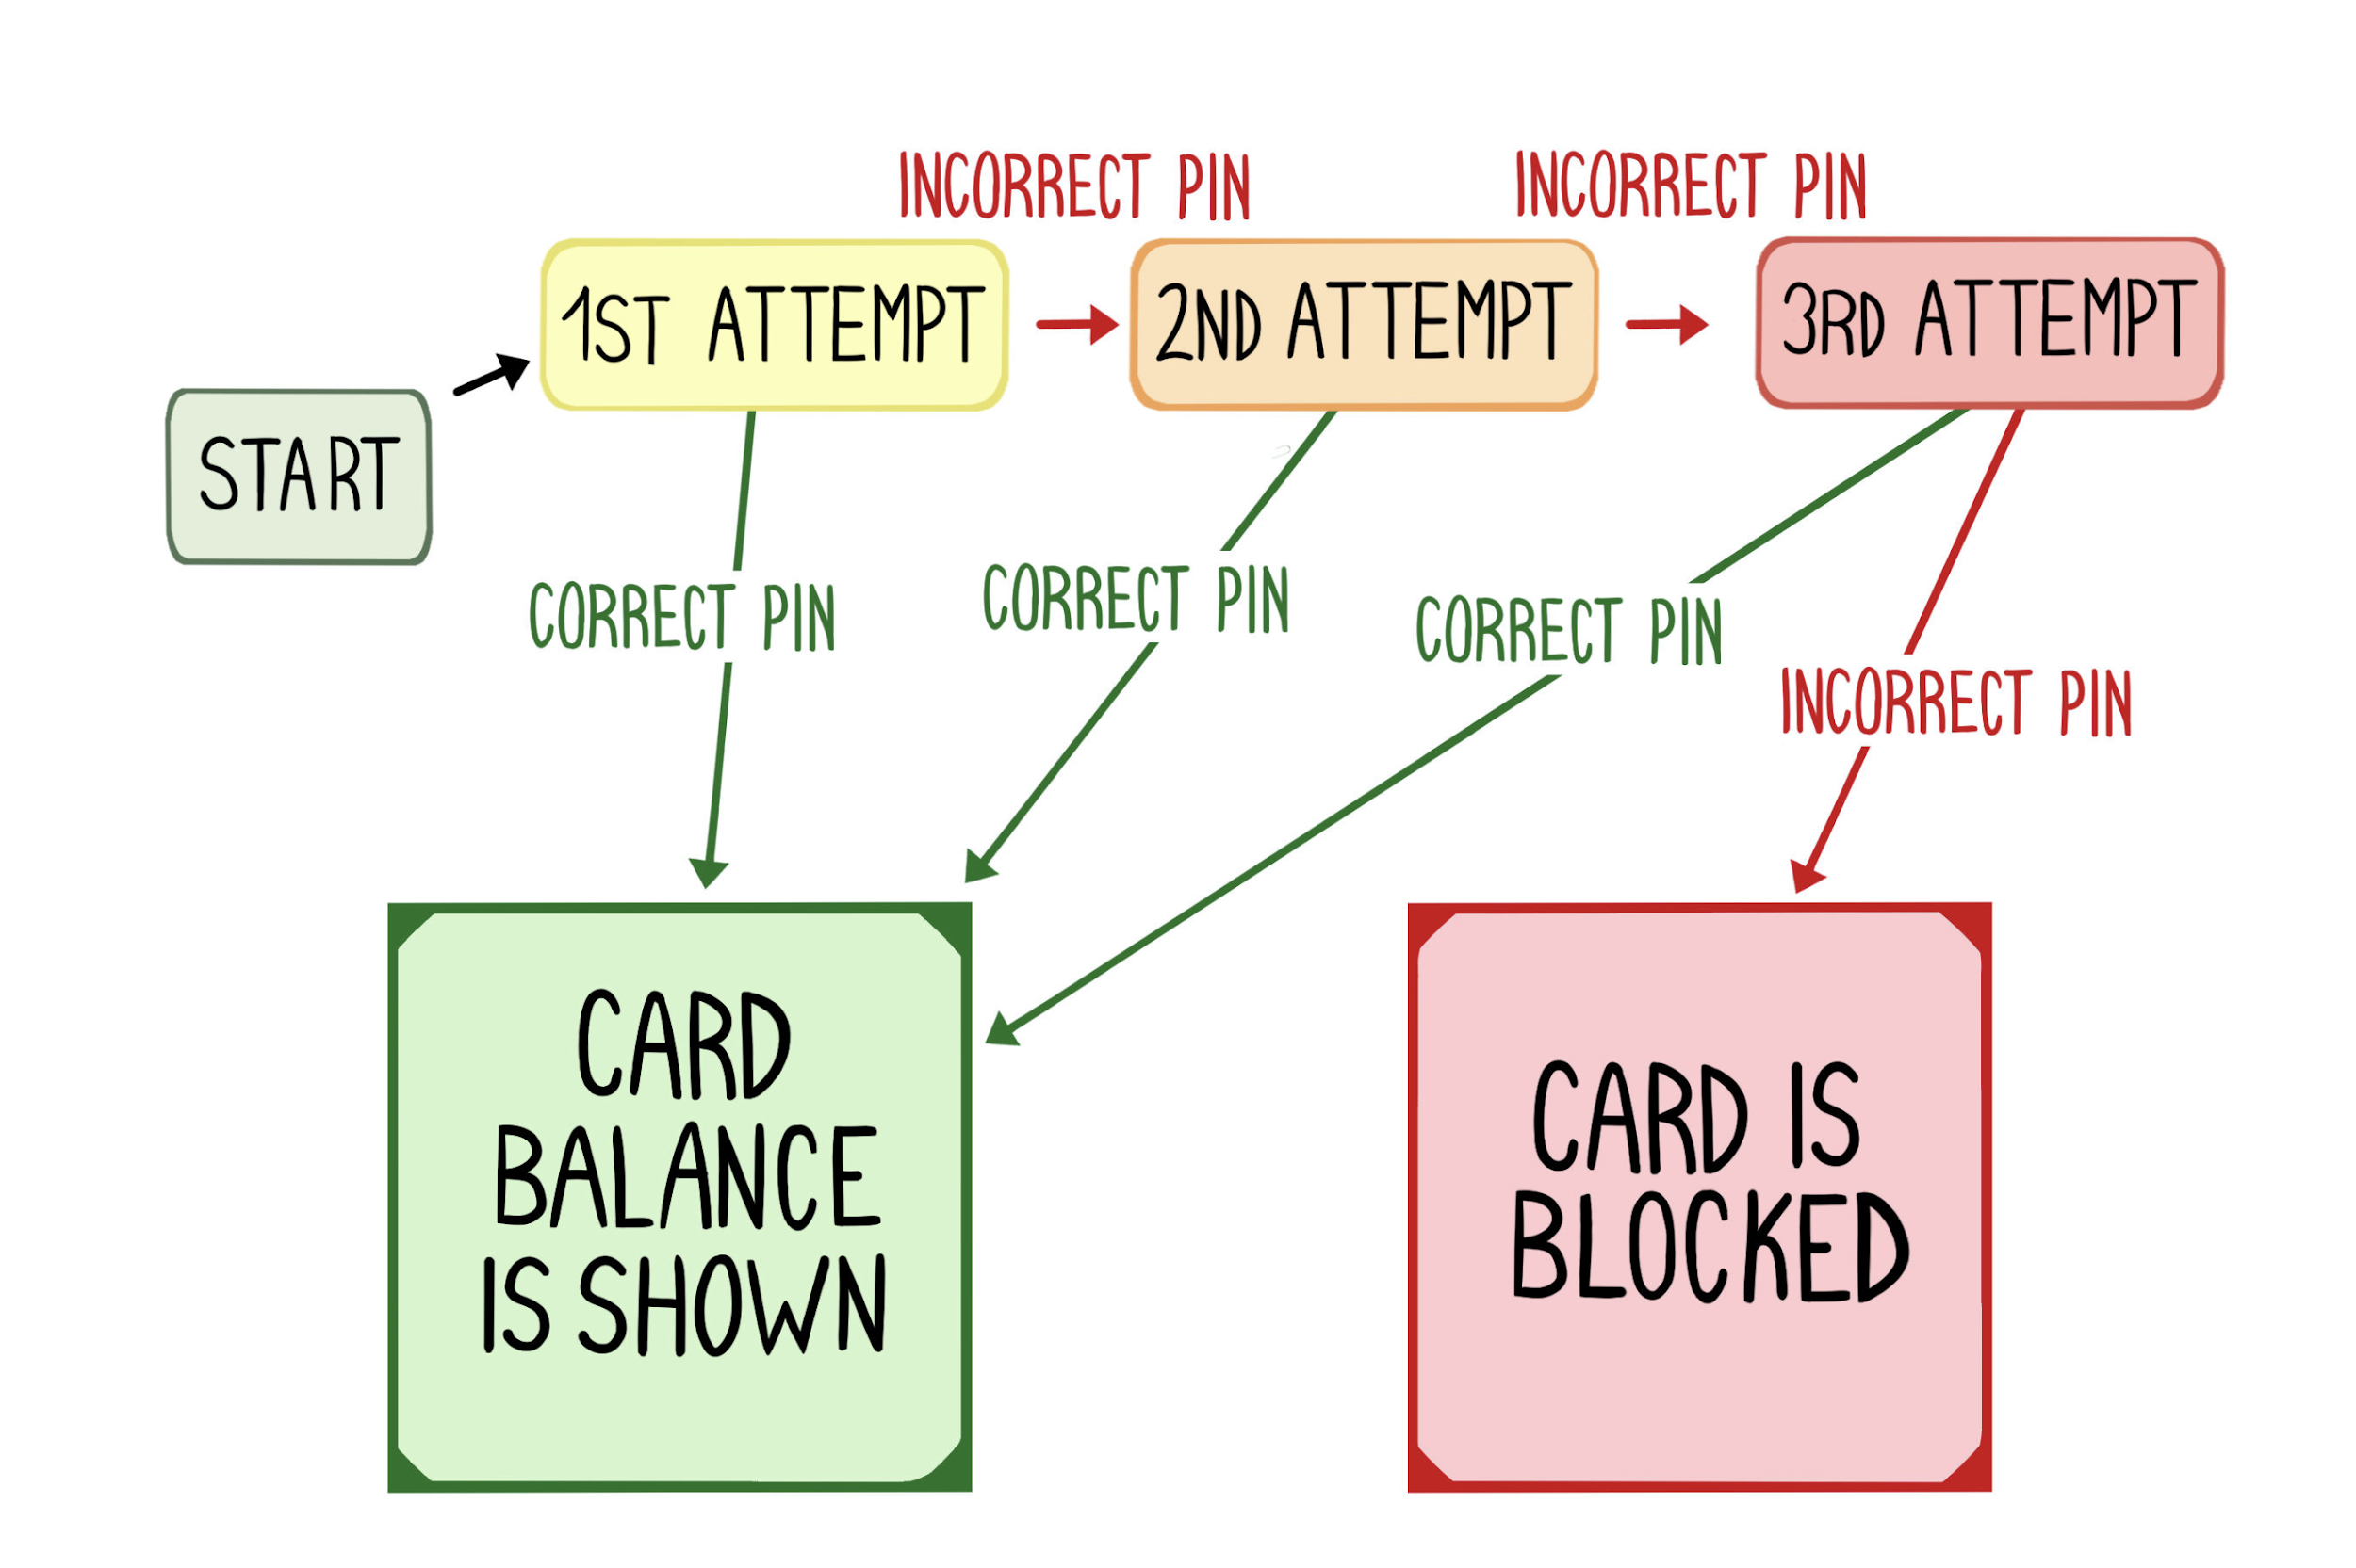
State Transition
In State Transition technique changes in input conditions change the state of the Application Under Test (AUT). This testing technique allows the tester to test the behavior of an AUT. The tester can perform this action by entering various input conditions in a sequence. In State transition technique, the testing team provides positive as well as negative input test values for evaluating the system behavior.
Guideline for State Transition:
State transition should be used when a testing team is testing the application for a limited set of input values.
The technique should be used when the testing team wants to test sequence of events which happen in the application under test.
Example:In the following example, if the user enters a valid
password in any of the first three attempts the user will be able to
login successfully. If the user enters the invalid password in the first or second try, the user will be prompted to re-enter the password. When the user enters password incorrectly 3rd time, the action has taken, and the account will be blocked.

Slide 5
Error Guessing
Error Guessing is a software testing technique based on guessing the error which can prevail in the code. The technique is heavily based on the experience where the test analysts use their experience to guess the problematic part of the testing application. Hence, the test analysts must be skilled and experienced for better error guessing.
The technique counts a list of possible errors or error-prone situations. Then tester writes a test case to expose those errors. To design test cases based on this software testing technique, the analyst can use the past experiences to identify the conditions.
Exploratory testing (Ad-hoc)
Technique (type) of software testing in which test cases are not created in advance, but the tester tests the application on the fly.
Pairwise Testing
Test design technique in which test cases are designed to perform all possible individual combinations of each pair of input parameters.

Slide 6
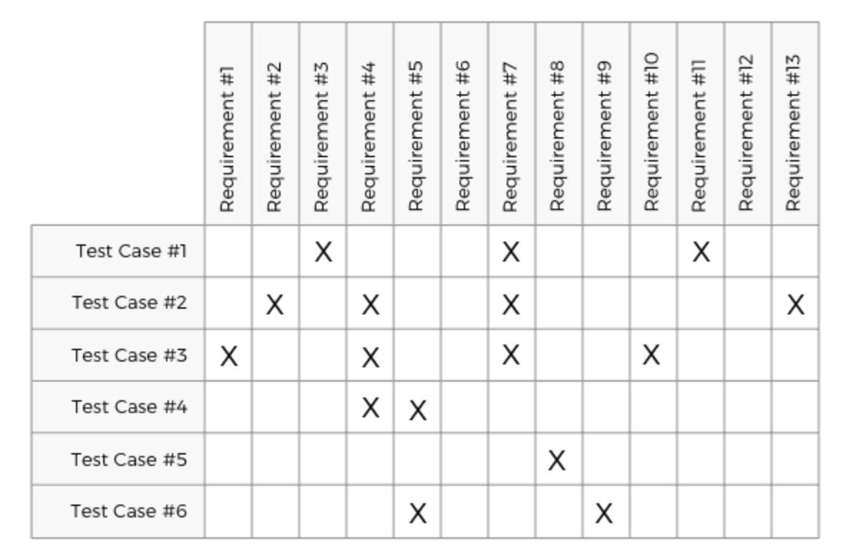
Requirement Traceability Matrix (RTM) is a document that maps and traces user requirement with test cases. It captures all requirements proposed by the client and requirement traceability in a single document, delivered at the conclusion of the Software development life cycle. The main purpose of Requirement Traceability Matrix is to validate that all requirements are checked via test cases such that no functionality is unchecked during Software testing.
Which Parameters to include in Requirement Traceability Matrix?
Requirement ID
Requirement # and Description

Slide 7
A software Bug could be something as menial as a misaligned image on a landing page, or as serious as a mobile app spontaneously crashing during use. Here are some explanations:
“A software bug is a problem causing a program to crash or produce invalid output. The problem is caused by insufficient or erroneous logic. A bug can be an error, mistake, defect or fault, which may cause failure or deviation from expected results.” (techopedia)
“A software bug is defined as an error, flaw, failure, or fault in a computer program or system that causes it to produce an incorrect or unexpected result, or to behave in unintended ways.” (steelkiwi)
“A Software DEFECT / BUG is a condition in a software product which does not meet a software requirement (as stated in the requirement specifications) or end-user expectation (which may not be specified but is reasonable). In other words, a defect is an error in coding or logic that causes a program to malfunction or to produce incorrect/unexpected results.” (softwaretestingfundamentals)

Slide 8
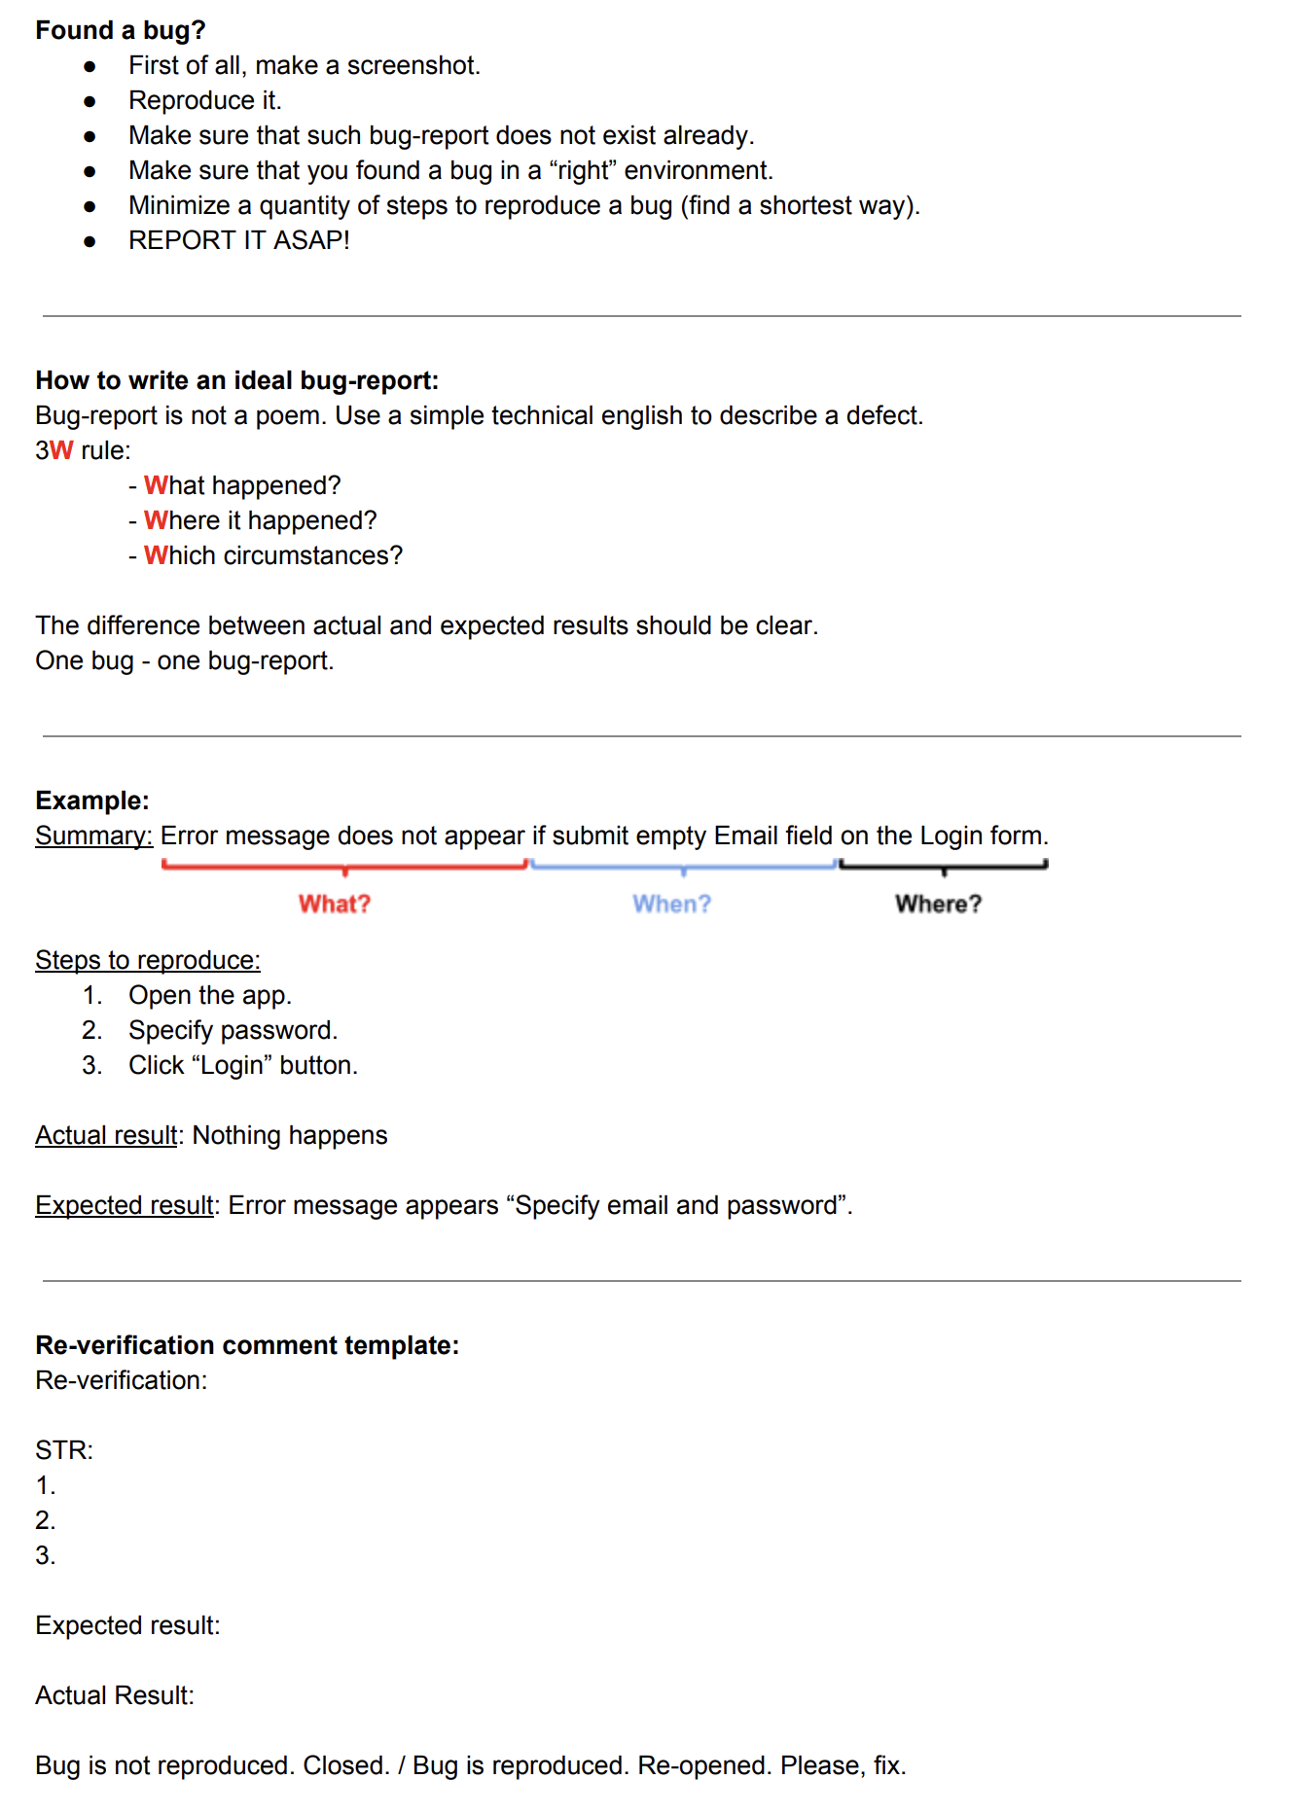

Slide 9
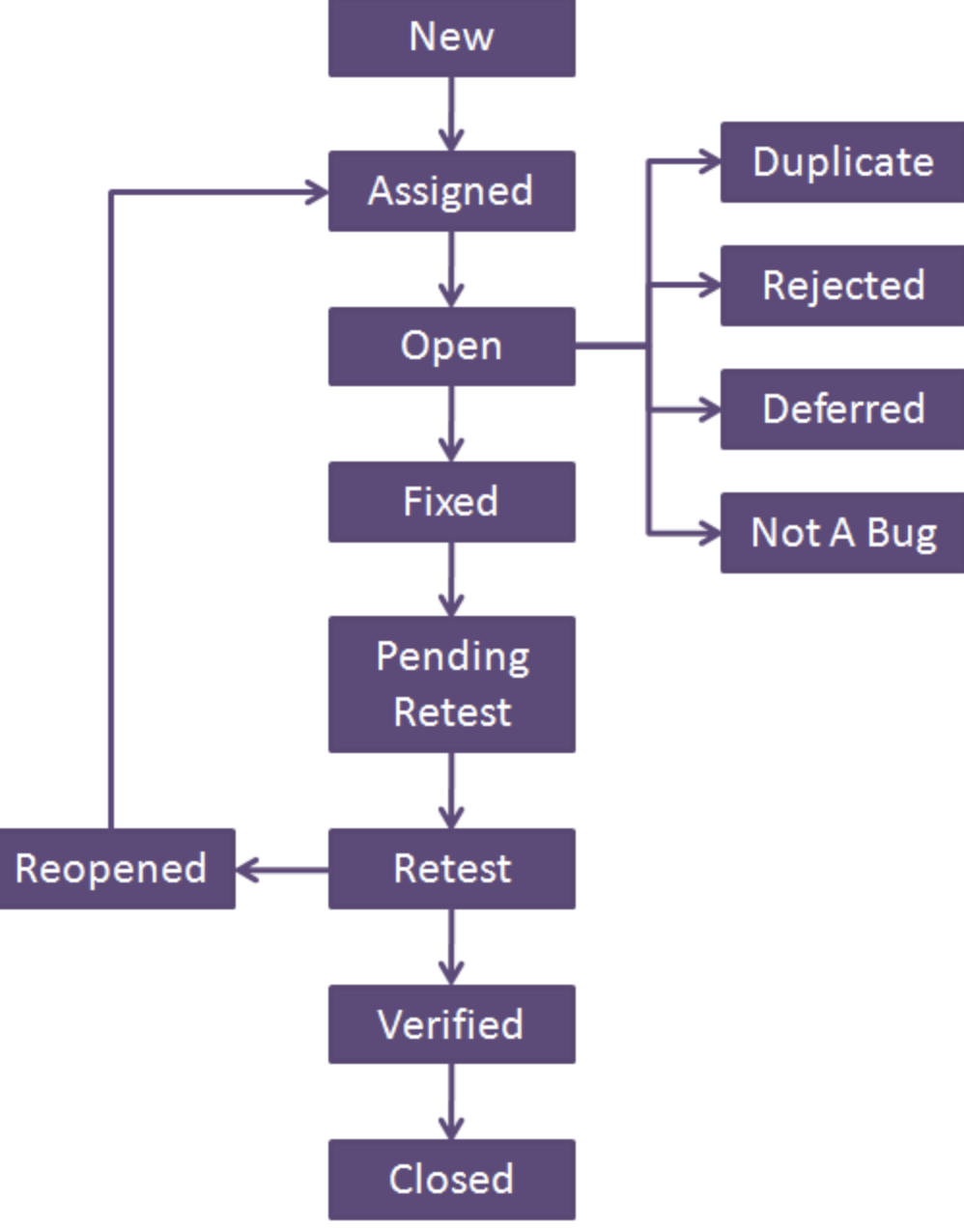
Defect States:
1) New: This is the first state of a defect in the defect life cycle. When any new defect is found, it falls in a ‘New’ state and validations and testing are performed on this defect in the later stages of the defect life cycle.
2) Assigned: In this stage, a newly created defect is assigned to the development team for working on the defect. This is assigned by the project lead or the manager of the testing team to a developer.
3) Open: Here, the developer starts the process of analyzing the defect and works on fixing it, if required. If the developer feels that the defect is not appropriate then it may get transferred to any of the below four states namely Duplicate, Deferred, Rejected or Not a Bug-based upon the specific reason.
4) Fixed: When the developer finishes the task of fixing a defect by making the required changes then he can mark the status of the defect as ‘Fixed’.
5) Pending Retest: After fixing the defect, the developer assigns the defect to the tester for retesting the defect at their end and till the tester works on retesting the defect, the state of the defect remains in ‘Pending Retest’.
6) Retest: At this point, the tester starts the task of working on the retesting of the defect to verify if the defect is fixed accurately by the developer as per the requirements or not.
7) Reopen: If any issue still persists in the defect then it will be assigned to the developer again for testing and the status of the defect gets changed to ‘Reopen’.
8) Verified: If the tester does not find any issue in the defect after being assigned to the developer for retesting and he feels that if the defect has been fixed accurately then the status of the defect gets assigned to ‘Verified’.
9) Closed: When the defect does not exist any longer then the tester changes the status of the defect to ‘Closed’.
FEW MORE:
Rejected: If the defect is not considered as a genuine defect by the developer then it is marked as ‘Rejected’ by the developer.
Duplicate: If the developer finds the defect as same as any other defect or if the concept of the defect matches with any other defect then the status of the defect is changed to ‘Duplicate’ by the developer.
Deferred: If the developer feels that the defect is not of very important priority and it can get fixed in the next releases or so in such a case, he can change the status of the defect as ‘Deferred’.
Not a Bug: If the defect does not have an impact on the functionality of the application then the status of the defect gets changed to ‘Not a Bug’

Slide 10
What is 'Defect Triage'?
Defect triage is a process where each bug is prioritized based on its severity, frequency, risk, etc. Triage term is used in the Software testing / QA to define the severity and priority of new defects.
Roles and Responsibilities of participants during 'Defect Triage.'
Test Team Leader
Scheduled bug triage meeting and send meeting notification for attendees.
Create a defect report and send it to all attendees before the meeting.
Assign priority and severity of the defects.
Give a presentation so that other members understand Root Cause of defect.
Every meeting note is captured and sent to meeting attendees.
Development Lead
Helps in the prioritization of the defects.
Discuss defect difficulty and explain the risk involved because of that defect.
Allocate work to fix defects to relevant developers.
Update the defect resolution and include development notes in case any information is missing or any additional information needed by developers.
Project Manager
Help in the prioritization of the defects.
Discuss the next iteration release date for QA.
Need to make sure that related user representatives are also invited to the bug triage meeting.
What happens during 'Defect Triage' Meeting?
Test Team leader sends out a bug report with the new defects. During the defect triage meeting, each defect is analyzed to see whether right priority and severity are assigned to it.
Priorities are rearranged if needed.
Defects are analyzed and evaluated by the degree of their severity.
This include discussion regarding the complexity of the defect, risks, rejection, reassignment of errors is done.
Updates are captured in bug tracking system.
The QA engineer will make the changes to each defect and discuss them with each attendee.
The "Comments" field is updated correctly by noting essential points of the meeting.
What is the outcome of the 'Defect Triage'?
At the end of every meeting, Defect Triage Metrics will be prepared and given to all the attendees. This report acts as the meeting minutes which will prove helpful for future meetings.

Slide 11
How much the bug is affecting the functionality of the application?
High Priority and Low Severity:
Company logo is not properly displayed on their website.
High Priority and High Severity:
Suppose you are doing online shopping and filled payment information, but after submitting the form, you get a message like "Order has been cancelled."
Low Priority and High Severity:
If we have a typical scenario in which the application get crashed, but that scenario exists rarely.
Low Priority and Low Severity:
There is a mistake like "You have registered success" instead of successfully, success is written.

Slide 12
What is a defect?
The variation between the actual results and expected results is known as defect.
If a developer finds an issue and corrects it by himself in the development phase then it’s called a defect.
What is a bug?
If testers find any mismatch in the application/system in testing phase then they call it as Bug.
As I mentioned earlier, there is a contradiction in the usage of Bug and Defect. People widely say the bug is an informal name for the defect.
What is an error?
We can’t compile or run a program due to coding mistake in a program. If a developer unable to successfully compile or run a program then they call it as an error.
What is a failure?
Once the product is deployed and customers find any issues then they call the product as a failure product. After release, if an end user finds an issue then that particular issue is called as failure.
Explain bug leakage and bug release.
Bug Leakage: When customer or end user discovered a bug which can be detected by the testing team. Or when a bug is detected which can be detected in previous build then this is called as Bug Leakage.
Bug release: is when a build is handed to testing team with knowing that defect is present in the release. The priority and severity of bug is low. It is done when customer want the application on the time. Customer can tolerate the bug in the released then the delay in getting the application and the cost involved in removing that bug. These bugs are mentioned in the Release Notes handed to client for the future improvement chances.

Slide 13
How will you determine what needs to be tested in the product if the requirements are not yet fixed?
What do you know about acceptance testing?
Tell us about yourself and your testing experience.
Why is it important to avoid the pesticide paradox?
What does a good test case mean?
What is a test case? What does a test case consist of?
Please include common "blanks" in documentation.
If you were given the choice of a development model, what would you choose and why?
List the basic test design techniques used in black box testing.
What techniques did you use on your project? Give an example.
What is traceability matrix? Do you use it on you project?
What is bug?
Bug life cycle?
What is triage in testing?
What is severity and priority of bug? Give some example.
How much the bug is affecting the functionality of the application?
Explain bug leakage and bug release.
What are the things the tests ensure?

Slide 14
Home work
Закрепить материал урока
Подготовить ответы на вопросы.
Пройти 6 секцию QA Manual.
Complete task for test cases.

