Slide 1
Messaging System
What is a Messaging System?
A Messaging System is responsible for transferring data from one application to another, so the applications can focus on data, but not worry about how to share it.
Types of messaging system:
Point to Point Messaging System
In a point-to-point system, messages are persisted in a queue.
One or more consumers can consume the messages in the queue, but a particular message can be consumed by a maximum of one consumer only.
Once a consumer reads a message in the queue, it disappears from that queue.

Slide 2
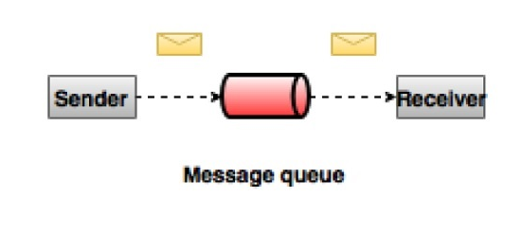
Point to point model

Slide 3
Publish-Subscribe Messaging System
In the publish-subscribe system, messages are persisted in a topic.
consumers can subscribe to one or more topic and consume all the messages in that topic

Slide 4
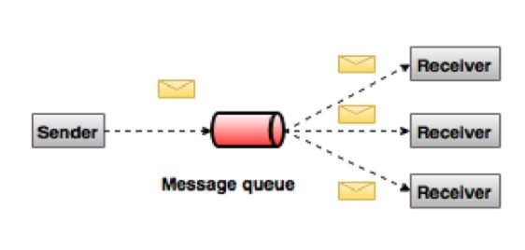
Pub-sub model

Slide 5
Apache Kafka
Apache Kafka is a distributed publish-subscribe messaging system .
Kafka messages are persisted on the disk and replicated within the cluster to prevent data loss.
Kafka is built on top of the Zookeeper synchronization service.
Kafka persists all data to the disk, which essentially means that all the writes go to the page cache of the OS (RAM). This makes it very efficient to transfer data from page cache to a network socket.

Slide 6
Benefits of Kafka:
Reliability
Scalability
Durability
Performance .
guarantees zero downtime and zero data loss.
Kafka is very fast, performs 2 million writes/sec.
scalable and distributed by design.

Slide 7
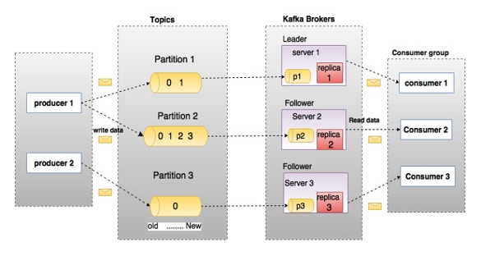
Kafka broker

Slide 8
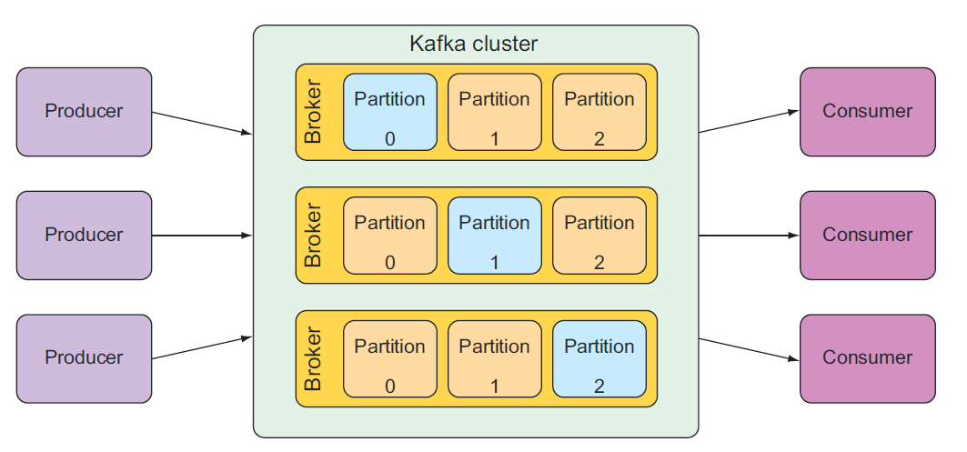
A Kafka cluster is composed of multiple brokers, each acting as a leader for partitions of the topics.

Slide 9
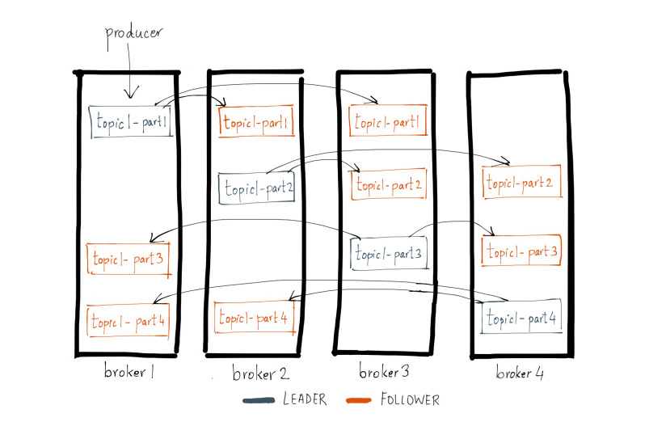
Leader and followers

Slide 10
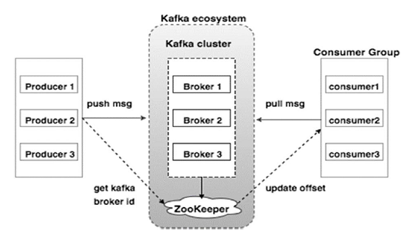
Kafka system

Slide 11
Kafka terms
Topics
Partition
Partition offset
Replicas of partition
Brokers
Kafka Cluster
Producers
Consumers
Leader
Leader is the node responsible for all reads and writes for the given partition. Every partition has one server acting as a leader.
Follower
Node which follows leader instructions are called as follower. If the leader fails, one of the follower will automatically become the new leader. A follower acts as normal consumer, pulls messages and up-dates its own data store.
ZooKeeper
ZooKeeper is used for managing and coordinating Kafka broker.
Kafka broker leader election can be done by ZooKeeper.

Slide 12
Consumer Group
Consumers can join a group by using the same “group.id”
The maximum parallelism of a group is that the number of consumers in the group ← no of partitions.
Kafka assigns the partitions of a topic to the consumer in a group, so that each partition is consumed by exactly one consumer in the group.
Kafka guarantees that a message is only ever read by a single consumer in the group.

Slide 13
Apache zookeeper
Apache Zookeeper is a distributed configuration and synchronization service.
Zookeeper serves as the coordination interface between the Kafka brokers and consumers.
The Kafka servers share information via a Zookeeper cluster.
Kafka stores basic metadata in Zookeeper such as information about topics, brokers, consumer offsets (queue readers) and so on.
The leader election between the Kafka broker is also done by using Zookeeper in the event of leader failure.
ZooKeeper service is mainly used to notify producer and consumer about the presence of any new broker in the Kafka system or failure of the broker in the Kafka system. As per the notification received by the Zookeeper regarding presence or failure of the broker then pro-ducer and consumer takes decision and starts coordinating their task with some other broker.

Slide 14
Apache Kafka producer/Consumer
kafka-clients jar:
https://mvnrepository.com/artifact/org.apache.kafka/kafka-clients/2.2.0
Producer
KafkaProducer class
ProducerRecord class
Properties props = new Properties();
props.put("bootstrap.servers", "localhost:9092");
-------------------
--------------------
Producer<String, String> producer = new KafkaProducer<String, String>(props);
producer.send(new ProducerRecord<String, String>(topicName, "key:"+Integer.toString(i), "value:"+Integer.toString(i)));

Slide 15
Producer properties
S.No | Configuration Settings and Description
1 | client.id identifies producer application
2 | producer.type either sync or async
3 | acks The acks config controls the criteria under producer requests are con-sidered complete.
4 | retries If producer request fails, then automatically retry with specific value.
5 | bootstrap.servers bootstrapping list of brokers.
6 | linger.ms if you want to reduce the number of requests you can set linger.ms to something greater than some value.
7 | key.serializer Key for the serializer interface.
8 | value.serializer value for the serializer interface.
9 | batch.size Buffer size.
10 | buffer.memory controls the total amount of memory available to the producer for buff-ering.

Slide 16
Consumer
Properties props = new Properties(); props.put("bootstrap.servers", "localhost:9092");
--------------------------------------
-------------------------------------
KafkaConsumer<String, String> consumer = new KafkaConsumer<>(props);
consumer.subscribe(Arrays.asList(topicName));
KafkaConsumer<String, String> consumer = new KafkaConsumer<>(props); consumer.subscribe(Arrays.asList(topicName));
ConsumerRecords<String, String> records = consumer.poll(100);

Slide 17
Consumer properties
S.No | Settings and Description
1 | bootstrap.servers Bootstrapping list of brokers.
2 | group.id Assigns an individual consumer to a group.
3 | enable.auto.commit Enable auto commit for offsets if the value is true, otherwise not committed.
4 | auto.commit.interval.ms Return how often updated consumed offsets are written to ZooKeeper.
5 | session.timeout.ms Indicates how many milliseconds Kafka will wait for the ZooKeeper to respond to a request (read or write) before giving up and continuing to consume messages.

Slide 18
Spring kafka
Gradle dependencies :
compile 'org.springframework.kafka:spring-kafka:2.2.5.RELEASE‘
Producer:
Map<String, Object> props = new HashMap<>(); props.put(ProducerConfig.BOOTSTRAP_SERVERS_CONFIG, "localhost:9092"); -------------------
-------------------
ProducerFactory<String, String> pf = new DefaultKafkaProducerFactory<String, String>(props);
KafkaTemplate<String, String> template = new KafkaTemplate<>(pf);
template.send(<topic>, “key",“value");
Template.flush()

Slide 19
Consumer
@EnableKafka
@EnableKafka enables detection of KafkaListener annotations on any Spring-managed bean in the container.
@KafkaListener
Map<String, Object> props = new HashMap<>(); props.put( ConsumerConfig.BOOTSTRAP_SERVERS_CONFIG , "localhost:9092");
------------
------------
ConsumerFactory<String, String> consumerFactory =new DefaultKafkaConsumerFactory<>(props )
ConcurrentKafkaListenerContainerFactory<String, String> containerFactory= new ConcurrentKafkaListenerContainerFactory<>(); containerFactory.setConsumerFactory(consumerFactory); containerFactory.setConcurrency(10);
public class Listener {
@KafkaListener( topics = "${kafka.messaging.email.topic}", groupId = "${kafkaEmailConsumer.group.id}", containerFactory = "containerFactory") public void listen1(String msg) { System.out.println("received value: "+msg); } }

Slide 20
FAQ
what is key in kafka message?
If a valid partition number is specified that partition will be used when sending the record. If no partition is specified but a key is present a partition will be chosen using a hash of the key. If neither key nor partition is present a partition will be assigned in a round-robin fashion.
What is meaning of enable.auto.commit ?
default value is true which enable auto update of offset to zookeeper.
use consumer.commitAsync() manually to update offset to zookeeper.

Slide 21
References
https://docs.spring.io/spring-kafka/docs/2.2.5.RELEASE/reference/
https://kafka.apache.org/quickstart
https://www.confluent.io/blog/hands-free-kafka-replication-a-lesson-in-operational-simplicity/
https://www.baeldung.com/spring-kafka

