Slide 1
Automated Data Configuration for NoSQL Systems
Kevin Lee
Akshay Mittal
Sachin Ravi

Slide 2
Motivation
Relational Databases struggle with web scale
Joins can be slow
Transactions involve locking
Can only vertically scale
NoSQL gaining prominence
Distributed! Decentralized!
Can horizontally scale
But no natural support for joins

Slide 3
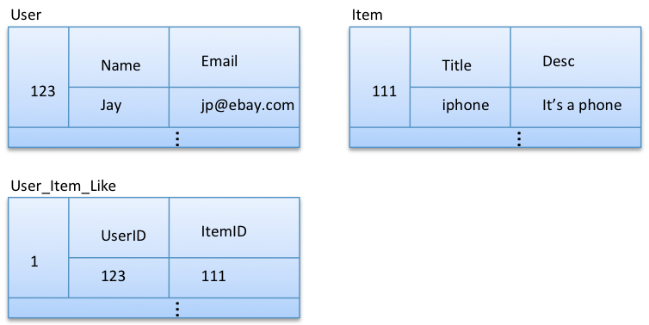
Motivation cont.
SQL Database
Normalized data model
Minimize redundancy
Notes:
How to query: All the items a particular user likes?

Slide 4
Motivation cont.
NoSQL
De-normalized data model
Store redundant data in order to avoid doing joins
What level of de-normalization?
What to store redundantly?
Dependent on query workload
Considerations:
Frequency of access
Storage cost
Cost to compute

Slide 5
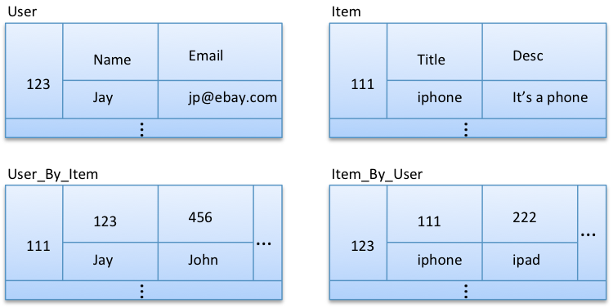
De-normalization example
Queries:
For item id, get item data and names of the users who liked that item.
For user id, get user data and item titles liked by that user.

Slide 6
Motivation cont.
Developer needs to do this calculation
Needs to understand query workload
Perform complicated cost-benefit analysis
Have automated way to do this
Given SQL query workload and data model
Give optimal configuration for NoSQL system

Slide 7
System Overview
Naive way to approach problem:
Enumerate all possible column combinations
Pick some k-best as de-normalized data
Expensive ̴2^N where N is number of columns
Do this approximately:
[Agrawal, Chaudhuri, Narasayya 2000]
Have heuristic to get “interesting” column combinations
Notes:
Set of columns to store redundantly

Slide 8
Picking Column Combinations
Only consider column combinations existing in queries
Start with column combinations of size 1 and work your way up
Each column combination will exist in some amount of queries
Have baseline for how expensive these queries are

Slide 9
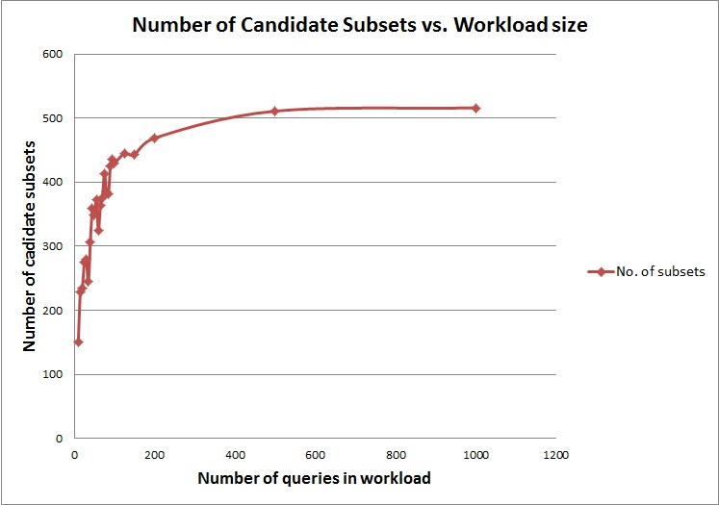
Performance
Naïve approach results in 1023 candidates irrespective of the workload size.

Slide 10
Picking best combinations
Need cost model to evaluate cost of storing a certain column combination
Two factors
Storage cost
Space used to store denormalized data
Computational cost
Cost to answer query given denormalized data
For every query in the workload, find column combination that minimizes heuristic cost as a candidate for denormalization

Slide 11



Heuristic Cost Model
Join of combination columns
Join of query columns not in combination
α*(rows*columns)
+ γ *(cost of joining) + β*(rows*columns)
Storage Factor
Computation Factor

Slide 12
Demo
Query 1:
SELECT users.name, item.title, item.desc
FROM users, item
WHERE item.itemid = 111
AND users.userid IN
(SELECT user_item_like.userid
FROM user_item_like
WHERE user_item_like.itemid = 111)
Query 2:
SELECT item.title, users.name, users.email
FROM item, users
WHERE users.userid = 123
AND item.itemid IN
(SELECT user_item_like.itemid
FROM user_item_like
WHERE user_item_like.userid = 123)
Tables all have 10,000 rows

Slide 13
Results
α >= γ, β
(storage at least as important as computation):
Query 1: [user_item_like#itemid, user_item_like#userid, users#name, users#userid]
Query 2: [item#itemid, item#title, user_item_like#itemid, user_item_like#userid]

Slide 14
Results
α < γ, β
(storage not as important as computation):
Query 1: [item#desc, item#itemid, item#title, users#name, users#userid]
Query 2: [item#itemid, item#title, users#email, users#name, users#userid]
-Store larger results (usually cross joins)

Slide 15
Results
α <<< γ, β
(storage not important):
Query 1: [item#desc, item#itemid, item#title, user_item_like#itemid, user_item_like#userid, users#name, users#userid]
Query 2: [item#itemid, item#title, user_item_like#itemid, user_item_like#userid, users#email, users#name, users#userid]
-Store everything

Slide 16
Thank you!

