Slide 1
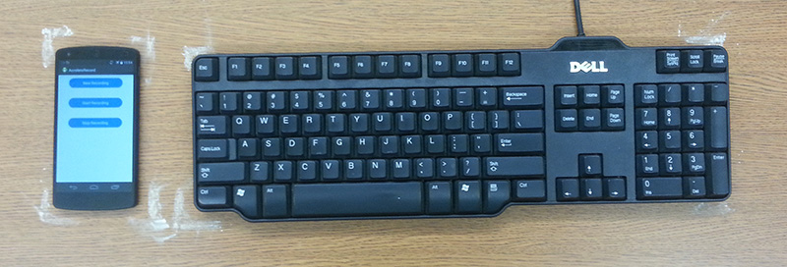
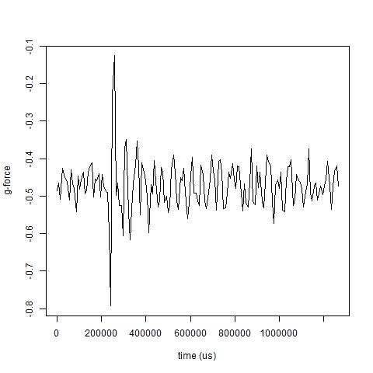
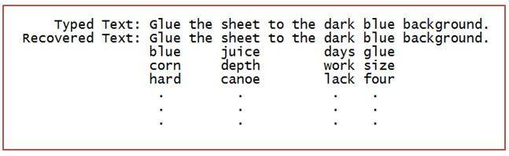
EavesDroid: Keystroke recovery using mobile phone
accelerometers
Jennifer Guo Yi-Hsien Lin Akshay Mittal Wathsala Vithanage
Princeton University
Threat Model
Data Processing Architecture
Smartphone accelerometers do not require explicit user permissions
Smartphones are often placed next to the user’s laptop or keyboard
Malicious applications can recover text by identifying signals from different keystrokes
Raw Accelerometer Data
Labeler
Supervised Learning Module
Clipper
Signal Breaker
Feature Extractor
Labeled
Features
AdaBoost With Decision Stump
Labeled Dataset | Algorithm | Test Accuracy (%)
L/R | AdaBoost (RandomForests) | 68.67
 | AdaBoost (DecisionStumps) | 69.82
 | Neural Networks | 68.10
U/D | AdaBoost (RandomForests) | 56.60
 | AdaBoost (DecisionStumps) | 58.68
 | Neural Networks | 58.62
Triads | AdaBoost (RandomForests) | 16.37
 | AdaBoost (DecisionStumps) | 13.21
 | Neural Networks | 14.65
Learning Phase
Attack Phase
Dictionary With Keyboard Features
Raw Accelerometer Data
Features
Trained AdaBoost With Decision Stump
Clipper
Signal Breaker
Feature Extractor
(L/R) (U/D)
Feature Matching
Prediction Output
# errors (L/R, U/D) | Recovered Words Accuracy (%)
0 | 5.46
1 | 23.41
2 | 41.64
3 | 70.31
4 | 85.67
5 | 94.54
6 | 97.27
“juice”
1=<x,y,z>
2=<x,y,z>
…
5=<x,y,z>
1=FV-1
2=FV-2
…
5=FV-5
1=FV-1
2=FV-2
…
5=FV-5
1=R
2=R
3=R
4=L
5=L
Phone
Feature Extractor
Keystrokes
L/R Classifier
Word Profile
RD.RU.RU.LD.LU
U/R Classifier
Feature Matching
1=FV-1
2=FV-2
…
5=FV-5
1=D
2=U
3=U
4=D
5=U
Word
Dictionary
“juice”

