Slide 1
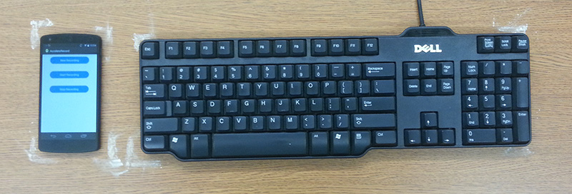
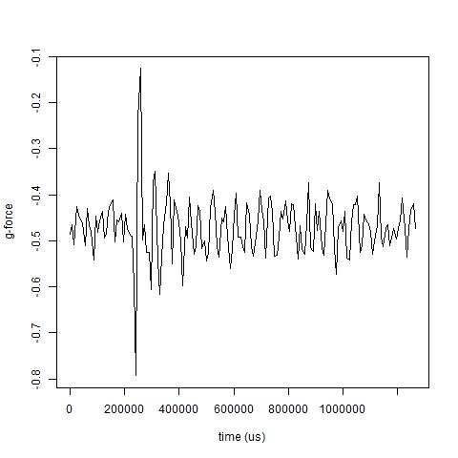
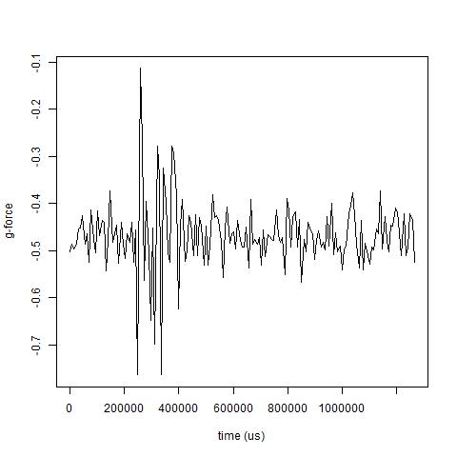
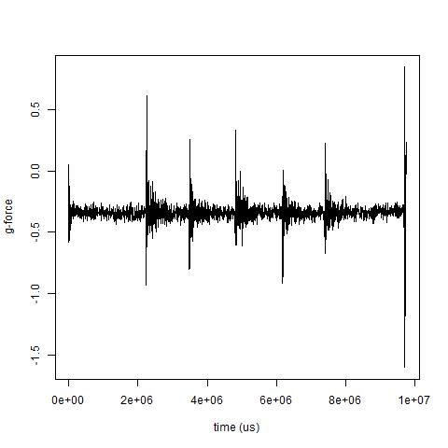
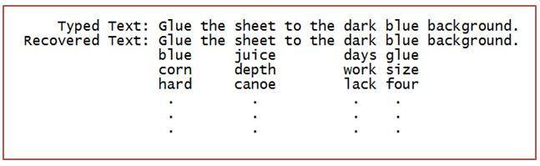
EavesDroid: Keystroke recovery using mobile phone
accelerometers
Jennifer Guo Yi-Hsien Lin Akshay Mittal Wathsala Vithanage
Princeton University
Threat Model
Data Processing Architecture
Smartphone accelerometers do not require explicit user permissions
Smartphones are often placed next to the user’s laptop or keyboard
Malicious applications can recover text by identifying signals from different keystrokes
Features extracted
mean, rms, skewness, kurtosis, variance, min, max
Fast Fourier Transformation coefficients (30)
Classifier used: AdaBoost with Decision Stump as weak learner
Raw Accelerometer Data
Labeler
Supervised Learning Module
Clipper
Signal Breaker
Feature Extractor
Labeled
Features
AdaBoost With Decision Stump
Labeled Dataset | Algorithm | Test Accuracy (%)
L/R | AdaBoost (RandomForests) | 68.67
 | AdaBoost (DecisionStumps) | 69.82
 | Neural Networks | 68.10
U/D | AdaBoost (RandomForests) | 56.60
 | AdaBoost (DecisionStumps) | 58.68
 | Neural Networks | 58.62
Triads | AdaBoost (RandomForests) | 16.37
 | AdaBoost (DecisionStumps) | 13.21
 | Neural Networks | 14.65
Contributions
Learning Phase
Develop an infrastructure for characterizing keypress vibrations
Captured, analyzed and built profiles of keypresses on a nearby keyboard based on the generated vibrations
Successfully recovered words using Boosted Decision Stumps
Dataset made publicly available
Provided noise-free signal data for each letter of the English alphabet
Developed an infrastructure for analysis and extraction of features
Attack Phase
Dictionary With Keyboard Features
Raw Accelerometer Data
Features
Trained AdaBoost With Decision Stump
Clipper
Signal Breaker
Feature Extractor
(L/R) (U/D)
Feature Matching
Dataset Overview
Prediction Output
Recorded 1000 data points in 40 sessions with 25 letters in each sessions.
Sampled vibration signals for letters ‘a’ and ‘b’ are quite distinct
Letter ‘a’ consists of one peak while letter ‘b’ is consist of three
SignalBreaker module breaks the word signal into individual letters
Predictions made by the classifier are matched against a dictionary
Used Harvard sentences as the candidate dictionary
Labeled dictionary using L/R and U/D labels
Hamming distance with each dictionary word is computed
Output dictionary words with lowest Hamming distance
Example
“juice”
1=<x,y,z>
2=<x,y,z>
…
5=<x,y,z>
1=FV-1
2=FV-2
…
5=FV-5
1=FV-1
2=FV-2
…
5=FV-5
1=R
2=R
3=R
4=L
5=L
Phone
Feature Extractor
Keystrokes
L/R Classifier
Word Profile
RD.RU.RU.LD.LU
# errors (L/R, U/D) | Recovered Words Accuracy (%)
0 | 5.46
1 | 23.41
2 | 41.64
3 | 70.31
4 | 85.67
5 | 94.54
6 | 97.27
U/R Classifier
Feature Matching
1=FV-1
2=FV-2
…
5=FV-5
1=D
2=U
3=U
4=D
5=U
Word
Dictionary
Sample vibration signal for the word “juice”
Shows distinct peaks for each letter
Clipper module removes the beginning and ending noise
“juice”
Left(L)/Right(R), Up(U)/Down(D) and Triads
Provides coarse grained labeling compared to exact alphabet labeling
Letters on the left side of and including T, G, B – Left (L)
Letter in the top row – Up (U)
Adjacent keys grouped into triples

