Slide 1

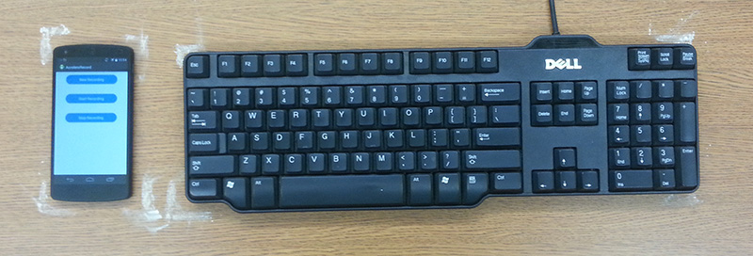
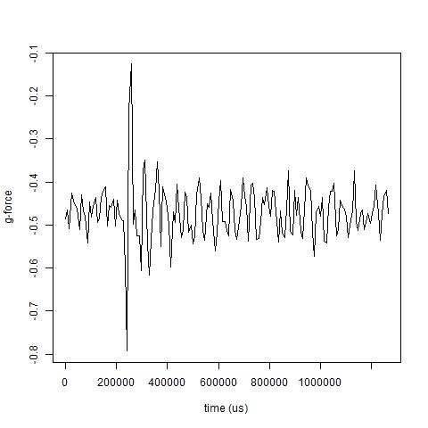
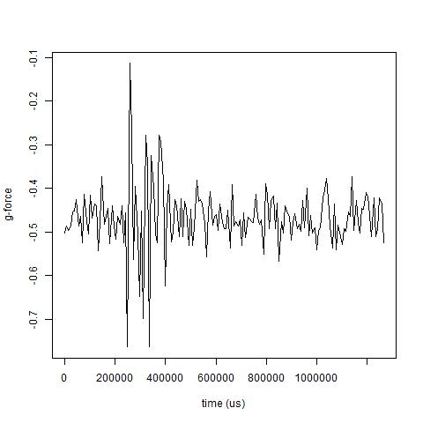
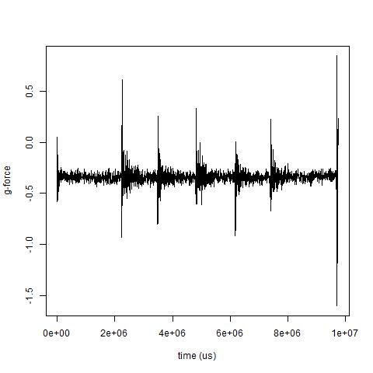
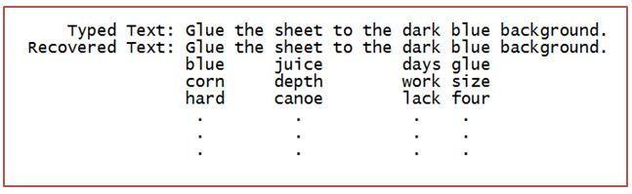
EavesDroid: Keystroke Recovery using Mobile Phone Accelerometers
Jennifer Guo Yi-Hsien Lin Akshay Mittal Wathsala Vithanage
Department of Computer Science
Threat Model
Data Processing Architecture
Experimentation
Smartphone accelerometers do not require explicit user permissions
Smartphones are often placed next to the user’s laptop or keyboard
Malicious applications can recover text by identifying signals from different keystrokes
Features extracted
mean, rms, skewness, kurtosis, variance, min, max
Fast Fourier Transformation coefficients (30)
Classifier used: AdaBoost with Decision Stump as weak learner
AdaBoost + Decision Stump achieves comparable accuracy with AdaBoost + Random Forests and Neural Networks.
By the principle of Occam’s Razor, we chose AdaBoost + Decision Stump as the classifier of EavesDroid
Raw Accelerometer Data
Labeler
Supervised Learning Module
Labeled Dataset | Algorithm | Test Accuracy (%)
L/R | AdaBoost (RandomForests) | 68.67
 | AdaBoost (DecisionStumps) | 69.82
 | Neural Networks | 68.10
U/D | AdaBoost (RandomForests) | 56.60
 | AdaBoost (DecisionStumps) | 58.68
 | Neural Networks | 58.62
Triads | AdaBoost (RandomForests) | 16.37
 | AdaBoost (DecisionStumps) | 13.21
 | Neural Networks | 14.65
Clipper
Signal Breaker
Feature Extractor
Labeled
Features
AdaBoost With Decision Stump
Contributions
Develop an infrastructure for characterizing keypress vibrations
Captured, analyzed and built profiles of keypresses on a nearby keyboard based on the generated vibrations
Successfully recovered words using Boosted Decision Stumps
Dataset made publicly available
Provided noise-free signal data for each letter of the English alphabet
Developed an infrastructure for analysis and extraction of features
Learning Phase
Attack Phase
Dictionary With Keyboard Features
Raw Accelerometer Data
Features
Trained AdaBoost With Decision Stump
Clipper
Signal Breaker
Feature Extractor
(L/R) (U/D)
Data set = Training set (66%) TR + Test set (33%) TE
Prediction model built using TR
Experiment 1: 72 sets of Harvard sentences (4490 words)
Represents words using individual letter signals from TE
Among 4490 words
85.67% have less than 5 labeling errors
Dataset Overview
Feature Matching
Recorded 1000 data points in 40 sessions with 25 letters in each sessions.
Sampled vibration signals for letters ‘a’ and ‘b’ are quite distinct
Letter ‘a’ consists of one peak while letter ‘b’ is consist of three
Prediction Output
SignalBreaker module breaks the word signal into individual letters
Predictions made by the classifier are matched against a dictionary
Used Harvard sentences as the candidate dictionary
Labeled dictionary using L/R and U/D labels
Each n-letter word gets 2n-labels
Hamming distance with each dictionary word is computed
Output dictionary words with lowest Hamming distance
Example
# labeling errors (L/R, U/D) | Recovered Words Accuracy (%)
0 | 5.46
1 | 23.41
2 | 41.64
3 | 70.31
4 | 85.67
5 | 94.54
6 | 97.27
1=<x,y,z>
2=<x,y,z>
…
5=<x,y,z>
1=FV-1
2=FV-2
…
5=FV-5
1=FV-1
2=FV-2
…
5=FV-5
1=R
2=R
3=R
4=L
5=L
“juice”
L/R Classifier
RD.RU.RU.LD.LU
Experiment 2: New York Times article (138 dictionary words + 257 new words)
121 out of 138 dictionary words have less than 5 labeling errors
This demonstrates practical applications of EavesDroid
Phone
Feature Extractor
Keystrokes
Word Profile
Feature Matching
Sample vibration signal for the word “juice”
Shows distinct peaks for each letter
Clipper module removes the beginning and ending noise
1=FV-1
2=FV-2
…
5=FV-5
U/R Classifier
Word
Dictionary
Challenges and Future Work
1=D
2=U
3=U
4=D
5=U
Number of candidate words increases along with dictionary size
Leads to additional work in contextual identification
Reducing search space is a possible solution (grouping letters into triads)
Accelerometer is extremely sensitive to surrounding noises
Better signal filtering techniques required
With advanced signal filtering techniques profiling of consecutive key presses into the model
Clustering on the letters’ signals and labeling them based on the frequency of each letter’s average appearance
Building the model on a word’s signal instead of the letter’s signal might identify word signatures with greater accuracy
“juice”
Input: A sentence from the Harvard dictionary
Output: All candidate words that constitute this sentence
Exact matches are shown without other candidates
Partial matches shown with lowest Hamming distanced words
EavesDroid is able to recover 1-3 lettered words (such as ‘box’, ‘key’, ‘in’) while Marquardt et. al work relies on human identification
Left(L)/Right(R), Up(U)/Down(D) and Triads
Conclusion
Provides coarse grained labeling compared to exact alphabet labeling
Letters on the left side of and including T, G, B – Left (L)
Letter in the top row – Up (U)
Adjacent keys grouped into triples
Provide a simple model based on AdaBoost + Decision Stump and achieve comparable accuracies to a Neural Network based model used by Marquardt et. al

