Slide 1
UNIX Internals – The New Frontiers
Device Drivers and I/O

Slide 2
16.2 Overview
Device driver
  An object that controls one or more devices and interacts with the kernel
  Written by third-party vendor
    Isolate device-specific code in a module
    Easy to add without kernel source code
    Kernel has a consistent view of all devices

Slide 3
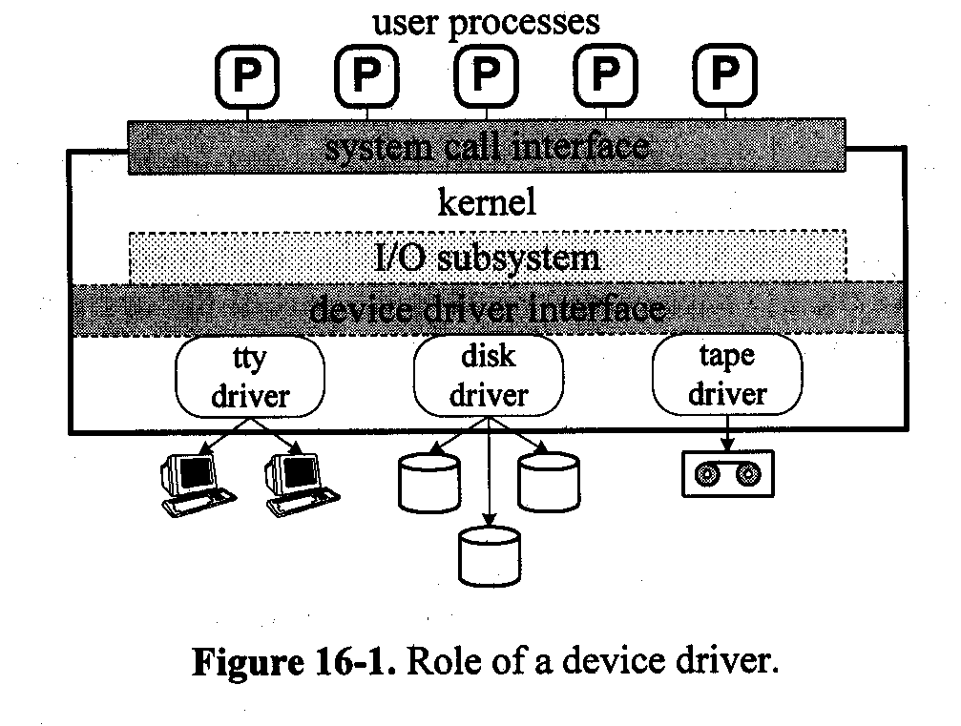
System Call Interface
Device Driver Interface

Slide 4
Hardware Configuration
BUS:
  ISA,EISA
  MASBUS,UNIBUS
  PCI
Two components
  Controller or adapter
    Connect one or more devices
    A set of CSRs for each
  Device:

Slide 5
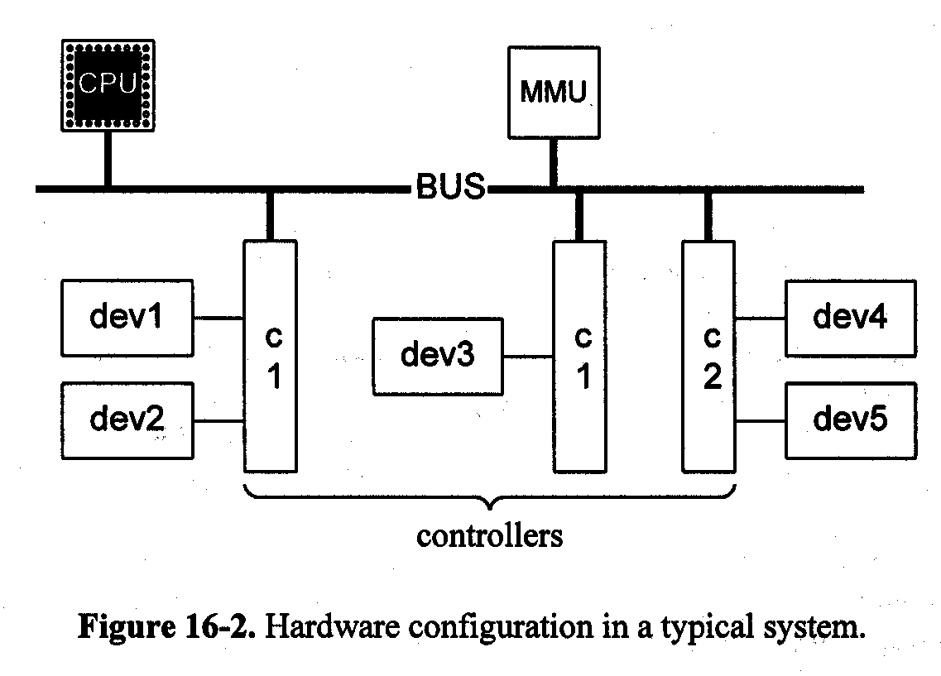

Slide 6
Hardware Configuration(2)
I/O space
  The set of all device registers
  Frame buffer
  Separate from main memory
  Memory mapped I/O
Transferring method
  PIO-Programmed I/O
  Interrupt-driven I/O
  DMA-Direct Memory Access

Slide 7
Device Interrupts
Each device interrupt has a fixed ipl.
Invoke a routine,
  Save the register & raise the ipl to the system ipl
  Calls the handler
  Restore the ipl and the register
Spltty(): raise the ipl to that of the terminal
Splx(): lowers the ipl to a previously saved value
Identify the handler
  Vectored: interrupt vector number & interrupt vector table
  Polled: many handlers share one number
Short & Quick

Slide 8
16.3 Device Driver Framework
Classifying Devices and Drivers
  Block
    In fixed size, randomly accessed block
    Hard disk, floppy disk, CD-ROM
  Character
    Arbitrary-sized data
    One byte at a time, interrupt
    Terminals, printers, the mouse, and sound cards
    Non-block: Time clock, memory mapped screen
  Pseudodevice
    Mem driver, null device, zero device

Slide 9
Invoking Driver Code
Invoke:
  Configuration: initialize
    Only once
  I/O: read or write data(sync)
  Control: control requests(sync)
  Interrupts: (asynchronous)

Slide 10
Parts of a device driver
Two parts:
  Top half:synchronous routines, execute in process context. They may access the address space and the u area of the calling process and may put the process to sleep if necessary
  Bottom half: asynchronous routines run in system contextand usually have no relation to the currently running process. They are not allowed to access the current user address space or the u area. They are not allowed to sleep, since that may block an unrelated process.
The two halves need to synchronize their activities. If an object is accessed by both halves, then the top-half routines must block interrupts while manipulating it. Otherwise the device may interrupt while the object is in an inconsistant state, with unpredictable results.

Slide 11
The Device Switches
A data structure that defines the entry points each device must support.
cdevsw{
int(* d_open)():
int(* d_close)():
int(* d_read)():
int(* d_write)():
int(* d_ioctl)():
int(* d_mmap)():
int(* d_segmap)():
int(* d_xpoll)():
int(* d_xhalt)():
struct streamtab* d_str:
} cdevsw[]
bdevsw{
int(* d_open ) ();
int(* d_close) ();
int(* d_strategy) ();
int(* d_size) ();
int(* d_xhalt) ();
……
} bdevsw[]:

Slide 12
Driver Entry Points
d_open():
d_close():
d_strategy():r/w for block device
d_size(): determine the size of a disk partition
d_read(): from character device
d_write(): to character device
d_ioctl(): for a character device define a set of cmds
d_segmap(): map the device memory to the process address space
d_mmap():
d_xpoll(): to check
d_xhalt():

Slide 13
16.4 The I/O Subsystem
A portion of the kernel that controls the device-independent part of I/O
Major and Minor Numbers
  Major number:
    Device type
  Minor number:
    Device instance
  *bdevsw[getmajor(dev)].d_open()(dev,…)
  dev_t:
    Earlier: 16b, 8 for major and minor
    SVR4: 32b, 14 for major, 18 for minor

Slide 14
Device Files
A specified file located in the file system and associated with a specific device.
Users can use the device file as ordinary
inode
  di_mode: IFBLK, IFCHR
  di_rdev: <major, minor>
mknod(path, mode, dev)
  Create a device file
Access control & protection
  r/w/e for o, g and others

Slide 15
The specfs File System
A special file system type
specfs vnode
  All operations to the file are routed to it
snode
E.g:/dev/lp
  ufs_lookup()->vnode of dev->vnode of lp ->the file type=IFCHR-><major, minor> -> specvp()->search the snode hash table by <major, minor>
  No, create snode and vnode: stores the pointer to the vnode of /dev/lp to the s_realvp
  Returns the pointer to the specfs vnode to ufs_lookup(), to open()

Slide 16
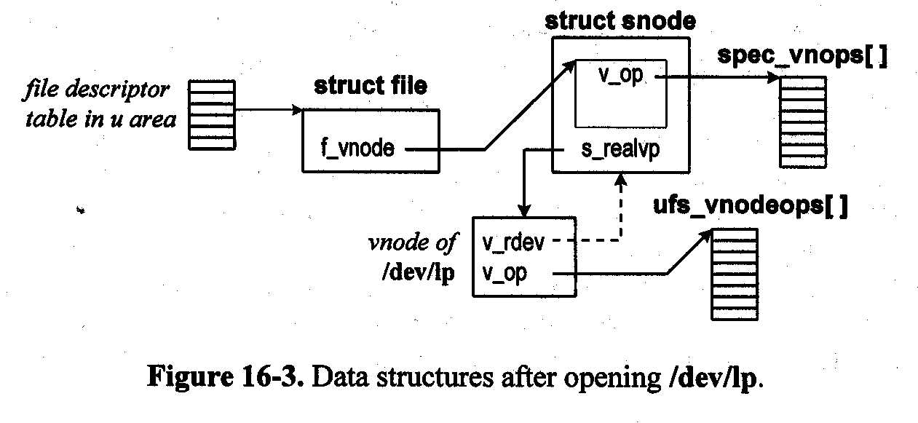
Data structures

Slide 17
The Common snode
More device files then the number of real devices
Many closing
  If many opened, the kernel should recognize the situation and call the device close operation only after both files are closed
Page addressing
  Many pages represents one device, maybe inconsistent

Slide 18
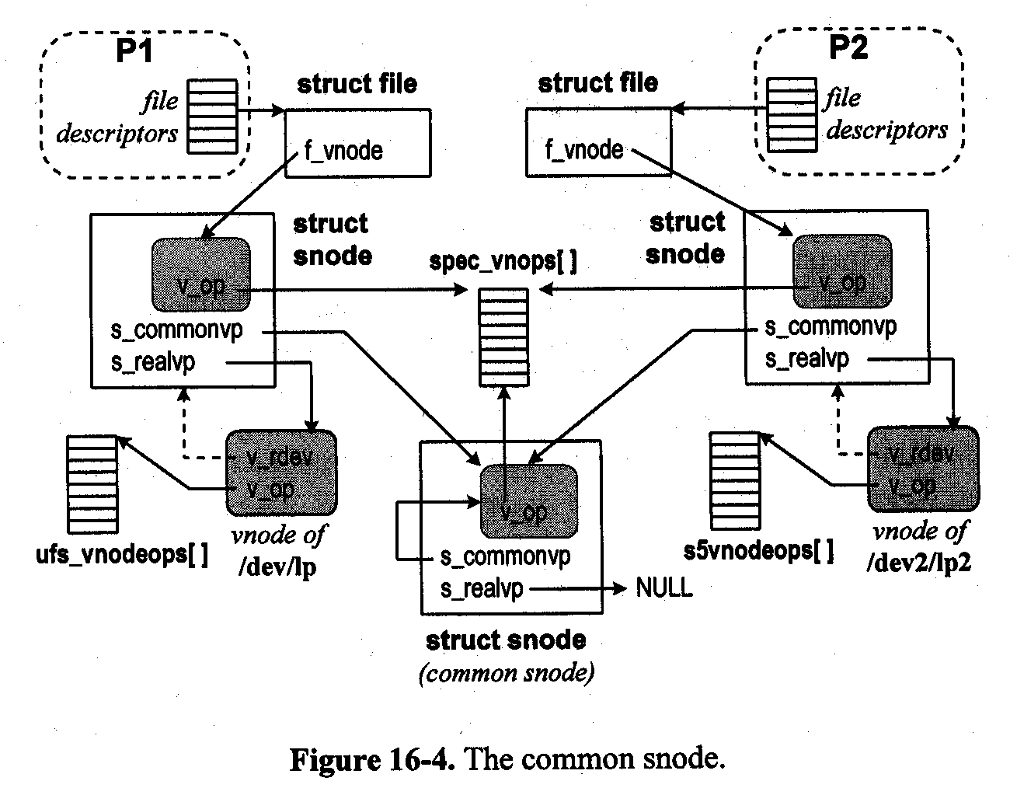

Slide 19
Device cloning
When a user does not care what instance of a device is used, e.g. for network access,
Multiple active connections can be created, each with a different minor dev. number
Cloning is supported by dedicated clone drivers with major dev. # = # of the clone device, minor dev. # = major dev. # of the real device
E.g. clone driver # = 63 (major #), TCP driver major # = 31, /dev/tcp major # = 63, minor # = 31; tcpopen() generates an unused minor device #

Slide 20
I/O to a Character Device
Open:
  Creates an snode, a common snode & file
Read:
  File, the vnode, validation, VOP_READ, spec_read()>checks the vnode type, looks up the cdevsw[] indexed by the <major> in v_rdev, d_read()>uio as the read parameter, uiomove()>copy data

Slide 21
16.5 The poll System call
Multiplex I/O over several descriptors
  An fd for each connection, read on an fd, and block
Read any?
  poll(fds, nfds, timeout):
    timeout: 0,-1, INFTIME
  struct pollfd{
  int fd:
  short events:
  short revents:
  }
Events
  POLLIN, POLLOUT, POLLERR, POLLHUP
An array[nfds] of struct pollfd
A bit mask

Slide 22
poll Implementation
Structures
  pollhead: with a device file, maintains a queue of polldat
  polldat:
    a blocked process(proc )
    the events
    link

Slide 23
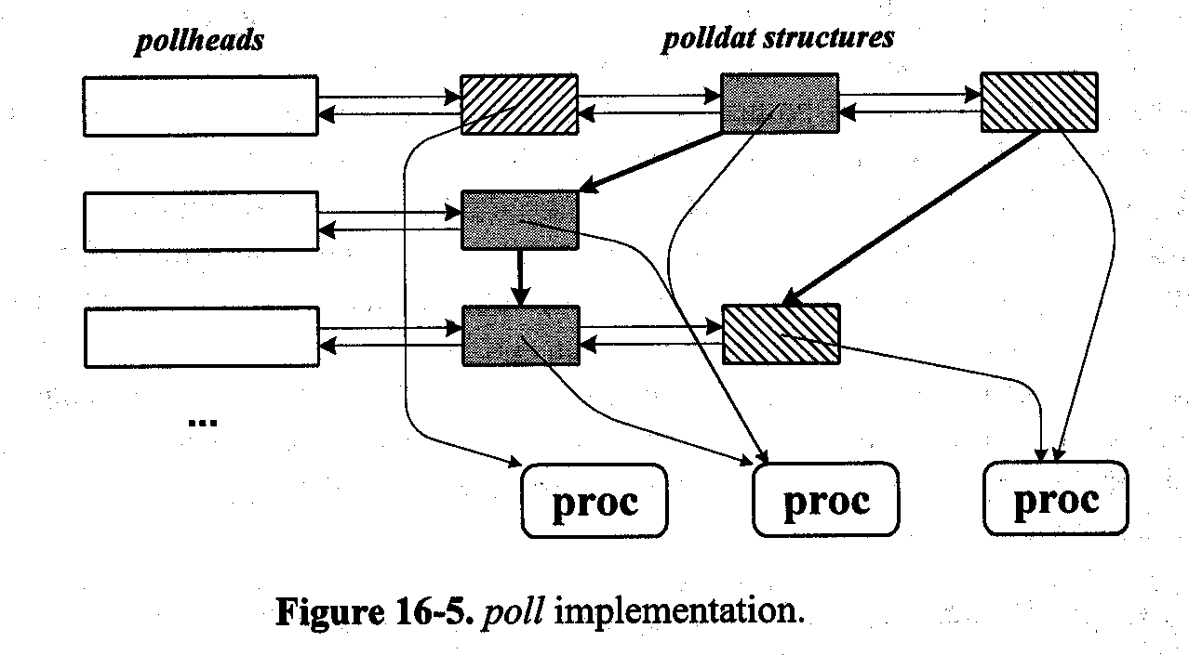
Poll

Slide 24
VOP_POLL
Error = VOP_POLL(vp, events, anyyet, &revents, &php)
  spec_poll() indexes cdevsw[] > d_xpoll()>checks events?updates revent, returns: anyyet=0?return a pointer to the pollhead
  Returns to poll()> check revents & anyyet
  Both = 0? Get the pollhead php, allocates a polldat, adds it to the queue, pointer to a proc, mask the events, link to another , block : !=0 in revents, removes all the polldat from the queue, free, anyyet+=number
Block, maintain the events in the driver, when occurs, pollwakeup(), event& the php

Slide 25
16.6 Block I/O
Formatted
  Access by files
Unformatted
  Access directly by device file
Block I/O:
  r/w file
  r/w device file
  Accessing memory mapped to a file
  Paging to/from a swap device

Slide 26
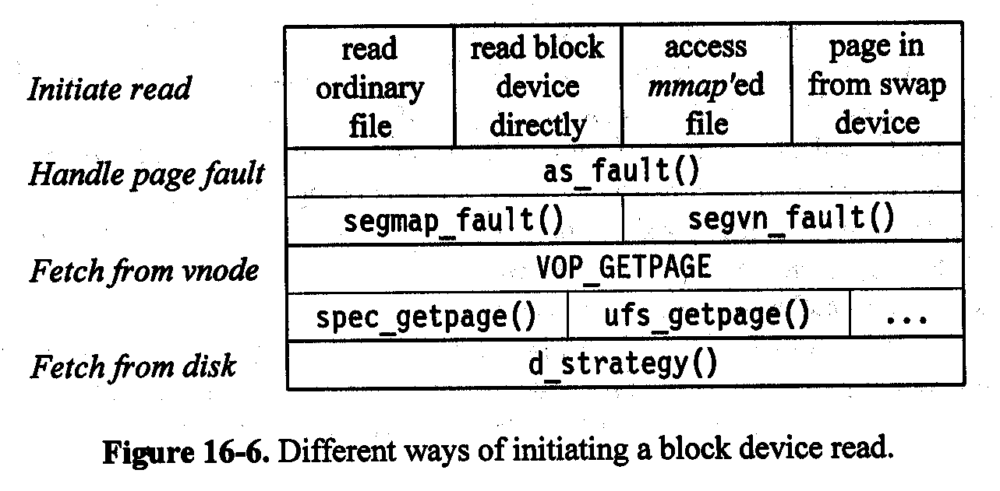
Block device read

Slide 27
The buf Structure
The only interface btwn kernel & the block device driver
  <major,minor>
  Starting block number
  Byte number: sectors
  Location in memory
  Flags: r/w, sync/async
  Address of completion routine
Completion status
  Flags
  Error code
  Residual byte count

Slide 28
Buffer cache
Administrative info for a cached blk
  A pointer to the vnode of the device file
  Flags that specify if the buffer free
  The aged flag
  Pointers on an LRU freelist
  Pointers in a hash queue

Slide 29
Interaction with the Vnode
Address a disk block by specifying a vnode, and an offset in that vnode
  The device vnode and the physical offset
    Only when the fs is not mounted
Ordinary file
  The file vnode and the logical offset
VOP_GETPAGE>(ufs)spec_getpage()
  Checks in memory, ufs_bmap()->pblk ,alloc the page, and buf, d_strategy() >read,wakes up
VOP_PUTPAGE>(ufs)spec_putpage()

Slide 30
Device Access Methods
Pageout Operations
  Vnode, VOP_PUTPAGE
    spec_putpage(), d_strategy()
    ufs_putpage(), ufs_bmap()
Mapped I/O to a File
  exec: page fault, segvn_fault(), VOP_GETPAGE
Ordinary File I/O
  ufs_read: segmap_getmap(), uiomove(), segmap_release()
Direct I/O to Block Device
  spec_read: segmap_getmap(), uiomove(), segmap_release()

Slide 31
Raw I/O to a Block Device
Copy the data twice
  From the user space – to the kernel
  From the kernel –to the disk
Caching is beneficial
  But no for large data transfer
  Mmap
  Raw I/O: unbuffered access
    d_read() or d_write()
  physiock()
Validates
Allocate a buf
as_fault()
locks
d_strategy()
Sleeps
Unlock
returns

Slide 32
16.7 The DDI/DKI Specification
DDI/DKI:Device-Driver Interface & Device-Kernel Interface
  5 sections:
    S1:data definition
    S2: driver entry point routines
    S3: kernel routines
    S4: kernel data structures
    S5: kernel #define statements
  3 parts:
    Driver-kernel: the driver entry points and the kernel support routines
    Driver-hardware: machine-dependent
    Driver-boot:incorporate a driver into the kernel

Slide 33
General Recommendation
Should not directly access system data structure.
Only access the fields described in S4
Should not define arrays of the structures defined in S4
Should only set or clear flags for masks and never assign directly to the field
Some structures opaque can be accessed by the routines
Use the functions in S3 to read or modify the structures in S4
Include ddi.h
Declare any private routines or global variables as static

Slide 34
Section 3 Functions
Synchronization and timing
Memory management
Buffer management
Device number operations
Direct memory access
Data transfers
Device polling
STREAMS
Utility routines

Slide 35
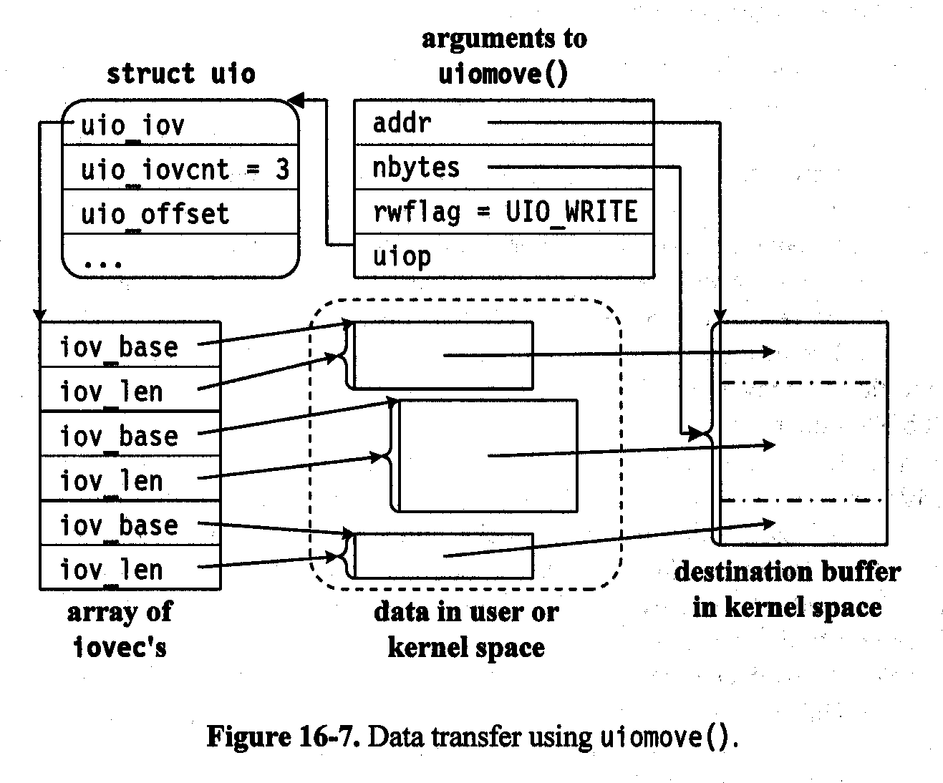

Slide 36
Other sections
S1: specify prefix, prefixdevflag, disk -> dk
  D_DMA
  D_TAPE
  D_NOBRKUP
S2:
  specify the driver entry points
S4:
  describes data structures shared by the kernel and the devices
S5:
  The relevant kernel #define values

Slide 37
16.8 Newer SVR4 Releases
MP-Safe Drivers
  Protect most global data by using multiprocessor synchronization primitives.
  SVR4/MP
    Adds a set of functions that allow drivers to use its new synchronization facilities.
    Three locks: basic, read/write and sleep locks
    Adds functions to allocate and manipulate the difference synchronization
    Adds a D_MP flag to the prefixdevflag of the driver.

Slide 38
Dynamic Loading & Unloading
SVR4.2 supports dynamic operation for:
  Device drivers
  Host bus adapter and controller drivers
  STREAMS modules
  File systems
  Miscellaneous modules
Dynamic Loading:
  Relocation and binding of the driver’s symbols.
  Driver and device initialization
  Adding the driver to the device switch tables, so that the kernel can access the switch routines
  Installing the interrupt handler

Slide 39
SVR4.2 routines
prefix_load()
prefix_unload()
mod_drvattach()
mod_drvdetach()
Wrapper Macros
  MOD_DRV _WRAPPER
  MOD_HDRV_WRAPPER
  MOD_STR_WRAPPER
  MOD_FS_WRAPPER
  MOD_MISC_WRAPPER

Slide 40
Future directions
Divide the code into a device-dependent and a controller-dependent part
PDI standard
  A set of S2 functions that each host bus adapter must implement
  A set of S3 functions that perform common tasks required by SCSI devices
  A set of S4 data structures that are used in S3 functions

