Slide 1
Domain Name
System
(DNS)

Slide 2
18.1
NAME SPACE

Slide 3
18.2
DOMAIN
NAME
SPACE

Slide 4
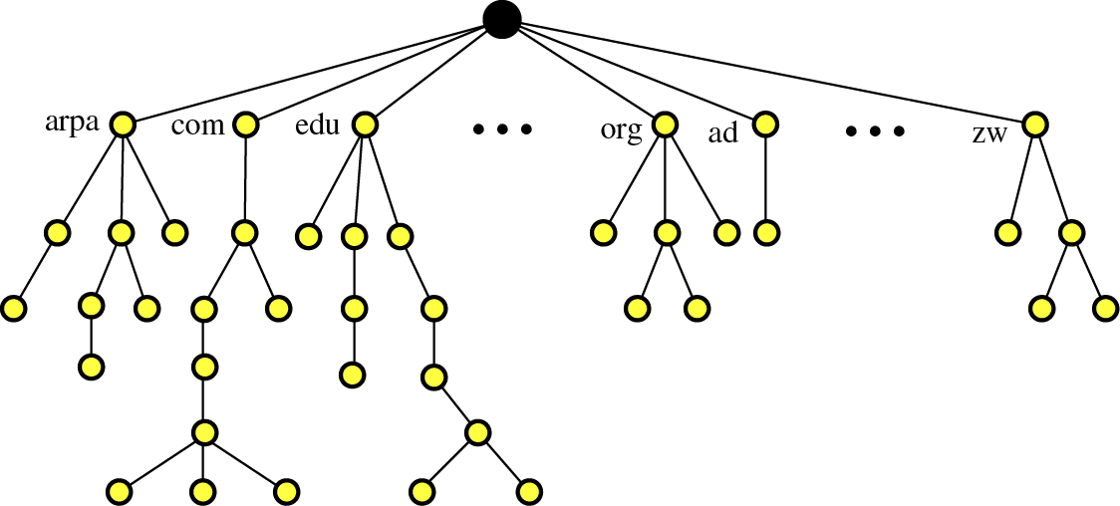
Figure 18-1
Domain name space

Slide 5
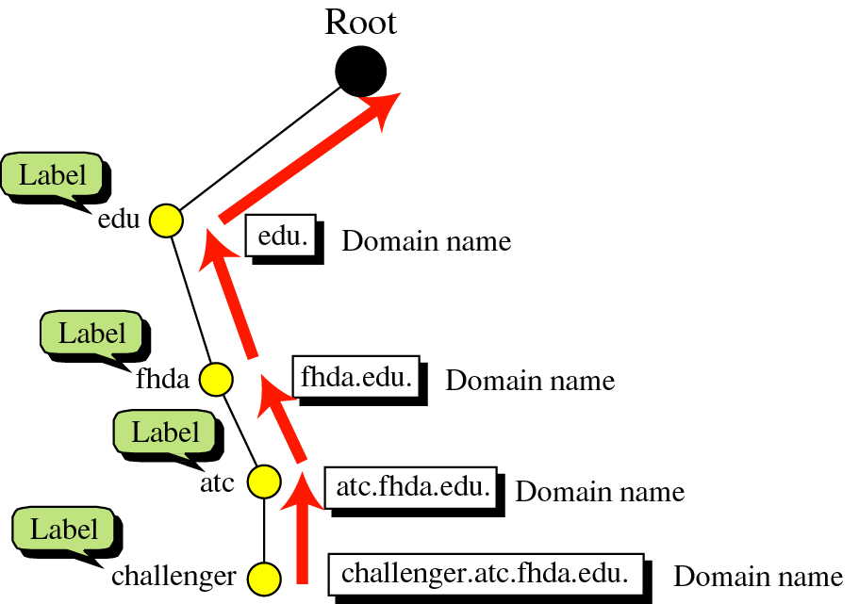
Figure 18-2
Domain names
and labels

Slide 6
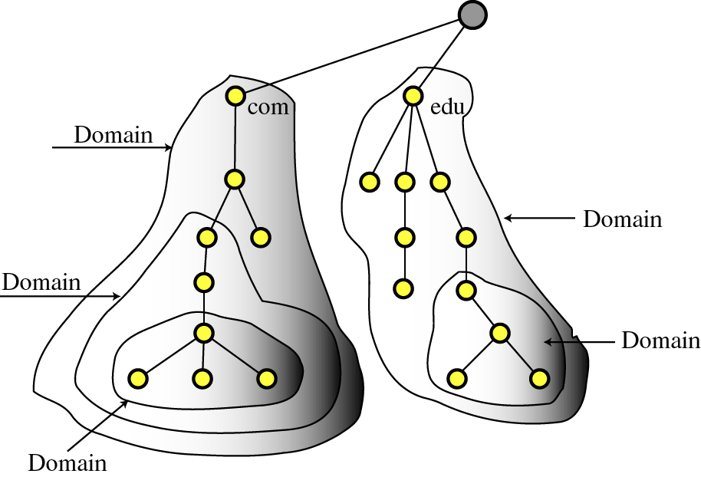
Figure 18-4
Domains

Slide 7
18.3
DISTRIBUTION
OF
NAME SPACE

Slide 8
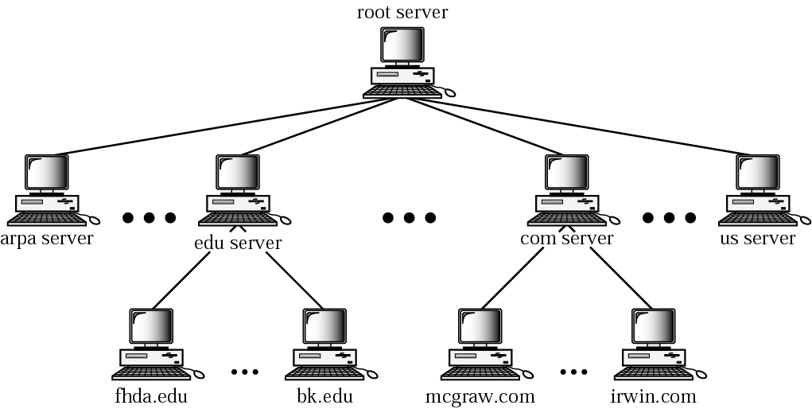
Figure 18-5
Hierarchy of name servers

Slide 9
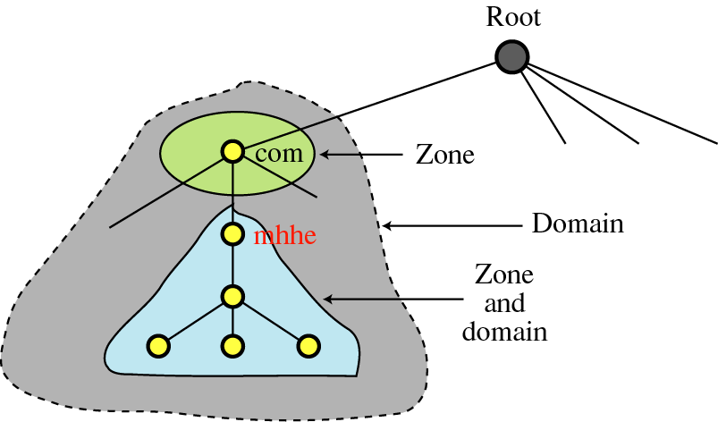
Figure 18-6
Zones and domains

Slide 10

A primary server loads all information from
the disk file; the secondary server loads
all information from the the primary server.
When the primary downloads information
from the secondary, it is called
zone transfer.

Slide 11
18.4
DNS
IN THE
INTERNET

Slide 12
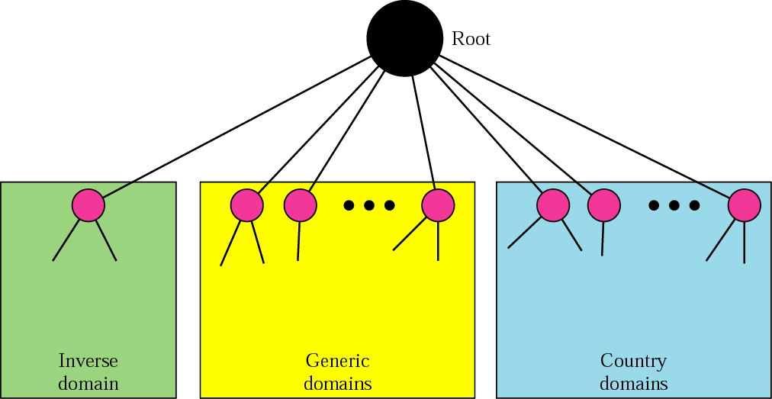
Figure 18-7
DNS in the Internet

Slide 13
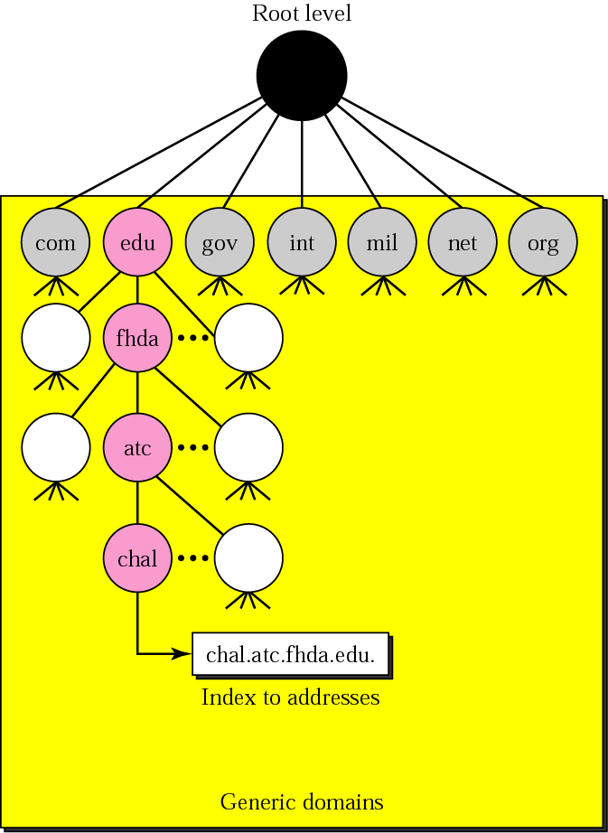
Figure 18-8
Generic domains

Slide 14
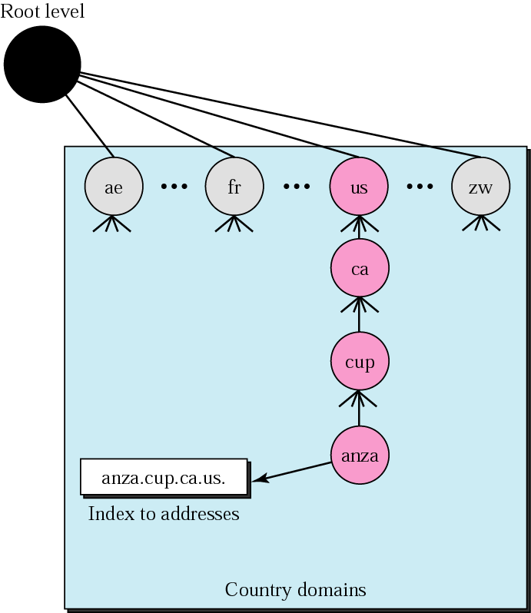
Figure 18-9
Country domains

Slide 15
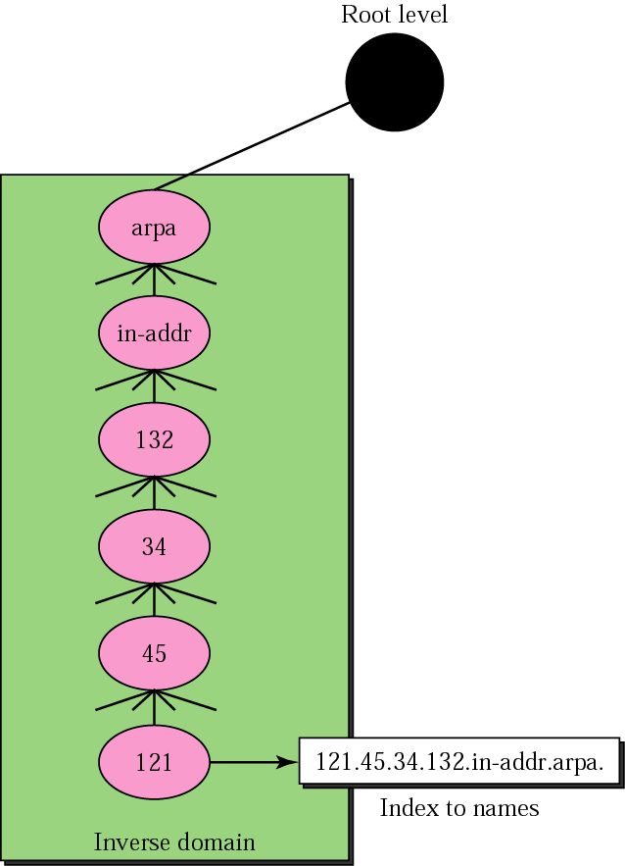
Figure 18-10
Inverse domain

Slide 16
18.5
RESOLUTION

Slide 17
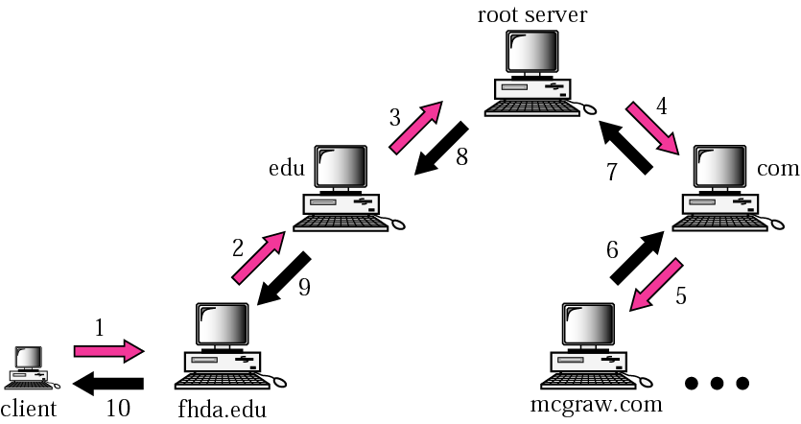
Figure 18-11
Recursive resolution

Slide 18
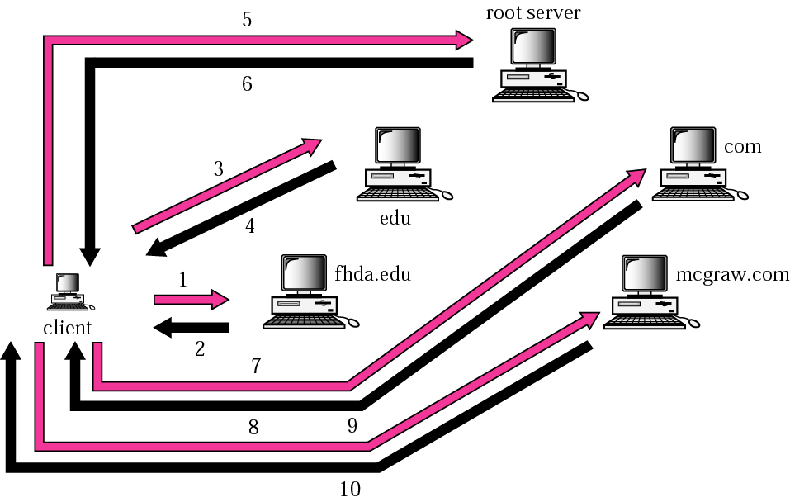
Figure 18-12
Iterative resolution

Slide 19
18.6
DNS
MESSAGES

Slide 20
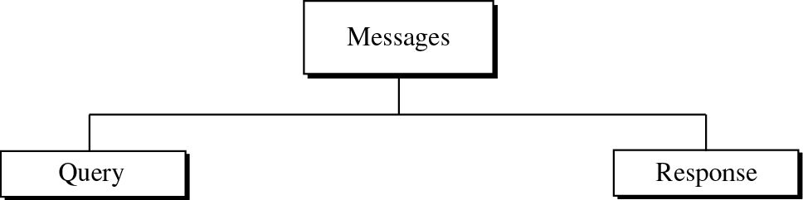
Figure 18-13
DNS messages

Slide 21
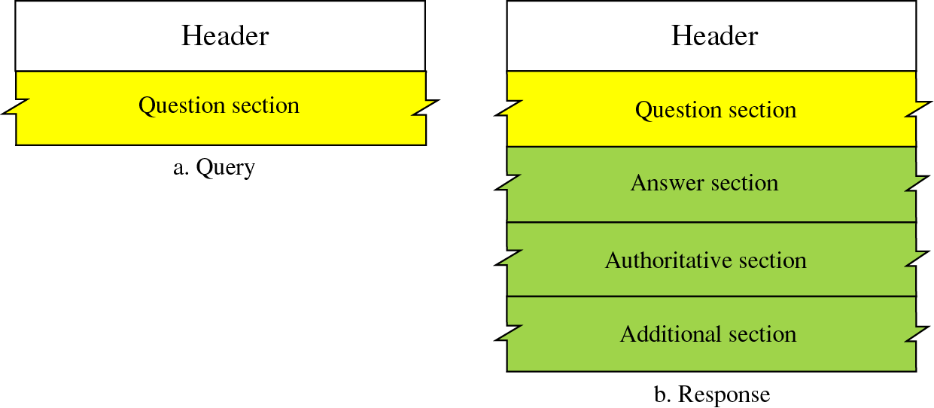
Figure 18-14
Query and response messages

Slide 22
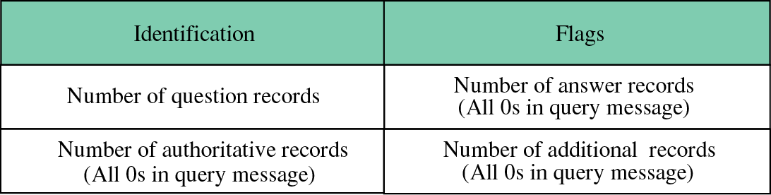
Figure 18-15
Header format

Slide 23
18.7
TYPES
OF
RECORDS

Slide 24

Figure 18-17
Question record format

Slide 25
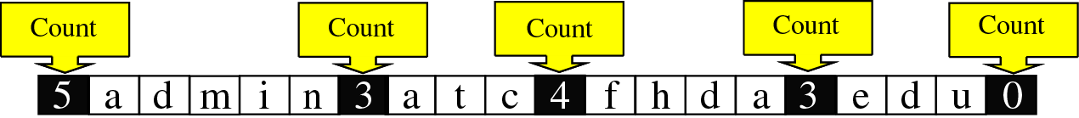
Figure 18-18
Query name format
admin.atc.fhda.edu.

