Slide 1
Internet Protocol
(IP)

Slide 2
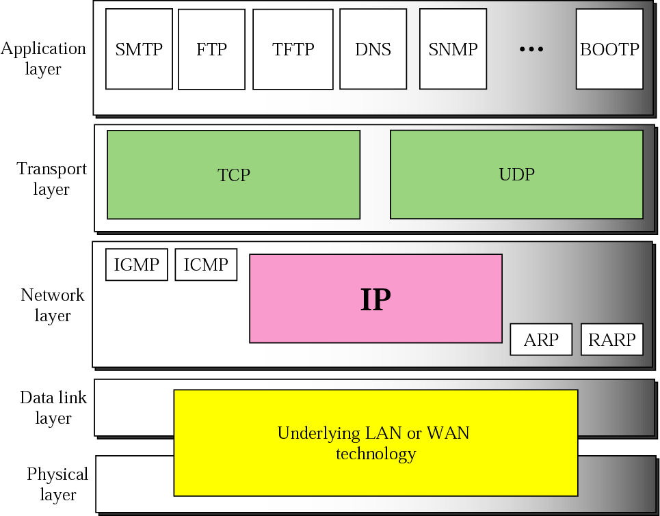
Figure 8-1
Position of IP in TCP/IP protocol suite

Slide 3
8.1
DATAGRAM

Slide 4
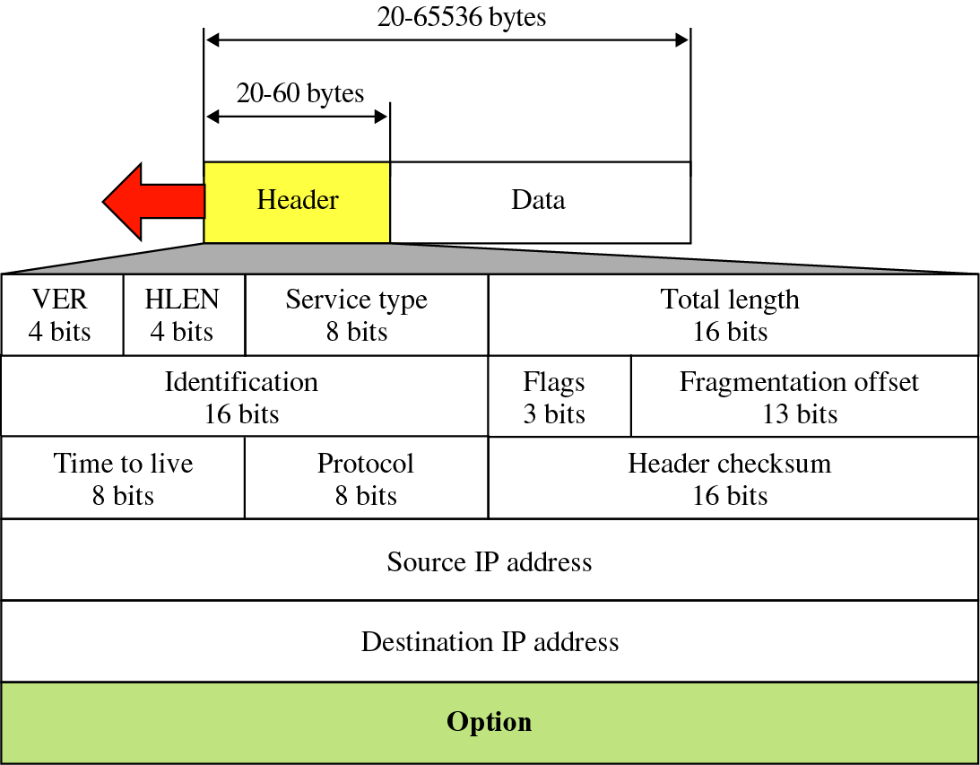
Figure 8-2
IP datagram

Slide 5
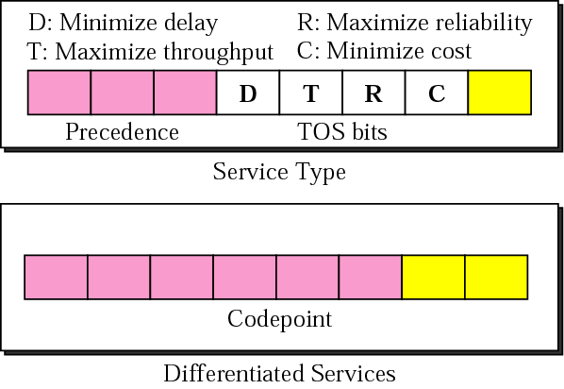
Figure 8-3
Service Type or Differentiated Services

Slide 6

The precedence subfield is
not used in version 4.

Slide 7
The total length field defines the
total length of the
datagram including the header.

Slide 8
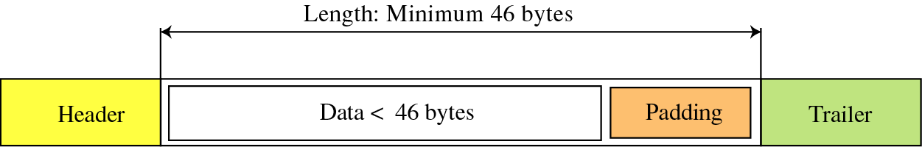
Figure 8-4
Encapsulation of a small datagram
in an Ethernet frame

Slide 9
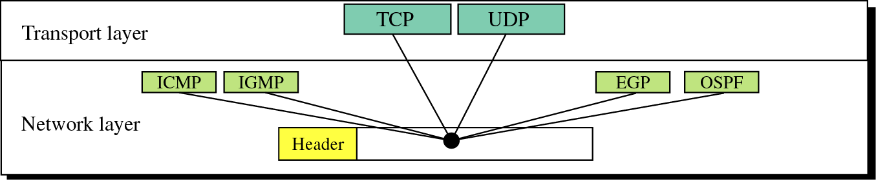
Figure 8-5
Multiplexing

Slide 10
8.2
FRAGMENTATION

Slide 11
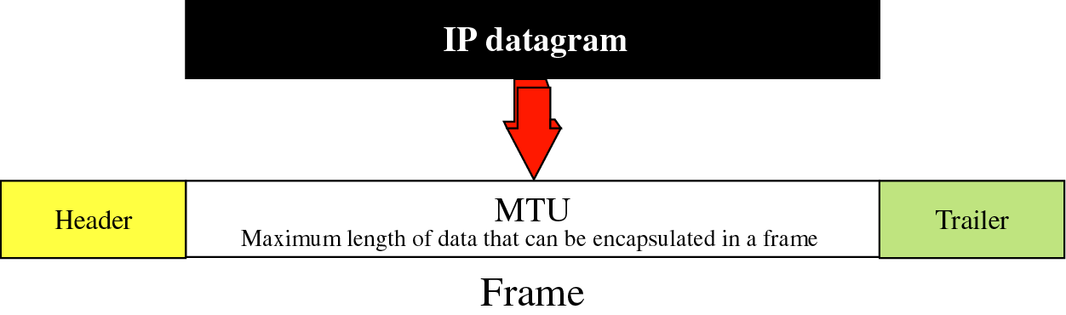
Figure 8-6
MTU

Slide 12
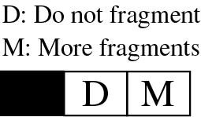
Figure 8-7
Flag field

Slide 13
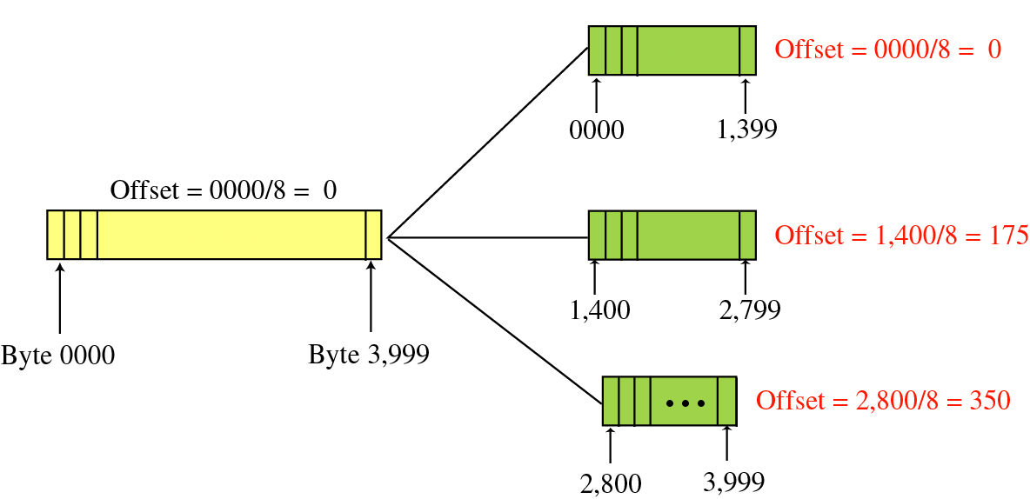
Figure 8-8
Fragmentation example

Slide 14
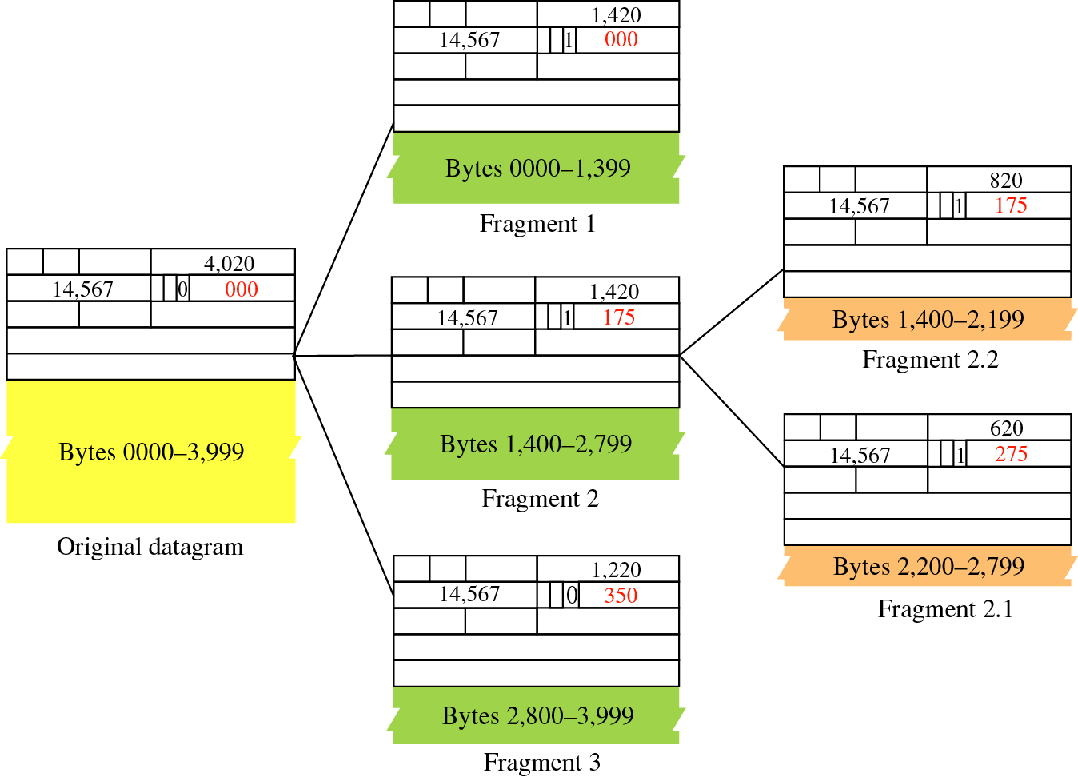
Figure 8-9
Detailed
example

Slide 15
8.3
OPTIONS

Slide 16
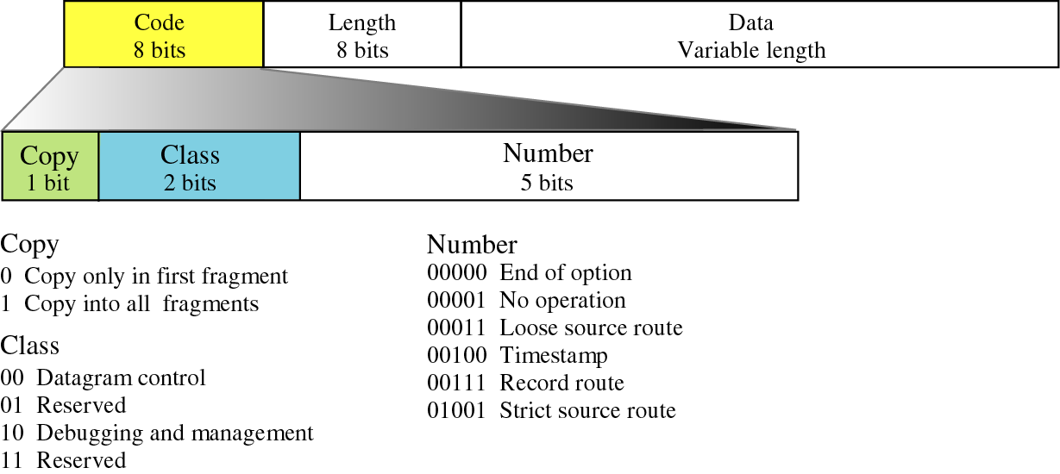
Figure 8-10
Option format

Slide 17
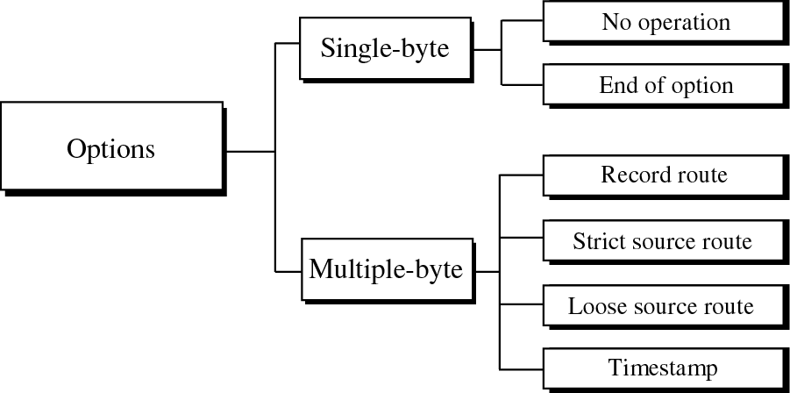
Figure 8-11
Categories of options

Slide 18
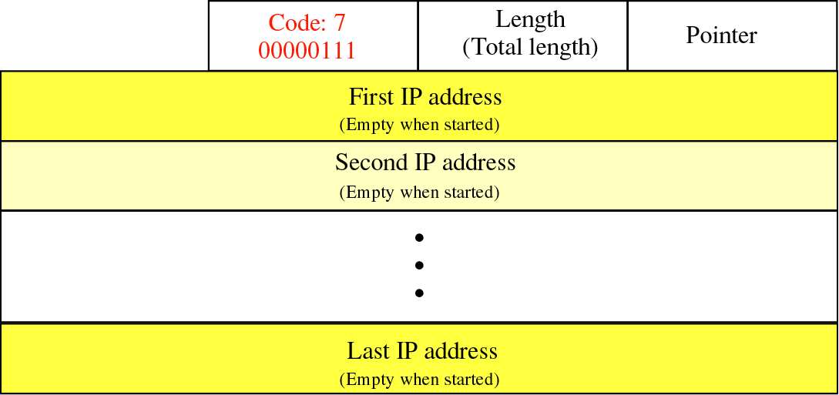
Figure 8-14
Record route option

Slide 19
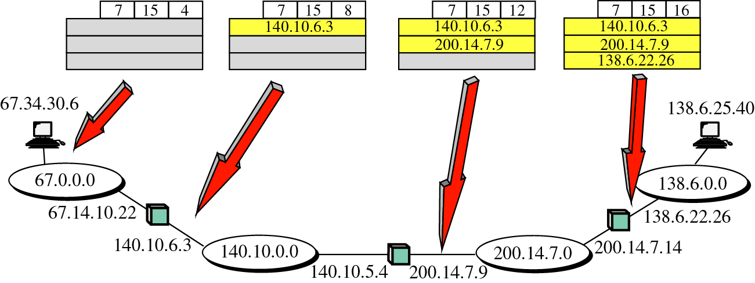
Figure 8-15
Record route concept

Slide 20
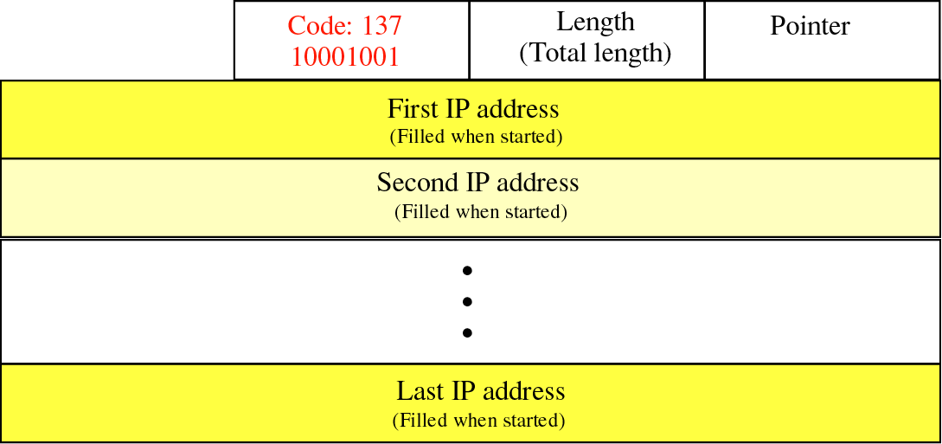
Figure 8-16
Strict source route option

Slide 21
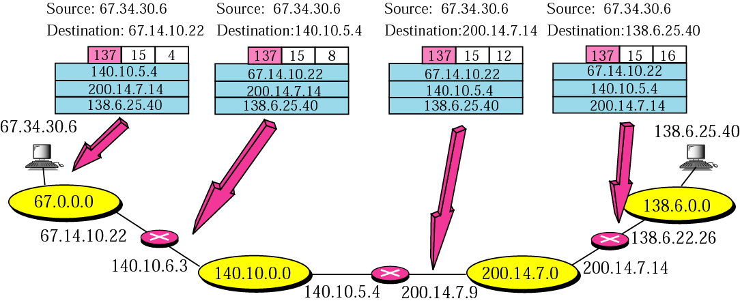
Figure 8-17
Strict source route concept

Slide 22
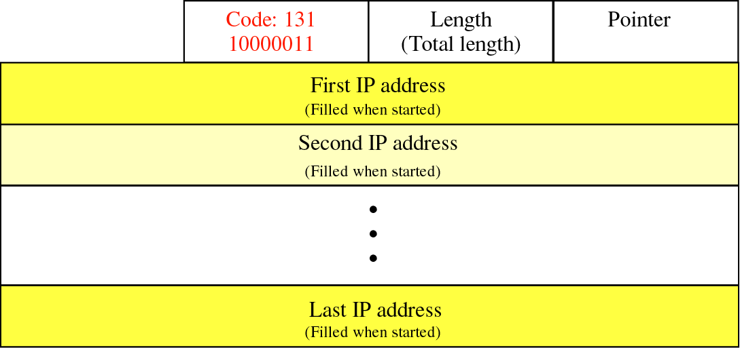
Figure 8-18
Loose source route option

Slide 23
8.4
CHECKSUM

Slide 24
To create the checksum the sender does
the following:
    1. The packet is divided into k sections,
    each of n bits.
    2. All sections are added together using
    one’s complement arithmetic.
    3. The final result is complemented
    to make the checksum.

Slide 25
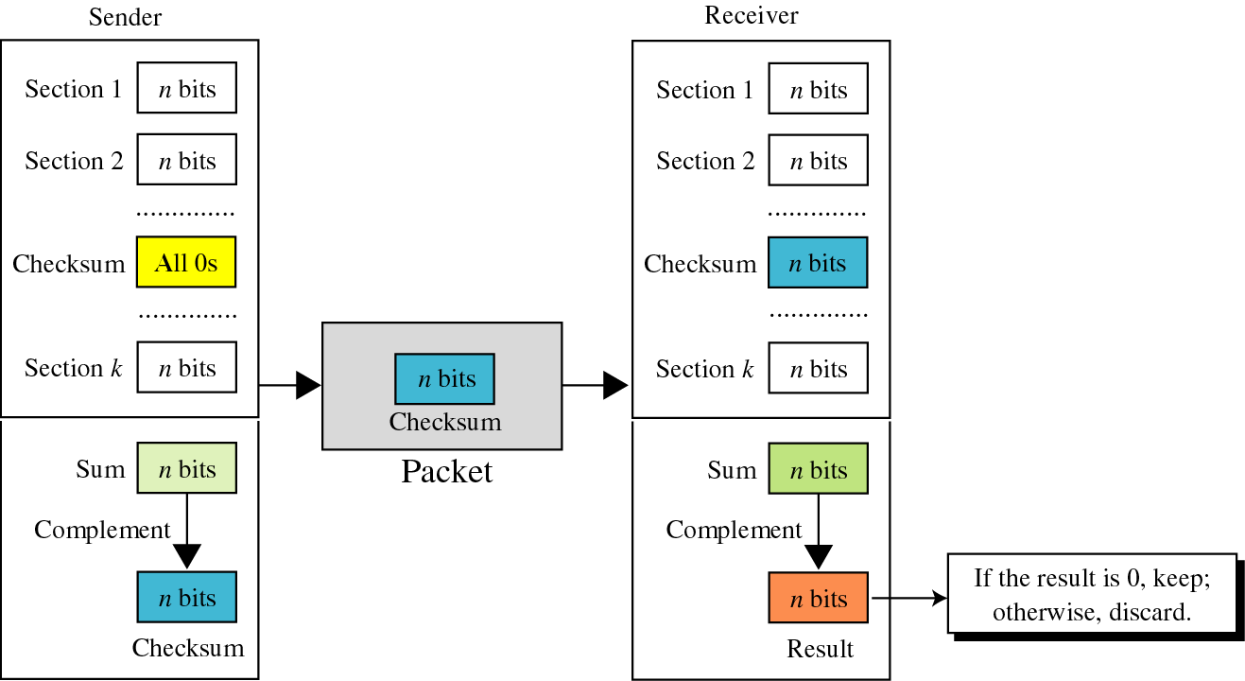
Figure 8-22
Checksum concept

Slide 26
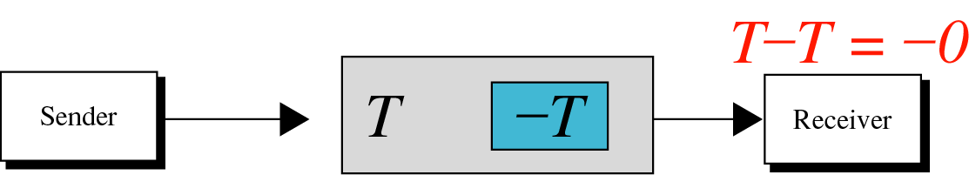
Figure 8-23
Checksum in one’s complement arithmetic

Slide 27
8.5
IP PACKAGE

Slide 28
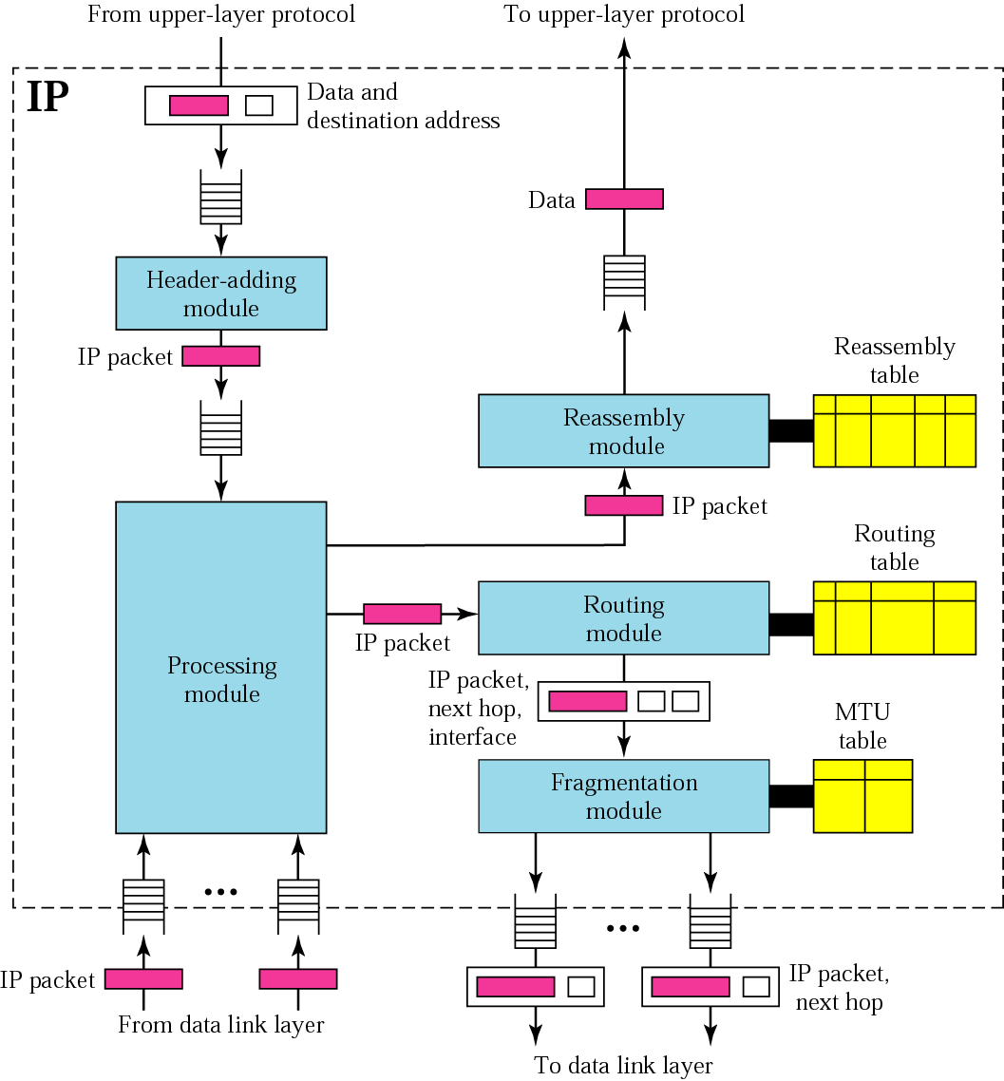
Figure 8-26
IP
components

Slide 29
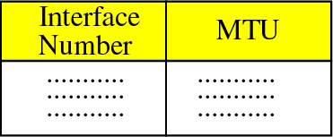
Figure 8-27
MTU table

Slide 30
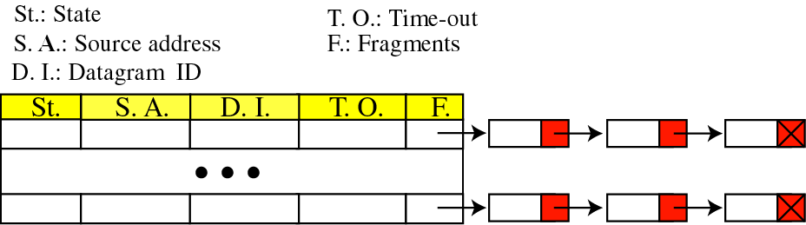
Figure 8-28
Reassembly table

