Slide 1
Transmission
Control Protocol
(TCP)

Slide 2
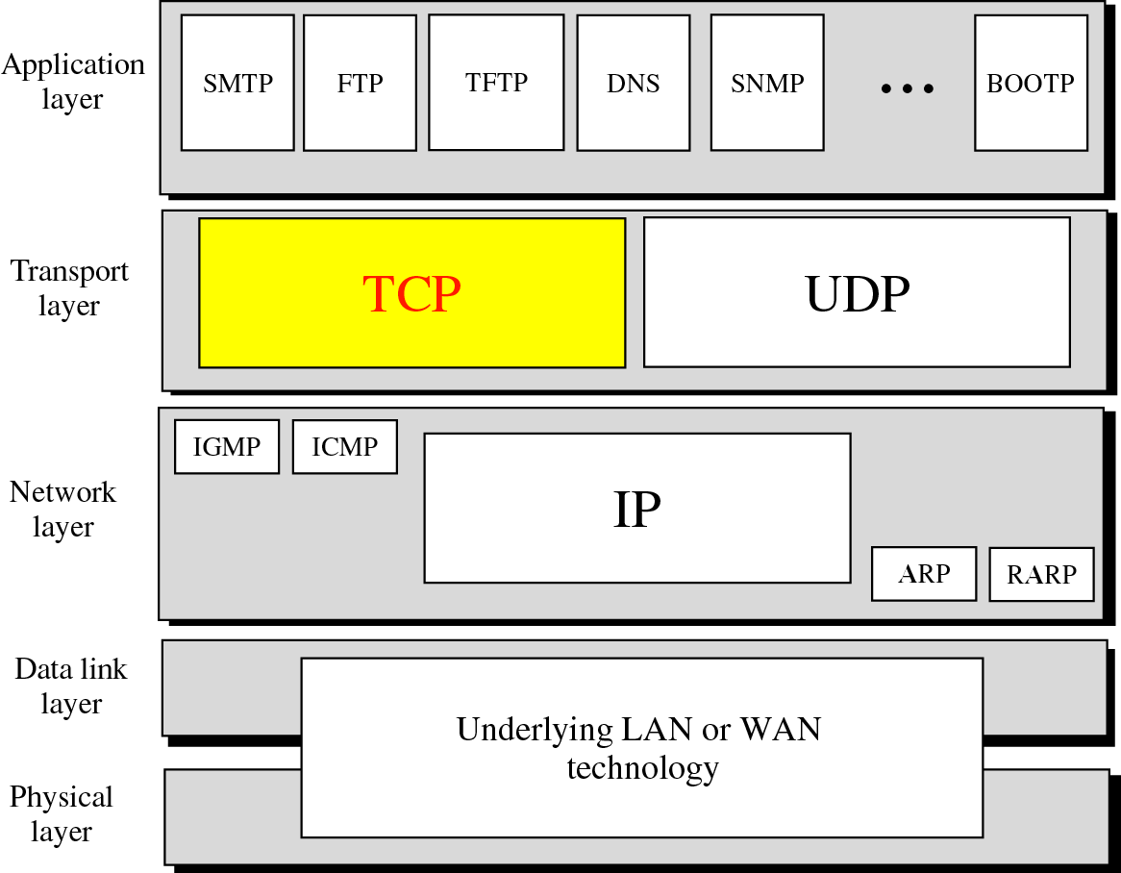
Figure 12-1
Position of TCP in TCP/IP protocol suite

Slide 3
12.1
PROCESS
TO
PROCESS
COMMUNICATION

Slide 4
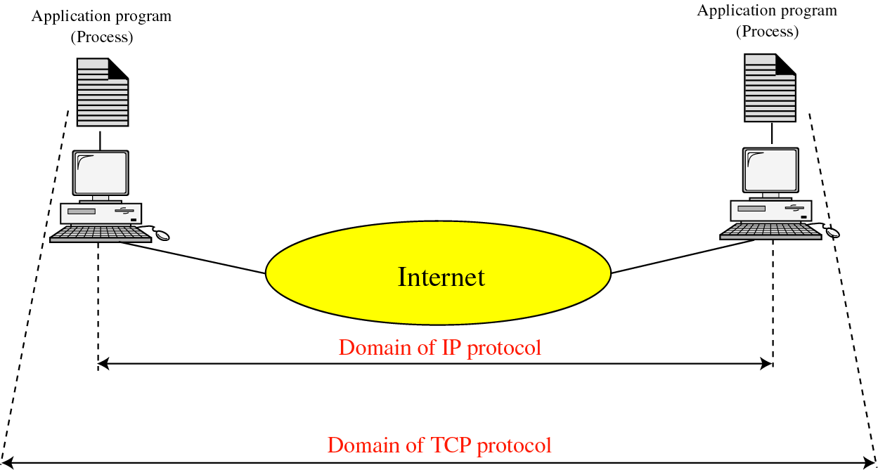
Figure 12-2
TCP versus IP

Slide 5
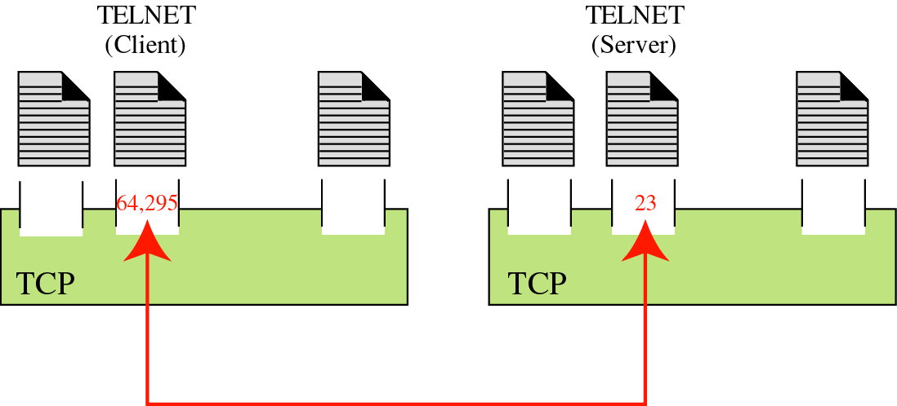
Figure 12-3
Port numbers

Slide 6
12.2
TCP
SERVICES

Slide 7
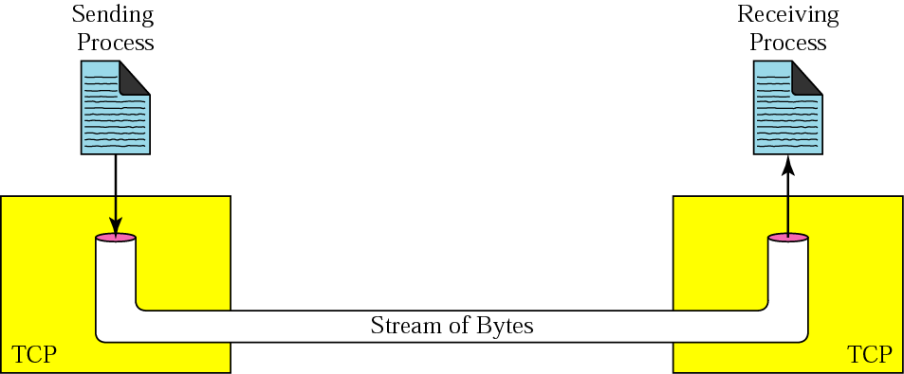
Figure 12-4
Stream delivery

Slide 8
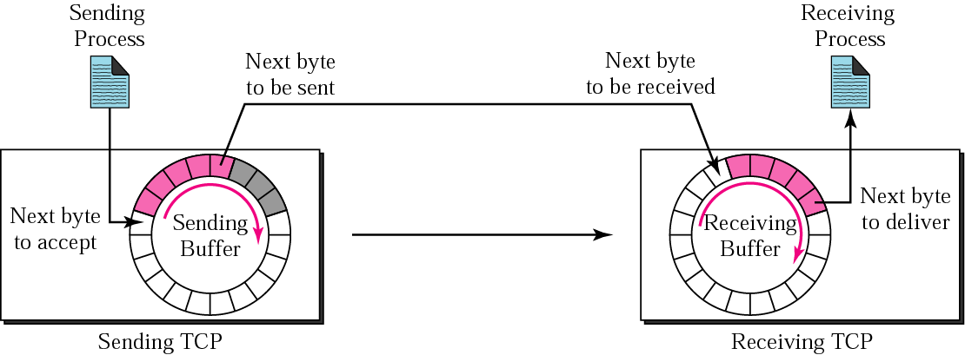
Figure 12-5
Sending and receiving buffers

Slide 9
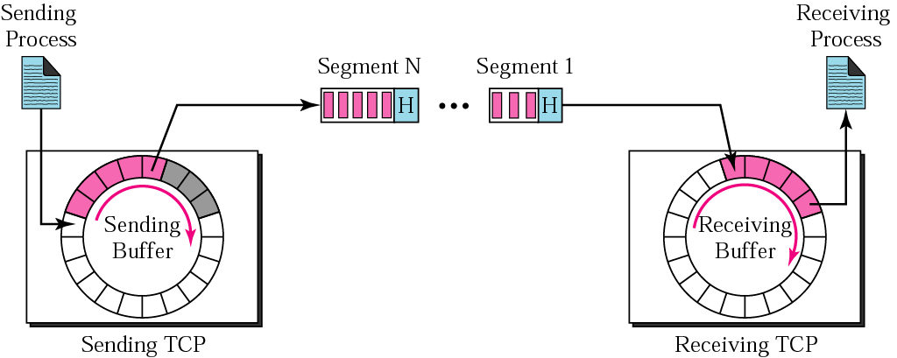
Figure 12-6
TCP segments

Slide 10
12.3
NUMBERING
BYTES

Slide 11

The bytes of data being transferred
in each connection are numbered by TCP.
The numbering starts with
a randomly generated number.

Slide 12
The value of the sequence number field in
a segment defines the number
of the first data byte
contained in that segment.

Slide 13
The value of the acknowledgment field in a
segment defines the number of the
next byte a party expects to receives.
The acknowledgment number is cumulative.

Slide 14
In TCP, the sender window
size is totally controlled
by the receiver window value.
However, the actual window size
can be smaller if there is
congestion in the network.

Slide 15
Some Points about TCP’s Sliding Windows:
1. The source does not have to send a
full window’s worth of data.
2. The size of the window can be increased
or decreased by the destination.
3. The destination can send an
acknowledgment at any time.

Slide 16
12.9
SEGMENT

Slide 17
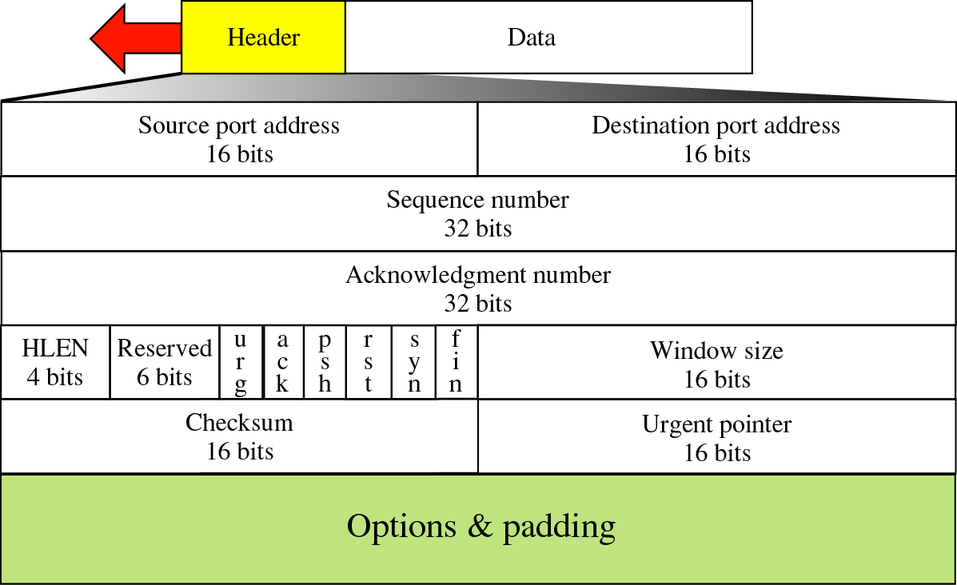
Figure 12-19
TCP segment format

Slide 18
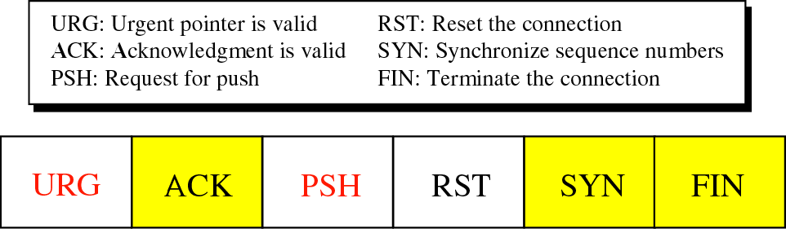
Figure 12-20
Control field

Slide 19
12.10
OPTIONS

Slide 20
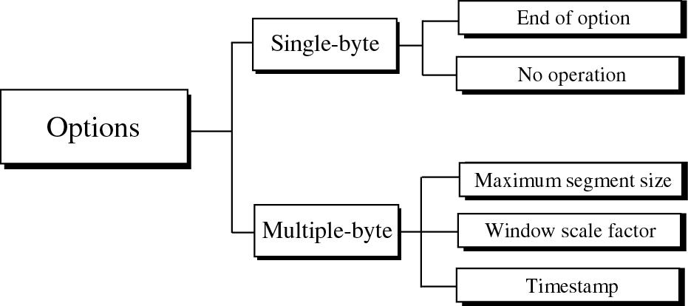
Figure 12-21
Options

Slide 21
12.12
CONNECTION

Slide 22
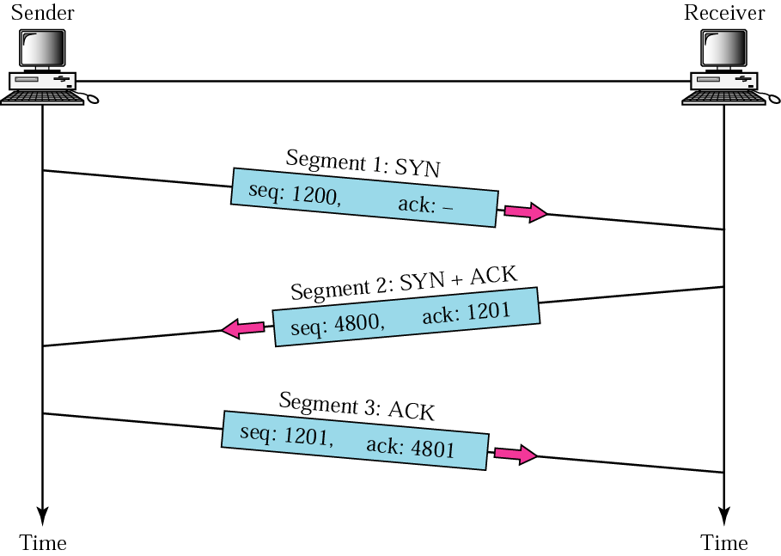
Figure 12-28
Three-way handshaking

Slide 23
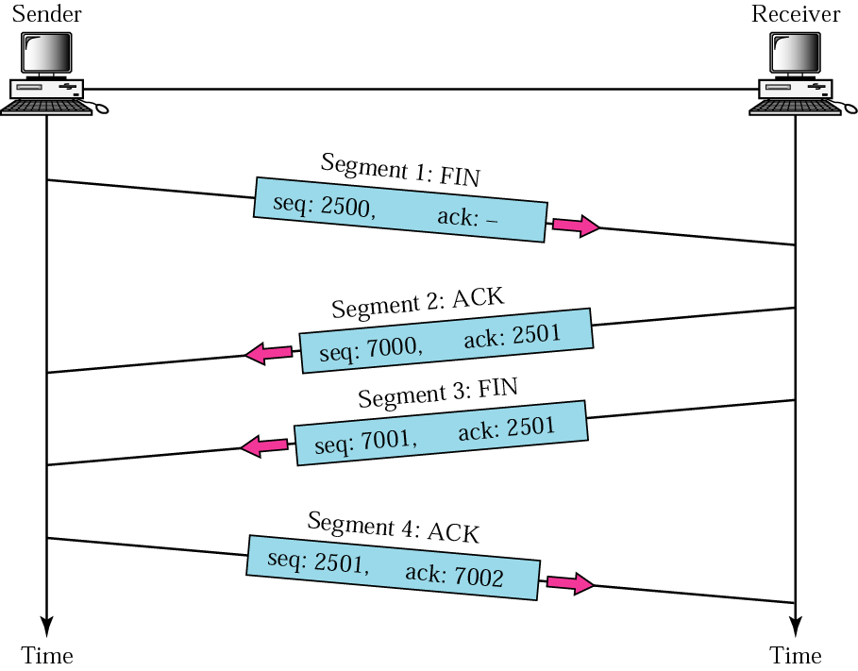
Figure 12-29
Four-way handshaking

Slide 24
12.14
TCP
OPERATION

Slide 25
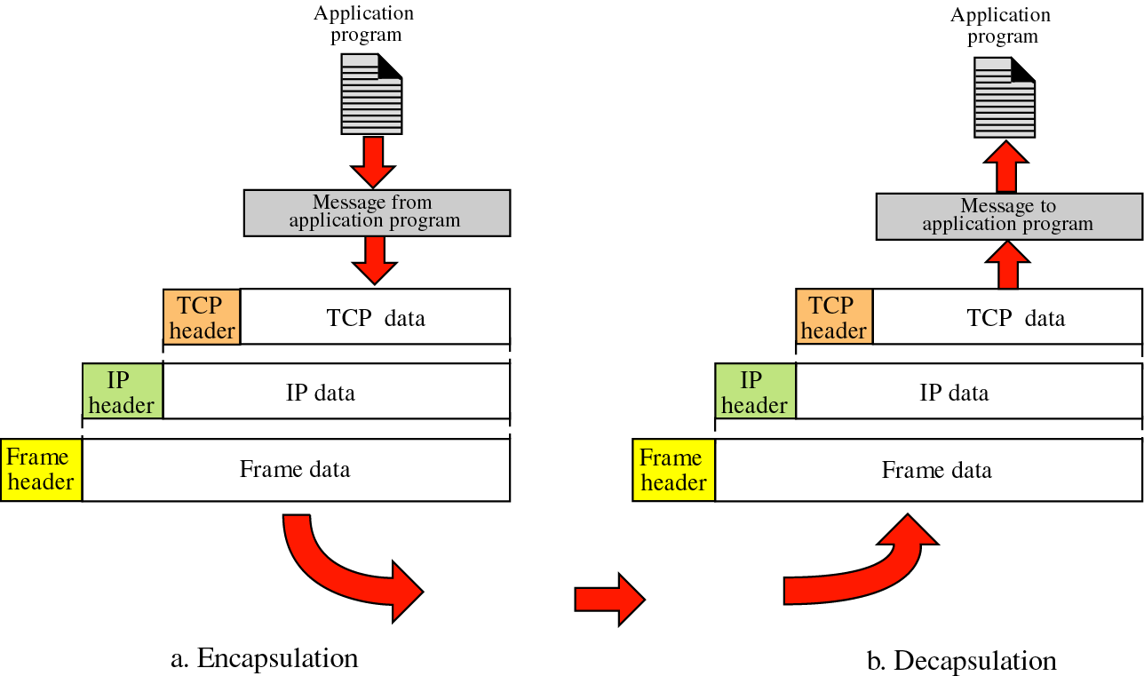
Figure 12-33
Encapsulation and decapsulation

Slide 26
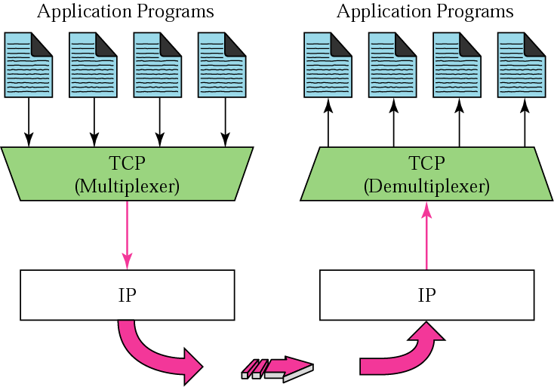
Figure 12-34
Multiplexing and demultiplexing

Slide 27
12.15
TCP
PACKAGE

Slide 28
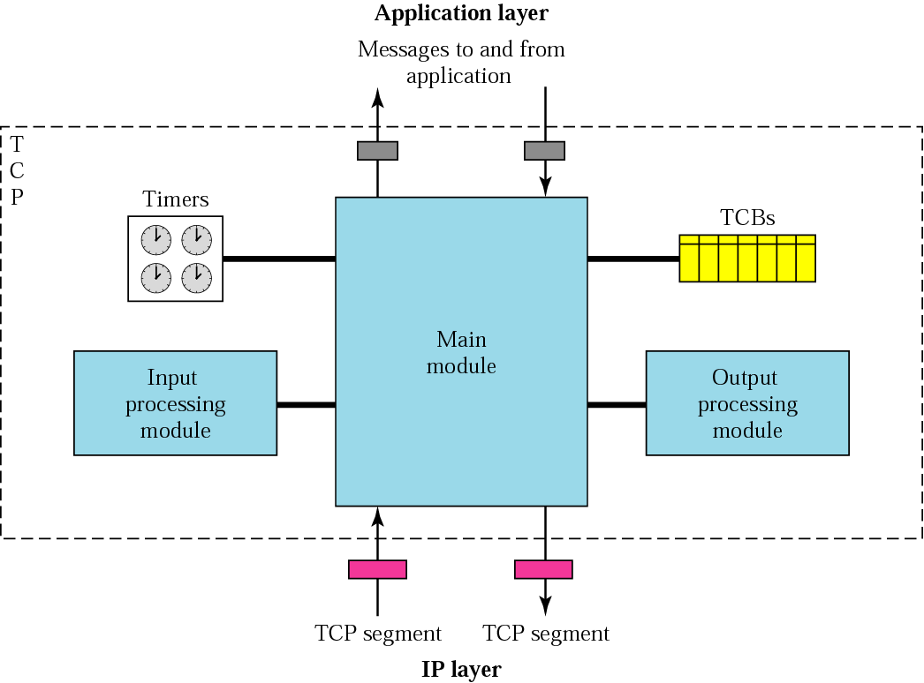
Figure 12-35
TCP package

Slide 29
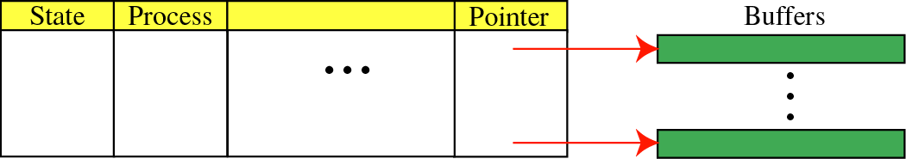
Figure 12-36
TCBs
Transmission control blocks

