Slide 1
AR Advertisement Detection
& Replacement
Reducing visual clutter through real-time AR advertisement blurring and replacement
Aksa Ahmed
Bachelor of Science · Software Engineering · Ulm University
October 6, 2026

Slide 2
Motivation
1
2
3
Visual overload
Cognitive load
AR as a filter
City centers are saturated with advertising, competing for pedestrians' attention.
Constant advertising exposure increases stress and mental effort while walking.
Instead of adding more content, AR can be used to remove or soften visual noise.
Research question: Does automatically detecting and blurring/replacing advertisements improve usability, reduce workload, and increase immersion - without lowering trust?
AR Advertisement Detection & Replacement
2

Slide 3
My task
Concept
Designed the AR advertisement detection & replacement concept, including an initial navigation feature that was later removed for safety/testability reasons.
Implementation
Built the Unity prototype: detects advertisement surfaces and applies a real-time blur or replaces them with a relaxing video.
Study design
Designed a within-subject user study with 3 conditions, 4 validated questionnaires (SUS, NASA-TLX, Trust, ARI), and a behavioral distraction task.
Data collection
Set up and ran the study in LimeSurvey with 18 participants across all three conditions.
Analysis
Cleaned, merged, and statistically analyzed the data (Shapiro-Wilk, RM-ANOVA / Friedman, post-hoc tests).
AR Advertisement Detection & Replacement
3

Slide 4
Concept overview
Capture
→
Detect
→
Decide
Camera view of the pedestrian's real-world surroundings
Advertisement surfaces (billboards, screens) are recognized in real time
System applies one of two treatments to the detected surface
Condition B - Blur
Condition C - Replacement
The detected advertisement is blurred in real time, reducing its visual salience while keeping spatial context intact.
The advertisement is replaced with a short relaxing video, turning a distracting surface into a calming visual element.
Note: an earlier version also included a pedestrian navigation overlay. It was removed, as testing it safely in real outdoor traffic was not feasible within this project.
AR Advertisement Detection & Replacement
4

Slide 5
Technical implementation
Platform
Meta Quest 3 (video passthrough AR headset)
Engine
Unity, C# (based on Meta's Passthrough Camera API samples)
Detection
YOLOv9 model, converted to Unity Sentis, running on-device (CPU backend) to detect advertisement surfaces in real time
Stability
Detections are filtered across multiple frames (median-based) before the overlay position is locked in place
Treatment
Detected regions are either blurred (shader-based) or overlaid with a video texture
AR Advertisement Detection & Replacement
5

Slide 6
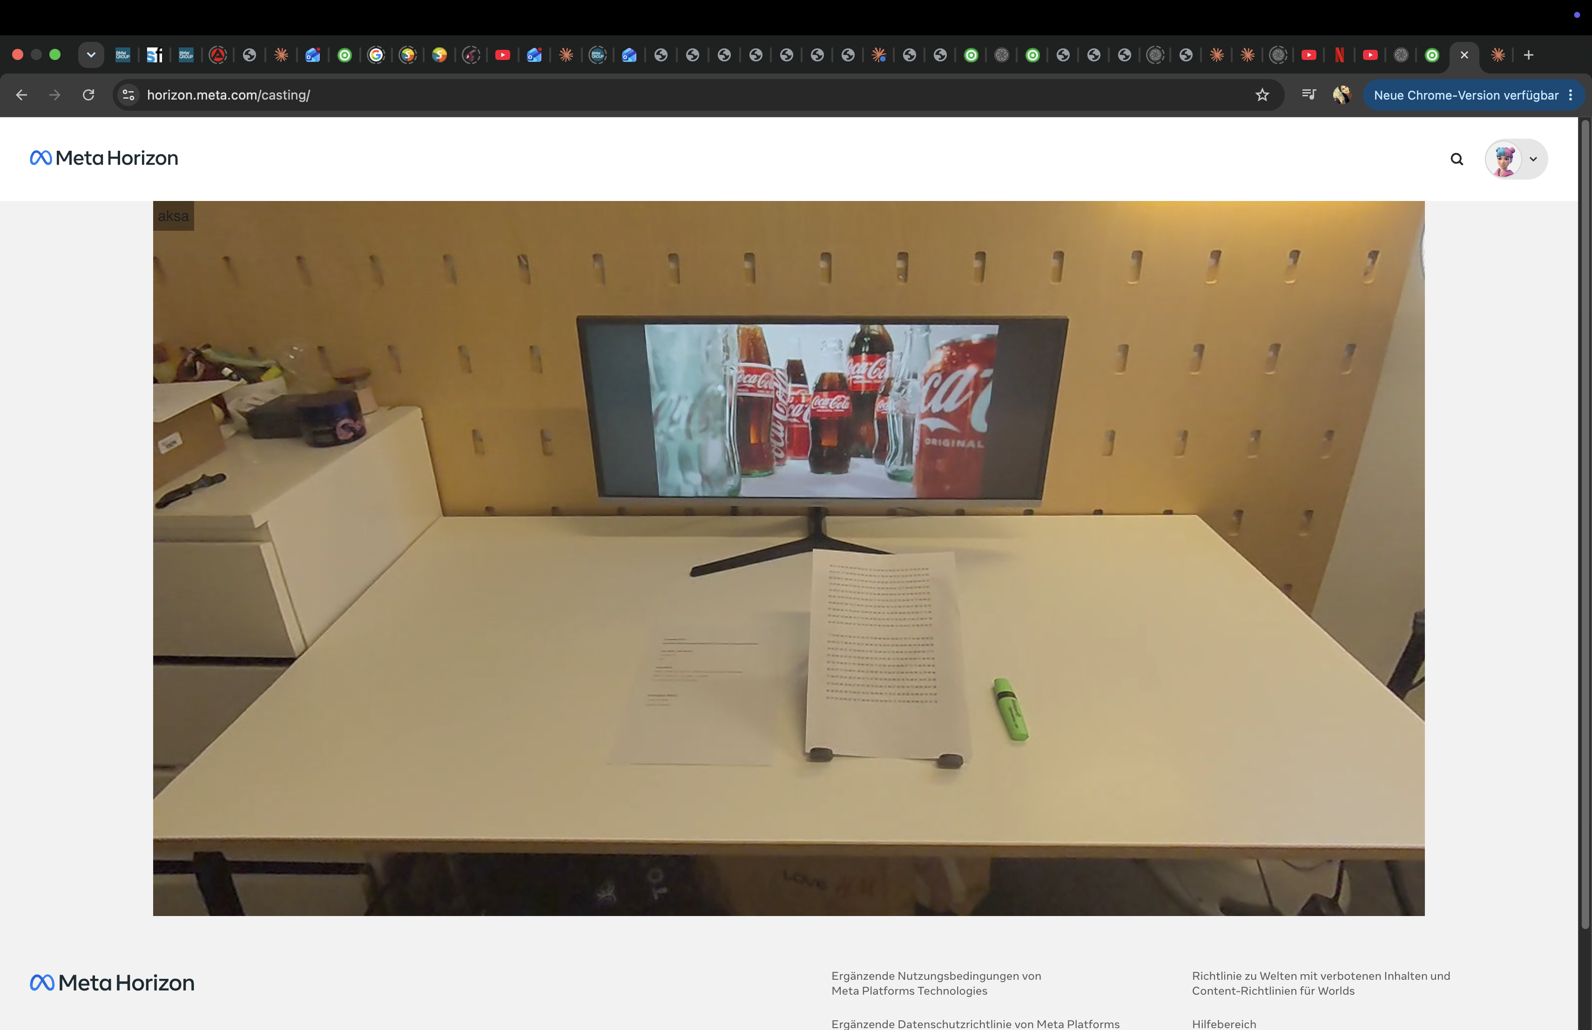
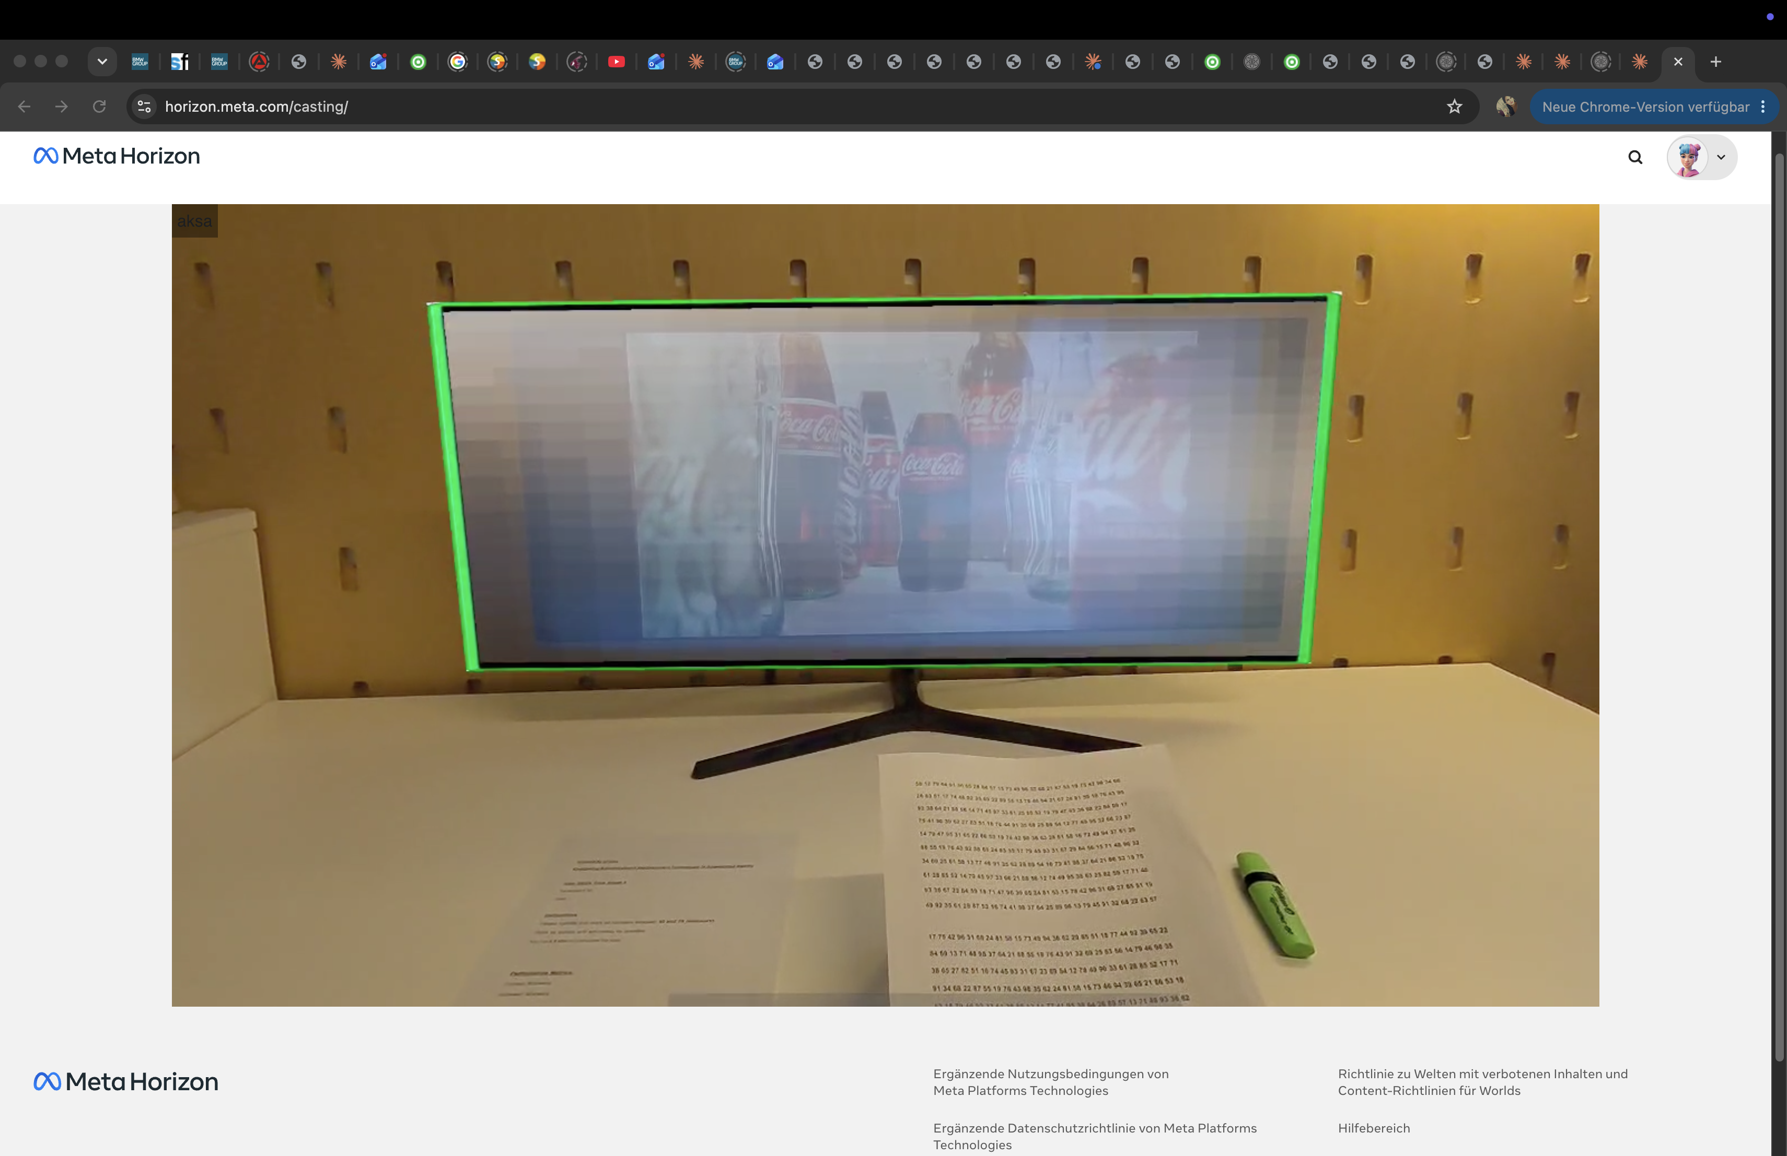
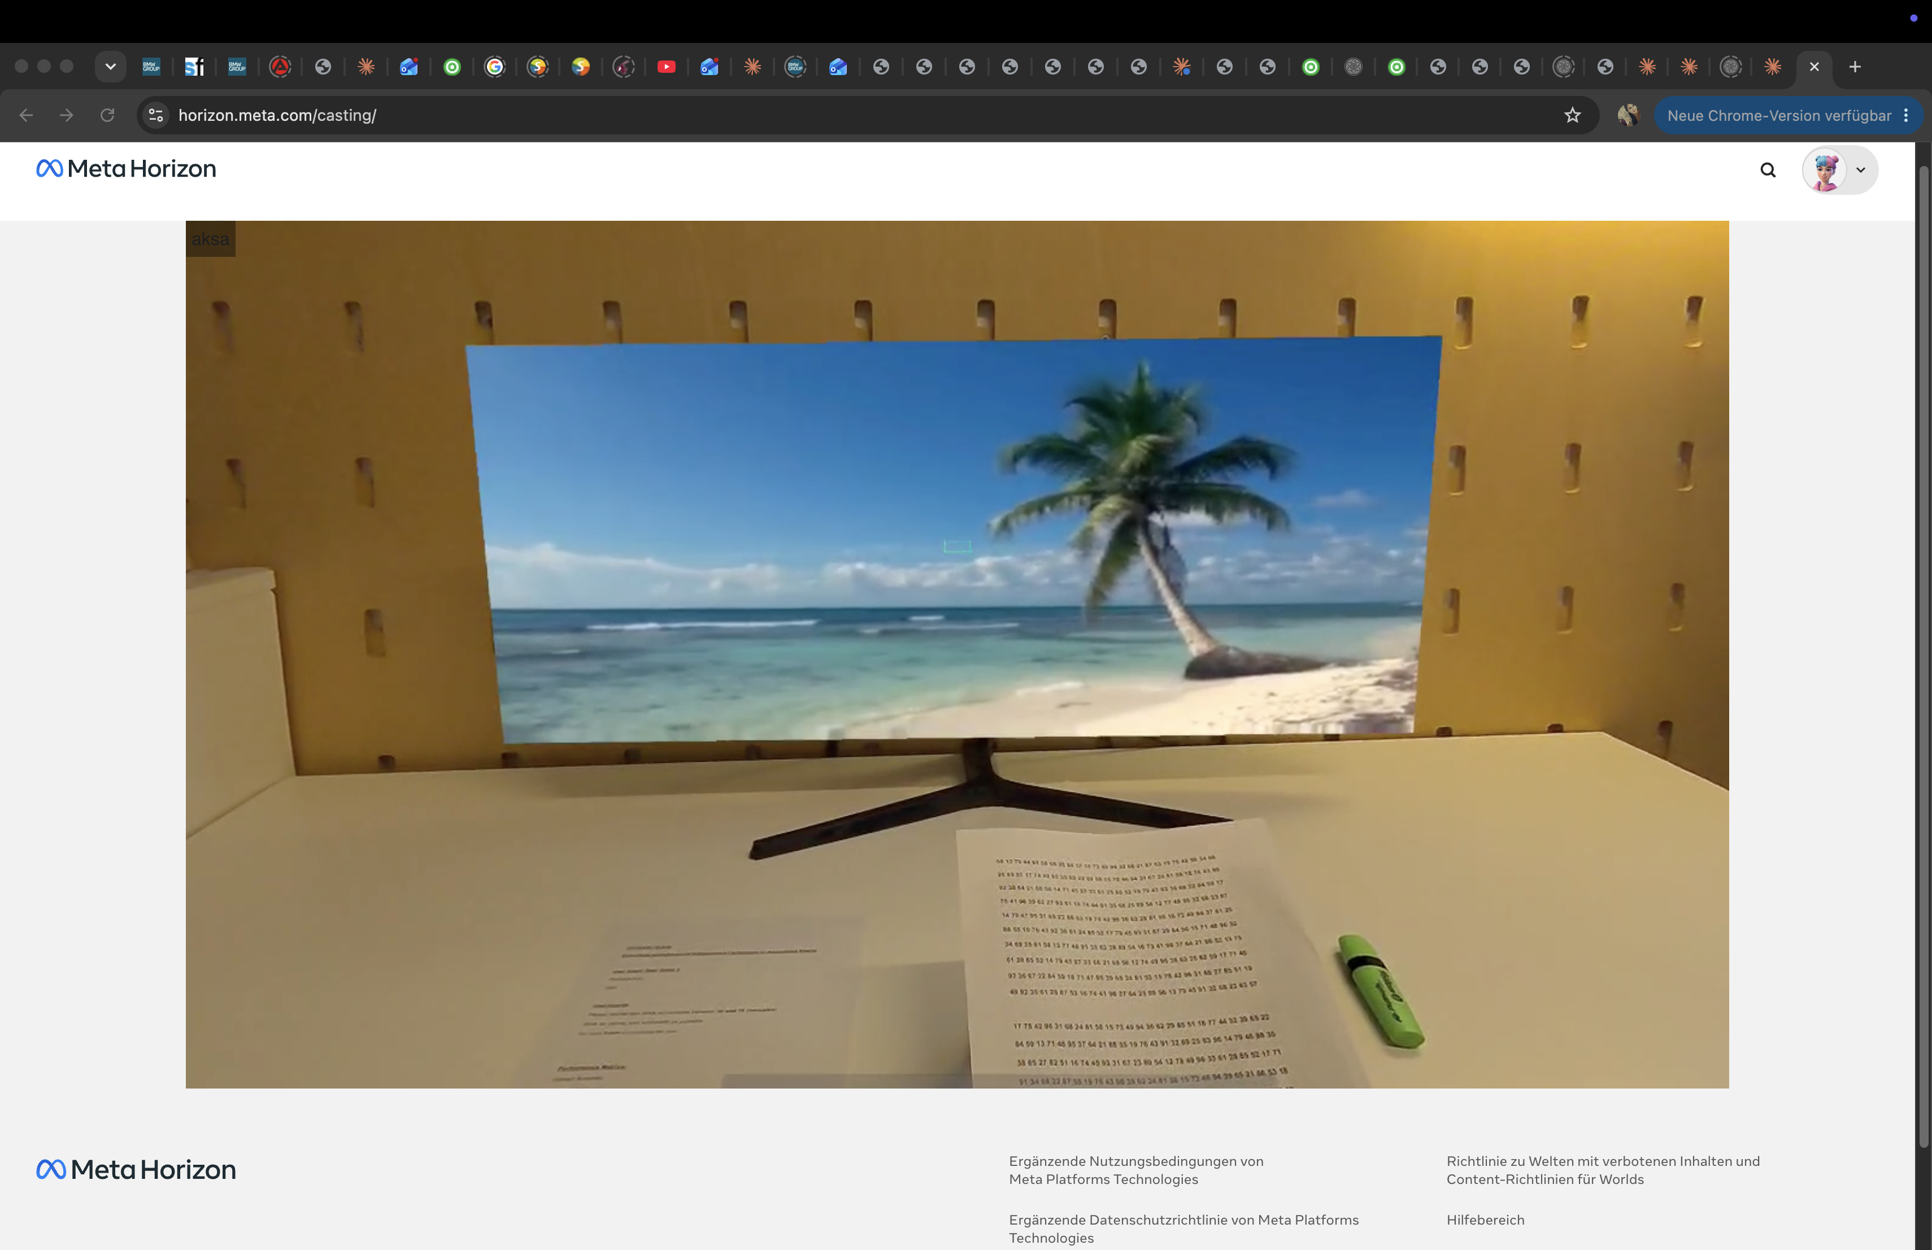
Prototype
A - Original advertisement
B - Blurred advertisement
C - Advertisement replaced
AR Advertisement Detection & Replacement
6

Slide 7
Study design
18
3
4
1
Participants
Conditions (within-subject)
Questionnaires per condition
Behavioral distraction task
Conditions
Measures
Sample
A Original advertisements
unmodified
SUS: perceived usability
NASA-TLX (raw): perceived workload
Trust in Automation: trust
ARI: immersion
Distraction task: error rate (objective)
18 participants, within-subject
Guideline: 36 (HCI Toolkit)
Convenience sample
B Blurred advertisements
diminished
C Advertisement replacement
altered
Based on mediated reality (Mann; MIRAGE)
Smaller sample limits statistical power
Sources: Mann & Barfield (2003); MIRAGE (CHI 2026); Schwind et al. (2023), HCI User Studies Toolkit.
AR Advertisement Detection & Replacement
7

Slide 8
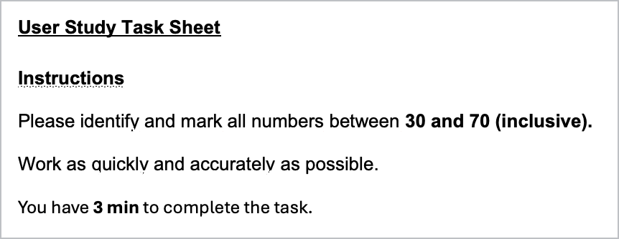
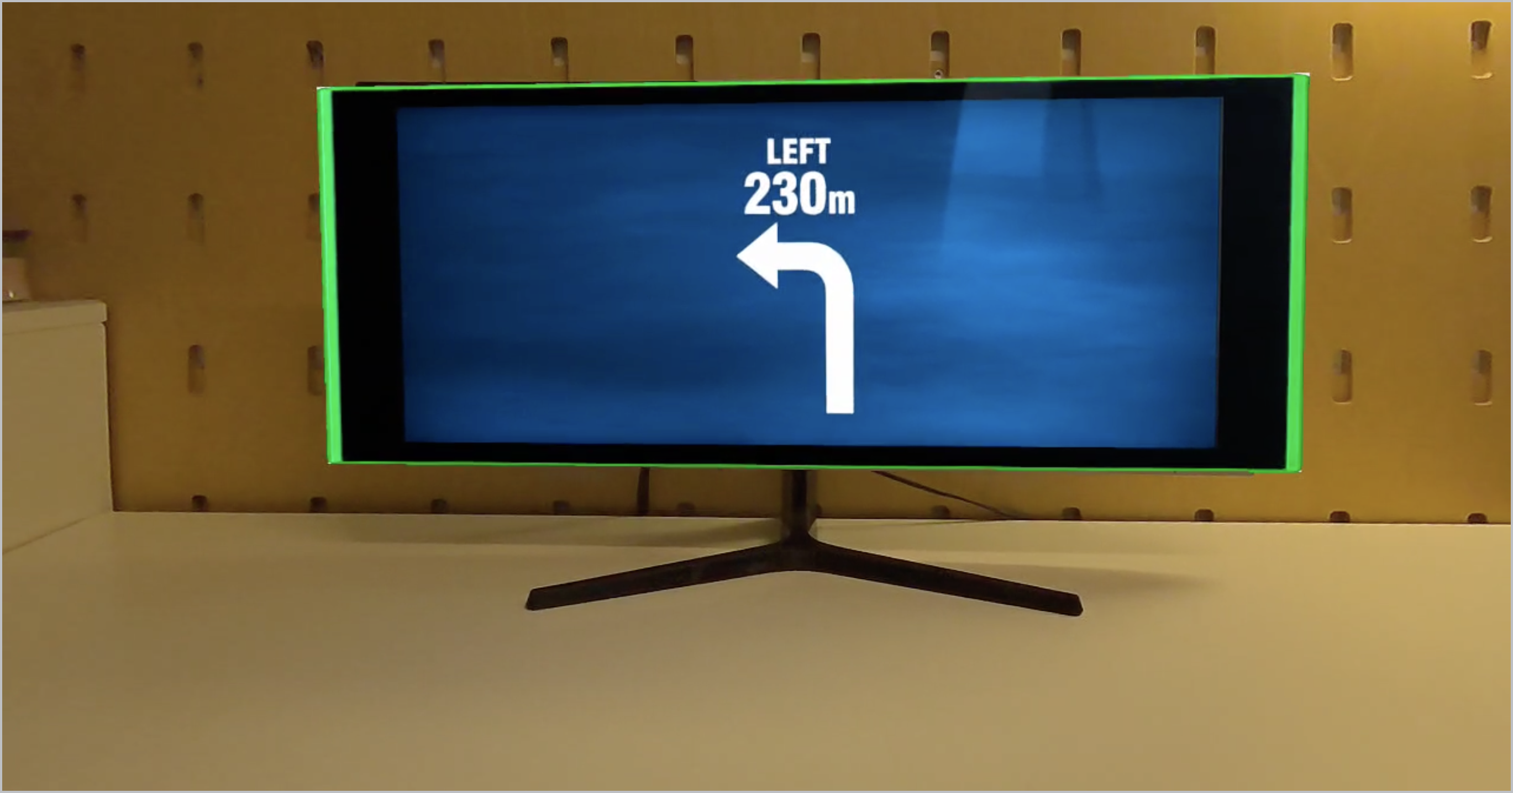
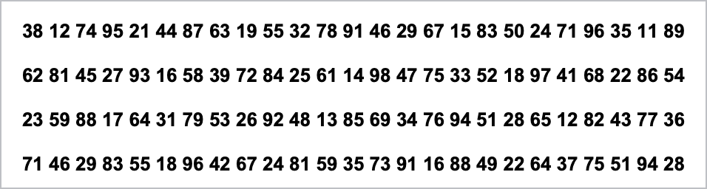
From navigation to a paper-based task
Used in the study: paper task
Original idea: navigation
Challenge: Safety risks when testing navigation
Solution: Paper-based task, completed with the headset on
Distraction measure: Error rate (objective)
Excerpt of the number grid
Note: Project partner dropped out early; remaining work completed individually.
AR Advertisement Detection & Replacement
8

Slide 9
Statistical approach
A = Original Advertisements · B = Blurred Advertisements · C = Advertisement Replacement
1. Compute scores
SUS, NASA-TLX, Trust, ARI, error rate - one score per participant per condition
2. Shapiro-Wilk test
Check normality of each score, separately for A, B and C
normal in all 3 conditions
not normal in at least one
One-way repeated-measures ANOVA (Trust)
Friedman test (SUS, TLX, ARI, error rate)
Post-hoc: paired t-tests + Holm correction
Post-hoc: Wilcoxon signed-rank + Holm correction
AR Advertisement Detection & Replacement
9

Slide 10
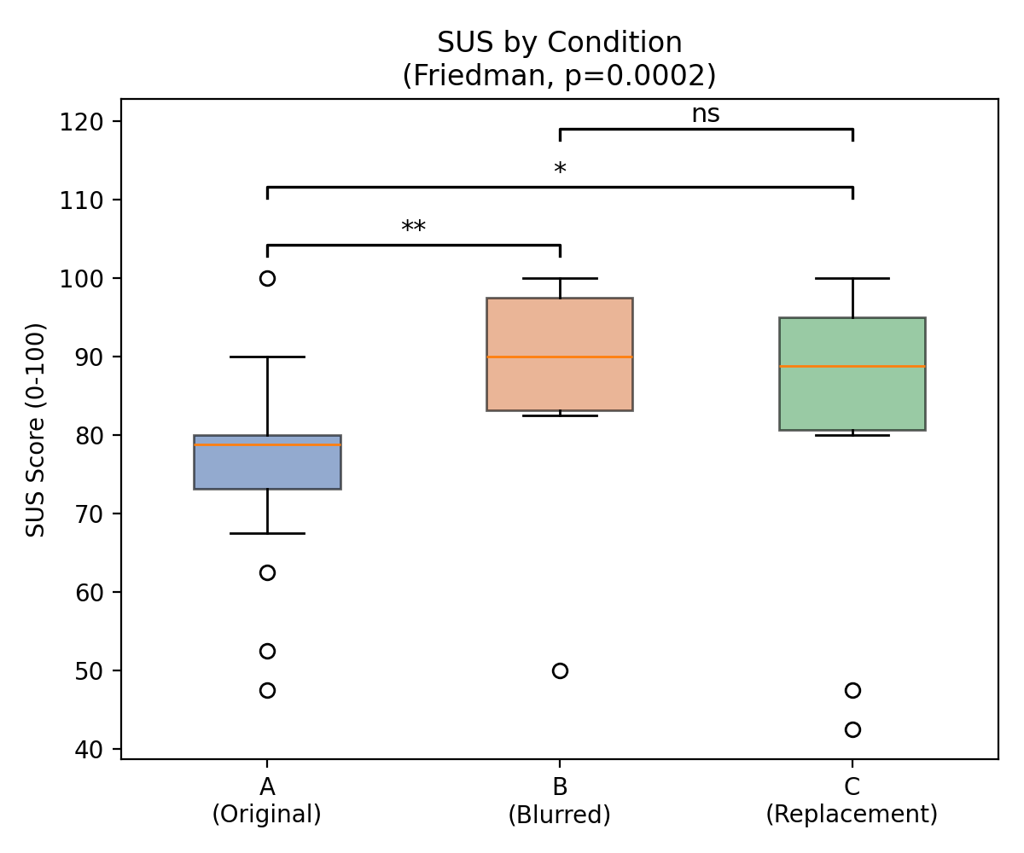
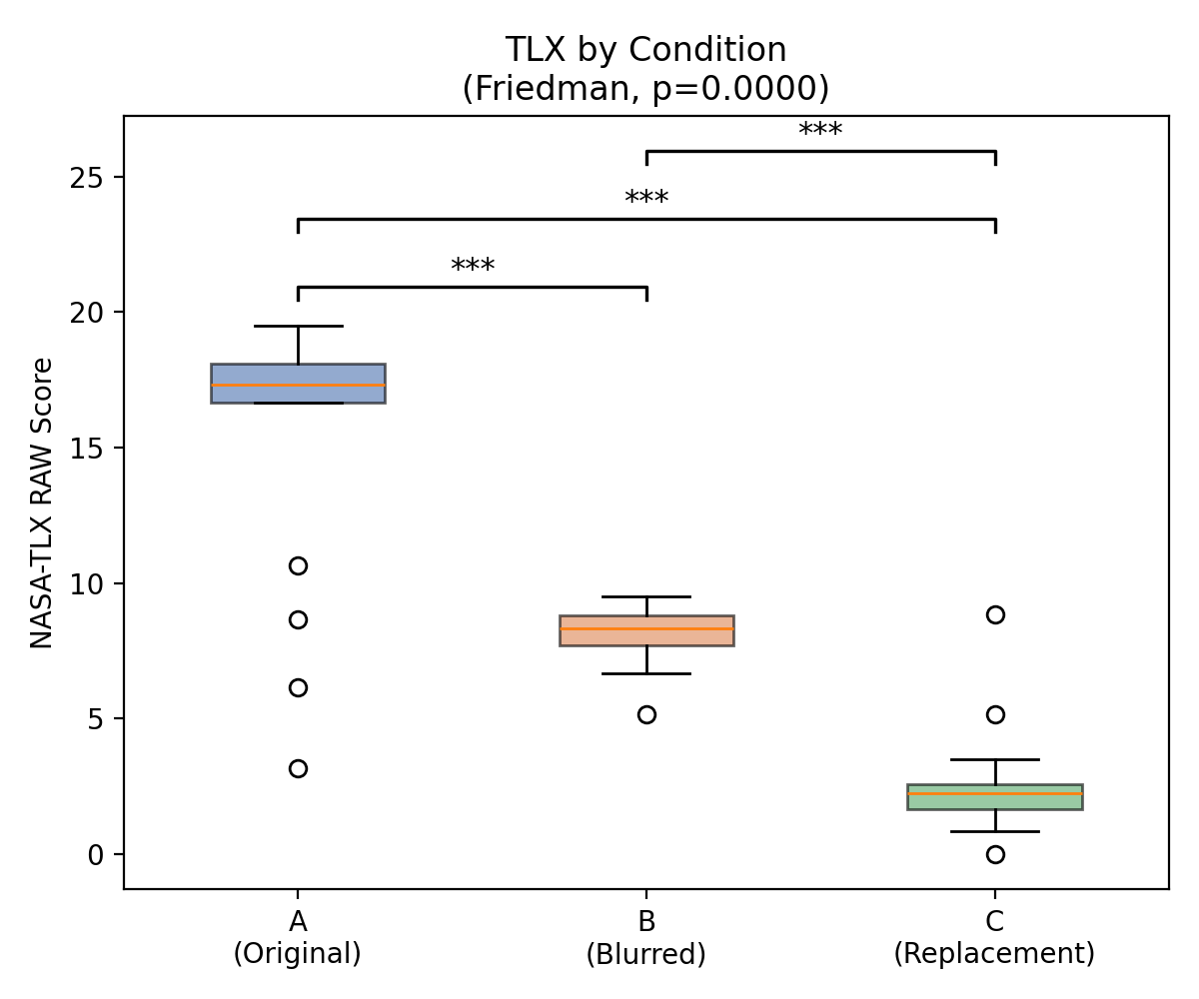
Results - usability & workload
AR Advertisement Detection & Replacement
10

Slide 11
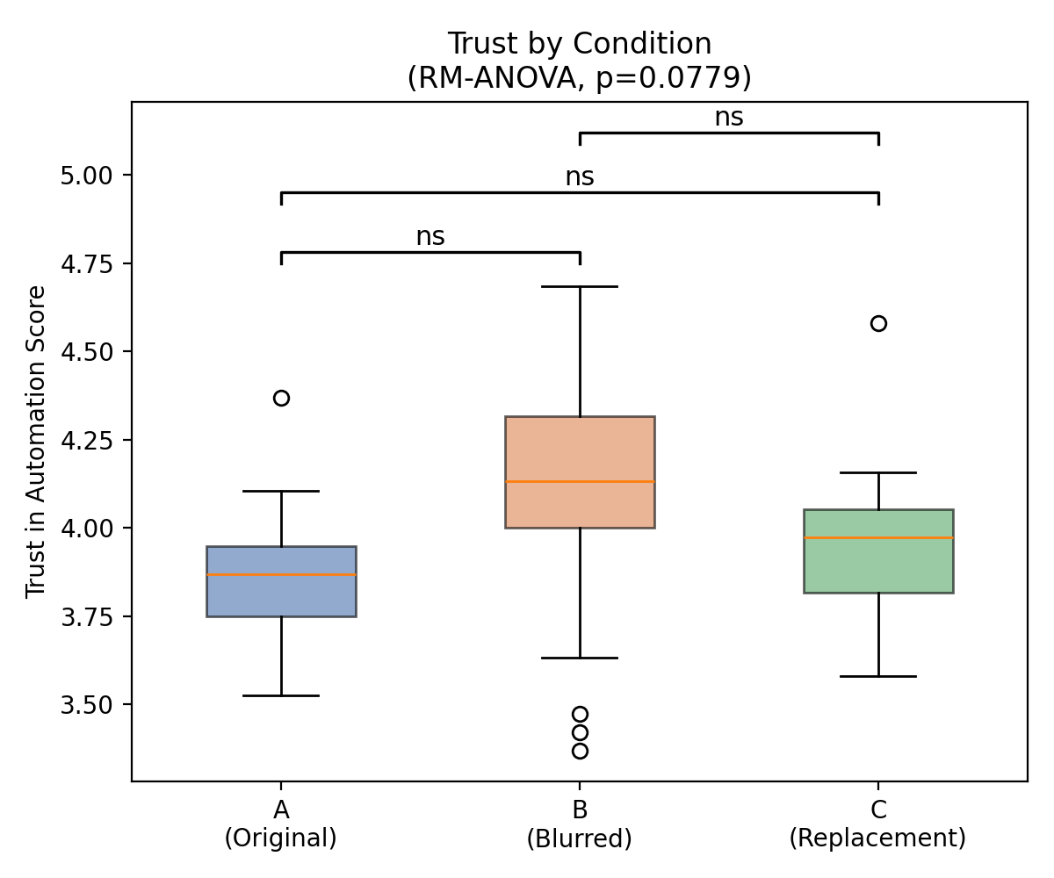
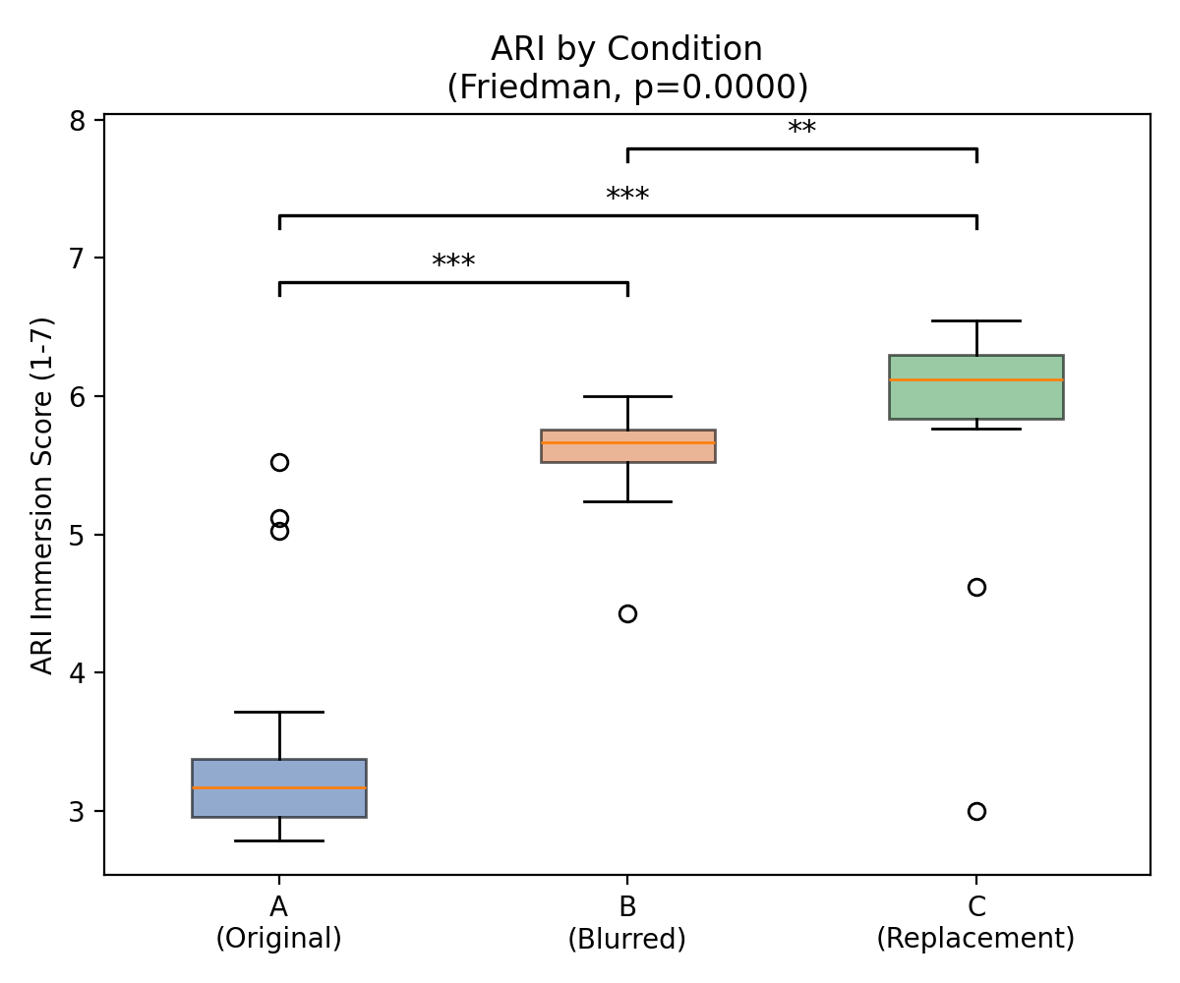
Results - trust & immersion
AR Advertisement Detection & Replacement
11

Slide 12
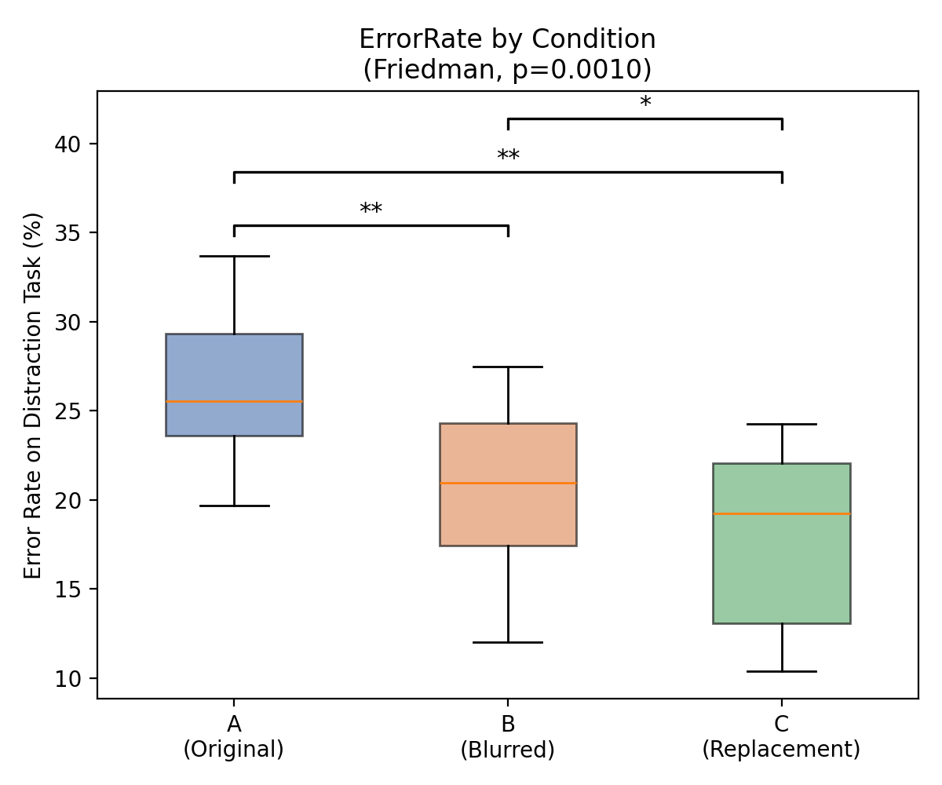
Results - distraction task
Objective behavioral measure: error rate on the number-finding task, done once per condition.
AR Advertisement Detection & Replacement
12

Slide 13
Discussion & conclusion
A = Original Advertisements · B = Blurred Advertisements · C = Advertisement Replacement
Usability ↑
Blurring or replacing ads (B, C) rated significantly more usable than the original view (A).
Workload ↓
Mental workload decreased clearly and significantly from A to B to C.
Trust →
No significant difference in trust - modifying ads did not make the system feel less trustworthy.
Immersion ↑
Immersion was significantly higher in B and C than in A.
Distraction ↓
Error rate on the distraction task also decreased significantly from A to B to C, confirming the questionnaire results with an objective measure.
Limitation
Small convenience sample (N = 18, guideline: 36) limits statistical power and generalizability.
Removing or replacing advertisements in AR makes the experience more usable, less demanding, and more immersive - without costing user trust.
AR Advertisement Detection & Replacement
13

Slide 14
References
Mann, S., & Barfield, W. (2003). Introduction to mediated reality. Int. J. Human-Computer Interaction, 15(2), 205-208.
MIRAGE: Enabling Real-Time Automotive Mediated Reality. CHI 2026. doi:10.1145/3772318.3791195
Schwind, V., Resch, S., & Sehrt, J. (2023). The HCI User Studies Toolkit. CHI EA '23. doi:10.1145/3544549.3585890
Brooke, J. (1996). SUS: A quick and dirty usability scale. In Usability Evaluation in Industry. Taylor & Francis.
Hart, S. G., & Staveland, L. E. (1988). Development of NASA-TLX. Advances in Psychology, 52, 139-183.
Körber, M. (2019). Theoretical considerations and development of a questionnaire to measure trust in automation. IEA 2018 Proceedings.
Georgiou, Y., & Kyza, E. A. (2017). The development and validation of the ARI questionnaire. Int. J. Human-Computer Studies, 98, 24-37.
Wang, C.-Y., Yeh, I.-H., & Liao, H.-Y. M. (2024). YOLOv9: Learning what you want to learn using programmable gradient information. ECCV 2024.
Meta Platforms Technologies. Unity-PassthroughCameraApiSamples (GitHub repository).
AR Advertisement Detection & Replacement
14

Slide 15
Thank you
Questions?

