Slide 1
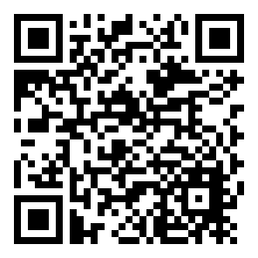
Short, long, and ‘broad’ timelines
Toby Ord, March 2026
The claim: Smart, informed experts disagree by decades. The right response is not to pick a side, but to have a broad distribution.
Every expert has wide uncertainty. Kokotajlo's 80% interval: 23+ years. Ord's: 97 years. The community aggregate is wider still.
Single numbers mislead. A median of 2030 obscures a 10% chance it's after 2050.
Practical consequence: Hedge against short timelines and invest in work that pays off if timelines are long.
Read more

Slide 2
TED-AI Timelines
Build your own probability distribution. Submit. Compare.
TED-AI
An AI system at least as good as top human experts at virtually all cognitive tasks. Operationally: given the resources of a large tech company and three months to prepare, it could fully automate 95% of remote-work jobs in the US. (AI Futures Model)
Elicit on your phone (8 min) → Submit (1 min) → Discuss (6 min)

Slide 3
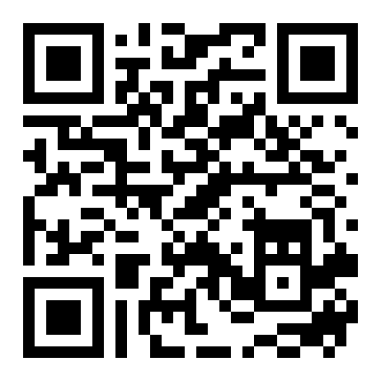
Build your distribution
labs.aksaeri.com/other/tedai-elicit

Slide 4
Discussion
Where is the group's disagreement — on medians, or on tail widths?
If you did this again in six months, which number would have moved most?
What would have to be true for the latest median in the room to be correct?

