Slide 1
Online Shopping Clickstream & Customer Behavior Analysis using Python
Exploratory Data Analysis (EDA) Project
Anunay Kumar Sah
B.Tech CSE, ITER (Siksha 'O' Anusandhan)

Slide 2
Objective and Dataset
Objective: understand how users browse an online clothing shop and find patterns in their behaviour
Dataset: UCI Clickstream Data for Online Shopping (e-shop clothing 2008)
165,474 rows (one row = one click) in 24,026 sessions, April to August 2008
There is no purchase column, so I use "highly engaged session" (more than 8 clicks) as a proxy for conversion
Tools: Python, Pandas, NumPy, Matplotlib, Seaborn, Google Colab

Slide 3
Data Cleaning
No missing values and no duplicate rows
Checked the click order and country of all 24,026 sessions: no problems
Removed 1 row where the product code did not match its category
Replaced number codes with names (country, category, colour, location)
Made a session table with clicks, pages, average price and more
Kept 17 very long sessions (100+ clicks, longest 195) because I cannot prove they are errors

Slide 4
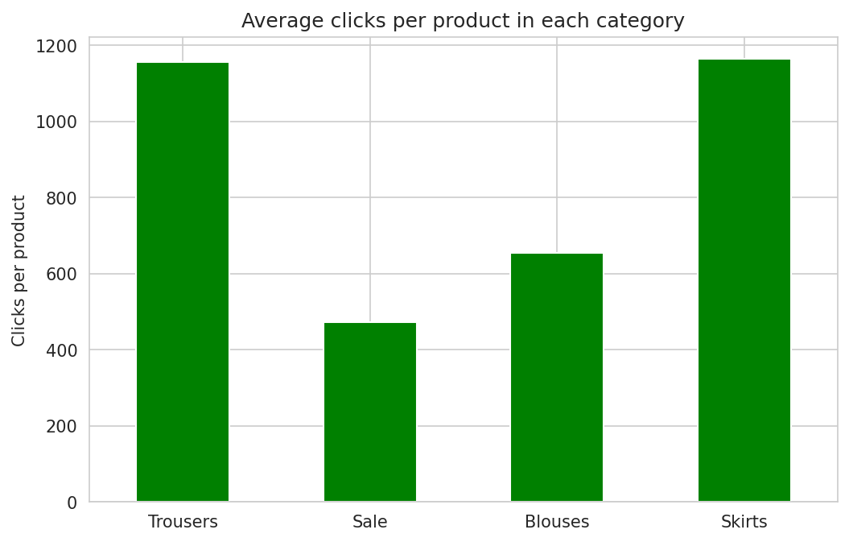
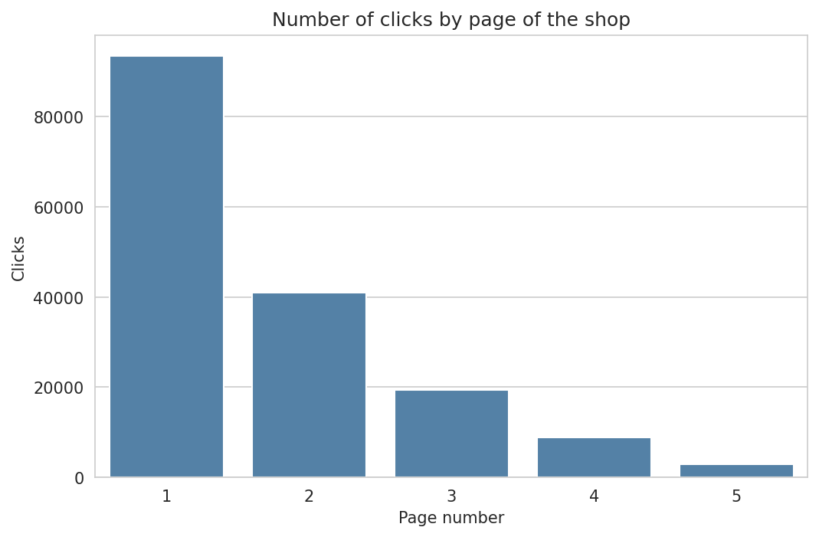
Categories and Pages
Trousers get the most clicks (30%)
Skirts and trousers get about 1,160 clicks per product, sale only 473
Page 1 gets 56.5% of all clicks
Page 5 gets only 1.7%

Slide 5
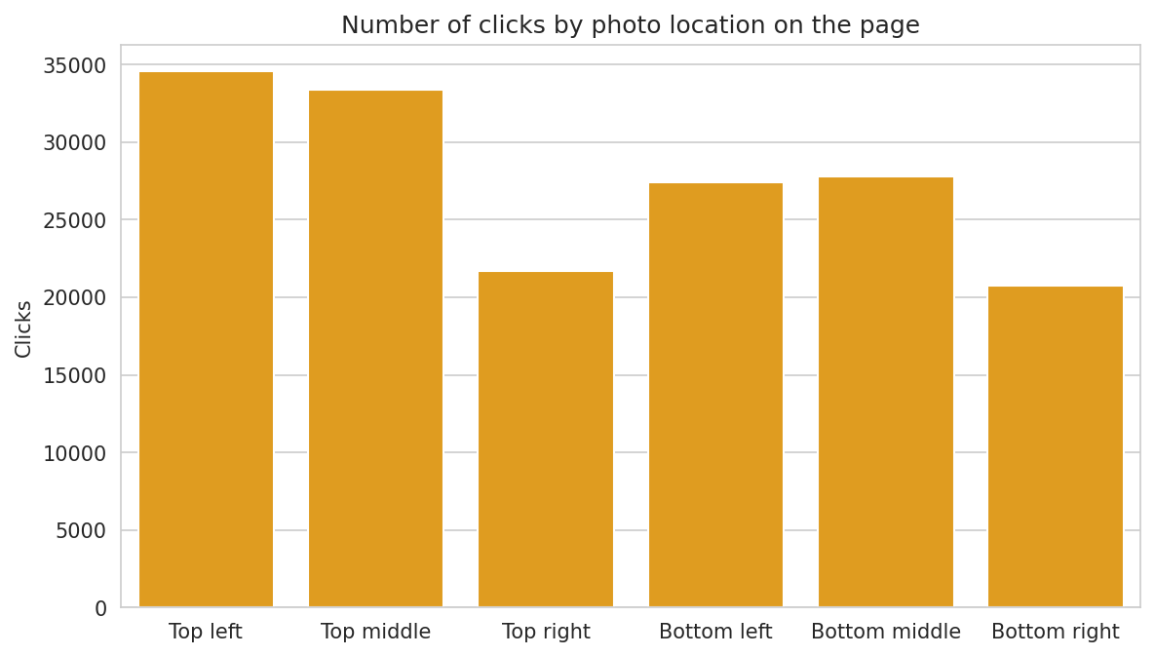
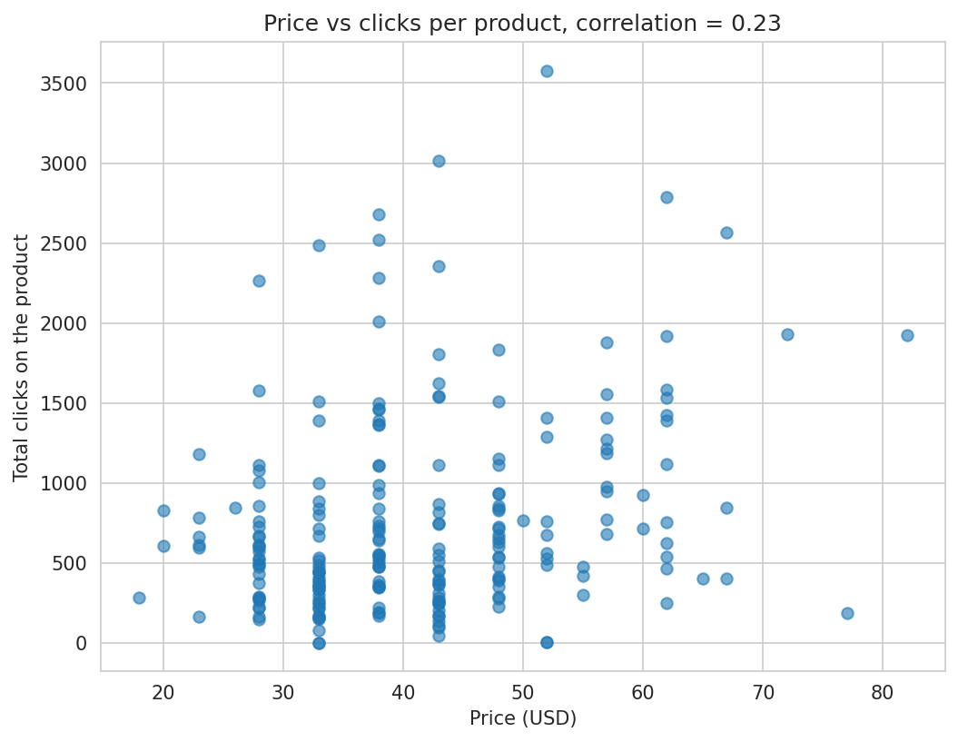
Photo Location and Price
Top left (20.9%) and top middle (20.2%) get the most clicks
Bottom right gets the least (12.5%)
Expensive products are not clicked less (correlation +0.23)
But expensive items are mostly on early pages

Slide 6
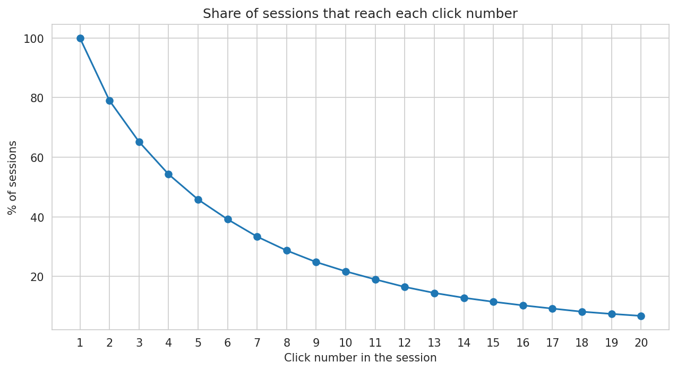
Users and Countries
21% of sessions have only 1 click
Only 46% of sessions reach the 5th click
Poland gives 81.5% of sessions, Czech Republic 9.4%
.net sessions look unusual: 53% have only 1 click (maybe robots)

Slide 7
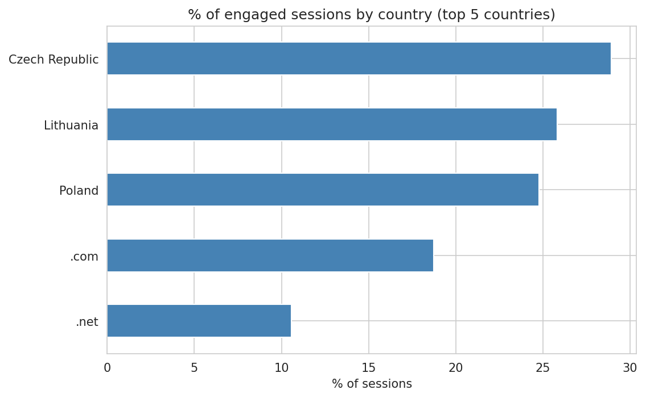
Engaged Sessions (Proxy for Conversion)
24.8% of sessions are highly engaged (more than 8 clicks)
They visit 2.8 categories, other sessions only 1.5
Czech Republic has the highest share (28.9%), .net the lowest (10.6%)
Sessions that start with trousers or sale are the most engaged

Slide 8
Recommendations and Conclusion
Put the products to sell on page 1, top left and top middle
Help users go on after the first click (related items, filters)
Recommend products from other categories
Show fewer, better sale items higher up
Target the Czech Republic and Lithuania, and record purchases to measure real conversion
Limitations: no purchase data, one shop, April to August 2008, 81% of traffic from Poland.
Thank You

