Slide 1
Power System Fault Detection and Classification
CAPSTONE PROJECT
Presented By:
Aksa Jiji Thomas - Fr. Conceicao Rodrigues Institute of Technology, Vashi - Information Technology

Slide 2
OUTLINE
Problem Statement
Proposed System/Solution
System Development Approach (Technology Used)
Algorithm & Deployment
Result (Output Image)
Conclusion
Future Scope
References

Slide 3
Problem Statement
Design a machine learning model to detect and classify different types of faults in a power distribution system. Using electrical measurement data (e.g., voltage and current phasors), the model should be able to distinguish between normal operating conditions and various fault conditions (such as line-to-ground, line-to-line, or three-phase faults). The objective is to enable rapid and accurate fault identification, which is crucial for maintaining power grid stability and reliability.

Slide 4
Proposed Solution
This project proposes a machine learning-based fault detection and classification system that utilizes electrical parameters such as voltage, current, power load, weather conditions, and component health to predict the type of fault in a power distribution network. The Random Forest Classifier was identified as the best-performing model with the highest accuracy among the tested algorithms.
Components of the solution:
Data Collection: Kaggle dataset with fault-related electrical parameters
Data Preprocessing: Cleaning, normalization, and feature engineering
Model Training: AutoAI-generated pipelines using IBM Watsonx.ai Studio
Best Model: Random Forest Classifier with 0.409 optimized accuracy
Deployment: Hosted and tested using IBM Cloud Lite deployment services

Slide 5
System Approach
The "System Approach" section outlines the overall strategy and methodology for developing and implementing the rental bike prediction system.
System requirements
IBM Watsonx.ai Studio
IBM Cloud Lite (Deployment)
Cloud Object Storage
Watsonx.ai Runtime
Multiple languages supported (auto-generated code by IBM for scoring endpoint): Python, Java, JavaScript, cURL, Scala
REST API (for real-time model scoring)
Library required to build the model
These are the internal libraries IBM AutoAI uses to build and score models:
Scikit-learn: Core modeling (Random Forest, Logistic Regression, etc.)
Pandas and NumPy: Data preprocessing and handling
Requests: REST API interaction during deployment and scoring

Slide 6
Algorithm & Deployment
Random Forest Classifier
AutoAI tested 8 different model pipelines.
Pipeline 8 using Random Forest achieved the best performance.
Snap Logistic Regression was the closest competitor but underperformed on recall/accuracy.
AutoAI enhancements like Feature Engineering (FE), Hyperparameter Optimization (HPO-1, HPO-2) were applied to improve results.
Training Process: The training process was fully managed by IBM Watsonx’s AutoAI, which handled data preprocessing, feature engineering, algorithm selection, and hyperparameter optimization automatically. Each pipeline was trained using internal cross-validation to reduce overfitting and improve the model's ability to generalize to unseen data. Pipeline 8, which used the Random Forest algorithm, emerged as the top performer.
Prediction Process: Once the best pipeline was deployed, predictions were made by submitting data via manual input or API. When new feature values are submitted, the model processes them and returns a predicted fault category along with confidence scores for all other possible classes.

Slide 7
Algorithm & Deployment
Input Features Considered:
Electrical: Voltage, Current, Power Load
Environmental: Temperature, Wind Speed, Weather Condition
Operational: Component Health, Maintenance Status
Fault Metadata: Duration, Downtime, Fault Location
Deployment Details:
The best model (Pipeline 8) was deployed using Watsonx Deployment Space.
A REST API endpoint was automatically generated.
IBM Watsonx auto-generated code snippets in multiple languages, including Python, Java, JavaScript, cURL, and Scala, to call the API endpoint.
For testing purposes, 10 sample rows were selected from the original Kaggle dataset and manually entered into the Watsonx prediction UI, instead of using a CSV file upload.
Output includes the predicted fault class and a probability/confidence score for each possible fault type.

Slide 8
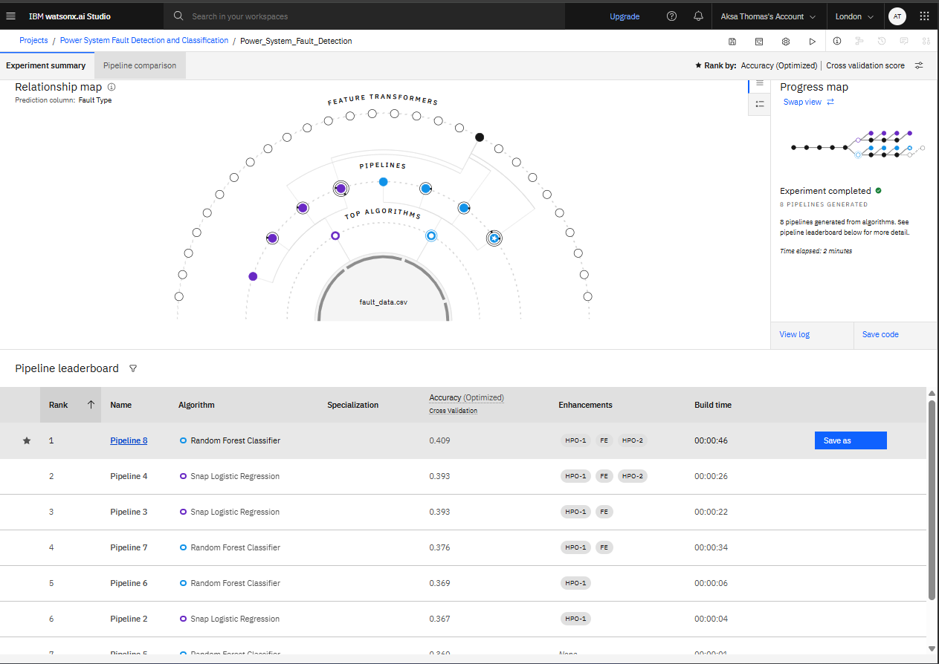
Result

Slide 9
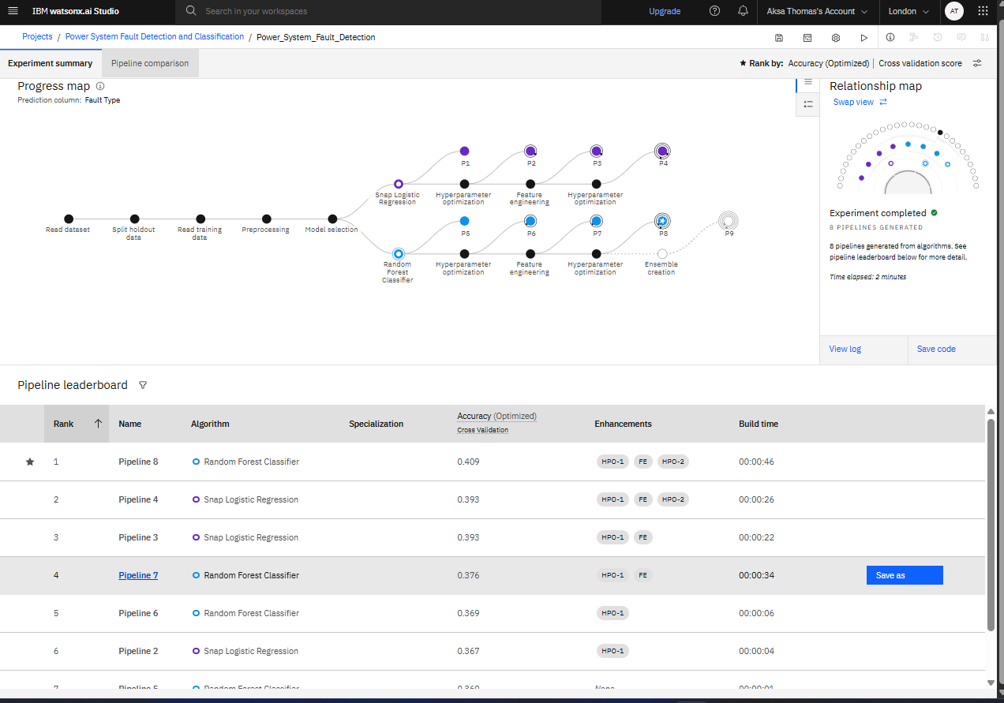
Result

Slide 10
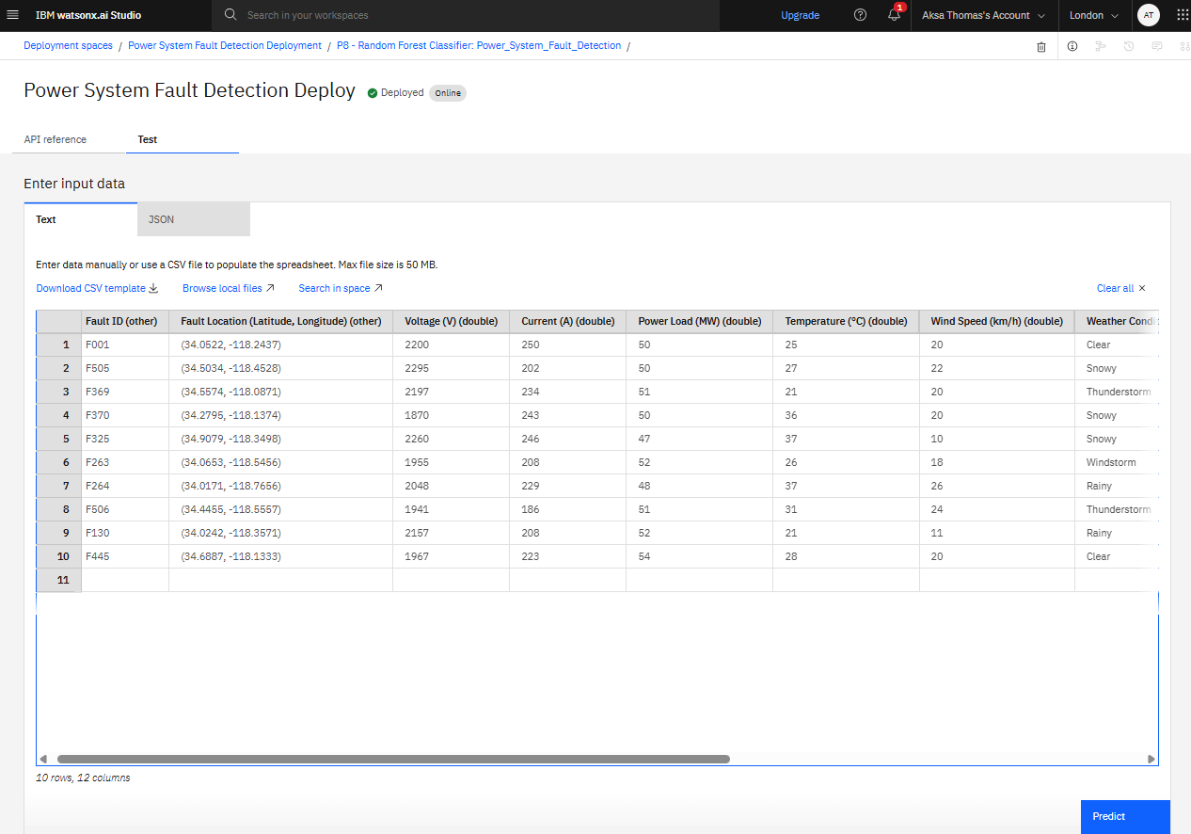
Result

Slide 11
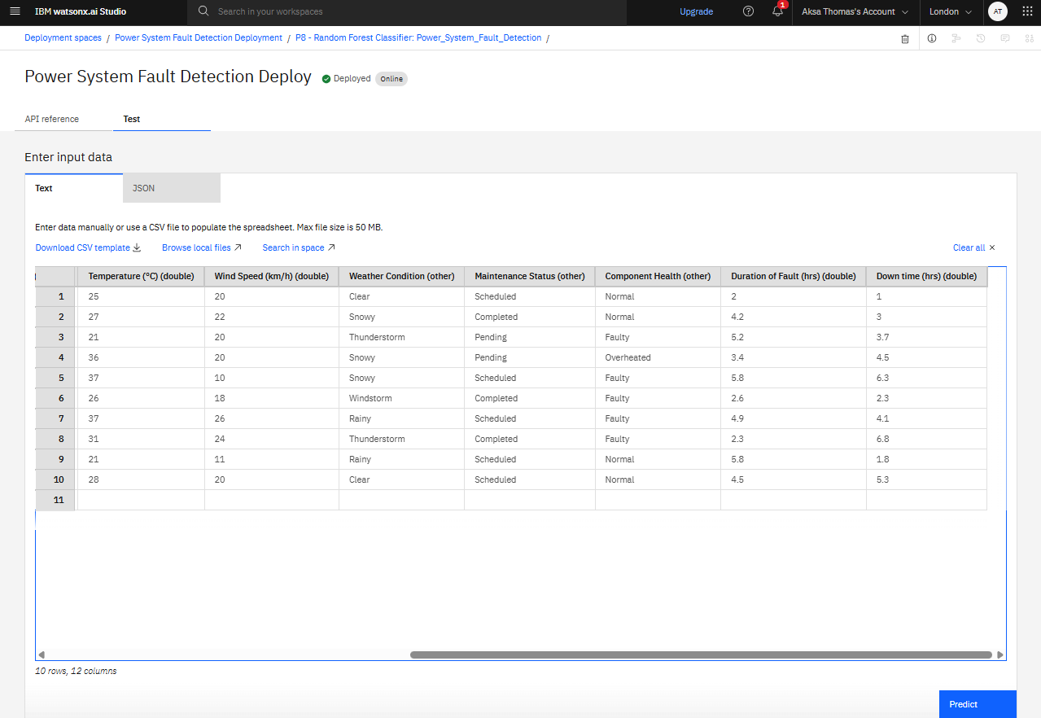
Result

Slide 12
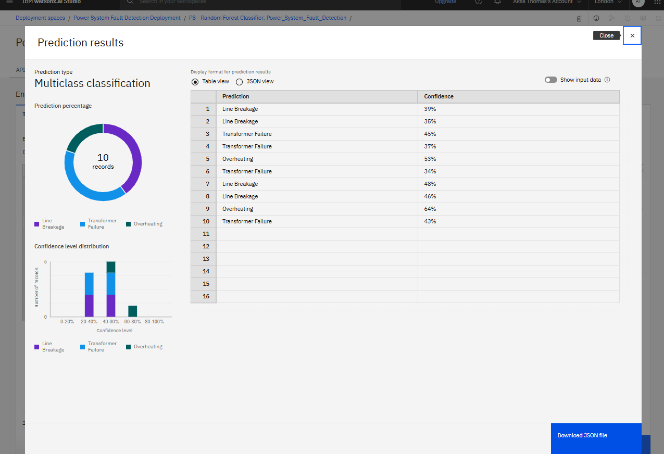
Result

Slide 13
Conclusion
The proposed system successfully demonstrates a practical and automated approach to detect and classify faults in power systems using machine learning. The use of IBM Watsonx’s greatly simplified model creation, optimization, and deployment by eliminating the need for manual tuning. While the current system used a limited number of test entries, it still validated the core predictive logic. The project lays a strong foundation for future scaling in real-time, data-rich environments and showcases the effectiveness of cloud-based AI tools in modernizing power infrastructure.

Slide 14
Future scope
Improve model accuracy with a larger and more diverse dataset
Use real-time IoT-based data feeds from smart meters/sensors
Extend fault detection to include 3-phase faults, transient faults, and cable insulation failures
Build a web dashboard that uses the REST API to display real-time fault classification results
Integrate SMS or email-based alerts for immediate field action

Slide 15
References
Kaggle dataset link – https://www.kaggle.com/datasets/ziya07/power-systemfaults-dataset
IBM Watsonx Documentation

Slide 16
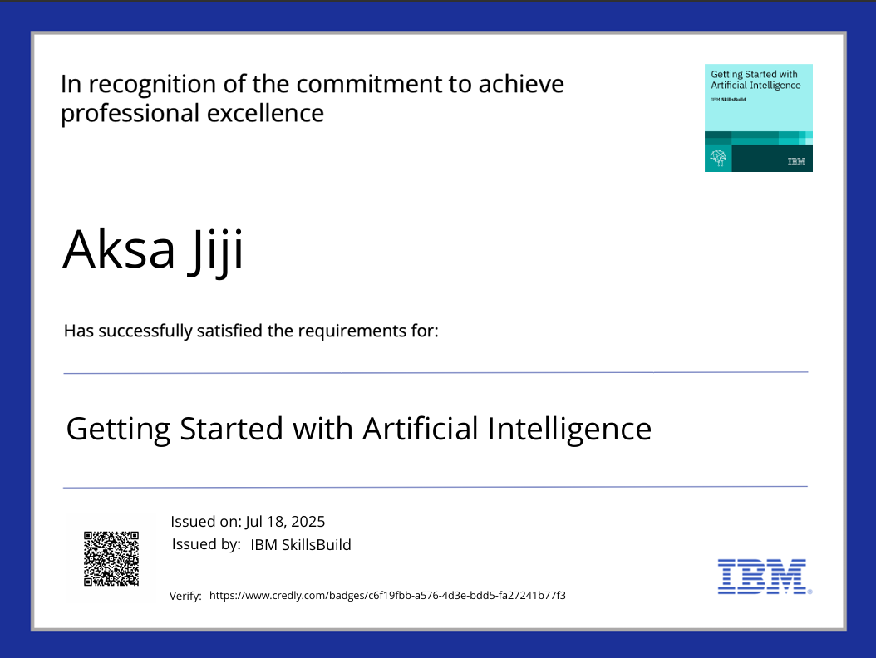
IBM Certifications

Slide 17

IBM Certifications

Slide 18
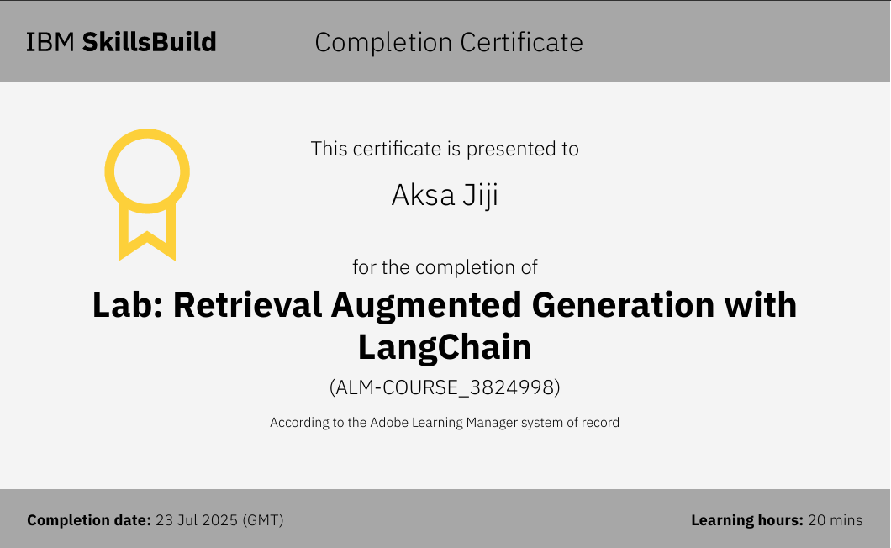
IBM Certifications

Slide 19
THANK YOU

