Slide 1
Spring Boot Rest Service Employee Management
Krish Ayyagari

Slide 2
Requirement
1. Search and View information on screen.
2. Add/Edit information like Employer registration or something.
3. Transaction Management
4. Exception Handling
5. Log4J logging
6. Queue Management – Any tool they may have used.

Slide 3
Architecture
Model Data
View Presentation Postman
Database
(MySQL)
Controller Request Handling
Service Business logic
Repository Database Access Operations
Client
Server
Notes:
Controllers - contains application logic and passing user input data to service
Services - The middleware between controller and repository. Gather data from controller, performs validation and business logic, and calling repositories for data manipulation.
Repositories - layer for interaction with models and performing DB operations
Models - common model files with relationships defined

Slide 4
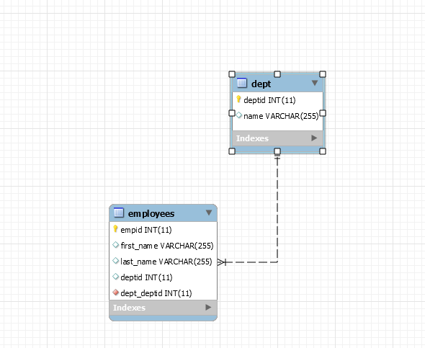
Database Design

Slide 5
1.Search and View information on screen.
By Employee ID
By Employee First Name
By Employee Last Name
By Both First & last name

Slide 6
2. Add/Edit information like Employer registration or something
Updating the Employer
-> Validating if the Employee Id is present
-> Validating if the Department Name is valid
-> Validating Mandatory Fields
Deleting the Employer
-> Validating if the Employee Id is present

Slide 7
3. Transaction Management
Enabled in the Spring Boot Configurations
Enabled Transaction Trace in the Log

Slide 8
4. Exception Handling
Validating Employees Details
Validating Department Name
Validating URL requests (Generic)
Validating CRUD Operations
Javax validations

Slide 9
5. logging
Log4j2 logging
JPA Show SQL
Transaction Interpreter Trace
-> Info
-> Error
-> warn
-> Debug
-> Trace

Slide 10
Additional - Unit Testing
Junit
Jmock
MockMVC

