Slide 1
NEXTHIKES IT SOLUTIONS
Disaster Tweet
Classification using NLP
An end-to-end machine learning pipeline that detects real disasters on Twitter in real time.
Presented by
Aksa Pathan
DATASET
MODEL
TEST F1
DEPLOYMENT
7,613 tweets
Logistic Regression
75.8%
Flask web app

Slide 2
NEXTHIKES IT SOLUTIONS
THE CHALLENGE
Not every “fire” is a fire.
Disaster relief agencies and news outlets want to monitor Twitter for real-time alerts — but tweets using disaster words metaphorically (“this song is fire”) look identical to real emergencies on the surface. The model must learn the difference.
1
Accuracy & Precision
2
Robustness
Minimize false alarms while catching real emergencies.
Handle slang, abbreviations, and cultural nuance.
3
Scalability
4
Real-time detection
Process large volumes of tweets continuously.
Support live monitoring, not batch review.
02 / 12

Slide 3
NEXTHIKES IT SOLUTIONS
PART 1 — DATA EXPLORATION
7,613 hand-labeled tweets
7,613
5
57% / 43%
Total tweets
Columns: id, keyword, location, text, target
Not-disaster / disaster split
222
0
110
Distinct keyword values
Missing text or target values
Duplicate tweet texts (retweets)
03 / 12

Slide 4
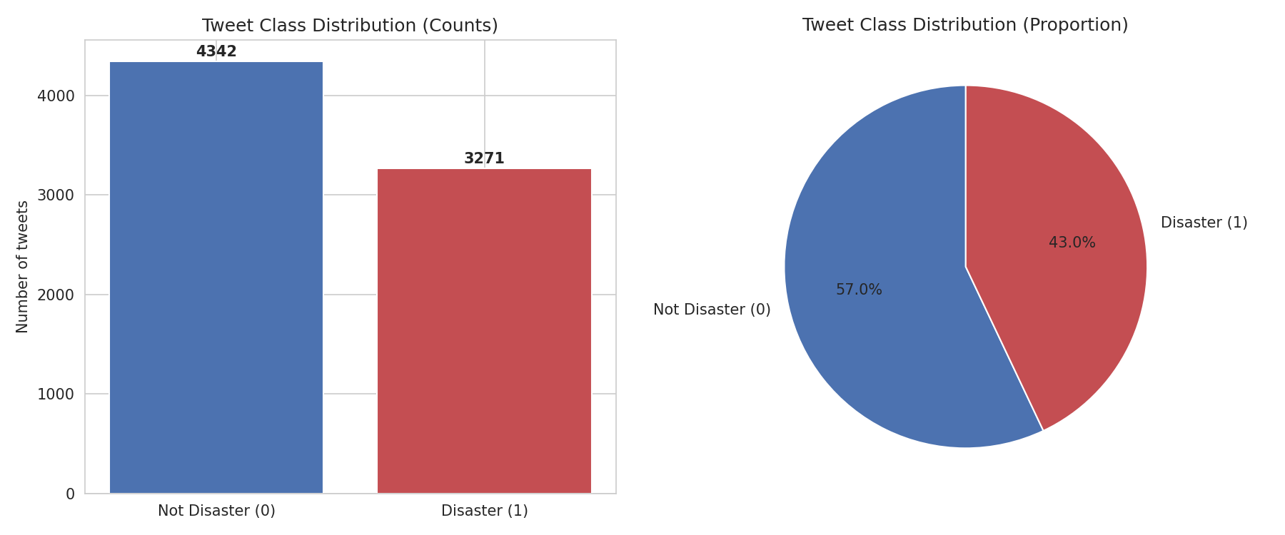
NEXTHIKES IT SOLUTIONS
EXPLORATORY DATA ANALYSIS
A mild class imbalance
Why this matters
4,342 non-disaster vs. 3,271 disaster tweets
A model that always guessed “not disaster” would already score ~57% accuracy
Accuracy alone is misleading — F1, precision & recall matter more
Stratified train/test split keeps this ratio consistent
04 / 12

Slide 5
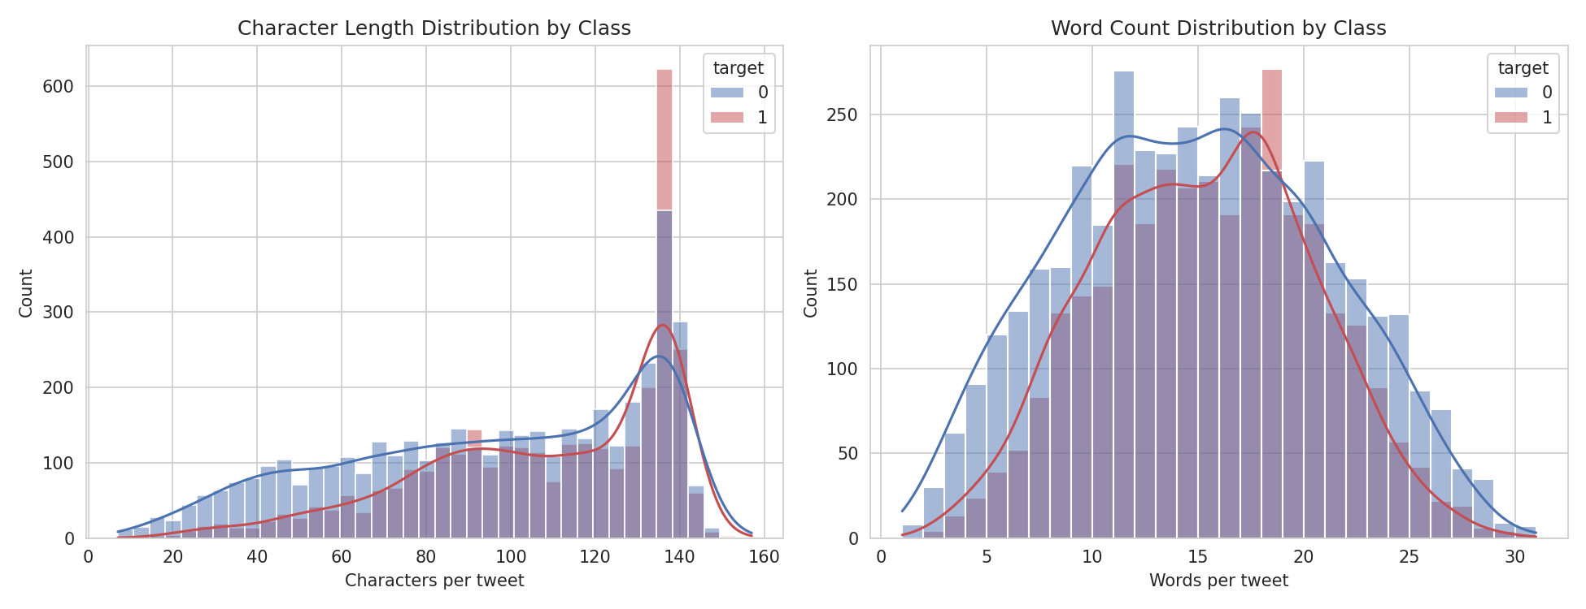
NEXTHIKES IT SOLUTIONS
EXPLORATORY DATA ANALYSIS
Length and keywords carry real signal
Disaster tweets run longer
Mean 108 vs. 96 characters — real reports pack in more concrete detail (location, casualty counts, official terms).
Keywords aren’t enough on their own
derailment, wreckage, debris
100% disaster
aftershock
0% disaster
body%20bags, blazing
~3% disaster
05 / 12

Slide 6
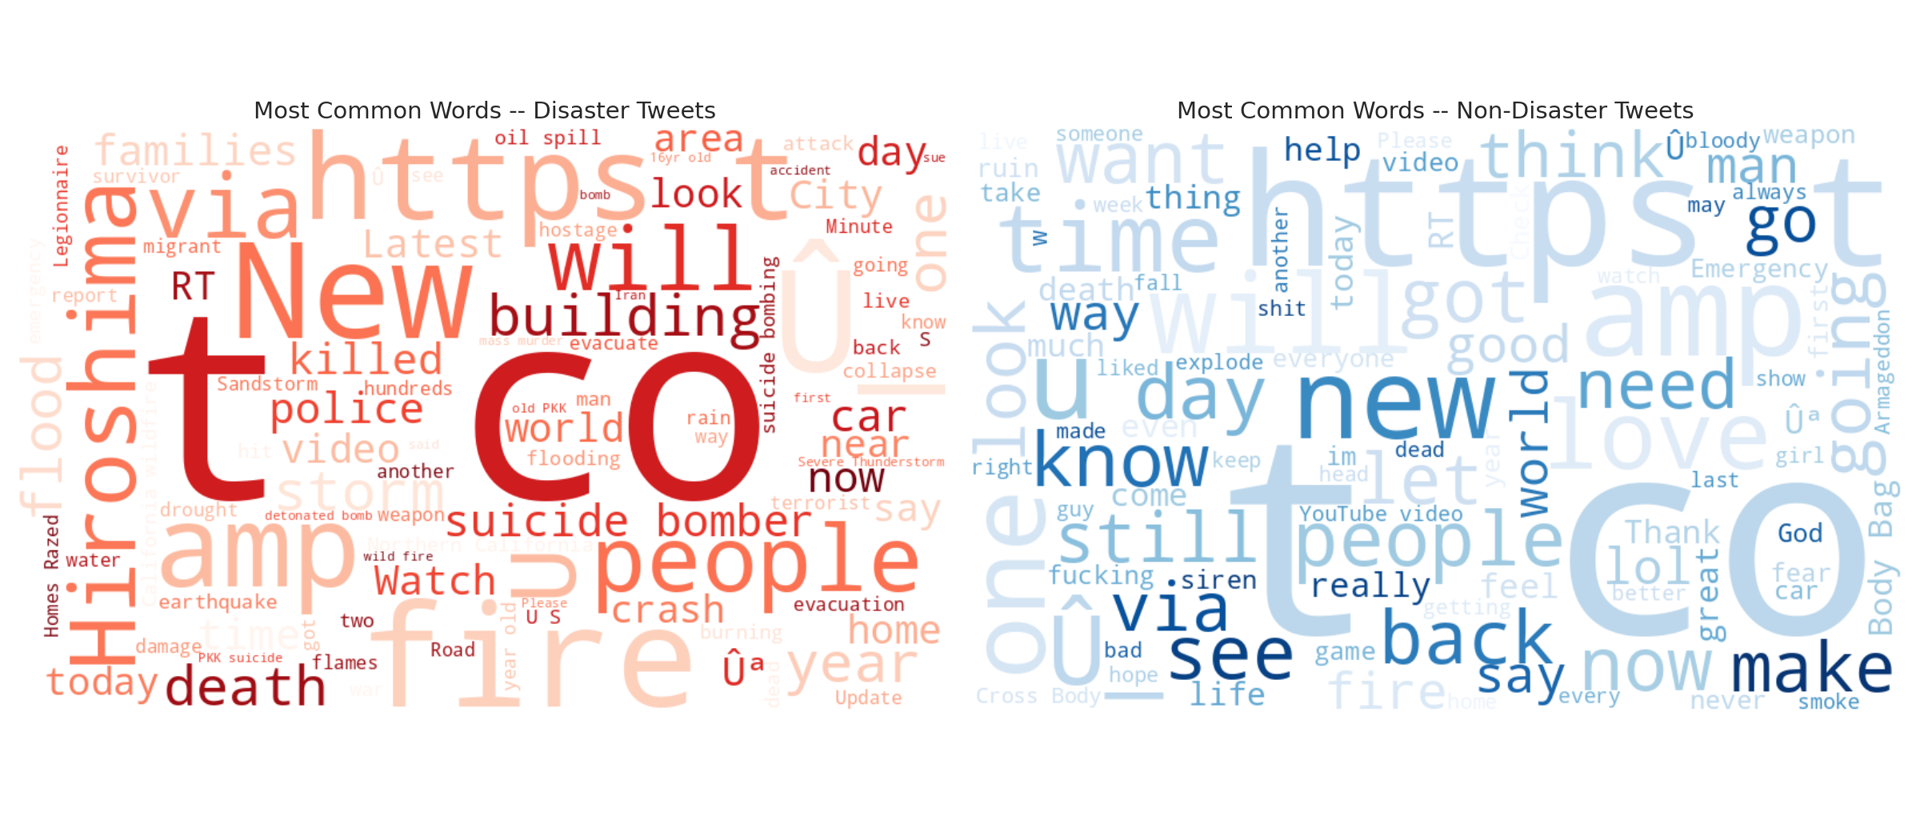
NEXTHIKES IT SOLUTIONS
EXPLORATORY DATA ANALYSIS
Most common words, by class
06 / 12

Slide 7
NEXTHIKES IT SOLUTIONS
PARTS 1–2 — PREPARATION & FEATURES
From raw tweet to model-ready features
1
2
3
4
Clean text
Tokenize & lemmatize
TF‑IDF vectorize
Add engineered features
→
→
→
Lowercase, strip URLs, mentions, HTML entities, punctuation & digits
NLTK word tokenizer + stopword removal + lemmatization
Uni-grams, up to 8,000 features, sublinear term scaling
Hashtag / mention / URL flags, punctuation intensity, word count
Labels were already numeric (0 = not disaster, 1 = disaster) — verified, not re-encoded. Data split 80/20 with stratification to preserve class balance in both sets.
07 / 12

Slide 8
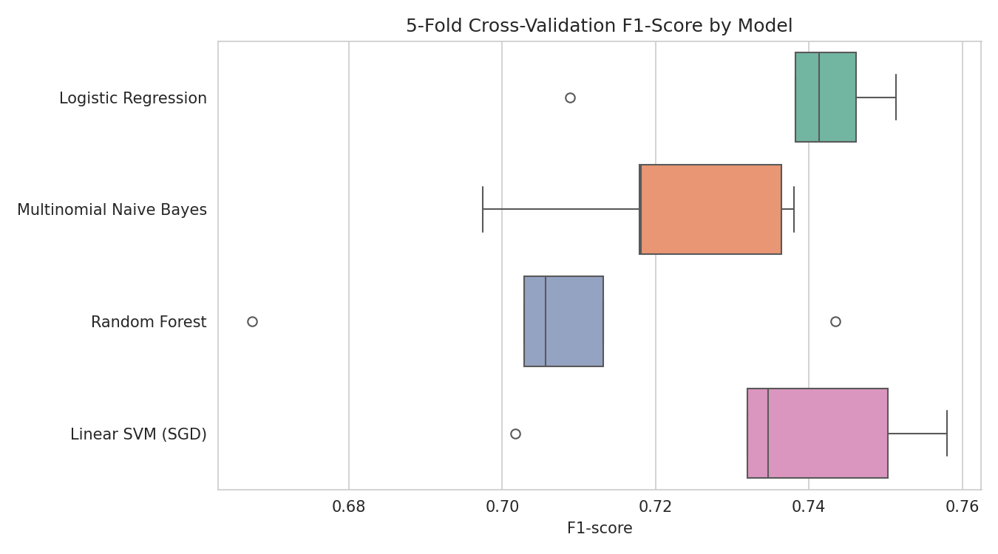
NEXTHIKES IT SOLUTIONS
PART 2 — MODEL SELECTION
Four models, benchmarked with cross-validation
5-fold CV — mean F1
Logistic Regression
0.737
Linear SVM (SGD)
0.735
Multinomial Naïve Bayes
0.722
Random Forest
0.707
Winner: Logistic Regression — tuned via GridSearchCV
Best params: C = 3.0, max_features = 8,000, ngram_range = (1,1)
08 / 12

Slide 9
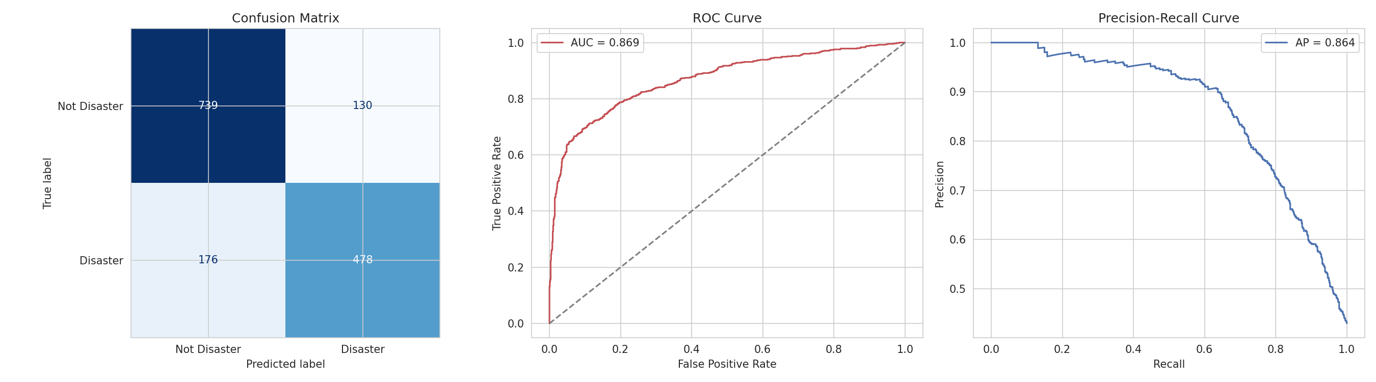
NEXTHIKES IT SOLUTIONS
PART 3 — MODEL EVALUATION & VALIDATION
Confusion matrix, ROC & precision-recall
79.9%
78.6%
73.1%
75.8%
ACCURACY
PRECISION
RECALL
F1-SCORE
09 / 12

Slide 10
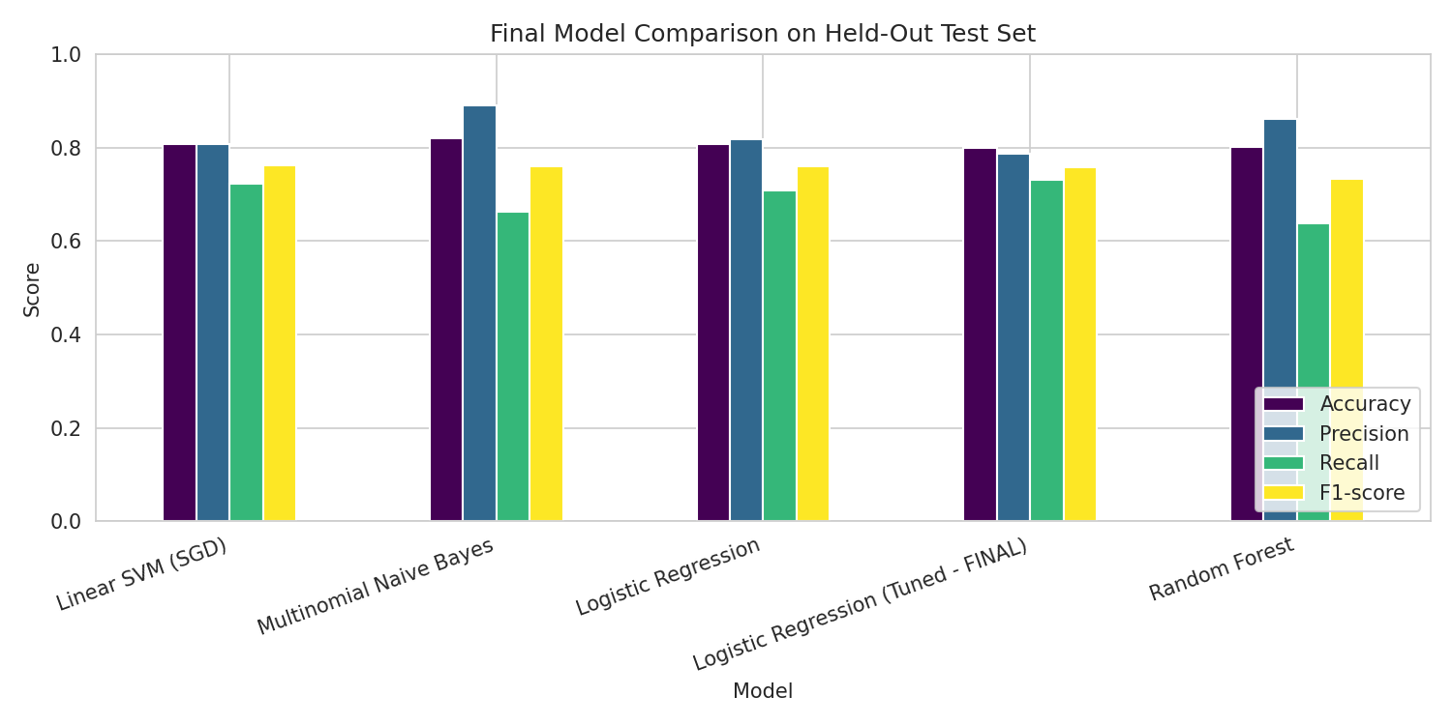
NEXTHIKES IT SOLUTIONS
PART 3 — FINAL COMPARISON
Held-out test set: final scoreboard
Error analysis (20% miss rate)
“I See Fire” (song title) → wrongly flagged as disaster
“The City was rioting” → missed as a false negative
Root cause: bag-of-words can’t detect slang, sarcasm, or song lyrics
10 / 12

Slide 11
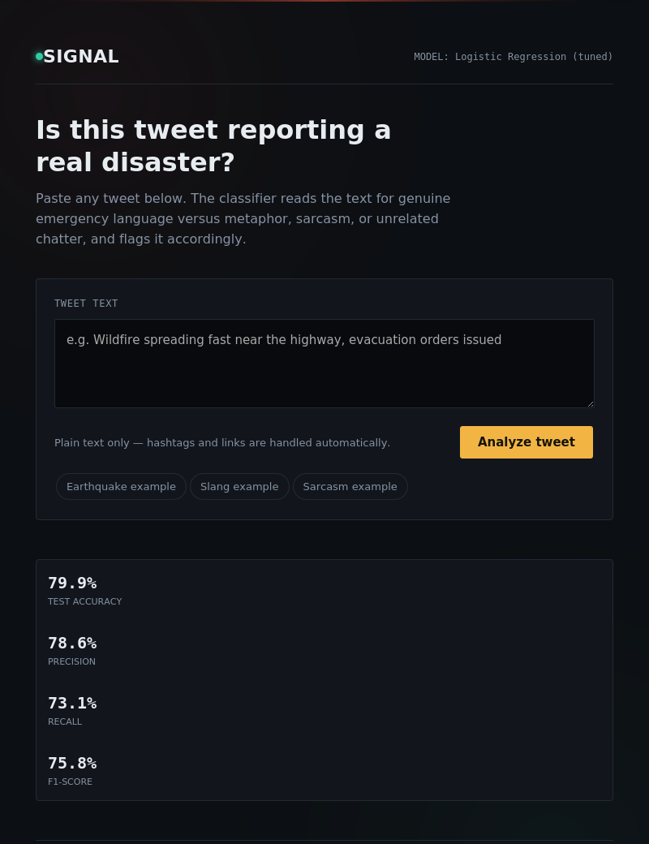
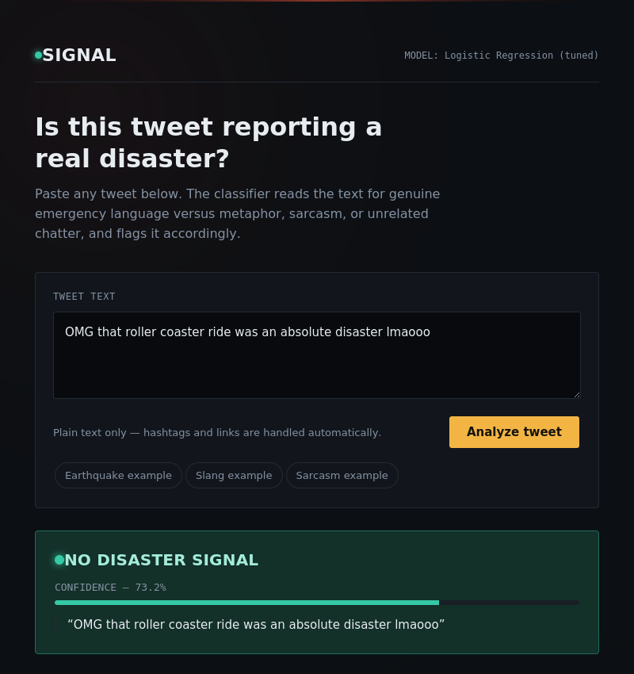
NEXTHIKES IT SOLUTIONS
PART 4 — DEPLOYMENT
Live in a Flask web app
How it works
Trained pipeline (TF-IDF + features + model) serialized as one joblib artifact
Flask backend reproduces identical text cleaning at inference time
GET / — web form with live confidence score
POST /api/predict — JSON REST endpoint for integration
GET /health — health check for cloud deployment
11 / 12

Slide 12
NEXTHIKES IT SOLUTIONS
CONCLUSION
What we built — and what’s next
Delivered
Future work
Full EDA on 7,613 hand-labeled tweets
Cleaned, tokenized, lemmatized text pipeline
4 models benchmarked, best one tuned via GridSearchCV
79.9% accuracy / 75.8% F1 on unseen tweets
Confusion matrix, ROC-AUC, and manual error analysis
Live Flask web app + JSON API for real-time predictions
Fine-tune a transformer (BERT/DistilBERT) for sarcasm & context
Use the location column (geocoded) as an extra feature
Connect to a live Twitter/X API stream for real monitoring
Add model monitoring & periodic retraining as slang evolves
Reduce the train/test F1 gap with stronger regularization
12 / 12

