Slide 1
CAPSTONE PROJECT
Predicting Property Prices
Using Machine Learning
A Data-Driven Approach to Real Estate Valuation using Regression, Ensemble Models,
and Dimensionality Reduction (PCA)
Prepared by: Aksa Pathan Organization: NextHikes IT Solutions

Slide 2
Introduction to the Project
The real estate market is highly dynamic, shaped by location, size, amenities, neighborhood, and dozens of structural features. Accurately estimating a property's price is critical for agents, buyers, and sellers alike.
This capstone project builds a machine learning pipeline that predicts residential property prices (Ames Housing-style dataset) using 81 raw features spanning structural quality, location, and sale conditions. The workflow covers data cleaning, exploratory data analysis, feature engineering, encoding, scaling, PCA-based dimensionality reduction, and comparison of multiple regression algorithms.
1,460
Property Records
81
Original Features
3
ML Models Compared
NextHikes IT Solutions | Property Price Prediction Capstone
2

Slide 3
Objectives of the Project
1
Data Collection & Cleaning
2
Ordinal vs Nominal Handling
Collect and clean real estate data for the target location, handling missing values and inconsistencies.
Separate ordinal and nominal columns using the metadata sheet for correct feature treatment.
3
Scaling, PCA & Imputation
4
Exploratory Data Analysis
Apply scaling, fillna() strategies, and PCA to handle missing data and boost model accuracy.
Perform EDA to uncover key variables that influence property prices.
5
Encoding Strategy
6
Model Building & Evaluation
Select the right encoding technique (Ordinal / One-Hot) for each variable type.
Train, compare, and evaluate multiple ML algorithms; target R² between 75%-85%+.
NextHikes IT Solutions | Property Price Prediction Capstone
3

Slide 4
Methodology
End-to-end workflow followed in this capstone
Data
Collection
Data
Cleaning
EDA
Feature
Engineering
Encoding &
Scaling
PCA
Model
Training
Evaluation &
Deployment
▶
▶
▶
▶
▶
▶
▶
Key techniques applied: • Missing values handled via None-fill (feature absent), mode-fill (categorical), and neighborhood-median fill (numeric) • OrdinalEncoder for ranked quality features; OneHotEncoder for nominal categories; StandardScaler for numeric features • PCA applied (95% variance retained) and benchmarked against the non-PCA pipeline across 3 regression models
Key techniques applied: None/mode/median imputation • OrdinalEncoder for ranked features • OneHotEncoder for nominal features • StandardScaler • PCA (95% variance retained) • Linear Regression, Decision Tree, Random Forest
NextHikes IT Solutions | Property Price Prediction Capstone
4

Slide 5
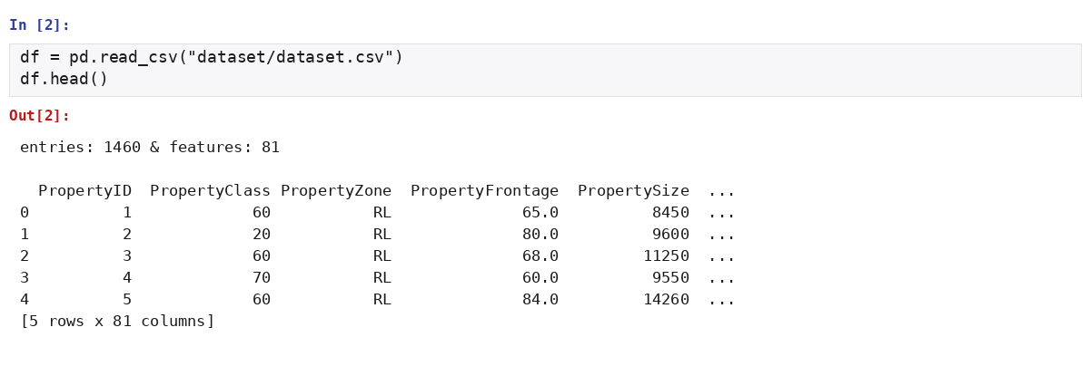
Dataset Overview
Screenshot of the working dataset in Jupyter Notebook
Dataset Snapshot
1,460 property records
81 raw features + target
Target: PropPrice (sale price in $)
Mix of numeric, ordinal & nominal columns
0 duplicate rows found
Sourced from local real estate records
Key fields include PropertySize, GrLivArea, OverallQual, Neighborhood, YearBuilt, KitchenQual, and BasementSqFootage — spanning structural, locational, and quality dimensions of each property.
NextHikes IT Solutions | Property Price Prediction Capstone
5

Slide 6
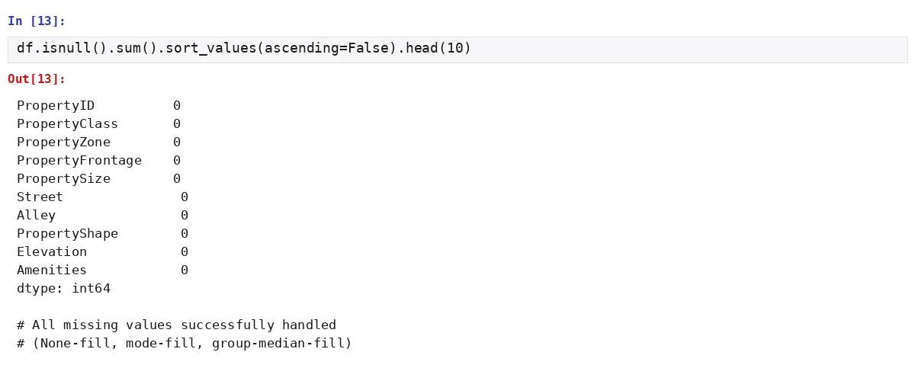
Data Cleaning & Missing Values
Screenshot: missing-value audit after imputation
Imputation Strategy
“None” fill — for features where a missing value means the amenity is absent (Alley, PoolQC, Fireplace Quality, Basement type)
Mode fill — for categorical columns with very few missing entries (Electrical, Basement finish ratings)
Group-median fill — PropertyFrontage imputed using the median within each Neighborhood
Zero fill — numeric garage/masonry fields where 0 correctly represents “none present”
NextHikes IT Solutions | Property Price Prediction Capstone
6

Slide 7
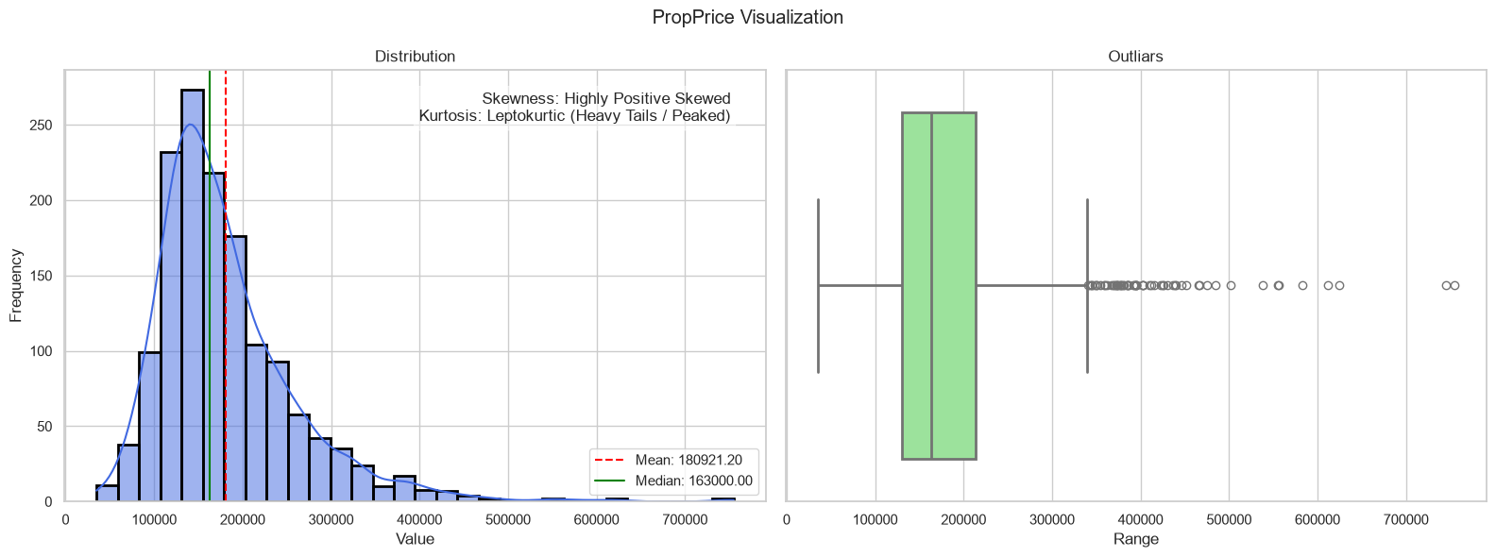
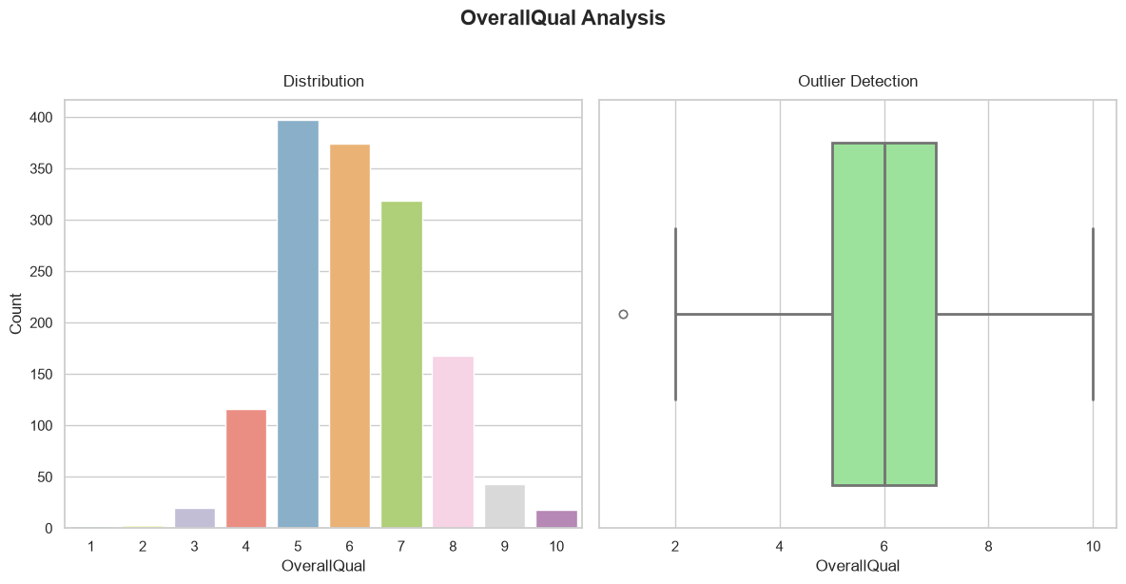
EDA — Univariate Analysis
Distribution & outlier check for the target and key discrete features
Interpretation
• PropPrice is highly right-skewed and leptokurtic — most homes cluster around $130K–$215K, with a long tail of premium properties. • Boxplots confirm genuine high-value outliers rather than data errors, typical of real estate markets. • OverallQual and BasementCars concentrate around average ratings — exceptionally high/low ratings are rare.
NextHikes IT Solutions | Property Price Prediction Capstone
7

Slide 8
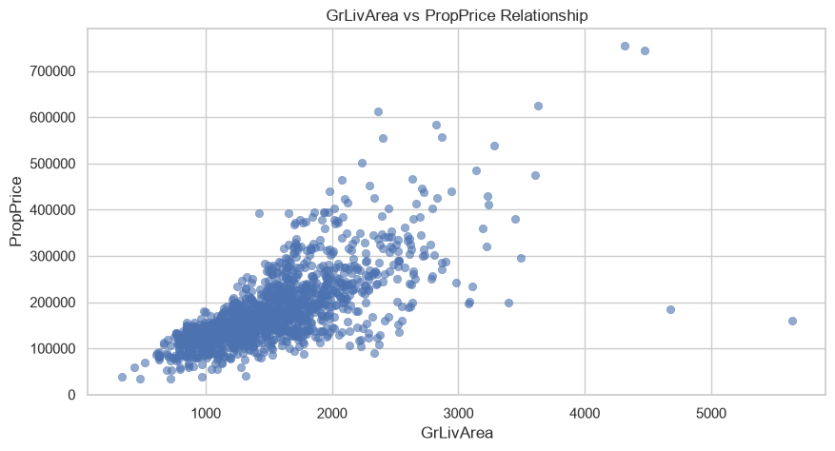
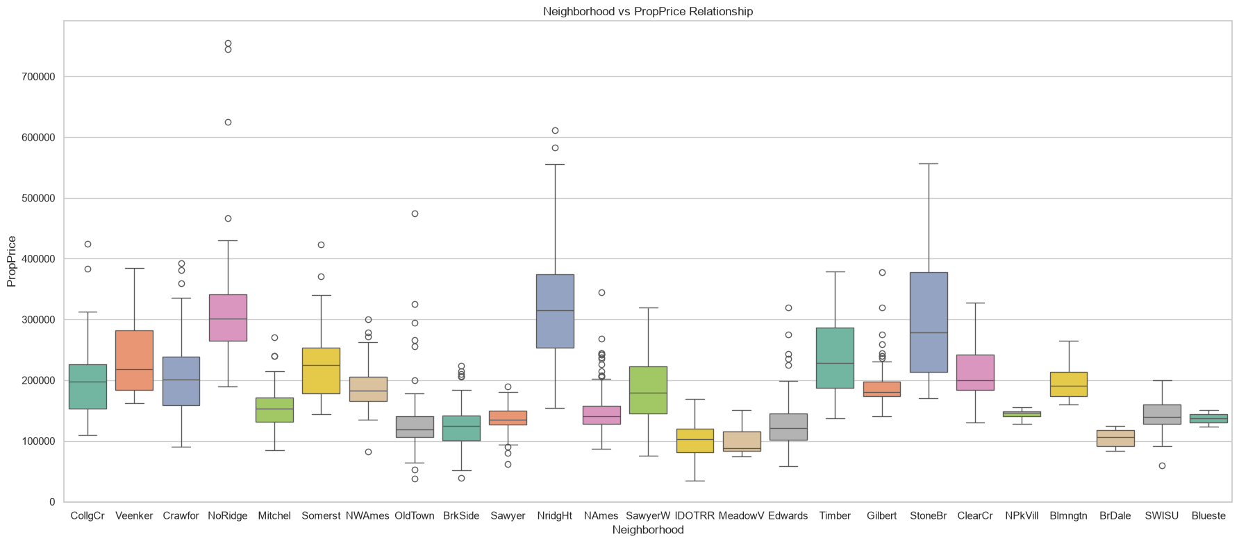
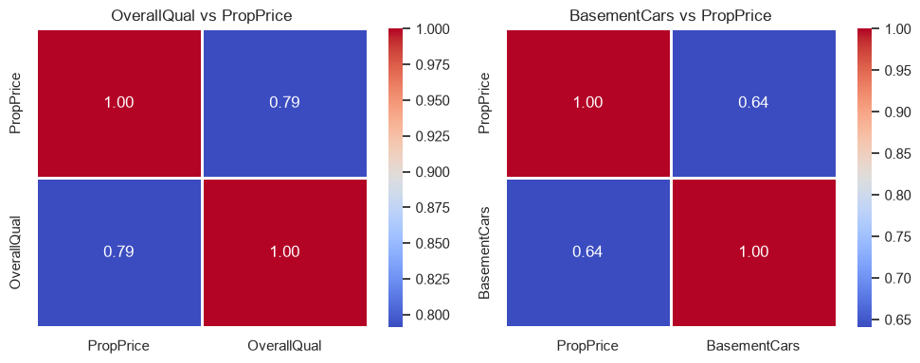
EDA — Bivariate Analysis
Relationship between key features and property price
Interpretation • GrLivArea shows a clear positive relationship with price — larger living areas command higher value. • Neighborhood and KitchenQual create visibly distinct price bands, confirming location & quality matter. • OverallQual and BasementCars both correlate positively with PropPrice.
NextHikes IT Solutions | Property Price Prediction Capstone
8

Slide 9
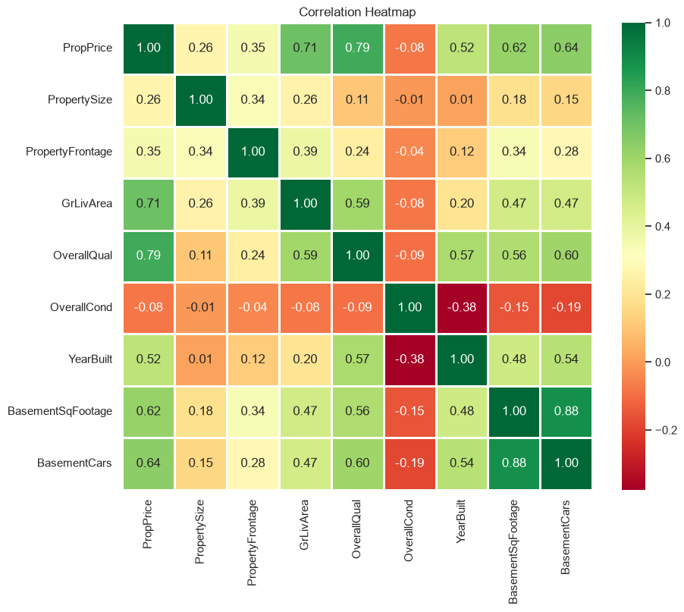
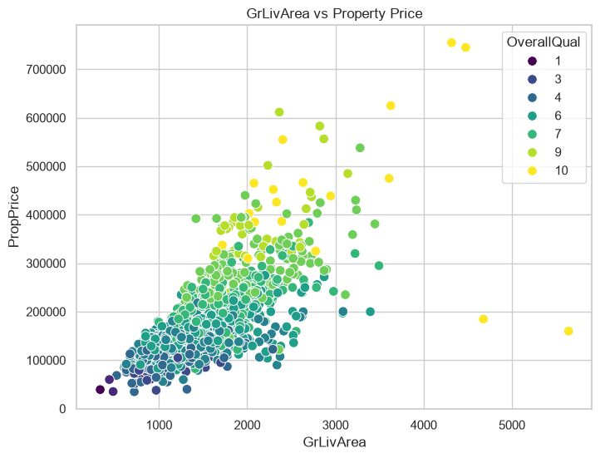
EDA — Multivariate Analysis
Correlation structure and combined feature effects
Living area, overall quality, property size, and garage capacity emerge as the strongest joint predictors of price, while moderate inter-feature correlation signals mild multicollinearity to watch for.
NextHikes IT Solutions | Property Price Prediction Capstone
9

Slide 10
Feature Engineering & Preprocessing
Engineered Features
Encoding & Scaling Pipeline
TotalBath
Numeric features → StandardScaler
Ordinal features (e.g. ExterQual, KitchenQual) → OrdinalEncoder, preserving natural rank
Nominal features (e.g. PropertyZone, Neighborhood) → OneHotEncoder
PCA (95% variance retained) applied post-scaling to test dimensionality reduction
70% / 20% train-test split, random_state = 42
Bath1 + 0.5×Bath2 + BsmtFullBath + 0.5×BsmtHalfBath
HouseAge
SaleYr − YearBuilt
RemodelAge
SaleYr − YearRemodAdd
TotalPorchSF
Open + Enclosed + 3-Season + Screen porch area
TotalArea
GrLivArea + BasementSqFootage (combined living space)
NextHikes IT Solutions | Property Price Prediction Capstone
10

Slide 11
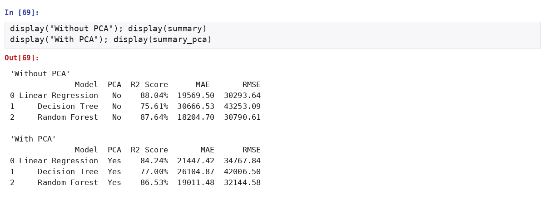
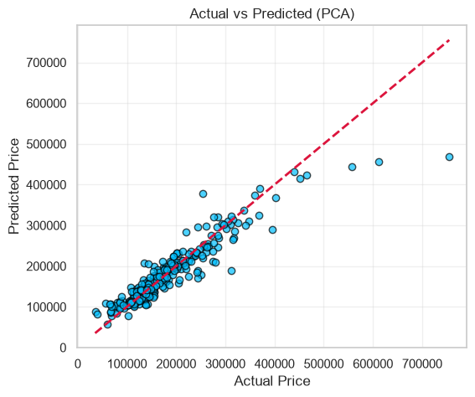
Model Building & Results
Linear Regression, Decision Tree & Random Forest — with and without PCA
Best Model: Random Forest
87.64%
R² Score (without PCA)
• Random Forest achieved the strongest predictive performance among all models tested. • Linear Regression was a close second (88.04% without PCA), showing the data is largely linearly separable. • PCA reduced dimensionality but slightly lowered accuracy across models — the original feature space carries valuable signal. • Final R² range (75%–88%) meets and exceeds the project's target benchmark.
NextHikes IT Solutions | Property Price Prediction Capstone
11

Slide 12
Learning Outcomes & Conclusion
Hands-on experience with real-world missing-data strategies (None-fill, mode-fill, group-median-fill)
Practical understanding of ordinal vs nominal encoding and when to apply each
Applied StandardScaler + PCA and measured their real impact on model accuracy
Compared Linear Regression, Decision Tree, and Random Forest on a common evaluation framework (R², MAE, RMSE)
Citations
De Cock, D. (2011). Ames Housing Dataset — original data documentation.
Pedregosa et al. (2011). Scikit-learn: Machine Learning in Python. JMLR 12.
McKinney, W. (2010). Data Structures for Statistical Computing in Python (pandas).
Waskom, M. (2021). seaborn: statistical data visualization. JOSS.
Hastie, Tibshirani & Friedman. The Elements of Statistical Learning.
Scikit-learn, pandas, seaborn & matplotlib official documentation.
Conclusion
The Random Forest model, using the full engineered feature set without PCA, delivers the most reliable property price predictions, giving real estate agents, buyers, and sellers a data-driven valuation tool.
NextHikes IT Solutions • Aksa Pathan • Property Price Prediction Capstone

