Slide 1
NEXTHIKES IT SOLUTIONS
Sales Forecasting Across
Multiple Retail Stores
Exploratory Data Analysis · Machine Learning · Deep Learning · MLOps
Six-week, store-level sales predictions to support finance-team planning and reduce reliance on manager intuition.
Prepared By - AKSA PATHAN

Slide 2
PROJECT BRIEF
Business Need & Objective
01
02
03
The Challenge
The Goal
The Deliverable
Rossmann store managers currently forecast sales using personal judgement and years of experience — inconsistent and hard to scale across hundreds of stores.
Build an end-to-end ML product that forecasts daily sales up to six weeks ahead for every store, using promotions, competition, holidays, seasonality and locality as inputs.
A reproducible modelling pipeline (EDA → ML → Deep Learning → MLOps) plus a web dashboard so finance-team analysts and store managers can self-serve predictions.
2

Slide 3
TASK 1 · DATA
Dataset Overview
1,017,209
41,088
1,115
844,338
Training rows
(before cleaning)
Test rows
Unique stores
Open-store rows
used for analysis
Key Fields Used
Store · Sales · Customers · Open · Promo / Promo2 · StateHoliday · SchoolHoliday · StoreType · Assortment · CompetitionDistance
Data Cleaning: 54 rows with Open=1 but Sales=0 were identified as anomalies and removed. Store metadata NAs (e.g. missing CompetitionDistance, Promo2Since*) were structural — stores simply not participating — and filled accordingly rather than imputed blindly.
3

Slide 4
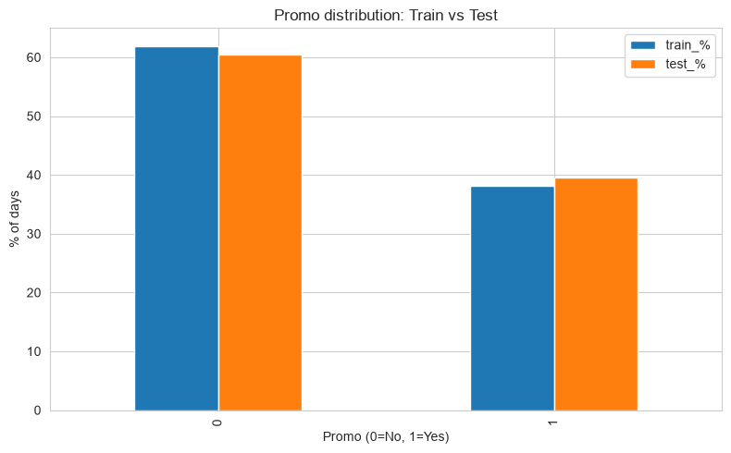
TASK 1 · EDA
Promo Distribution: Train vs. Test
38.2%
of training days ran a promo
39.6%
of test days ran a promo
Insight: Promo share is nearly identical across train and test (<1.5pt gap). The split is representative, so no re-sampling or class-weighting correction is needed before modelling.
4

Slide 5
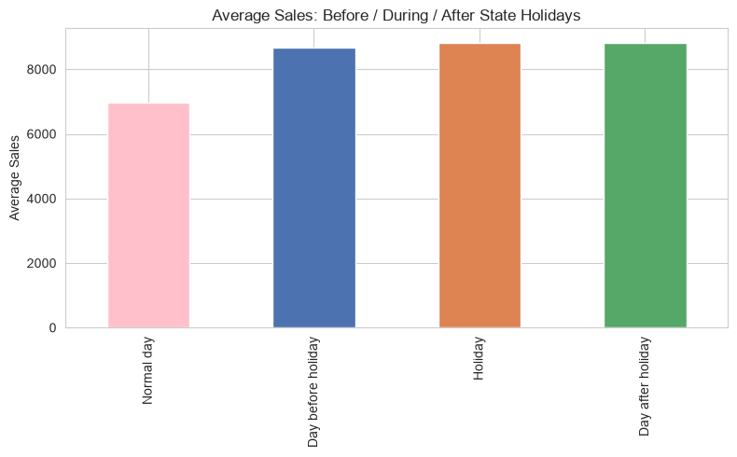
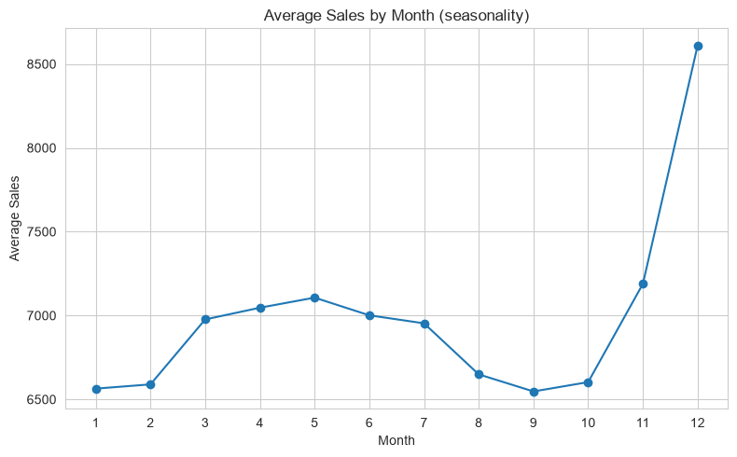
TASK 1 · EDA
Holiday & Seasonal Sales Patterns
Sales rise from 6,954 (normal day) to 8,682 the day before a holiday, 8,809 on the holiday, and stay high at 8,823 the day after — a ~27% sustained lift.
December sales average 8,609 — 31% above the September low (6,547) — confirming a strong Christmas peak with a smaller Easter bump in spring.
5

Slide 6
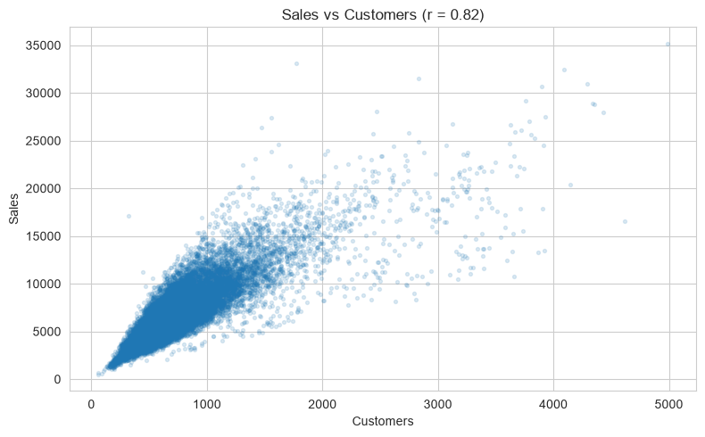
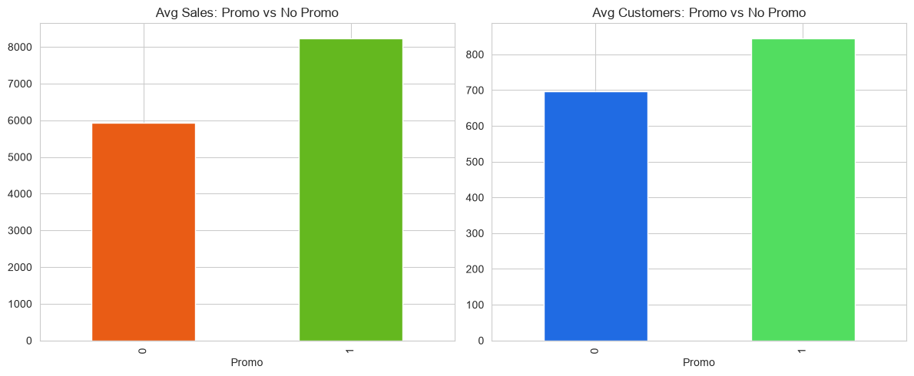
TASK 1 · EDA
Customer Traffic & Promo Effectiveness
Promo lifts avg sales from 5,930 to 8,229 (+38.8%) and traffic from 697 to 844 (+21.2%). Spend-per-customer also rises (8.51 → 9.74, +14.4%) — promos bring new footfall AND grow basket size.
r = 0.824
Strong Sales–Customers correlation, but not 1:1 — a basket-size (Sales/Customer) feature adds signal beyond raw footfall.
6

Slide 7
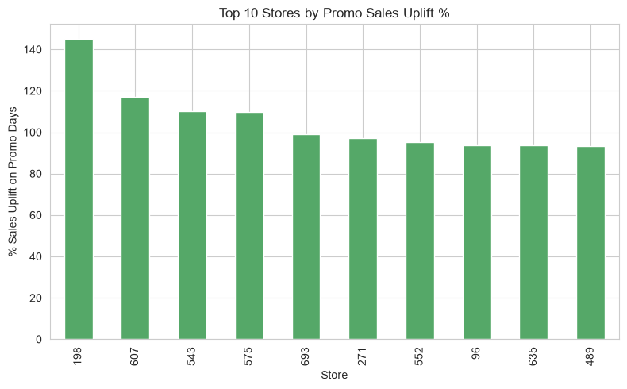
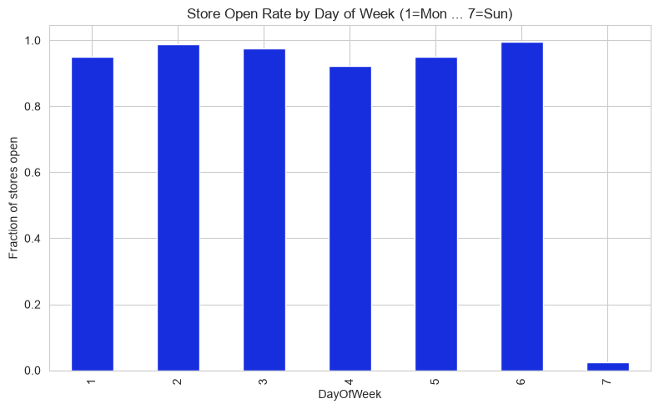
TASK 1 · EDA
Store-Level Promo Targeting & Weekly Trading
Promo uplift is highly store-specific (Store 198: +144.9%, Store 607: +117.2%) — targeted deployment beats a blanket promo calendar.
Stores trade 92–99.5% of weekdays/Saturdays but only 2.5% of Sundays. The 10 stores open every day earn 13,249 avg Sunday sales vs. 82 for the rest.
7

Slide 8
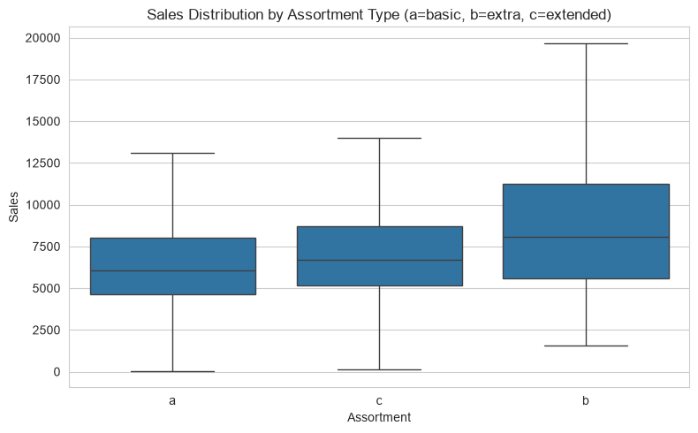
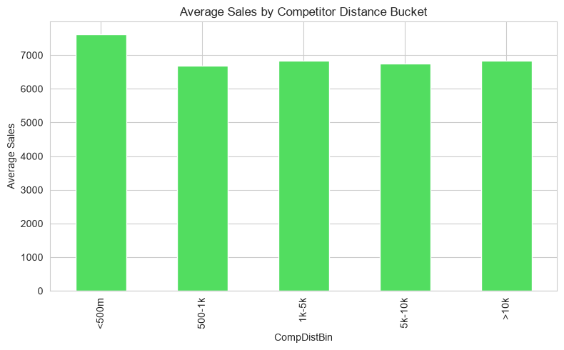
TASK 1 · EDA
Assortment Type & Competition Distance
Assortment 'b' (extra) stores average 8,643 in sales — well above 'c' (7,301) and 'a' (6,622). Richer assortments drive materially higher sales.
Competition-distance correlation is near zero (r = -0.036); stores <500m from a rival post the HIGHEST sales — a locality/urban-density confound, not a true distance effect.
8

Slide 9
TASK 1 · WRAP-UP
From Insight to Feature Engineering
Days-to / days-after-holiday features
Month & seasonal encoding (December peak)
1
2
Basket-size (Sales ÷ Customers) feature
Store-level historical promo-uplift feature
3
4
Assortment type as a categorical feature
Locality / urban-density proxy (not raw distance)
5
6
These six engineered feature groups, derived directly from the EDA, feed into the Random Forest and LSTM models built in Task 2.
9

Slide 10
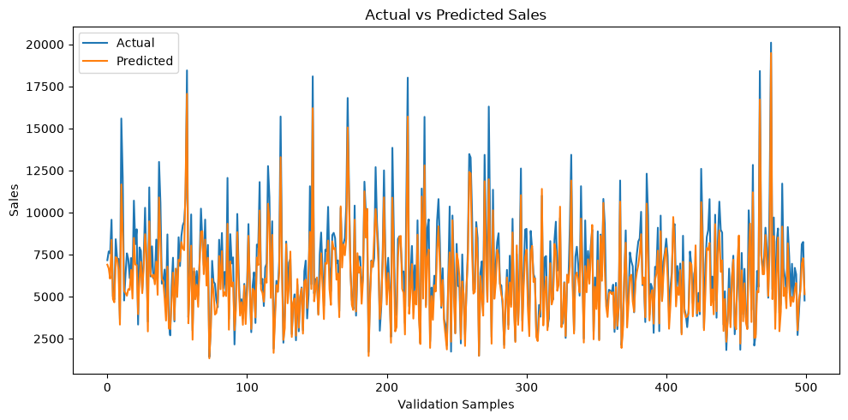
TASK 2 · MODELLING
Random Forest: Actual vs. Predicted Sales
0.827
18.93%
R²
RMSPE
821.03
1,272.32
MAE
RMSE
Pipeline: 25 engineered features → sklearn Pipeline (scaling + encoding) → RandomForestRegressor, trained on 675,958 rows and validated on 168,380 rows using a chronological split.
Insight: R² = 0.827 means the model explains ~83% of daily sales variance — a strong first-pass baseline. An approximate 95% prediction interval was also derived from residual spread, giving finance both a point forecast and a confidence band.
10

Slide 11
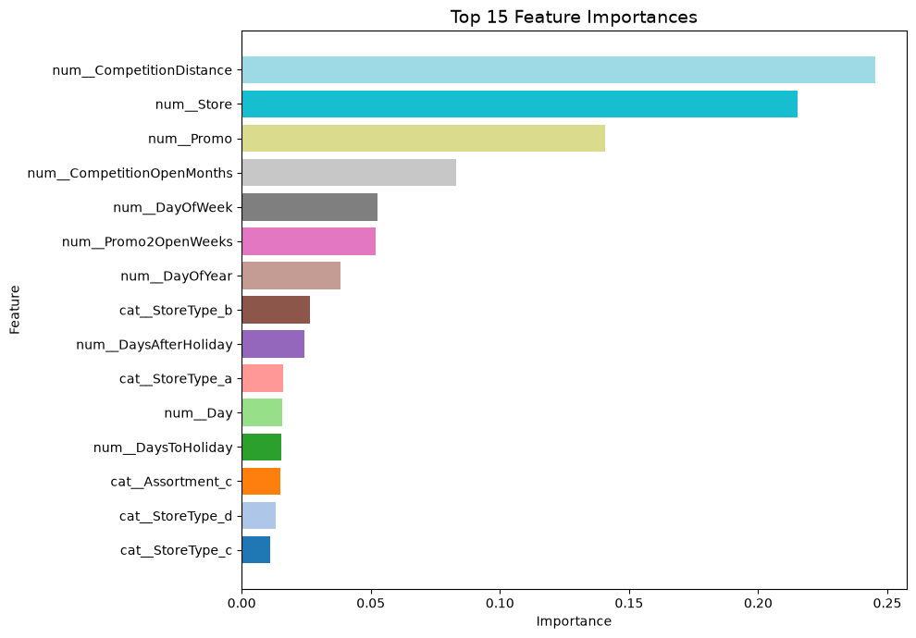
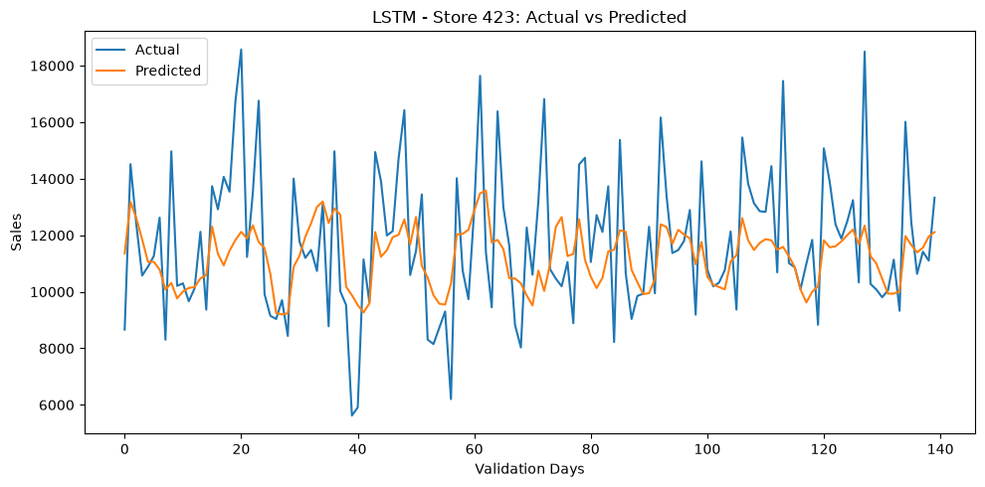
TASK 2 · DEEP LEARNING & MLOPS
Feature Importance, LSTM & MLflow Tracking
1,714.27
2,236.16
0.205
MAE
RMSE
R²
Feature importance & pred. interval give managers interpretable drivers, not just a number.
Two-layer LSTM (store 423, stationary series, ADF p<0.001) underperforms RF — it sees only one store's history vs. RF's full feature set. MLflow Run d684968... logged & verified for inference.
11

Slide 12
CONCLUSION
Overall Takeaway & Next Steps
Random Forest is the stronger, production-ready model for the 6-week forecast (R² ≈ 0.83 vs. 0.21 for the single-store LSTM), and it is already serialized and MLflow-tracked for deployment.
1
Extend LSTM to multi-store / multivariate inputs, or ensemble it with Random Forest to test for incremental lift.
2
Wire the serialized .pkl model into the Task 3 Flask/Streamlit dashboard for store-manager-facing predictions and CSV export.
3
Set up scheduled retraining with DVC-tracked data versions, comparing each new timestamped model against the current MLflow baseline before promotion.
NextHikes IT Solutions · Rossmann Pharmaceuticals Sales Forecasting Project
12

