Slide 1
IMGC CORPORATION
Policy Administration System
Enterprise Platform — Complete Application Walkthrough
Version 3.2.1 | Confidential | March 2026
14+
150+
5
256-bit
Modules
API Endpoints
User Roles
Encryption
Platform Capabilities
Policy Lifecycle Management — Quote to issuance in minutes
Claims Automation — FNOL to settlement tracking
Risk Intelligence — Real-time underwriting scoring
Billing & Payments — Full invoicing and payment lifecycle
Compliance Ready — Regulatory audit trails built-in (SOC 2, IRDAI)

Slide 2
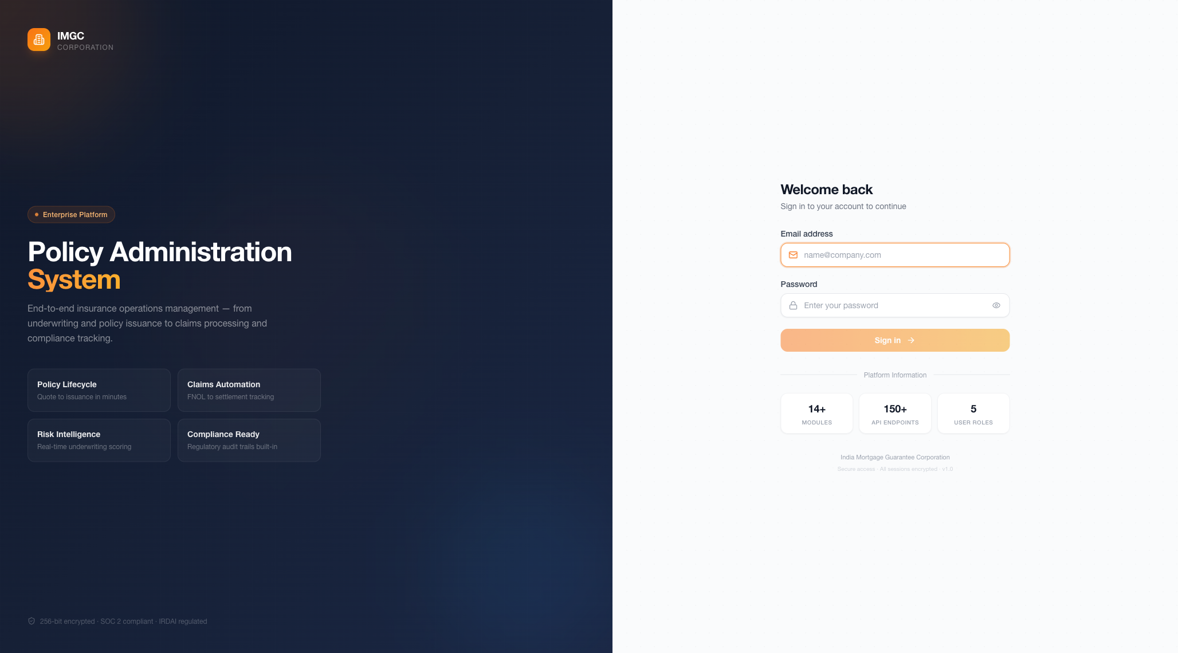
01 LOGIN & AUTHENTICATION
Secure Authentication
• JWT-based authentication with refresh tokens
• Encrypted password storage (bcrypt)
• Session management with auto-expiry
• Role-based access control from login
• 256-bit encryption end-to-end
Enterprise UX Design
• Split-screen: Brand showcase + Login form
• Platform highlights (Policy, Claims, Risk, Compliance)
• SOC 2 & IRDAI compliance badges
• Responsive design for all devices
• Orange accent theme (30% coverage)
5 User Roles
• Admin — Full system access
• Underwriter — Risk assessment & approval
• Claims Adjuster — Claims processing
• Operations — Customer-facing operations
• Viewer — Read-only compliance review

Slide 3
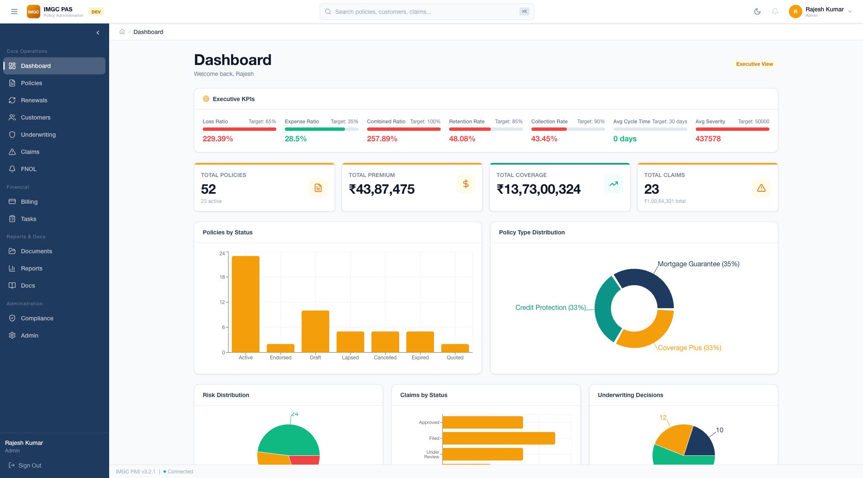
02 EXECUTIVE DASHBOARD
Executive KPIs
• 7 Executive KPIs with target tracking:
— Loss Ratio (Target: 65%)
— Expense Ratio (Target: 35%)
— Combined Ratio (Target: 100%)
— Retention Rate (Target: 85%)
— Collection Rate (Target: 90%)
— Avg Cycle Time (Target: 30 days)
— Avg Severity (Target: ₹50,000)
KPI Cards & Charts
• 4 KPI Summary Cards:
— Total Policies: 52 (23 active)
— Total Premium: ₹43,87,475
— Total Coverage: ₹13,73,00,324
— Total Claims: 23 (₹1.00Cr total)
• Policies by Status bar chart
• Policy Type Distribution pie chart

Slide 4
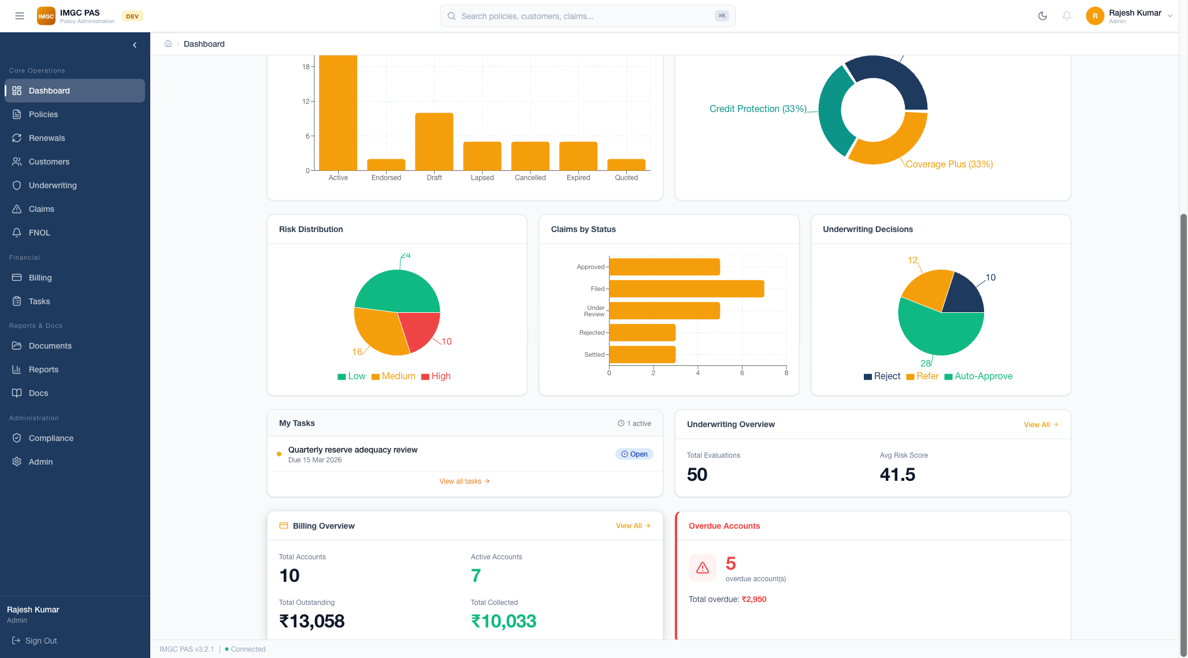
02 DASHBOARD — ANALYTICS & WIDGETS
Analytics Charts
• Risk Distribution pie chart:
— Low: 24, Medium: 16, High: 10
• Claims by Status horizontal bar chart
• Underwriting Decisions donut chart:
— Auto-Approve: 28, Refer: 12, Reject: 10
Dashboard Widgets
• My Tasks widget with SLA deadlines
• Underwriting Overview:
— 50 Total Evaluations, 41.5 Avg Risk Score
• Billing Overview:
— 10 Accounts, ₹13,058 Outstanding
— ₹10,033 Collected
• Overdue Accounts alert (5 accounts, ₹2,950)

Slide 5
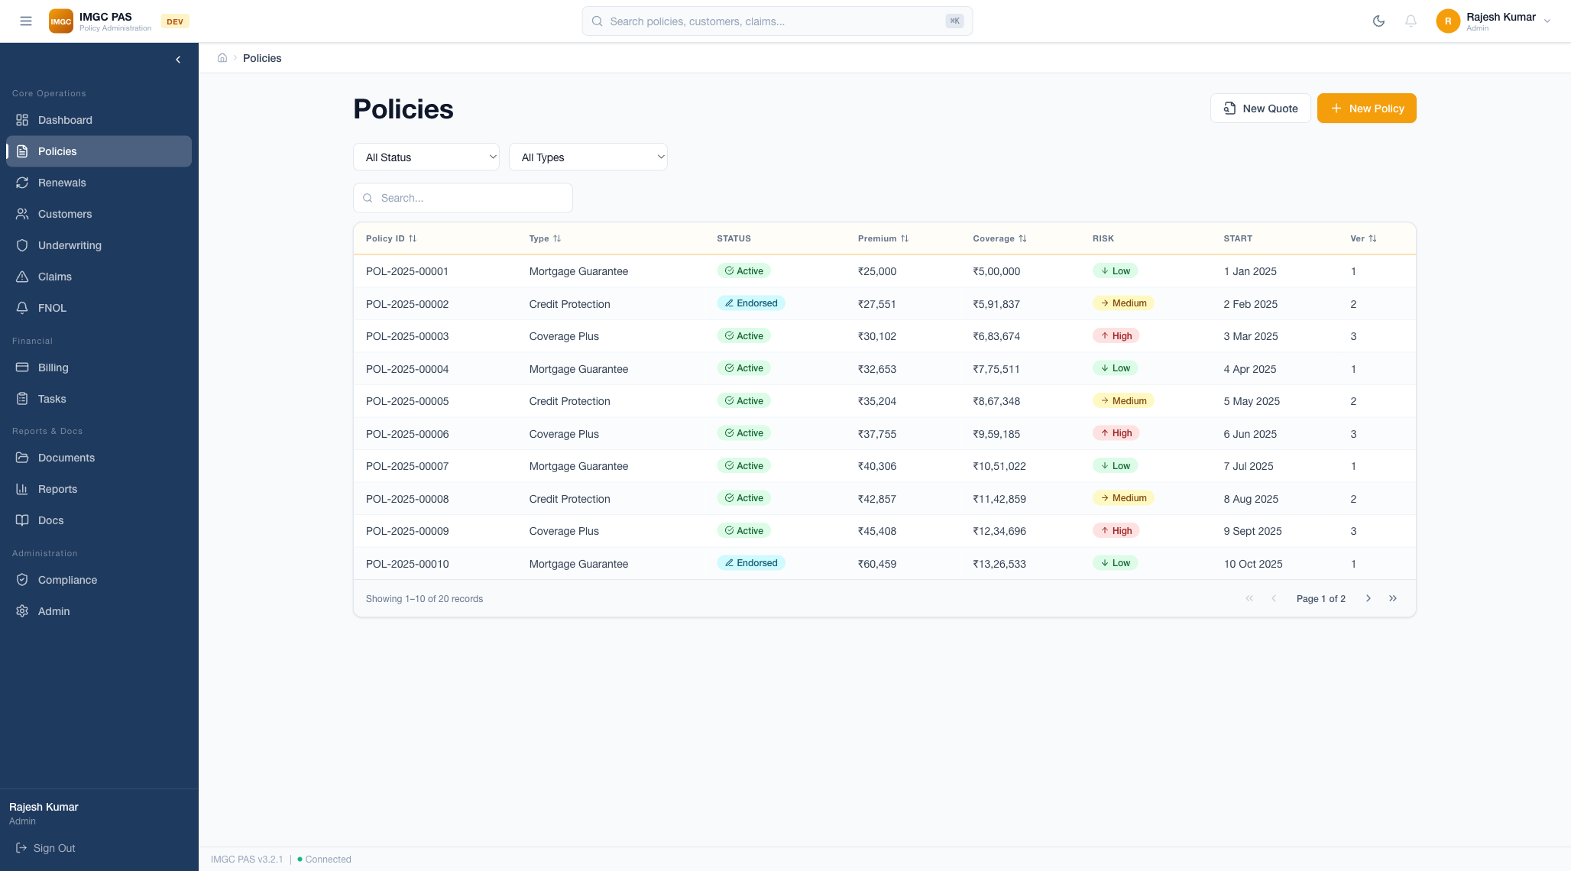
03 POLICY MANAGEMENT
Policy List Management
• Comprehensive policy table with 8 columns
• 12 Policy statuses: Draft, Quoted, Bound,
Issued, Active, Endorsed, Renewal Pending,
Reinstated, Lapsed, Cancelled, Expired
• Filter by status and policy type
• Real-time search across all fields
• Sortable columns (ID, Type, Premium, etc.)
• Pagination: 10 records/page
Quick Actions
• "New Quote" — Start quote wizard
• "New Policy" — Direct policy creation
• 3 Policy Types:
— Mortgage Guarantee
— Credit Protection
— Coverage Plus
• Color-coded risk badges (Low/Medium/High)
• Status badges with icons

Slide 6
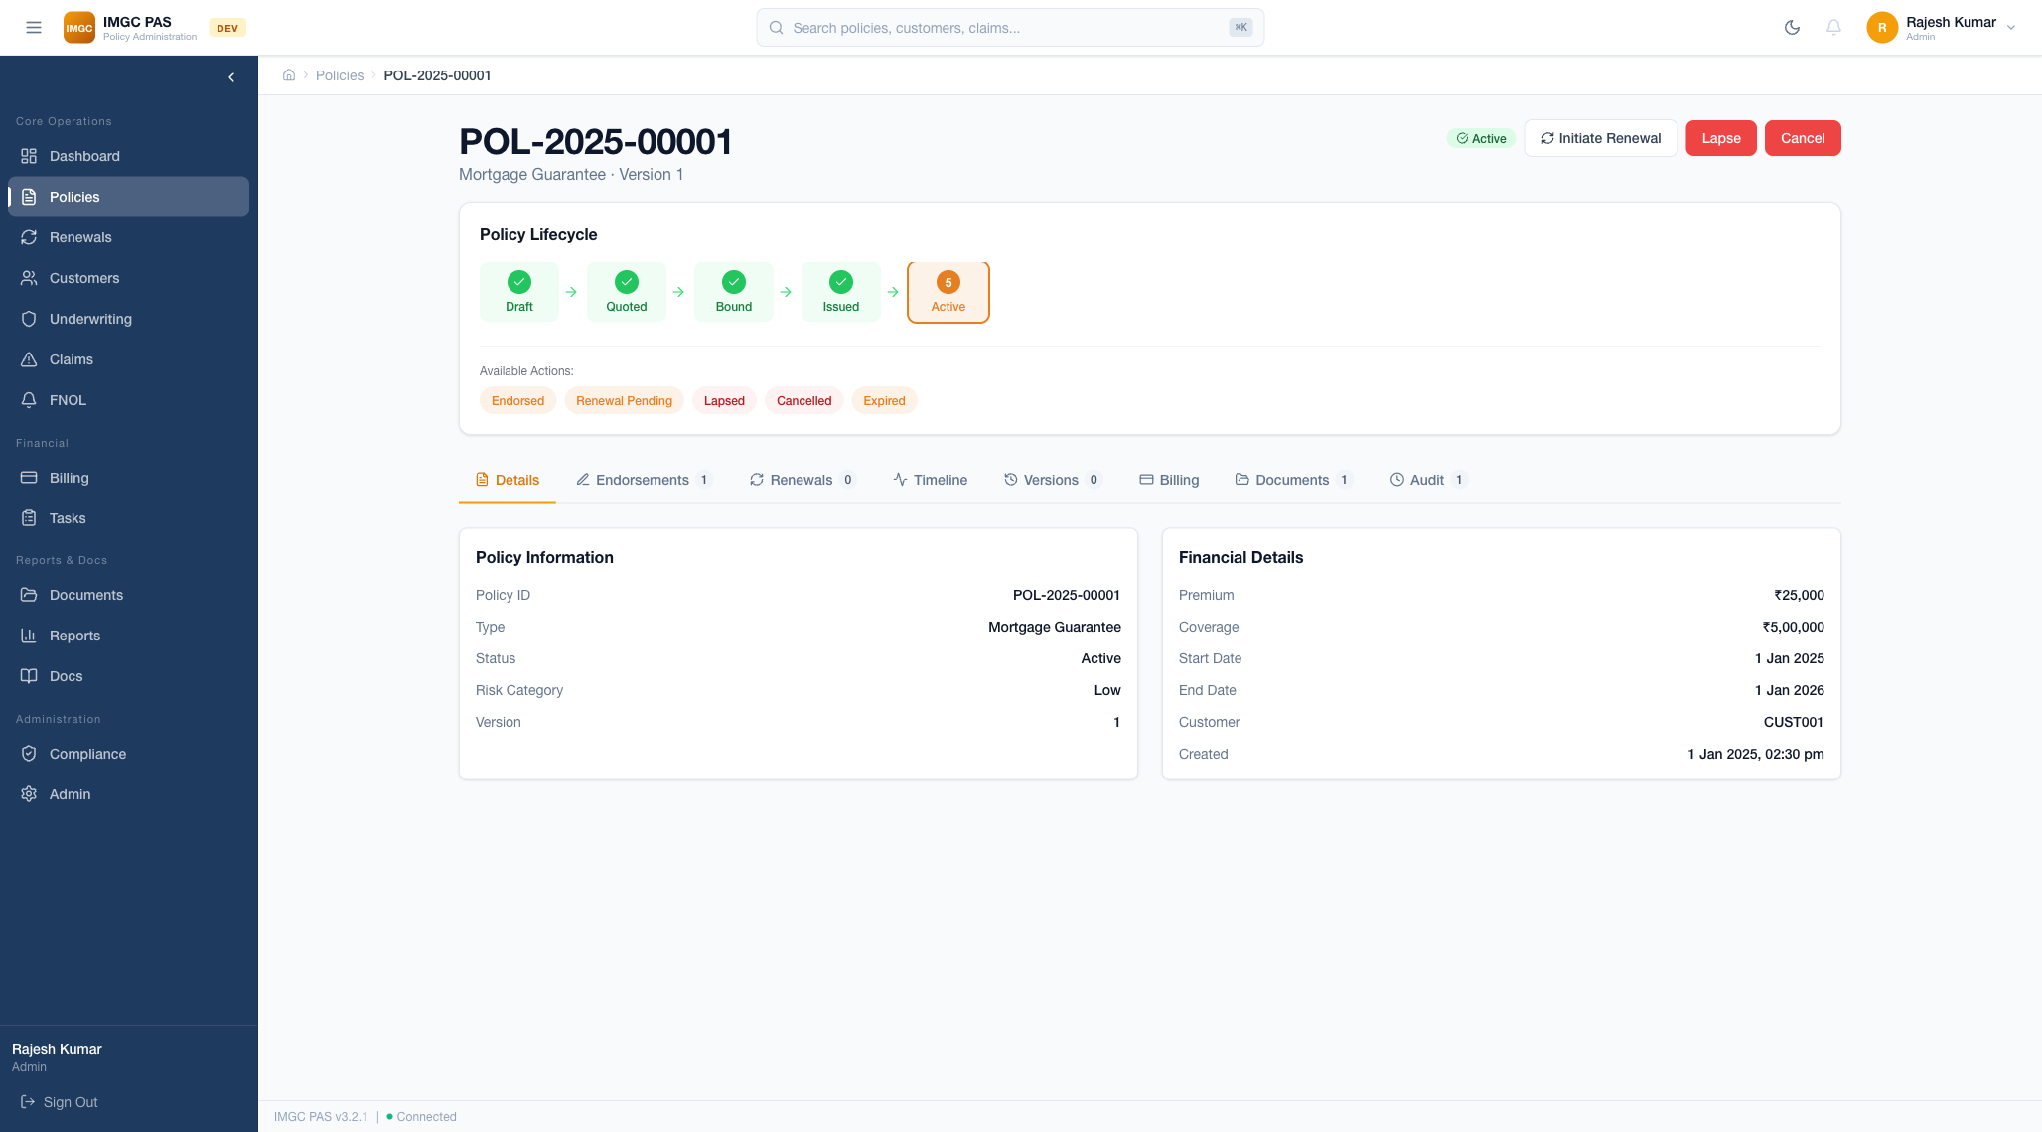
04 POLICY DETAIL & LIFECYCLE
Policy Lifecycle
• Visual Lifecycle Stepper:
Draft → Quoted → Bound → Issued → Active
• Checkmarks on completed stages
• Available Actions display:
Endorsed, Renewal Pending, Lapsed,
Cancelled, Expired
• Header buttons: Initiate Renewal,
Lapse, Cancel
Detail Tabs
• 8-Tab Detail View:
1. Details — Policy & Financial info
2. Endorsements — Mid-term changes
3. Renewals — Renewal history
4. Timeline — Event chronology
5. Versions — Version comparison
6. Billing — Payment tracking
7. Documents — Generated docs
8. Audit — Complete audit trail

Slide 7
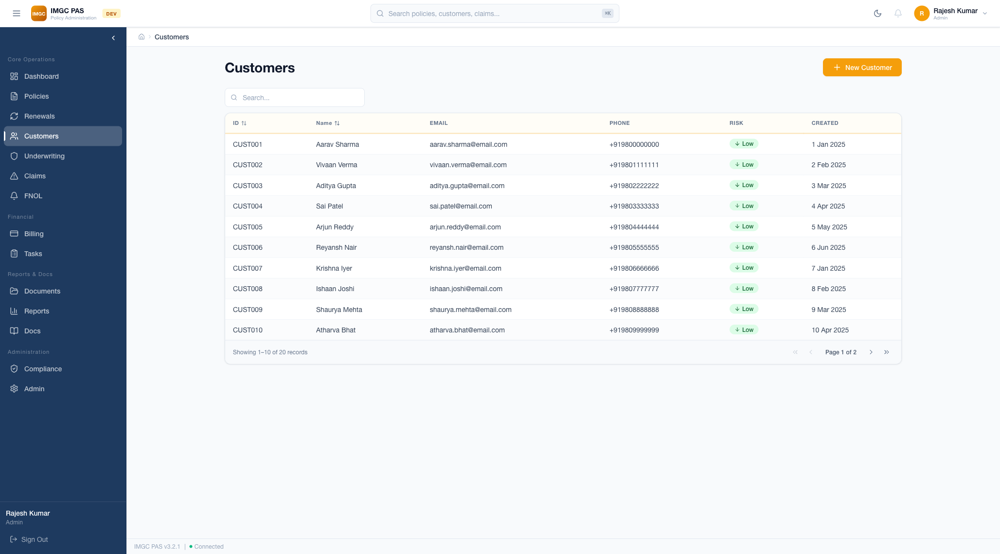
05 CUSTOMER MANAGEMENT
Customer Records
• Customer table: Name, Email, Phone,
Status, Policies, Risk Profile
• Real-time search across all fields
• Active/Inactive status badges
• Risk profile indicators (Low/Med/High)
• Direct link to customer policies
• Pagination with record counts
Customer Operations
• Create new customers with full profile
• Edit existing customer information
• View linked policies and claims
• Risk profile assessment per customer
• Customer detail with all linked entities
• Search by name, email, or phone

Slide 8
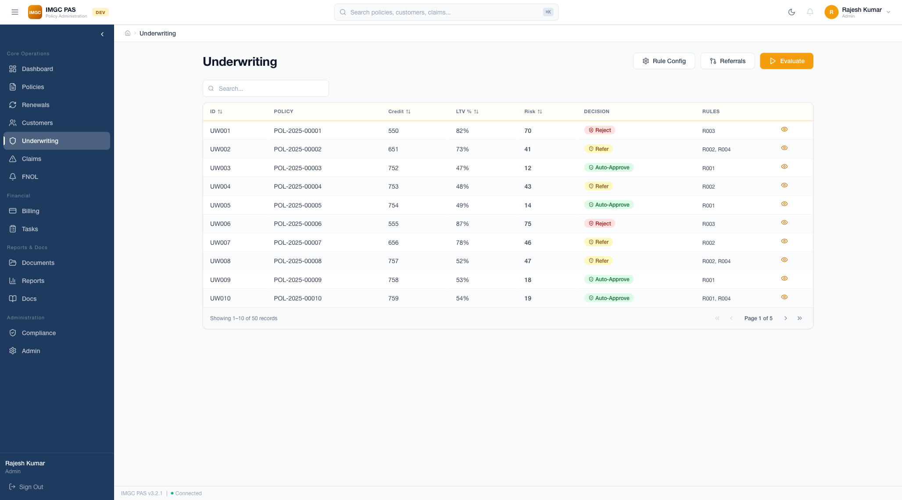
06 UNDERWRITING ENGINE
Risk Assessment
• Automated risk scoring (1-100 scale)
• 6 Underwriting Rules:
— Property value limits
— LTV ratio thresholds
— Credit score requirements
— Employment verification
— Property type eligibility
— Coverage ratio limits
Decisions & Workflow
• Decision Categories:
— Auto-Approve (Low Risk)
— Refer (Medium Risk)
— Reject (High Risk)
• Manual override with justification
• Configurable rules (Admin)
• Referral queue for senior UW review
• Delegated authority management

Slide 9
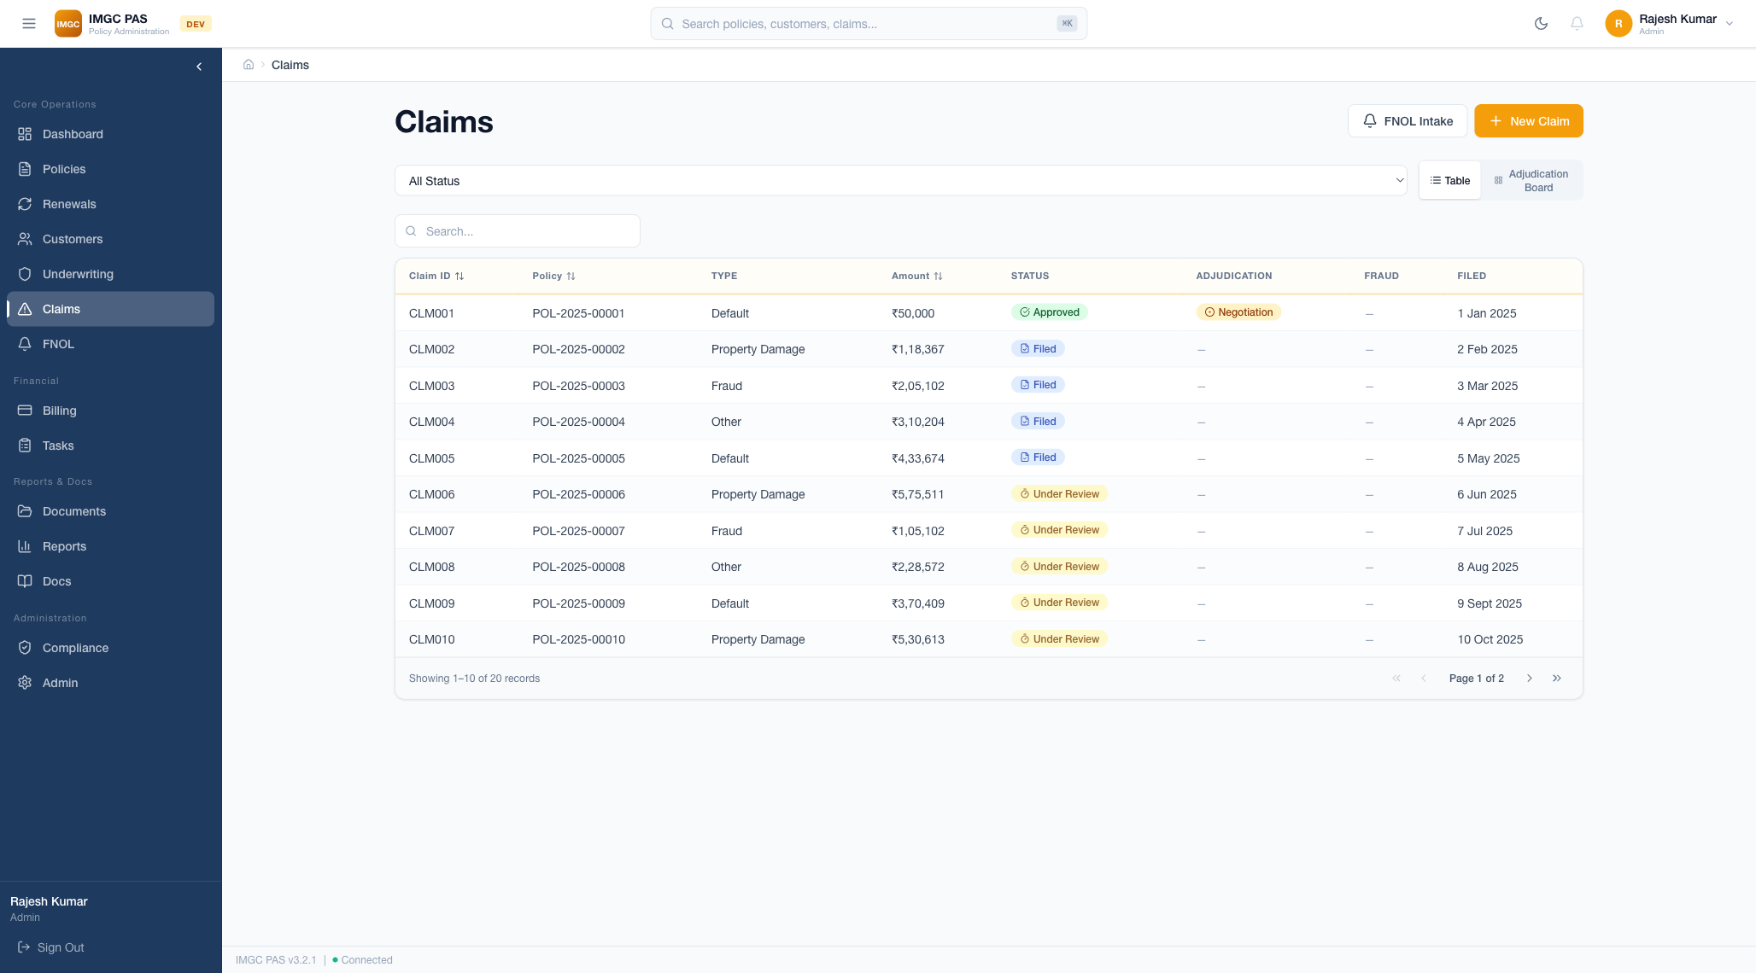
07 CLAIMS MANAGEMENT
Claims Processing
• Claims table: ID, Policy, Type, Status,
Amount, Filed Date
• Status flow:
Filed → Under Review → Approved/Rejected
→ Settled
• FNOL intake wizard (5-step process)
• Reserve management & tracking
• Fraud indicator scoring
FNOL Workflow
• FNOL Intake Steps:
1. Incident Information
2. Policy Lookup
3. Damage Details
4. Document Upload
5. Review & Submit
• Claims timeline with event history
• Loss mitigation tracking
• Settlement processing

Slide 10
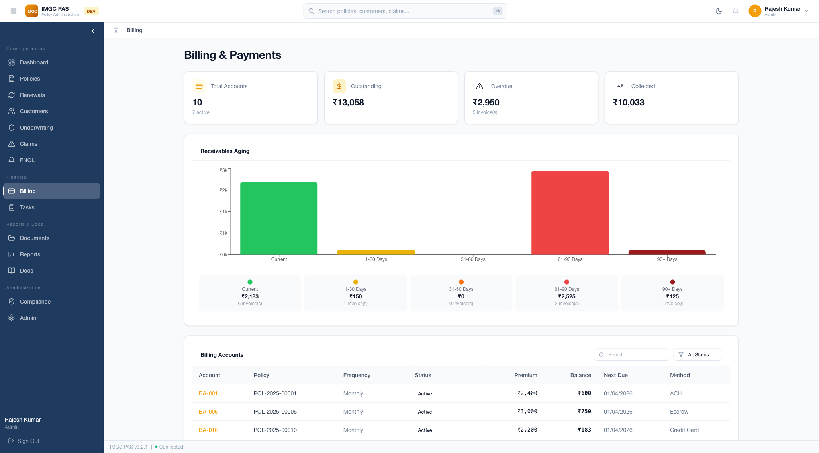
08 BILLING & PAYMENTS
Billing Lifecycle
• Billing accounts linked to policies
• Auto-generated invoices with line items
• Payment tracking by method:
Cash, Check, UPI, Bank Transfer
• Installment plans: Annual, Semi-Annual,
Quarterly, Monthly
• Receivables Aging chart
(Current, 30d, 60d, 90d, 90+)
Automation & Ledger
• Grace period automation
(Overdue → Grace → Lapse)
• Double-entry ledger:
Premiums, Payments, Refunds, Write-offs
• KPIs:
— 10 Total Accounts (7 Active)
— ₹13,058 Outstanding
— ₹10,033 Collected
— 5 Overdue (₹2,950)

Slide 11
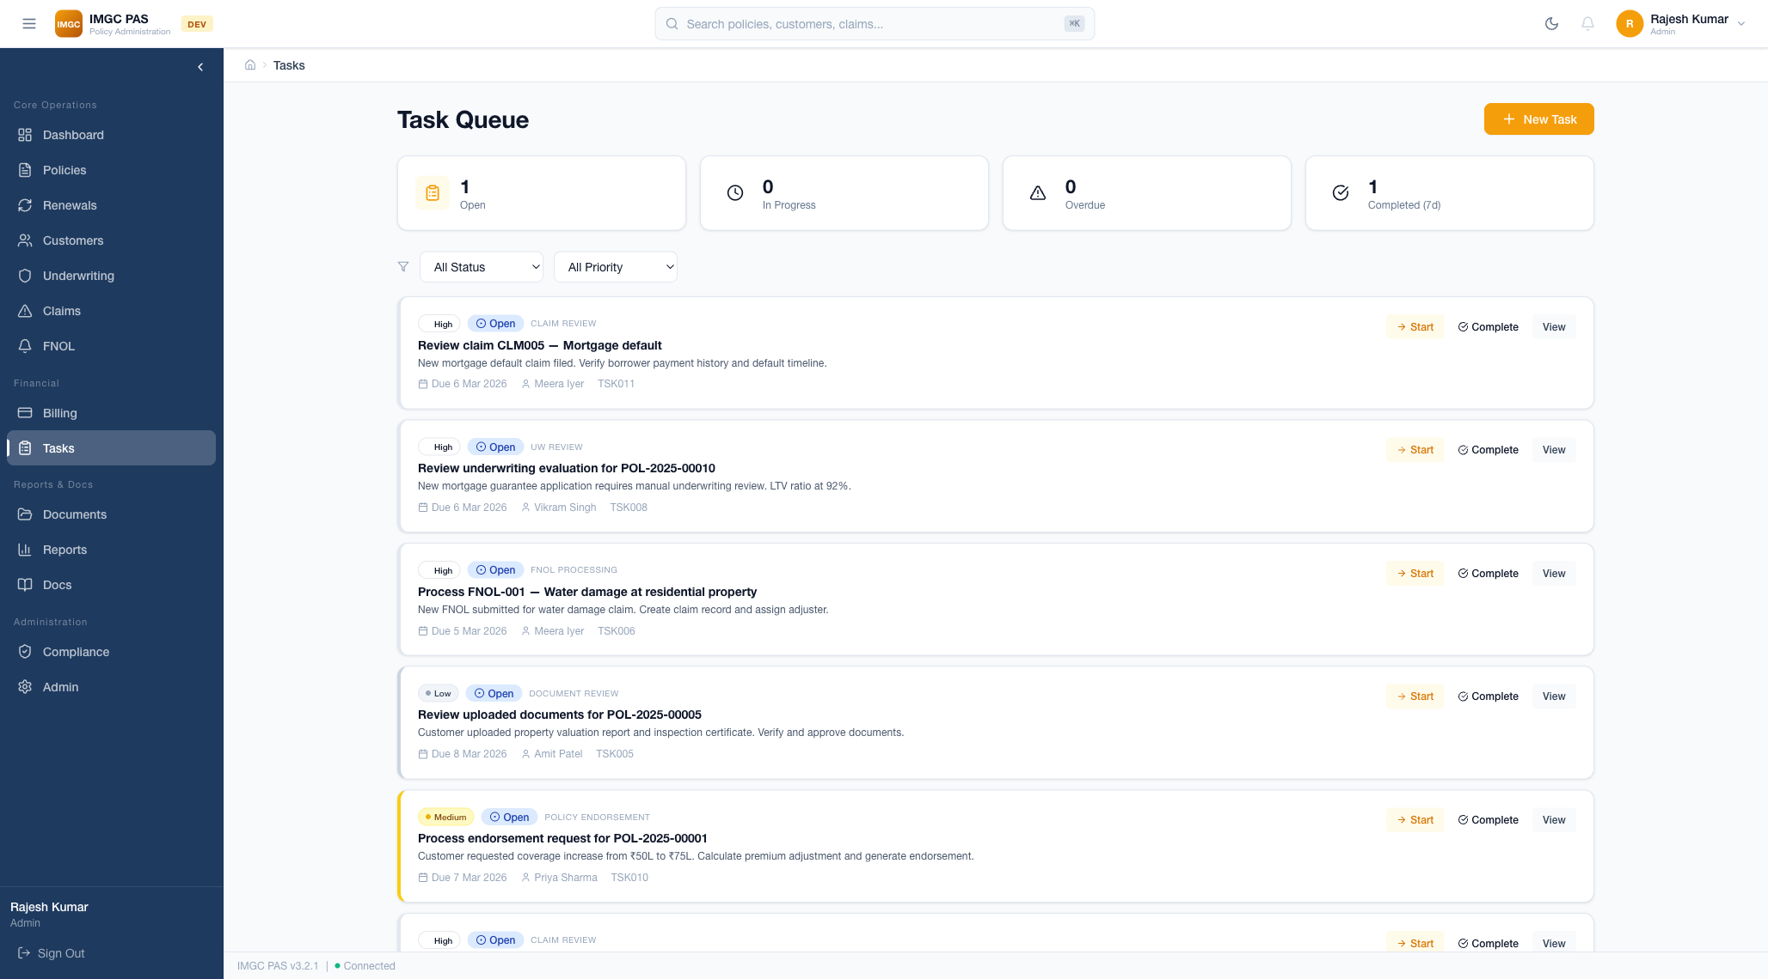
09 TASK MANAGEMENT
Task Queue
• Summary cards: Open, In Progress,
Completed, Overdue counts
• Task table: Title, Assignee, Priority,
Due Date, Status
• Priority: Urgent, High, Medium, Low
• SLA countdown with overdue alerts
• Task assignment/reassignment
Workflow Automation
• Auto-task creation from workflows:
— New claim → Claims adjuster task
— UW referral → Senior UW task
— Renewal due → Operations task
— Overdue payment → Billing task
• Dashboard widget for quick access
• Task detail drawer with activity log

Slide 12
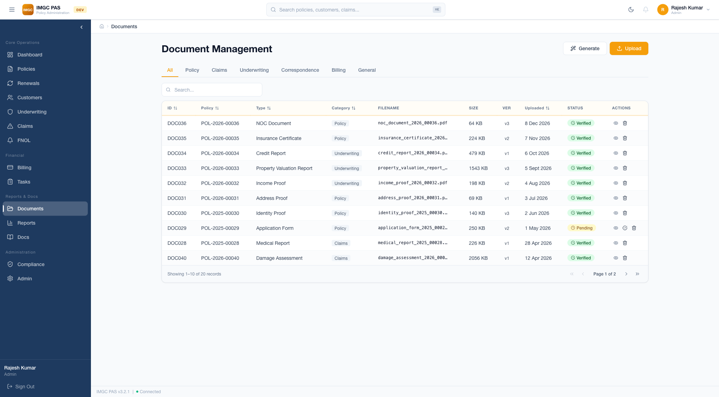
10 DOCUMENT MANAGEMENT
Document System
• Category tabs: All, Policy, Claims,
Underwriting, Correspondence
• Document table: Name, Category,
Entity, Date, Size, Actions
• Drag-and-drop file upload
• Document generation from templates
• Full-text search
• Version control with history
Generation & Templates
• Generated Document Types:
— Policy Declarations
— Certificates of Insurance
— Endorsement Schedules
— Claims Correspondence
— Billing Invoices
• In-app preview for PDF/images
• Bulk download as ZIP

Slide 13
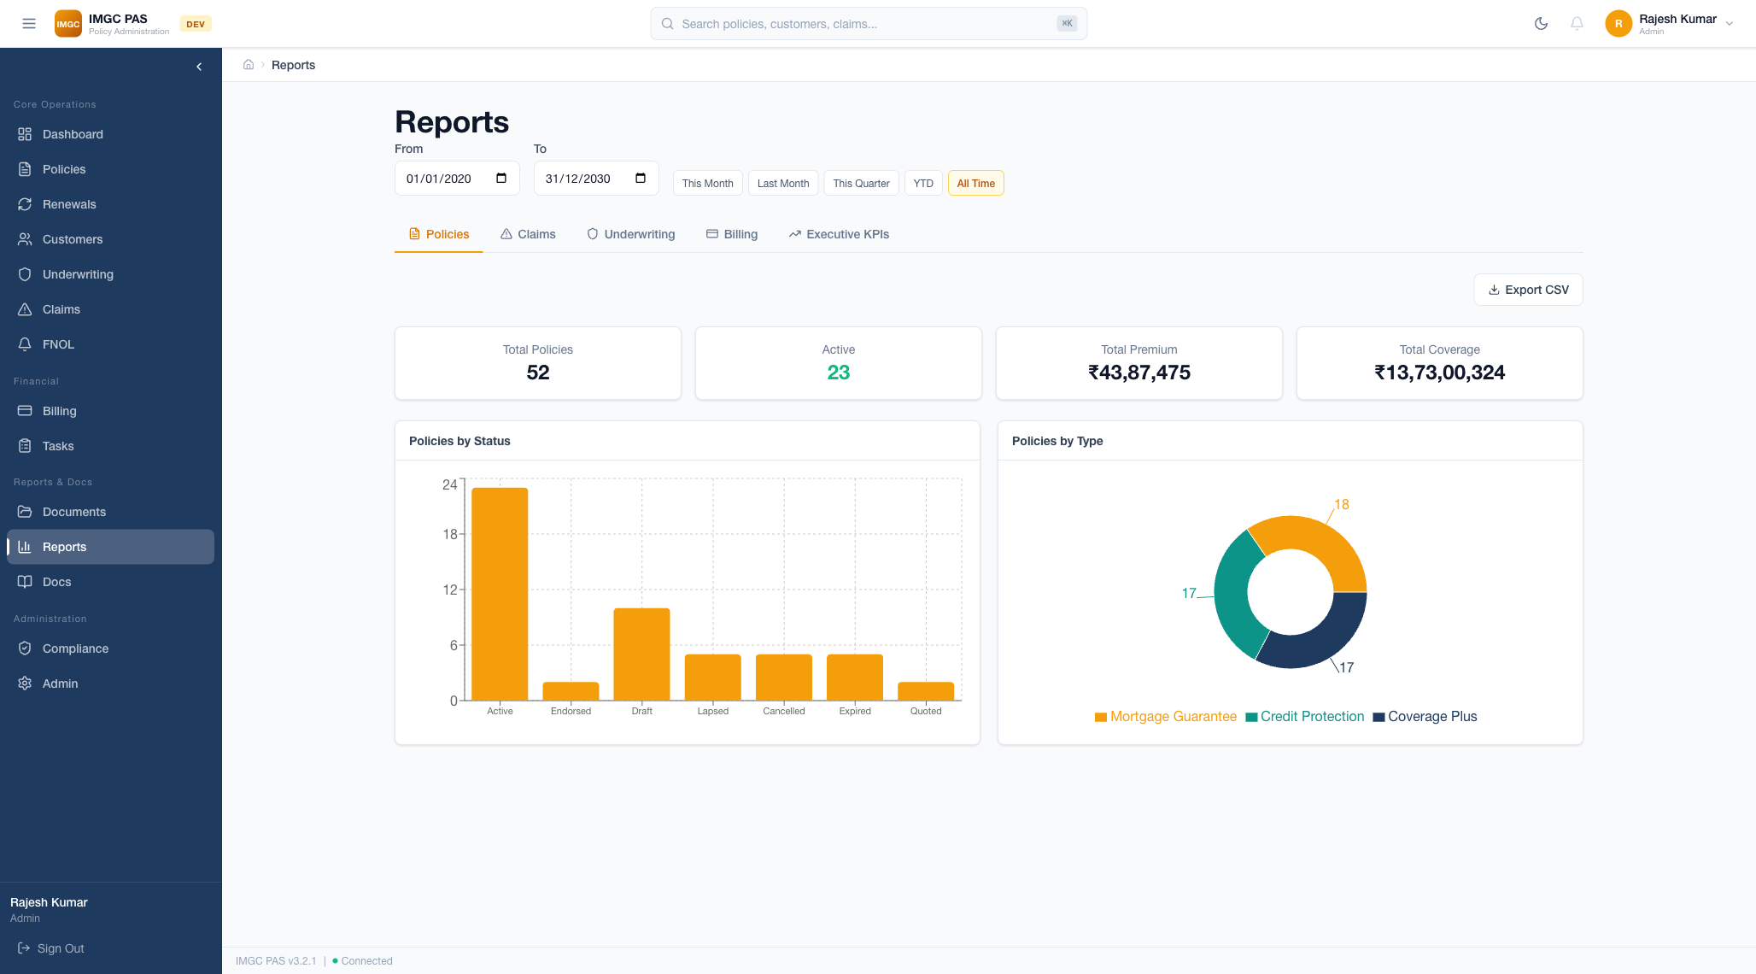
11 REPORTS & ANALYTICS
Report Types
• Report Types:
— Policy Reports (premium trends)
— Claims Reports (severity, cycle time)
— Financial Reports (revenue, loss ratios)
• Interactive bar charts and pie charts
• Summary metrics with trend indicators
Filtering & Export
• Date range presets:
This Month, Last Month, Last Quarter,
Year-to-Date, Custom range
• Tab-based navigation
(Policy, Claims, Financial)
• Export capabilities for data analysis
• Visual summaries with KPI cards

Slide 14
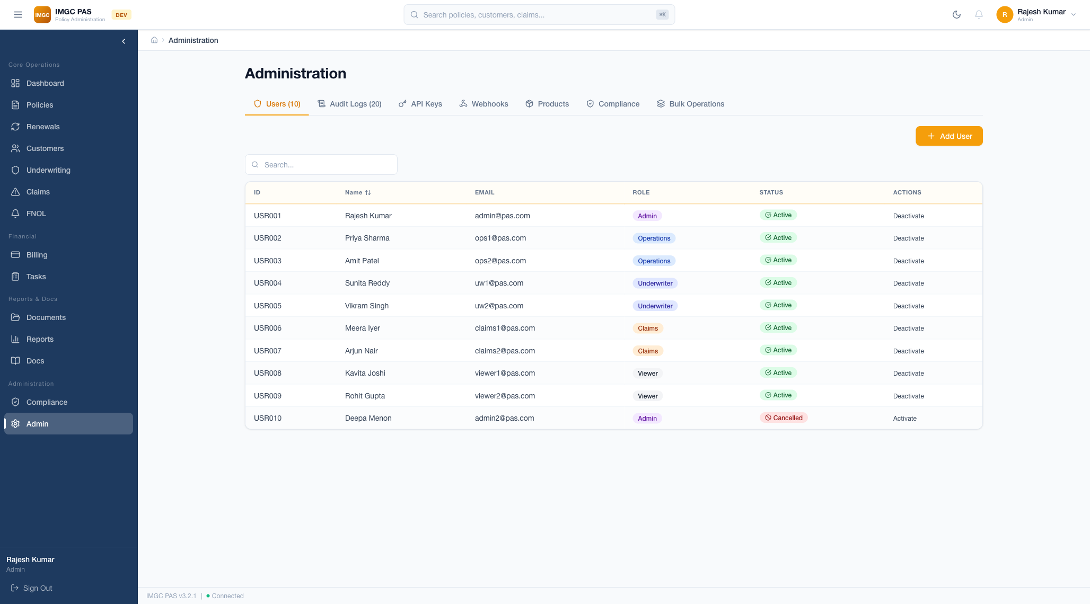
12 ADMINISTRATION & USER MANAGEMENT
User Management
• User table: Name, Email, Role,
Status, Last Active, Actions
• RBAC with 5 predefined roles
• Add/Edit/Activate/Deactivate users
• Color-coded role badges
• Complete audit logging
RBAC & Permissions
• Role Permissions Matrix:
— Admin: Full access to all modules
— Underwriter: Evaluation access
— Claims Adjuster: Claims processing
— Operations: Customer-facing operations
— Viewer: Read-only compliance
• Session management controls

Slide 15
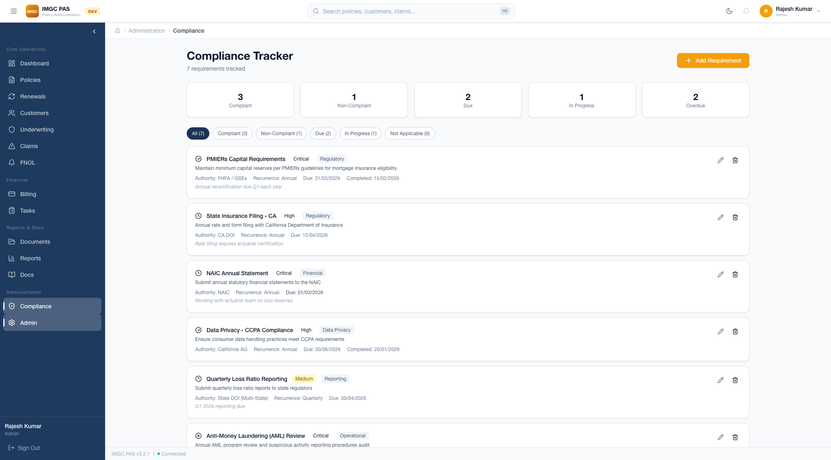
13 COMPLIANCE MANAGEMENT
Regulatory Compliance
• Regulatory requirements tracker
• Status: Compliant, Non-Compliant,
Under Review, Due
• IRDAI regulatory filing status
• Compliance calendar with deadlines
• Alert system for upcoming deadlines
Audit & Governance
• Complete audit trail for all actions
• User action logging with timestamps
• Data change history (before/after)
• Compliance report generation
• SOC 2 documentation
• Regulatory filing tracking

Slide 16
14 MODULE SUMMARY
#
Module
Key Capabilities
1
Dashboard
Executive KPIs, 7 charts, role-based views, widgets
2
Policies
Full lifecycle (Quote→Bind→Issue→Endorse→Renew→Cancel), versioning
3
Customers
CRUD operations, risk profiles, linked policies/claims
4
Underwriting
6 rules, risk scoring (1-100), manual override, referral queue
5
Claims
FNOL intake, status workflow, reserve management, fraud scoring
6
Billing
Invoicing, payments, installments, aging reports, ledger
7
Tasks
Queue management, SLA tracking, auto-assignment from workflows
8
Documents
Upload, template-based generation, categories, versioning
9
Reports
Policy/Claims/Financial reports, date filtering, charts
10
Admin
User CRUD, RBAC (5 roles), audit logs, session management
11
Compliance
Regulatory tracking, deadline alerts, filing status
12
Renewals
Renewal queue, batch processing, auto-renewal workflow
13
FNOL
Structured 5-step intake wizard, document collection
14
Notifications
In-app alerts, bell icon, read/unread management

Slide 17
15 TECHNOLOGY STACK & ARCHITECTURE
Frontend
Styling
Charts
Next.js 14, React 18, TypeScript
Tailwind CSS, Lucide Icons
Recharts
Server-side rendering, type safety, modern component architecture
Enterprise UI with consistent design system, 30% orange accent
Interactive data visualizations — bar, pie, donut, horizontal bar charts
Backend
Auth
Storage
Express.js, TypeScript
JWT + Refresh Tokens
JSON File Persistence
RESTful API server with 150+ endpoints, middleware architecture
Stateless authentication, RBAC, session management
Rapid prototyping with database-ready architecture
Non-Functional Features
Responsive
Accessible
Performant
Secure
Enterprise UX
Desktop, tablet, mobile
WCAG 2.1, ARIA labels, keyboard nav
Skeleton loading, staggered animations
256-bit encryption, RBAC, JWT, input sanitization
Toasts, confirmations, breadcrumbs, search

Slide 18
IMGC CORPORATION
Thank You
Policy Administration System — Enterprise Edition
For questions or demo access, contact the PAS Development Team
Confidential | IMGC PAS v3.2.1 | March 2026
14+ Modules
150+ APIs
5 User Roles
256-bit Encrypted
SOC 2 Compliant
IRDAI Regulated

