Slide 1

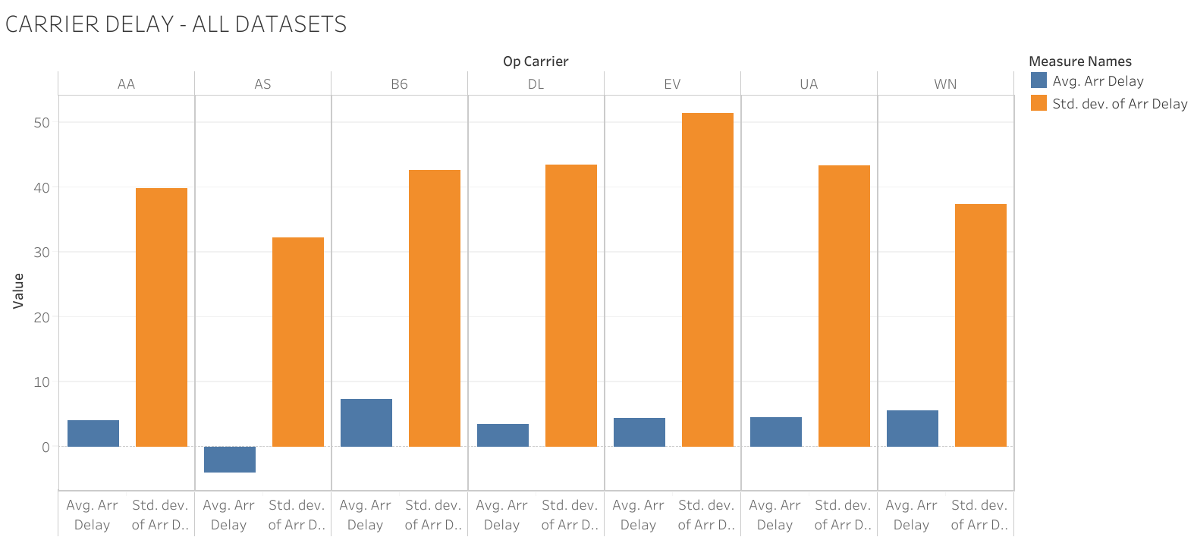
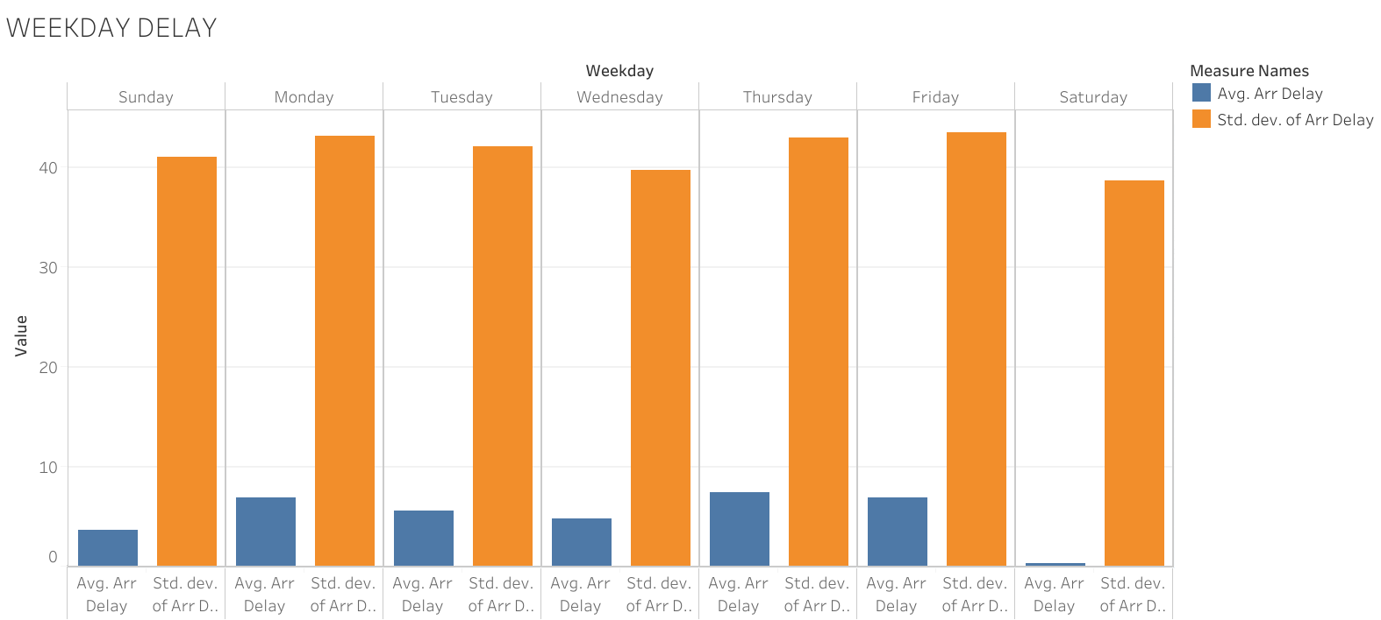
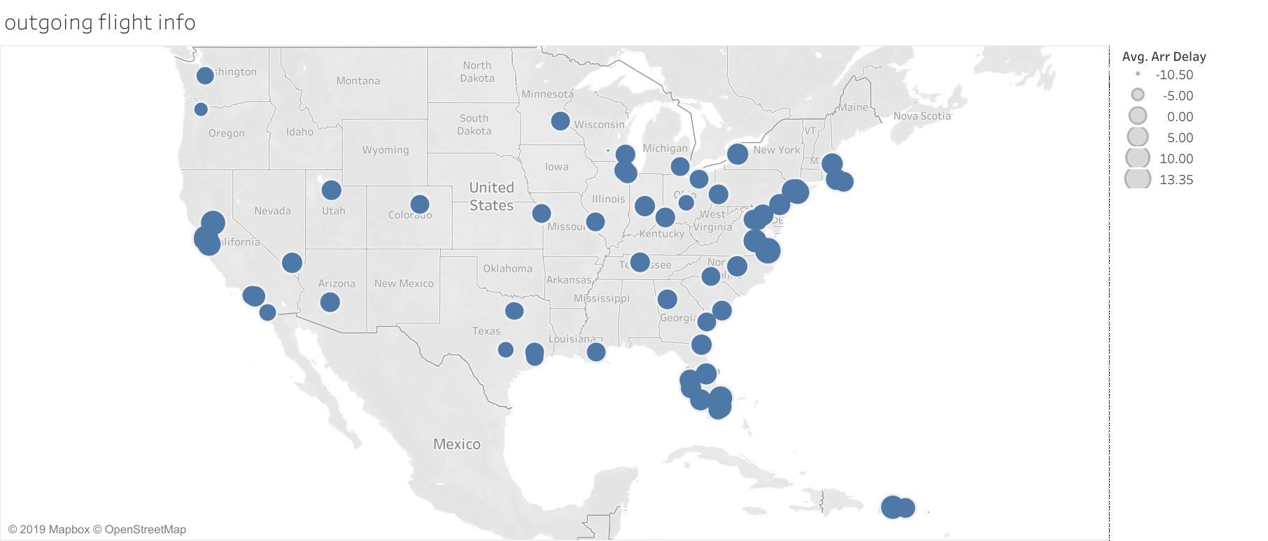
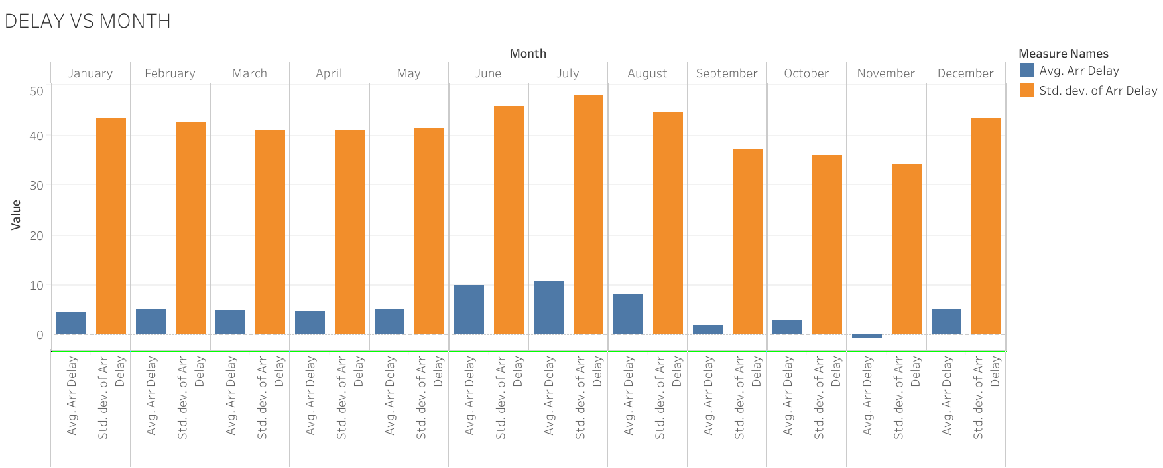
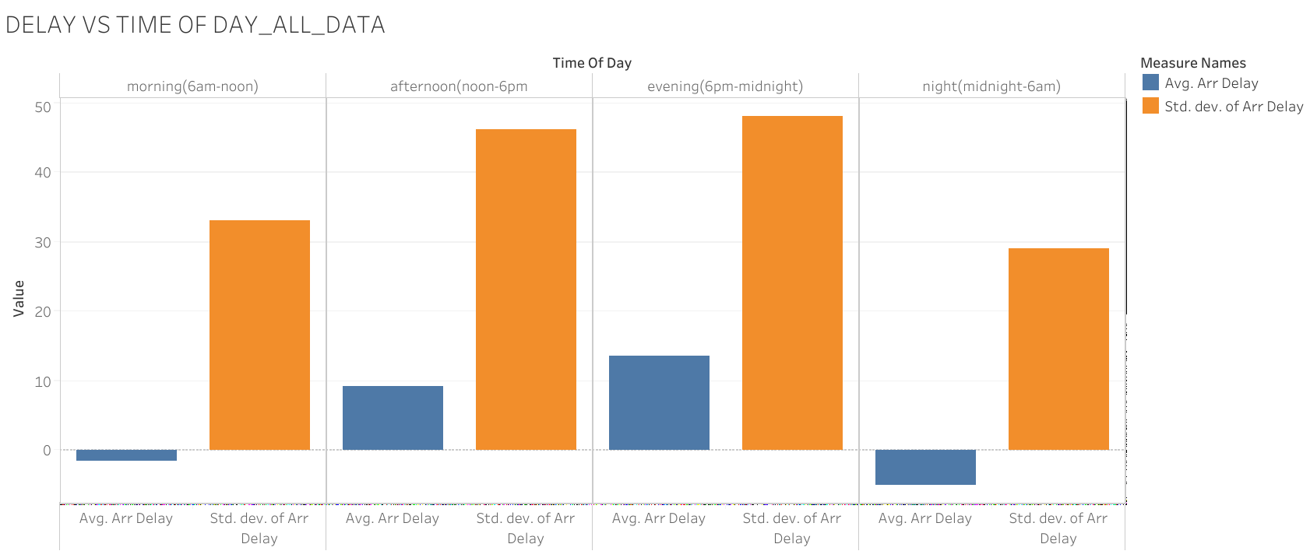
Project title
Team member 1 (program) Team member 4 (program)
Team member 2 (program) Team member 3 (program)
Executive summary
Data
Takeaways
We aim to provide a toolbox for customers to choose their flights based on the delay predicted by our model for each future flight based on DoT data on historical flight performance.
Problem
Conclusion
Results
Key questions
15.071—The Analytics Edge Fall 2019
15.071—The Analytics Edge Fall 2019

Slide 2
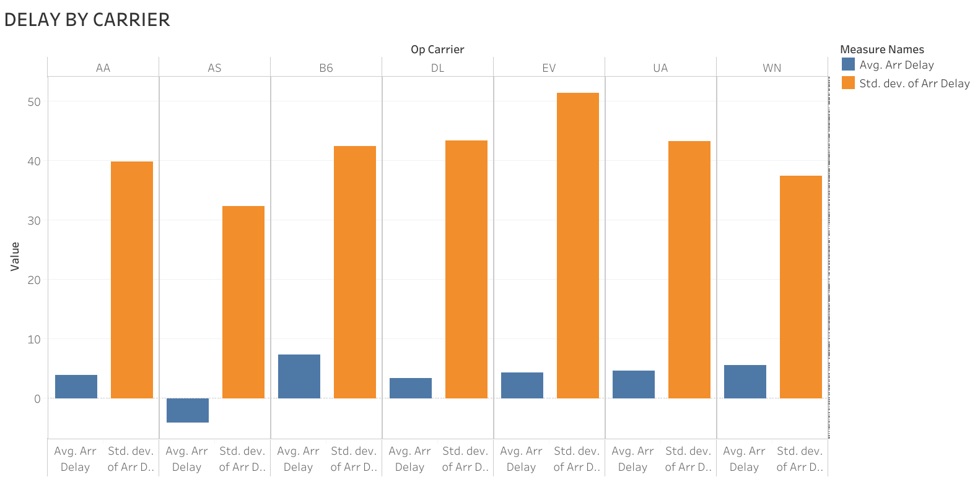
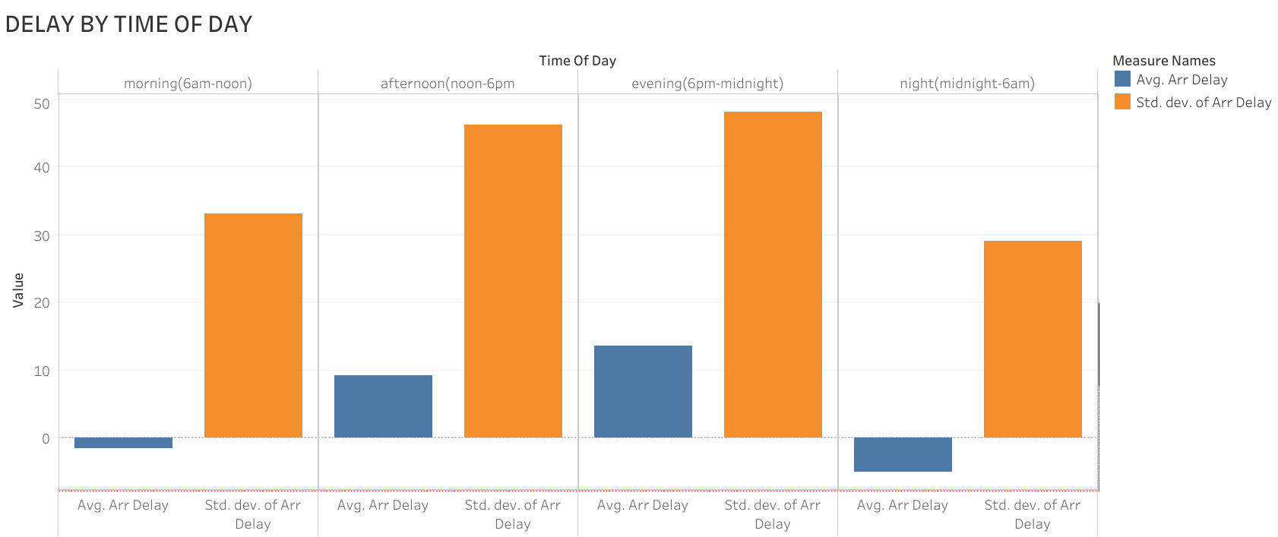
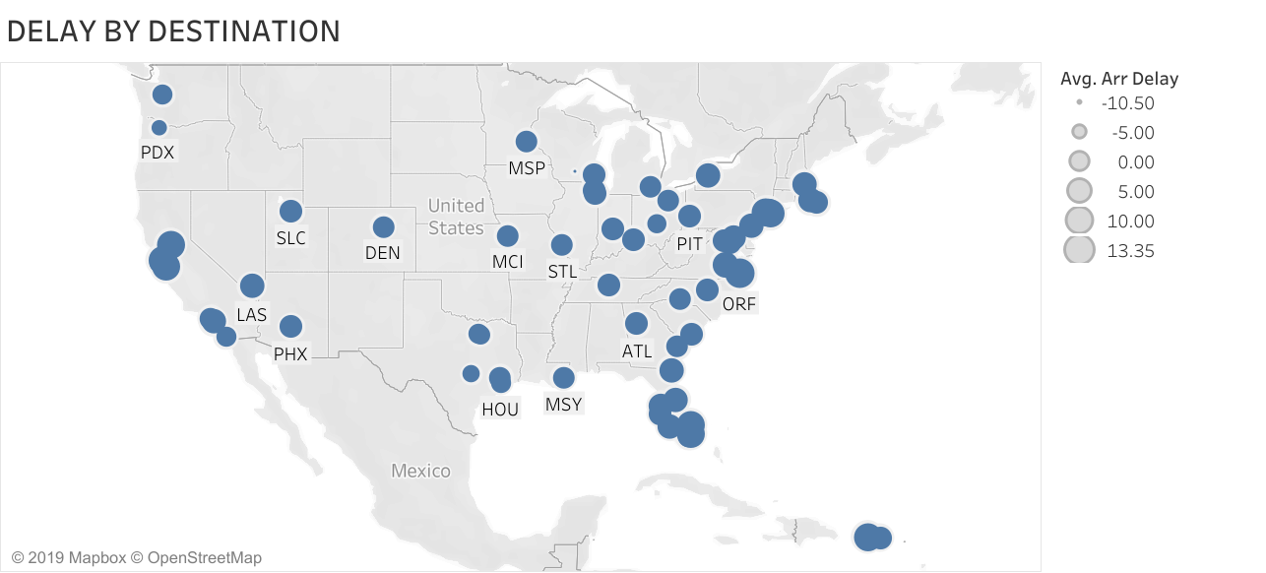
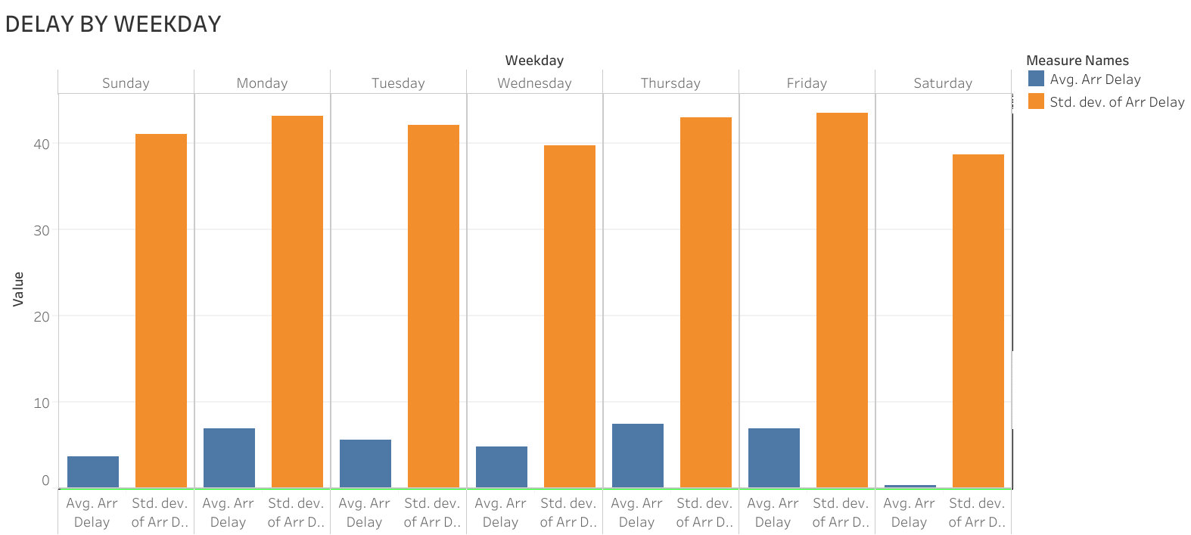

Predicting Flight Delay
Aksel Danielsen (EECS) Nithin Narayanan (SDM)
Jayanth Kumar (SDM) Phillip Schmedeman (SDM)
Executive summary
Data Visualization
Takeaways
Using commercial aviation flight data, we created a model that predicts the delay times for future flights. This provides travelers with decision-relevant information they can use to reduce the duration of their travel delays.
Results & Conclusion …
Problem
A study estimated that in 2007, the total direct cost to US passengers from air transportation delay was $16.7 billon. Despite the cost and inconvenience of delays, travelers have to make many decisions (airports, airline, flight time and date), with little information about how those variables impact the likelihood of delay.
Conclusion
Key questions
How should we structure the data to achieve the best results?
What are the most significant independent variables affecting flight delay?
How will the decisions travels make when selecting a flight impact the expected duration of delay?
What model family will provide the best prediction of future flight delays?
What model parameters will provide the best performance?
Results
Carrier | Destination | Time of Day | Weekday | Month
Jet Blue Southwest United Express Jet American Delta Alaska | ORF … PDX | Evening (1800-2400) Afternoon (1200-1800) Morning (0600-1200) Night (2400-0600) | Thursday Friday Monday Tuesday Wednesday Sunday Saturday | July June August May April March February January October September November
Data
We utilize a dataset from the Bureau of Transportation Statistics containing commercial aviation flight data from 2009 to 2018. After processing the dataset contains 1.8 million entries across 8 variables. The dependent variable is Arrival Delay. Independent variables:
15.071—The Analytics Edge Fall 2019
15.071—The Analytics Edge Fall 2019

