Slide 1
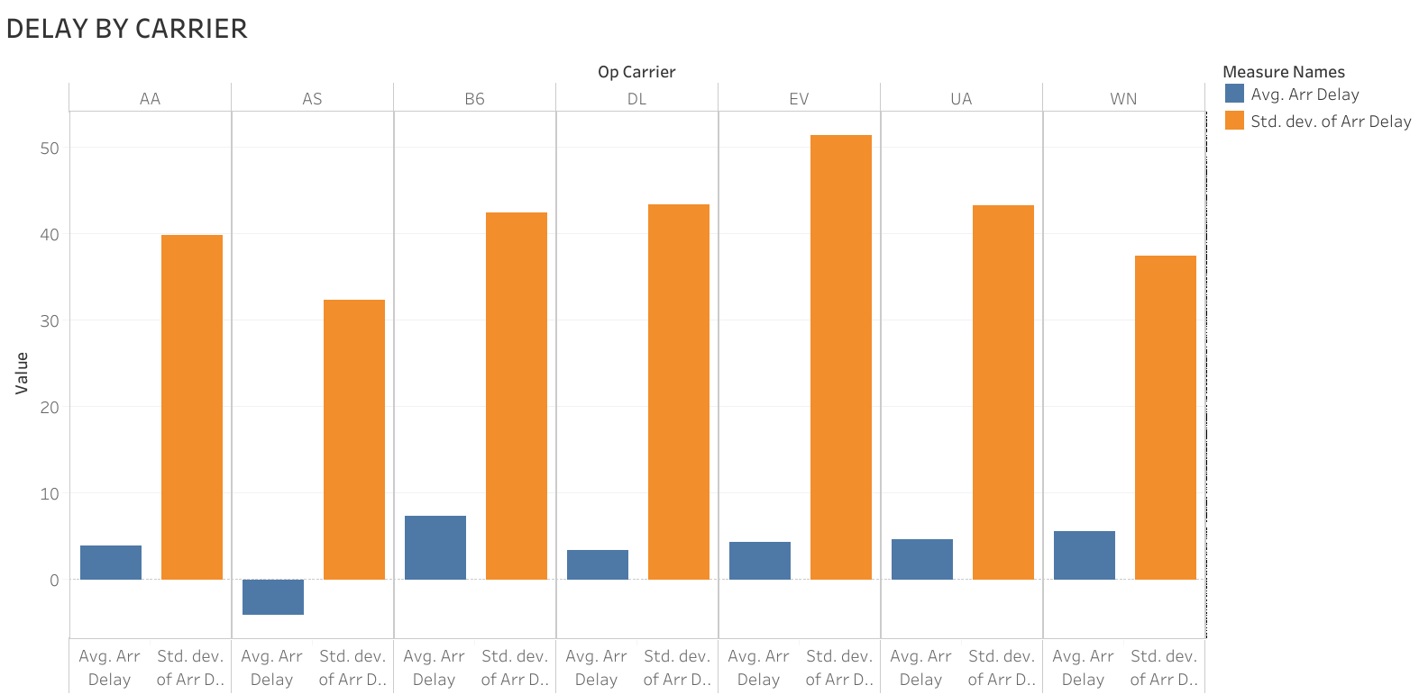

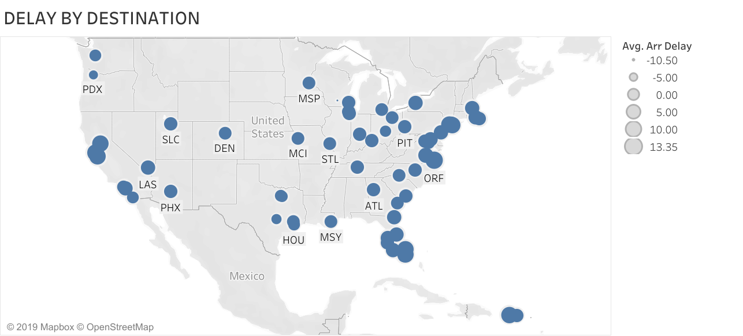
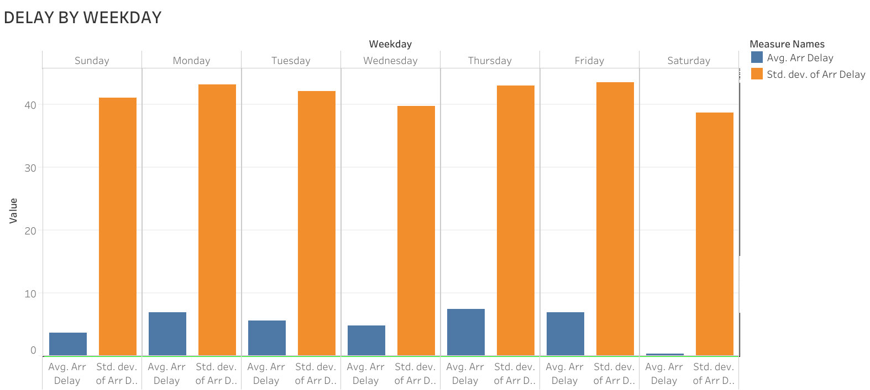
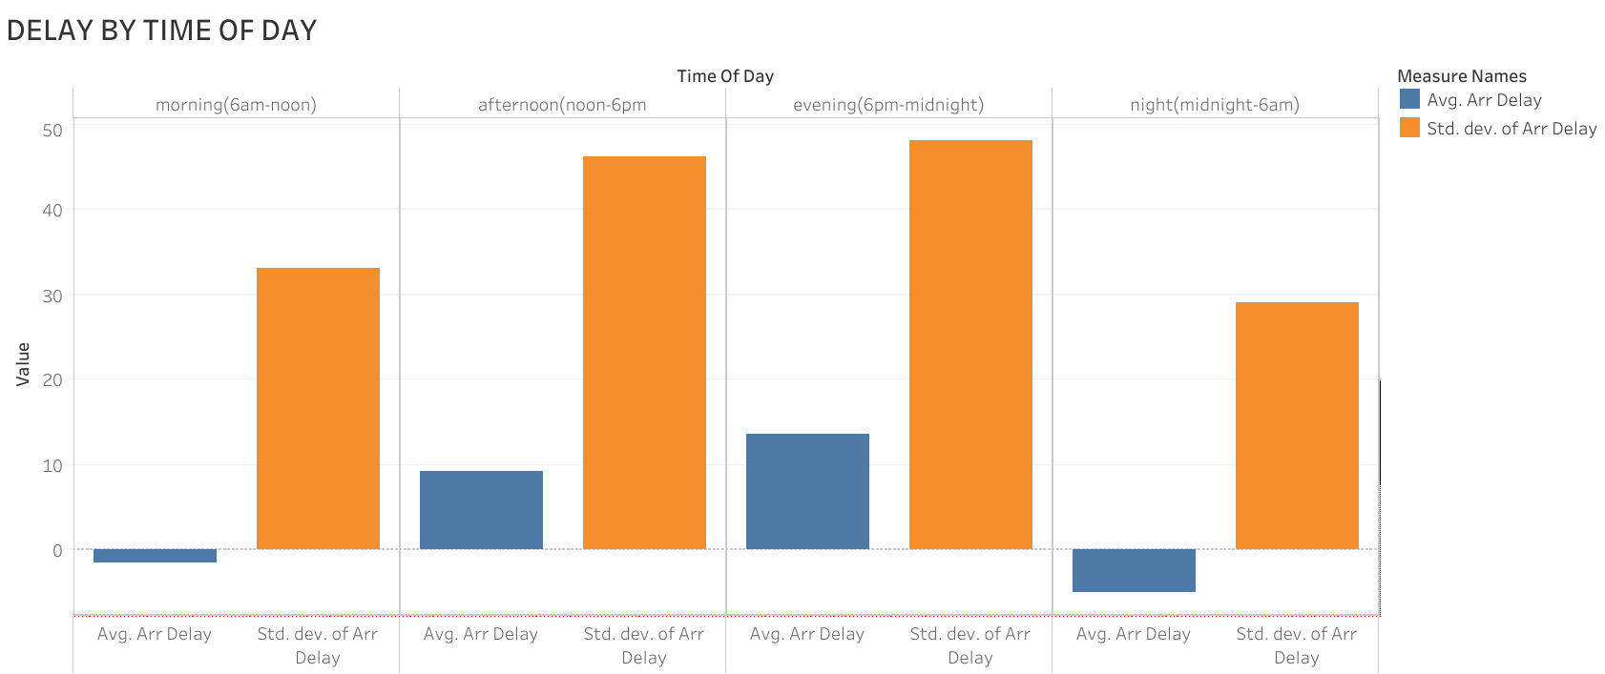
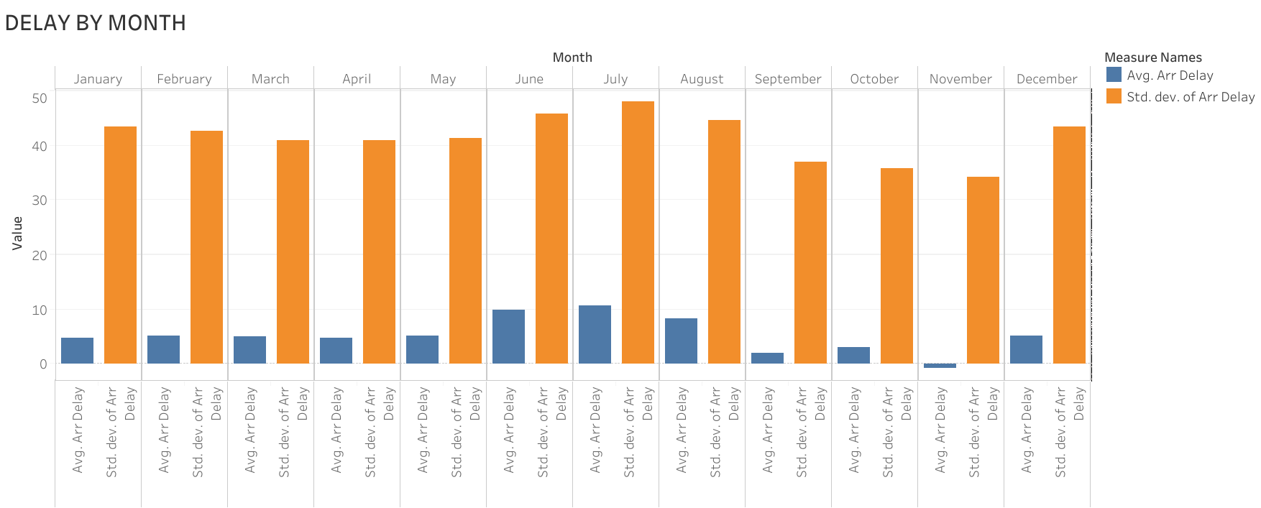
Predicting Flight Delay
Aksel Danielsen (EECS) Nithin Narayanan (SDM)
Jayanth Kumar (SDM) Phillip Schmedeman (SDM)
Executive summary
Data Visualization
Results
Using commercial aviation data, we created a model that predicts the delay times for future flights. This provides travelers with decision-relevant information they can use to reduce the duration of their travel delays.
Model | OSR2 | MAE | RMSE
Linear Regression (all variables) | 0.03876 | 26.31 | 2040
Linear Regression Stepwise Variable Selection (-Distance) | 0.0388 | 26.31 | 2040
CART (cp = 1.5e-05) | 0.0410 | 26.17 | 2042
Random Forest
Problem
A study estimated that in 2007, the total direct cost to US passengers from air transportation delay was $16.7 billon. Despite the significant cost and inconvenience of delays, travelers have to make many decisions (airports, airline, flight time and date), with little information about how those variables impact the amount of delay they experience.
Which model performed the best?
Variable and parameters? (variables, cp value)
…
Data
Conclusion
Dataset from U.S. Department of Transportation
Commercial aviation flight data from 2009 to 2018
1.8 million observations and 9 variables (post-processing)
Required wrangling comment…
Our model can predict flight delays…
Use Case: Thursday evening flight in Dec, BOS to SFO (2,704 miles) via Jet Blue.
Predicted Delay: 20 mins
Recommendation: switch to morning or night flight and reduce delay by … mins
Recommendation: switch carrier to … and reduce delay by … mins
How user can decrease delay risk
Future work: incorporate weather metrics, additional airports, flight cancelation
Significance Increases
Time of Day | Month | Destination | Carrier | Weekday
Evening (1800-2400) | July | MSN | Express Jet | Thur
 | June | PDX | Jet Blue | Fri
 | Aug | SYR
 | Dec | SAN | United | Mon
Afternoon (1200-1800) | Feb | .
 | May | . | Southwest | Tues
 | Mar | .
Morning (0600-1200) | April | SJC | Delta | Wed
 | Jan | SMF
 | Oct | OAK | American | Sun
 | Sep | FLL
Night (2400-0600) | Nov | ORF | Alaska | Sat
Analytical Approach
Dependent Variables: average arrival delay for all flights during a given hour; all flights of a carrier during an hour (aggregate)
Independent Variables: Time of day, month, destination, carrier, weekday
Models: Linear Regression, CART, Random Forest
…
Delay Increases
15.071—The Analytics Edge Fall 2019
15.071—The Analytics Edge Fall 2019

Slide 2
Project title
Team member 1 (program)
Team member 2 (program)
Team member 3 (program)
Team member 4 (program)
Team member 5 (program)
Executive summary
Data
Takeaways
Text box
Problem
Results
Conclusion
Key questions
15.071—The Analytics Edge Fall 2019
15.071—The Analytics Edge Fall 2019

