Slide 1
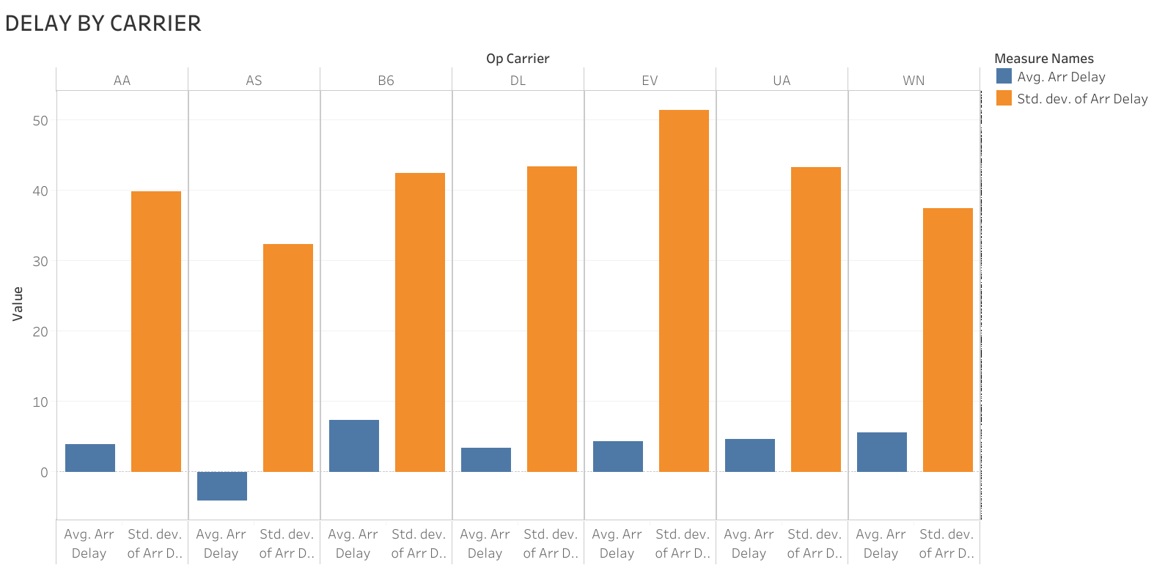

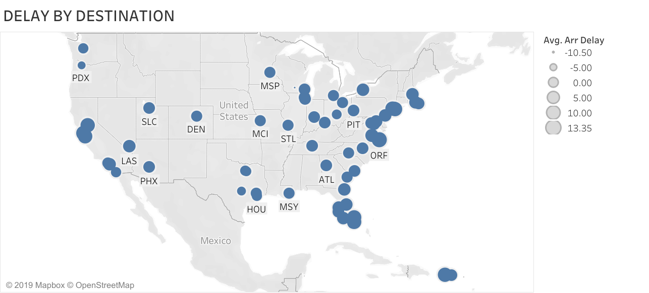
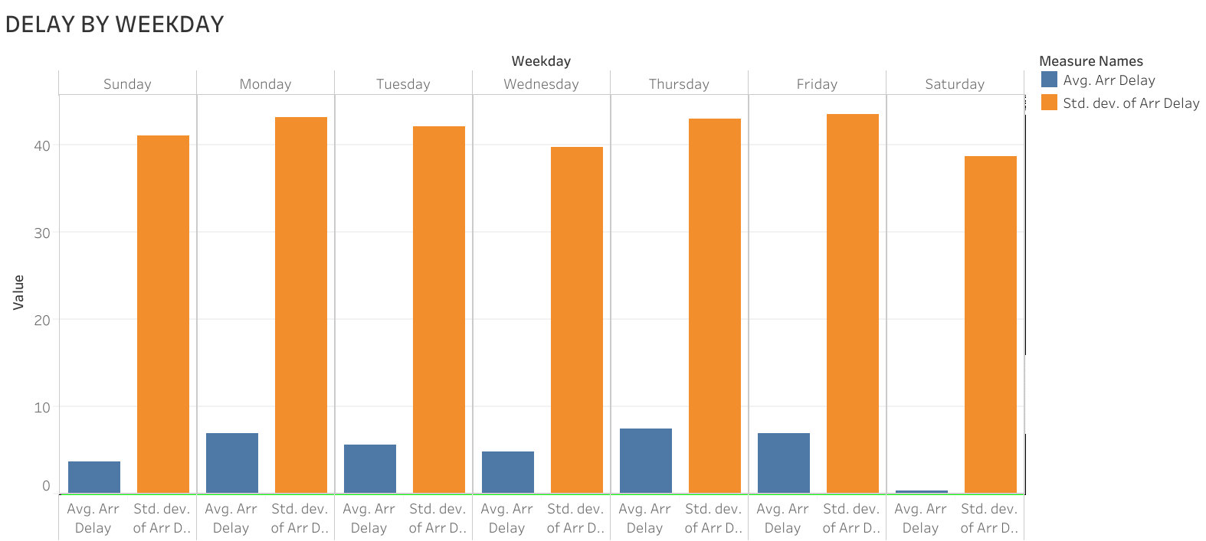
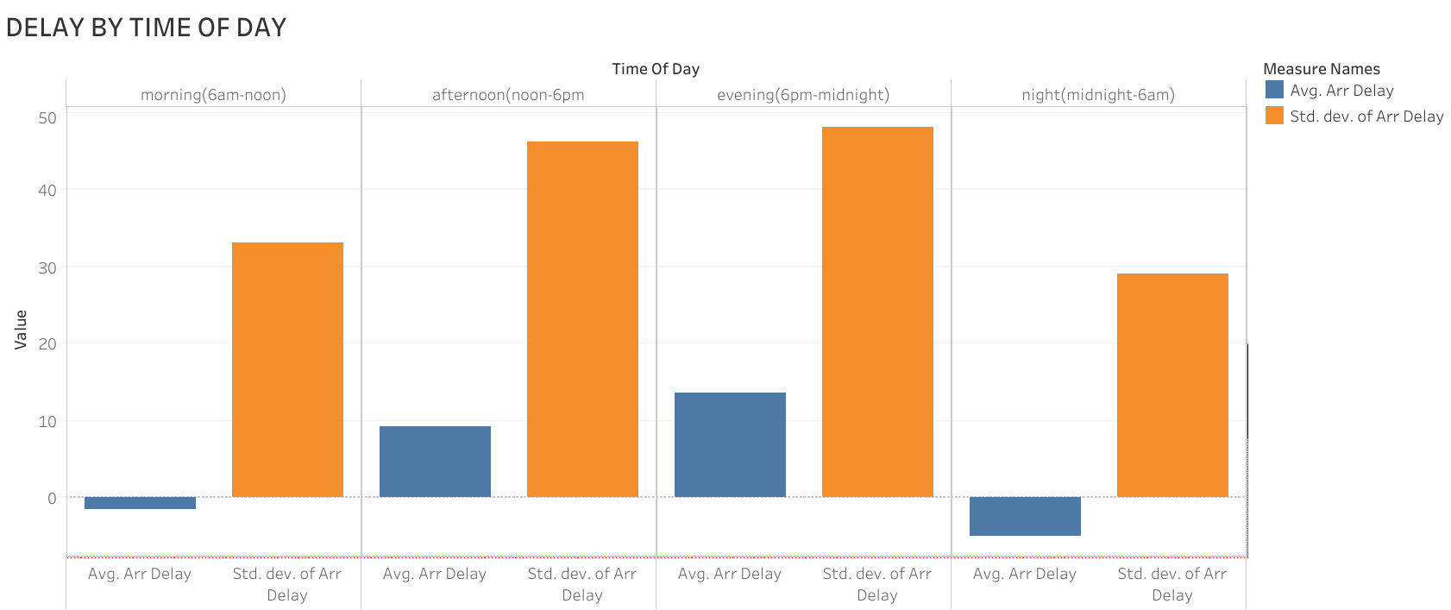
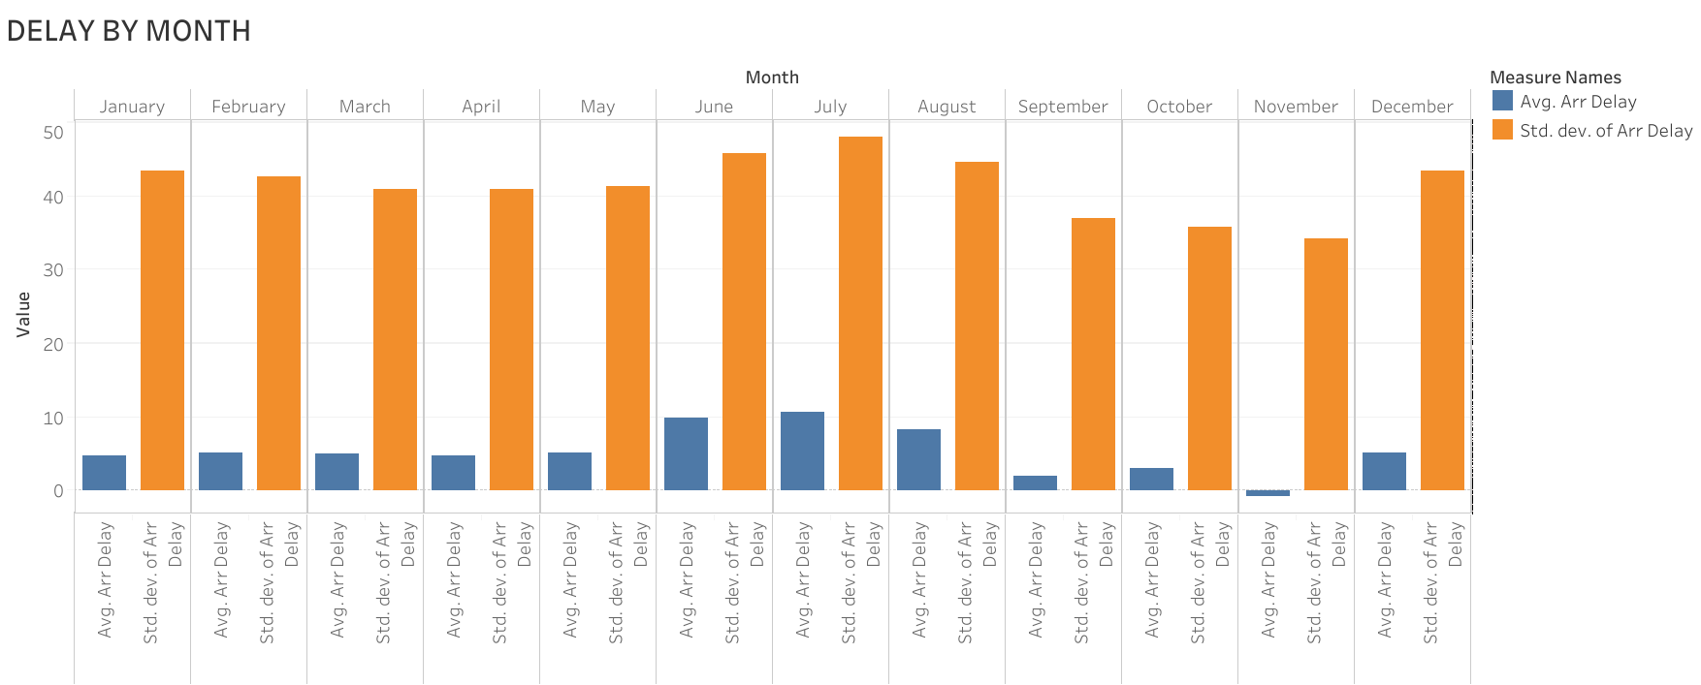
Predicting Flight Delay
Aksel Danielsen (EECS) Nithin Narayanan (SDM)
Jayanth Kumar (SDM) Phillip Schmedeman (SDM)
Executive summary
Data Visualization
Results
Using commercial aviation data, we created a model that predicts the delay times for future flights. This provides travelers with decision-relevant information they can use to reduce the occurrence and duration of travel delays.
Model | OSR2 | MAE | RMSE
Linear Regression | 0.09018 | 17.21 | 26.4
CART (cp = 1e-04) | 0.1018 | 16.98 | 25.86
Random Forest | 0.06255 | 17.33 | 26.44
Problem
Complex problem—airport dynamics (weather, safety, security) without corresponding input variables—yields poor prediction performance
Predicting flight-level delays (specific outcomes) with aggregate indicators is inappropriate
CART (with cross-validated cp=1e-04) results in the best performance
A study estimated that in 2007, the total direct cost to US passengers from air transportation delay was $16.7 billon. Despite the significant cost and inconvenience of delays, travelers have to make many decisions (airports, airline, flight time and date), with little information about how those variables impact the amount of delay they experience.
Avg Delay
Morning
Afternoon
Evening
Night
Data
Conclusion
Dataset from U.S. Department of Transportation
Commercial aviation flight data from 2009 to 2018
1.8 million observations and 9 variables (post-processing)
Pre-Processing: removed inconsistent airlines and airports; removed post-event variables; removed outliers (>4hr delay) and canceled flights
Avg Delay
Std Dev
Travelers can use the model to predict flight delays and inform decisions to reduce the occurrence and duration of delay.
Use Case: Evening flight (7pm) on Dec 19 (Thurs), BOS to ORD (867 miles) via Jet Blue.
Predicted Delay: 16 mins
Recommendation 1: switch carrier to American and reduce delay by 10 mins
Recommendation 2: fly the following morning (Fri) to eliminate delay
Limitation: model neglects dependency across flights
Future Work: predict flight cancelation, incorporate weather metrics, additional airports, explore dependency between flights
Significance Increases
Time of Day | Month | Destination | Carrier | Weekday
Evening (1800-2400) | July | MSN | Express Jet | Thur
 | June | PDX | Jet Blue | Fri
 | Aug | SYR
 | Dec | SAN | United | Mon
Afternoon (1200-1800) | Feb | .
 | May | . | Southwest | Tues
 | Mar | .
Morning (0600-1200) | April | SJC | Delta | Wed
 | Jan | SMF
 | Oct | OAK | American | Sun
 | Sep | FLL
Night (2400-0600) | Nov | ORF | Alaska | Sat
Analytical Approach
Dependent Variable: average arrival delay (customer focus) for all flights of a carrier during an hour (aggregate prediction)
Independent Variables: time of day (hour bins), month, destination, distance, carrier, weekday
Models: Linear Regression, Stepwise Variable Selection, CART, and Random Forest
Delay Increases
15.071—The Analytics Edge Fall 2019
15.071—The Analytics Edge Fall 2019

Slide 2
Project title
Team member 1 (program)
Team member 2 (program)
Team member 3 (program)
Team member 4 (program)
Team member 5 (program)
Executive summary
Data
Takeaways
Text box
Problem
Results
Conclusion
Key questions
15.071—The Analytics Edge Fall 2019
15.071—The Analytics Edge Fall 2019

