Slide 1

Smart Compiler with AI-Based Syntax Error Detection and Auto Correction
CSA1403 – Compiler Design
Presented By
SELVA PRABHU A K (192421224)
K Avinash (192411044)
Supervised By
Dr. Michael. G
SIMATS Engineering

Slide 2


Introduction
Smart Compiler provides an intelligent environment for writing, analyzing, and correcting programming code.
The system combines traditional compiler techniques with AI-based error detection for improved code analysis.
It identifies syntax errors and provides meaningful explanations to help users understand their mistakes.
AI-based correction suggests suitable changes and generates an improved version of the source code.
The proposed compiler helps beginners reduce debugging time and improve their programming skills.

Slide 3
PROBLEM STATEMENT
Traditional compilers mainly display syntax errors without providing detailed explanations or correction suggestions.
Beginners may find compiler error messages difficult to understand and identify the exact cause of errors.
Manually locating and correcting multiple syntax errors can increase development and debugging time.
Existing compiler systems generally separate error detection from intelligent code correction.
An intelligent solution is required to detect syntax errors and provide automatic correction suggestions.

Slide 4
Project Scope & Objectives
Develop a smart compiler that analyzes source code and identifies common lexical and syntax errors.
Implement lexical and syntax analysis techniques to validate the structure of the given programming code.
Integrate AI-based techniques to understand detected errors and suggest appropriate corrections.
Provide clear error messages with error location, description, and recommended correction.
Create a simple interface that helps users analyze, correct, and understand programming errors easily.

Slide 5


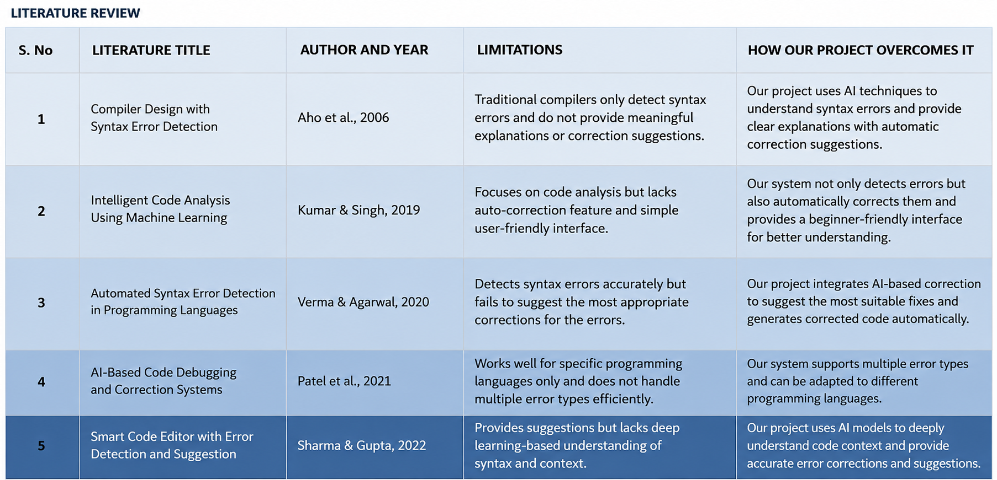
LITERATURE REVIEW

Slide 6
Module 1: Lexical & Syntax Analysis
The module accepts source code from the user and performs initial code analysis.
Lexical analysis identifies keywords, identifiers, operators, constants, and special symbols in the code.
Syntax analysis checks whether the tokens follow the rules of the selected programming language.
The module detects errors such as missing semicolons, brackets, and incorrect statement structures.
Detected errors are displayed with their location and suitable descriptions for further processing.

Slide 7
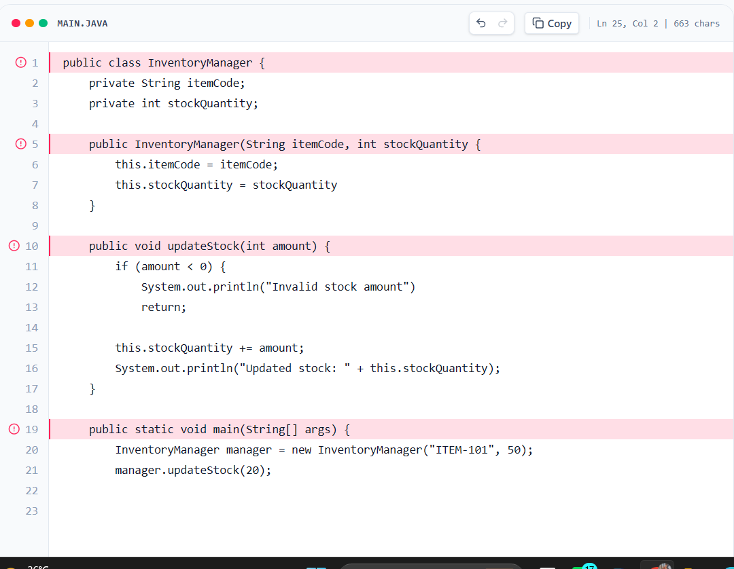
Module 1: Output

Slide 8
Module 2: AI-Based Error Detection & Auto Correction
The module analyzes detected syntax errors using AI-based techniques for intelligent error understanding.
It identifies the possible cause of the error and generates a meaningful explanation for the user.
The system suggests the most appropriate correction based on the surrounding source code.
The auto-correction feature generates a corrected version of the code without changing its intended logic.
The module displays the original code, detected error, suggested correction, and corrected code.

Slide 9
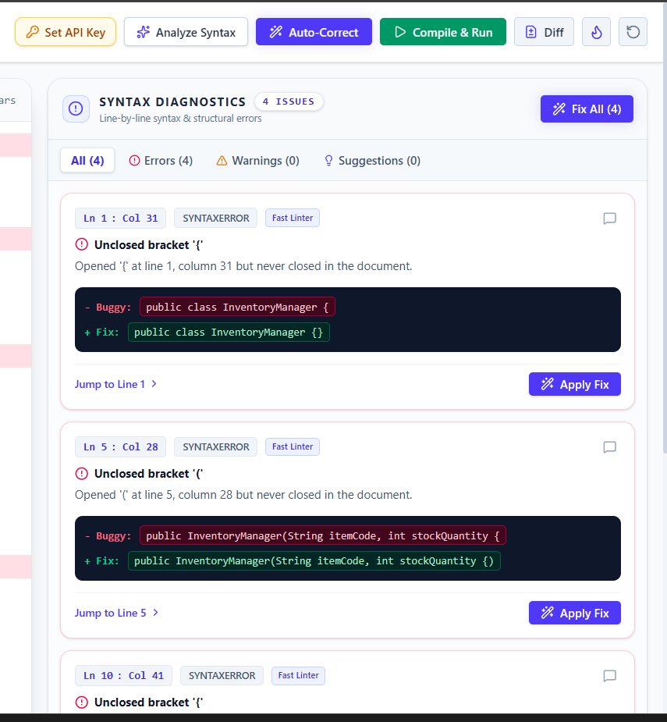
Module 2: Output

Slide 10
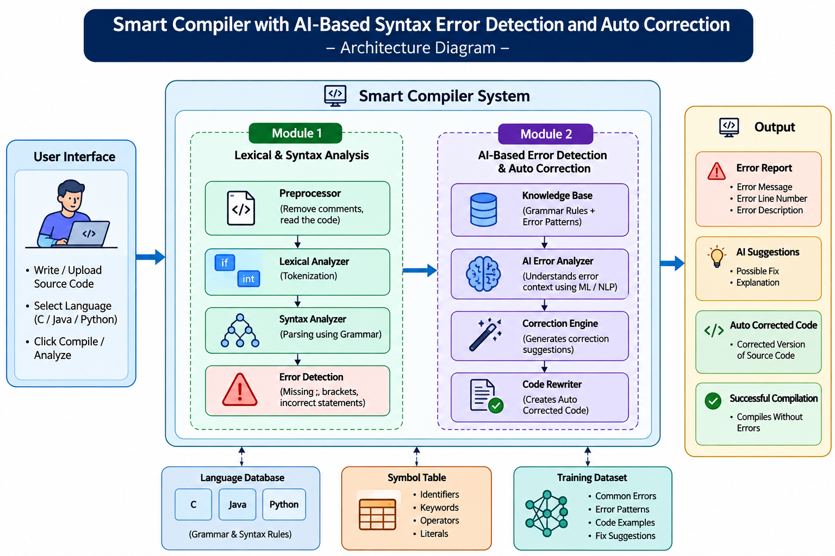
Architecture Diagram

Slide 11
Expected Outcomes
The system is expected to detect common syntax errors accurately during the compilation process.
AI-based suggestions can help users understand programming errors and correct them more effectively.
Automatic correction can reduce the time required for manually identifying and fixing simple syntax errors.
The system can provide a beginner-friendly environment for learning programming and debugging code.
The proposed solution can improve the overall efficiency and usability of traditional compiler systems.

Slide 12
Conclusion
The Smart Compiler combines conventional compiler techniques with AI-based error detection and correction.
The system provides meaningful error information instead of displaying only traditional compiler error messages.
AI-based correction helps users quickly identify suitable solutions for common syntax errors.
The project can reduce debugging effort while improving the learning experience for beginner programmers.
The proposed Smart Compiler demonstrates how AI can enhance traditional compilation and error-handling processes.

Slide 13
Thank You!

