Slide 1

CAPSTONE EDA PROJECT TOPIC -II
HOTEL BOOKINGS ANALYSIS
Team Members:
Shubham Joshi
Kanika Kakra
Akshay Fasale
Rishikesh Damale

Slide 2
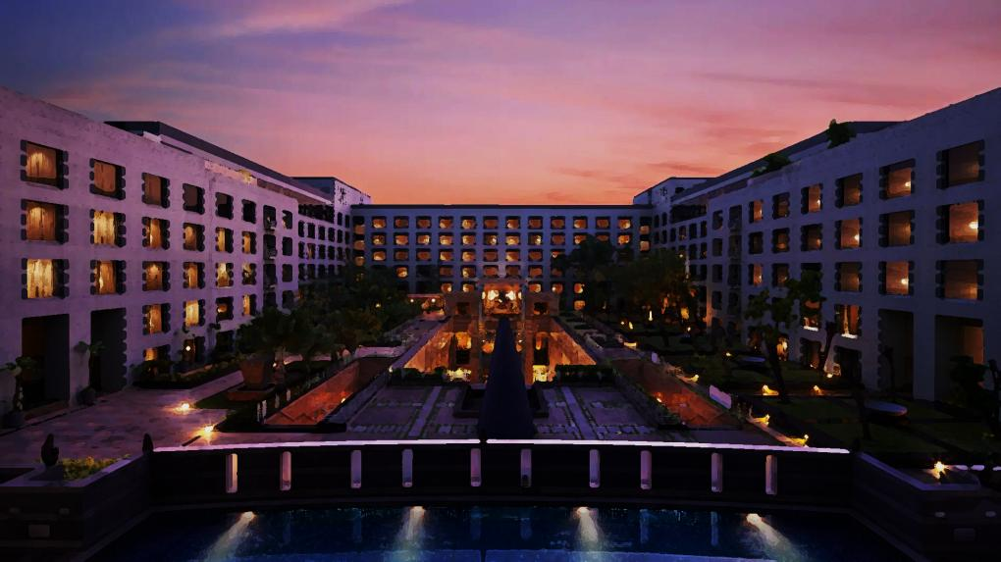
ACKNOWLEDGEMENT
We would express our gratitude towards the entire team of “Almabetter” for acknowledging us with such important domain and providing us an opportunity to work on real life problems through Capstone Project.

Slide 3

Data Analytics and its importance
Data analytics (DA) is the process of examining data sets in order to find trends and draw conclusions about the information they contain.
Data analytics initiatives can help businesses increase revenue, improve operational efficiency, optimize marketing campaigns and bolster customer service efforts.
Analytics also enable organizations to respond quickly to emerging market trends and gain a competitive edge over business rivals.
The ultimate goal of data analytics, however, is boosting business performance.

Slide 4
Algorithm/Steps followed
Importing necessary packages and libraries.
Mount the drive in colab and read the .csv file.
Analysing the data sheet.
Removing null/NAN/duplicate rows.
Fixing the outliers.
Drop certain columns/combined certain columns to make our data sheet free Avoid of any irrelevant data.
Applying the concept of Data Wrangling and Data Visualization such that we can analyse the data sheet and retrieve required information.

Slide 5
Problem Statement
Have you ever wondered when the best time of year to book a hotel room is? Or the optimal length of stay in order to get the best daily rate? This hotel booking dataset can help you explore those questions!
This data set contains booking information for a city hotel and a resort hotel, and includes information such as when the booking was made, length of stay, the number of adults, children, and/or babies, and the number of available parking spaces, among other things. All personally identifying information has been removed from the data. Explore and analyze the data to discover important factors that govern the bookings.e

Slide 6
Description of columns
Column_name | Column_description
Hotel | Contain data values hotel City ,Resort
is_canceled | Contains boolean data values 0→not_canceled 1→canceled
lead_time | Number of days between the entering date of booking and arrival date
arrival_date_year | Year of the arrival date of guests
arrival_date_month | Month of the arrival date of guests
arrival_date_week_number | Week number of year of arrival date
arrival_date_day_of_month | Day of the arrival of guests

Slide 7
distribution_channel | TA/TO
is_repeated_guest | Having values 1->repeated guests 0->no repeated guests
previous_cancellations | Number of previous bookings that were cancelled by the guests prior to the current booking
Previous_booking_not_cancellations | Number of previous bookings that were not cancelled by the guests prior to the current booking
reserved_room_type | Room type -- reserved
booking_changes | Number of changes made to the booking from the moment the booking was entered on the pms until the moment of check-in or cancellation
deposit_type | Categorical values—No deposit , Refund, Non-refund
agent | ID of the travel agency made the booking

Slide 8
Stays_in_weekend_nights | Number of days for stay on weekend night
Stays_in_week_nights | Number of days for stay on week day
adults | Number of adults
children | Number of children
babies | Number of babies
meal | Type of meal offered
country | Countries from where guests arrived
market_segment | Categorical values like TA→Travel agent TO→ Tour Operators

Slide 9
company | ID of the company which made the booking
days_in_waiting_list | Number of days the booking was in the waiting list before it was confirmed
customer_type | Categorical values→ contract group, trasisent, party
Average_daily_rate | Obtained by dividing the sum of all lodging transaction by the total number of staying nights
required_car_parking_spaces | Number of car parking spaces used by guests
total_of_special_requests | Number of special requests made by guests(eg-extra bedsheet)
reservation_status | Contains the current status
total_members | Number of adults + Number of children + Number of babies

Slide 10
Analysis & Observations
Full_stay | Number of stays_in_weekend_nights + Number of stays_in_week_nights
Here we present some of the basic as well as some advanced observations retrieved from the data sheet.

Slide 11
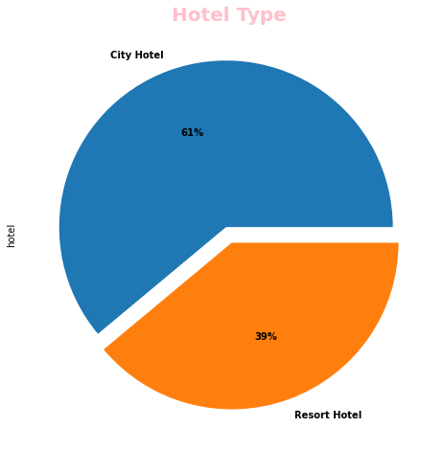
1. Hotel type Percentage
We observed City Hotel shares 61% out of 100 than Resort Hotel.

Slide 12
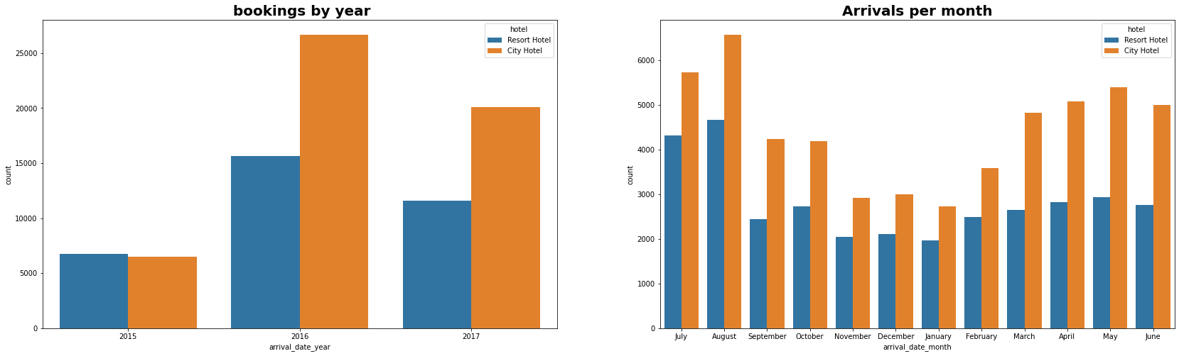
2.Hotel Wise Bookings based on Month and Year
Bookings for City hotels are higher than Resort hotels over the years and in year 2016 the bookings for both the hotels were maximum.
Most bookings were done in the month of May,June, July, August.

Slide 13
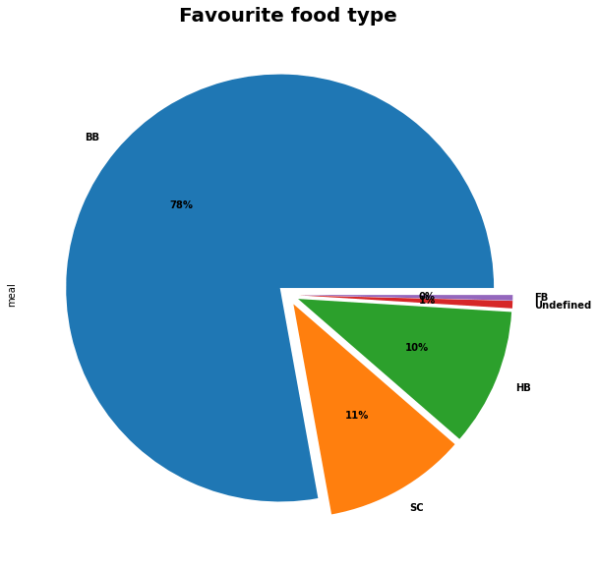
3.Favorite meal by hotel type
BB-Bed and Breakfast
HB-Half Board
FB-Full Board
SC-Self Catering
We observed 78% of people prefer 'BB' type meal.

Slide 14
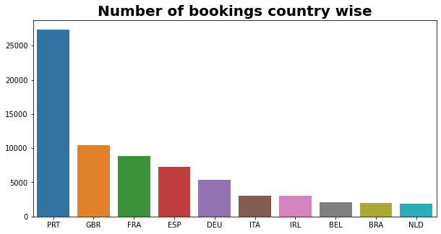
4.From which country guests are visiting the hotel?
We observed most guests visited the hotels where from European countries and most of them from Portugal

Slide 15
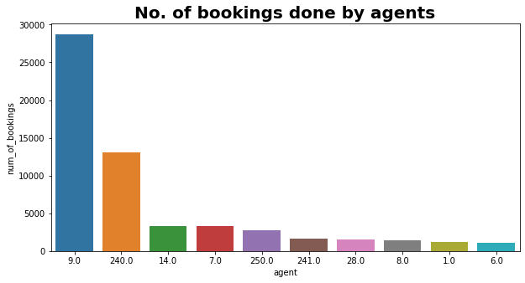
5.Which agent made the maximum bookings?
We observed Agent no. 9 has made most no. of bookings.

Slide 16
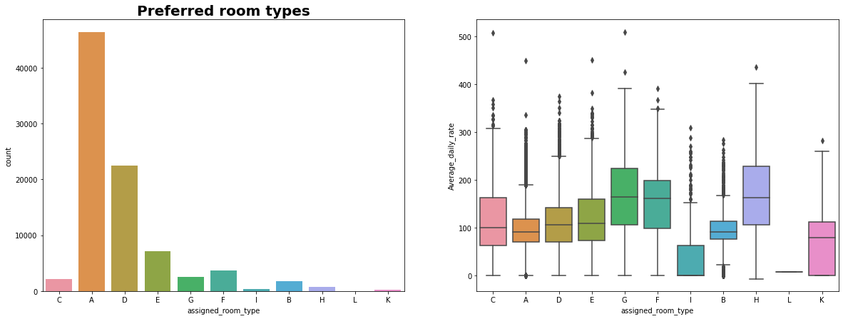
6.Preferred Room Type
It's clearly seen that the most people preferred Type A, type of room. Also, the average daily rate of type A rooms seems to be less .
Also, those whose average daily rate is higher i.e.(Type C,G,F,H) it's seen that preference is also less.

Slide 17
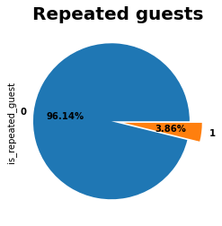
7.Percentage of guests visiting the hotel repeatedly
guest retention rate is low.
We observed nearly 4% people are repeated guests.
The guests retention rate is low, which is a concern.

Slide 18
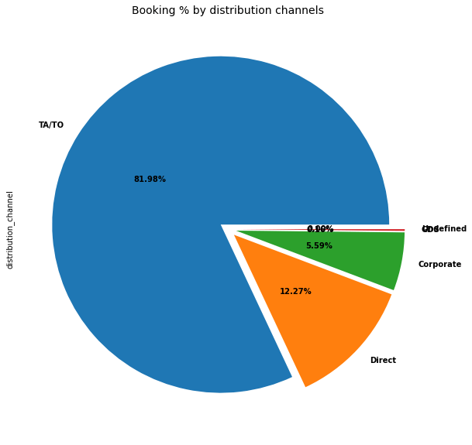
8. Distribution Channel Type
We observed 81.98% of share is occupied by TA/TO
Where TA/TO stand for Travel Agent/Travel organisation.

Slide 19
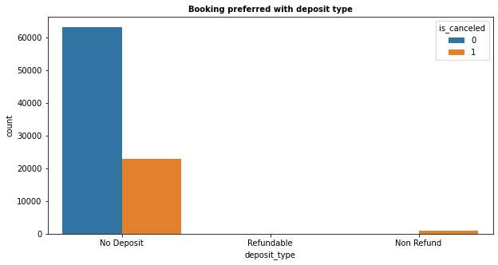
9. Bookings preferred with deposit type
As expected , Most Bookings are done with 'No deposit' and most cancellations are also in 'no deposit' bookings. It is a surprise to see cancellations with 'Non-refundable' bookings

Slide 20
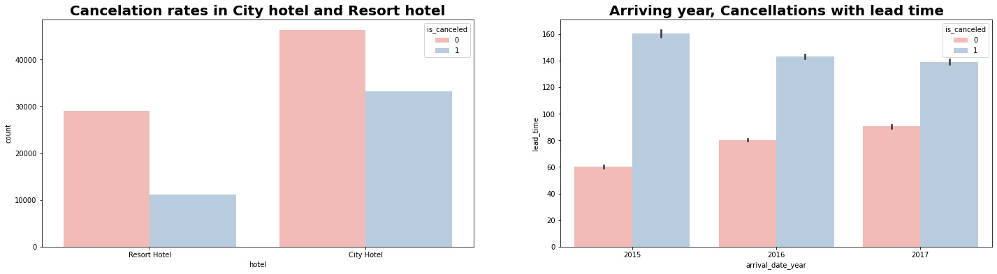
10.Cancellation rates in hotel and year-wise analysis
Kk
We observed rate of cancellation is higher in City hotel.
In year 2015 rate of cancellation was low.

Slide 21
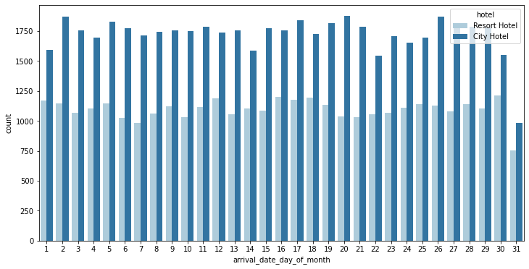
11.Day-wise analysis of guests arrival
We observed everyday the guest arrival is more in city hotel .

Slide 22
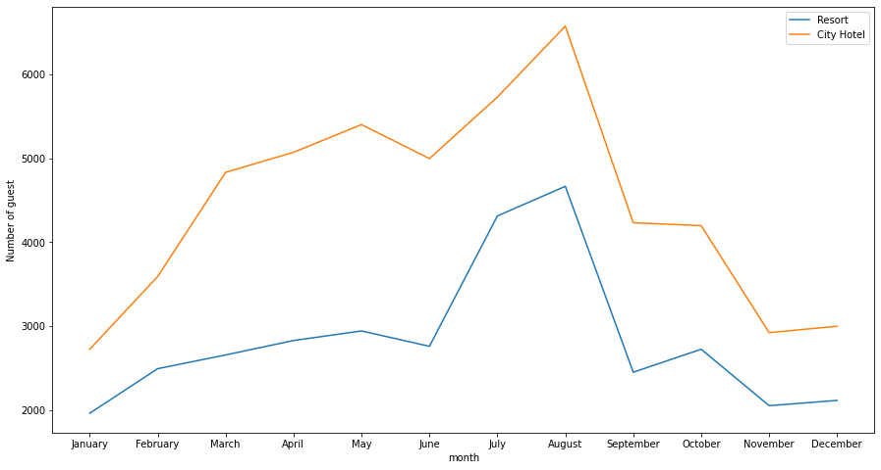
12.Figuring out the busiest months of the year
We observed that the busiest months for both the hotels are May,June ,
July,August.

Slide 23
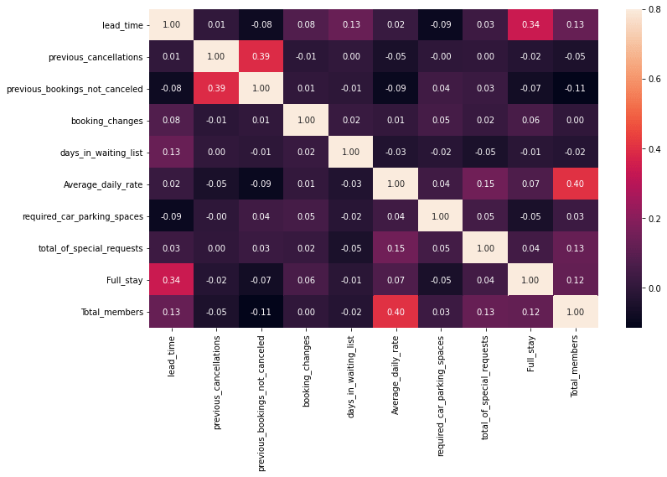
13.Analysing the correlation
Full_stay length and lead time have slight correlation. This may means that for longer hotel stays people generally plan little before the the actual arrival.
Average_daily_rate is slightly correlated with Total_members, which makes sense as more no. of people means more revenue, therefore more Average_daily_rate.

Slide 24
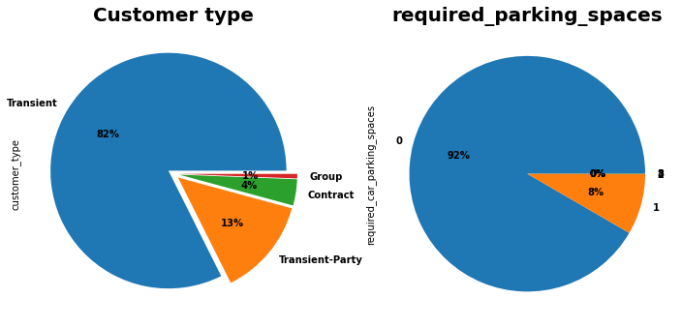
14.Customer type and car parking details
There are 4 types of Customer. Out of them most are 'Transient Type"
only 8% people require parking spaces

Slide 25
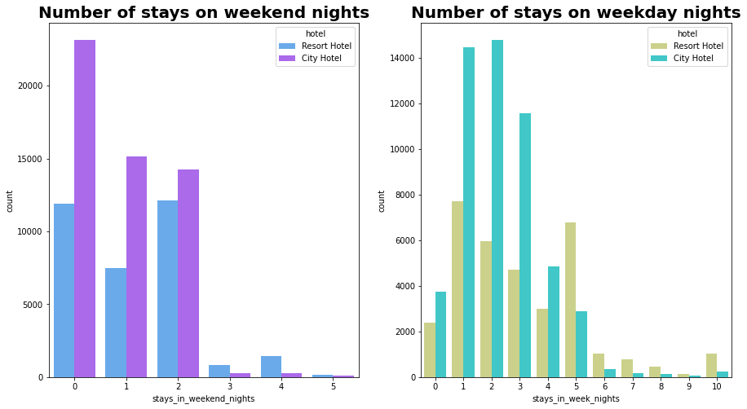
15.Bookings on weekends and weekdays
We observed:- City hotels have more number of stays irrespective of week or weekend stays.

Slide 26
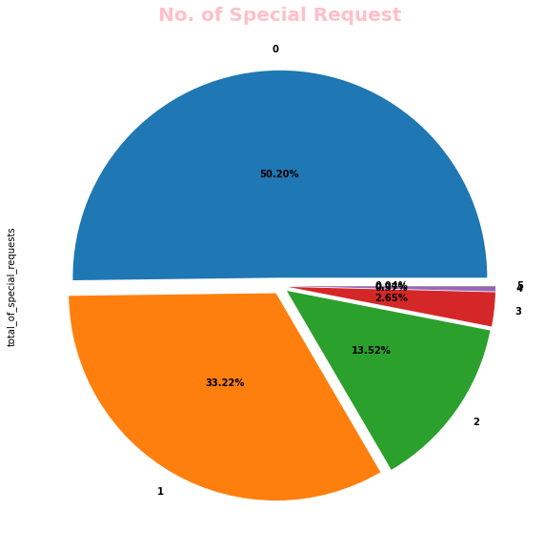
16.Special requests service offered by hotels
We observed City hotels have more no. of special requests. Most of them ask for only 1 special request.

Slide 27
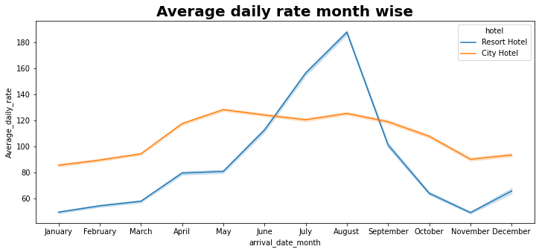
17. Average_daily_rate month-wise
We observed: For resort hotels, the average daily rate is more expensive during August,July and September.
For city hotels, the average daily rate is more expensive during August, July, June and May.

Slide 28
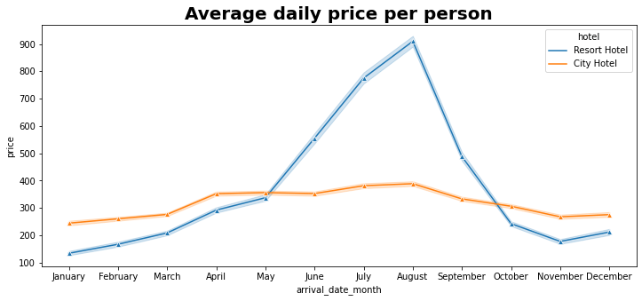
18.Average_daily_price per person
Prices of resort hotel are much higher.
Prices of city hotel do not fluctuate that much.

Slide 29
Conclusion
Around 61% bookings are for City hotel and 39% bookings are for Resort hotel, therefore City Hotel is busier than Resort Hotel.
The majority of guests come from western Europe countries. We should spend a significant amount of our budget on those area.
July- August are the busiest and profitable months for both of hotels.
Couples are the most common guests for hotels, hence hotels can plan services according to couples needs to increase revenue.
July and August month have high Average daily price per person for resort hotel.
Most common stay length is less than 4 days and generally people prefer City hotel for short stay, but for long stays, Resort Hotel is preferred.
November,December, February And January are the months which has less booking this period you can get rooms with less average daily rate.
)

Slide 30
References
https://pandas.pydata.org/pandas-docs/stable/index.html
https://www.geeksforgeeks.org/matplotlib-tutorial/?ref=lbp
https://seaborn.pydata.org/
https://matplotlib.org/
Lectures by Almabetter

Slide 31
THANK YOU

