Slide 1
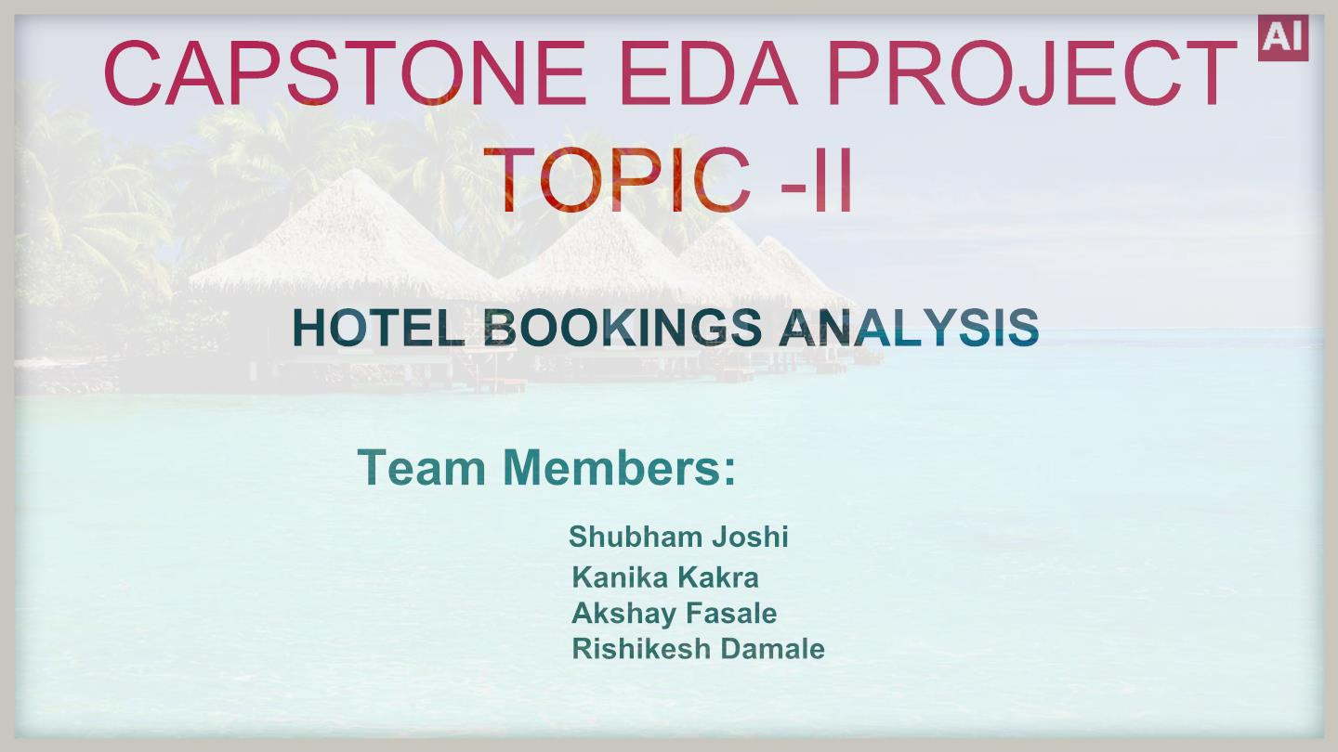

Slide 2


Slide 3
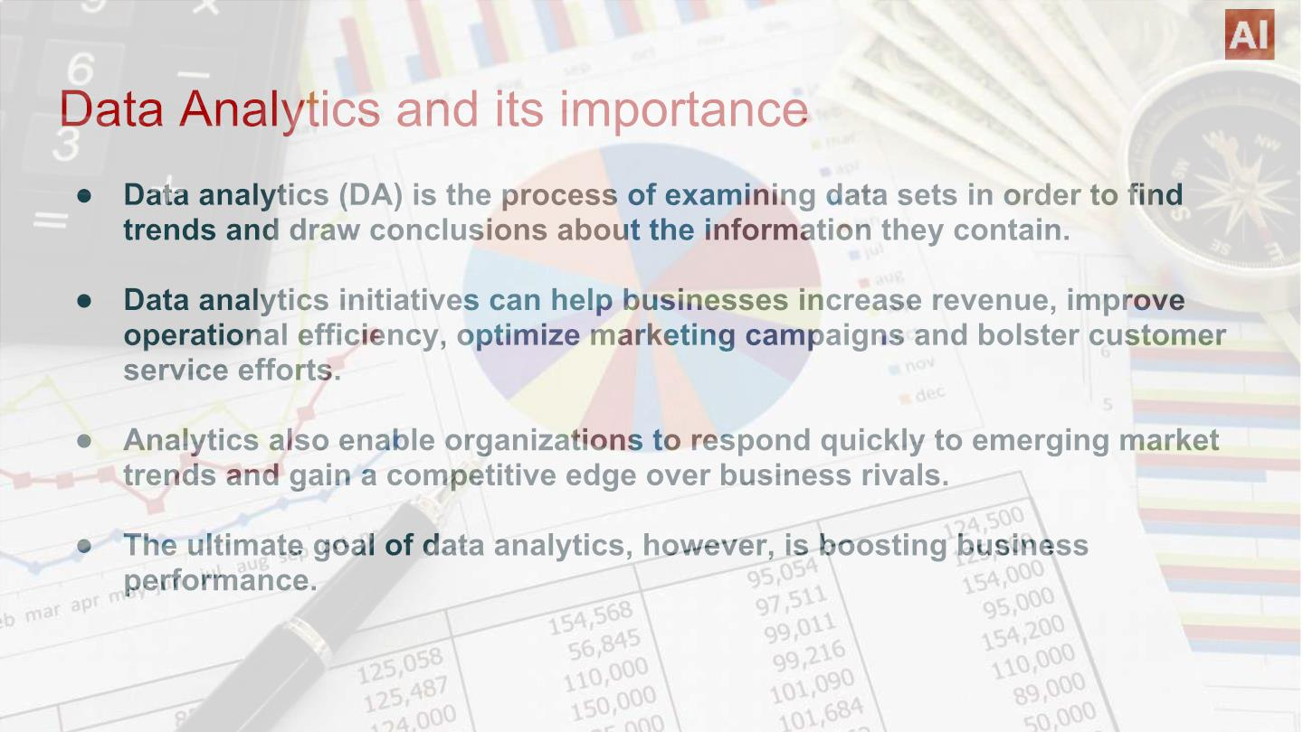

Slide 4

Algorithm/Stepsꢀfollowedꢀ
● Importingꢀnecessaryꢀpackagesꢀandꢀlibraries.
● Mountꢀtheꢀdriveꢀinꢀcolabꢀandꢀreadꢀtheꢀ.csvꢀfile.
● Analysingꢀtheꢀdataꢀsheet.
● Removingꢀnull/NAN/duplicateꢀrows.
● Fixingꢀtheꢀoutliers.
● Dropꢀcertainꢀcolumns/combinedꢀcertainꢀcolumnsꢀtoꢀmakeꢀourꢀdataꢀsheetꢀfreeꢀ
Avoidꢀofꢀanyꢀirrelevantꢀdata.
● ApplyingꢀtheꢀconceptꢀofꢀDataꢀWranglingꢀandꢀDataꢀVisualizationꢀsuchꢀthatꢀweꢀ
canꢀanalyseꢀtheꢀdataꢀsheetꢀandꢀretrieveꢀrequiredꢀinformation.

Slide 5
ProblemꢀStatement
Haveꢀyouꢀeverꢀwonderedꢀwhenꢀtheꢀbestꢀtimeꢀofꢀyearꢀtoꢀbookꢀaꢀhotelꢀroomꢀis?ꢀOrꢀ
theꢀ optimalꢀ lengthꢀ ofꢀ stayꢀ inꢀ orderꢀ toꢀ getꢀ theꢀ bestꢀ dailyꢀ rate?ꢀ Thisꢀ hotelꢀ bookingꢀ
datasetꢀcanꢀhelpꢀyouꢀexploreꢀthoseꢀquestions!ꢀ
Thisꢀ dataꢀ setꢀ containsꢀ bookingꢀ informationꢀ forꢀ aꢀ cityꢀ hotelꢀ andꢀ aꢀ resortꢀ
hotel,ꢀ andꢀ includesꢀ informationꢀ suchꢀ asꢀ whenꢀ theꢀ bookingꢀ wasꢀ made,ꢀ lengthꢀ ofꢀ
stay,ꢀtheꢀ numberꢀ ofꢀ adults,ꢀ children,ꢀ and/orꢀ babies,ꢀ andꢀ theꢀ numberꢀ ofꢀ availableꢀ
parkingꢀ spaces,ꢀ amongꢀ otherꢀ things.ꢀ Allꢀ personallyꢀ identifyingꢀ informationꢀ hasꢀ
beenꢀremovedꢀfromꢀtheꢀdata.ꢀExploreꢀandꢀanalyzeꢀtheꢀdataꢀtoꢀdiscoverꢀimportantꢀ
factorsꢀthatꢀꢀgovernꢀtheꢀbookings.e

Slide 6
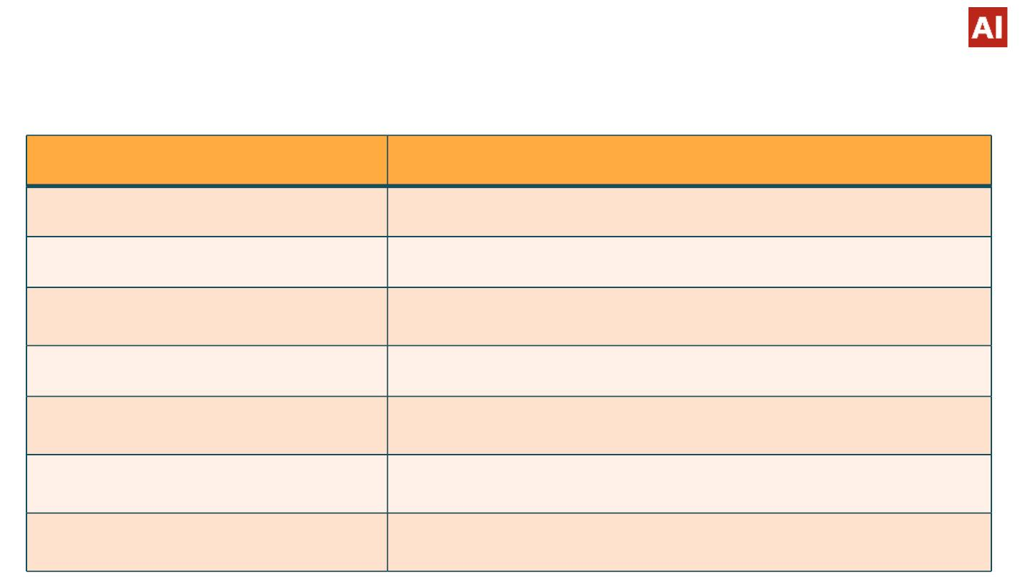
Descriptionꢀofꢀcolumns
Column_name
Hotel
Column_description
ContainꢀdataꢀvaluesꢀꢀhotelꢀCityꢀ,Resort
is_canceled
lead_time
Containsꢀꢀbooleanꢀdataꢀvaluesꢀ0→not_canceledꢀ1→canceled
Numberꢀofꢀdaysꢀbetweenꢀtheꢀenteringꢀdateꢀofꢀbookingꢀandꢀarrivalꢀ
date
arrival_date_year
Yearꢀofꢀtheꢀarrivalꢀꢀdateꢀofꢀguests
arrival_date_month
Monthꢀofꢀtheꢀarrivalꢀdateꢀofꢀguests
arrival_date_week_number
arrival_date_day_of_month
Weekꢀnumberꢀofꢀyearꢀofꢀarrivalꢀdate
Dayꢀofꢀtheꢀarrivalꢀofꢀguests

Slide 7
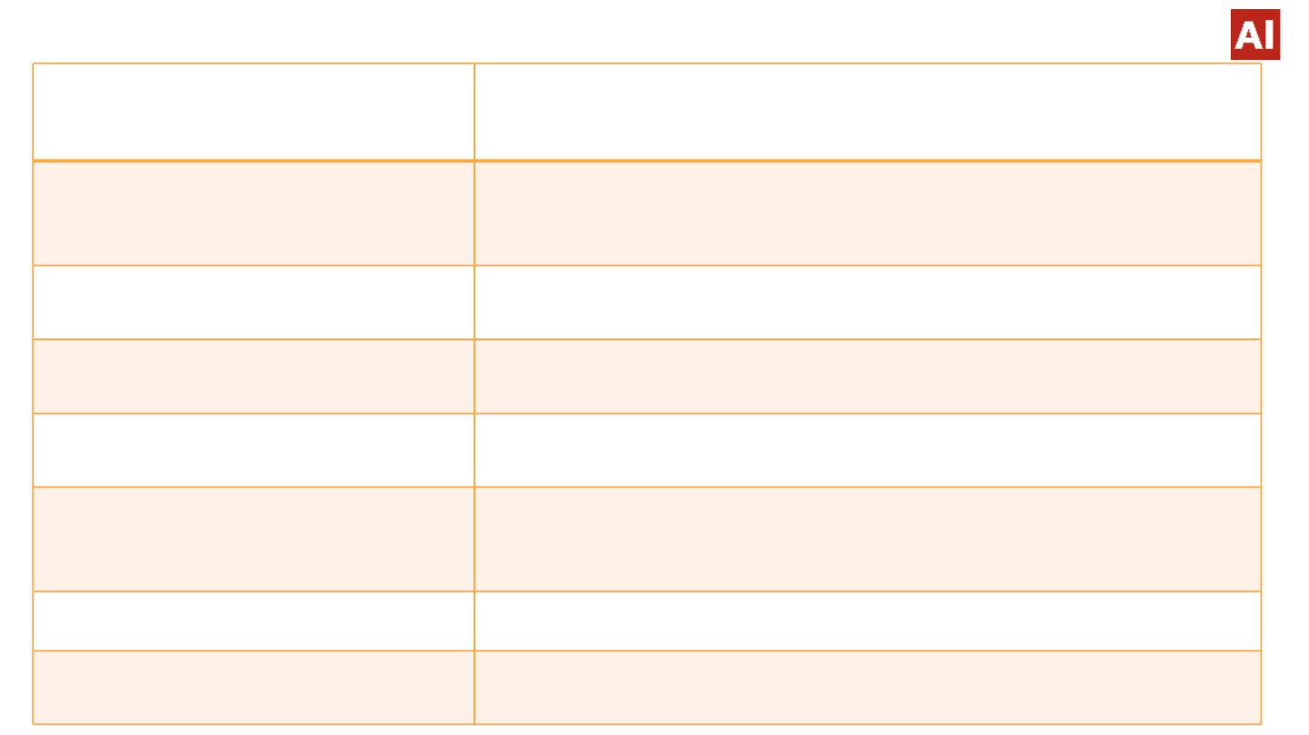
distribution_channel
is_repeated_guest
TA/TO
Havingꢀvaluesꢀ1->repeatedꢀguests
ꢀꢀꢀꢀꢀꢀꢀꢀꢀꢀꢀꢀꢀꢀꢀꢀꢀꢀꢀꢀꢀꢀꢀꢀ0->noꢀrepeatedꢀguests
previous_cancellations
Numberꢀofꢀpreviousꢀbookingsꢀthatꢀwereꢀcancelledꢀbyꢀtheꢀguestsꢀ
priorꢀtoꢀtheꢀcurrentꢀbooking
Previous_booking_not_cancellations Numberꢀofꢀpreviousꢀbookingsꢀthatꢀwereꢀꢀnotꢀcancelledꢀbyꢀtheꢀ
guestsꢀpriorꢀtoꢀtheꢀcurrentꢀbooking
reserved_room_type
Roomꢀtypeꢀ--ꢀreserved
booking_changes
Numberꢀofꢀchangesꢀmadeꢀtoꢀtheꢀbookingꢀfromꢀtheꢀmomentꢀtheꢀ
bookingꢀwasꢀenteredꢀonꢀtheꢀpmsꢀuntilꢀtheꢀmomentꢀofꢀcheck-inꢀorꢀ
cancellation
deposit_type
agent
Categoricalꢀvalues—Noꢀdepositꢀ,ꢀRefund,ꢀNon-refund
IDꢀofꢀtheꢀtravelꢀagencyꢀmadeꢀtheꢀbooking

Slide 8
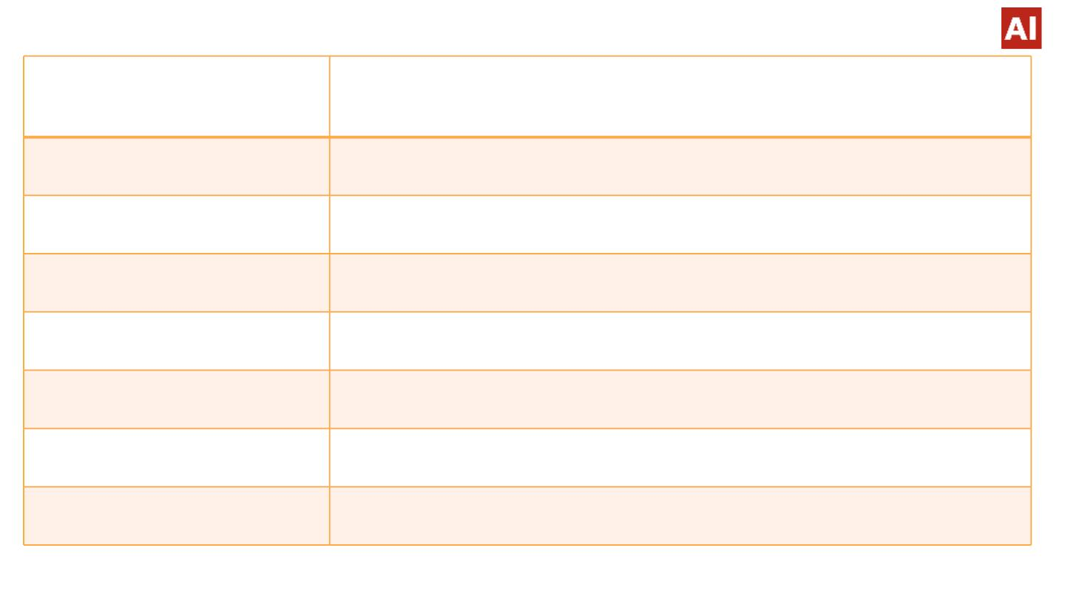
Stays_in_weekend_nights
Numberꢀofꢀdaysꢀforꢀstayꢀonꢀweekendꢀnight
Stays_in_week_nights
adults
Numberꢀofꢀꢀdaysꢀforꢀstayꢀonꢀweekꢀdayꢀ
Numberꢀofꢀadults
children
Numberꢀofꢀchildren
babies
Numberꢀofꢀbabies
meal
Typeꢀofꢀmealꢀoffered
country
Countriesꢀfromꢀwhereꢀguestsꢀarrived
CategoricalꢀvaluesꢀlikeꢀꢀTA→TravelꢀagentꢀꢀTO→ꢀTourꢀOperators
market_segment

Slide 9
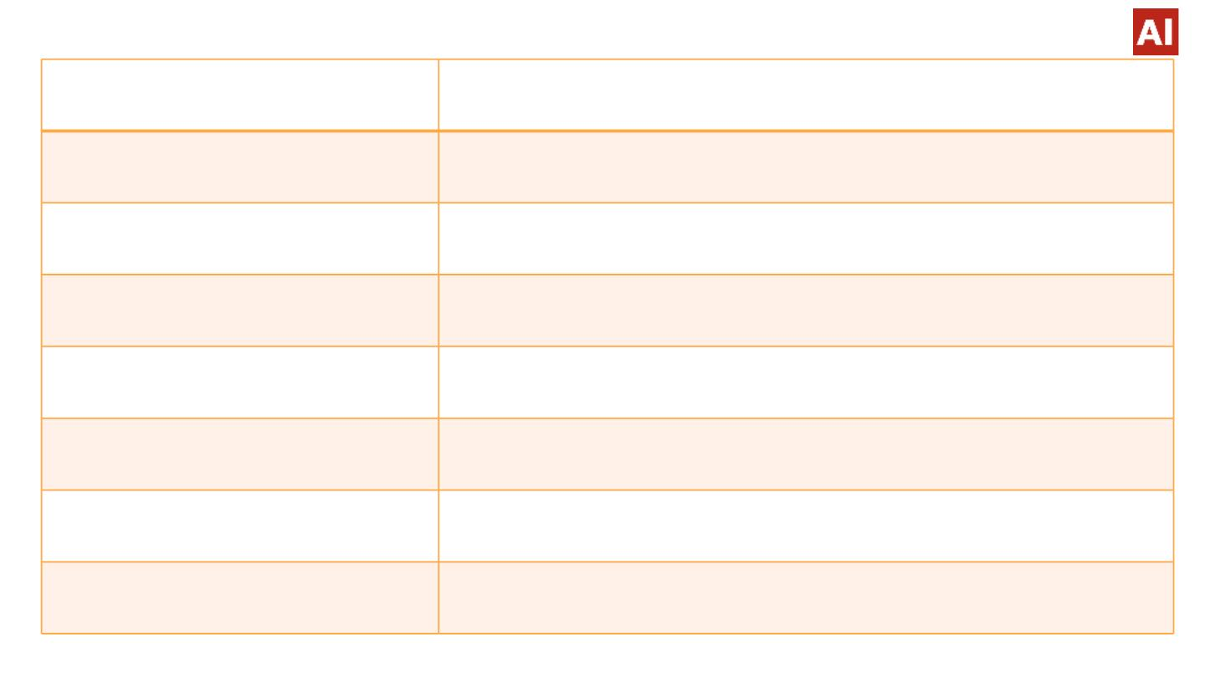
company
IDꢀofꢀtheꢀcompanyꢀwhichꢀmadeꢀtheꢀbooking
days_in_waiting_list
customer_type
Numberꢀofꢀdaysꢀtheꢀbookingꢀwasꢀinꢀtheꢀwaitingꢀlistꢀbeforeꢀitꢀwasꢀ
confirmed
Categoricalꢀvalues→ꢀcontractꢀgroup,ꢀtrasisent,ꢀparty
Average_daily_rate
required_car_parking_spaces
total_of_special_requests
reservation_status
total_members
Obtainedꢀbyꢀdividingꢀtheꢀsumꢀofꢀallꢀlodgingꢀtransactionꢀbyꢀtheꢀtotalꢀ
numberꢀofꢀstayingꢀnights
Numberꢀofꢀcarꢀparkingꢀspacesꢀusedꢀbyꢀguests
Numberꢀofꢀspecialꢀrequestsꢀꢀmadeꢀbyꢀguests(eg-extraꢀbedsheet)
Containsꢀtheꢀcurrentꢀstatus
Numberꢀofꢀadultsꢀ+ꢀNumberꢀofꢀchildrenꢀ+ꢀNumberꢀofꢀbabies

Slide 10
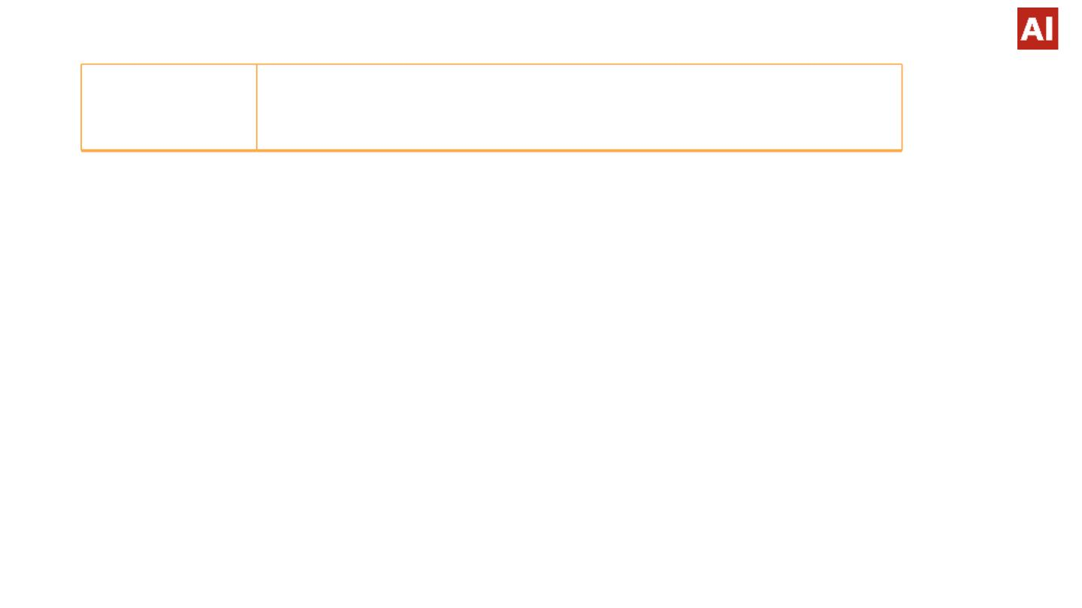
Full_stay
ꢀNumberꢀofꢀstays_in_weekend_nightsꢀ+ꢀNumberꢀofꢀ
stays_in_week_nights
Analysisꢀ&ꢀObservations
● Hereꢀweꢀpresentꢀsomeꢀofꢀtheꢀbasicꢀasꢀwellꢀasꢀsomeꢀadvancedꢀobservationsꢀ
retrievedꢀfromꢀtheꢀdataꢀsheet.

Slide 11
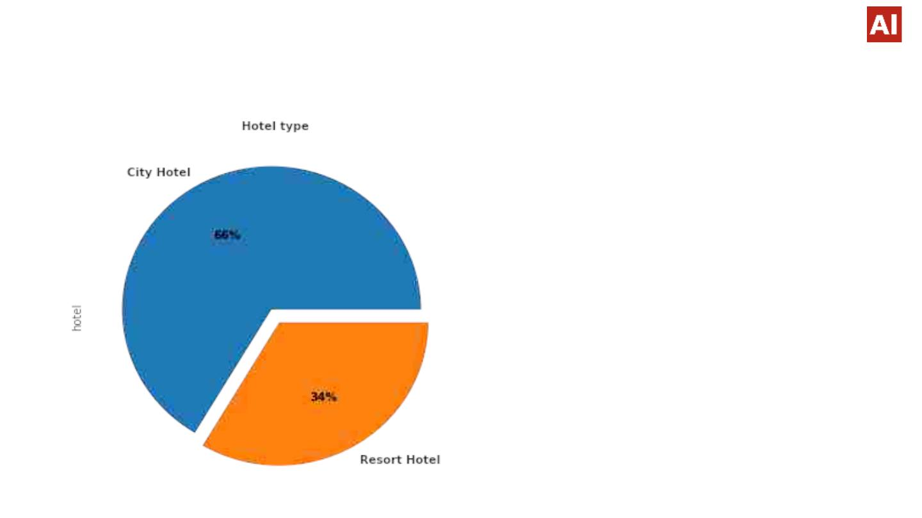
1.ꢀHotelꢀtypeꢀPercentage
● WeꢀobservedꢀCityꢀHotelꢀsharesꢀ
61%ꢀoutꢀofꢀ100ꢀthanꢀ
ResortꢀHotel.

Slide 12
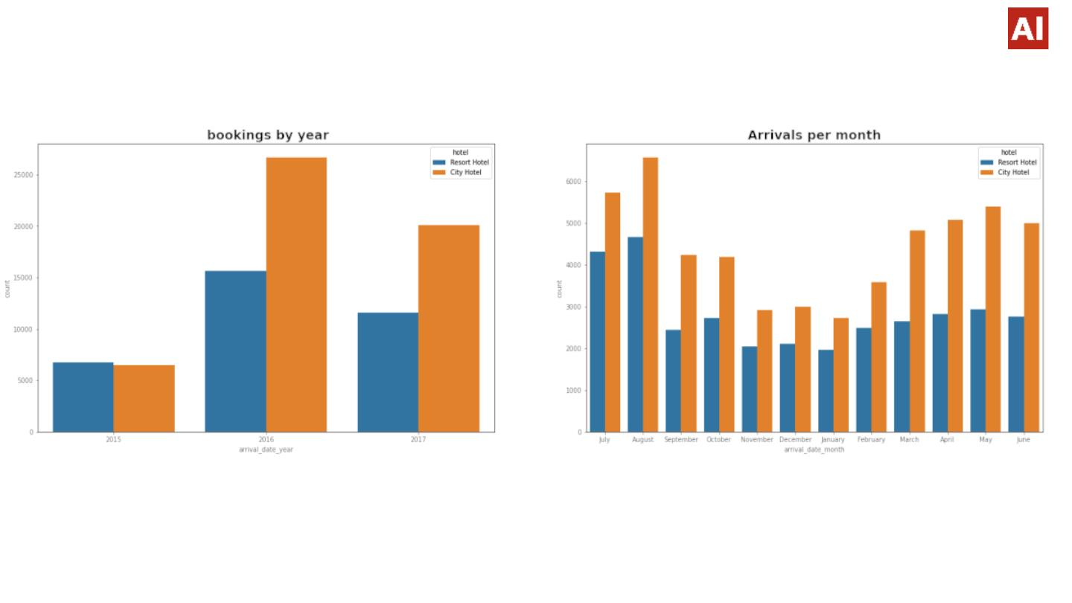
2.HotelꢀWiseꢀBookingsꢀbasedꢀonꢀMonthꢀandꢀYear
● BookingsꢀforꢀCityꢀhotelsꢀareꢀhigherꢀthanꢀ
Resortꢀhotelsꢀoverꢀtheꢀyearsꢀandꢀinꢀyearꢀ
2016ꢀtheꢀbookingsꢀforꢀbothꢀtheꢀhotelsꢀ
wereꢀmaximum.
● Mostꢀbookingsꢀwereꢀ
doneꢀinꢀtheꢀmonthꢀofꢀ
May,June,ꢀJuly,ꢀ
August.

Slide 13
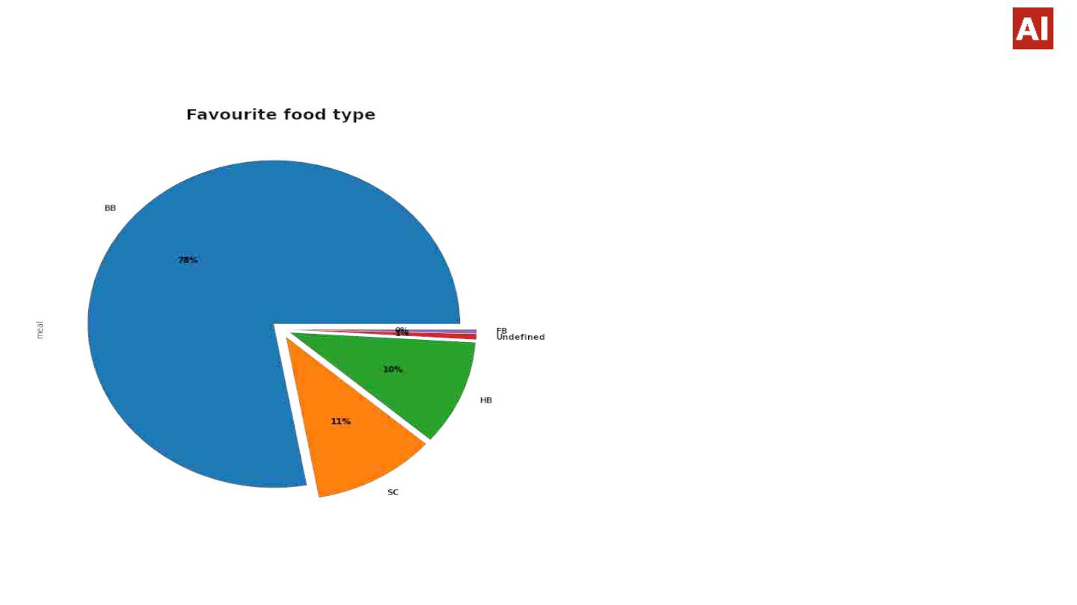
3.Favoriteꢀmealꢀbyꢀhotelꢀtype
BB-Bed and Breakfast
HB-Half Board
FB-Full Board
SC-Self Catering
We observed 78% of people
prefer 'BB' type meal.

Slide 14
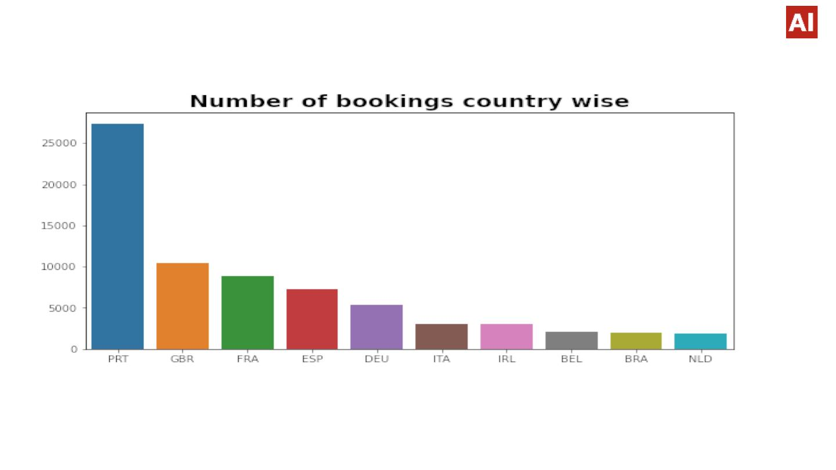
4.Fromꢀwhichꢀcountryꢀguestsꢀareꢀvisitingꢀtheꢀhotel?
Weꢀ observedꢀ mostꢀ guestsꢀ visitedꢀ theꢀ hotelsꢀ whereꢀ fromꢀ Europeanꢀ
countriesꢀandꢀmostꢀofꢀthemꢀfromꢀPortugalꢀ

Slide 15
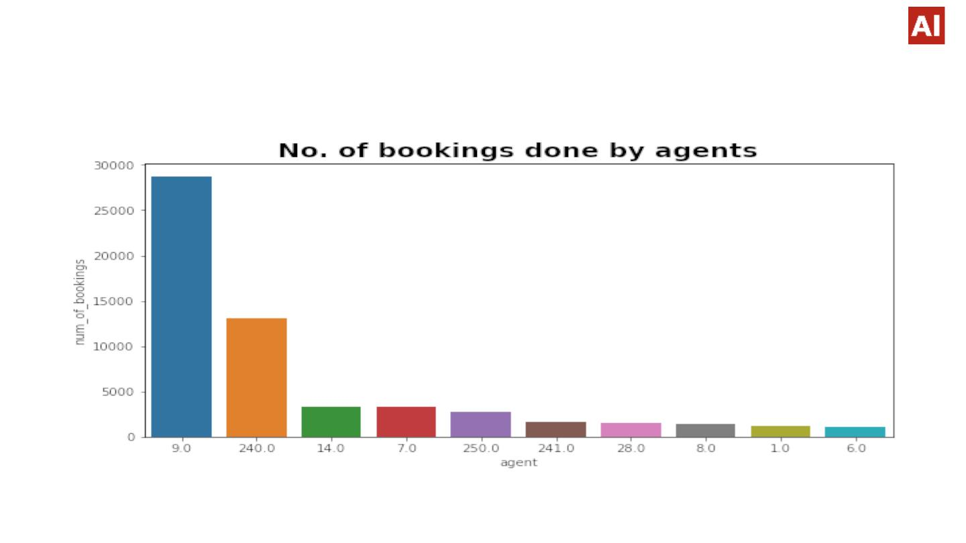
5.Whichꢀagentꢀmadeꢀtheꢀmaximumꢀbookings?
WeꢀobservedꢀAgentꢀno.ꢀ9ꢀhasꢀmadeꢀmostꢀno.ꢀofꢀbookings.

Slide 16
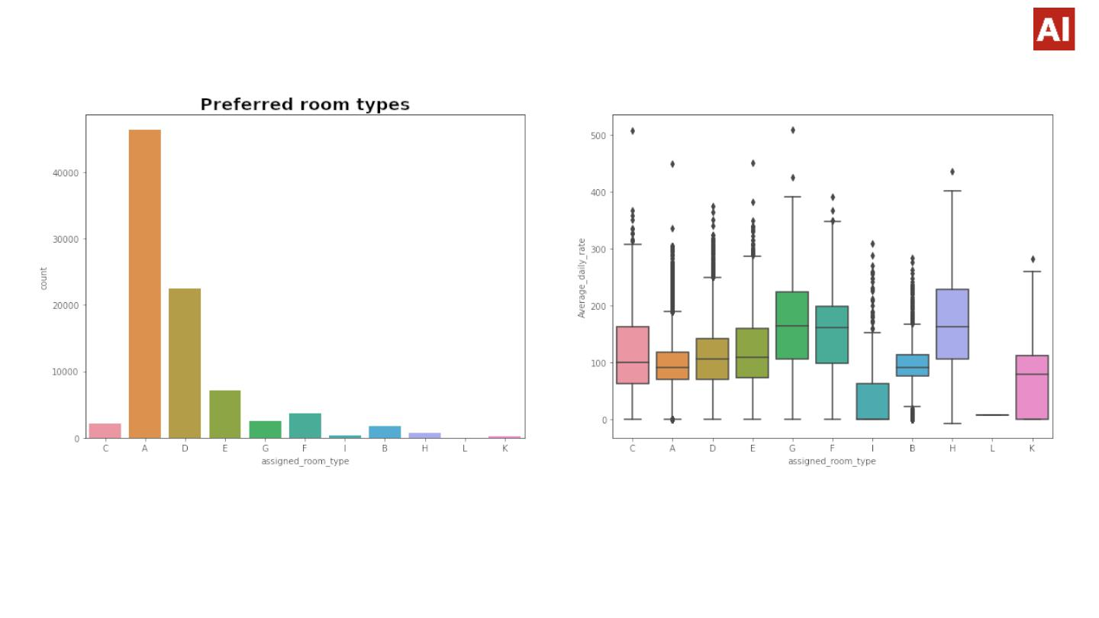
6.PreferredꢀRoomꢀType
• It's clearly seen that the most people preferred Type A, type of room. Also, the average
daily rate of type A rooms seems to be less .
• Also, those whose average daily rate is higher i.e.(Type C,G,F,H) it's seen that preference is
also less.

Slide 17
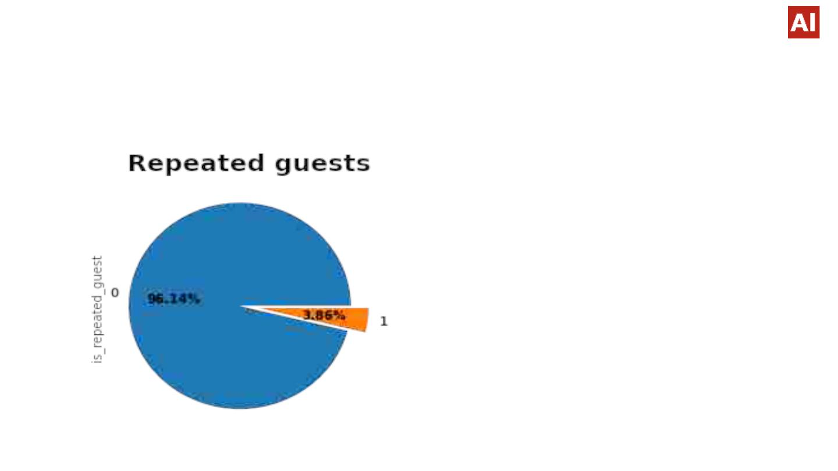
7.Percentageꢀofꢀguestsꢀvisitingꢀtheꢀhotelꢀrepeatedly
● ꢀꢀꢀꢀꢀꢀꢀꢀꢀꢀꢀꢀꢀꢀꢀꢀꢀꢀꢀꢀꢀꢀꢀꢀꢀꢀꢀꢀꢀꢀꢀꢀꢀꢀꢀꢀꢀꢀꢀꢀꢀꢀꢀꢀꢀꢀꢀꢀꢀꢀꢀꢀꢀꢀꢀꢀꢀꢀꢀꢀꢀꢀꢀꢀꢀꢀꢀꢀꢀꢀꢀꢀꢀꢀꢀꢀꢀꢀꢀꢀꢀꢀꢀꢀꢀꢀꢀꢀꢀꢀꢀꢀꢀꢀꢀꢀꢀꢀꢀꢀꢀꢀꢀꢀꢀꢀꢀꢀꢀꢀꢀꢀꢀꢀꢀꢀꢀꢀꢀꢀꢀꢀꢀꢀꢀ
● Weꢀobservedꢀnearlyꢀ
4%ꢀpeopleꢀareꢀ
repeatedꢀguests.ꢀ
● Theꢀguestsꢀretentionꢀ
rateꢀisꢀlow,ꢀwhichꢀisꢀaꢀ
concern.

Slide 18
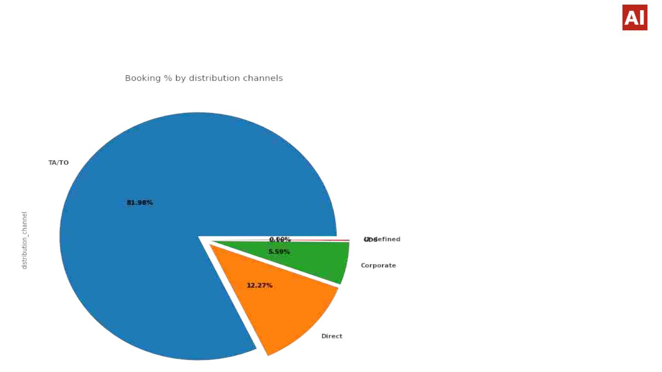
8.ꢀDistributionꢀChannelꢀType
ꢀꢀꢀꢀꢀꢀꢀꢀꢀꢀꢀꢀꢀꢀꢀꢀꢀꢀꢀꢀꢀꢀꢀꢀꢀꢀꢀꢀꢀꢀꢀꢀꢀꢀꢀꢀꢀꢀꢀꢀꢀꢀꢀ
Weꢀobservedꢀ81.98%ꢀofꢀ
shareꢀisꢀoccupiedꢀbyꢀ
TA/TO
WhereꢀTA/TOꢀstandꢀforꢀ
TravelꢀAgent/Travelꢀ
organisation.

Slide 19
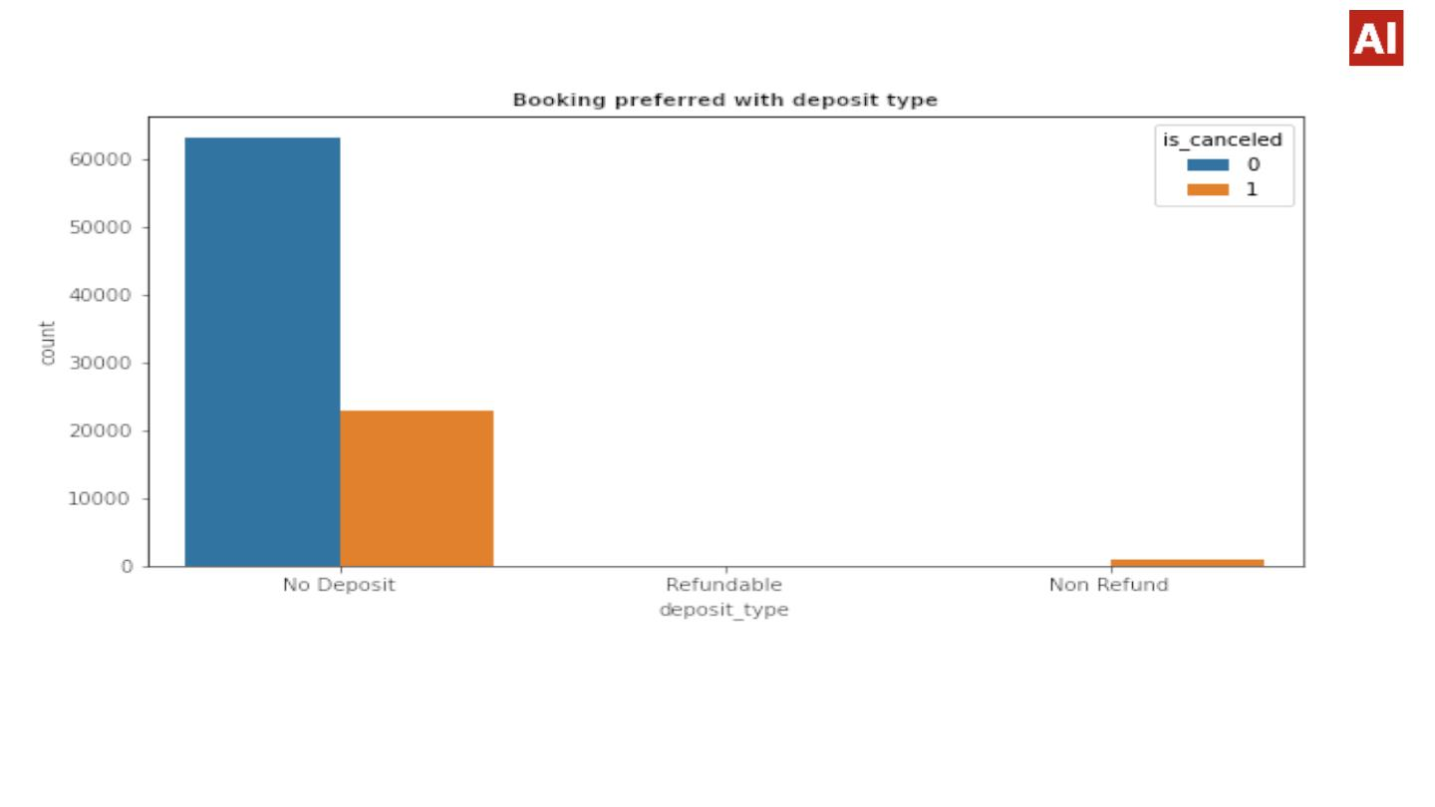
9.ꢀBookingsꢀpreferredꢀwithꢀdepositꢀtype
● Asꢀexpectedꢀ,ꢀMostꢀBookingsꢀareꢀdoneꢀwithꢀ'Noꢀdeposit'ꢀandꢀmostꢀ
cancellationsꢀareꢀalsoꢀinꢀ'noꢀdeposit'ꢀbookings.ꢀItꢀisꢀaꢀsurpriseꢀtoꢀseeꢀ
cancellationsꢀwithꢀ'Non-refundable'ꢀbookings

Slide 20
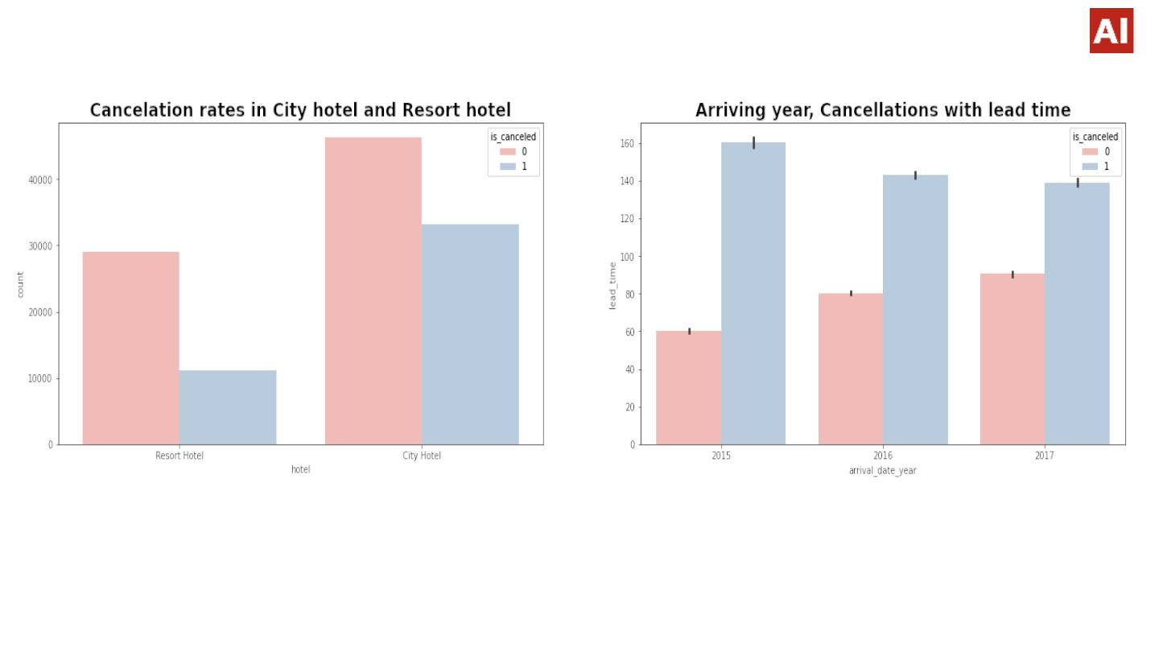
10.Cancellationꢀratesꢀinꢀhotelꢀandꢀyear-wiseꢀanalysis
● WeꢀobservedꢀrateꢀofꢀcancellationꢀisꢀhigherꢀinꢀCityꢀhotel.
● Inꢀyearꢀ2015ꢀrateꢀofꢀcancellationꢀwasꢀꢀlow.

Slide 21
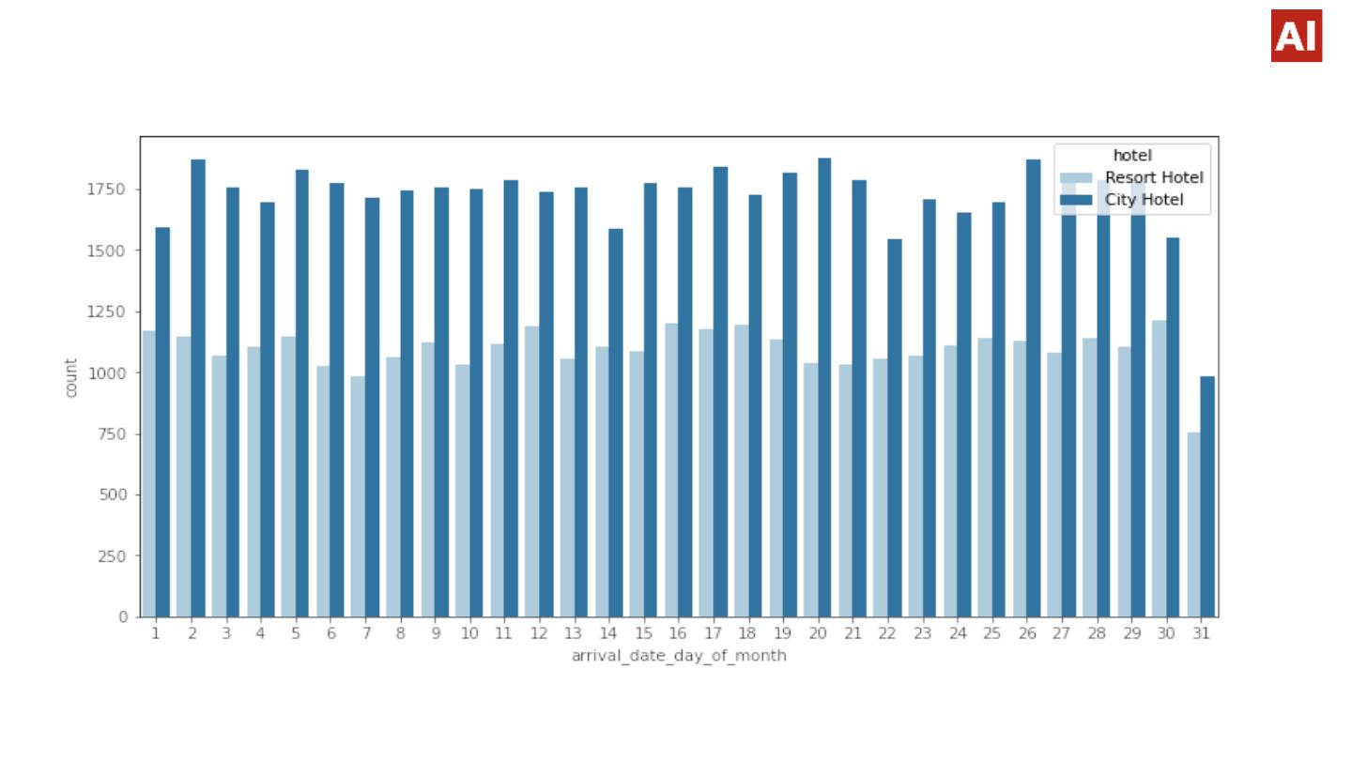
11.Day-wiseꢀanalysisꢀofꢀguestsꢀarrival
Weꢀobservedꢀeverydayꢀtheꢀguestꢀarrivalꢀisꢀmoreꢀinꢀcityꢀhotelꢀ.

Slide 22
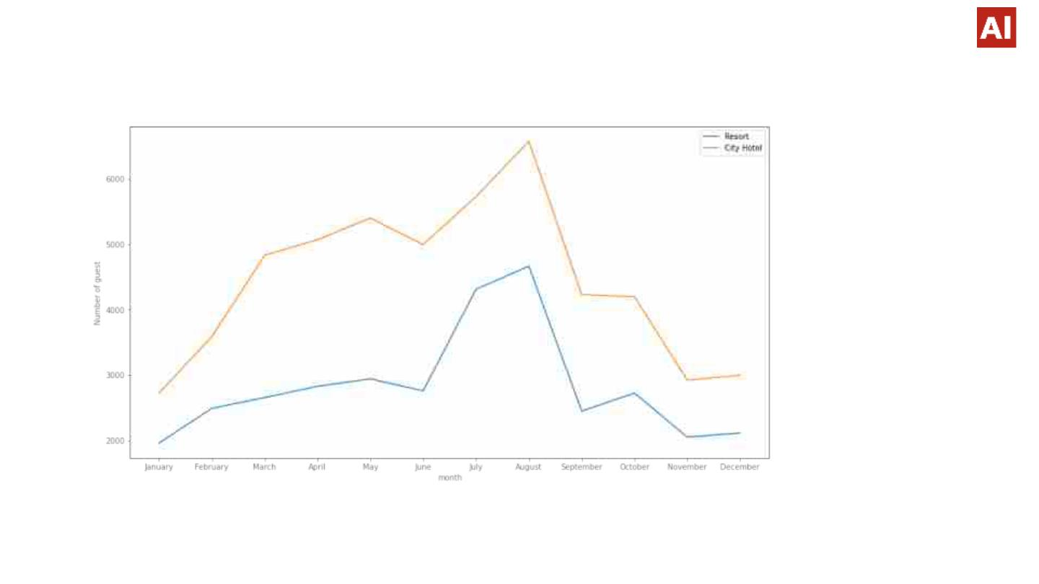
12.Figuringꢀoutꢀtheꢀbusiestꢀmonthsꢀofꢀtheꢀyear
● WeꢀobservedꢀthatꢀtheꢀbusiestꢀmonthsꢀforꢀbothꢀtheꢀhotelsꢀareꢀMay,Juneꢀ,
July,August.

Slide 23
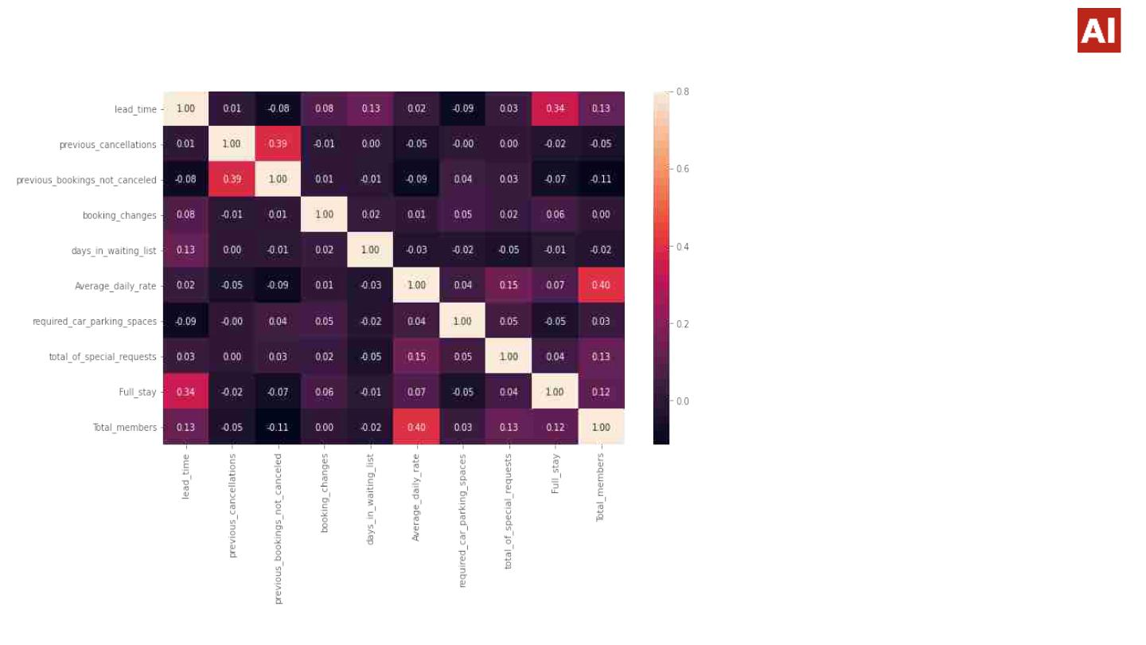
13.Analysingꢀtheꢀcorrelationꢀ
● ꢀFull_stayꢀlengthꢀandꢀleadꢀ
timeꢀhaveꢀslightꢀcorrelation.ꢀ
Thisꢀmayꢀmeansꢀthatꢀforꢀ
longerꢀhotelꢀstaysꢀpeopleꢀ
generallyꢀplanꢀlittleꢀbeforeꢀ
theꢀtheꢀactualꢀarrival.
● ꢀAverage_daily_rateꢀisꢀ
slightlyꢀcorrelatedꢀwithꢀ
Total_members,ꢀwhichꢀ
makesꢀsenseꢀasꢀmoreꢀno.ꢀ
ofꢀpeopleꢀmeansꢀmoreꢀ
revenue,ꢀthereforeꢀmoreꢀ
Average_daily_rate.

Slide 24
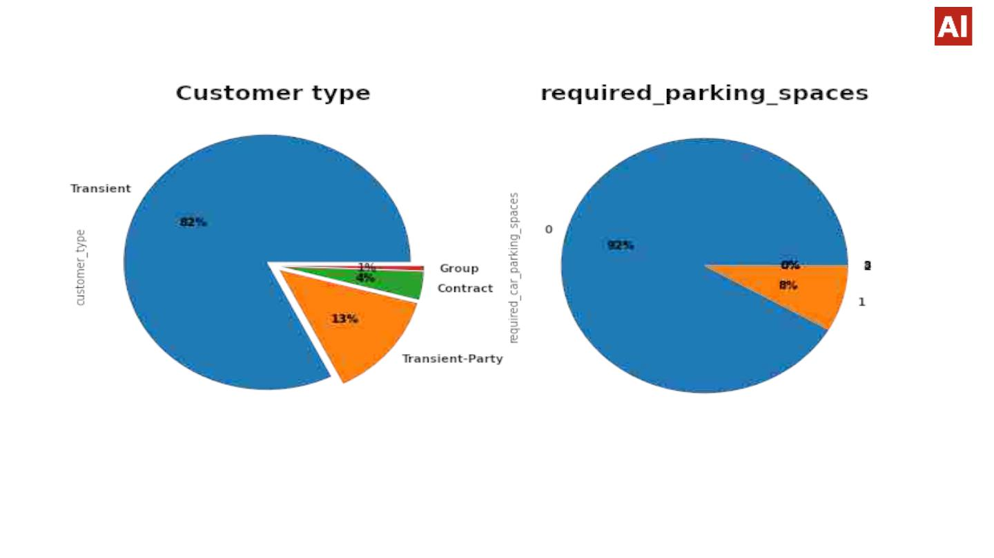
14.Customerꢀtypeꢀandꢀꢀcarꢀparkingꢀdetails
● Thereꢀareꢀ4ꢀtypesꢀofꢀCustomer.ꢀOutꢀofꢀthemꢀmostꢀareꢀ
'TransientꢀType"
● onlyꢀ8%ꢀpeopleꢀrequireꢀparkingꢀspaces

Slide 25
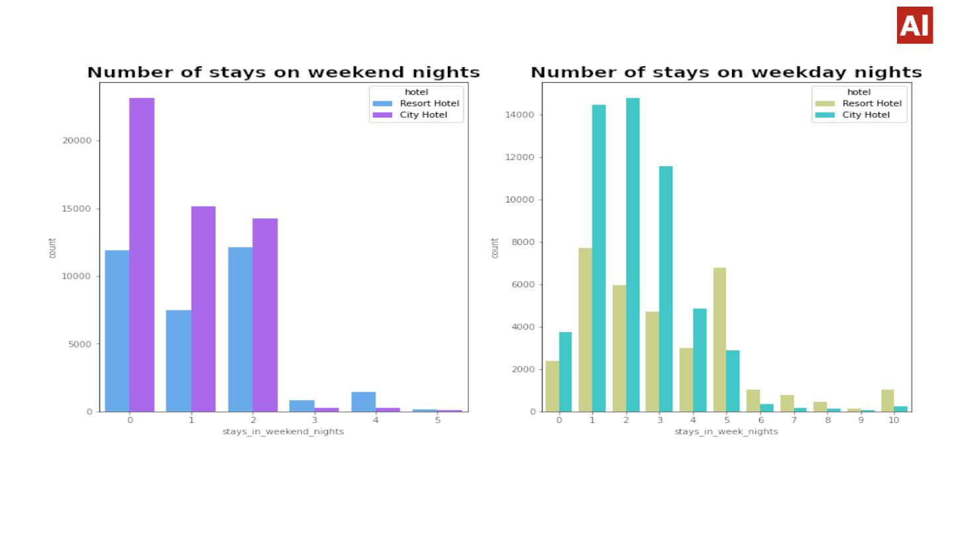
15.Bookingsꢀonꢀweekendsꢀandꢀweekdays
● Weꢀobserved:-ꢀCityꢀhotelsꢀhaveꢀmoreꢀnumberꢀofꢀstaysꢀirrespectiveꢀofꢀweekꢀorꢀ
weekendꢀstays.

Slide 26
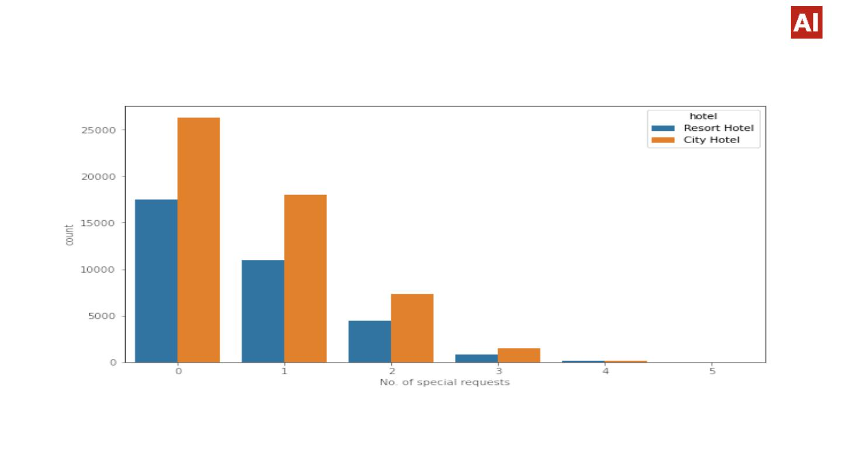
16.Specialꢀrequestsꢀserviceꢀofferedꢀbyꢀhotels
● WeꢀobservedꢀCityꢀhotelsꢀhaveꢀmoreꢀno.ꢀofꢀspecialꢀrequests.ꢀMostꢀofꢀthemꢀaskꢀ
forꢀonlyꢀ1ꢀspecialꢀrequest.

Slide 27
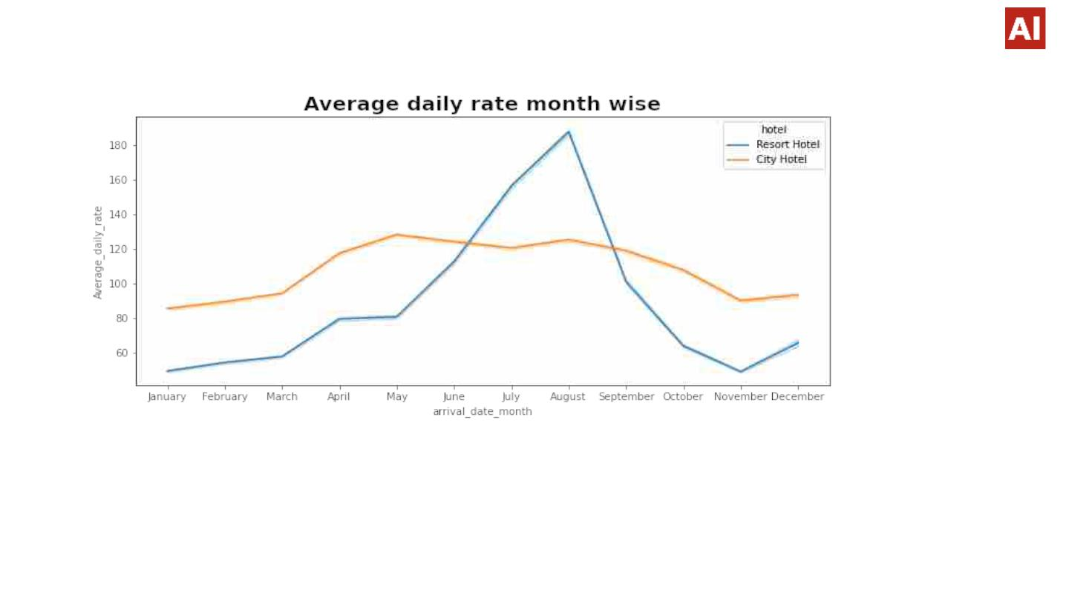
17.ꢀAverage_daily_rateꢀmonth-wise
● Weꢀobserved:ꢀForꢀresortꢀhotels,ꢀtheꢀaverageꢀdailyꢀrateꢀisꢀmoreꢀexpensiveꢀ
duringꢀAugust,JulyꢀandꢀSeptember.
● Forꢀcityꢀhotels,ꢀtheꢀaverageꢀdailyꢀrateꢀisꢀmoreꢀexpensiveꢀduringꢀAugust,ꢀJuly,ꢀ
JuneꢀandꢀMay.

Slide 28
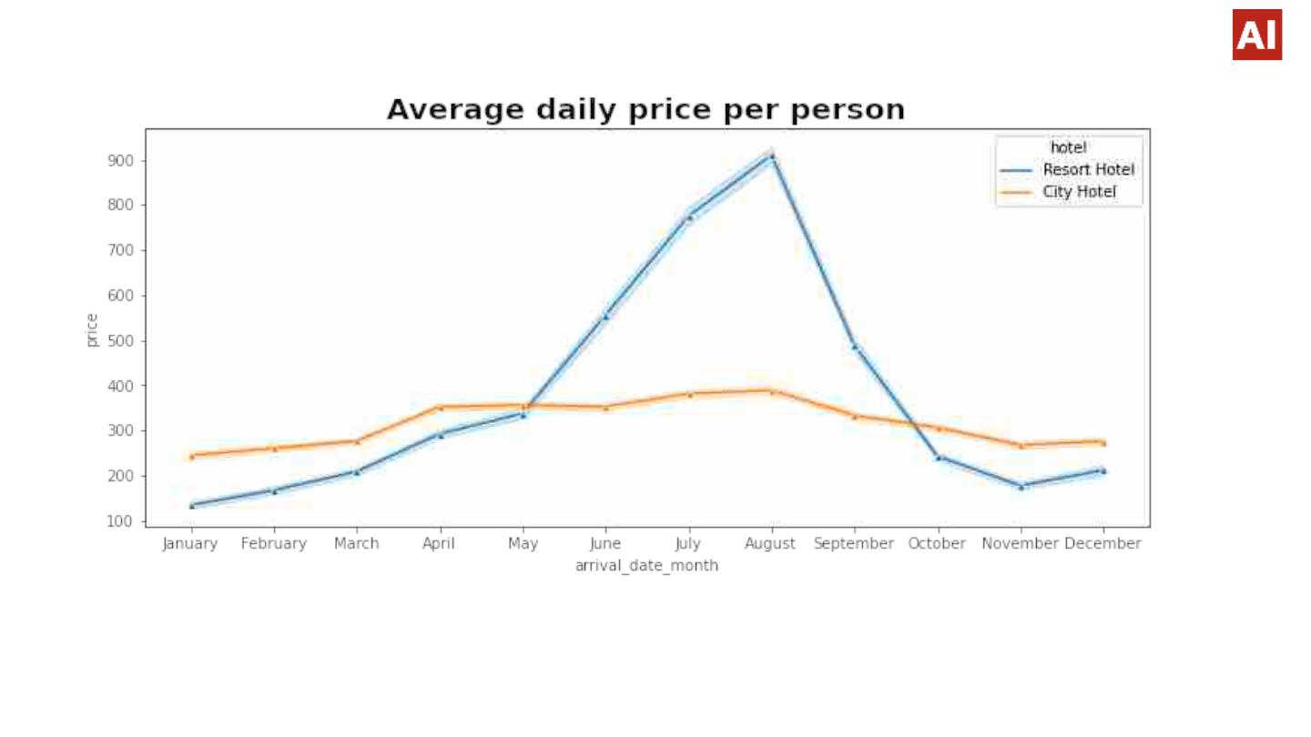
18.Average_daily_priceꢀperꢀperson
● ꢀꢀꢀꢀꢀꢀꢀPricesꢀofꢀresortꢀhotelꢀareꢀmuchꢀhigher.
ꢀꢀꢀꢀꢀꢀꢀPricesꢀofꢀcityꢀhotelꢀdoꢀnotꢀfluctuateꢀthatꢀmuch.

Slide 29
Conclusion
● Aroundꢀ61%ꢀbookingsꢀareꢀforꢀCityꢀhotelꢀandꢀ39%ꢀbookingsꢀareꢀforꢀResortꢀhotel,ꢀthereforeꢀ
CityꢀHotelꢀisꢀbusierꢀthanꢀResortꢀHotel.
● TheꢀmajorityꢀofꢀguestsꢀcomeꢀfromꢀwesternꢀEuropeꢀcountries.ꢀ
significantꢀamountꢀofꢀourꢀbudgetꢀonꢀthoseꢀarea.
Weꢀshouldꢀspendꢀaꢀ
● July-ꢀAugustꢀareꢀtheꢀbusiestꢀandꢀprofitableꢀmonthsꢀforꢀbothꢀofꢀhotels.
● Couplesꢀ areꢀ theꢀ mostꢀ commonꢀ guestsꢀ forꢀ hotels,ꢀ henceꢀ hotelsꢀ canꢀ planꢀ servicesꢀ
accordingꢀtoꢀcouplesꢀneedsꢀtoꢀincreaseꢀrevenue.
● JulyꢀandꢀAugustꢀmonthꢀhaveꢀhighꢀAverageꢀdailyꢀpriceꢀperꢀpersonꢀforꢀresortꢀhotel.
● Mostꢀcommonꢀstayꢀlengthꢀisꢀlessꢀthanꢀ4ꢀdaysꢀandꢀgenerallyꢀpeopleꢀpreferꢀCityꢀhotelꢀforꢀshort
ꢀstay,ꢀbutꢀforꢀlongꢀstays,ꢀResortꢀHotelꢀisꢀpreferred.
● November,December,ꢀFebruaryꢀAndꢀJanuaryꢀareꢀtheꢀmonthsꢀwhichꢀhasꢀlessꢀbookingꢀthisꢀper
iodꢀyouꢀcanꢀgetꢀroomsꢀwithꢀlessꢀaverageꢀdailyꢀrate.ꢀ
● )

Slide 30
THANKꢀYOU
●

