Slide 1



Demystifying Deep Learning
Webinar Session 3

Slide 2
AGENDA
Neural Network – Revision
Setting up environment
Writing modules
layers.py
losses.py
nn.py
Mini Project – Hand-Written Digits Classifier
Prerequisites – Dataset, Pre-Processing, NN (Layers, and Loss Functions)
From Scratch
Assignment – Hand-Written Digits Classifier

Slide 3
Neural Network
Comprises of
Data-fitting Layers – Weights & Biases (ANN, RNN, RTNN)
Activation Layers – Introduce Non-Linearity
Regularization Layers – Apply modifications to prevent Overfitting/underfitting
Neural Network:
Layers
Forward Pass
Forward Propagation of Input through layers
Backward Pass
Loss function & Derivative
Back-propagation of gradient loss through layers in reverse

Slide 4
Setting up environment
Requirements
Python 3
Visual Studio Code
Setup a virtual environment
pip install virtualenv
python –m venv [name_of_your_environment]
.\[name_of_your_environment]\Scripts\activate == Cmd Prompt
cmd -> .\[name_of_your_environment]\Scripts\activate == Powershell
Developer Dependencies
Libraries: Numpy, Tensorflow, Matplotlib

Slide 5
Setting up environment
Project Structure
MNIST/ - Virtual Environment
models/ - To store trained NN model
layers.py - Neural Network layers
losses.py - Loss functions
nn.py - Module to Train, Validate, Save & Load NN
train.py - Train hand-written digits classifier
test.py - Test hand-written digits classifier
dev-requirements.txt - Development Dependencies
deploy-requirements.txt - Deployment Dependencies
README.md - README file for project documentation
.gitignore - Files/Folders to be ignored for Git uploads

Slide 6
Modules
layers.py
Linear
ReLU
LeakyReLU
losses.py
MSE & Derivative
Binary Cross-entropy & Derivative
Softmax/Categorical Cross-entropy & Derivative
nn.py
Model
Sequential

Slide 7
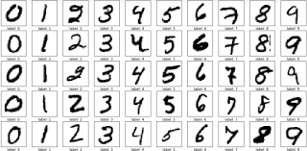
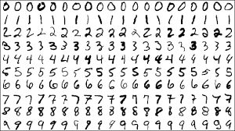
Hand-written Digits Classifier
Dataset
MNIST Database
The MNIST database of handwritten digits, available from this page, has a training set of 60,000 examples, and a test set of 10,000 examples. It is a subset of a larger set available from NIST. The digits have been size-normalized and centered in a fixed-size image.
Grayscale Images of resolution 28x28

Slide 8
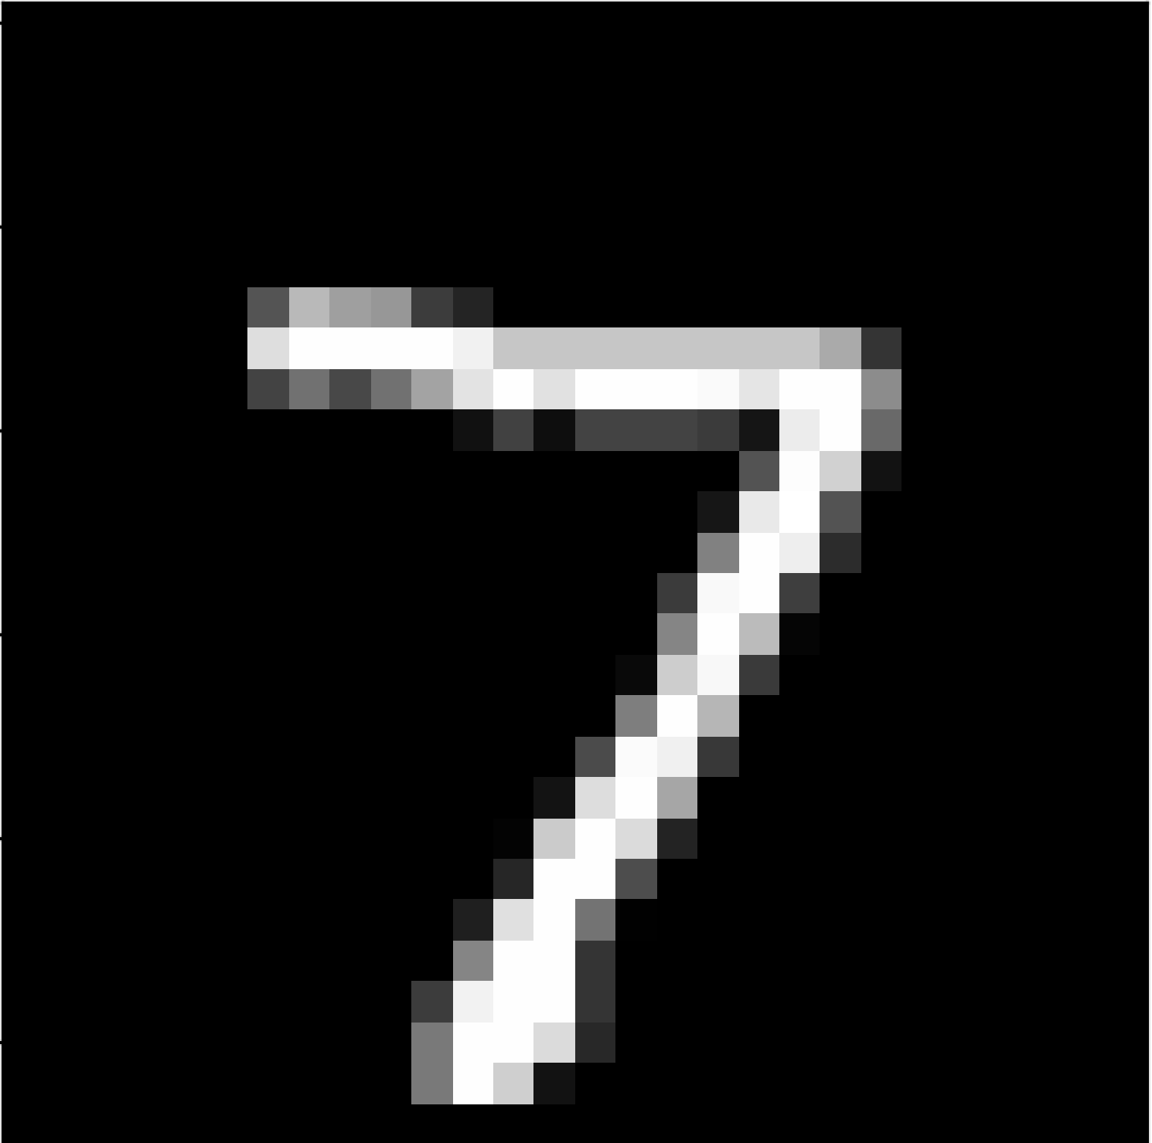
Hand-written Digits Classifier
Dataset
MNIST Pre-Processing
A single MNIST Image is a tensor of shape
1x 28 x 28 x 1
[ N x H x W x C ]
N = Number of Samples
H = Height of the Image
W = Width of the Image
C = Number of Colour channels in the image (R, G, B)

Slide 9
Hand-written Digits Classifier
Dataset
MNIST Pre-Processing
A single MNIST Image is a tensor of shape
1x 28 x 28 x 1
Reshape the image into a 2-Dimensional matrix
1 x 784
Now we get a 2-Dimensional Matrix containing one sample with 784 features.

Slide 10
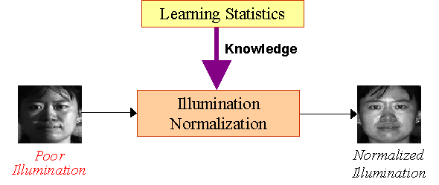
Hand-written Digits Classifier
Dataset
MNIST Pre-Processing
Normalizing
Normalization is a feature scaling technique used in Image Processing.
X = (X – Min. Pixel) /
(Max. Pixel – Min. Pixel)
Ranges from 0 to 1

Slide 11
Hand-written Digits Classifier
Dataset
MNIST Pre-Processing
Standardizing
Standardization is a feature scaling technique used in Image Processing.
X = (X – Mean) / Std. Dev
Ranges from -1 to 1

Slide 12
Hand-written Digits Classifier
Neural Network
Architecture
Inputs
Linear -> Activation -> Linear -> Activation -> Linear
Output
Input layer
ReLU or Leaky ReLU
Hidden layer
ReLU or Leaky ReLU
Output layer
(784, 256)
(784, 256)
(256, 512)
(256, 512)
(512, 10)

Slide 13
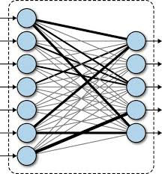
Hand-written Digits Classifier
Linear
Form: y_hat = W^{T} * X + b
Also called as Dense / Fully Connected / Linear layer.
Direct connection between one neuron and another.
Y_hat = W1 * X1 + W2 * X2 + … + Wn * Xn + b
1 Neuron
1 Neuron
1 Neuron
Relationship = Addition
Form of Multi-Variate Linear Regression

Slide 14
Hand-written Digits Classifier
Linear
Contents:
Weights – Tensor of shape (input features, output features), Xavier Initialization
Bias - Tensor of shape (output features), Xavier Initialization
forward() – Calculate y_hat = Weights^{T} * X + b and return it.
backward() - Optimize layer weights & biases by using incoming gradient loss & input used for forward.
New Grad Loss = Grad Loss . Weights
Dw = Inputs . Grad Loss
Db = Mean(Grad Loss)
Weights = Weights – Learning Rate * Dw
Bias = Bias – Learning Rate * Db
Return New Grad Loss

Slide 15
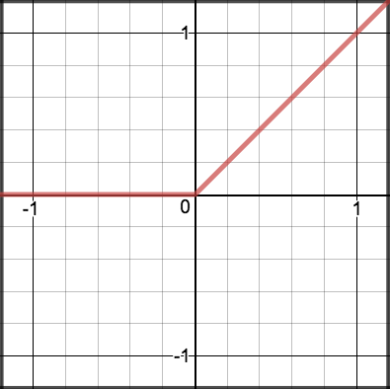
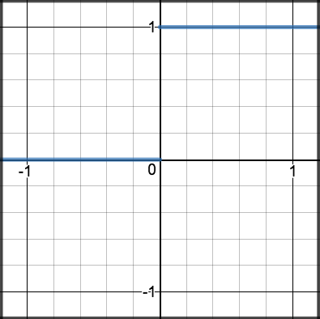
Hand-written Digits Classifier
Activation Layers
ReLU:
forward(x):
return max(0, x)
backward(x, grad):
z = inputs > 0.0
return grad * z

Slide 16
Hand-written Digits Classifier
Activation Layers
Problem with ReLU
Dying neurons/Dying ReLU problem
ReLU discards a neuron if it is zero or close to zero.
This is known as Dying ReLU problem.
This can also be considered as a Vanishing Gradients problem and Range problem.
*Neuron

Slide 17
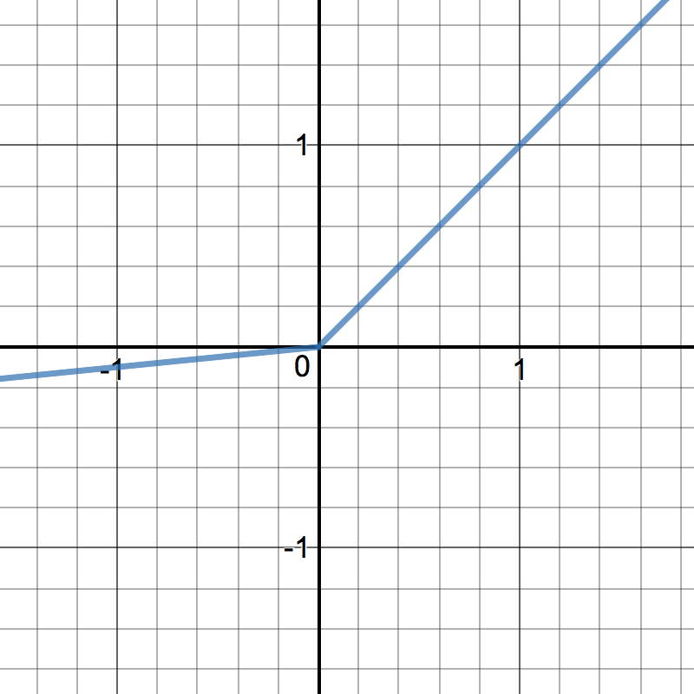
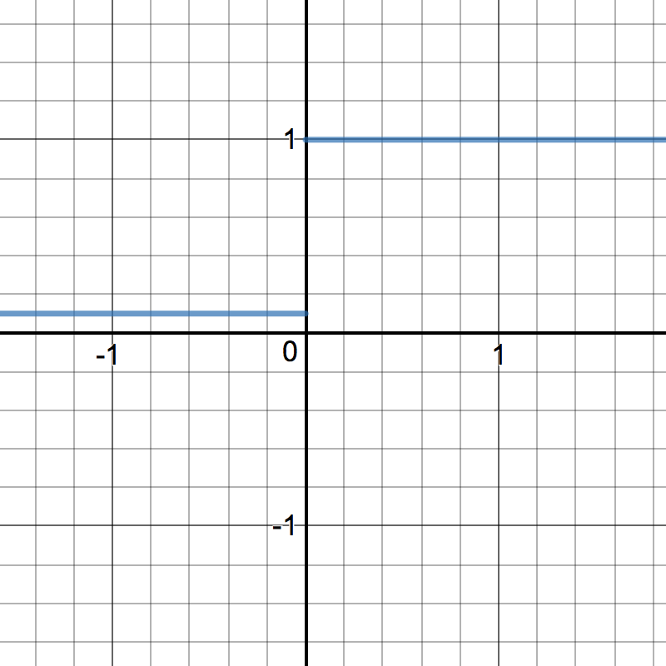
Hand-written Digits Classifier
Activation Layers
LeakyReLU:
forward(x, alpha=0.2):
return max(x, x*alpha)
backward(x, grad):
x[x <= 0] = alpha
return grad * x

Slide 18

Hand-written Digits Classifier
Loss Function
Softmax Categorical Cross-Entropy
Apply Softmax Activation to output neurons to get the probabilities of each neuron’s class.
Use Categorical Cross-Entropy loss function for it to calculate the loss.

Slide 19
Hand-written Digits Classifier
Neural Network
Final Architecture
Inputs
Linear (784, 256)
Grad Loss
LeakyReLU (α=0.2)
Grad Loss
Linear (256, 512)
Grad Loss
LeakyReLU (α=0.2)
Grad Loss
Linear (512, 10)
Grad Loss
Softmax
Categorical Cross-Entropy
Outputs
(Each class’s probability)
Loss

Slide 20
Hand-written Digits Classifier
Let us try coding this simple project
From Scratch

