Slide 1



Demystifying Deep Learning
Webinar Session 1

Slide 2
AGENDA
Introduction to Machine Learning & Deep Learning
History of AI
Pre-requisites
Linear Algebra
Calculus
Probability & Statistics
Types of Learning
Machine Learning Model
What is a Machine Learning model?
Structure of a typical Machine Learning algorithm and model
Basic Algorithms
Linear Regression - Theory
Linear Regression - Practical
Logistic Regression – Theory
Assignment
Logistic Regression – Practical

Slide 3
Introduction to Machine Learning & Deep Learning
Machine Learning
Machine learning (ML) is the study of computer algorithms that improve automatically through experience. It is seen as a subset of artificial intelligence. Machine learning algorithms build a mathematical model based on sample data, known as "training data", in order to make predictions or decisions without being explicitly programmed to do so.
Deep Learning
Deep learning (also known as deep structured learning) is part of a broader family of machine learning methods based on artificial neural networks with representation learning.

Slide 4
Introduction to Machine Learning & Deep Learning
“I have heard this before.”
“Umm…So what’s new?”
“Meh! Basic”

Slide 5
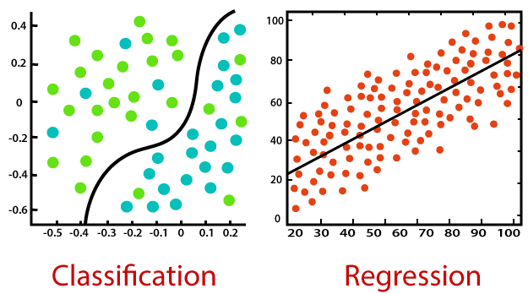
Introduction to Machine Learning & Deep Learning
Machine Learning & Deep Learning can both be viewed as just a geometrical problem which is all about curve fitting.
Machine Learning is built upon a single equation for curve-fitting whereas Deep Learning allows us to have a chain of equations to form a curve fitting function.

Slide 6
History of AI
The first case of neural networks was in 1943, when neurophysiologist Warren McCulloch and mathematician Walter Pitts wrote a paper about neurons, and how they work. They decided to create a model of this using an electrical circuit, and therefore the neural network was born.
In 1950, Alan Turing created the world-famous Turing Test. This test is fairly simple - for a computer to pass, it has to be able to convince a human that it is a human and not a computer.
1952 saw the first computer program which could learn as it ran. It was a game which played checkers, created by Arthur Samuel.
Frank Rosenblatt designed the first artificial neural network in 1958, called Perceptron. The main goal of this was pattern and shape recognition.

Slide 7
History of AI
Fathers of AI: John McCarthy, Alan Turing, Arthur Samuel
Both ML & DL were built using statistical concepts at a very base level.
Progression (1943-1960)
First Mathematical model of neurons
Pitts & McCulloch (1943) [MP43]
Beginning of artificial neural networks
Perceptron, Rosenblatt (1958) [R58]
A single neuron for classification
Perceptron learning rule
Perceptron convergence theorem [N62]
Degression (1960-1980)
Perceptron can’t even learn the XOR function [MP69]
We don’t know how to train MLP
1963 Backpropagation (Bryson et al.)
∗ But not much attention

Slide 8
History of AI
Progression (1980-)
1986 Backpropagation reinvented:
∗ Learning representations by back-propagation errors. Rumilhart et al. Nature [RHW88]
Successful applications in
∗ Character recognition, autonomous cars, ..., etc.
But there were still some open questions in
∗ Overfitting? Network structure? Neuron number? Layer number? Bad local minimum points? When to stop training?
Hopfield nets (1982) [H82], Boltzmann machines [AHS85], ..., etc.
Degression (1993-)
SVM: Support Vector Machine is developed by Vapnik et al.. [CV95] However, SVM is a shallow architecture.
Graphical models are becoming more and more popular
Great success of SVM and graphical models almost kills the ANN (Artificial Neural Network) research.
Training deeper networks consistently yields poor results.
However, Yann LeCun (1998) developed deep convolutional neural networks (a discriminative model). [LBBH98]

Slide 9
History of AI
Progression (2006-)
Deep learning is a rebranding of ANN research.
– Deep Belief Networks (DBN)
∗ A fast learning algorithm for deep belief nets. Hinton et al. Neural Computation. [HOT06]
∗ Generative graphical model
∗ Based on restrictive Boltzmann machines
∗ Can be trained efficiently
– Deep Autoencoder based networks
∗ Greedy Layer-Wise Training of Deep Networks.Bengio et al. NIPS [BLPL07]
– Convolutional neural networks running on GPUs
∗ Great success for NN since the massiave usage of GPUs.
∗ AlexNet (2012). Krizhevsky et al. NIPS [KSH12]

Slide 10
Prerequisites
Linear Algebra
Everything we deal in ML/Dl will be in the form of a tensor.
Matrix & Vector operations.
Normal algebraic operations (Sometimes it can be little complex).
Calculus
Differentiation of mathematical equations (Activation & Loss functions) is done.
Very important to understand Backpropagation / Weight optimization.
Used over “layers” in Neural Networks.
Probability & Statistics
Base of ML/DL is probability & Statistics
Important to understand loss functions, neural network layers and certain ML algorithms such as Naïve Bayes, Decision Trees, etc.

Slide 11
Types of Learning
Supervised Learning
Unsupervised Learning
Reinforcement Learning
Semi-Supervised Learning
Self-Supervised Learning

Slide 12
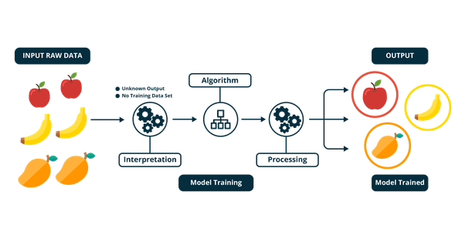
Types of Learning
Supervised Learning
Supervised learning is the machine learning task of learning a function that maps an input to an output based on example input-output pairs. It infers a function from labeled training data consisting of a set of training examples.
A supervised learning algorithm learns from labeled training data, helps you to predict outcomes for unforeseen data.

Slide 13
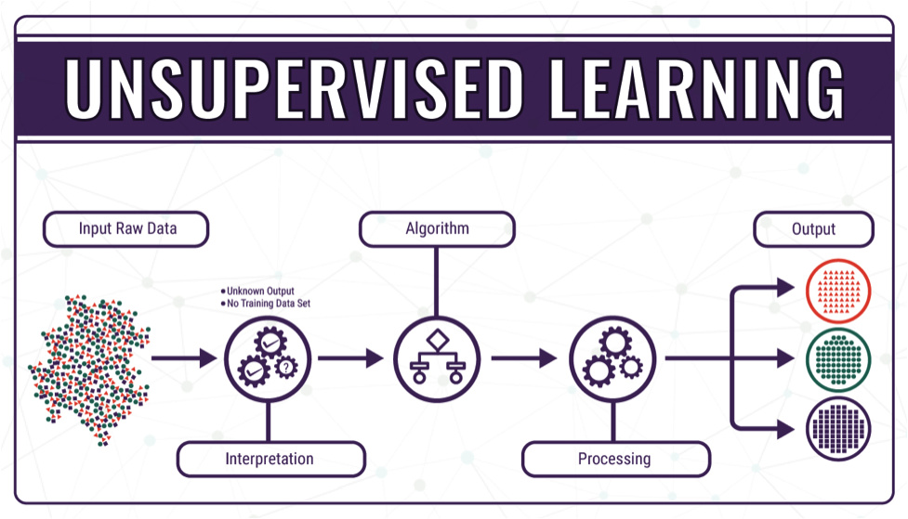
Types of Learning
Unsupervised Learning
Unsupervised learning is a type of machine learning algorithm used to draw inferences from datasets consisting of input data without labeled responses.
The most common unsupervised learning method is cluster analysis, which is used for exploratory data analysis to find hidden patterns or grouping in data. The clusters are modeled using a measure of similarity which is defined upon metrics such as Euclidean or probabilistic distance.

Slide 14
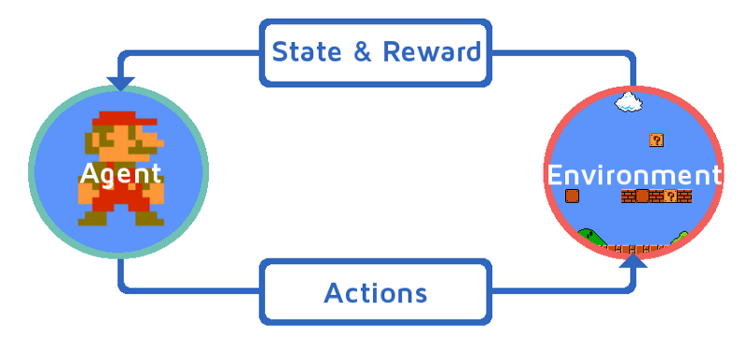
Types of Learning
Reinforcement Learning
Reinforcement learning (RL) is an area of machine learning concerned with how software agents ought to take actions in an environment so as to maximize some notion of cumulative reward.
It differs from supervised learning in that labelled input/output pairs need not be presented, and sub-optimal actions need not be explicitly corrected. Instead the focus is finding a balance between exploration (of uncharted territory) and exploitation (of current knowledge).

Slide 15
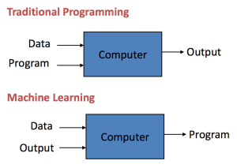
Machine Learning Model

Slide 16
Machine Learning Model
“Hmm…WTH?”

Slide 17
Machine Learning Model
Training
Testing / Deploying
Input
Model
Optimized Model
Output
New Data Input
Optimized Model
Predicted Output

Slide 18
Machine Learning Model
Contents of a Machine Learning / Deep Learning algorithm
Weights & Biases
Data fitting equation / function
Loss function
Differentiated Loss Function
Optimizer / Gradient Descent or Gradient Ascent Algorithm
Contents of a Machine Learning model
Optimized Weights & Biases (Just values/arrays that can be assigned to variables)

Slide 19
Basic Algorithms

Slide 20
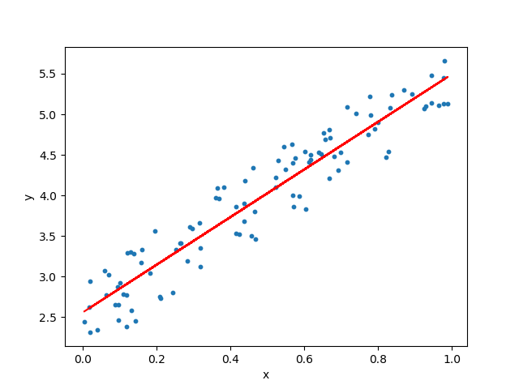
Linear Regression
Linear Regression is a statistical learning algorithm.
Used for predicting continuous values and hence trained on datasets that have continuous values.
Two types of Linear Regression:
Uni-Variate Linear Regression (Only for a single feature)
Multi-Variate Linear Regression (For N number of features)

Slide 21
Linear Regression
Uni-Variate Linear Regression
Weights – 1 floating point value drawn from Uniform/Normal Distribution
Bias - 1 floating point value drawn from Uniform/Normal Distribution
Data fitting equation
Slope formula: y = w * x + b
Loss/Cost function
Mean Squared Error (MSE) : loss = ((predicted_value – true_value)^2/num_samples)
Mean Absolute Error (MAE) : loss = ((predicted_value – true_value)/num_samples)
Root Mean Squared Error (RMSE) : loss = sqrt(MSE)
Differentiated Loss function
Optimization Algorithm
Gradient Descent

Slide 22
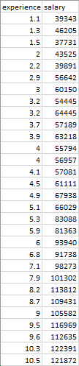
Linear Regression
Let’s have a look at the dataset:
Feature Column(s) – experience, let us take this as X
Value to be predicted – salary, let us take this as y
Any new value that can be predicted is written as a function:
y_pred = Weights * X + Bias
Calculate loss: loss = MSE(y, y_pred)
Minimize loss by changing Weights & Biases based on the currently calculated loss using
optimization algorithm. (Iteratively)
Gradient Descent: w = w – learning_rate * dw
b = b – learning_rate * db

Slide 23
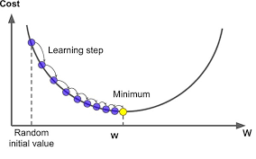
Linear Regression
Gradient Descent:
It is an AI algorithm that is used to find global minimum, which is its goal.
Define learning rate (step size) for the algorithm based on which the algorithm moves step by step to find the global minimum value.

Slide 24
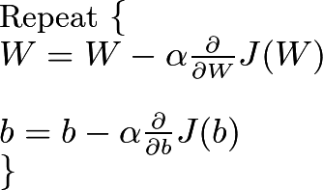
Linear Regression
Gradient Descent:
Use gradient descent to minimize loss by changing Weights and Biases.
w = w – learning_rate * dw
b = b – learning_rate * db
So, how do I calculate dw & db?
dw = dw + differentiated_loss_equation(X) * X
db = db + differentiated_loss_equation(X)
The differentiated weights & biases are termed as Gradients.
α is the learning rate / step size

Slide 25
Linear Regression
Run Gradient Descent for N iterations to get the optimized Weights & Biases.
This number of iterations taken to optimize the weights & biases are termed as Epochs.

Slide 26
Linear Regression
Multi-Variate Linear Regression
Weights – A tensor of shape (N, 1), containing values drawn from Uniform/Normal Distribution (N = Number of Feature Columns)
Bias - 1 floating point value drawn from Uniform/Normal Distribution
Data fitting equation
Slope formula: y = w^{T} * x + b
Loss/Cost function
Mean Squared Error (MSE) : loss = (1/num_samples) * (predicted_value – true_value)^2
Differentiated Loss function
Optimization Algorithm
Gradient Descent

Slide 27
Linear Regression
Linear Regression – Generalized
Weights – A tensor of shape (N, 1), containing values drawn from Uniform/Normal Distribution (N = Number of Feature Columns)
Bias - 1 floating point value drawn from Uniform/Normal Distribution
Data fitting equation
Slope formula: y = w^{T} * x + b
Loss/Cost function
Mean Squared Error (MSE) : loss = (1/num_samples) * (predicted_value – true_value)^2
Differentiated Loss function
Optimization Algorithm
Gradient Descent
Time Complexity of Gradient Descent – O(kn²) k = No. of weights, n = No. of samples

Slide 28
So How do I create Weights and Biases?
Answer: Initialization Techniques

Slide 29
Initialization Techniques
Normal Distribution
Draw values from Normal Distribution by passing random values through the formula
Z = X – Mean / Standard Deviation
Uniform Distribution
Draw values from Uniform Distribution by passing random values through the formula
Limit = 1 / high - low
Kaiming He Initialization
Multiply random values with sqrt(2.0 / tensor.shape[0])
Xavier / Glorot Initialization
Draw values from Uniform Distribution by passing random values through the formula
Limit = sqrt(6.0 / (tensor.shape[0] + tensor.shape[1] + 1))
Distibution = [-Limit, Limit]

Slide 30
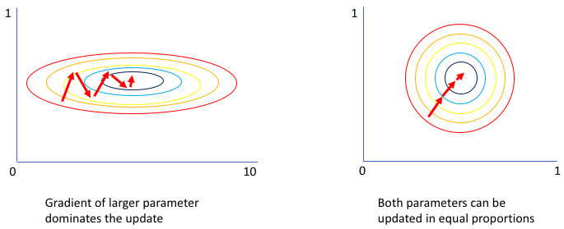
Feature Scaling
Feature Scaling is done to reduce the bias in the performance of a model.
Make the model perform better for input of any range of values.
Center the values around 0.0

Slide 31
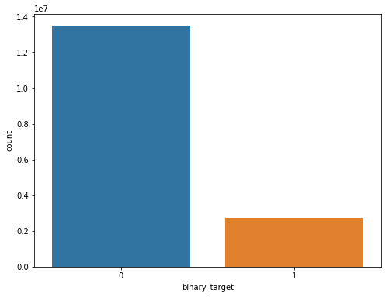
Feature Engineering
Feature engineering is the process of creating new features or deriving new features from existing features. Leads to better features for better prediction and performance.
Often requires domain knowledge.
Sampling
Sampling is required when you have class imbalance in the dataset.
These are nothing but sampling techniques used in conventional statistics.
Popular sampling techniques:
Over sampling
Under sampling
Synthetic Sampling

Slide 32
Let us try coding Linear Regression
From scratch
Using frameworks

Slide 33
Requirements
Numpy – Linear Algebra library
Pandas – Data manipulation library (read csv files, excel files, etc.)
Matplotlib – Plot graphs
Scikit-Learn – Popular Machine Learning framework + Utility functions

Slide 34

Logistic Regression
Weights – A tensor of shape (N, 1), containing values drawn from Uniform/Normal Distribution (N = Number of Feature Columns)
Bias - 1 floating point value drawn from Uniform/Normal Distribution
Data fitting equation
Slope formula: y = w^{T} * x + b
Activation function:
f(z) = sigmoid(z) = 1 / (1 + e^-z)
f(y) = sigmoid(y) = 1 /( 1 + e^-(w^{T} * x + b))
Loss/Cost function
Binary Cross-Entropy: loss =
Differentiated Loss function
Optimization Algorithm
Gradient Descent

Slide 35
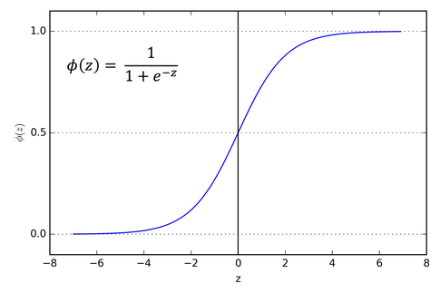
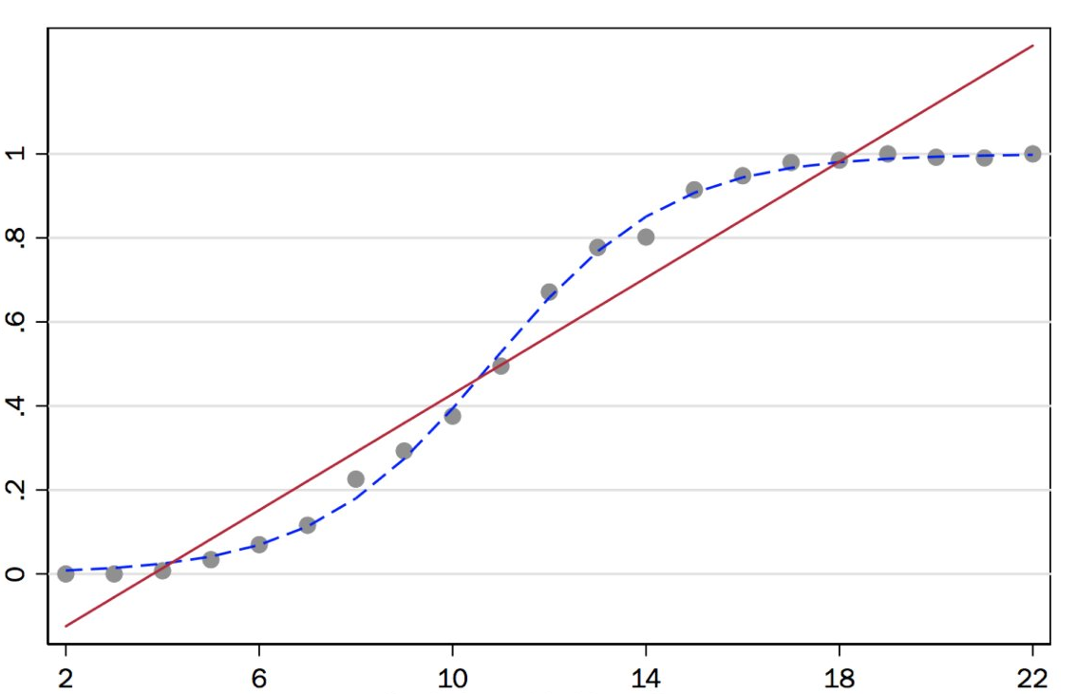
Logistic Regression
Activation function:
f(z) = sigmoid(z) = 1 / (1 + e^-z)
f(y) = sigmoid(y) = 1 /( 1 + e^-(w^{T} * x + b))
Threshold = 0.5

Slide 36
Logistic Regression
Gradient Descent:
Use gradient descent to minimize loss by changing Weights and Biases.
w = w – learning_rate * dw
b = b – learning_rate * db
So, how do I calculate dw & db?
dw = dw + differentiated_loss_equation(X) * X
db = db + differentiated_loss_equation(X)
The differentiated weights & biases are termed as Gradients.
Clue: derivative for w = ∂J(w)/∂z = −(y/z−(1−y/1−z)) = z−y/z(1−z)
α is the learning rate / step size

