Slide 1



Demystifying Deep Learning
Webinar Session 2

Slide 2
AGENDA
Logistic Regression in Code
What’s happening? – Simplifying things
Neural Networks – Theory
Introduction
Working of a perceptron
Multi Layer Perceptron
Types of Neural Networks
Understanding Back-Propagation
Issues
Neural Networks – Practical
Building our ANN layer
Back to basics – Linear Regression & Logistic Regression
Types of layers & building other layers
Performing forward pass through a Multi-Layered Neural Network
Assignment
Forward Pass & Back-Propagation for custom network

Slide 3

Logistic Regression
Weights – A tensor of shape (N, 1), containing values drawn from Uniform/Normal Distribution (N = Number of Feature Columns)
Bias - 1 floating point value drawn from Uniform/Normal Distribution
Data fitting equation
Slope formula: y = w^{T} * x + b
Activation function:
f(z) = sigmoid(z) = 1 / (1 + e^-z)
f(y) = sigmoid(y) = 1 /( 1 + e^-(w^{T} * x + b))
Loss/Cost function
Binary Cross-Entropy: loss =
Differentiated Loss function
Optimization Algorithm
Gradient Descent

Slide 4

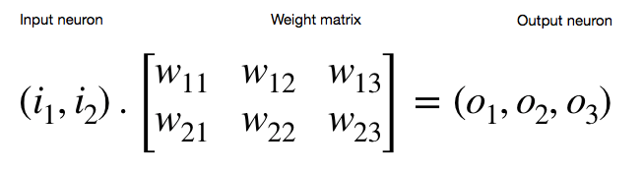
What’s happening? – Simplifying things
for i in range(0, samples):
dw += - (2 * (y[i] - self.__slope(x[i], w, b)[0]) * x[i]) / samples
db += - (2 * (y[i] - self.__slope(x[i], w, b)[0])) / samples
Element wise, we’re calculating:
Error / Gradient loss = - (2 * (y[i] - self.__slope(x[i], w, b)[0])
Dw = ( Error * Input )
Db = Mean ( Error )
This is called as dot product / Hadamard product / element wise multiplication.

Slide 5
Neural Network
Neural Networks are basically networks of neurons that is present in our brain.
These neurons get fired up based on information received through the thalamus and sends signals to various networks of nerves based on action decided to perform.
Neural Networks in Deep Learning are for the same purposes which allows our algorithm to perform some action by learning, which mimics the working of the brain.
MADALINE was the first neural network to be applied to a real world problem. It is an adaptive filter which eliminates echoes on phone lines. This neural network is still in commercial use.
More applications: Image Classification, Object Detection, Self-Driving cars, Voice assistant, etc.

Slide 6
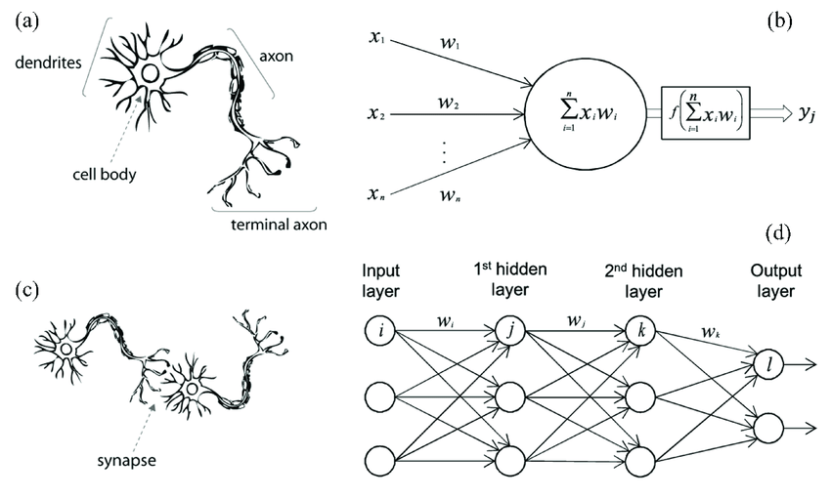
Neural Network

Slide 7
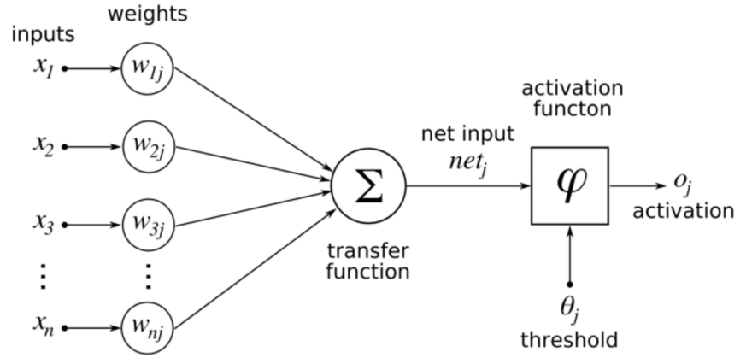
Neural Network
A neural network layer consists of
Neurons –> y_hat = W^{T} * X + b
Activation function (or followed by an activation layer)
Example: ReLU, ELU, Sigmoid, TanH, etc.

Slide 8
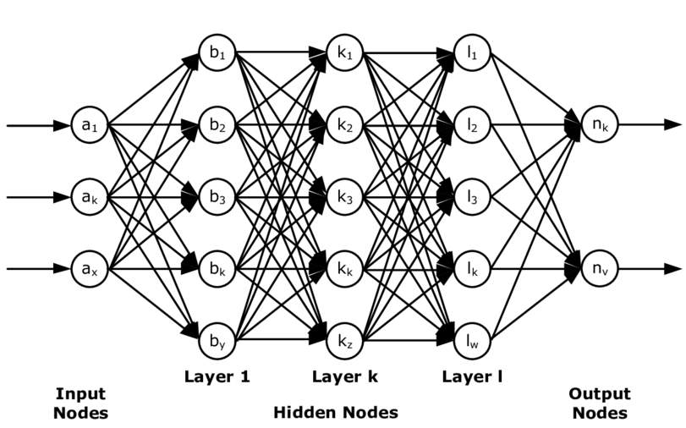
Neural Network
Multi Layer Perceptron model

Slide 9
Neural Network – Types of NNs
Artificial Neural Network (ANN)
Multiple layers of Linear equations with Probabilistic output equation that simulates a neural network.
Most basic type of Neural Network
Convolutional Neural Network (CNN)
Multiple layers of equations that perform Convolutions on the image to find patterns and learn them.
Based on Image Processing concepts.
Used in Computer Vision.
Recurrent Neural Network (RNN)
Advanced Neural Networks that is actually based on the working of human brain.
Output of one Neural Network can be Input to another or the same.
Used for complex numerical data, Computer Vision, Time Series data (like weather, music), Stock Returns and Predictions, and much more.

Slide 10
Neural Network – Understanding Back Propagation
Consider a network with 3 layers and 3 activation functions.
Layer_1 {Weights, Bias} – L1
Activation_1 – A1
Layer_2 {Weights, Bias} – L2
Activation_2 – A2
Layer_3 {Weights, Bias} – L3
Activation_3 – A3
Calculate output by performing forward pass
Output = A3 ( L3 ( A2 ( L2 ( A1 ( L1 ) ) ) ) )
Loss = loss(Output, y_true)
Grad Loss = derivative_loss(Output, y_true)

Slide 11
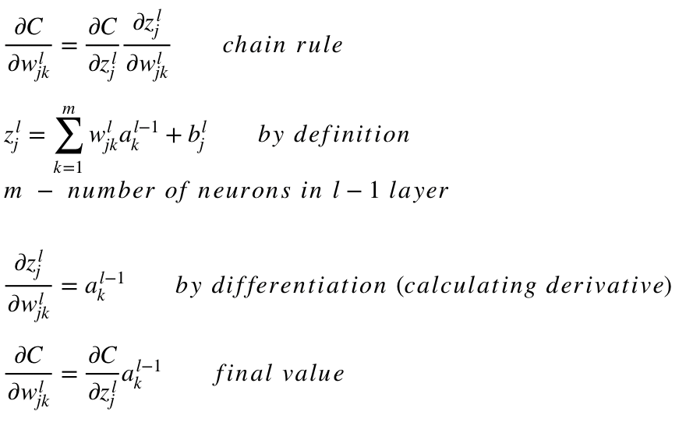
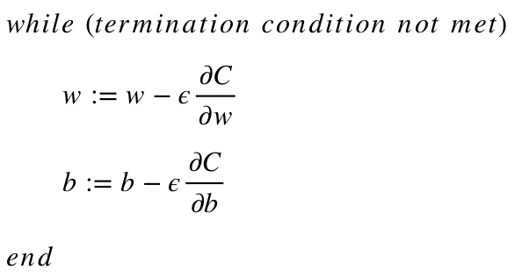
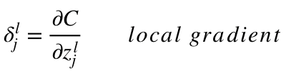
Neural Network – Understanding Back Propagation

Slide 12
Neural Network – Understanding Back Propagation
In5
In4
In3
In2
In1
Input - In
Causes significant Loss
Output = A3 ( <- L3 ( <- A2 ( <- L2 ( <- A1 ( <- L1 ) ) ) ) )
Non-Linearity
W & b
Non-Linearity
W & b
Non-Linearity
W & b
Grad Loss = derivative_loss(Output, y_true)
Overall loss to be minimized, can be negative or positive

Slide 13
Neural Network – Understanding Back Propagation
L3
Calculate
Grad Loss = Weights * Grad Loss
Dw, Db for ln4
Perform Gradient Descent once to optimize W, b with calculated Dw & Db
d A3
Calculate
Grad Loss = d A3(ln5) * Grad Loss
Grad Loss
L2
Calculate
Grad Loss = Weights * Grad Loss
Dw, Db for ln2
Perform Gradient Descent once to optimize W, b with calculated Dw & Db
All layers optimized based on calculated loss
d A2
Calculate
Grad Loss = d A2(ln3) * Grad Loss
L1
Calculate
Grad Loss = Weights * Grad Loss
Dw, Db for ln
Perform Gradient Descent once to optimize W, b with calculated Dw & Db
d A1
Calculate
Grad Loss = d A1(ln1) * Grad Loss

Slide 14
Neural Network – Understanding Back Propagation
Output = A3 ( L3 ( A2 ( L2 ( A1 ( L1 ) ) ) ) )
Grad Loss = derivative_loss(Output, y_true)
for layer in layers:
Grad Loss = layer.backward(Input_for_layer, Grad Loss, Learning Rate)
backward(Input_for_layer, Grad Loss, Learning Rate):
New_grad_loss = dot(Grad Loss, Weights)
Dw = dot(Input, Grad Loss)
Db = mean(Grad Loss)
Weights -= Learning Rate * Dw
Bias -= Learning Rate * Db
Return New_grad_loss

Slide 15
Neural Network – Issues
Overfitting
When the algorithm/network starts to learn undesirable patterns/noise present in the data.
Loss <<< Validation Loss & Accuracy >>> Validation Accuracy
Underfitting
When the algorithm/network doesn’t learn desirable patterns present in the data properly.
Loss >>> Validation Loss & Accuracy <<< Validation Accuracy
Vanishing Gradients
The layers are chained in NNs and gradients are calculated by applying chain rule for reducing loss.
When we use lot of layers, we’ll get a huge chained function where the gradient may become zero after undergoing differentiation under a particular point during back propagation.

Slide 16
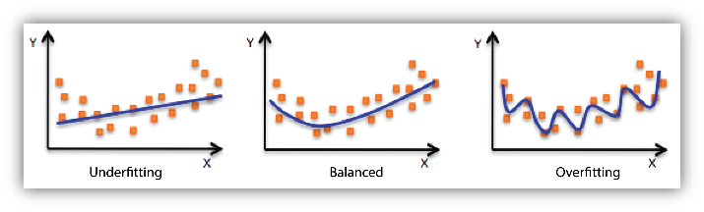
Neural Network – Issues
Loss >>> Validation Loss
&
Accuracy <<< Validation Accuracy
Loss <=/>= Validation Loss
&
Accuracy <=/>= Validation Accuracy
Loss <<< Validation Loss
&
Accuracy >>> Validation Accuracy
Identifying / Debugging Overfitting & Underfitting

Slide 17
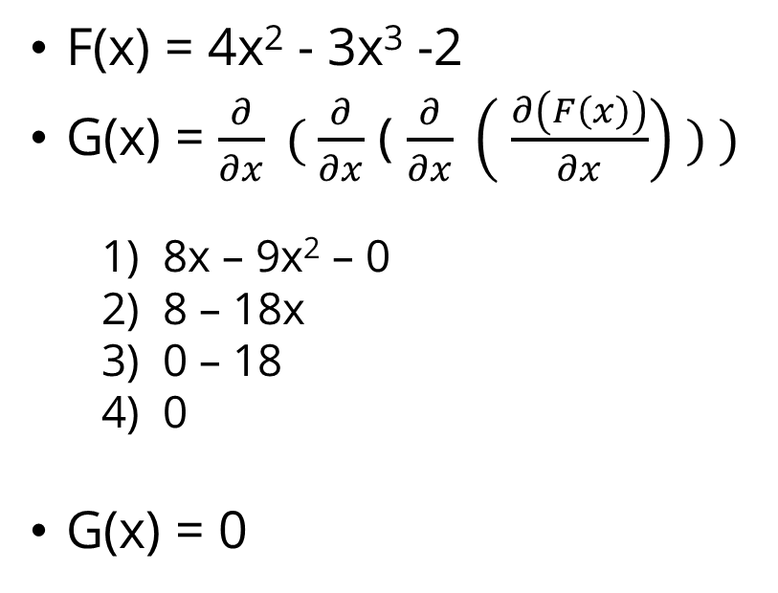
Neural Network – Issues
Solution:
Use activation functions that cause better non-linearity.
Example:
ReLU
Leaky ReLU
SoftPlus
ELU
BRU
F(x) = 4x² - 3x³ -2
G(x) = $\frac{∂}{∂x} ( \frac{∂}{∂x}$ ( $\frac{∂}{∂x} \left( \frac{∂\left(F\left(x\right)\right)}{∂x}\right) ) )$
1) 8x – 9x² – 0
2) 8 – 18x
3) 0 – 18
4) 0
G(x) = 0
Identifying / Debugging Vanishing Gradients

Slide 18
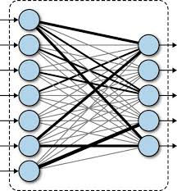
Neural Network
Building our ANN layer
Form: y_hat = W^{T} * X + b
Also called as Dense / Fully Connected / Linear layer.
Direct connection between one neuron and another.
Y_hat = W1 * X1 + W2 * X2 + … + Wn * Xn + b
1 Neuron
1 Neuron
1 Neuron
Relationship = Addition
Form of Multi-Variate Linear Regression

Slide 19
Neural Network
Building our ANN layer
Contents:
Weights – Tensor of shape (input features, output features), Xavier Initialization
Bias - Tensor of shape (output features), Xavier Initialization
forward() – Calculate y_hat = Weights^{T} * X + b and return it.
backward() - Optimize layer weights & biases by using incoming gradient loss & input used for forward.
New Grad Loss = Grad Loss . Weights
Dw = Inputs . Grad Loss
Db = Mean(Grad Loss)
Weights = Weights – Learning Rate * Dw
Bias = Bias – Learning Rate * Db
Return New Grad Loss

Slide 20
Neural Network – Back to Basics
Let us build our ANN Layer
Use it for:
Linear Regression
Logistic Regression

Slide 21
Neural Network
Types of Layers
Data Fitting Layer
This is used to learn the pattern in data by optimizing Weights & Biases of that layer.
Example: ANN, RNN
Feature Extraction Layer
This is used to extract features from data for the data fitting layer to learn better.
Example: CNN, Embedding, etc.
Activation Layer
This is used to introduce non-linearity to data in neuron that comes from its preceding layer.
Example: ReLU, Sigmoid, TanH, etc.
Regularization Layer
This is used to prevent overfitting / underfitting in the network thus helping the network to learn better.
Example: Dropout, Batch Normalization, etc.

Slide 22
Neural Network
Building other Layers
Activation Layers
forward(): Apply non-linearity function
backward(): Apply derivative of non-linearity function for input and return dot product of gradient loss and derivative applied input.
Regularization Layers
forward(): Perform modification of Input Neuron
backward(): Perform modification of Gradient loss neuron the same way it was done for input neuron and return it.
Let us see about few Activation layers & Regularization layers

Slide 23
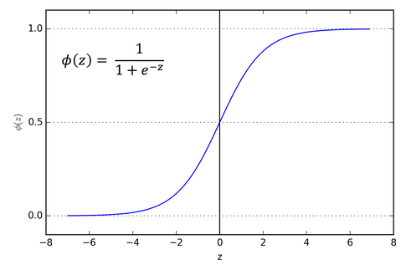
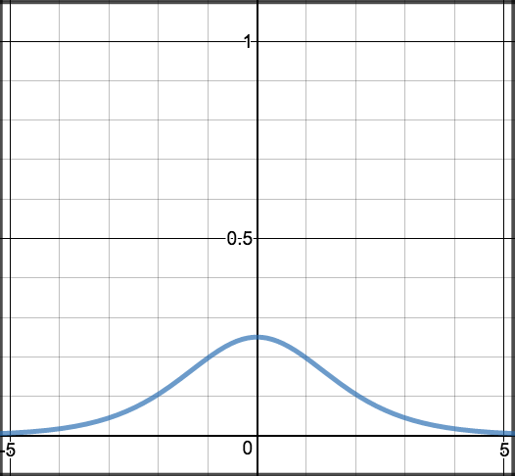
Neural Network
Activation Layers
Sigmoid:
forward(x):
return 1.0 / (1.0 / exp^{-x})
backward(x, grad):
z = forward(x) * forward(1 - x)
return grad * z

Slide 24
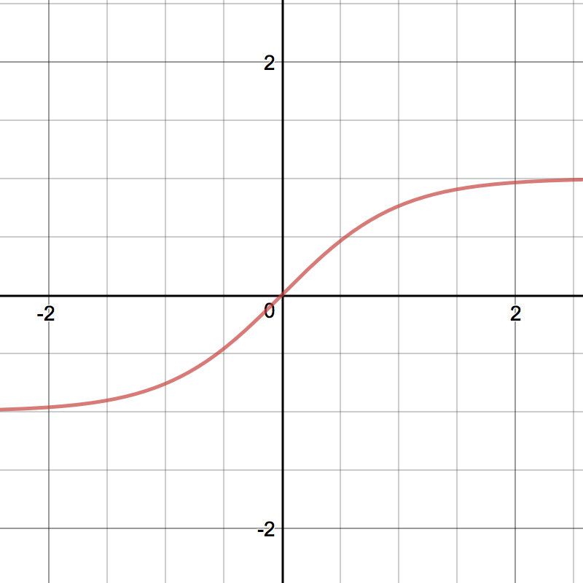
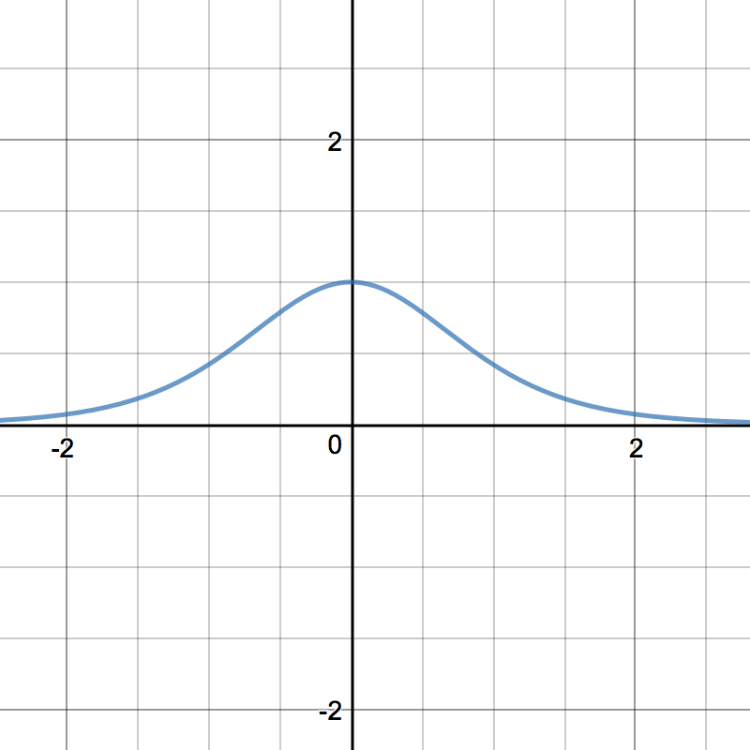
Neural Network
Activation Layers
TanH:
forward(x):
return (exp^{x} – exp^{-x})/ (exp^{x} + exp^{-x})
backward(x, grad):
z = (1 – forward(x))²
return grad * z

Slide 25
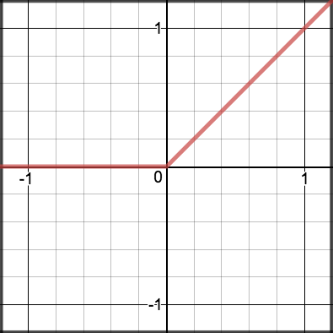
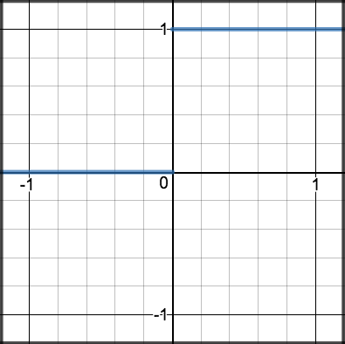
Neural Network
Activation Layers
ReLU:
forward(x):
return max(0, x)
backward(x, grad):
z = inputs > 0.0
return grad * z

Slide 26
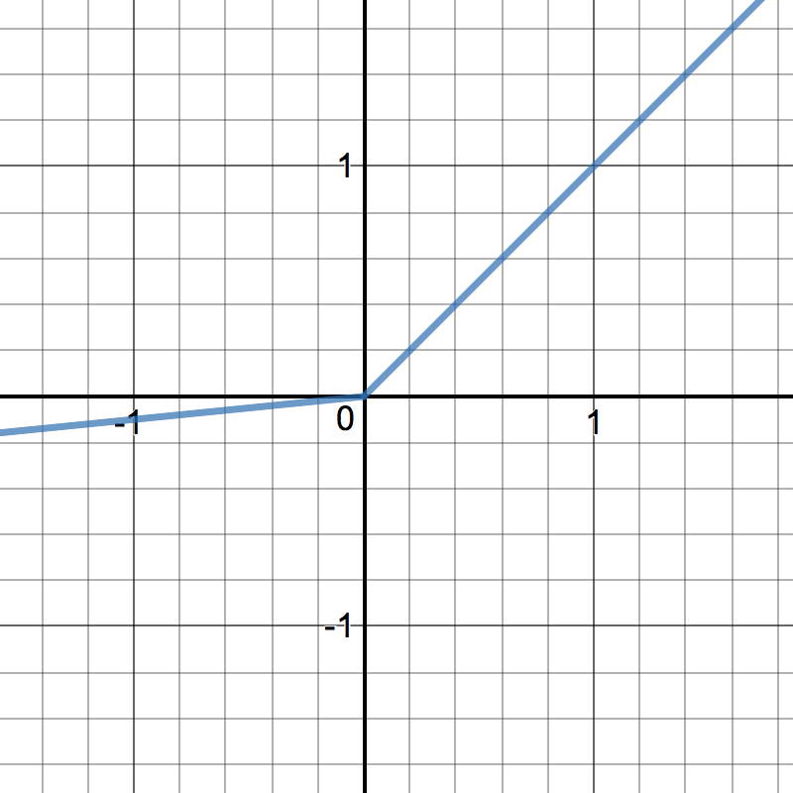
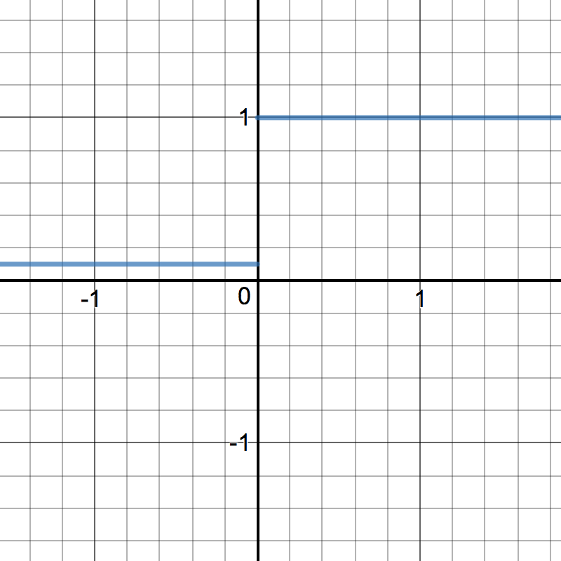
Neural Network
Activation Layers
LeakyReLU:
forward(x, alpha=0.2):
return max(x, x*alpha)
backward(x, grad):
x[x <= 0] = alpha
return grad * x

Slide 27
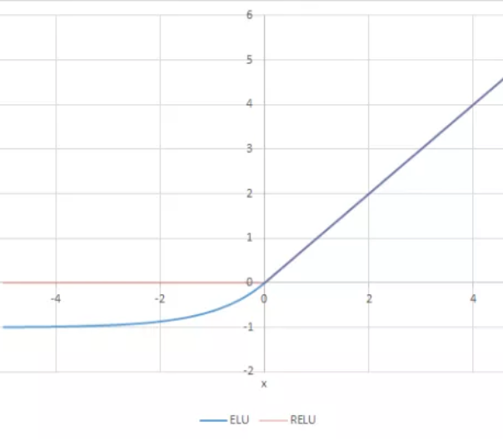
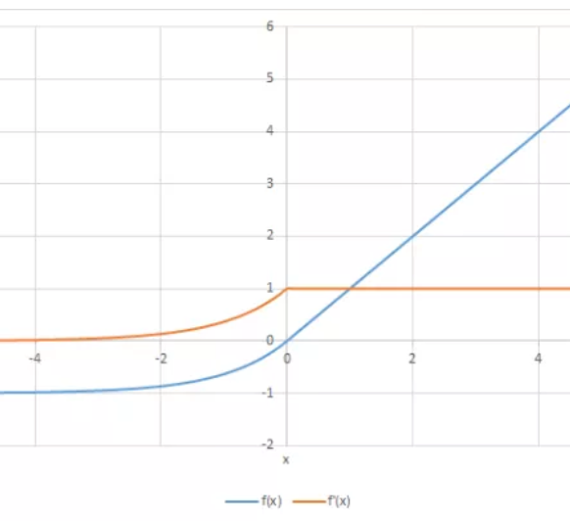
Neural Network
Activation Layers
ELU:
forward(x, alpha=0.2):
return max(x, alpha * (exp^{x} - 1))
backward(x, grad):
x[x <= 0] = alpha * exp^{inputs}
return grad * x

Slide 28
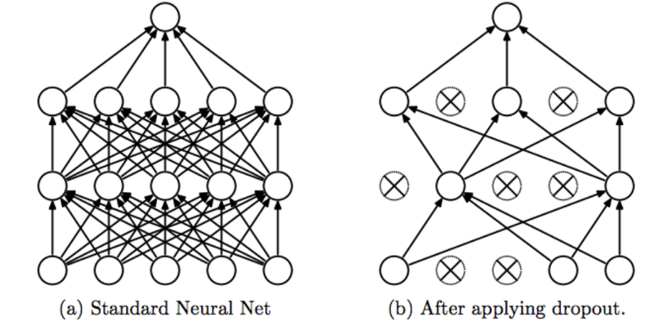
Neural Network
Regularization Layers
Dropout:
It is a regularization technique, where randomly selected neurons are discarded / set to zero to avoid overfitting.
No weight updates are performed on this layer, and can be removed during the process of prediction.

Slide 29
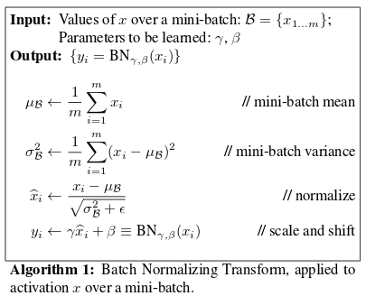
Neural Network
Regularization Layers
Batch Normalization:
The process of performing normalization on the data received from previous layer in a network (which is a batch).
Commonly used as a regularization technique to avoid overfitting in CNNs.

Slide 30
Neural Network
Forward Pass in a Neural Network
In, Out
layer1 = Linear(784, 256)
layer2 = Linear(256, 512)
layer3 = Linear(512, 10)
Number of Output features from one layer & Number of Input features of succeeding layer should be equal.
layers = [layer1, layer2, layer3]
Add them to a list or call forward method of each layer distinctively.

Slide 31
Neural Network
Forward Pass in a Neural Network
layers = [layer1, layer2, layer3]
X = inputs
for layer in layers:
X = layer.forward(X)
X now contains the output tensor
(or) You can build a class

Slide 32
Neural Network
Forward Pass in a Neural Network
class ANN:
def __init__(self):
self.fc1 = Linear(784, 256)
self.fc2 = Linear(256, 512)
self.fc3 = Linear(512, 10)
def forward(self, X):
X = self.fc1.forward(X)
X = self.fc2.forward(X)
X = self.fc3.forward(X)
return X
class ANN:
def __init__(self):
self.fc1 = Linear(784, 256)
self.fc2 = Linear(256, 512)
self.fc3 = Linear(512, 10)
self.layers = [self.fc1, self.fc2, self.fc3]
def forward(self, X):
for layer in self.layers:
X = layer.forward(X)
return X

Slide 33
Back propagation for Custom Neural Network
Network = [ Linear(10, 64),
ReLU(),
Linear(64, 128),
ReLU(),
Linear(128, 1),
TanH()
]
Assignment
Write forward passing chained function and simulate it using Python
Write backward passing procedure

