Slide 1

FDE ACADEMY CLASSROOM CHALLENGE
SetuHaul
Driver Exception & Dock-Slot Coordination
A conversational agent that proposes real dock slots and never double-books one -- proven against the live seeded database, not a mock-up.
Aksh Sood · Jamuna · Neeraj
Design Document & Working Prototype — August 2026

Slide 2





What we'll cover
Six sections, from the problem to a live, real-backend demo
The Problem
The Core Principle
Why dock coordination breaks down at scale
The LLM proposes, the database decides -- enforced by atomic Postgres RPCs
Architecture
How It's Built & Hosted
LangChain agent on Bedrock AgentCore Runtime, deployed to real AWS
Project structure, the AWS backbone, and the eight tools the agent can call
Live Demo
Results & Roadmap
The real FleetPulse app, live at set-haul-ui.vercel.app
How we'd measure this, and what's next
02

Slide 3
Coordinating drivers and docks at scale
Business context
280–360
No single system holds the full picture
truckload shipments per day
The shipment plan gives the original ETA
The driver can declare a revised ETA through chat
Gate check-in shows what's actually happening in the yard
The warehouse system alone owns real dock capacity and rules
6
destination facilities · 32 dock doors
4+
SetuHaul's job: unify these through ordinary chat, without ever promising the same dock slot to two trucks.
disconnected systems in play
03

Slide 4

One boundary drives every design decision
“SetuHaul does not need an LLM to calculate warehouse capacity or safely allocate scarce slots.”
— the brief, section 2. Every design choice in this project follows from taking that sentence seriously.
Conversational
Operational
Allowed to be approximate
Must be deterministic
Understand a free-text message
Ask a clarifying question when unsure
Explain an option in plain language
Is this slot actually feasible?
Who gets it when two drivers want it?
Is the booking safely, atomically recorded?
04

Slide 5
The operational problem
Truck delays create a scheduling problem, not just a chat problem
1 · EXCEPTION
2 · IMPACT
3 · COORDINATION
A driver reports a delay
Will the appointment still work?
If not, find a safe alternative
Traffic / road closure
Vehicle breakdown
Facility / dock waiting
Safety or weather impact
Recalculate or record ETA
Check current appointment
Analyze dock/facility state
Avoid unnecessary rescheduling
Offer only feasible slots
Prevent double-booking
Hold → confirm atomically
Escalate when automation should stop
05

Slide 6
Our solution
A conversational layer that understands the driver, while deterministic systems control operational truth
1
2
3
4
5
UNDERSTAND
VERIFY
ANALYZE
ACT
CONFIRM
Interpret the driver's issue
Read shipment / ETA / appointment
Assess operational impact
Record, hold, confirm or escalate
Report only verified outcomes
Core rule: the LLM never claims an operational action happened unless a tool/database operation returns success.
06

Slide 7
The architecture, end to end
Every request passes through the same non-negotiable core, no matter which door it came in
PRESENTATION
Chat UI
Booking UI
Driver
FleetPulse chatbot widget — posts to /api/chat
Active Shipment & Dock Slot screens — direct hold/confirm
Free-text chat, or taps inside the app
CONVERSATION
LangChain Agent
Model
chat_messages
agent.py — 8 typed tools, AgentExecutor on Bedrock AgentCore Runtime
Gemini 2.5 Flash via OpenRouter — not a Bedrock-native model
Every driver/assistant message persisted per session
CORE — THE LLM PROPOSES, THE DATABASE DECIDES
Direct REST API
schema.py
Agent Tools
server/routes.ts — independent of the agent, same RPCs
Every write is pydantic-validated first
8 typed tools: lookup, record, check, hold/confirm/release, escalate
hold_slot_atomic
confirm_slot_atomic
release_hold_atomic
Reserve a slot — conflict if already held/booked
Commit a hold — verifies still valid & unexpired
Release a hold early (driver changes their mind)
DATABASE
Supabase Postgres
Upstash Redis
shipments · appointments · appointment_slots · driver_exceptions · eta_updates · chat_messages
Session ID cache — not in the write path
Run migration_v2.sql before the agent — the RPCs and tables it depends on must exist first.
07

Slide 8



Project structure — the SetHaul repo
Three top-level folders: AWS deploy config, agent code, and the FleetPulse driver app
agentcore/
app/SetHaul/
agentcore.json — Runtime, env vars, and credential provider config
main.py — BedrockAgentCoreApp entrypoint
aws-targets.json — Deployment target (AWS account + region)
agentcore_app.py — Maps AgentCore invoke payloads to the LangChain chain
.env.local — Local secrets (gitignored)
agent.py — Tools, system prompt, and the dispatch chain itself
.llm-context/ — TypeScript type defs for the agentcore.json schema
schema.py — Pydantic models/enums for tool inputs and DB writes
cdk/ — CDK infra — deploy via `agentcore deploy`
model/load.py — Model client + AgentCore Identity API key resolution
observability.py — OTel metrics (messages loaded, response length)
mcp_client/ — MCP client helper (not currently wired into the agent)
frontend/ — FleetPulse driver web app (React + Express, Vite)
server.ts — Dev/prod entrypoint (Vite middleware or static dist/)
server/bedrockAgentCore.ts — Bedrock AgentCore invoke client + reply parsing
server/app.ts — Express app + /api/chat (agent proxy, with fallback)
api/index.ts — Vercel serverless entrypoint (wraps the Express app)
server/routes.ts — Driver/shipment/dock-slot REST API
src/App.tsx — Tab shell: shipment, booking, history, profile
server/supabaseClient.ts — Supabase client (service-role key, server-side)
src/components/ — ActiveShipment · SlotBooking · History · Profile · Auth · Chatbot
server/shipmentShaping.ts — Joins raw rows into the client-facing Shipment view
src/api/client.ts — Typed fetch wrappers for the /api/* routes
08

Slide 9
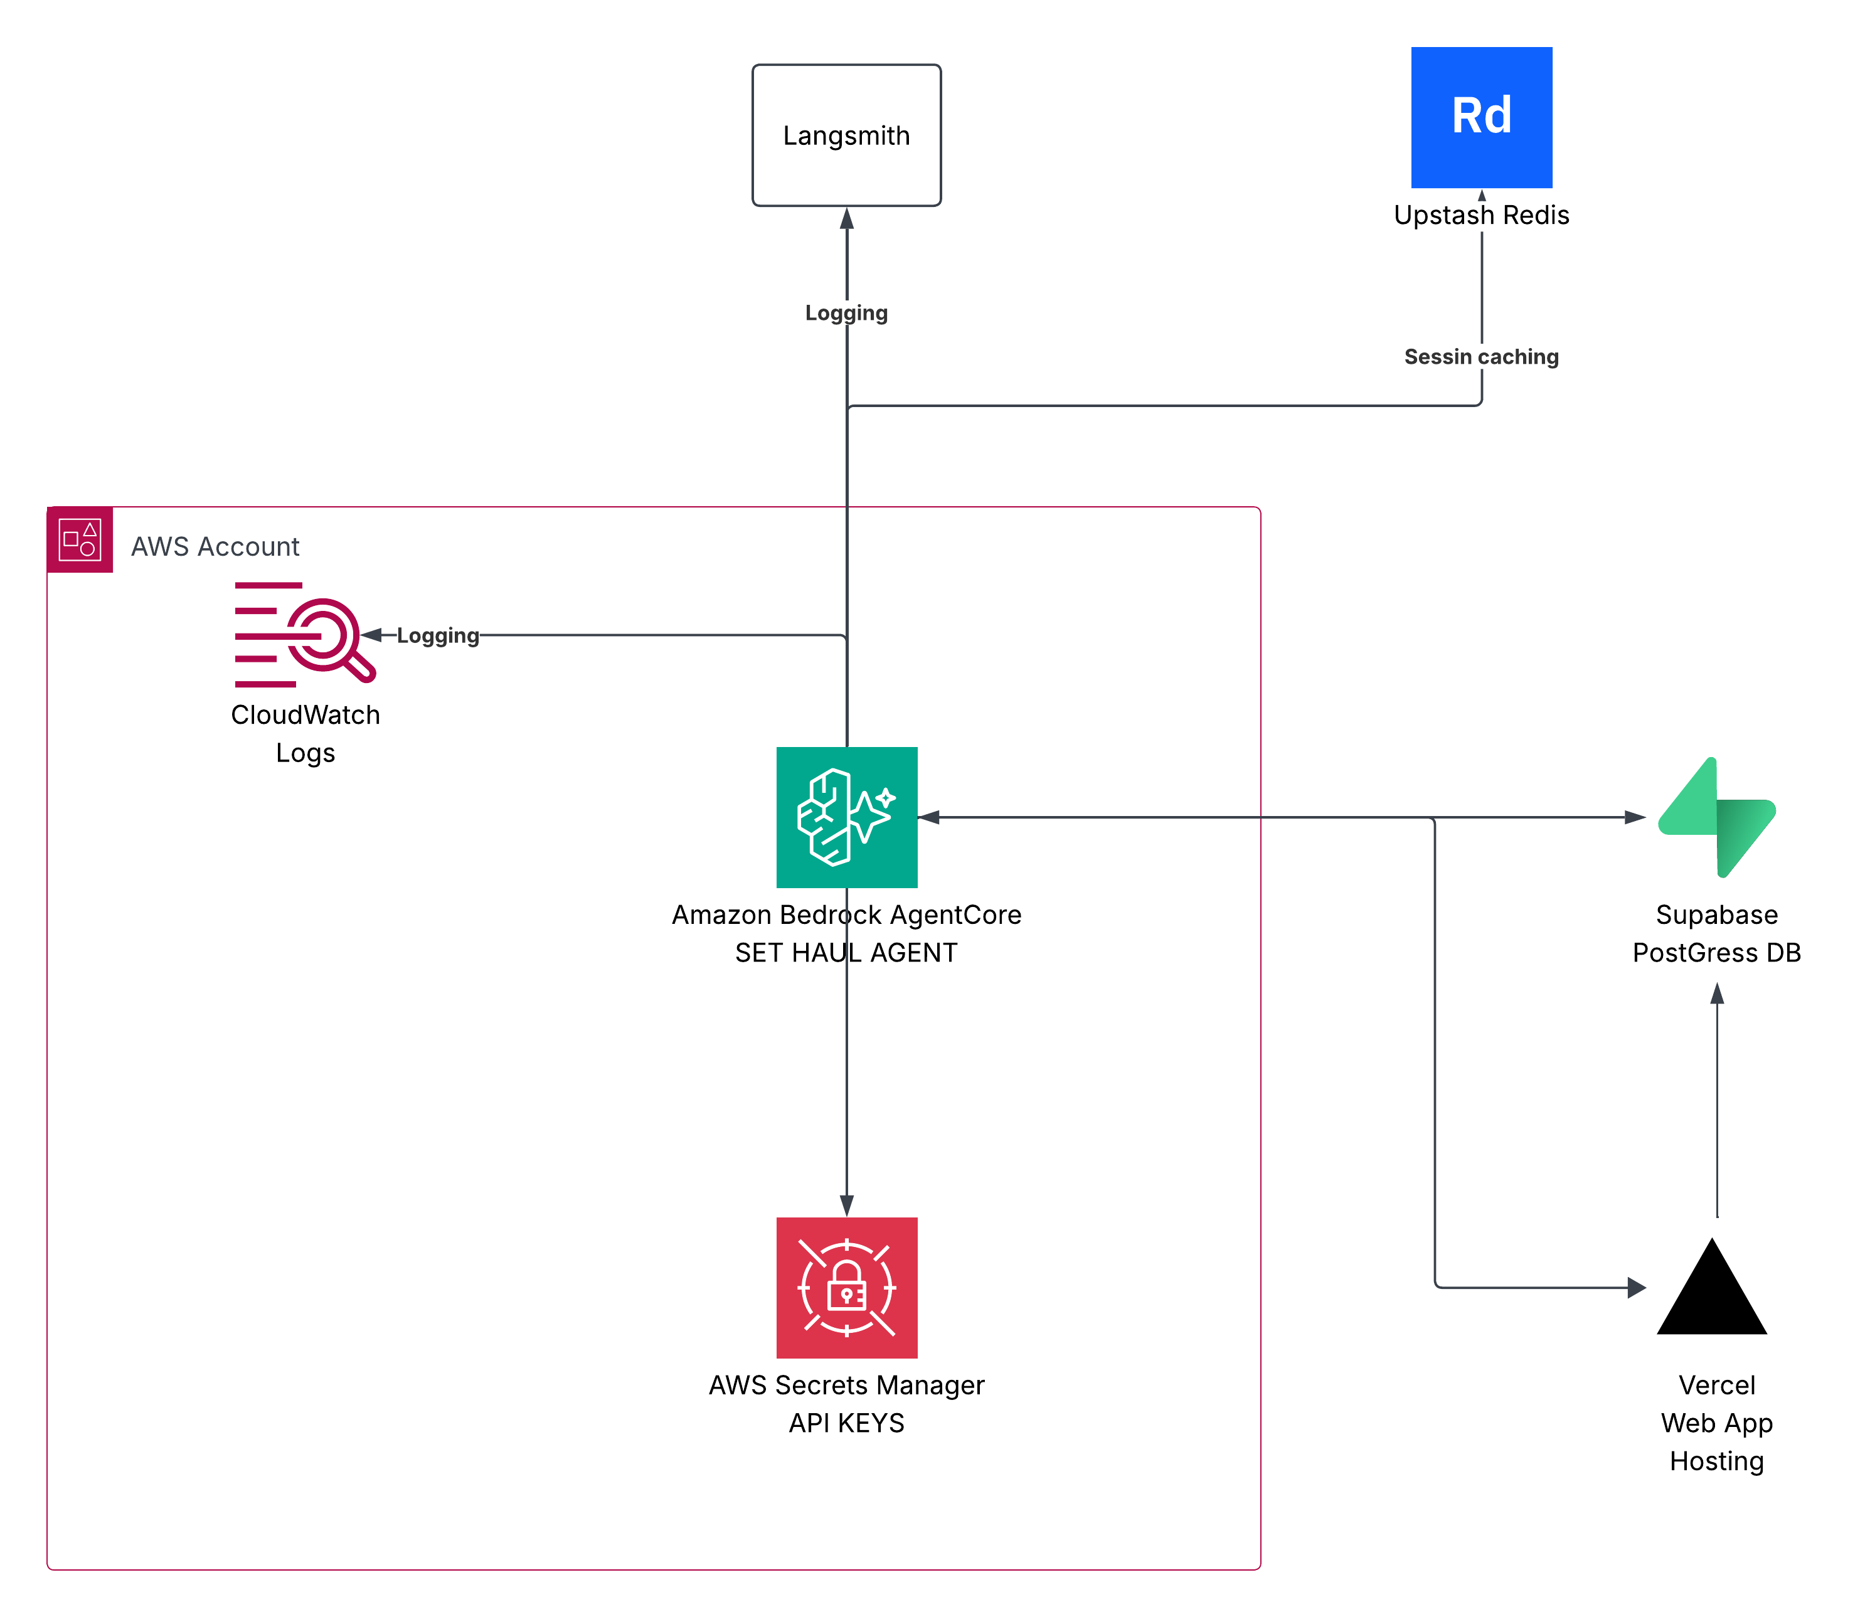
The AWS hosting backbone
Agent runtime, observability, secrets, caching, and hosting — how every piece is actually wired together
09

Slide 10
Eight tools — nothing else the agent can do
Every action is a named, typed tool call — schema.py validates every write, every message is logged to chat_messages
get_driver_shipment_details
check_existing_open_exception
Look up a driver's active shipment
Avoid duplicate exception rows on retries
record_exception
record_eta_update
Insert or update a driver-reported exception
Append a driver-declared ETA (additive audit trail)
check_slot_availability
hold_slot / confirm_slot / release_hold
Only source of truth for feasible, available dock slots
Atomic slot lifecycle via Postgres RPCs
get_appointment_status
escalate_to_human
Current pending/confirmed appointment for a shipment
Hand off when no feasible slot, contradictory info, or outside automated authority
10

Slide 11


Live now — not a local-only demo
set-haul-ui.vercel.app
Active Shipment
Dock Slot Booking
Shipment History
Driver Profile
Live load status, ETA, and one-tap issue reporting
Browse, hold and confirm real slots — hits hold_slot_atomic live
Completed and cancelled loads, pulled straight from Supabase
Assigned vehicle and carrier details
The chatbot calls the real deployed agent — and degrades honestly if it can't
The “FleetPulse Dispatch Co-Pilot” widget posts to /api/chat, which invokes the live Bedrock AgentCore runtime. If AWS is unreachable or unconfigured, it falls back to clear, honest canned responses instead of failing silently — the UI never pretends a broken connection is a working one.
11

Slide 12
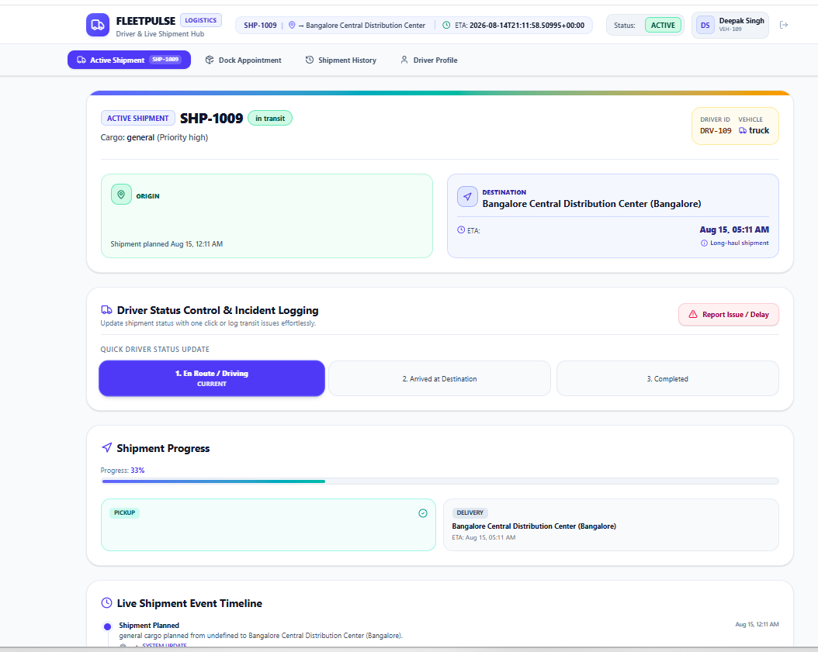
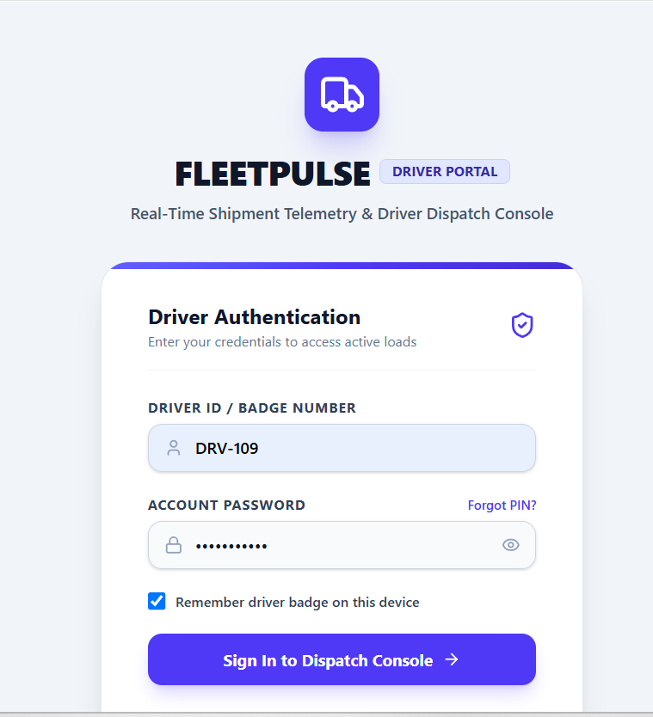
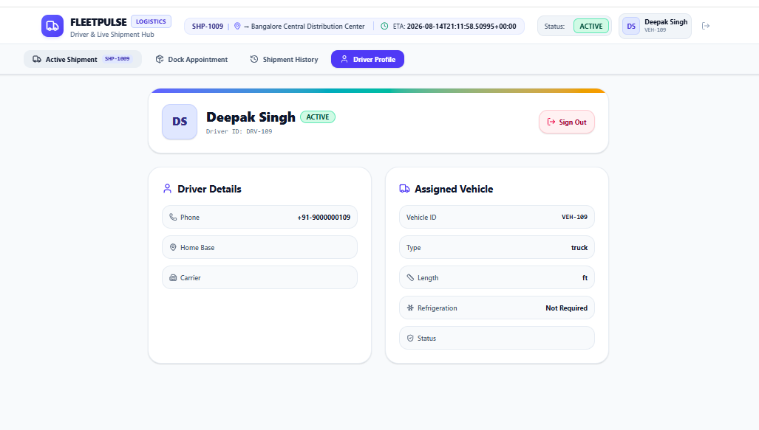
What it actually looks like
Real screens captured from set-haul-ui.vercel.app — not mockups
Active Shipment — SHP-1009, driver Deepak Singh (DRV-109)
Driver Authentication
Driver Profile
12

Slide 13
How we'd measure this — and what we'd add next
Success metrics
Honest limitations
Time from first message to usable outcome
Share of exceptions resolved without manual takeover
Double-booking rate — zero, by construction
No-feasible-slot escalations handled correctly
Average driver waiting time after rescheduling
Chatbot degrades to canned keyword-matched replies if AWS/Bedrock is unreachable — not a graceful LLM fallback
mcp_client/ helper exists in the repo but isn't wired into the agent yet
Underlying model is Gemini 2.5 Flash via OpenRouter, not a Bedrock-native model
Fairness across carriers is flagged, not implemented
No background sweep to auto-expire stale holds yet
13

Slide 14
Thank you
Questions?
Aksh sood · Jamuna · Neeraj
SetuHaul Logistics — Driver Exception & Dock-Slot Coordination — FDE Academy
14

